Slide 1
Rachel Dunk (r.dunk@mmu.ac.uk), Valeria Vargas (v.vargas@mmu.ac.uk), Konstantinos Tzoulas, & Hannah Matthews
School of Science and the Environment
Auditing the ESD content of Programmes
Development of a holistic ESD audit tool &
Embedding ESD during Programme Review
Paper in preparation for submission to Journal of Cleaner Production

Slide 2
Increasing level of difficulty and risk and of time and resource requirements
Awareness raising events
Staff student surveys
Research impact
Student projects
Curriculum audit
Graduate attributes
Sustainability placements
CPD for academics
Programme review
Adapted from: Stirling (2012)
Good practice projects
Management support
Course approval
Campus operations
University policies (T&L)
Academic appointments
Stand alone
(vertical)
Embedding
(horizontal)

Slide 3
Why conduct an audit?
Driver: School keen to ensure ESD embedded in curriculum – including both knowledge of SD issues and transferable skills that have been identified as necessary for addressing sustainability challenges.
Overarching Aim:
Ensure our graduates have a grounding in ESD knowledge & skills
Near Term Objectives:
Conduct an audit of ESD knowledge & skills in the curriculum
Identify best practice case studies (champions), and where there are opportunities for improvement (conservatives)
Identify where/how we can support colleagues who want to engage with ESD
Inform Programme Review, ensuring ESD embedded in new curriculum

Slide 4
Developing and piloting the audit tool
A tool was developed for auditing the key SD themes that are, or may be, incorporated in the curriculum
1
2
3
Identification of SD Key Terms, Themes and Domains
Auditing the occurrence of SD Key Terms, Themes and Domains
Analysis of (potential) contribution of the units to ESD
informed by literature
unit specifications searched for key terms
identify champions and conservatives & inform Programme Review

Slide 5
Developing and piloting the audit tool
Stage 1: Identification of SD Key Terms, Themes and Domains
Review of:
Policy documents relating to ESD in the UK HE sector
Published audit tools and approaches to embedding ESD in HE curricula
Identified 28 Themes grouped into 5 Domains
Initial list of literature derived key terms for each Theme was then extended to reflect disciplinary foci / use of language
Total of 120 Key Terms (1-13 per Theme)
Notes:
(Cade, 2008; Dawe et al., 2005; Drayson et al., 2013; HEFCE, 2009; Lozano, 2010; QAA, 2012; Ryan et al., 2012; Segalas et al., 2009; Sterling, 2012; UNESCO, 2010)

Slide 6
Cross Cutting
1 Sustainability
2 Development
3 Spatial Perspectives
4 Time perspectives
5 Philosophy, Responsibility & Behaviour
6 Politics, Government & Governance
7 Risks, Impacts & Limits
8 Responses
Society
Economy
Environment
9 Society
10 Citizenship & Cultural Diversity
11 Rights, Equity & Justice
12 Health & Wellbeing
13 Economy
14 Business & Industry
15 Production & Consumption
16 Resources
17 Environment
18 Pollution & Climate Change
19 Biodiversity & Ecology
20 Land Use & Land Use Change
Skills & Competencies
A Skills & Competencies
B Critical Thinking
C Holistic Thinking & Creative Problem Solving
D Real World Examples, Case Studies & Scenarios
E Perspectives of Others
F Working with Others
G Communication
H Professional Development & Reflective Practice

Slide 7
Cross Cutting Themes & Key Terms
1 Sustainability
sustainability/sustainable
2 Development
develop/developing/development
3 Spatial Perspectives
spatial, space, global/globalisation, world, trans- / multi- / inter-national, nation/national, region/regional, local/localism
4 Time perspectives
time(scale), past, pal(a)eo, history/historic, current, contemporary, future, predict, generations
5 Philosophy, Responsibility & Behaviour
philosophy/philosophical, ethics/ethical, values, responsibility/responsible, behaviour
6 Politics, Government & Governance
political/politics/polity, government, democracy/democratic, participant/participatory/participation, governing/governance, policy/policies, regulator(y)/regulations
7 Risks, Impacts & Limits
risks, hazards, threats/threatened, stresses/stressors, impacts, anthropogenic/anthropocene, human/mankind, population, limits, carrying capacity/biocapacity
8 Responses
prevent/prevention, manage/management, conserve/conservation, abate/abatement, mitigate/mitigation, remediate/remediation, compensate/compensation, adapt/adaptation, resilience/resilient

Slide 8
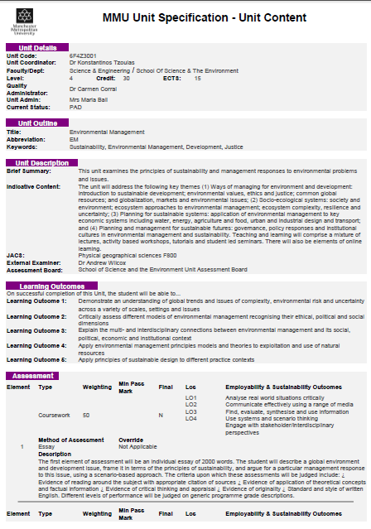
Developing and piloting the audit tool
Stage 2: Auditing the occurrence of Key Terms, Themes and Domains
Searched e-copy of unit specifications for occurrence of Key Terms (roots) in:
Unit Title
Key Words
Unit Description (Brief Summary and Indicative Content)
Learning Outcomes
Assessment Descriptions
Learning Resources (‘To Buy’ and ‘Essential Reading’ textbook and journal titles)

Slide 9
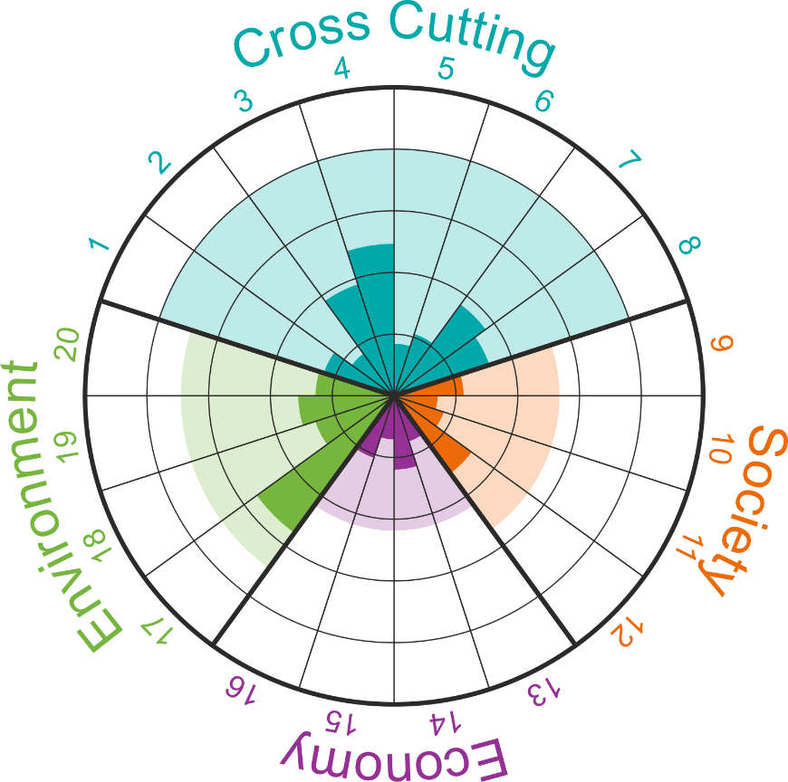

Developing and piloting the audit tool
Stage 2: Representation of Themes and Domains in the curriculum

Slide 10
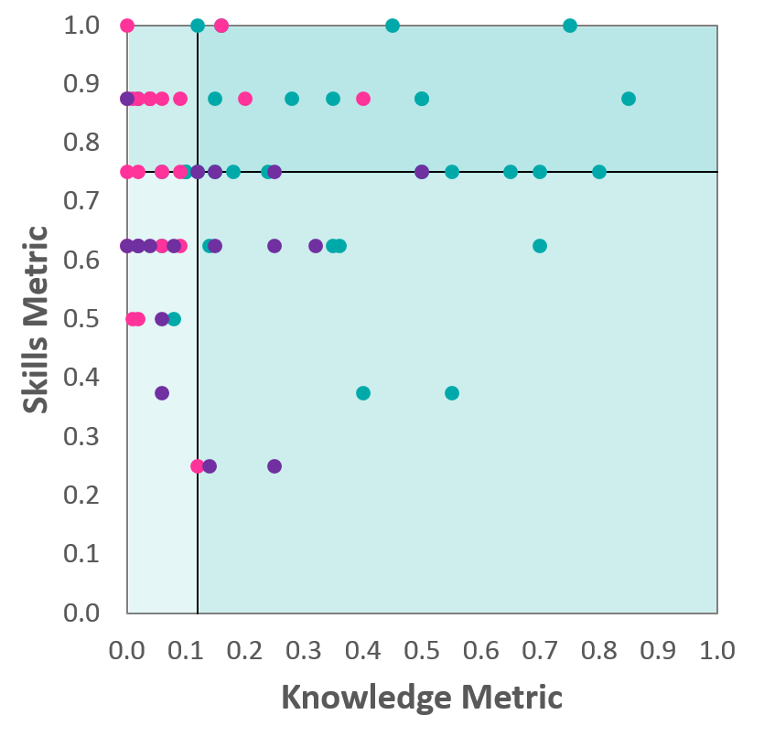


Developing and piloting the audit tool
Stage 3: Analysis of contribution of units to ESD in curriculum
Weighted Knowledge Metric
knowledge
breadth
weighting factor
(domain representation)
}
}
$$\frac{T_{C}+T_{S}+T_{Ec}+T_{En}}{20}x\frac{2D_{C}+D_{S}+D_{Ec}+D_{En}}{5}$$
Skills Metric
skills & competencies
breadth
$$\frac{T_{S\&C}}{8}$$

Slide 11
Embedding ESD during Programme Review
Chemistry
Incorporated stand-alone units at all levels
The whole curriculum includes links to the context and applications of teaching content
L6
Chemistry in Society 3
Advanced Topics in Green Chemistry
L5
Chemistry in Society 2
Green Chemistry
L4
Chemistry in Society 1

Slide 12
Embedding ESD during Programme Review
Biology
The curriculum highlights problem solving and system thinking throughout.
L6
Contemporary Issues in Sustainability
L5
Conservation Science in Practice
L4
Applied Animal Behaviour

Slide 13
Embedding ESD during Programme Review
Geography
Wide range of ESD skills and knowledge
Highlights include creative problem solving skills, and knowledge linked to themes including politics, citizenship, time and spatial perspectives, risks limits and impacts
Bodies, Sexualities and Space
River Coastal Management
Music, Sound and Space
Volcanoes and Society
L6
L5
Earth Surface Processes
Skills for Professional Success
L4

Slide 14
Embedding ESD during Programme Review
Environmental Science
L4 provides a good foundation in terms of ESD, which supports the more detailed knowledge and skills that follow at L5 and L6.
A key feature is that systems thinking skills are highlighted throughout.
L6
Sustainable Resource & Waste Management
L5
Sustainability of Organisations
Global Environmental Issues
Society and Environment
L4

Slide 15
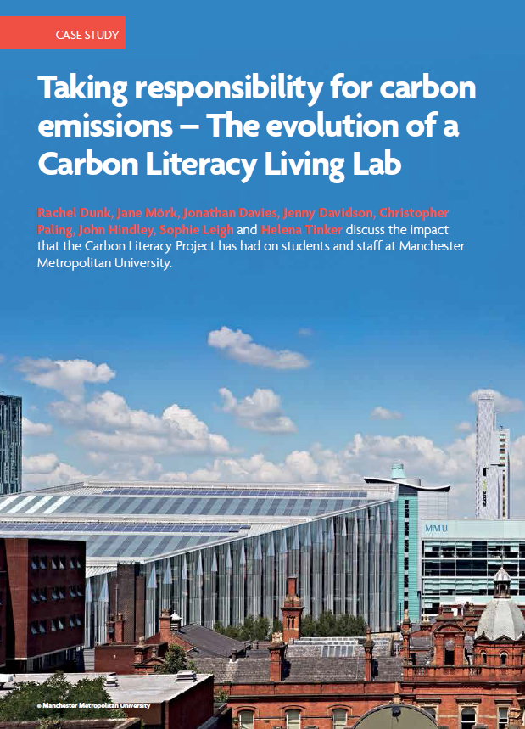
Carbon Literacy (Formal / Informal Curriculum)
Environmental Scientist, Dec 2017

Slide 16
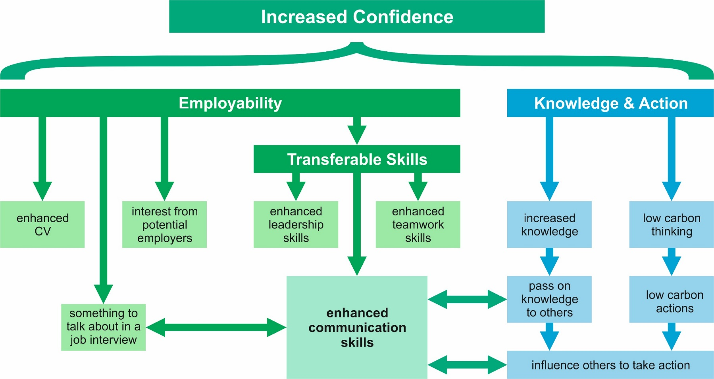
Carbon Literacy (Formal / Informal Curriculum)
Paper in preparation

Slide 17
Thank-you for Listening…
…Any Questions?

