Slide 1
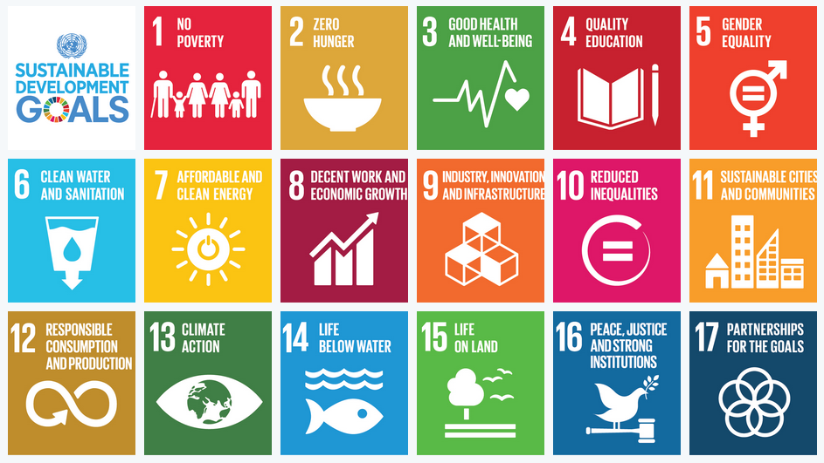
http://www.un.org/sustainabledevelopment/sustainable-development-goals/
Notes:
17 SDGs 169 targets
2015-2030 Transforming our world: the 2030 Agenda for Sustainable Development

Slide 2
Conversations about LfS (2014)
SDG goal 4 Target 4.7 Sustainable Development and Global Citizenship
By 2030, ensure that all learners acquire the knowledge and skills needed to promote sustainable development, including, among others, through education for sustainable development and sustainable lifestyles, human rights, gender equality, promotion of a culture of peace and non-violence, global citizenship and appreciation of cultural diversity and of culture’s contribution to sustainable development

Slide 3
SDGs: Indicators
4. Ensure quality education for all (10 targets)
https://sustainabledevelopment.un.org/sdg4
Indicator 4.7.1
Extent to which (i) global citizenship education and (ii) education for sustainable development, including gender equality and human rights, are mainstreamed at all levels in: (a) national education policies, (b) curricula, (c) teacher education and (d) student assessment
Notes:
Goal 4 Education
Reporting 2019

Slide 4
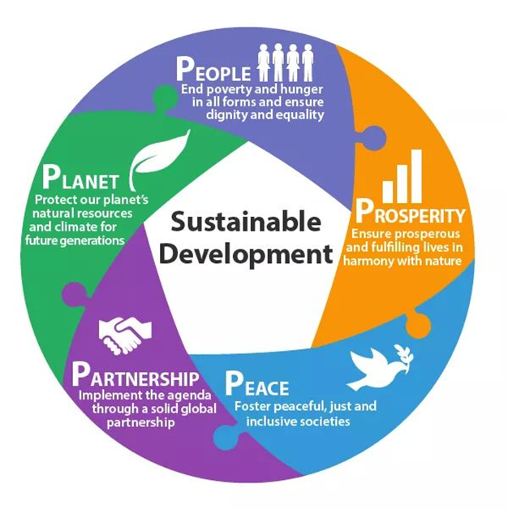
Global Education Monitoring Reports
http://en.unesco.org/gem-report/
Notes:
Global reporting.
GEM Report 2016 set the Framework using PPPP
Targets refer to all learners and all education levels including tertiary level
Knowledge and skills are broad concepts linked to quality of education
Indicators still under discussion. Terminology contested
PISA 2018 will include global competence
GEM 2017 had a focus on accountability
Seen as a shared responsibility between government, citizens, students, institutions, international organisations etc
In UK have consulted on targets and indicators and Scotland is developing mechanism for reporting allied to the National Performance Framework which is being reviewed.

