Slide 1


UN SDGs18 Accord at
Glasgow Kelvin College
Friday February 8th, 2019

Slide 2


Slide 3




Quality Education

Slide 4

Introduce Healthy Street Indicators (HSI):
Provide contextual evidence for the local area:
Introduce ‘Charrette’ procedure
Focus is on improving the streets around the campus – create framework to address an HSI for chosen location
Divide class into groups of 4/5
and
Assign HSI to each group (chosen at random)
Day 1: Introduction to Charrette, HSIs and SDGs
Highlight Sustainable Development Goals (SDGs): focusing on Good Health
Explain process and roles
Define objectives
Outline timescale
Considerations and criteria
Processes for identifying solutions
Factors affecting street health
Local Authority (LA) developments
Community Organisations
Local businesses
SIMD
Day 3: Scenario planning - what change is needed to achieve HSI? Use post-its to highlight issues on a map. Share ideas with class.
Day 4: Create planned scenes (drawing).
Day 5: Presenting final outcomes to class.
Day 2: Site visit to identify issues pertaining to assigned HSI; +ve/ -ve evidence, photos.
Engagement Weeks
NUS Teach-In
Teach-In week takes place between 18th- 22nd February
Asking Staff to get involved with a ‘Charrette’ activity based in the Healthy Street Indicators
Feedback has been positive and discussions ongoing

Slide 5

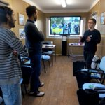
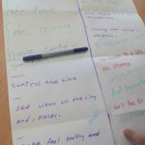
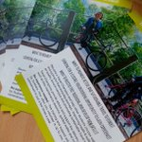
Active Travel at GKC
Sustrans Volunteer Induction
Student Travel Champion programme

Slide 6

Engagement Weeks
Go Green Week
11th- 15th February 2019

Slide 7










Climate Action

Slide 8





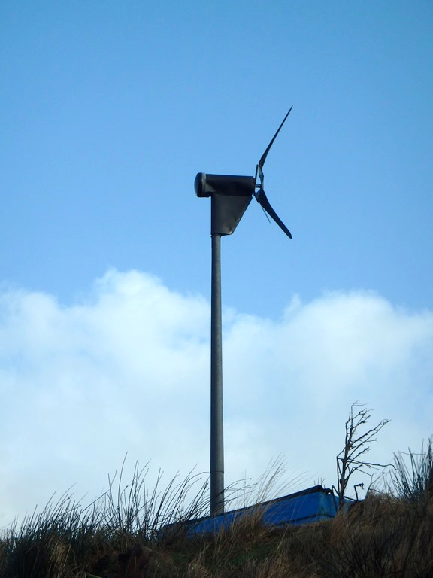
Renewables
Servicing and Upgrading
Wind Turbine
Biomass and Heating
Wind Turbine servicing and repair to take place on Friday 1st February
Upgrading of Biomass and Heating system at East End campus under investigation
HWEnergy to deliver proposed retrofit/ upgrade of existing system
Proposal would be delivered through an ESCo
Meeting with Resource Efficient Scotland to discuss energy supply opportunities across the College (Thursday 7th February)

Slide 9
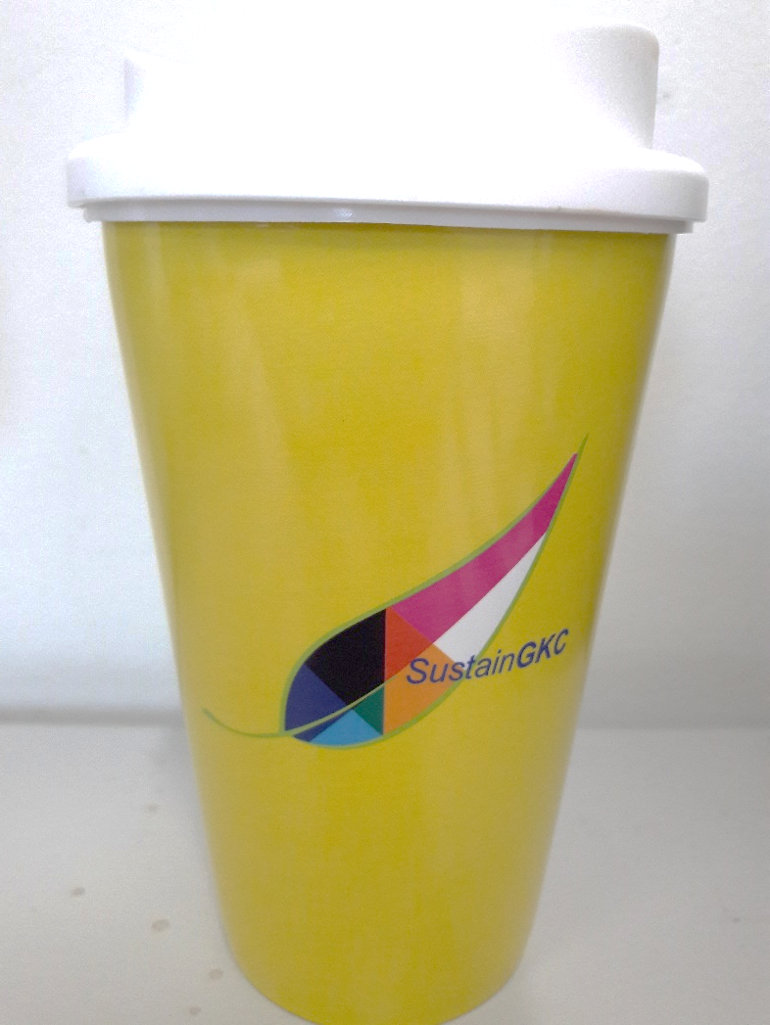




11% of all hot drinks sales with a Reusable cup
Case for new RDC purchase?

Slide 10
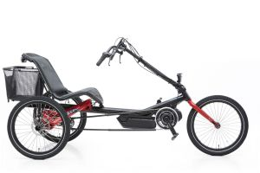
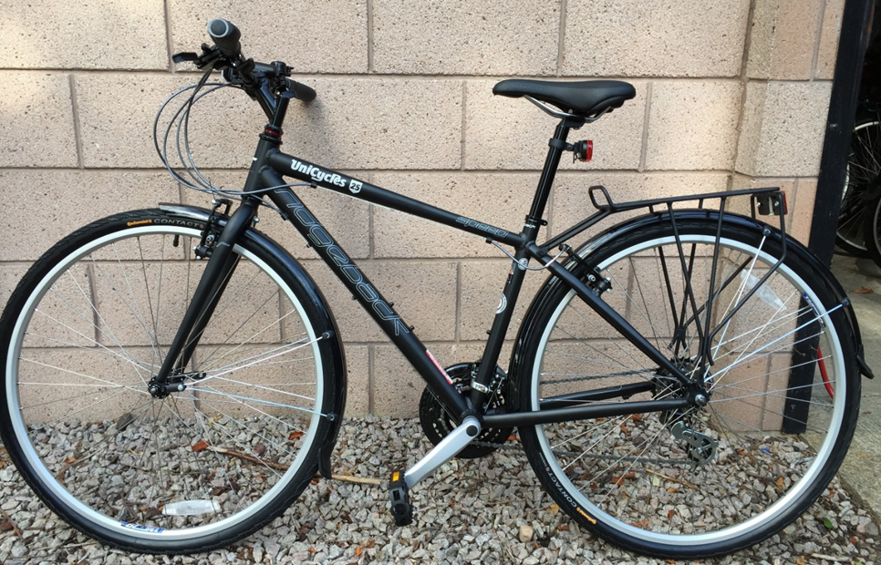

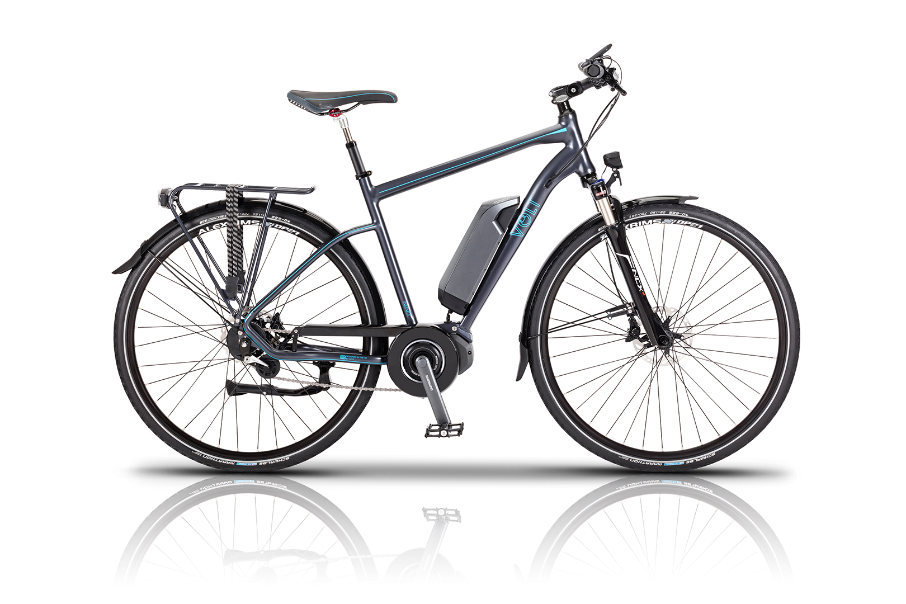



Active Travel at GKC
Pool bikes and e-Bikes
Successfully secured 6-pool bikes from University of Edinburgh
To be used as part of Student Bike-Hire scheme
Funding from Energy Saving Trust (EST)
3 e-Bikes; 1 e-Trike

Slide 11


Active Travel at GKC
Springburn campus Rail Link
Preparing application for Community Links Funding
Graham Beveridge and Mark Scanlan (Civil Engineering) to use the project as a real-life design project for HND/ NC students
Project idea shared with local Council
Feedback has been highly positive
Support received from Councillor Anna Richardson
Scotrail requiring feasibility study/ cost breakdown
Waiting for further details on requirements

Slide 12


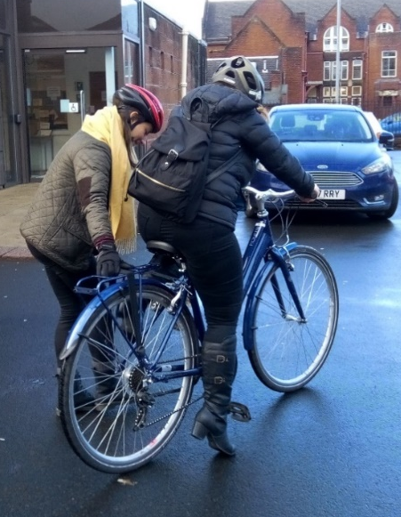


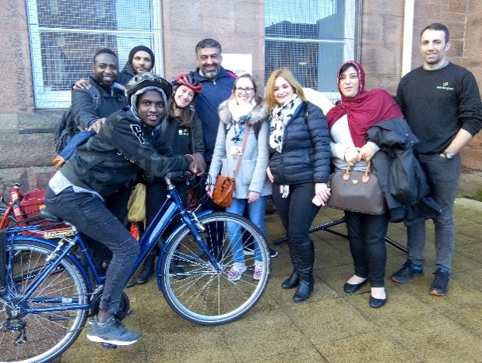
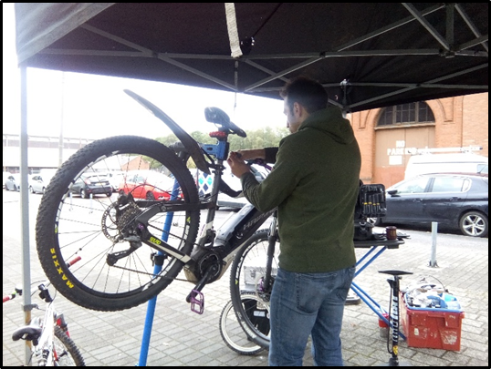
Active Travel at GKC
Student and Community Engagement
Promoting cycling within the ESOL department
Partnership with Bike for Good
Promoting cycling within the local community
Sharing dates of events
To develop activities with ‘Your Space’ Springburn Park youth group
Free training courses being organised
Local nursery and Staff@GKC informed

Slide 13
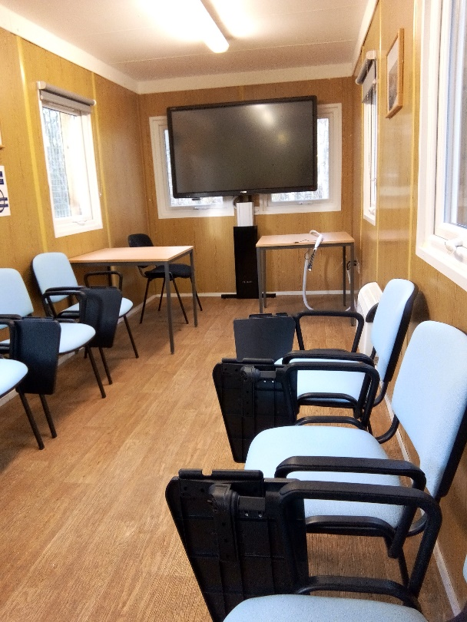
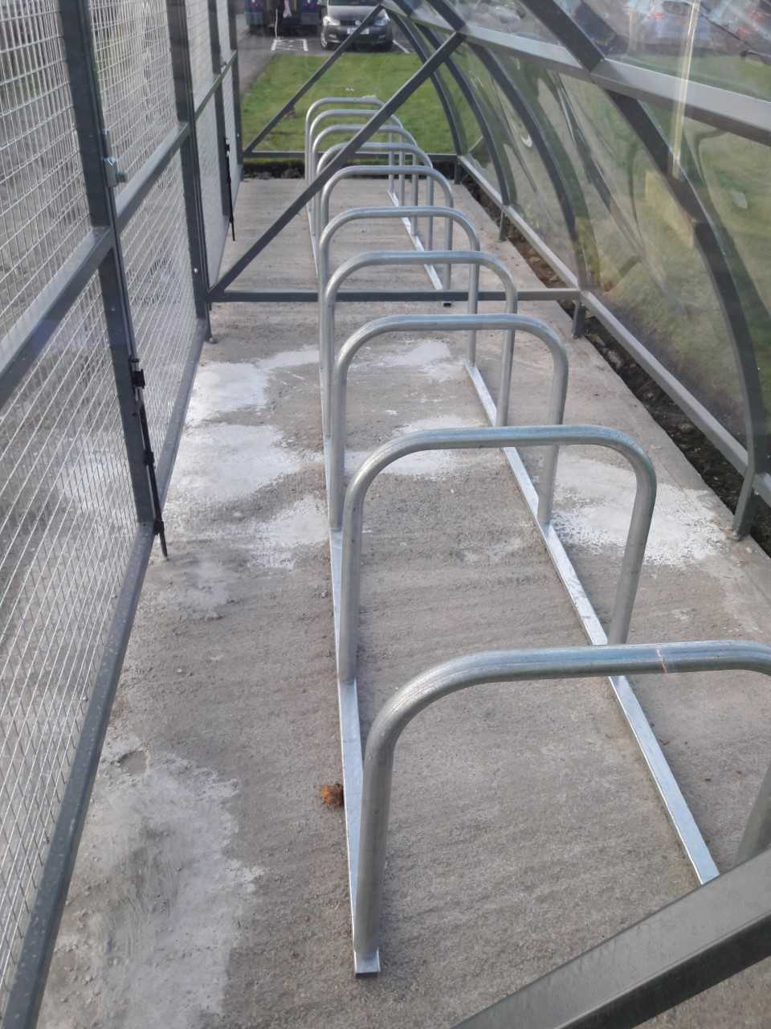
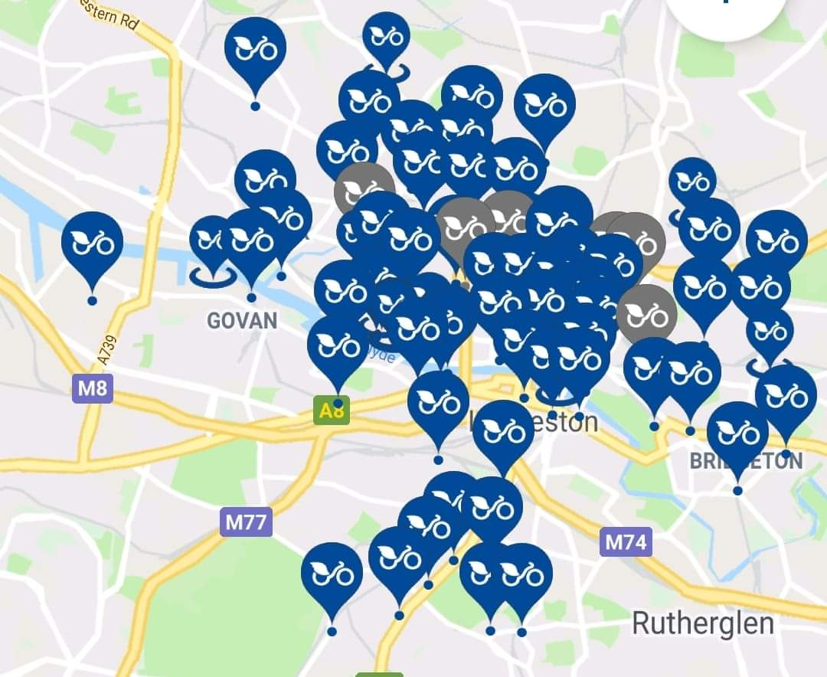

Active Travel at GKC
Cycling Facilities and ongoing inquiries
Promotion of ‘Critical Mass’ survey to support introduction of NextBike docking stations at Springburn campus
New Cycle Shelter installed at Easterhouse campus
New seating and screen at Velocity cycle hub

Slide 14

Community and Partnership

Slide 15
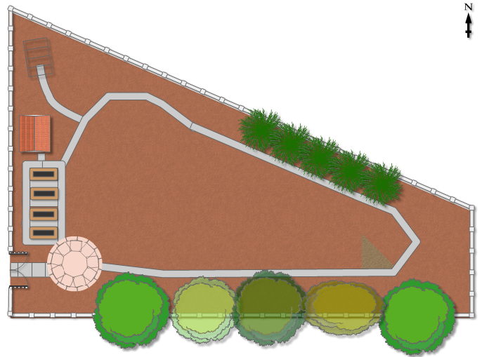
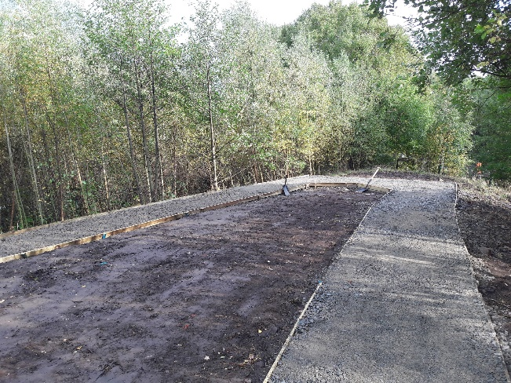
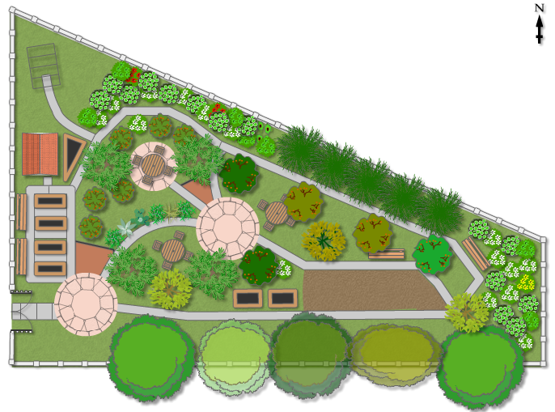
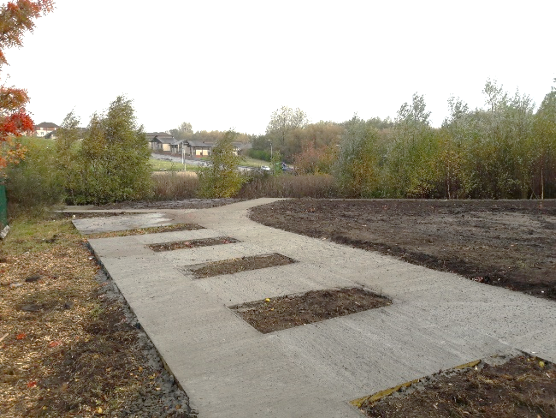
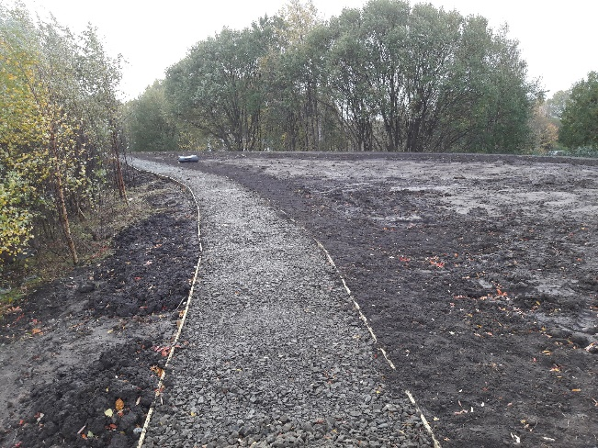
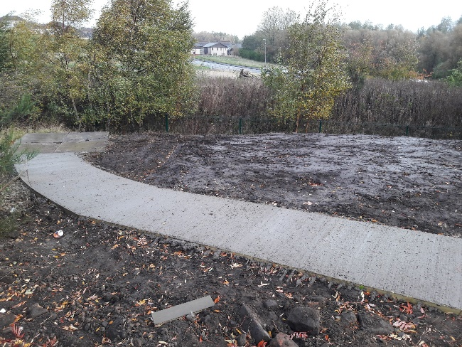
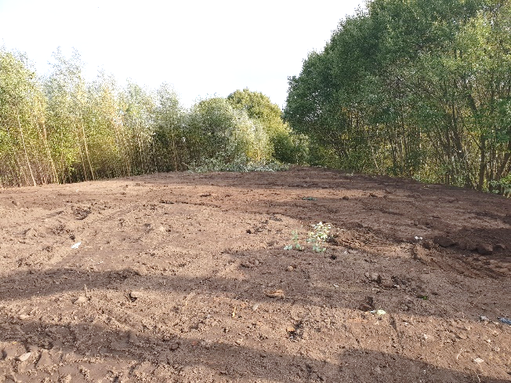
East End Community Garden
Joinery and Construction student groups to assist in planter building and path laying projects;
Support from local Blue Vale project may include materials for building planters, and benches/ picnic tables;
Art & Design and Support for Learning student groups to assist in projects promoting biodiversity;
Collaboration with local community groups including Thenue HA, Impact Arts, Cranhill DT, WofScotland HA;
Developing link with The Conservation Volunteers and Community Ranger Service
Support from SRUC to design garden flower beds (Feb- May 2019);
15 trees confirmed from The Woodland Trust (arriving March 2019);

Slide 16



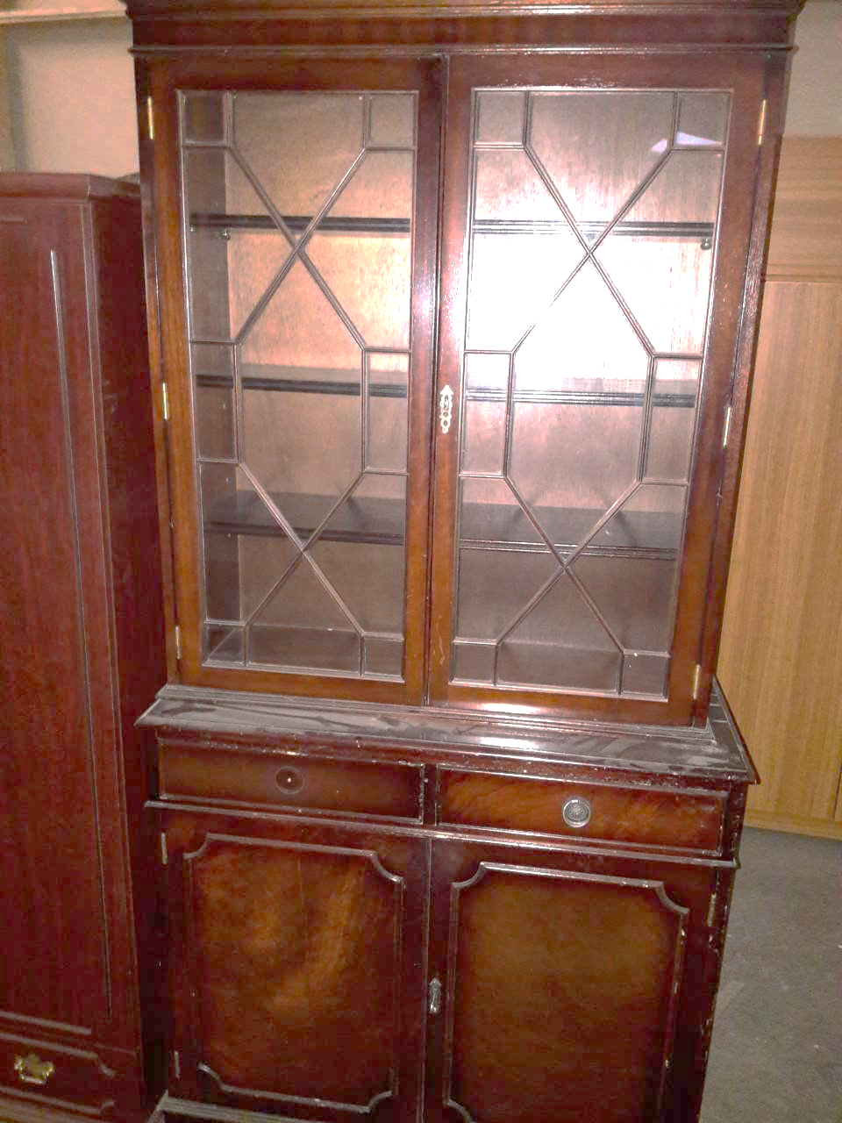


Partnership Work
Student projects
Wall Art Project confirmed with students from Art & Design and Support for Learning departments
The Orchard Project
@Springburn campus
Provisional planting day arranged for Tuesday 5th March
Back to the Furniture (West campus) group to upcycle furniture item for Velocity Cycle hub

Slide 17

Partnership work
Home Energy Scotland
Delivering support across campuses during Big Energy Saving Week
eBike trials being planned for period around Go Green Week
Plan to promote and further uptake of Home Energy Efficiency course delivered through John Wheatley Network
Arranging Love Food Hate Waste workshop for next month
To be delivered to students studying Nutrition/ Catering
Coordinating delivery of Home Energy efficiency workshops with North East Glasgow Recovery Community, SpARC, and Kinship carers

Slide 18




WINNERS!
Student Engagement
WINNERS!
Innovation in delivering a Sustainable Education Facility

