Slide 1
Supporting Financial wellbeing
Emma Mamo
Assistant Director - Workplace
& Business Development
8 June 2023

Slide 2
Today’s session
Introduction to money and mental health
Impact of the cost of living crisis
Supporting the financial wellbeing of staff and students
Top tips for supporting your own financial wellbeing
Support available

Slide 3
Introduction to money and mental health

Slide 4
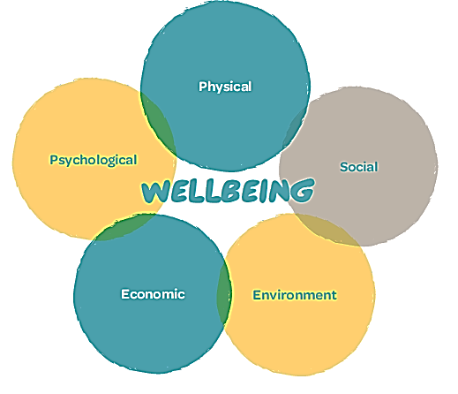
mental health & wellbeing
Health
A state of complete physical, mental and social wellbeing and not merely the absence of disease or infirmity
Mental Health
A state of wellbeing in which every individual:
realises their own abilities
can cope with the normal stresses of life
can work productively
is able to make a contribution to their community
Notes:
Mental health is a state of wellbeing in which every individual realised their own abilities, can cope with normal stresses without this becoming a wider issue, can work productively and is able to make a contribution to their community.
Mental health is more than the absence of mental disorders.
Mental health is an integral part of health; indeed, there is no health without mental health.
Mental health is determined by a range of socioeconomic, biological and environmental factors.
Wellbeing is at the root of our physical, social, environment, economic and psychological aspects of our life. This suggests that if we give equal attention and focus to each of these areas of our life, in turn our wellbeing should improve. We can see from the diagram how each of these are interlinked.

Slide 5
What keeps people well?
Protective (and risk) factors:
Diet
Sleep
Physical health
Financial stability
Employment status
Relationships (with self and others)
Social capital
Alcohol and substance use

Slide 6
Money and mental health
Money problems can affect your mental health
Mental health can affect the way you deal with money
Notes:
Mental health impacting on money
Low mood – neglect your finances
High from spending – over-spend
Experiencing mania - impulsive decisions when (conditions like bipolar)
If you can’t work or study – reduced income
Money impacting on mental health
Certain situations trigger anxiety – brown envelopes
Experience sleep problems if worrying about money
Can’t afford to do things to maintain your wellbeing
May lead to isolation

Slide 7
Impact of the cost of living crisis

Slide 8
Key insights
1. The cost of living crisis means more people are living in poverty
2. People living in poverty or experiencing financial stress are more likely to develop mental health problems
3. Groups of people who already experience marginalisation, higher rates of poverty and mental health problems will be most impacted by the cost of living crisis
4. There is likely to be an increase in need for mental health support
Notes:
Mental health and the Cost-of-Living Crisis report, January 2023 - MHF
We are seeing increased reports across the UK that more people are going without basic living essentials, such as food and a warm home.
People who have already experienced stress because of existing poverty, the impact of the recession in 2008 and, most recently, the Covid-19 Pandemic, are more vulnerable to the cost-of-living crisis and are at higher risk of mental health problems.
Many social and economic groups who were at higher risk during the Covid-19 pandemic are also more vulnerable to the negative effects of the Cost-of-Living Crisis. These groups include people who are unemployed, people with mental health problems, lone parents, young people, people with disabilities and, people who are Black or from minority ethnic communities, as well as asylum-seekers and refugees.
Financial stress, through its influence on parental mental health, marital interaction, and parenting, impacts on the mental health of children and adolescents

Slide 9
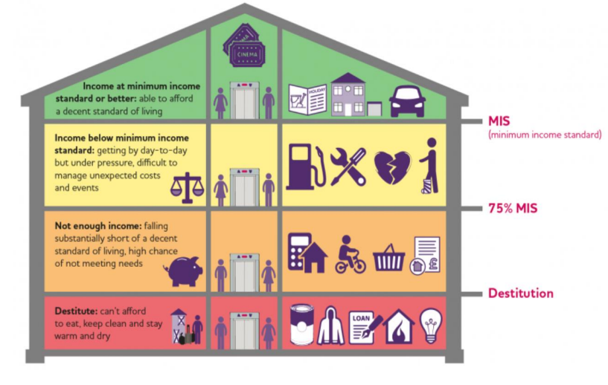
What is poverty?
According to the Joseph Rowntree Foundation, poverty is when your resources are well below what is enough to meet people’s minimum needs, including the need to take part in society.
There is no single best measure of poverty, and it is a complex problem that requires a range indictors. It can be helpful to think about splitting poverty into three levels:
Those who have incomes below the ‘Minimum Income Standard’
Those who don’t have enough income to meet their needs
Those living in destitution
Image from Joseph Rowntree Foundation website: ‘What is poverty’
Notes:
JRF
Single person needs to earn £25k per year to reach a minimum acceptable standard of living
A couple with two children needs to earn £43k between them

Slide 10
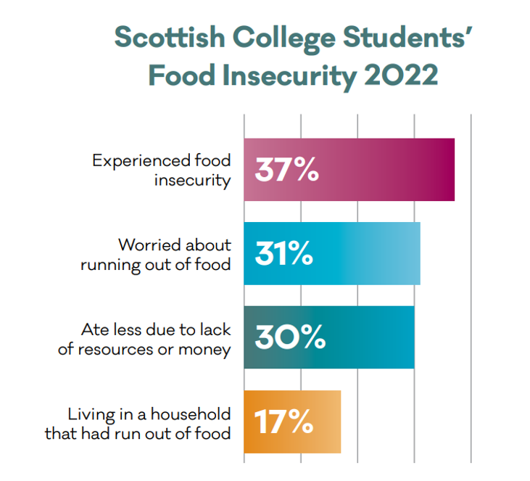
Impact on students
Office for Students Insight Brief, March 2023
1 in 5 had considered dropping out of university or college (higher for postgraduate and students with disabilities)
Nearly half (43 per cent) say they have cut back on food shopping
Over half (56 per cent) have reduced what might be seen as non-essential spending
Awareness of the support provided by universities and colleges to alleviate cost of living pressures appears to be varied
Just under half (44 per cent) agreed that their university or college has done enough to support students with cost of living issues
Notes:
MHF – Thriving Learners report – data was collected in early 2022
OfS research
Poll of 4,021 students on the Youthsight panel responded to an online poll between 23 January and 15 February 2023
Roundtable discussions with university and college representatives, student representatives and higher education mission groups and representative bodies.
Compared with other published evidence on students’ experiences of cost of living rises

Slide 11
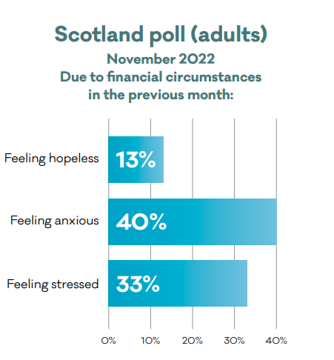
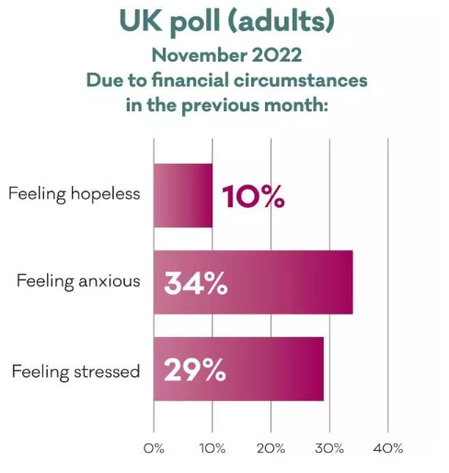
Impact on our mental health
Notes:
Mental health and the Cost-of-Living Crisis report, January 2023 - MHF

Slide 12
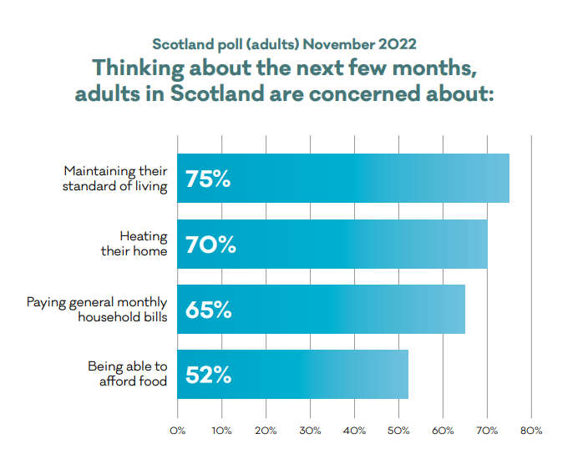
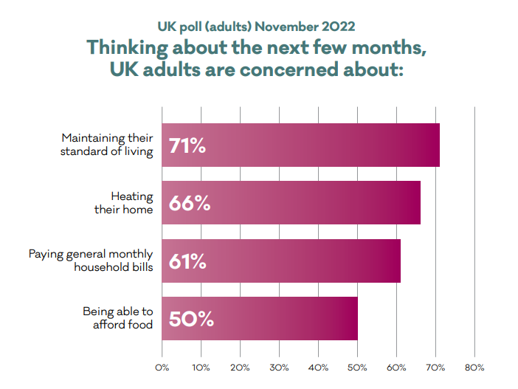
Impact on our mental health
Notes:
Mental health and the Cost-of-Living Crisis report, January 2023 - MHF

Slide 13
Impact on our mental health
Concerns about finances are having a negative effect on people’s ability to engage in some of the activities known to help protect mental health and prevent problems from developing:
30% of adults in the UK have poorer quality sleep
23% meet with friends less often
15% pursued a hobby less often
12% exercised less often
Notes:
Mental health and the Cost-of-Living Crisis report, January 2023 - MHF

Slide 14
Supporting the financial wellbeing of staff and students

Slide 15
What support is helpful?
Increasing financial management skills
Improving sense of control
Increasing
self-esteem
All of the above help to reduce the impact of financial stress on people’s mental health and wellbeing

Slide 16
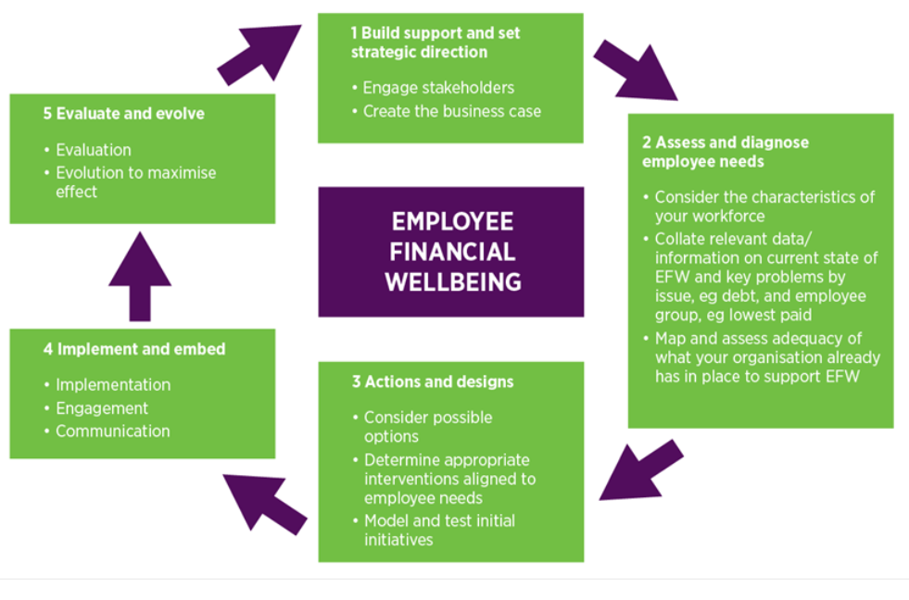
Supporting staff: developing a policy
Taken from CIPD website: ‘Employee financial wellbeing’

Slide 17
What should a policy cover?
Enable people to lead a dignified life and meet the cost of living
If people are paid hourly then being able to work enough hours is import
Transparency about pay and communication are key
Paying a fair and liveable wage
Offer clear progression paths
Ensure line managers are supportive
Offer targeted training and development
Offer mentoring, shadowing and work experience
Supporting in-work progression
Offer occupational sick pay
Offer crisis loans to support with unexpected financial shocks
Explore flexibility on how often people are paid
Offer financial awareness programmes
Providing financial wellbeing benefits
Notes:
£9.90 across UK

Slide 18
Helpful types of Benefits
People on low incomes value benefits that reduce their highest living costs:
Housing and utilities – rental deposit schemes, accommodation and rent subsidies, and technology and telecommunications subsidies or loans, etc
Child/eldercare – flexible working, paid time-off for emergency caring responsibilities, subsidised childcare, or aiding access to the Government’s Tax-Free Childcare scheme, etc
Travel – transport season ticket loans, travel expenses, cycle-to-work, or work bus/public transport subsidies, etc
Food and leisure – free or subsidised meals and drinks, shopping and lifestyle discounts, vouchers, gym membership, etc
Notes:
JRF research

Slide 19
Supporting Students
Consider ways to reduce costs - consolidate the teaching timetable, offer online lectures, offer ‘warm’ spaces, set up a community larder/freezer, etc
Review relevant policies - mitigating circumstances and extension policy to take account of hardship on learning and assessment
Make provision for the impact of digital poverty
Offer financial wellbeing support – advice and guidance
Offer mental health and wellbeing support
Notes:
Different cohorts of students – young students, mature students, international students
WONKHE – article by Michelle Morgan, Dean of Students at the University of East London.

Slide 20
Case study: gcu’s support for students
Student Funding team Offers advice on funding, lifestyle, budgeting & more
Student Wellbeing Priority Response team Supports students who are referred to them because they are at risk of or in a financial crisis
Student Wellbeing team Provides advice and signposting for students facing financial/hardship difficulties

Slide 21
Creating wellness action plans
For staff:
What keeps you well at work?
What are your personal workplace triggers?
What are some early warning signs for your manager or colleagues to be aware of?
What impact does poor mental health problem have on your performance?
What steps can your manager take to support you?
What steps can you take?
For students:
What keeps you well while studying?
What are your personal triggers?
What are some early warning signs for your tutor or peers to be aware of?
What impact does poor mental health problem have on your ability to study?
What steps can your tutor take to support you?
What steps can you take?

Slide 22
Supporting YOUR FINANCIAL WELLBEING

Slide 23
TOP TIPS
Make sure you’re claiming any extra money or support you’re entitled to
Check your bank balance at a regular, set time
Build money tasks into your daily or weekly routine – build in something relaxing to do after
Create a realistic weekly budget and stick to it
Use bank accounts which allow you to put money aside in separate pots
Set up direct debits for your bills and other regular payments so they don’t pile up
If you’re struggling to pay off debts, get debt advice

Slide 24
Support available

Slide 25
Money advice
Coping with money worries webpage Practical advice about money worries and the cost of living
Mental Health and Money Advice website Resources on managing your money and mental health
National Debtline
Free impartial advice and cost of living hub
Notes:
Emma

Slide 26
Money advice
Age UK website
Information for older people on cost of living and taking control of your finances
Young Scot website
Information for young people including money tips and mental health support
Student Space website
Expert information and advice to help you through the challenges of student life
Notes:
Emma

Slide 27
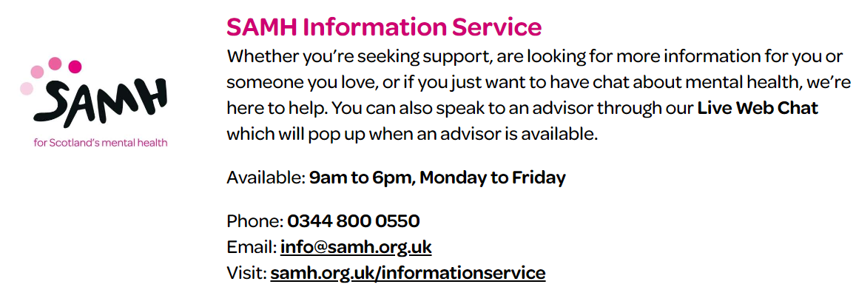
Mental health support
SAMH Workplace
Whether you want to begin a mental health revolution across your entire organisation or wish to provide a few key members of staff with mental health management skills, it makes good business sense to choose SAMH Workplace.
Email: workplace@samh.org.uk
Notes:
Emma

Slide 28
Notes:
Emma

