Slide 1
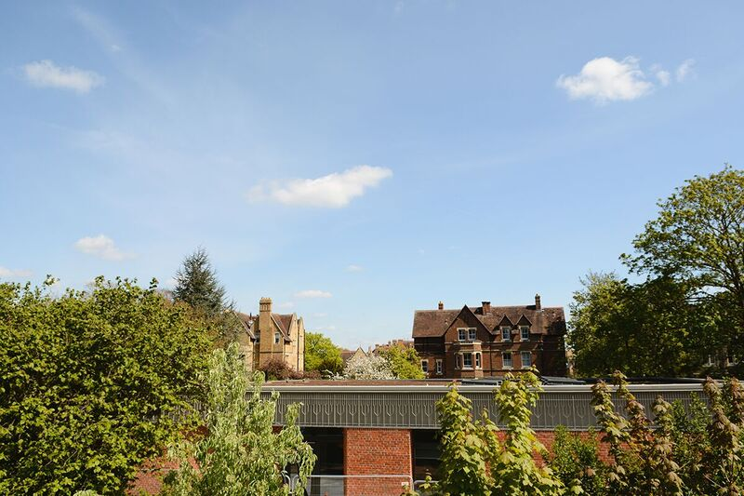
Perspectives from Procuring the Kellogg College Hub
Supply Chain Management on a smaller project
Adrian Speller – Director of Sustainability

Slide 2
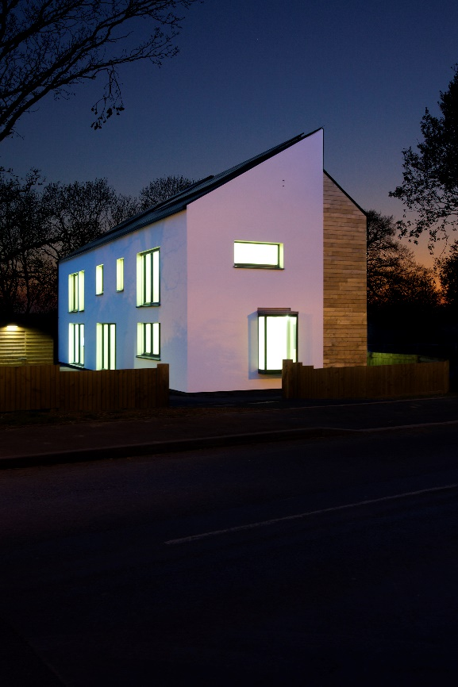
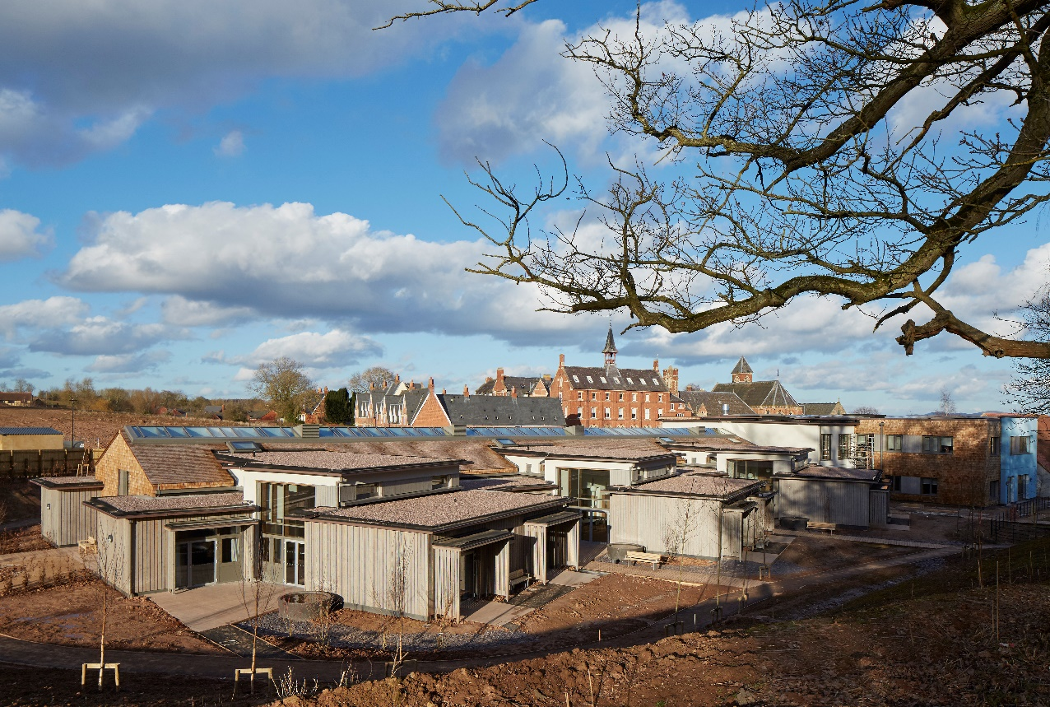
Principal Contractor, turnover circa. £130m across Midlands, SW & London
Projects £300k - £40m
Leading edge in Sustainable Construction since 2008. BREEAM, BIM, Zero Carbon & Passivhaus.
Innovation & excellence in construction

Slide 3
SUPPLY CHAIN SELECTION – CONTEXT – WHAT ARE WE TRYING TO BUILD?
Standard mass market vs. Engineered Low Energy…
innovation & excellence in construction

Slide 4
…to create low energy comfortable buildings fit for the ‘Passivhaus Hoff’
innovation & excellence in construction

Slide 5
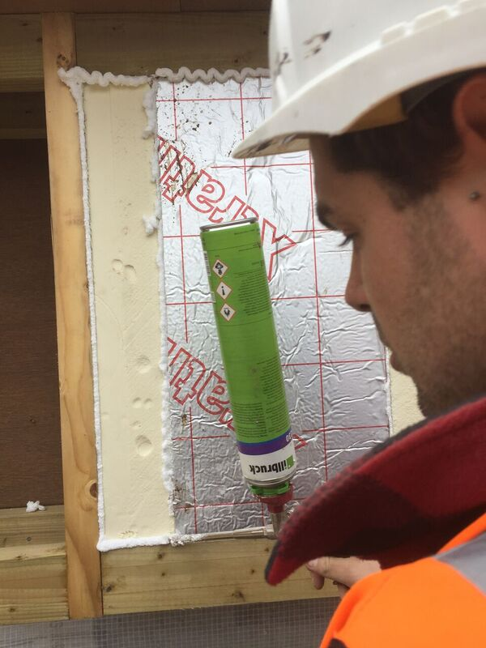
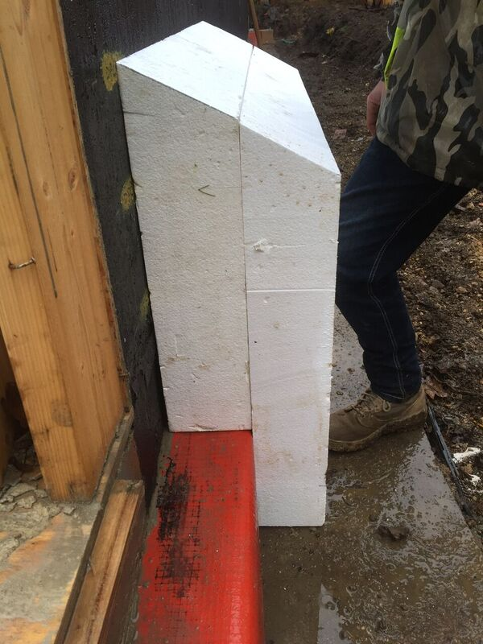
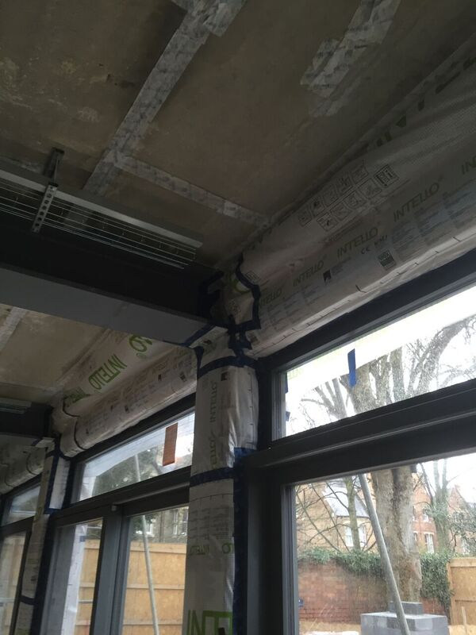
Precision and accuracy needed
innovation & excellence in construction

Slide 6
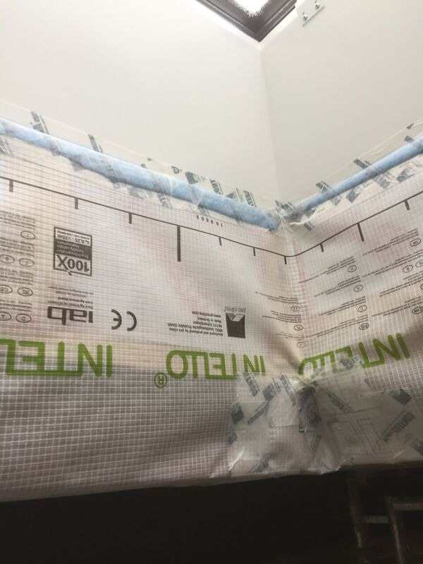
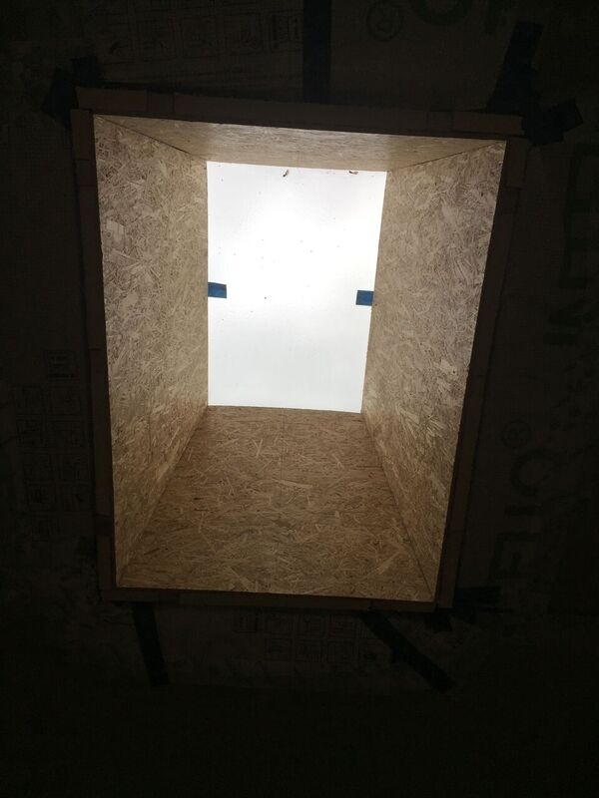
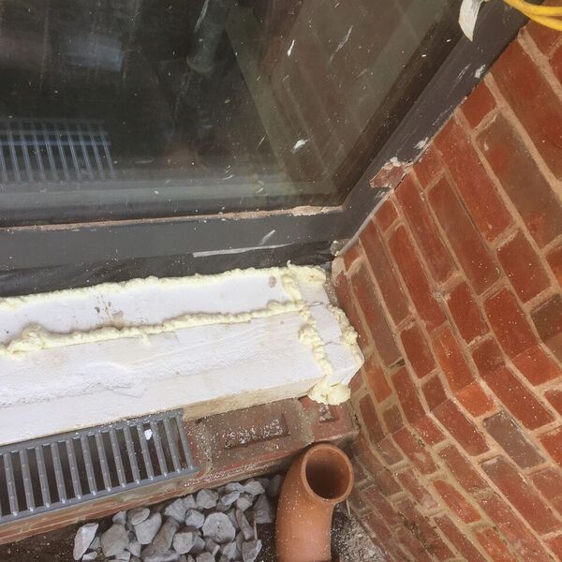
TLC not ‘Gung Ho’
innovation & excellence in construction

Slide 7
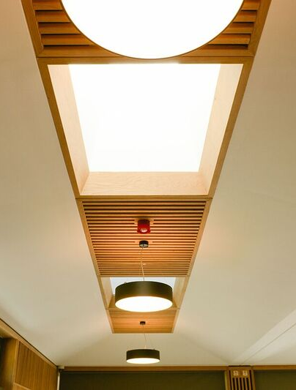
Supply Chain Availability - Problems
Construction Industry under massive resource strain.
Trend for Supply Chain to go where it can make an easy buck.
Smaller Passivhaus projects unlikely to appeal; packages not large enough to attract subcontractors who will work to a price. No economy of scale.
Additional ‘Oxford’ location factor – sparser supply chain?
innovation & excellence in construction

Slide 8
Supply Chain Availability - Solutions
Daywork becomes viable procurement route – particularly for complex details requiring precision.
Focus on Tier 1 Supply Chain Partners; robust existing relationships – repeat work.
The opportunity to broaden the skills base can be a selling point for forward thinking organisations.
Could use builder with directly employed labour – but unlikely to get through PQQ process??
Focus on solutions which incorporate offsite for critical details – e.g. insulation
innovation & excellence in construction

Slide 9
Training the Workforce
The majority of the workforce will not have worked on a low energy building before.
Comprehensive training covering all trades is needed.
Passivhaus Tradesperson qualification for Site Management Team
Passivhaus Induction & Trade Specific Toolbox Talks for all.
innovation & excellence in construction

Slide 10
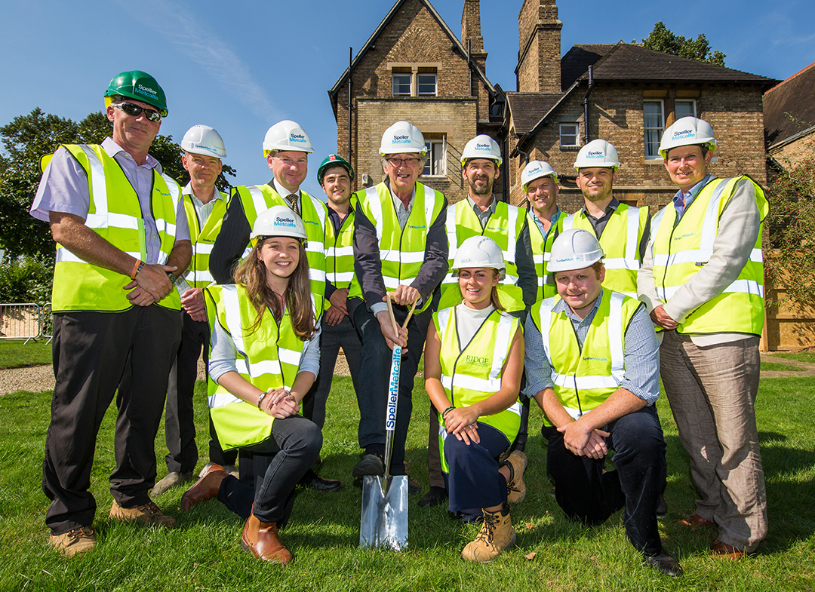
Building a Team Ethos
Easier to foster a sense of teamwork on smaller projects.
Performance targets are stringent, but give a common goal to work towards – most people do not like to fail.
innovation & excellence in construction

Slide 11
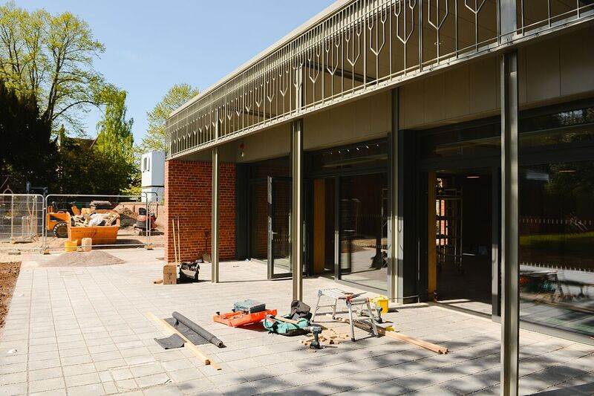
What we would like to see as Principal Contractor
Engagement in projects as early as possible to allow engagement of supply chain, a focus on buildability and collaborative management of risk.
A coherent policy and legislative roadmap for low energy buildings from Government.
Stringent requirements for post occupancy monitoring.
Further trade specific accredited training offered by the Passivhaus Trust & other trade bodies (e.g. CITB).
innovation & excellence in construction

Slide 12
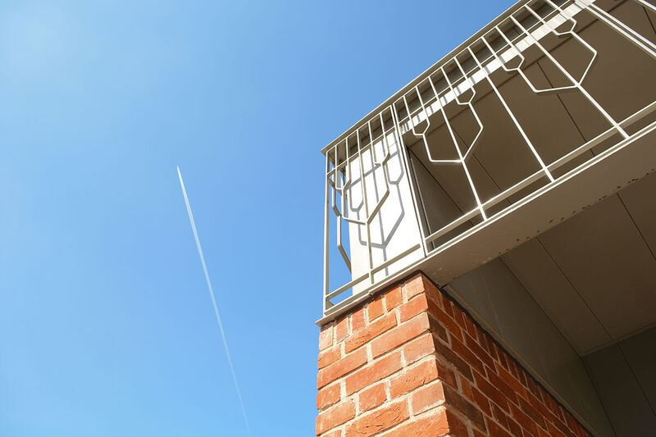
Thank For Listening
Any Questions?

