Slide 1
Mainstreaming Education for Sustainable Development Common Challenges and the case of De Montfort University
Dr Andrew Reeves
De Montfort University, Leicester, UK
ESD Topic Support Network: Implementing ESD across institutions
Tuesday 26th April 2022

Slide 2
Where are you now?
At my institution, sustainability is…
A: Adopted in pockets but not mainstreamed
B: Supported strategically, but not adopted across all activities
C: Supported and resourced well and visible across all university activities
Note in the chat window

Slide 3
Navigating towards mainstreaming
Two key contextual influences: Capacity and Commitment
Pockets of Practice
Low commitment
Emerging Agenda
High commitment
Integrated Impact
High commitment
Off the Agenda
Low commitment
Low capacity
Low capacity
High capacity
High capacity
Capacity: knowledge, skills, motivation and staff/financial resources required to pursue ESD. Predominantly bottom-up, reflecting the engagement and activities of staff.
Commitment: “an institution’s high-level strategic support of the sustainability agenda”. Reflected in strategy documents, governance procedures, etc. Predominantly top-down, often linked to wider national/international drivers
This gives four scenarios and three common situations to focus upon:
From Pockets of Practice to Emerging Agenda
From Emerging Agenda to Integrated Impact
Maintaining Integrated Impact
See EUA (2021) Environmental sustainability of learning and teaching. Available from: https://www.eua.eu/news/653:sustainable-learning-and-teaching-eua-learning-teaching-thematic-peer-groups-focus-on-grande-challenges.html
Notes:
AR to present

Slide 4
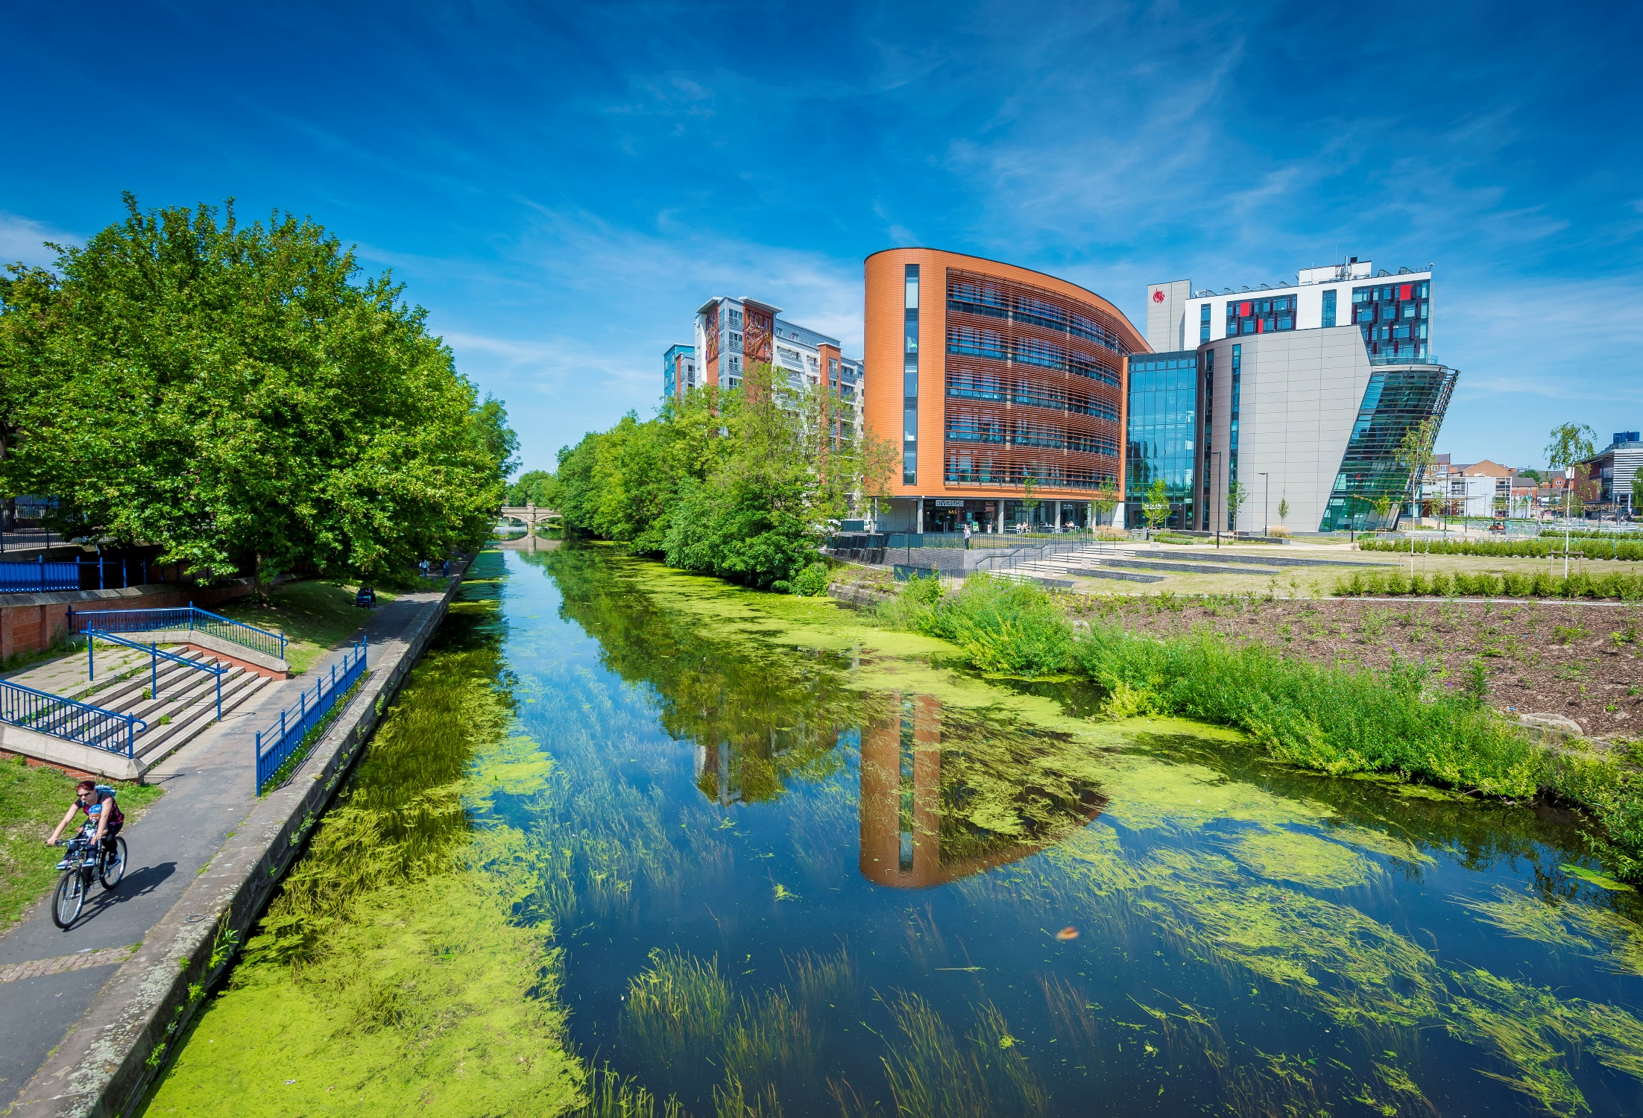
De Montfort University (DMU)
Based in the Midlands of England
~24,000 students, 2,500 staff
City centre campus in Leicester
New overseas campuses (Dubai, Kazakhstan)
Teaching-focussed
Four faculties
Business and Law
Health & Life Sciences
Arts, Design & Humanities
Computing, Engineering and Media
Strategic Commitment
Sustainability and SDGs strategy theme
Education for Sustainable Development (ESD) funded project
SDG16 Global Hub
Sustainability a key issue to address in recent cross-university curriculum redesign

Slide 5
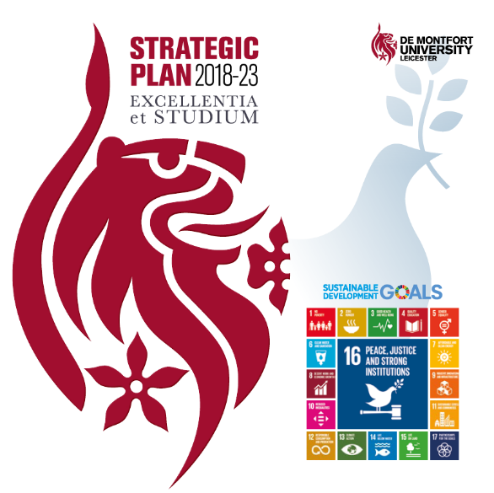
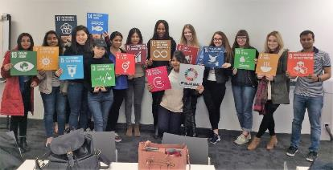
What helped and when at DMU?
From Pockets of Practice to Emerging Agenda
ESD Forum Community of Practice
Peer-to-peer learning across sector
Pilot Projects (Teaching Innovation)
Engaging with senior leaders and student union
From Emerging Agenda to Integrated Impact
Strategic Commitment and ESD Strategic Project
Sustainability and SDGs within processes (research themes; PhD bursaries; programme accreditation; staff training)
External Metrics (e.g. Responsible Futures Accreditation framework, People & Planet League)
Maintaining Integrated Impact
Linking with emerging strategic priorities (curriculum refresh; overseas campuses; decolonising)
High-level leadership role (PVC Sustainability) and permanent funding
Demonstrating sector leadership and unique approach (SDG16 Hub; local projects)
National/international influence – QAA ESD project, Green Gowns recognition
Pockets of Practice
Low commitment
Emerging Agenda
High commitment
Integrated Impact
High commitment
Off the Agenda
Low commitment
Low capacity
Low capacity
High capacity
High capacity
Notes:
AR to present

Slide 6
Discussion and Q&A
Contact:
Dr Andrew Reeves. Associate Professor and Project Director (Education for Sustainable Development), De Montfort University, Leicester.
areeves@dmu.ac.uk @andrewreeves44
ESD and Academic Quality project:
https://www.qaa.ac.uk//en/membership/collaborative-enhancement-projects/education-for-sustainable-development/esd-and-academic-quality

