Slide 1


Interdisciplinarity and Sustainability Teaching
Education for Sustainable Development in Higher Education Topic Support Network
Andy Samuel
Lecturer in Sociology

Slide 2
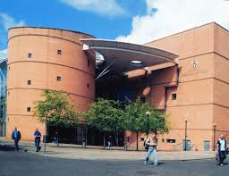
ESD at Abertay
Two Approaches
  Whole University Approach
  Elective Modules at Level 1 & 2

Slide 3
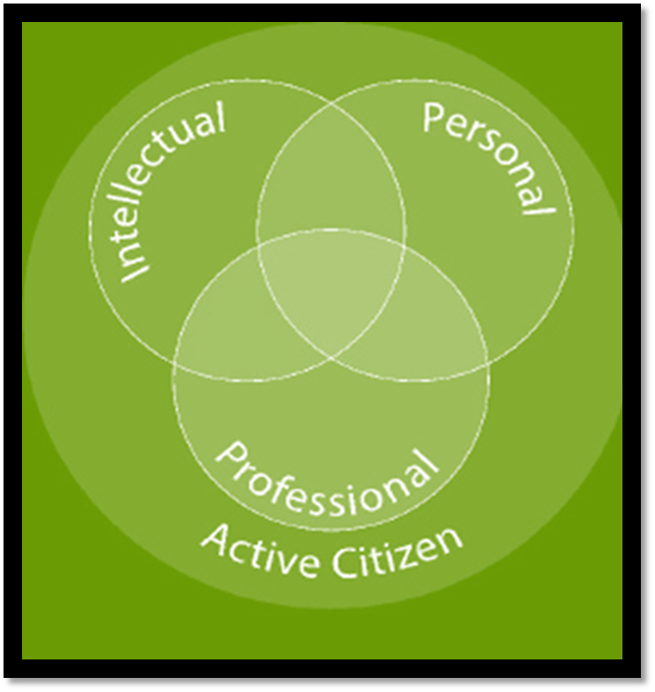
Whole Institutional Approach
New Teaching and Learning Plan
  Reforming our curriculum
  Incentivising students’ performance
  Raising the status of teaching
ABERTAY ATTRIBUTES
“We will enhance our graduates’ employability and enterprising skills through evolving our Graduate Attributes to provide a framework for student progression throughout their time at the University and inform staff development and strategic planning.”
Professional related to Hand
Personal related to Heart
Intellectual Related to Head
Taken together, our attributes lead to active citizenship;
a ‘civic consciousness’.

Slide 4
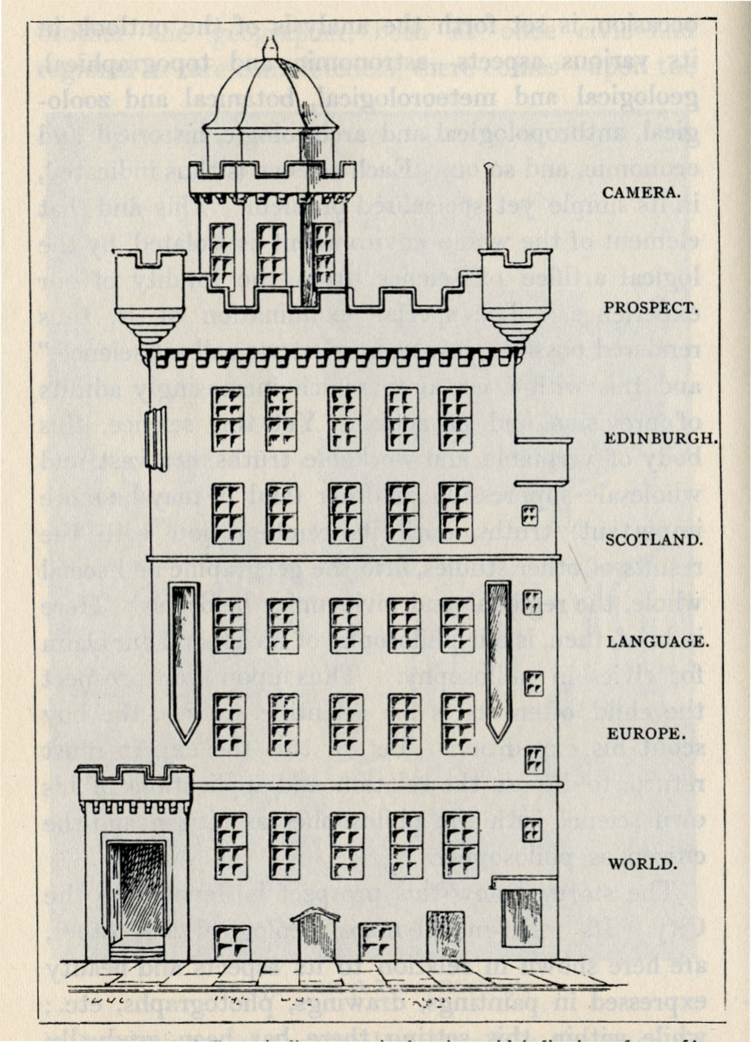
Elective Modules at Levels One and Two
Sustainability in Scotland: Innovating Locally, Transforming Globally
  Geddes: Learning by Doing
  Fieldtrips

