Slide 1


How to build resilience into student-led food gardens
Rebecca Laycock Pedersen
Postdoctoral Researcher
Blekinge Institute of Technology
@bekkika

Slide 2
Notes:
In 2013 I began my PhD research and I wanted to focus on a project that was close to my heart. I had just finished my Master’s degree and had been researching and involved in project-based work on community gardens. Alongside of my PhD I was also working as a Sustainability Project Officer at Keele University and was working a lot with an NUS-funded project called Student Eats which was being rolled out in 18 universities. The focus of the project was to support students in leading food growing projects.
I decided I wanted to focus on this scheme as the topic of my PhD

Slide 3
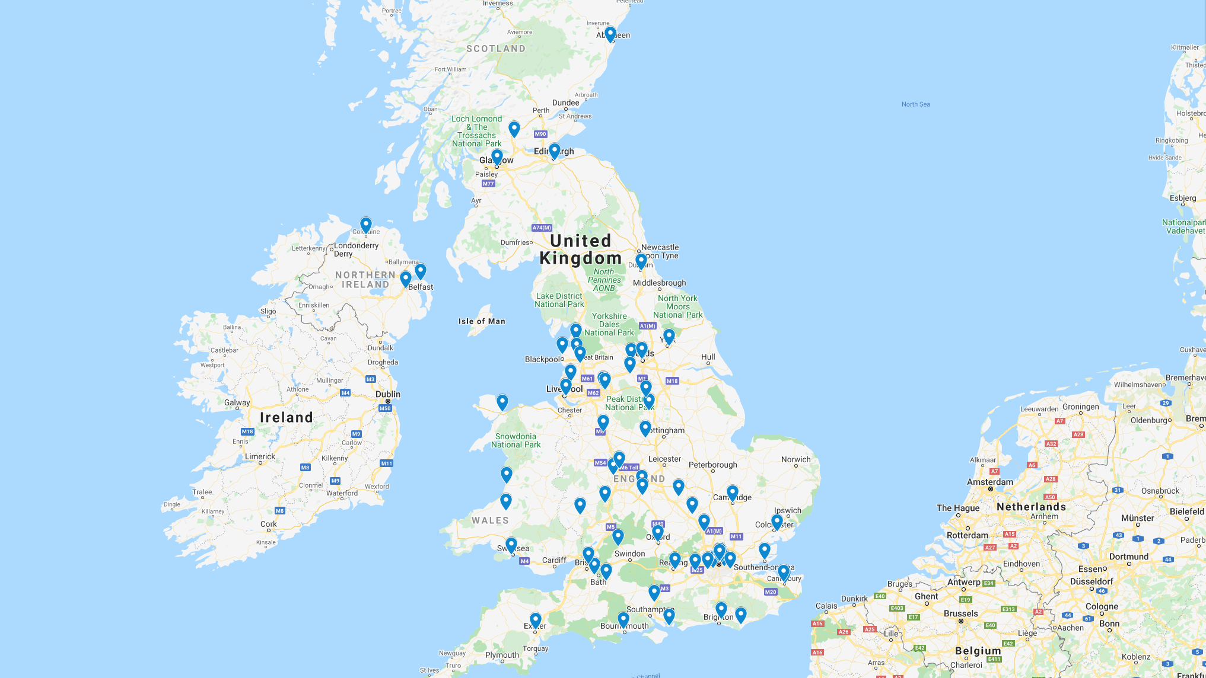
Notes:
Since I started working with Student Eats at Keele in 2013, the number of universities which are affiliated with the scheme grown to now more than 60.
The scheme has also broadened out to support food enterprises, like farmer’s markets, food co-ops and food preserving enterprises.
My research only explored food gardens, not other food schemes, however what I’m presenting will probably have relevance for student-led initiatives more broadly.

Slide 4
  What are the benefits of university community gardens?
  What keeps student-led gardens from fulfilling their potential?
  How can we help student-led gardens fulfill their potential?
Notes:
Obviously a PhD is a big piece of work, so I’ve focused on pulling out the parts that I think will be of most interest to you. I’ll be focusing the rest of this presentation around three main questions, which are:
What are the benefits of student-led food gardens?
What keeps student-led gardens from fulfilling their potential?
How can we help student-led gardens fulfill their potential?
You are of course welcome to ask questions, and I’ll also provide some resources towards the end of the presentation if you want to know more about my thesis.

Slide 5
What are the benefits of student-led food gardens?
1

Slide 6
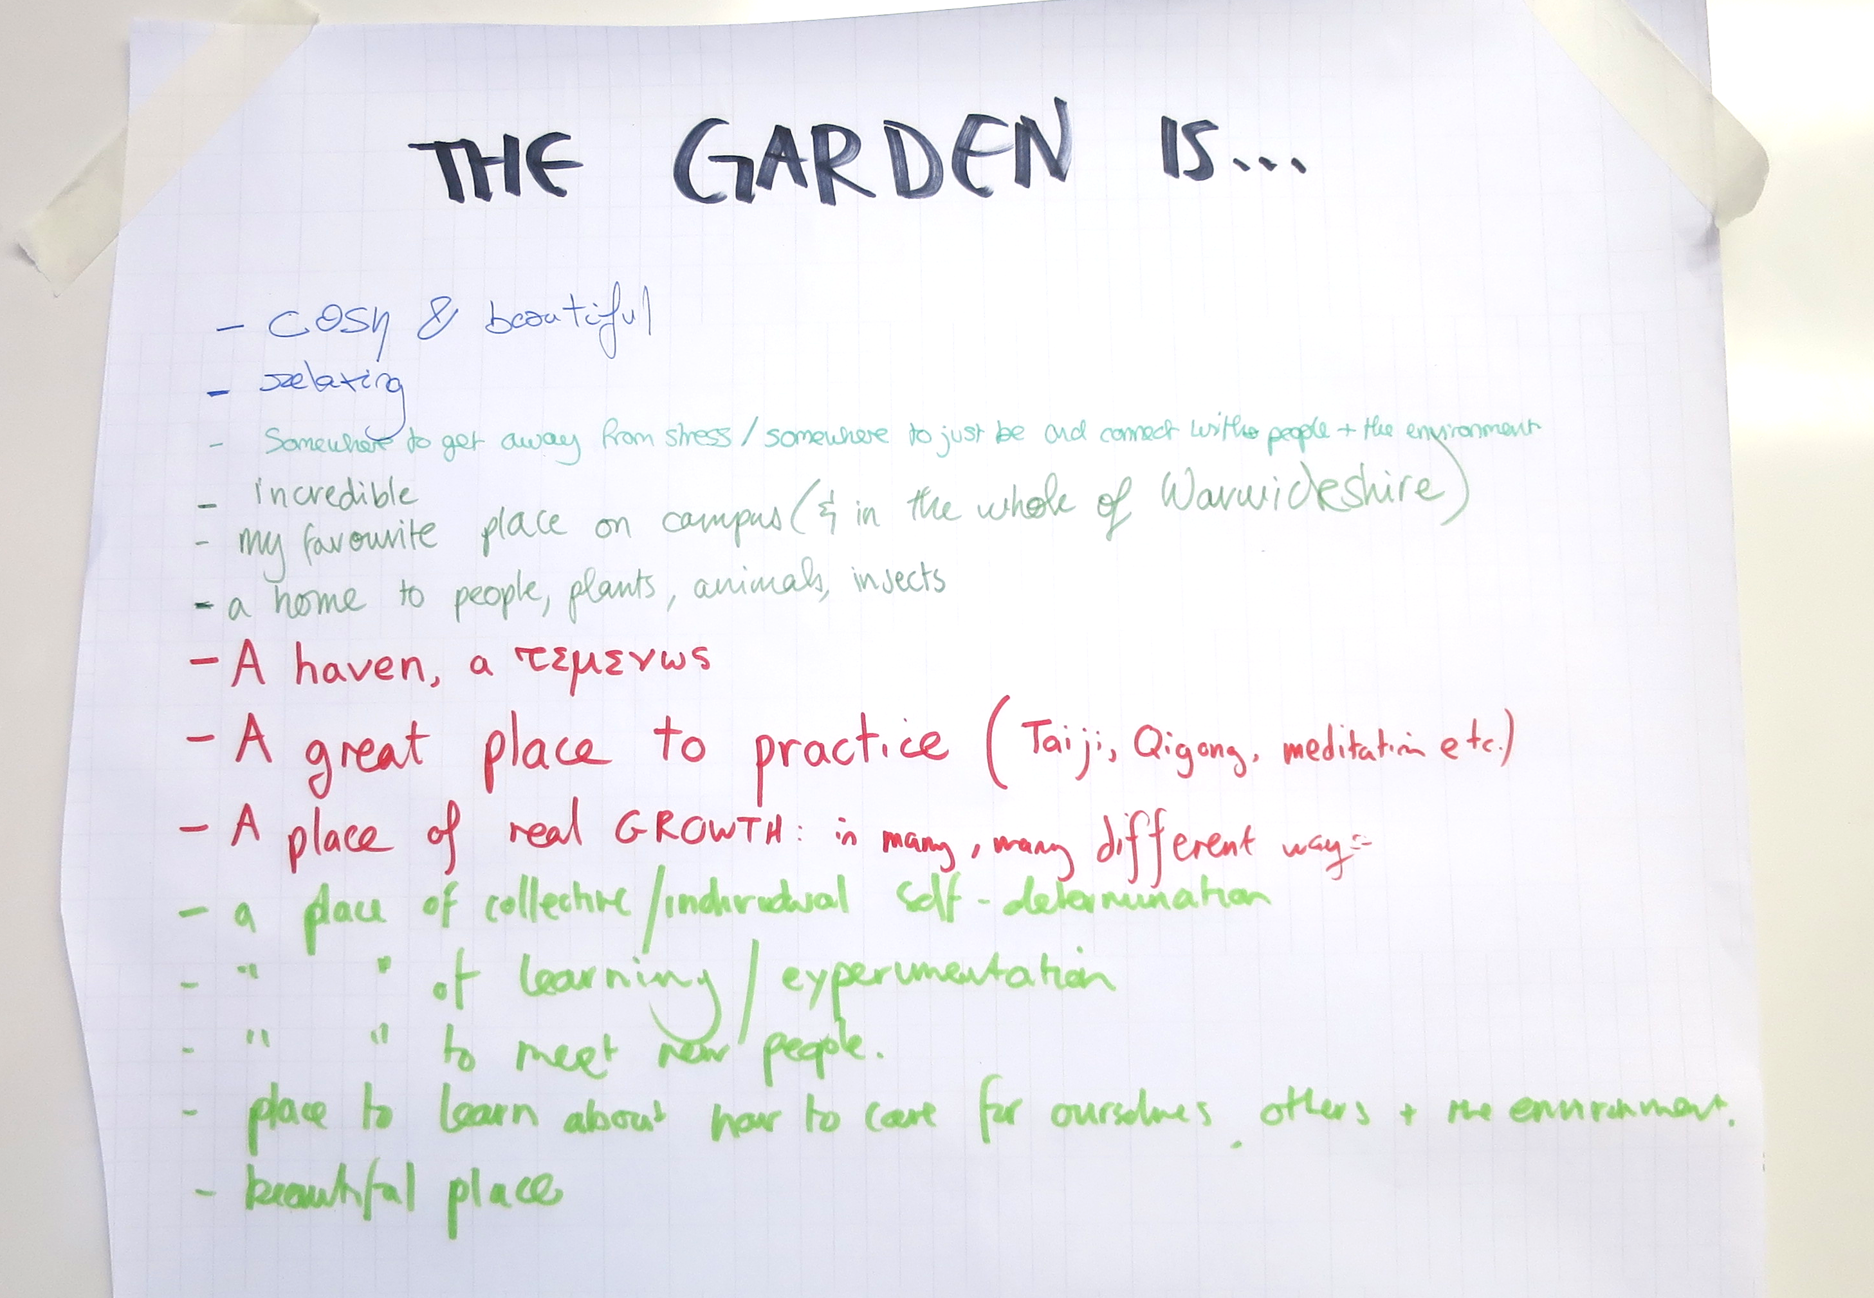
Notes:
This is a picture from one of the workshops I led during my research, where you can see that students feel there are considerable benefits to their garden.

Slide 7
The percentage of articles reporting different types of benefits of university community gardens
Notes:
I didn’t just ask students about the benefits of their gardens though. I also reviewed the literature about university community gardens. This figure is from that review. You can see that the educational benefits were the most ubiqitous. All articles discussed edcautional benefits, and most also demonstrated them.
Other notable benefits were
Social benefits, like increasing interdisciplinary interaction, and establishing a supportive community around a specific issue, and
Benefits to the university included the use of the garden for research purposes, outreach and community engagement, or improving the appearance of the campus

Slide 8
What keeps student-led gardens from fulfilling their potential?
2
Notes:
The next question I’ll be focusing on is: what keeps student-led gardens from fulfilling their potential?
This question was really the question which I oriented my thesis around.

Slide 9
...the nature of it, is like, inherently non-continuous. Because students, they stay for a year, and then they do something else.
Student gardener
Notes:
This quote from a student sums it up nicely. This student said: ’...the nature of it, is like, inherently non-continuous. Because students, they stay for a year, and then they do something else.’
This is probably something, you in this call can all relate to. Students are constantly in and out of the university. They spend usually around 3 or four years on campus, and even within that time they leave for summer holidays and have considerable ebbs and flows in their workload which affect their participation in other activities.
What I call this phenomenon is ’transience’

Slide 10
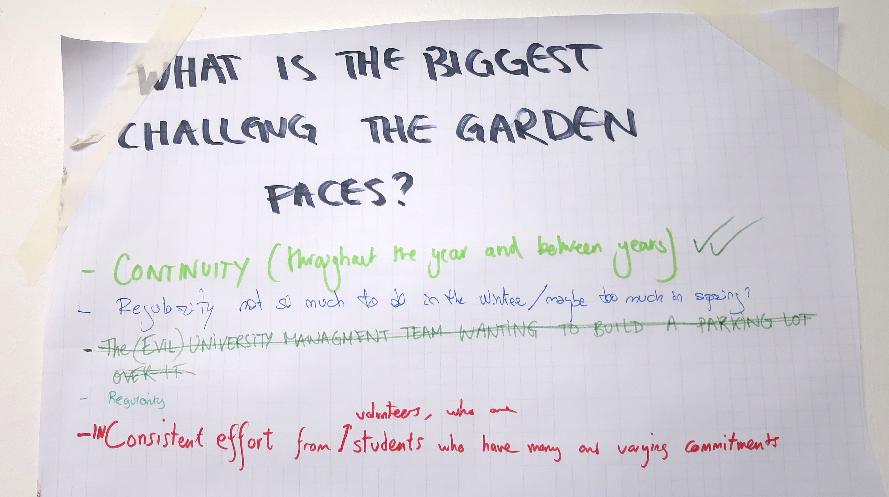
Notes:
You can see this also reflected in this poster from one of the workshops.

Slide 11

Students’ transience
Barriers to participation
Potential new recruits
New participants
Problematic participation
Problems
The relationship between different factors impacted by students’ transience
Notes:
So at a fundamental level, we know that there are problems being caused by transience, such as a constant need to recruit new participants, conflicts between staff and students, and lack of knowledge transfer between generations of students. But I was asking, how does this actually happen.
So what I found is that students transience (or the fact that they come and go from the university so much) creates problematic modes of participation in student-led gardens. For example, these might be low participation, irregular participation, or inadequate amounts of participation.
But then I also found that transience was not the only barrier to participation. There were others, such as as students lacking time or being unwilling to commit
Then I found the part which made it even more messy. This is that some problems caused by low participation, irregular participation, or inadequate amounts of participation actually cause more problematic participation. For example, low participation reduced social interation in the garden, which makes students not want to come back, further lowering participation.
But I also found that some of these problems increased some of the barriers to participation as well. For example, problematic participation caused conflicts between staff and students, which meant that university staff were less likely to give students autonomy over the garden space, and this further increased problematic modes of participation.
However, transience also paradoxically reduced problematic participation. Because there were new students coming to university every year, there were new people to recruit from and therefore an increase in new participants. However, barriers to participantion also reduced the number of new participants.

Slide 12
Notes:
This diagram can also be expanded out to show all of the different barriers to participation and the problems they cause.
But next I’m going to highlight a couple key problems from within this diagram

Slide 13
Some of the main problems
Students lacking (perceived or actual) control or autonomy
Lack of continuity
  ’Handing over’ a challenge
Without the right structures in place, learning can be maladaptive
Notes:
Some of the main problems were that students often lacked (perceived or actual) control or autonomy over the garden space and this made them feel like their work wasn’t ’their’s or even meaningful, necessarily.
There was a lack of continuity which made handing over knowledge, key information, and even responsibility a challenge
Also, without the right structures in place, learning can be maladaptive. According to previous research, education is the main benefit of student-led gardens. However, some students were coming to unhelpful conclusions in their learning, such as that their action doesn’t matter in the long-run.

Slide 14
  It’s just not really our space is it? You can’t really do what we want with it. It’s really limited, so much. When you don’t feel like you own the place. Yeah, it’s just, you’re, like, just extracted for labour, basically.
Student gardener
Notes:
I mentioned another key problem earlier, which was that student-staff relationships were not always positive.
You can see from this quote from a student gardener that the student-staff relationship was thought to be an adversarial one by this student because they weren’t given much autonomy over the space.

Slide 15
How students see the academic year
How students’ union and university staff see the academic year
Notes:
One of the major sources of conflict, I believe, is that students have different different understandings of time.
Students saw time in a ’linear’ way because they saw their involvement in the gardens as a time-limited activity or a ’one-off mission.’
So, in other words, participation in the gardens was seen as an activity with a beginning, middle and and end.
For university/students’ union staff, time was seen in a more ’cyclical’ way because staff involvement in the garden tends to take place over a longer time. Therefore, it would be expected they would see recuccuring patterns and routines that came in cycles.
The implications of this were that each year or two, new students joined the gardens and experienced the challenges of being involved in such a project for the first time.
For example, new students would have to approach university or students’ union staff that they found intimidating and be challenged by the power dynamics at play. For staff, however, these interactions were routine.
Furthermore, possibly because students had linear perceptions of time, many struggled to see how their own transience impacted the gardens. This inhibited their ability to take meaningful action to address the impacts of their transience.

Slide 16
  …what about the... the general dynamic of the university being very, very careful, and very, very cautious with what they do? And what they allow? Maybe? And students being more progressive and wanting to do more edgy things… or more – just try. Because it’s a playground, isn’t it? A university. You try out things…
Student gardener
Notes:
These different perceptions of time also come with different approaches to risk.
Students tend toview risk positively and as opportunity, while staff tend to be more risk adverse.

Slide 17
How can we help student-led gardens fulfill their potential?
3
Notes:
So moving from these challenges, how can we make sure student-led gardens fulfil their potential?

Slide 18
Improve student-staff relationships
Pay attention to power asymmetries between staff and students, and develop strategies to compensate for them
Pay attention to the quality of relationships between students and staff
Ensure time is allotted for supporting students, preferably from both more traditionally student-facing roles (i.e., students’ union or sustainability staff) as well as estates, grounds, or operations staff

Slide 19
Give students autonomy
Ensure students are actively involved in decision-making about the garden space
Ensure the space is widely accessible, including out of business hours
Devolve as much decision-making power to students as possible

Slide 20
Help students learn and retain knowledge within the project
Help students transfer plans and documentation on to future generations of students
Embed opportunities for reflection about taking part in the garden in leadership accreditations, volunteering awards, or other such schemes

Slide 21
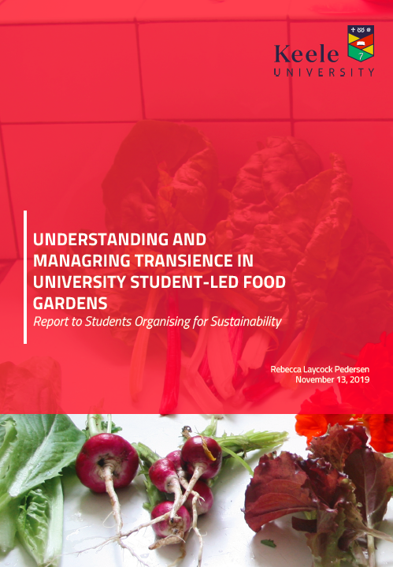
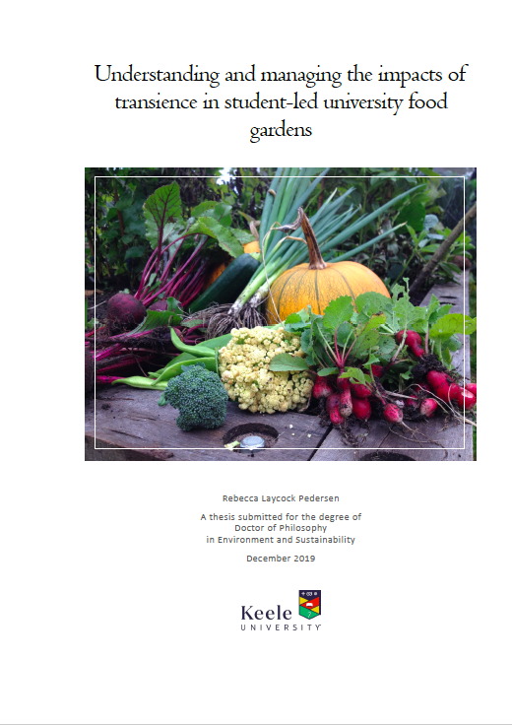
A video for student gardeners
https://youtu.be/okJ0ETOeNnk
A report for students’ unions & universities
https://www.researchgate.net/publication/338607371_Understanding_and_managing_transience_in_student-led_food_gardens_Report_for_students'_unions_and_universities
My thesis
http://eprints.keele.ac.uk/7536/

Slide 22
Thanks!
Any questions?
You can find me at rebecca.laycock@bth.se or
@bekkika

