Slide 1
Sustainability in the Maths & Stats Curriculum at St Andrews

Slide 2
Daddy,
you are not a scientist

Slide 3
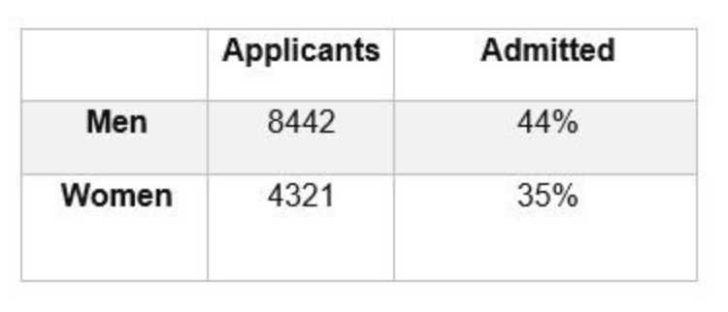
Simpson’s Paradox
In 1973 UC Berkeley was sued for sex-discrimination. It turned out of all the female students who applied — only 35% of them were admitted. While out all the male students who applied 44% of them were admitted.
Admission %
Male
Male

Slide 4
Simpson’s Paradox
In 1973 UC Berkeley was sued for sex-discrimination. It turned out of all the female students who applied — only 35% of them were admitted. While out all the male students who applied 44% of them were admitted.
Admission %
Male
Male
School A
School B

Slide 5
Simpson’s Paradox

Slide 6
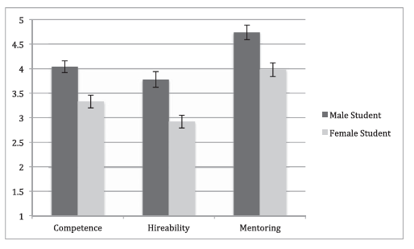

Slide 7
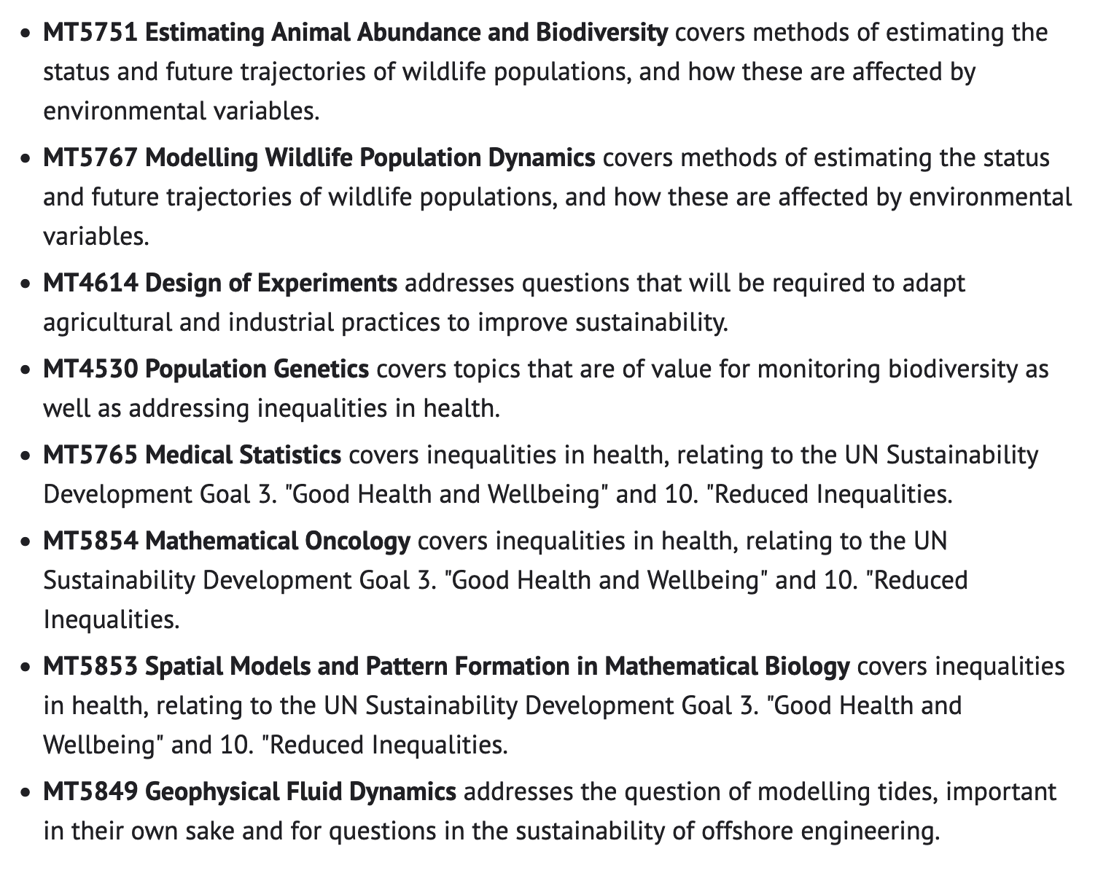
We provide analytic tools
Sustainability issues enter via Examples and Case Studies

Slide 8
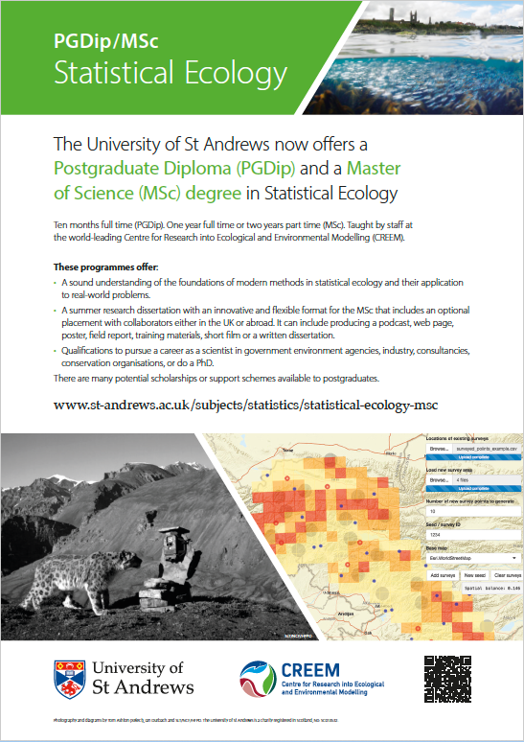
Motivation: Research with conservationists/managers & historic lack of quantitative skills in this area.
Explicitly interdisciplinary (70% to 80% from biology/ecology backgrounds).
Substantial fraction (~ 30%) of practicing scientists (as opposed to new graduates).
Industry partners for projects and placements.
Finance a huge obstacle to reaching people in less developed regions: We have 2 fee-waiver scholarships (due to disappear) and 1 private living cost scholarship for students from less developed country.

