Slide 1
Borders College Sustainability Journey

Slide 2
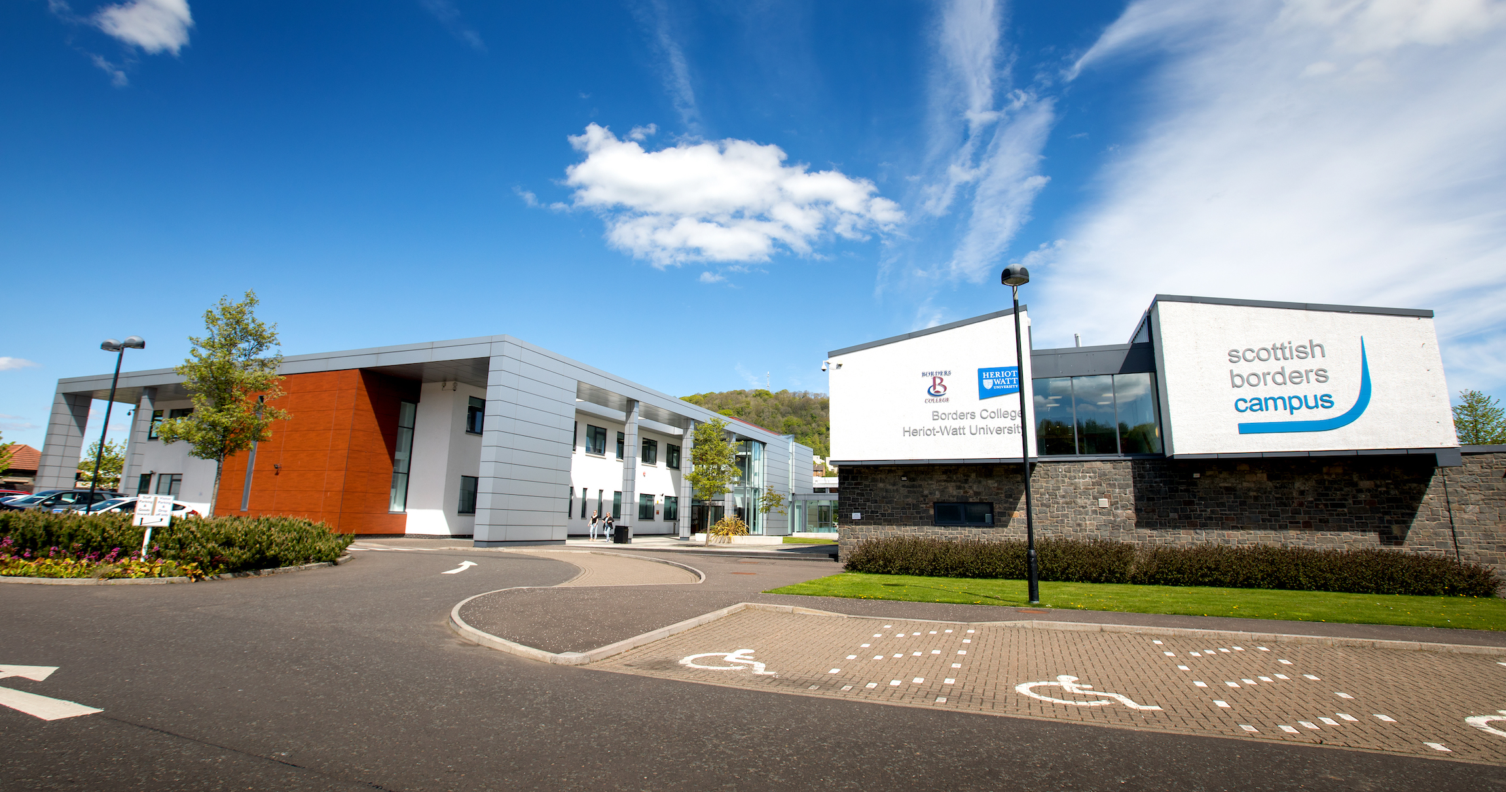
College Context
One of the smallest Colleges in Scotland
4 Campuses across the Borders region
Main Campus at Galashiels shared with HWU
Cover a very large Geographical rural area

Slide 3
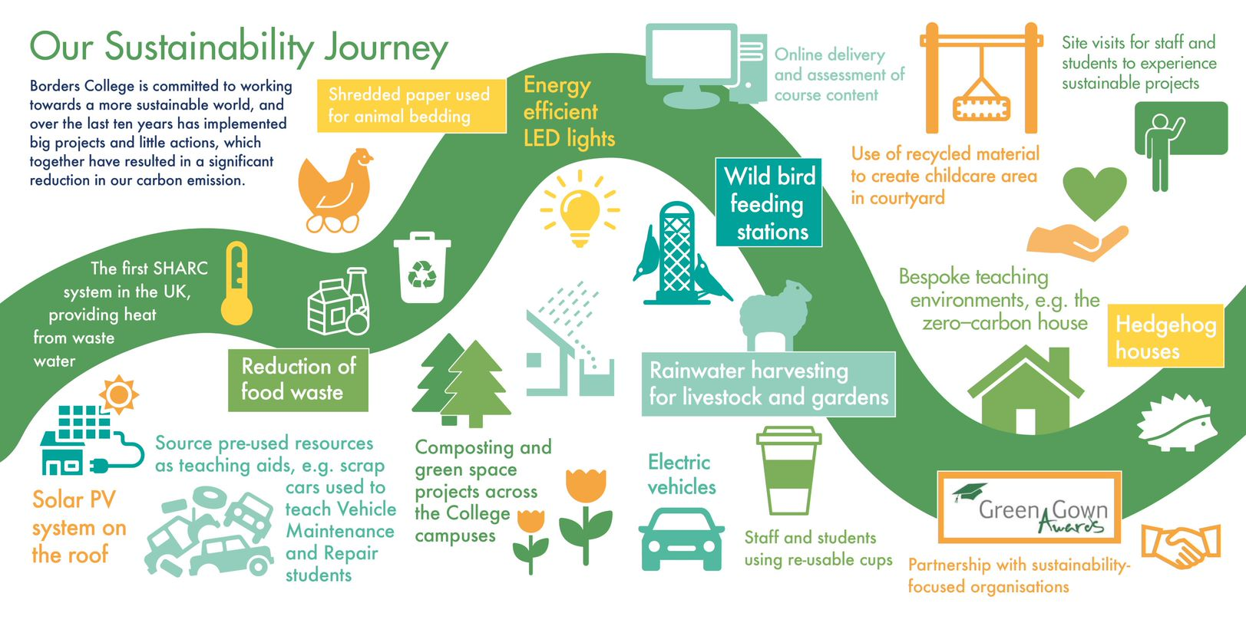
Our Journey

Slide 4
Development of Sustainability Strategy 2020-2025
Completed internal review of previous activities and recognised sustainability was too narrow focused throughout the College
Held Working groups with broad College and external representation led by College Principal.
Set strategic Ambition
Set Strategic Objectives
Set Performance measurers
Underpinning Themes, Behavioural Changes, Circular Economy, Global Citizenship

Slide 5
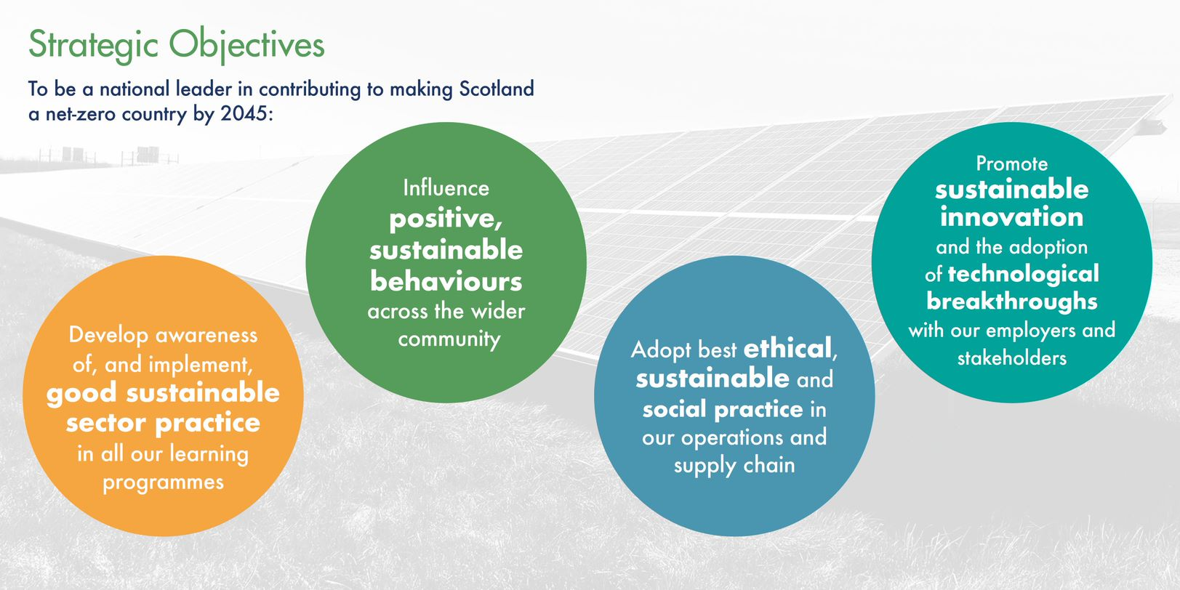
Strategic Objectives

Slide 6
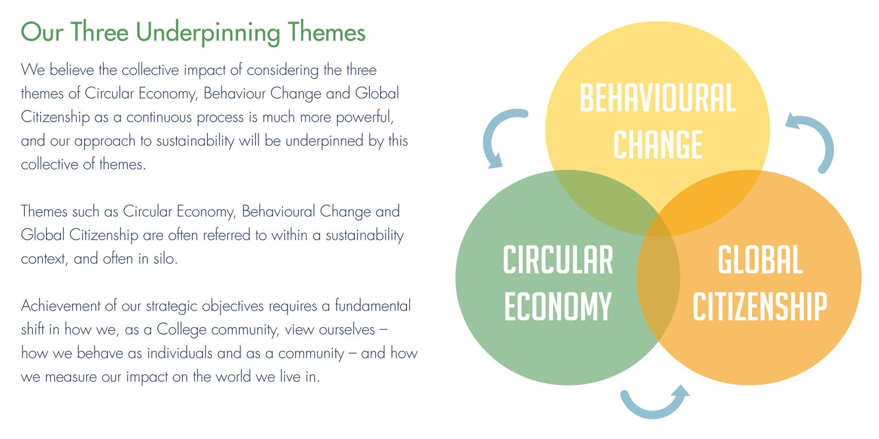
Underpinning Themes

Slide 7
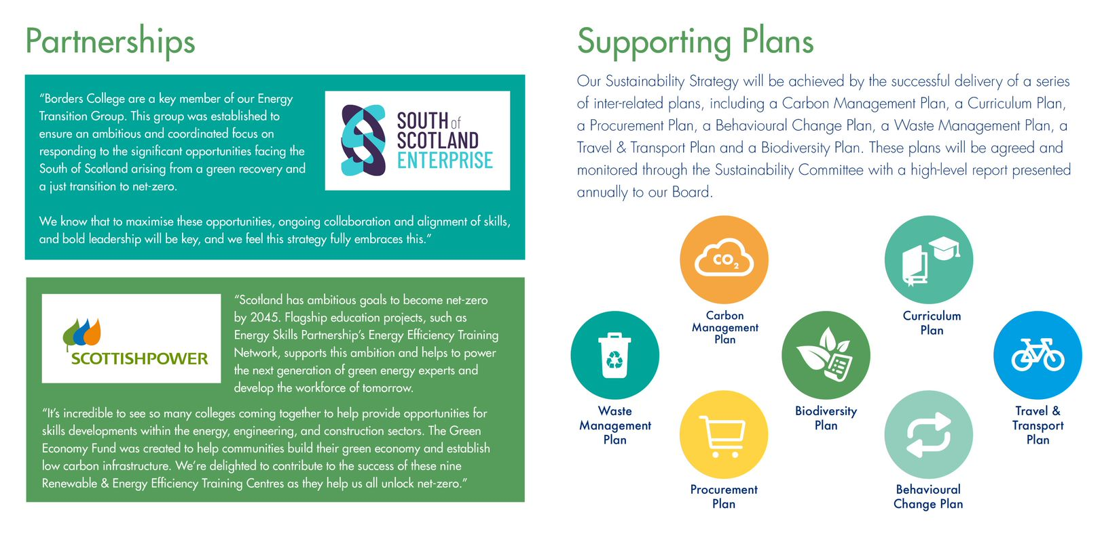
Partnerships and Plans

Slide 8
Key elements of Strategy
Partnerships
EAUC- Central and Southern Scotland College Partnership, Borders College, West Lothian College and Forth Valley College.
Supporting plans, The college have developed 7 plans and works streams, these are, Carbon Management, Waste Management, Travel and Transport, Curriculum Plan, Procurement Plan, Biodiversity Plan, Behavioural Change Plan, Each Stream led by Members of the College Senior leadership team reporting back to SLT and BOM on progress.
Global Citizenship awards- Recently awarded our 100th award

Slide 9
Next Steps
Evaluate against current targets
Begin to develop strategies for outline of sustainable objectives and targets 2025-2030.
GG Judging Panel Comments- This is an impressive comprehensive, whole institution approach. The project was well thought out, aligning their journey to many important factors such as behaviour change and the circular economy. It is replicable for large universities and small colleges alike. The breadth and reach of the initiative for a small institution is outstanding.
Don’t be afraid to start afresh from top to bottom.

Slide 10
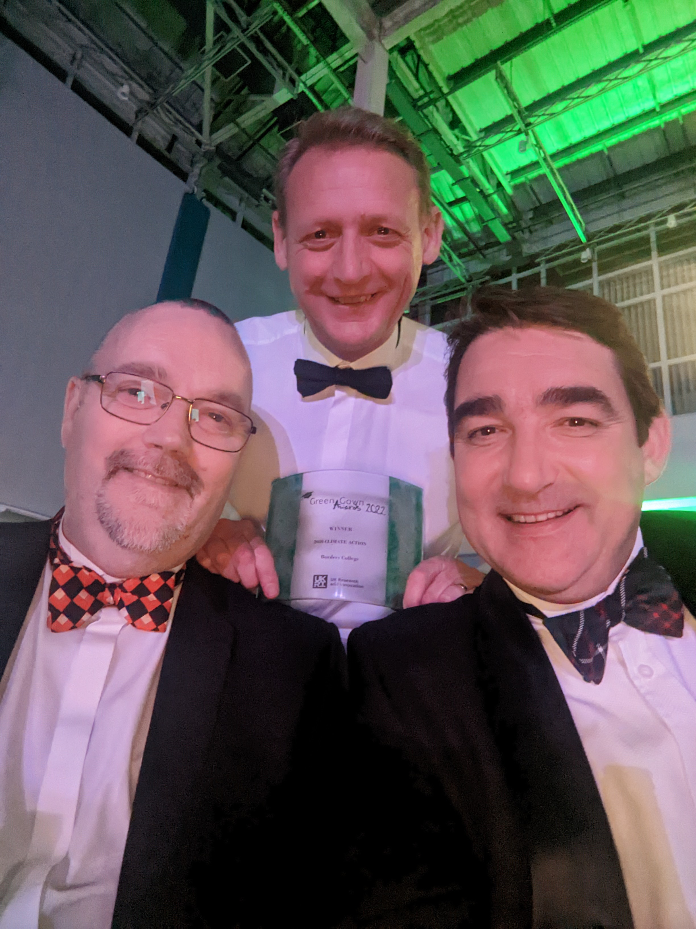
Any Questions?

