Slide 1

Useful Reuse and
Resourceful Recycling
Capabilities and Realities
Alison Gallacher

Slide 2
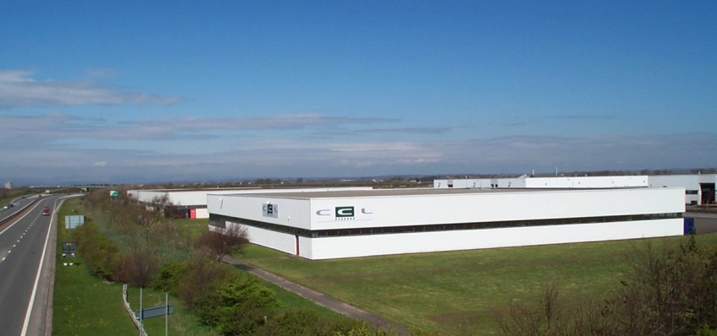
Who We Are
Established in March 2000
Fully licensed facility
Capability to collect ,reuse and recycle all 14 categories of WEEE
Last year we recycled approx 2,400 Tonnes of WEEE equipment
Have capability to process up to 4,000 Tonnes
We operate in 2 main sectors including B2B collections and collections from HWRC

Slide 3
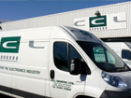
What We Do
Tailored disposal solutions for
end of life IT and WEEE equipment
Carry out all collections using own fleet of liveried, satellite tracked vehicles
All material collected and processed by our own full time employees in house
Focus is on security to ensure no possibility for data to escape

Slide 4

Customer Examples
For the period 2014
  Over 400 unique collections,
  collecting approximately 130 Tonnes of material,
  over 12,000 items in total

Slide 5
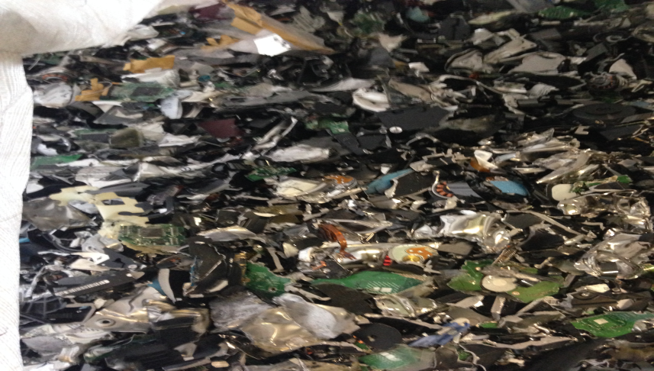
How We Do It
Full traceability on all equipment collected
Where permitted, reuse is given as a priority
(where there are viable end markets!)
Full testing, data wiping / destruction, refurbishment and PAT testing carried out
Work closely with UK companies for resale of equipment
Secure Data Recycling

Slide 6
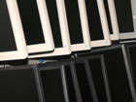
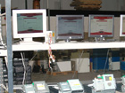

Why We Do It
By encouraging reuse we work towards a Circular Economy Business Model (CEBM)
This business model keeps products and materials in use for as long as possible
Increases the value that can be recovered and keeps recycling costs low

Slide 7
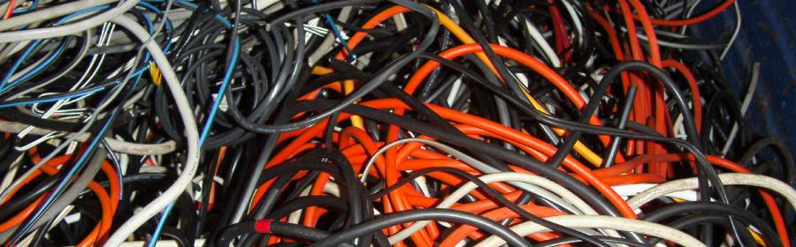


Benefits
Diverts valuable material from landfill
By keeping material in UK it creates jobs and retains recyclate value within the UK market

Slide 8
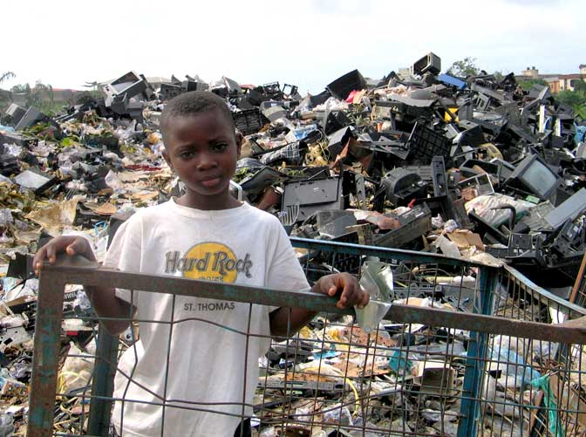
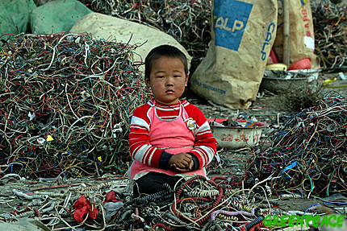
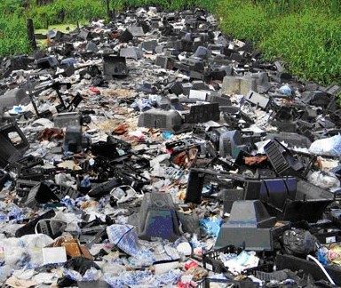
Risks
Data leaks when material not handled properly
Material being sent overseas for processing

Slide 9
Sources
https://www.youtube.com/watch?v=8tVdTBnBXw0
http://www.ban.org/E-waste/technotrashfinalcomp.pdf
http://ban.org/library/TheDigitalDump.pdf

Slide 10
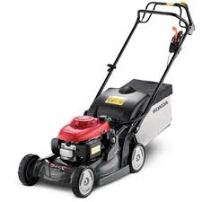
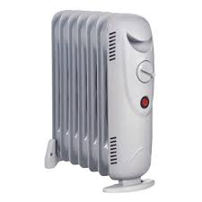
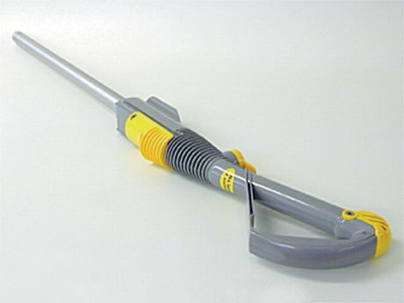
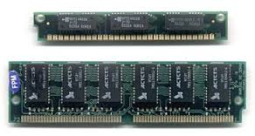
Realities
Lack of viable end markets for material
Lack of willingness to buy second hand electrical items
Lack of awareness of legislation
Reuse focused on whole items and not components
Rogue traders

Slide 11
CCL would like to openly invite anyone interested to visit our facilities in Irvine.
Thank you!
Alison Gallacher
CCL (North) Ltd.
1 Dunlop Drive, Meadowhead Industrial Estate, Irvine, Ayrshire, KA11 5AU
www.cclnorth.com
01294 278844

