Slide 1

Carbon Footprint and Project Register Tool Training
Clare Wharmby
Chris Asensio

Slide 2
Time | Agenda for today
9:30 – 9:45 | Introduction to workshop and identification of key organisational needs
9:45 – 10:00 | Overview of the CFPR tool
10:00 – 10:45 | Organisational boundary and operational carbon footprint
10:45 – 11:00 | How to complete the Carbon Reduction Project List
11:00 – 11:15 | Coffee break
11:15 – 11:45 | Practice of carbon costing a range of different project types
11:45 – 12:00 | Identification of key factors impacting on your future carbon footprint
12:00 – 12:30 | Incorporating factors into the Business as Usual Scenario
12.30 – 13.15 | Lunch
13:15 – 13:45 | Using graphs and outputs for tracking targets and management information
13.45 – 14.20 | Using the CFPR tool to complete your PBCCD report (and EMR report)
14:20 – 14:50 | Trouble shooting – typical problems and how to solve them
14:50 - 15:00 | Wrap up

Slide 3

Exercise: Organisational needs
Using the post-it notes on the tables, note down your key organisational need from today:
Get a better idea of how to manage our project list
Understand how to mange our data for reporting purposes
Notes:
Explain that the day will be interactive and the idea is that over the course of the workshop, they will enter footprint data, projects, targets and BAU scenarios.

Slide 4
Glossary
Carbon/carbon emissions
Greenhouse gas emissions measured in tonnes CO₂e
Business As Usual
Changes to the organisation without any carbon management
Emission factors
Factors to convert activity data into tonnes CO₂e
Decarbonisation
Refers to reducing the carbon intensity of electricity or heat generated by increasing the efficiency of supply or changing the fuel or generation mix

Slide 5
Philosophy of the CF&PR tool
Designed to be easy to use with minimal data entry
Builds on the previous RES tools - same format and style
Useful elements within the tool to allow filtering of data and comparisons between projects
Full explanatory section at start with notes throughout
Tool is issued annually with updates to Carbon Emission Factors

Slide 6
Anatomy of the CF&PR tool
Target setting allows sensible targets to be set and progress monitored
The project list calculates the savings against the footprint over time
The future BAU carbon footprint is estimated from current activity and future changes
Activity data is converted into units of cost and carbon using reference sheets
In the centre of the tool is a large spreadsheet containing current activity data
The historical footprints tab enables previous year’s data to be stored for reference
Current and future costs and emission factors
The outputs tab automatically generates tables and graphs for use in other reporting
Notes:
RES have developed a tool to support CM Plans
Tool supports establishment of:
Current and future CFs
Project register
Outputs includes graphs and tables for entry into your CM Plan
Progress towards target (if already set)
Setting a new target (if required)

Slide 7
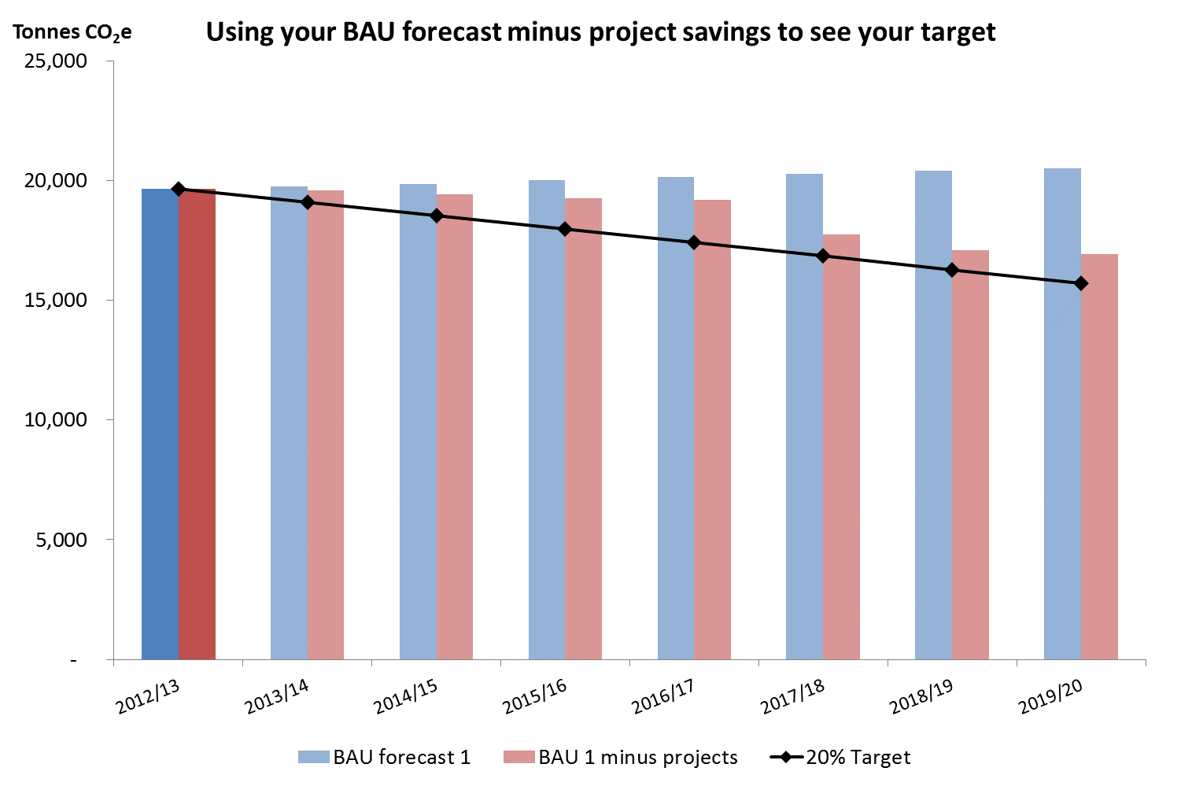
Organisational boundaries and carbon footprints

Slide 8
Why do carbon footprinting?
Provides a reference point (baseline) for setting targets
Tells you how far you have come (annual carbon footprint)
Tells you when you have met your target
Provides a focus for Carbon Management actions
Helps identify where you are likely to get greatest carbon return on investment
Provides an evidence base for business cases
Required for PBCCD reporting

Slide 9
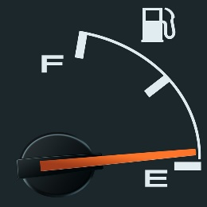
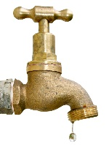



What are scopes?
Fuel use in buildings
Fuel use in fleet
Grid electricity:
Generation
Indirect emissions:
Direct emissions from estate/vehicles:
Water supply and treatment
Waste/recycling
Business travel
T&D losses
Scope 1
Scope 2
Scope 3

Slide 10
What is the boundary of my organisation?
GHG Protocol sets out two methods of determining your boundary; financial and operational control
However, these were set with businesses in mind, rather than the public sector
Therefore there are 4 key questions:
  Do we have sufficient control to be able to reduce emissions?
  Is it recognised as part of our estate or organisation by the public?
  Can we get hold of the data?
  Do we pay the bill?
Notes:
The Greenhouse Gas (GHG) Protocol, developed by World Resources Institute (WRI) and World Business Council on Sustainable Development (WBCSD), sets the global standard for how to measure, manage, and report greenhouse gas emissions.
The GHG Protocol can be found at http://www.ghgprotocol.org/

Slide 11
Out of boundary:
Emission sources within Carbon Management boundary:
3 campus buildings
Refrigerants
Direct fuel use
Waste disposal
Business travel
Natural gas (kWh)
Recycling (tonnes)
Landfill (tonnes)
Taxi
Bus
Commercial & industrial
Mixed
Rail
Biomass (kWh)
Student commuting
Electricity
Generation (kWh)
Water
Staff commuting
Supply (m³)
Treatment (m³)
T&D losses (kWh)
Procurement of goods/services
Fleet vehicles
Business travel
CO₂ from biomass
Diesel (litres)
Private car (km)
Air (passenger km)
Key
Scope 1
Scope 2
Scope 3
Out of scope
Notes:
It is useful to back up your Carbon Footprint boundary diagram with an actual asset list
This should list all the buildings in your estate that are included in the boundary
It should also detail the rationale for inclusion in the notes
For emission sources that are related to a building, it should show whether these are included
For fleet, a summary of vehicles should be sufficient

Slide 12
Exercise – carbon footprint data entry
Building 2
Electricity: 3,000,000 kWh
Gas: 500,000 kWh
Biomass: 4,500,000 kWh
Floor area: 5,000 m²
Building 1
Electricity: 2,000,000 kWh
Gas: 5,000,000 kWh
Floor area: 2,000 m²
Building 3
Electricity: 5,000,000 kWh
Gas: 10,000,000 kWh
Floor area: 10,000 m²
Category | Emission source | Emission type | Amount
Water supply | Water | Water - Supply (m3) | 100,000
Water treatment | Water | Water - Treatment (m3) | 95,000
Waste recycling | Waste | Paper & Board (Mixed) Recycling (tonnes) | 4,500
Waste to landfill | Waste | Refuse Commercial & Industrial to Landfill (tonnes) | 2,000
Fleet | Transport | Diesel - average biofuel (litres) | 70,000
Business travel car | Transport | Car - Unknown fuel - Average (km) | 5,000,000
Business travel flights | Transport | Short Haul Flights - Average passenger (passenger km) | 5,000,000

Slide 13
Things to be aware of:
There are certain columns that have to be completed (hover over headings for detail):
  Existing building/operation? Yes
  Future new build/operation? N/a
  Future changes (three columns) – answer N/a for now
You can pull some completed cells down, but not if they contain numbers or years
You cannot add rows to the workbook

Slide 14
Output of the carbon footprint

Slide 15
Project List
  Acts as a project register to store ALL carbon saving project information
  Asks to identify project owner and implementer and helps keep track of implementation status
  Calculates all future carbon and cost savings for your project
  Allow you to compare projects and decide which are best to fund
  Helps in predicting your progress against your Carbon Reduction target

Slide 16
Exercise – project data entry
Project Description | Location | Com Year | Cap Cost | Type of Saving | Type of Emission | Amount | Annual Savings for…
Lighting upgrade to LED | Building 1 | 2015/16 | 36,000 | Stationary | Grid Elec | 65,000 | No

Slide 17
Exercise – Updating the Project list
Look through the Project List tab and amend the following projects. Note the impact of each:
  Increase the number of lamps changed over to 50% of all lamps.
  The CHP supplier has come back and stated the CHP should be able to run for 5,500hrs instead of 5,000hrs
  Change food recycling from AD to composting
  Instead of using Tele conf for ‘saved’ flights, train travel will be permitted instead. How do you reflected this in the tool?
  The PV project has been abandoned.

Slide 18
Keeping the Project List LIVE
The Project List tab should be considered a ‘live’ register
Should be used any time a new project is identified or a project update occurs
For existing projects, updates can include:
  Timing (change to commissioning year)
  Responsibilities
  Capital costs
  Project Status
  Amount of Saving
Always update the ‘Estimate of Confidence’ and Add ‘User Notes’ at the end of each project

Slide 19
Carbon costing projects
A key challenge is to carbon cost a project i.e. identify the savings associated with it
Range of projects should be mapped against the emissions distribution and the future of the estate
Don’t be afraid to start with estimates that are refined over time

Slide 20
Example of initial estimating
Campus building uses 1,130,000 kWh per year
UK-wide data on lighting as end use of electricity in commercial office sector = 32%
Electricity saving 62,000 kWh (total use x 0.32 x 0.86 x 0.2)
Estimated savings of technology for 5W LED replacements of 35W halogen spots = 86%
Amount of light fittings to be replaced = approximately 20%

Slide 21
Sources of costing information
Use information about buildings, energy consumption of different end uses and technology efficiencies to estimate savings
Various sources of information can help:
  Metered data
  Consultants reports
  Equipment suppliers
  EAUC Tech Catalogue
  Guidance Documents (RES and Carbon Trust)
  Data from the Department of Business, Energy and Industrial Strategy (energy consumption in the UK)
Notes:
Useful links:
EAUC Tech Catalogue: www.sustainabilityexchange.ac.uk/energy_efficiency_technologies_catalogue
Resource Efficient Scotland: www.resourceefficientscotland.com/resource-types/guides
Carbon Trust: www.carbontrust.com/resources/guides/energy-efficiency/technology-and-energy-management-publications/
ECUK tables from the DBEIS: www.gov.uk/government/collections/energy-consumption-in-the-uk

Slide 22
Exercise – carbon costing a project
Plan is to install ‘weather compensation’ on all boilers in Building 1
Calculate gas used in Building 1 (CF&PR tool)
Determine typical % of gas used for heating (Use ECUK tables)
Determine typical saving % for technology (‘EAUC Tech Catalogue’ )
CALC: 5,000,000 kWh x 0.84 x 0.05 = 210,000 kWh
Notes:
Building 1 gas consumption = 5,000,000kWh
ECUK Tables to determine % of gas used for heating in a typical Uni building = 84%
EAUC Tech Catalogue states 5% savings achievable.
CALC = 5,000,000*0.84*0.05 =

Slide 23
Exercise – identification of factors that impact on your footprint
Student numbers
Staff numbers
Your organisation’s carbon footprint
Service provision
Estate changes
Emission factors
Weather e.g. degree days

Slide 24
Example 1– building closure
Building 1
Electricity: 2,000,000 kWh
Gas: 5,000,000 kWh
Floor area: 2,000 m²
Year of change | % change | Final year of full operation
2016/17 | -50% | 2016/17
What will be the impact on the footprint in 2016/17?
What will be the impact on the footprint in 2017/18?
CF decrease by 1,819 tCO₂e x 50%
CF decrease by 1,819 tCO₂e x 100%

Slide 25
Example 2 – increase of 25% in student and staff numbers at Building 3
Building 3
Electricity: 5,000,000 kWh
Gas: 10,000,000 kWh
Floor area: 10,000 m²
Year of change | % change | Final year of full operation
2016/17 | +25% | N/a
What emission sources will student/staff numbers affect?
  Heated area?
  Lighted area?
  Opening hours?
  IT and other uses?
Notes:
Users have to make judgements about how to estimate the impact of increasing student/staff numbers at a particular building. A useful rule of thumb is that electricity tends to be increased more than heating fuels when more people use a building.
The important thing is to document the assumptions in the user notes so these can be reassessed/challenged if necessary.

Slide 26
Impact of BAU on future forecast

Slide 27
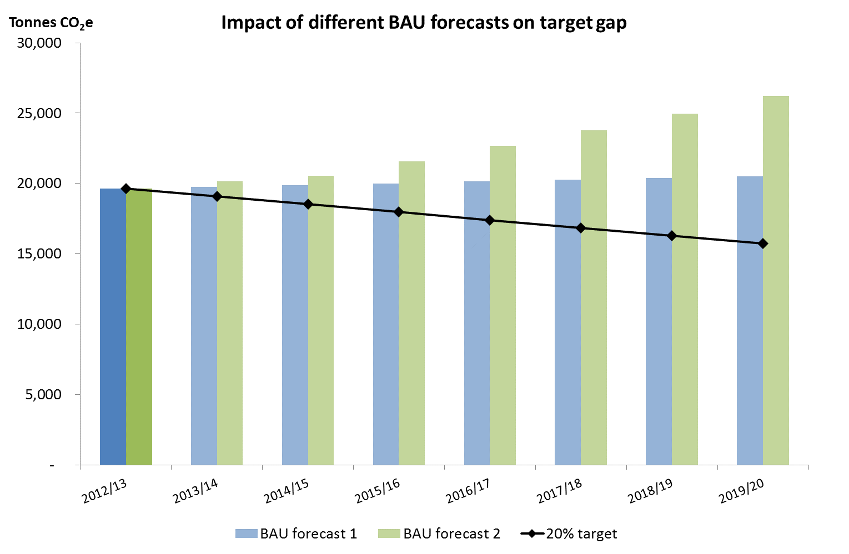
Impact of getting BAU wrong

Slide 28
Using the Outputs
Tool generates a variety of graphs and tables designed for use in:
  Carbon Management Plans
  Sustainability Reporting
  Public Bodies Climate Change Duties Report
  Estates Management Report

Slide 29
Using the Outputs for PBCCD
Question
3a | Historical footprint tab, split by scope, and output table 1c for most recent year
3b | Currently by filtering spreadsheet but will be a new output table with activity data – CF&PR tool uses the same EFs as the PBCCD report
3c | Renewables output data from the organisation
3d | Targets tab
3e | Filtered project list for year and status and emission source e.g. all complete electricity projects for 2016/17
3f | Filtered project list for correct year and status ‘complete’
3g | BAU scenario
3h | Filtered project list for year and status and emission source e.g. all complete electricity projects for 2017/18
3i | All completed projects since baseline year
Notes:
For further information and guidance about completing your PBCCD report, go to: www.keepscotlandbeautiful.org/sustainability-climate-change/sustainable-scotland-network/climate-change-reporting/

Slide 30
Troubleshooting
Read the ‘Read This First’ tab
Keep a saved version and manage your version control
Keep back up documentation (more notes than you think you need!)
Use it regularly
Keep it simple
Notes:
For further information about Carbon Management Plans and other RES tools, go to:
www.resourceefficientscotland.com/resource/carbon-management-plans

