Slide 1
City of Glasgow College in collaboration with Ruth Impey and Lab AIR
March 2023

Slide 2
ABOUT SMOGWARE
•Smogware is a publicly engaging project by Lab AIR, Rotterdam to support and provoke debate and change towards improved air quality.
•This toxic matter is made visible, highlighting the poor air quality that surrounds us.
•Settled particulate matter is collected in ‘expeditions’ and then used to stain ceramic glazes.
•Smogware launched the project in different cities and Glasgow was one of those cities selected, working with students at City of Glasgow College.

Slide 3
SMOGWARE GLASGOW
The Smogware project was contextualized within the history and heritage of Glasgow’s historic pottery industry. The tea set was cast from moulds created from an historic tea set made in the city.
In a period of three months the students made their interpretation of the tea set. Giving a voice to their concerns about their future.
The Glasgow Smogware tea set was used at an afternoon tea on National Clean Air Day, 15 June 2023 and was held in The City Chambers and hosted by Asthma & Lung and The Lord Provost.
This event, of about 50 guests brought together, students, and stakeholders in the project to advocate for better air quality in Glasgow.
Dust collected from the M8

Slide 4
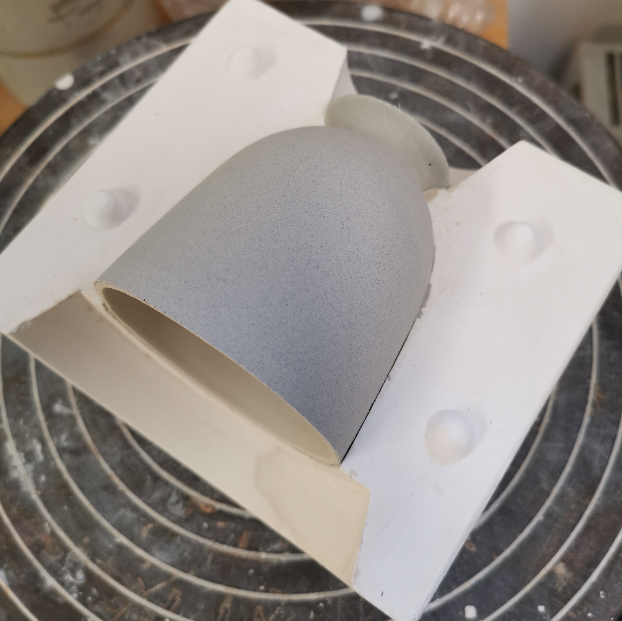
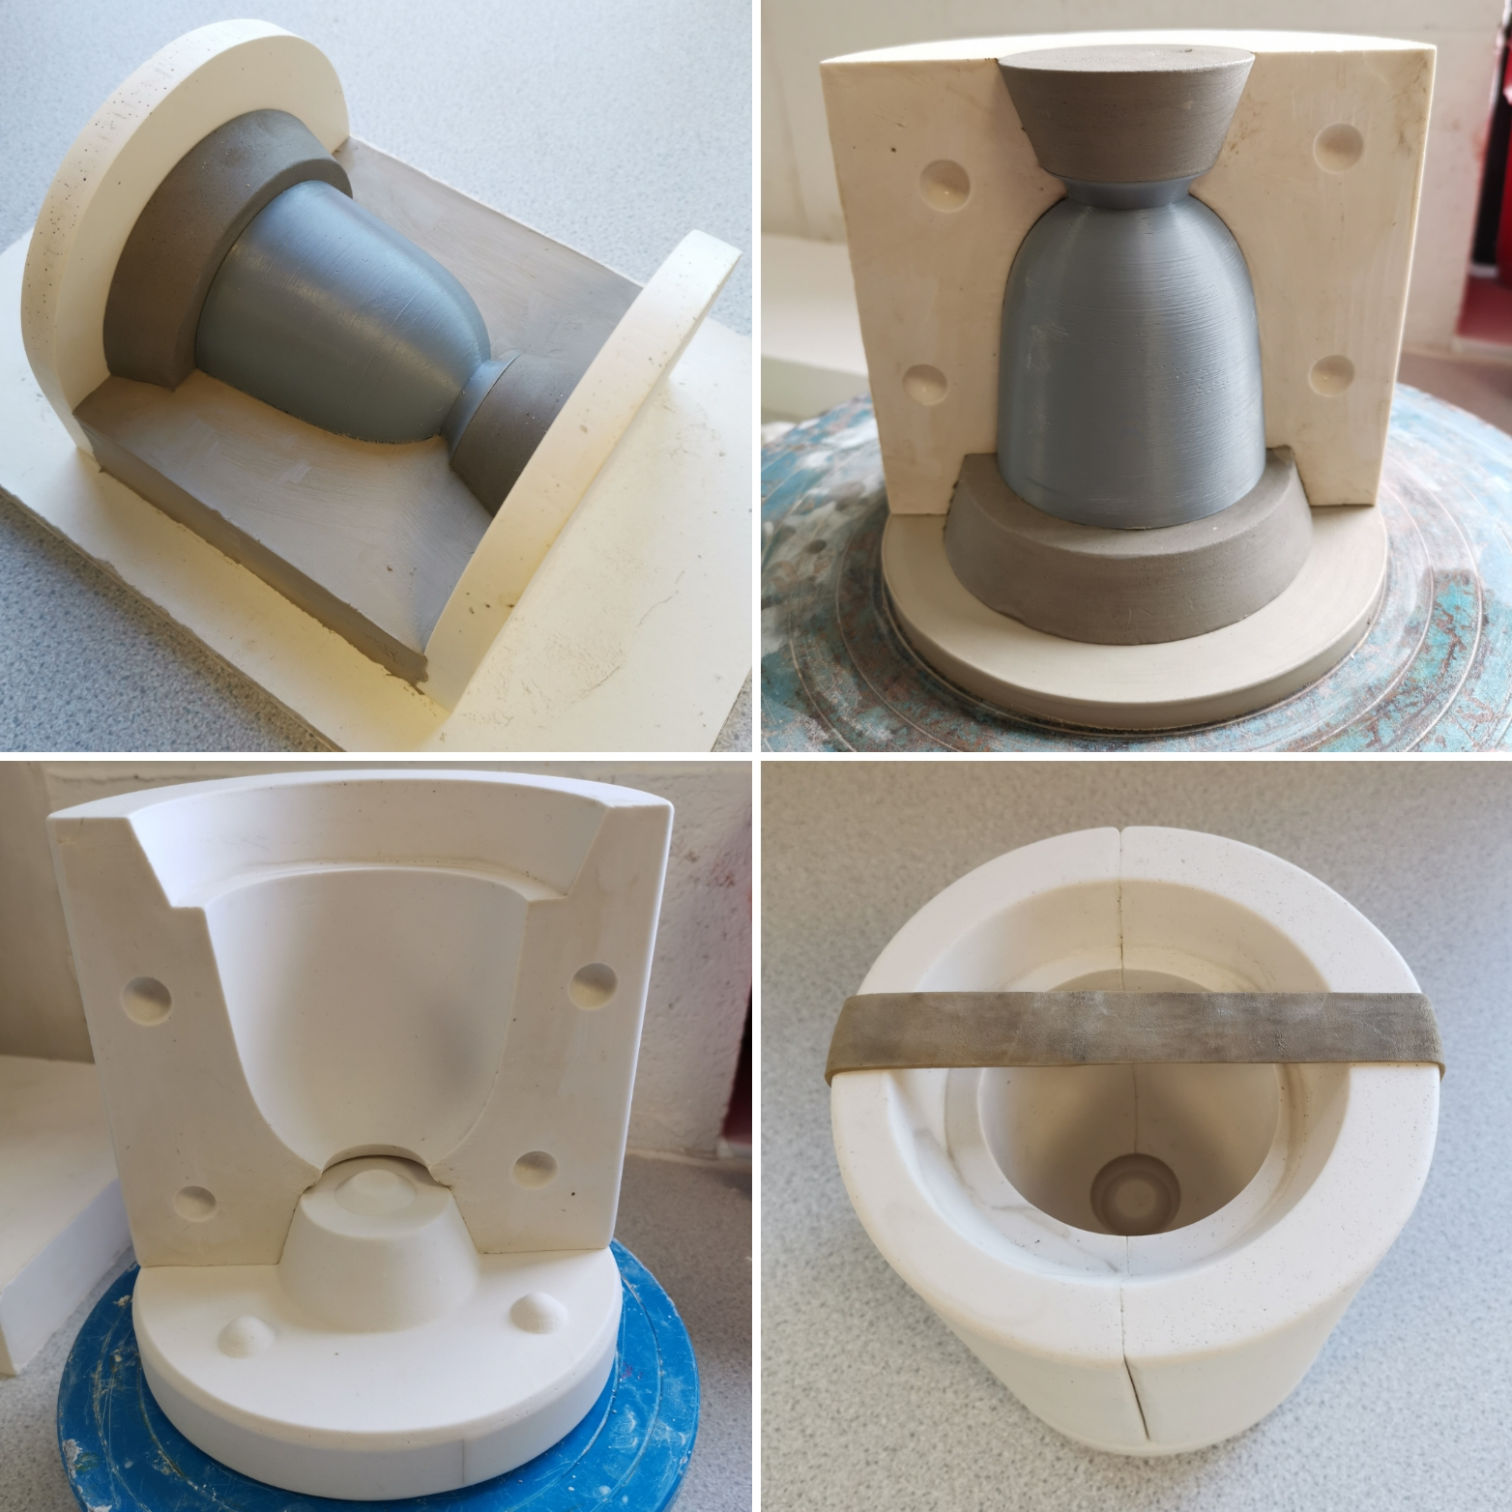
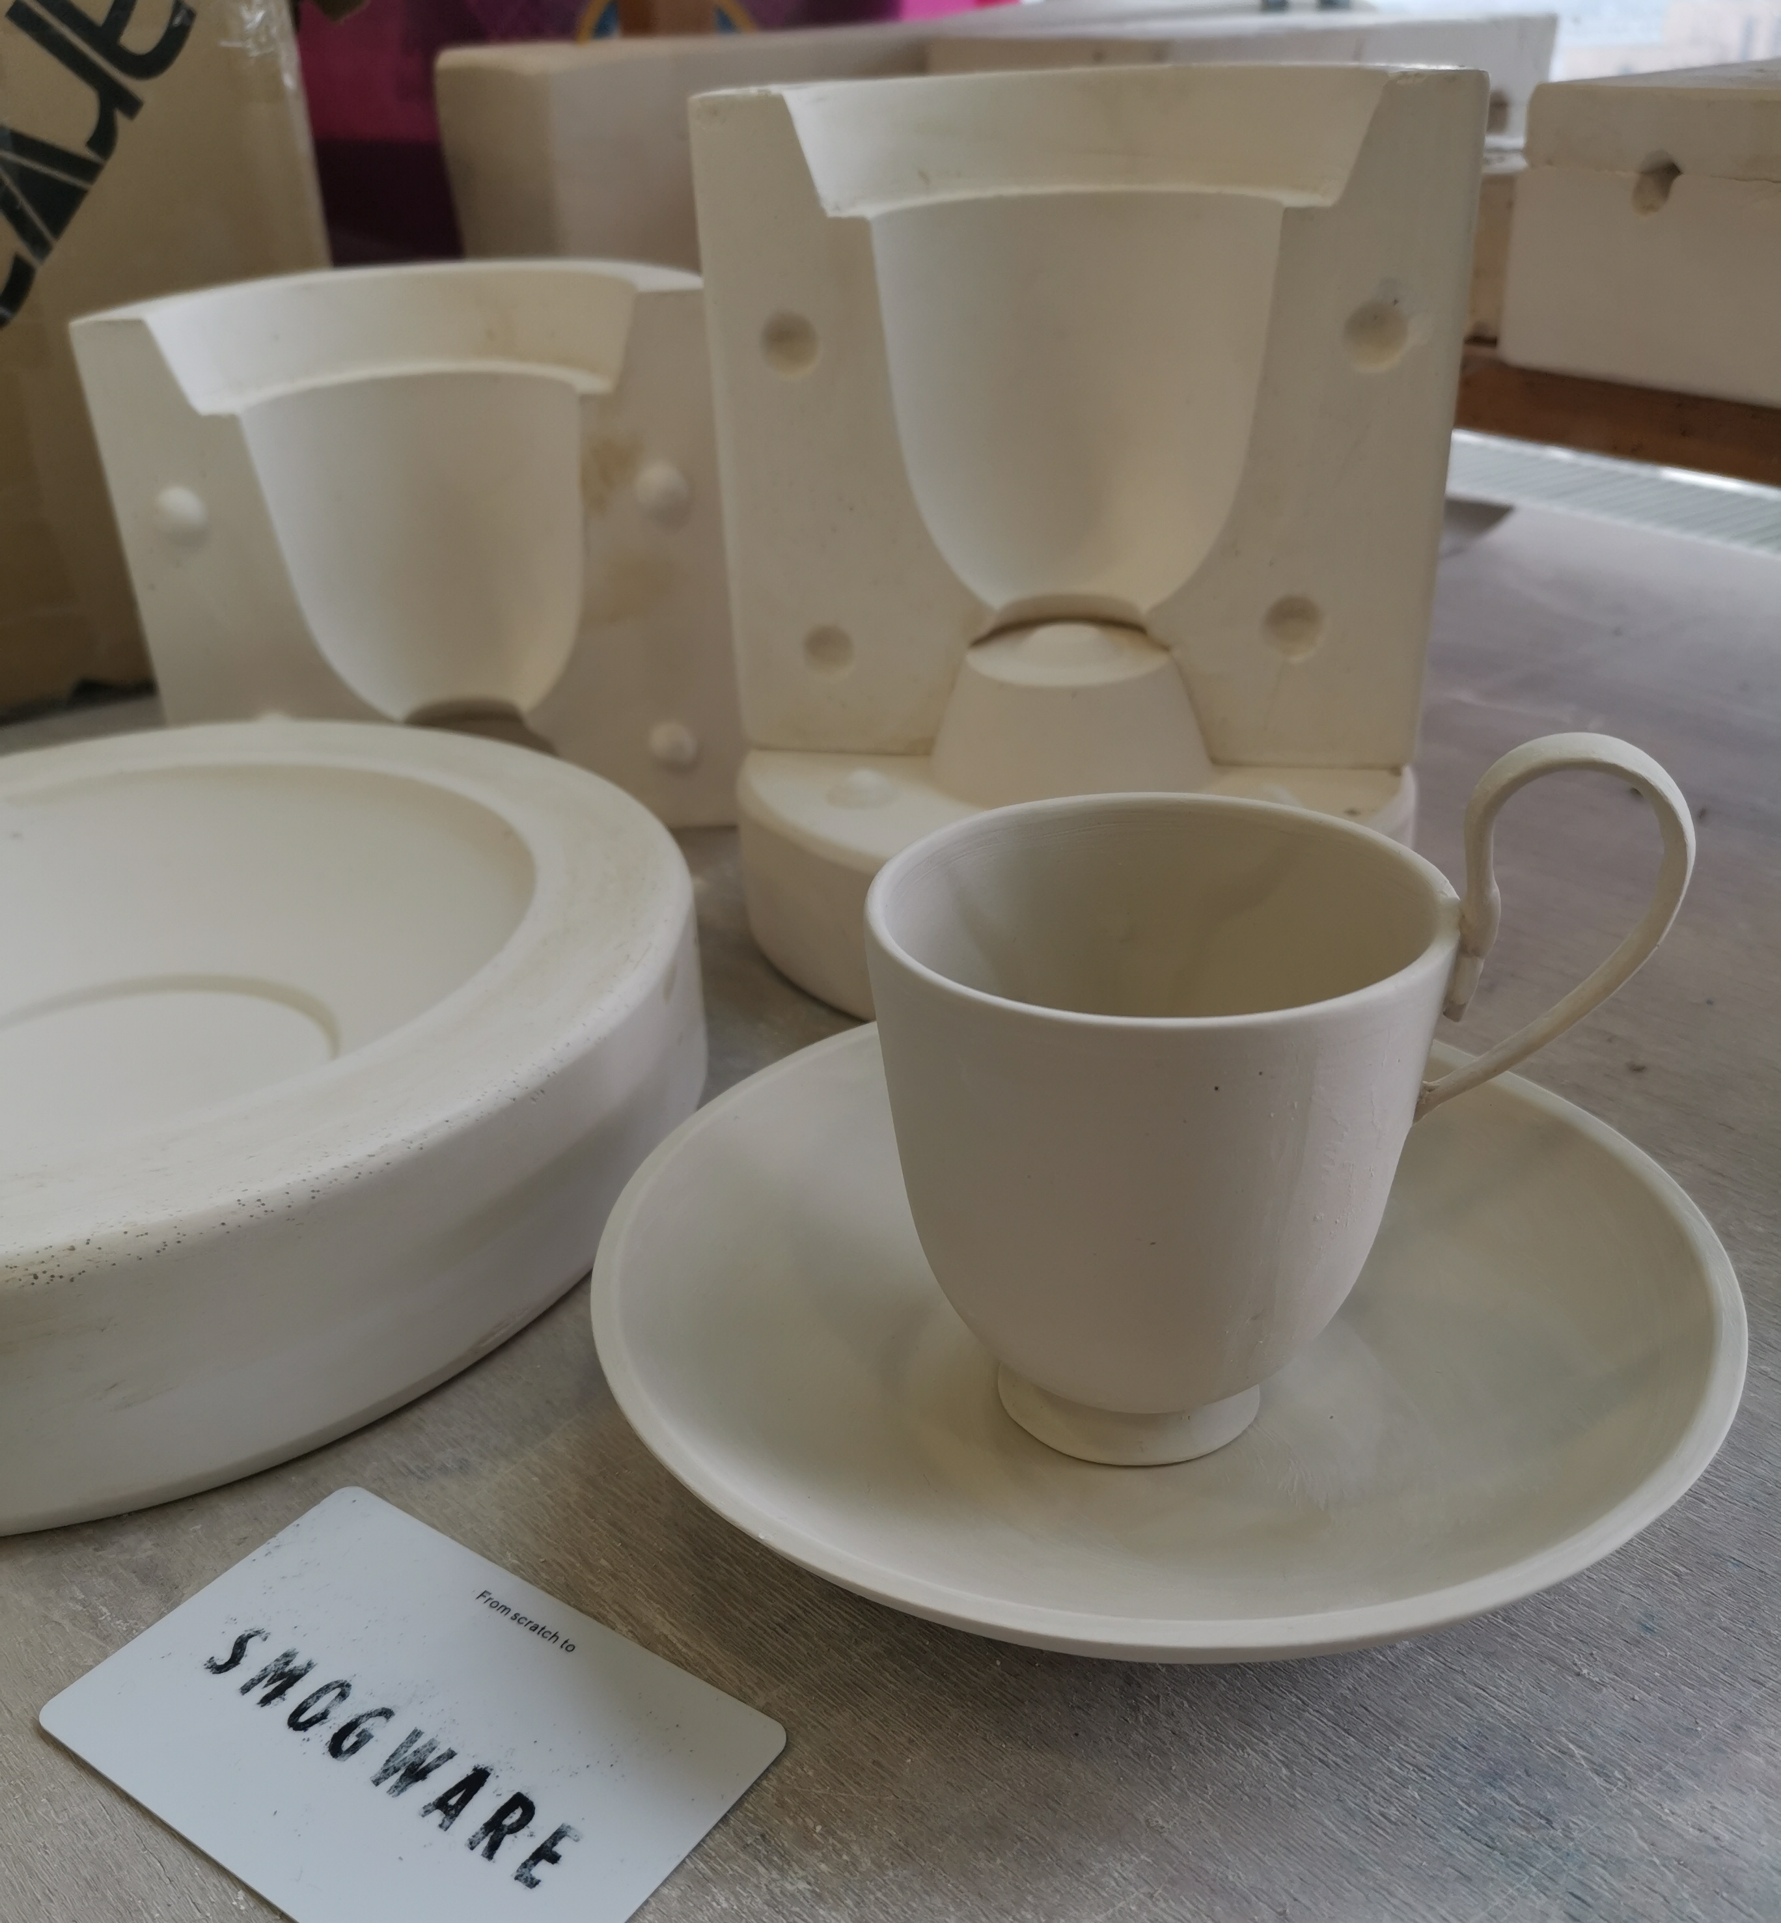
COLLABORATION
Smogware (Iris de Kievith and Annemarie Piscaer of LabAIR), City of Glasgow College Staff and students, Make it Glasgow (Ruth Impey), Asthma & Lung UK.
City of Glasgow College Applied Arts students harvested the ‘dust’.
The dust was used to create a glaze for slip cast porcelain vessels, visualising particulate matter breathed in Glasgow over time.
Gavin Burnett created the moulds of the tea set using a 3D printed copy from the famous J & M P Bell’s Glasgow Pottery. Ruth Impey and the City of Glasgow College students slip cast the tableware in porcelain.
Asthma & Lung UK contributed with their channels of communication and campaigning for the LEZ and co-hosted the afternoon tea on National Clean Air Day.

Slide 5
Harvesting dust
Ruth Impey took City of Glasgow College students on a Smogware dust collecting expedition. They collected dust from Anderson station and the M8.

Slide 6
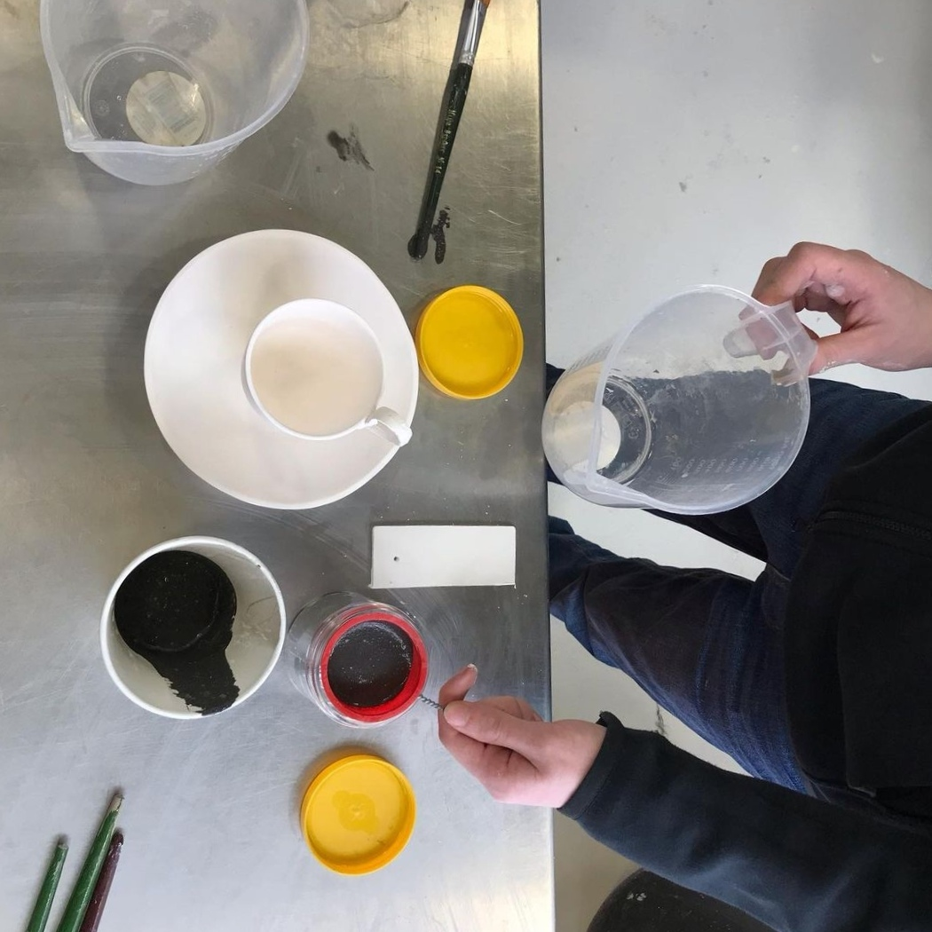
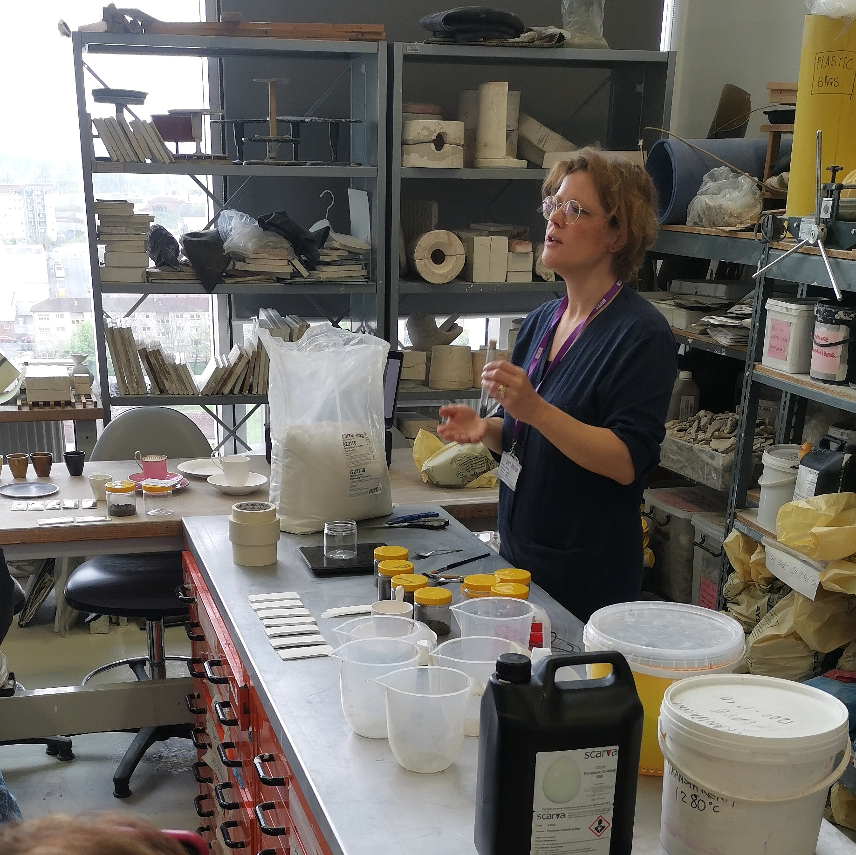
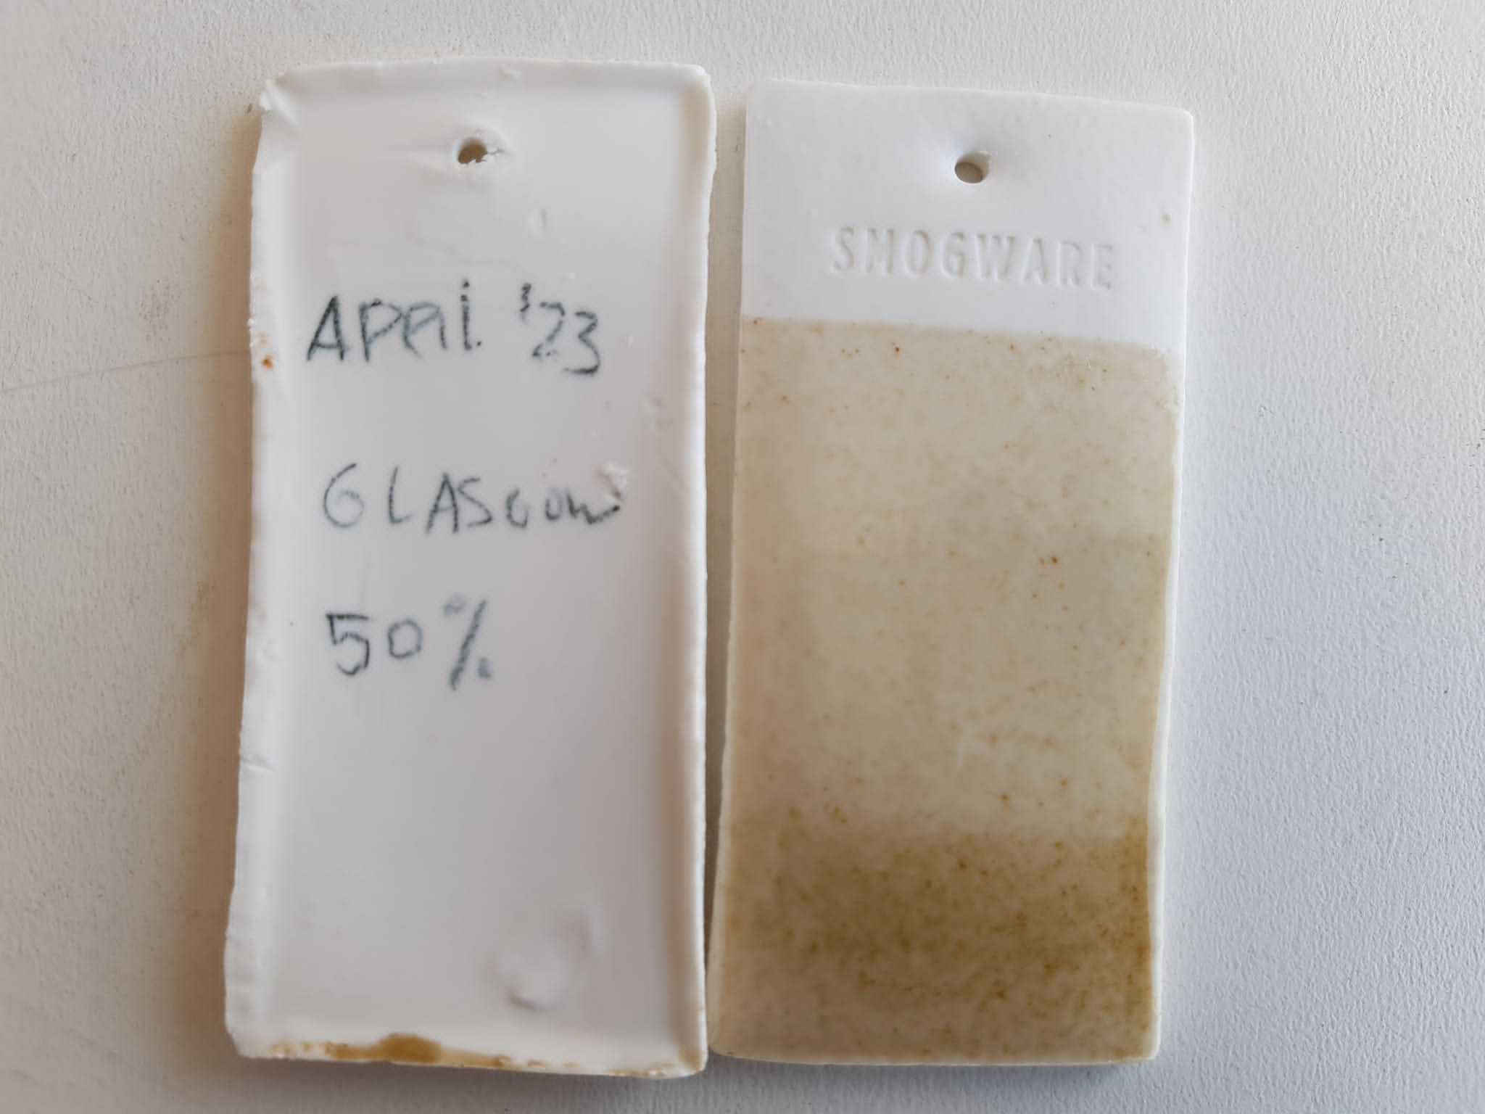
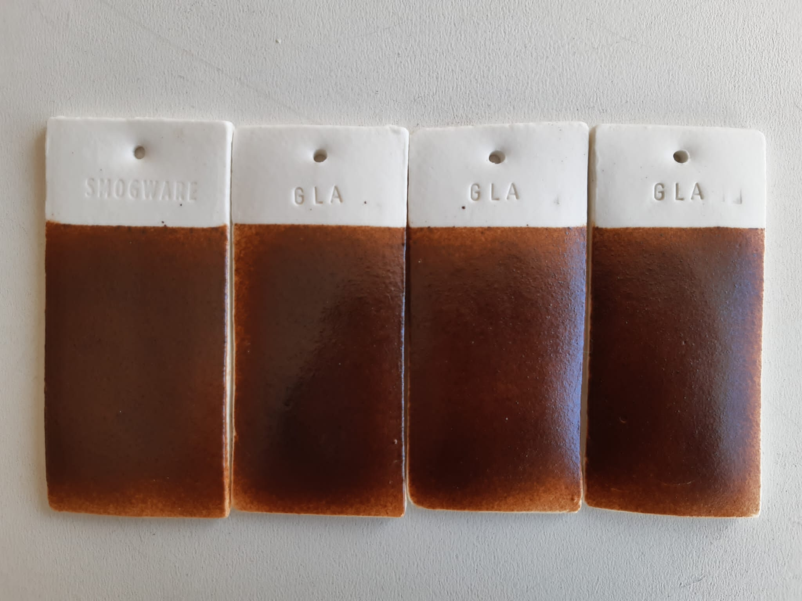
Examples of workshops - from dust to design in City of Glasgow College.

Slide 7
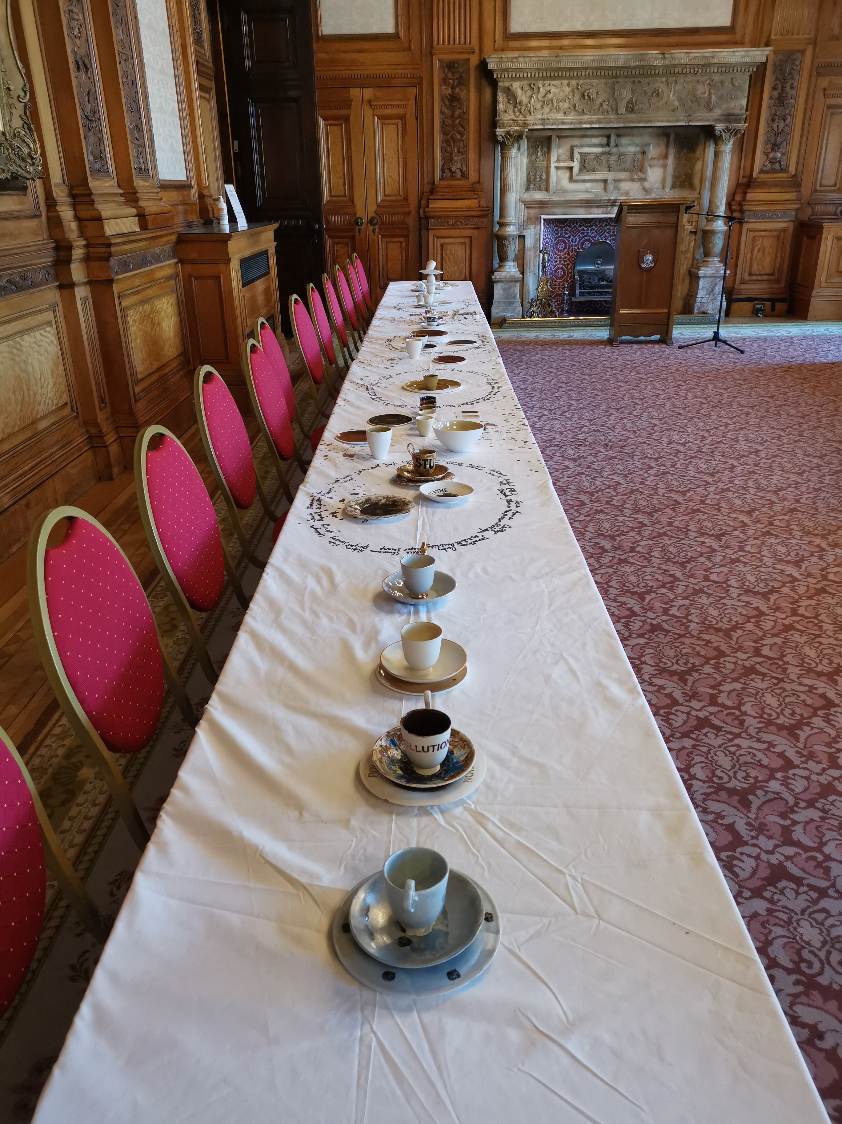
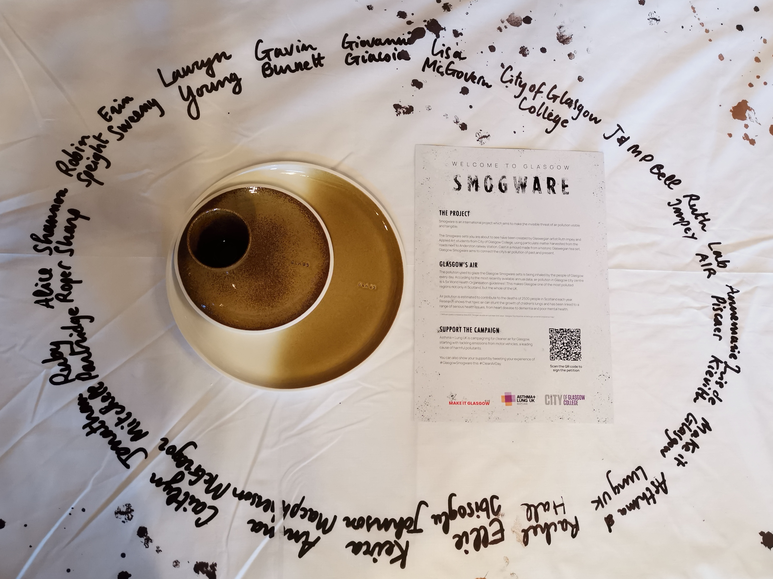
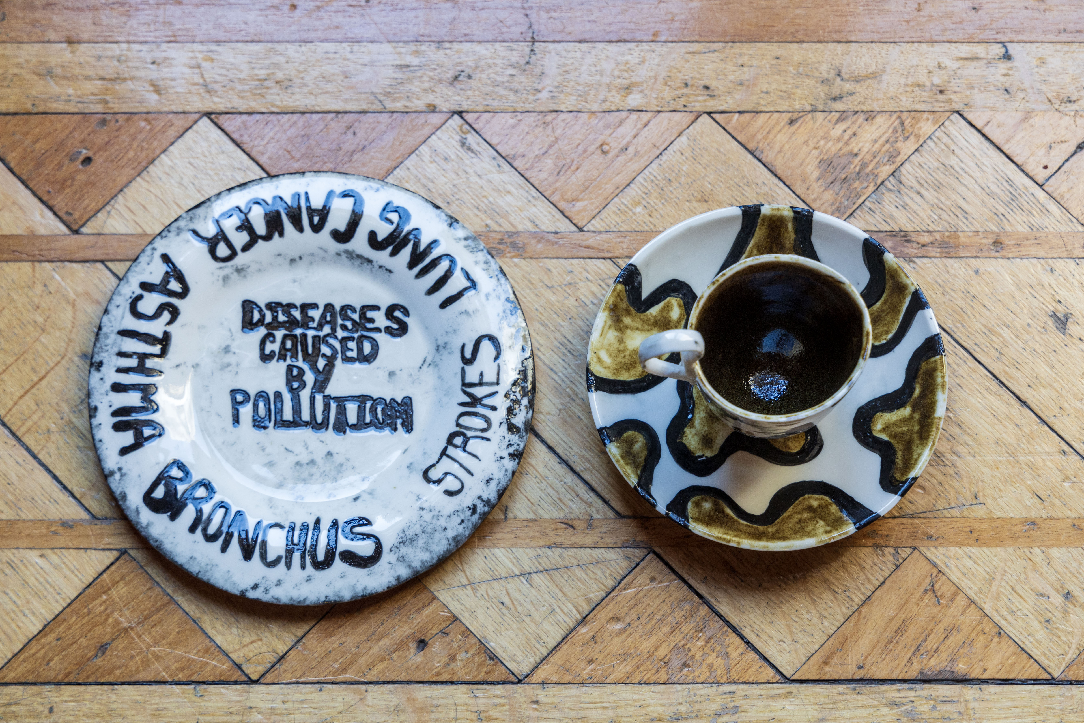
Afternoon tea on National Clean Air Day, 15th June 2023 at the City Chambers with the Lord Provost as Host.

