Slide 1

A Competency Framework to Assess and Activate Education for Sustainable Development:
Addressing the UN Sustainable Development Goals 4.7 Challenge
Rehema White
University of St Andrews

Slide 2
contents
Why do we have learning for sustainability?
Competency frameworks
Our competency framework (Giangrande et al 2019)
https://www.competencyworks.org/case-study/highlighting-deeper-learning-competencies-in-new-hampshire/

Slide 3

Learning for sustainability
Sustainable development is a process, and needs adaptive support
Education (specific skills, knowledge and capacities) is required to enable SD
The UN SDGs offer aspirations and targets up to 2030
SDG 4.7.1 indicator
“extent to which i) global citizenship education and ii) education for sustainable development, including gender equality and human rights, are mainstreamed at all levels in: a) national education policies, b) curricula, c) teacher education and d) student assessment”

Slide 4

Assessing learning for sustainability
LfS includes:
  Socialization
  promotion of citizenship
  vocational preparation
  allowing learners to achieve full potential
  transformative possibilities (Sterling 2008)
  How to assess this?
  Beyond ‘participation numbers’ to ‘abilities’ (and impact?)
https://www.slideshare.net/kristeljoyjadormio9/transformative-education-53138050

Slide 5
Competencies
A competence is “a functionally linked complex of knowledge, skills, and attitudes that enable successful task performance and problem solving” (Wiek et al 2011)
“A competence is defined as the ability to successfully meet complex demands in a particular context through the mobilization of psychosocial prerequisites (including cognitive and noncognitive aspects)” Rychen and Salganik 2003
behaviour
skills
competence
knowledge
ability
experience

Slide 6
Rather than focusing on acquisition of facts and specific skills, competences emphasise us nurturing ‘change agents’, ‘problem solvers’ and ‘transition managers’ (Wiek et al 2011)
Various competence frameworks have been suggested
Forbes.com

Slide 7

Example competence areas for ESD
Anticipatory
Futures
Risk
Uncertainty
Backcasting
Scenarios
Complexity
https://www.visioncritical.com/blog/future-design-thinking-3-c-s-success

Slide 8
Some of the suites of key competencies or outcomes that have previously been developed to assess ESD
Barth et al. 2007 | Weik et al. 2011
Key competencies in: Foresighted thinking Interdisciplinary work Cosmopolitan perception Transcultural understanding and cooperation Participatory skills Planning and implementation Capacity for empathy, compassion and solidarity Self-motivation and in motivating others Distanced reflection on individual and cultural models | Anticipatory Developing narratives of the future Backcasting and forecasting skills Working with scenarios, risks, intergenerational equity, and unintended consequences Systemic working Ability to work with key aspects of systems theory; tipping points, nested hierarchies and slow and fast variables and resilience Interpersonal Including skills around mediation and conflict resolution Leadership and team building Communication skills, including empathy and empathic responses Transcultural thinking and deliberation and negotiation Normative The development of worldviews and perspectives Ability to assess the stability of current or future states Ethical questions, including risks and tradeoffs Ability to assess well being Strategic Planning, decision making, assessment of obstacles, identification of success factors Knowledge of behavioural change Organisational development Use of Kolb’s action reflection cycle.

Slide 9
Transition network
Intra-personal competences

Slide 10
Proposed Competency Framework
Key Competency Area | Example of Competencies
Intrapersonal | Presencing, self awareness, stress management, meaning making, connection with self, capacity for inner peace, mental wellbeing, self-reflection
Interpersonal | Communication skills, empathy, compassion, leadership, teamwork, mediation, cooperation, collaboration, participation
Future thinking | Visioning, developing scenarios, backcasting, recognising heritage, intergenerational equity
Systems thinking | Systems thinking, working with complex problems, promoting resilience, understanding tipping points and feedback loops
Disciplinary and interdisciplinary | Understand the links between knowledge and experience, critical thinking, discipline specific framing, interdisciplinarity, expressing multiple ways of knowing
Normative and cultural | Ethical responsibility, development of world views and perspectives, awareness of values, understanding of justice, cosmopolitan perception, transcultural understanding, awareness of local context and global trends
Strategic | Planning, decision making, implementing, addressing challenges, organisational development, use of Kolb’s action reflection cycle.

Slide 11
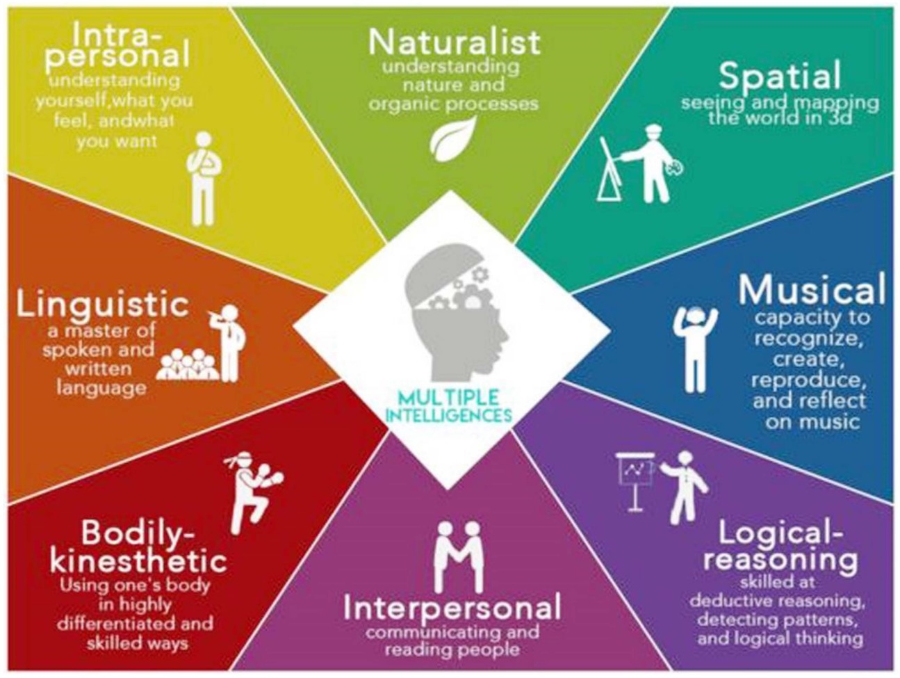
Figure 1. The multiple intelligence model developed by Gardner [16]—image http://thedailynewnation.com.

Slide 12
Examples uses
Key Competencies | Human rights | Gender equality
Interpersonal. Collaborative skills, mediation, leadership, cooperation, empathy, teamwork | Are learners given the opportunity to develop empathy? What is leadership in promotion of human rights? What role does cooperation play in human rights? | Do learners have the possibility of experiencing their world from the viewpoint of the opposite sex? Do opposite sexes have opportunities to collaborate together on shared goals? Do both sexes look together at issues of gender equality in a spirit of enquiry? Are different forms of gender included and enabled?

Slide 13
Proposed framework combines general areas of competence with specific areas
Questions can be asked by student or teacher and encourage reflection and self assessment on learning and reflection on content
Can add more technical and specific questions
Learn.solent.ac.uk

Slide 14
Conclusions
Competencies offer a meaningful way to assess ESD and LfS
Can we combine with audit participation numbers eg number of programmes, number of students?
Is this framework useful for FHE?
How can we implement it?
How can we add it to specific skills and make it work across different programmes?

