Slide 1
Switching from a public to commercial charge point network in Scotland
Travel and Transport Topic Support Network meeting
Jack Hamston-Goodfellow & Elyse Jacks
27.05.25
Notes:
Introduction to both of us.
What we are going to talk about.
Warn that it isn’t full and they should seek other advice.
Mostly for CPS owners but some advice could be useful.

Slide 2
Introduction
Energy Saving Trust

Slide 3


Slide 4
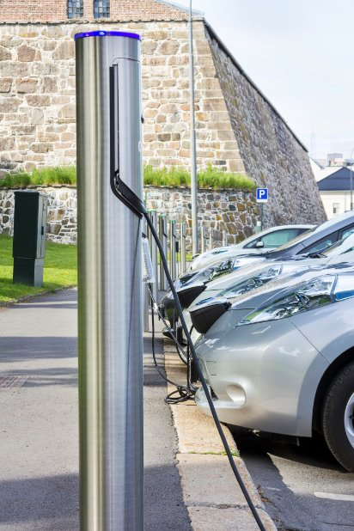
The history of CPS...
Established 2011.
£65m worth of grants to public, private and third sectors.
Delivered benefits but inherent challenges:
        Impact on commercial market due to low/no tariffs.
        Not targeted with a clear strategy.
        400+ owners are responsible for all key decisions.
        Emerging best practice raising the bar.
        Accessibility, reliability & overall experience.

Slide 5
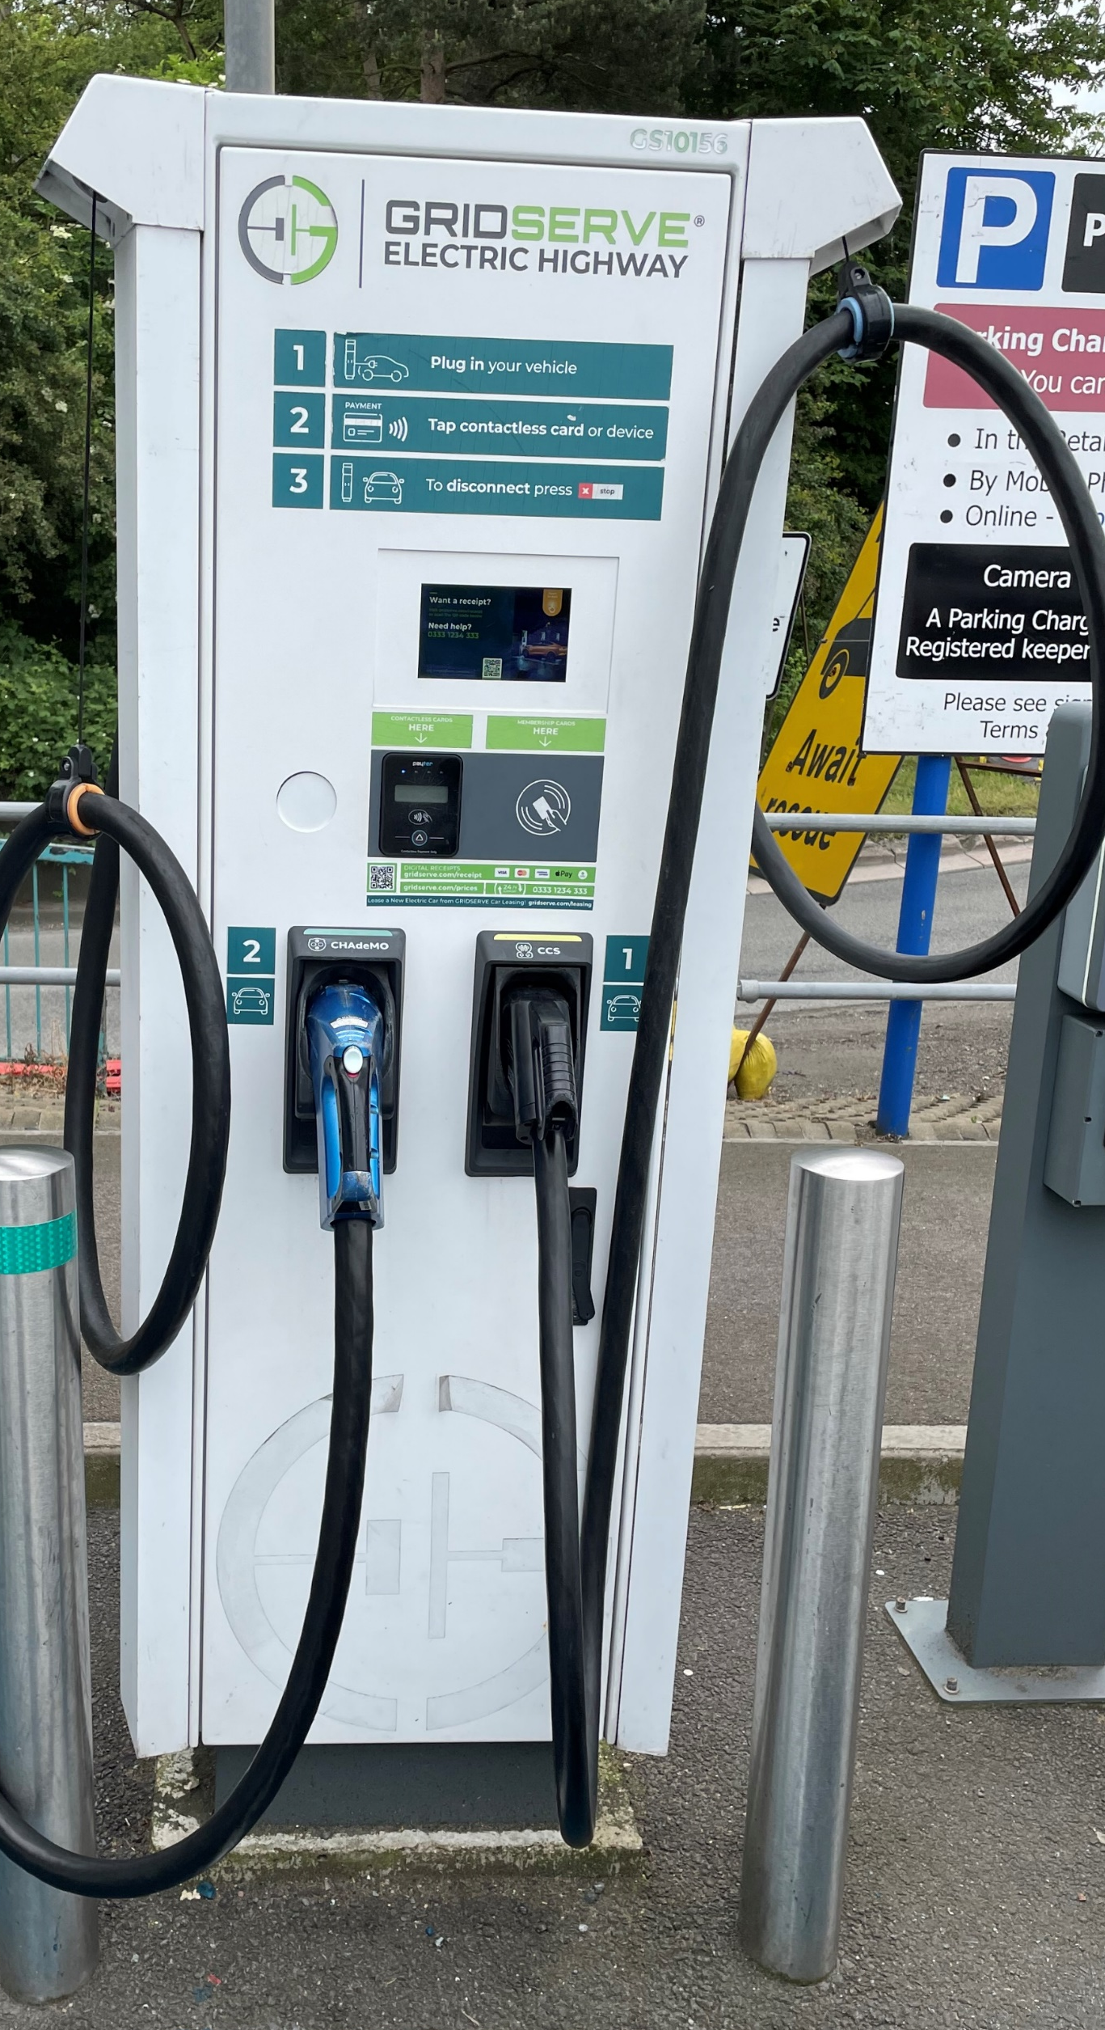
...and why is it closing?
Pace and scale of EVI roll-out needs to increase.
Private sector to play bigger role is a key part of the Scottish Government vision.
Shift to a more commercially oriented market, focussing public funds on where needed most.

Slide 6
What advice is available?
Energy Saving Trust

Slide 7
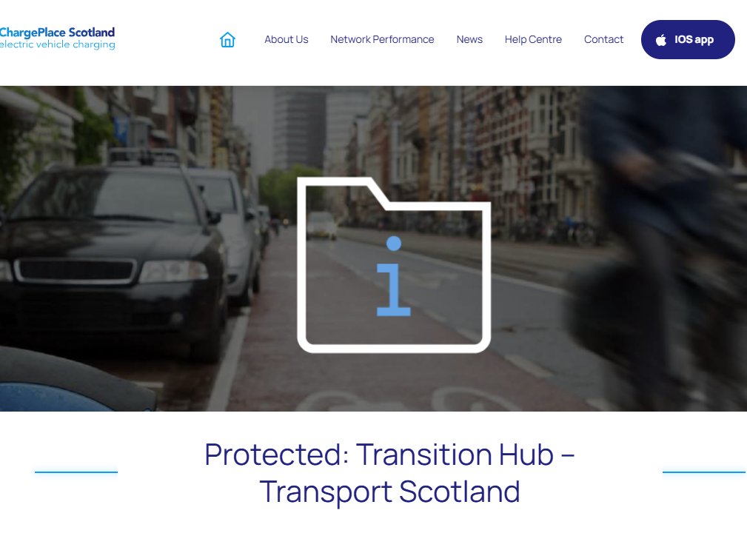
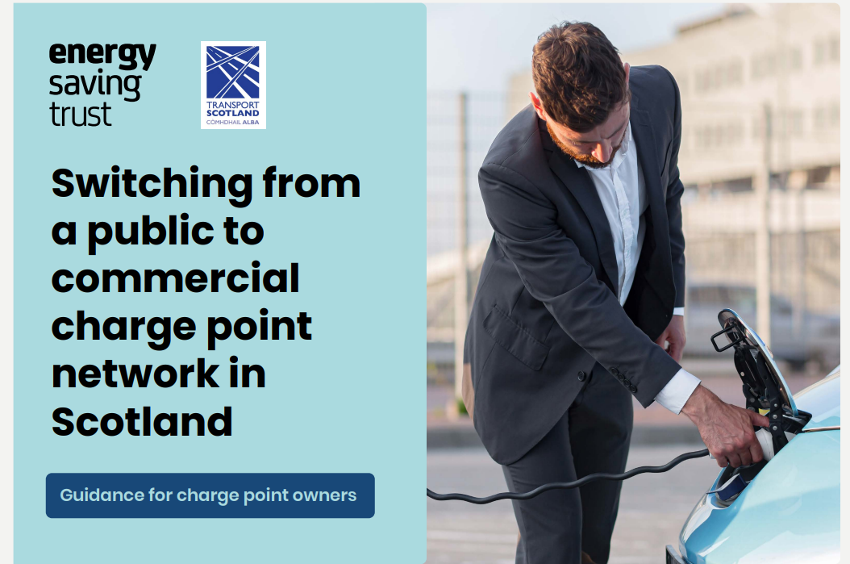
What does EST have to offer - Guidance
Owners Hub and FAQs
Back to Basics pack

Slide 8
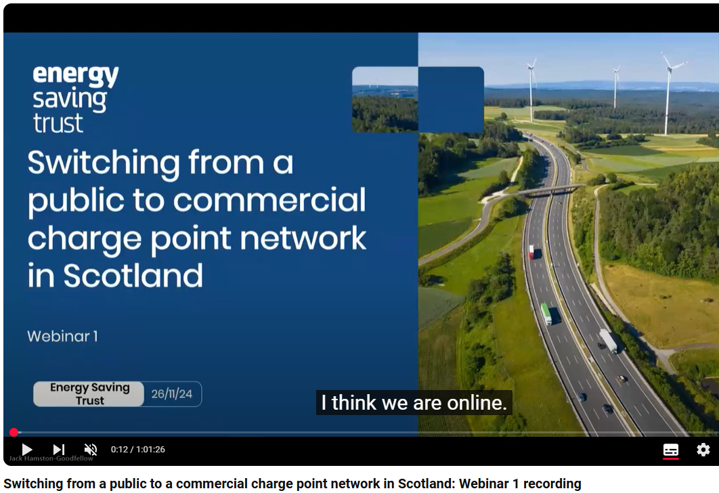
What does EST have to offer - Webinars
Session 1
General overview of the transition.
Key terms and definitions.
Key considerations when transitioning.
Session 2
List of CPOs and CPNOs.
Step by step guide.
CPS branding and DNO information
Session 3
A case study on East Lothian council.
Advice from Scottish Futures Trust
Further guidance for community groups
All can be found on our website.

Slide 9
What do owners have to do now?
Energy Saving Trust

Slide 10

What does this mean for owners and users?
Owners must…
Decide what they want to do with their charge point – Migrate, upgrade, retire.
Decide on what new operating model is best for their operation.
Approach a new operator to run the back office.
Work with CPS to move to new operator.
Migrate off the Charge Place Scotland Network by 31 December 2025
Users must…
Potential new RFID cards needed. Not the case if interoperability or contactless installed.

Slide 11

So, what is a CPO/CPNO?
A CPO or Charge point operator
Provides a full, comprehensive package from ground up.
Responsible for installation, maintenance and ongoing support.
A CPNO or Charge point network operator
Facilitates connection to a private network where charging can be advertised.
Does not work with infrastructure, installation or maintenance.
A CPO may act as a CPNO.

Slide 12

Key Considerations.
What to do with your charge point?
What do you want from your site/what do you want to do with your points?
What model fits with this plan?
What CPO/CPNO would best fit this plan?
What does your site offer?
Is your site a short stay or destination charger?
What is your USP? Do you have car parking? Do you offer another service alongside charging?
Other considerations.
Private or public? Or both?
Use of accessibility guidelines.

Slide 13
Operating models
FULLY FUNDED
CPO provides charging infrastructure with no upfront costs.
The CPO will have a higher degree of control over decisions.
PURCHASE
Owner covers all capital expenditure.
Owner receives revenue, but takes on greater risk since this model is dependent on usage
PART FUNDED
Owner provides some initial capital expenditure towards units.
Results in greater share of revenue generated.
LAND LEASING
CPO leases your land
CPO installs, manages charging infrastructure
CPO provides back-office support.
MANAGE YOUR OWN
Software may be offered by operator to manage, monitor and monetise your charge points.
Great for small/low utilisation sites.
Contact CPS directly at cps-transition@evoltcharging.co.uk to obtain your usage data.

Slide 14
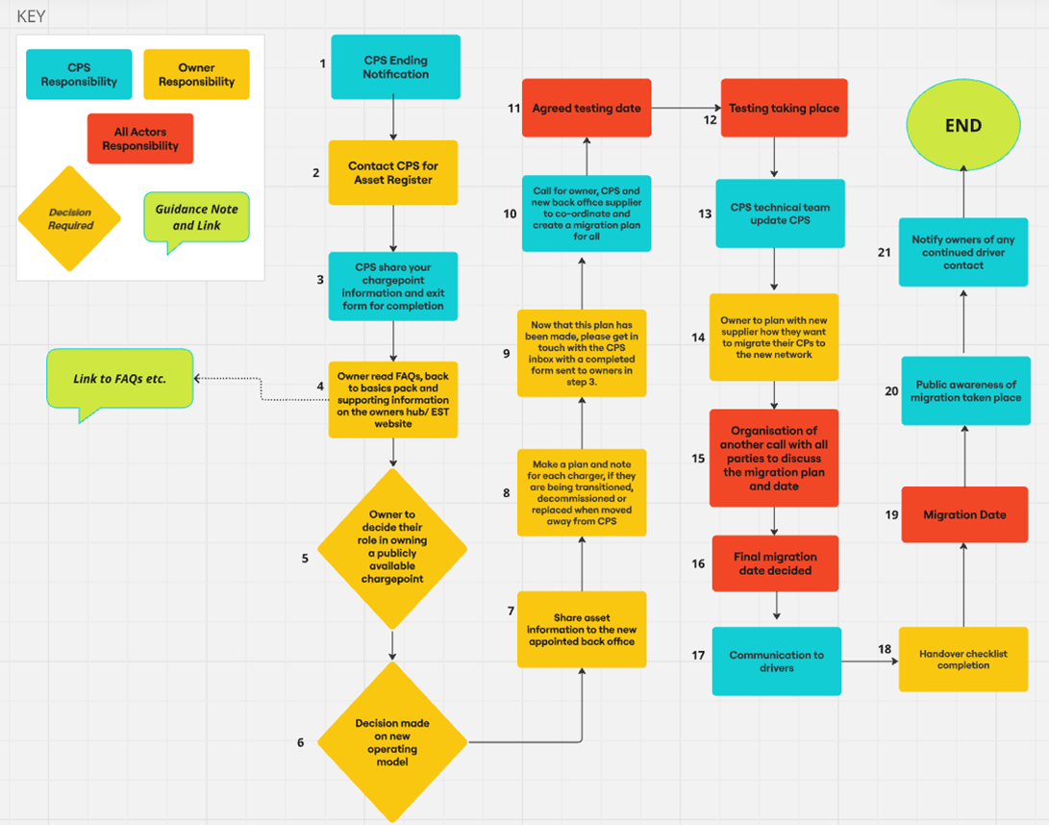
To do list – Flow Chart
Step by Step list
Get your data from CPS.
Read the guidance and watch the seminars.
Decide on what to do with your site.
Find a new CPO/CPNO.
Set up testing with new CPO and CPO.
Set a migration date and advertise this.
Migrate away from CPS.

Slide 15
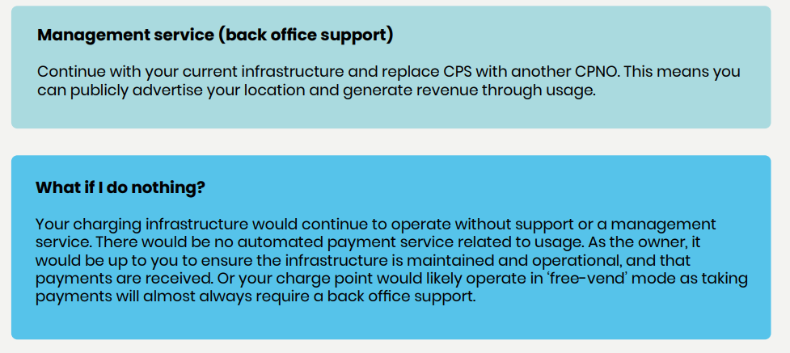
So what's next?

Slide 16
Questions and further support
Questions can always be submitted to electricvehiclesscotland@est.org.uk

Slide 17
Contact CPS at cps-transition@evoltcharging.co.uk
Contact EST at electricvehiclesscotland@est.org.uk

