Slide 1
What’s preventing you from greening your data centre?
Dave Kings - Deputy Communications and Systems Manager
Alex Gwinn -
IT Training Supervisor and Staff Governor – Business Support

Slide 2


Introduction
Air Conditioning (AC) data centre cooling costs of near £10,000 a year
AC created 62,617kg of CO2 per year
www.jisc.ac.uk
www.celsiusdesign.co.uk
5 years or less payback

Slide 3
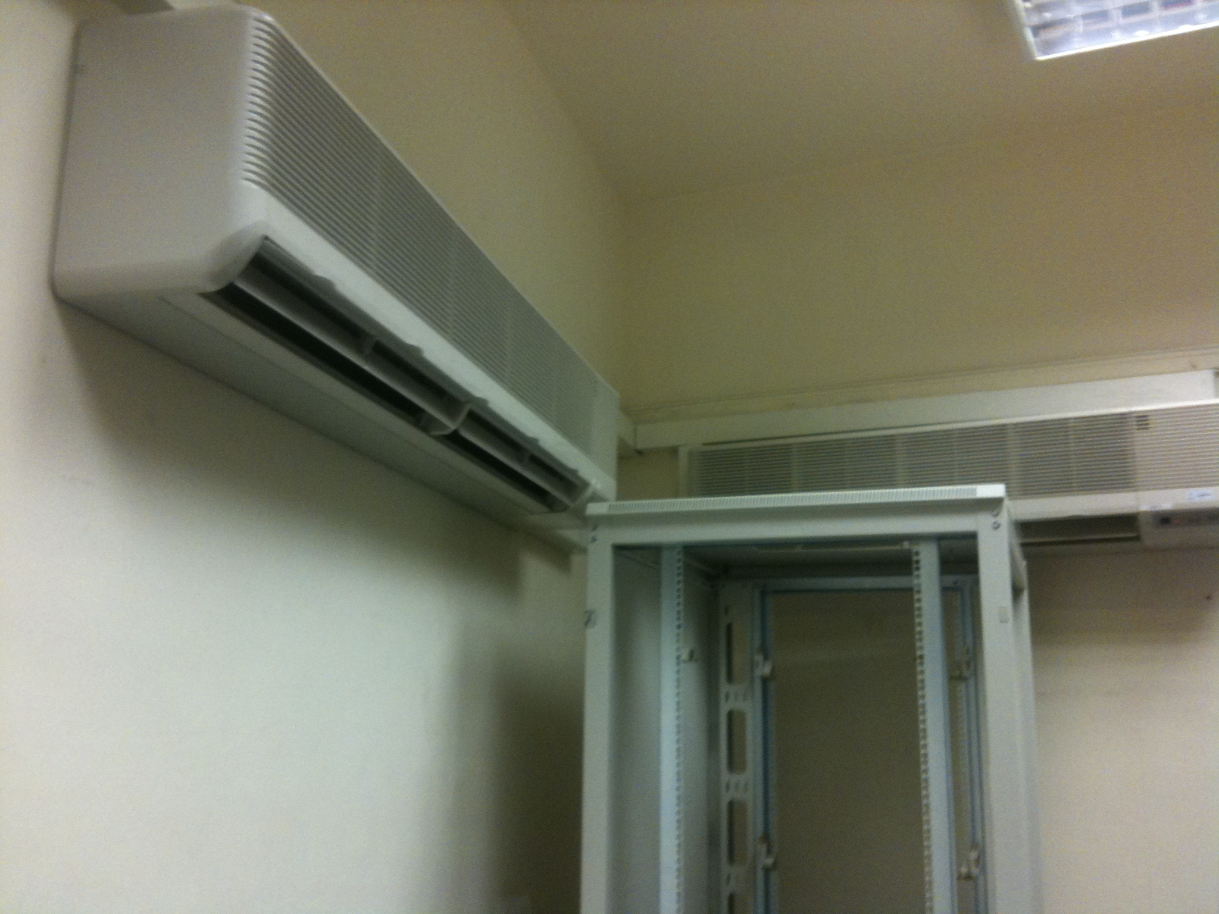
Greening our data centre

Slide 4
Expensive to run
Expensive to maintain
Not particularly efficient?
Traditional Air Conditioning

Slide 5
So what did we do?
Evaporative cooling
claims of up to 90% greater efficiency
Energy required to run the
evap coolers offset by
photovoltaic cells

Slide 6
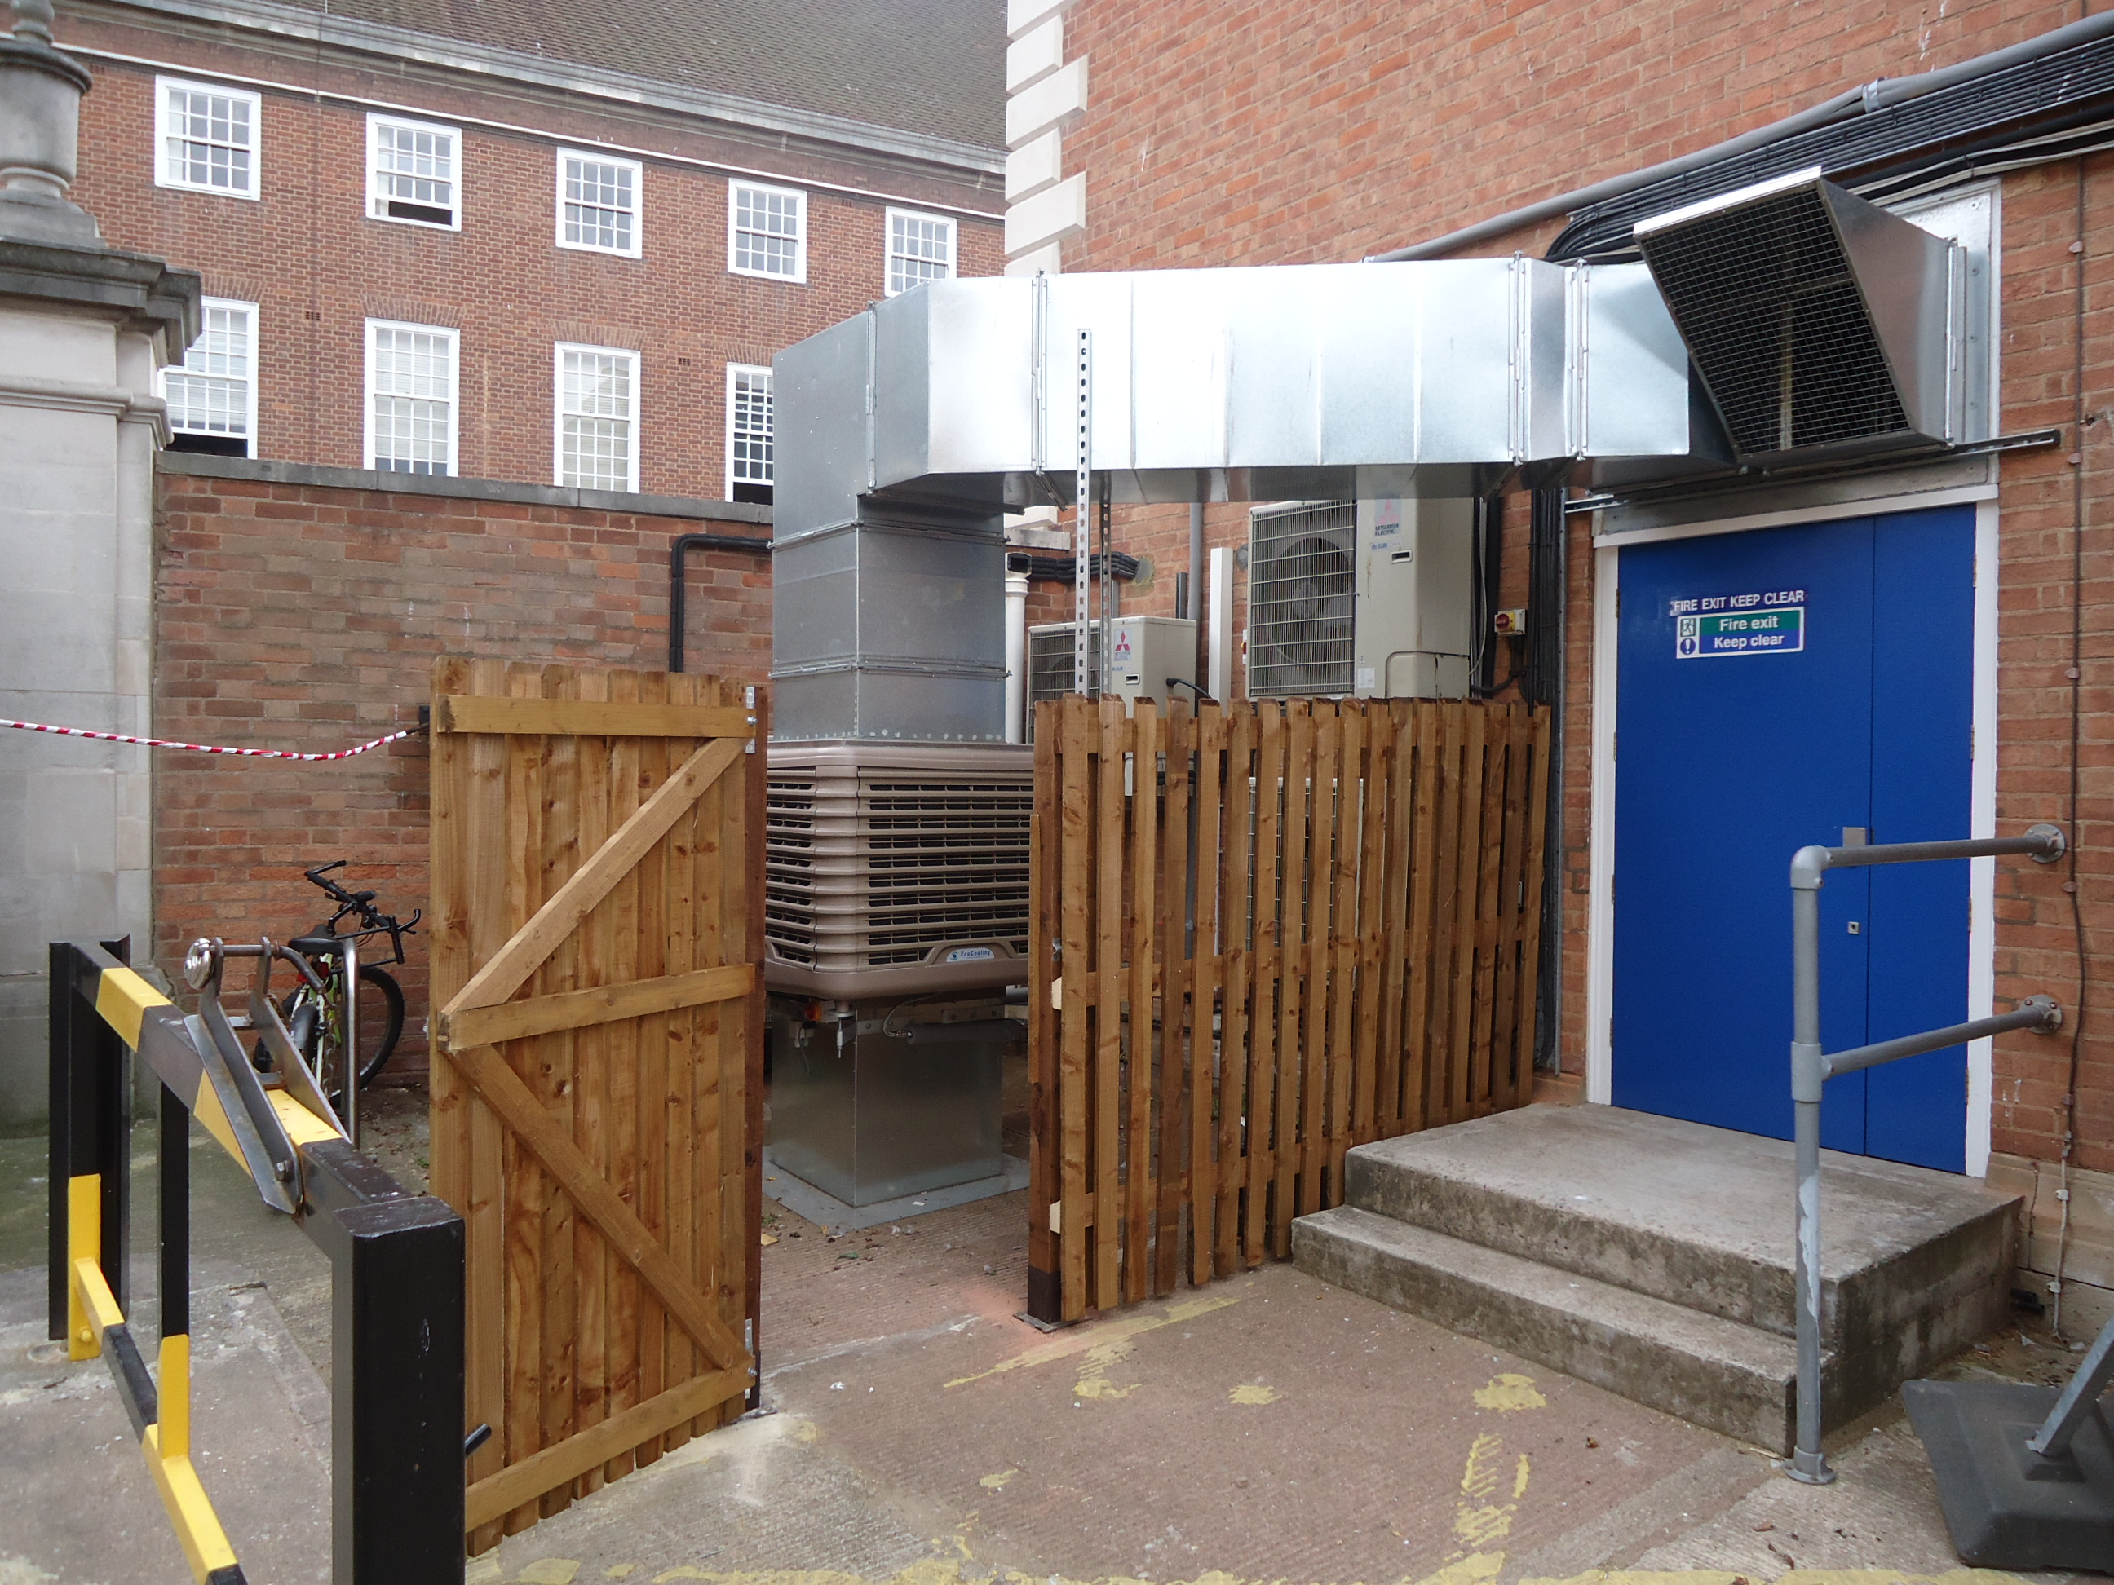
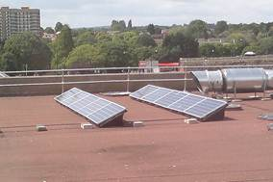
Evaporative cooler
Photovoltaic Cells

Slide 7
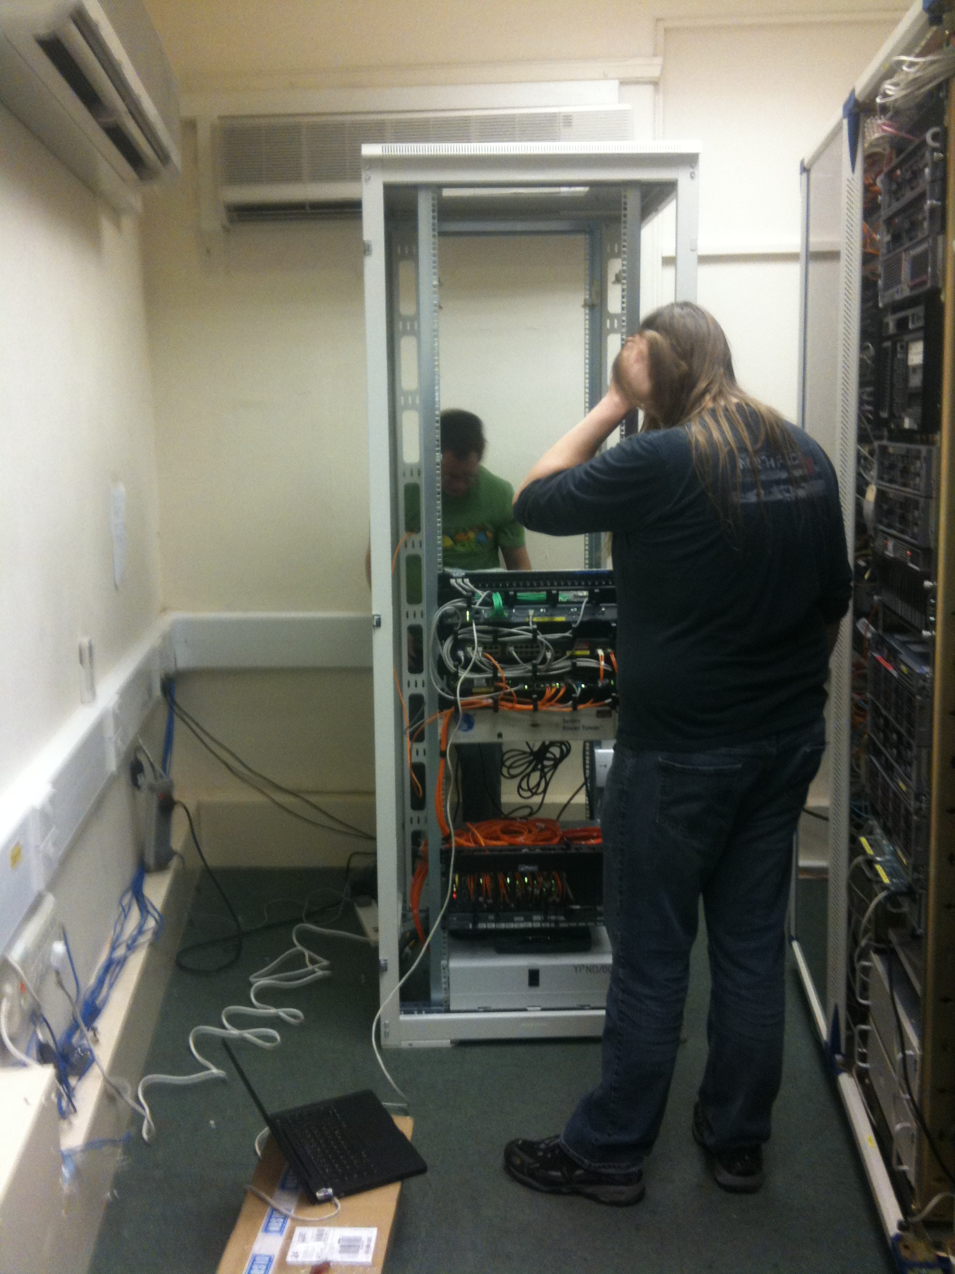
Regional PoP sideways…
Please…

Slide 8
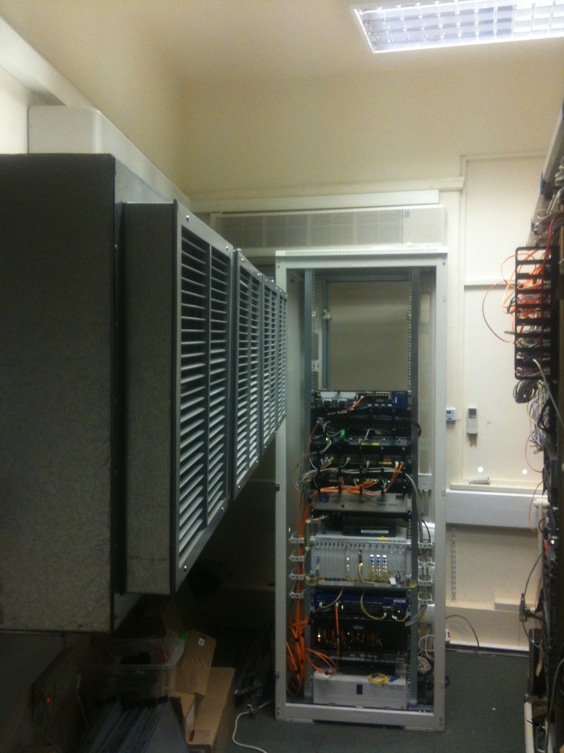
and afterwards

Slide 9
Key points
This is where it gets interesting. Are FE Colleges at a point where they can monitor energy consumption. We are struggling…
Evaporative cooling doesn’t work well in humid conditions (surprising considering they have earned the nickname of swamp coolers) so don’t throw out your old A/C
If space is an issue before undertaking a retro fit of a system like ours, it gets worse after install!
http://projects.wortech.ac.uk/cool-it

Slide 10
The Story So Far…
A good system is needed to monitor energy consumption
PV cells are producing enough energy to power the evap cooling system

Slide 11
Final Thoughts…
You can cool your data centre environmentally
IT has a huge part to play in leading in sustainability
Estates, IT and Senior Management must all work together to ensure success

Slide 12
Your next steps – making the most of your EAUC Membership…
Resources - visit the SUSTE-TECH Project site for a whole range of resources on Green ICT www.eauc.org.uk/sustetech
Recognition - want recognition for your green ICT initiatives - enter the 2012 Green Gown Awards green ICT category. Entries open summer 2012
Networks – launching soon: Green ICT Community of Practice - for those wanting to share resources and learn from each others' experiences. Visit the EAUC desk to find out more and sign up!
Measure and improve - sign up to LiFE www.thelifeindex.org.uk. EAUC Members receive a significant discount
LiFE offers a dedicated ‘sustainable ICT’ framework for implementation
Membership matters at www.eauc.org.uk

