Slide 1
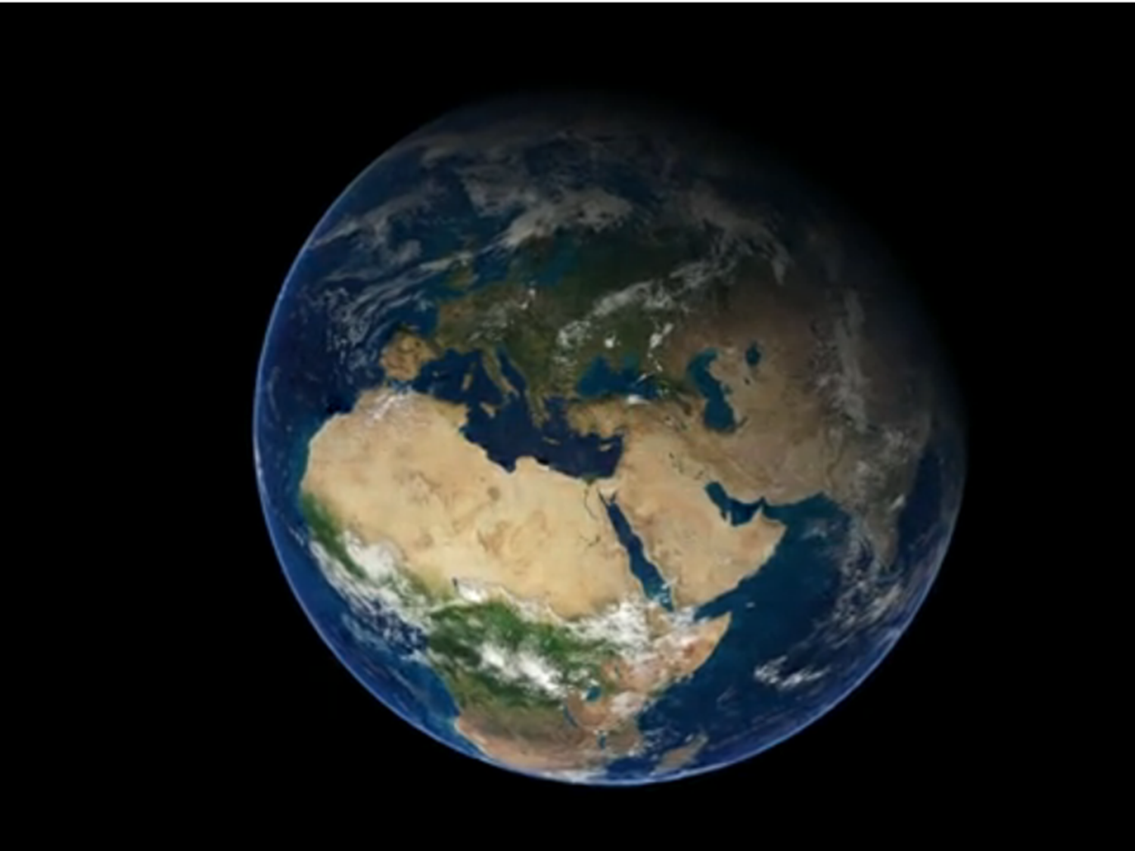
Interdisciplinarity and Sustainability Teaching
Education for Sustainable Development in Higher Education TSN
Dr Donald Gray
University of Aberdeen

Slide 2
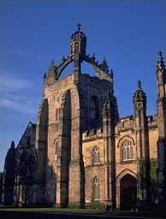
Curriculum Reform Process 2010.
6th Century Courses from 2011
“The introduction of a series of inter-disciplinary Sixth Century Courses (named to celebrate the University being in its sixth century) was among the most exciting innovations of the Curriculum Reform process.”
“With academics from across the University working across disciplinary boundaries, these courses lend themselves to the discussion of different approaches to the challenges facing modern society. Initially focussed on levels 1 and 2, the course options include”:
Sustainability: Challenges and Opportunities
Oceans and Society
Sustainable International Development
Natural World
Humans and Other Animals
What Gives us Rights?
Mankind in the Universe: The Question of Objectivity

Slide 3
SX1011: Sustainability: Challenges and Opportunities
Course themes:
Conceptualising and understanding sustainability
The inter-connectedness of local and global issues
Food systems and sustainability
Science and other ‘ways of knowing’ the world
Sustainability science as a new paradigm
The politics of sustainability
Legislative challenges
Becoming a global citizen
SX1019 Africa: Sustainable Development for All?
(Developed from SX1012 Sustainable International Development)
This 6th Century course is very innovative and the first of its type at the University of Aberdeen as it is a combination of a six week on-line course (see https://www.futurelearn.com/courses/africa-sustainable-development) together with personal tuition, self-directed learning and group work.
The course addresses the big question of why although Africa as a continent is rich in natural resources and has increasing rates of wealth in some countries, there are many sub-Saharan African countries which are performing poorly on development indicators for reducing poverty, hunger, unemployment and have poor maternal health, whilst some other countries are forging ahead.

Slide 4
SX1504: The Natural World
In doing this course, we hope that you will develop your appreciation of the natural world around us through your own experiences. We also hope that you will learn from others' perceptions of nature through visual art, literature, education and science.
These issues will be covered in a set of six lectures and seminars and in the accompanying field visits. Your participation in these events should expose you to new concepts, with the exploration and synthesis of ideas your own personal values.
There are two coursework assessments: (a) Observing nature using a choice of media, and (b) Reflecting on how your thoughts and values correspond with those of others.

Slide 5
Environmental Humanities Programme
How does it work?
The Aberdeen Environmental Humanities degree is a joint degree, because we believe you must work together across a range of disciplines to solve the environmental crisis. You can do EH together with biology, with anthropology, or with history. In each year there are two required courses:
Year 1: Mountains Islands
Year 2: Resources Justice
Year 3: Posthumanities Roots and Branches
Year 4: EH Seminar I & II and Keystone project
Through competition, some students may be selected for an internship; some students will choose to undertake a creative project; and some will undertake a research project. All students are expected to choose a specific place, such as an estuary, valley, village or island and build their keystone project both in and about that place and its social and biological communities.

