Slide 1
Biodiversity Index
Richard Moore
Dr Janet Jackson

Slide 2



SEED Project
Shared Enterprise Empowering Delivery
Purpose – to research enterprising, collaborative approaches for improving sustainability at a county level across public and private sector organisations
Funded by:

Slide 3
Project Focus
Biodiversity
Energy
Water
Waste
Transport

Slide 4
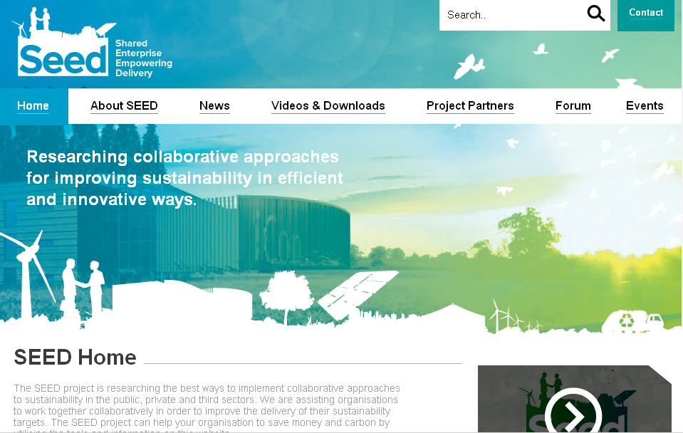

Slide 5
Results & Outcomes
Combined Waste Solution – industrial estate
Biodiversity Index – assessment tool
Sustainability Practitioners Group
County Sustainability Website

Slide 6
The Biodiversity Index
is a NEW interactive web-based tool
Enables an organisation to quickly and simply assess plant diversity on any UK site
Provides advice on how to improve total biodiversity with simple and cost effective measures
Developed by The University of Northampton

Slide 7
Biodiversity
Many scientists struggle with the concept
Measuring true biodiversity is complex
The tool kit is designed to help you
measure the diversity in structure and
texture of habitats
These measures are indicate that more
species may be present and thus be more
Biodiverse.

Slide 8


Why is Biodiversity important?
From International to local level....

Slide 9
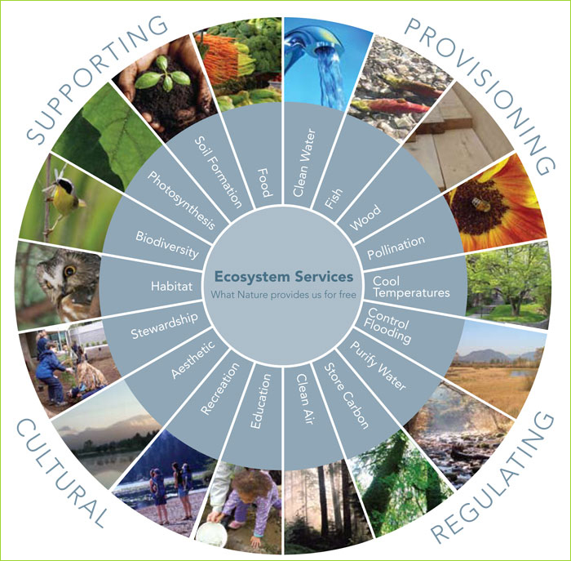
Ecosystem Services
http://www.metrovancouver.org

Slide 10

Education and Mainstreaming
Businesses – CSR and consumer ethics
Governments – National to Local
Planners and urban designers
“Calling for Tools to help decision makers”

Slide 11
Biodiversity…increasingly part of CSR
Many organisations are taking an increasing interest in the overall impact they and their suppliers have on the environment
Biodiversity is part of the equation
In fact, many larger companies and public sector organisations now specifically ask suppliers to show how they are managing biodiversity on their sites.

Slide 12
Who is likely to use it?
Sustainability managers
Environmental managers
Estates/Facilities managers
FE/School teachers - geography, biology and environmental science
University Lecturers and students

Slide 13
Features
A numerical Biodiversity Index score
A summary with a detailed printable report
Suggest a range of activities that will benefit biodiversity on your site
Provide you with links to further information/organisations and websites

Slide 14
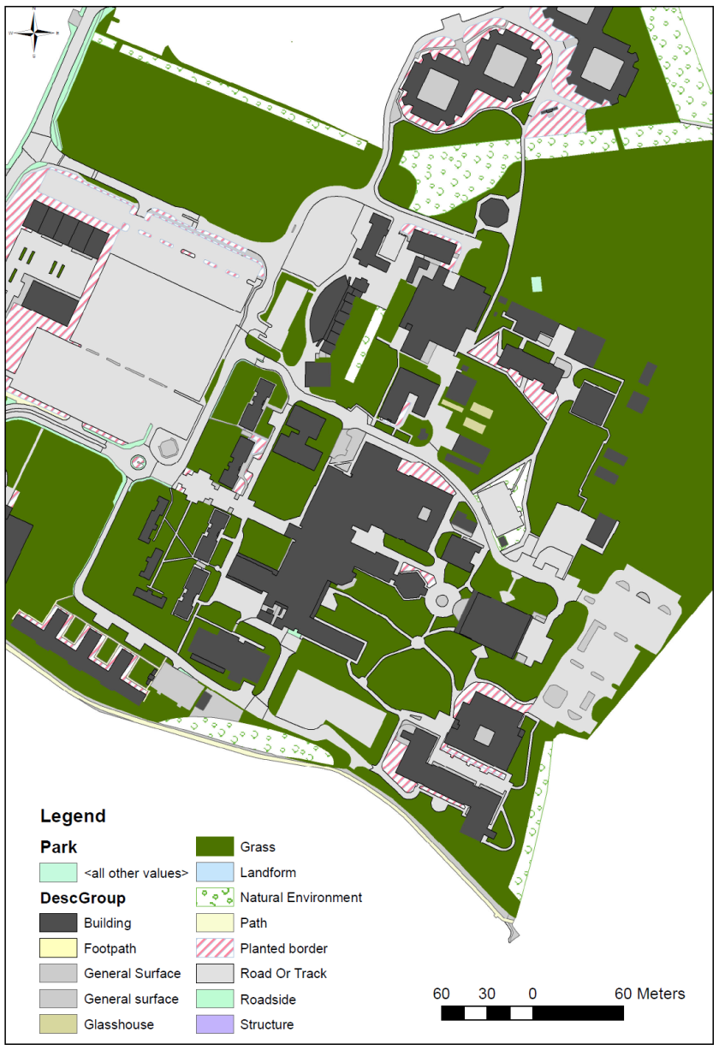
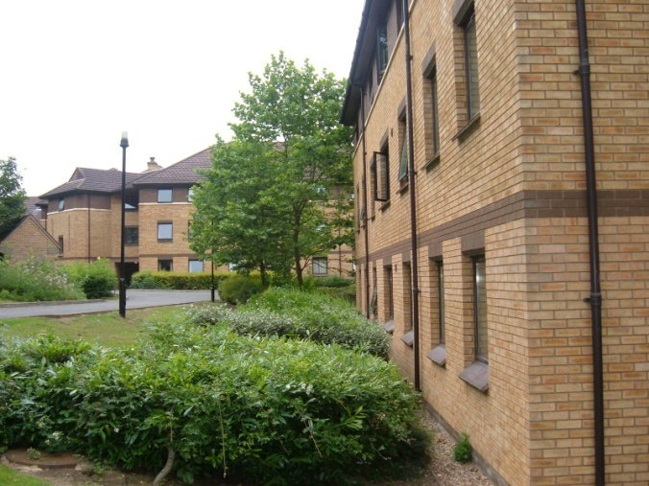
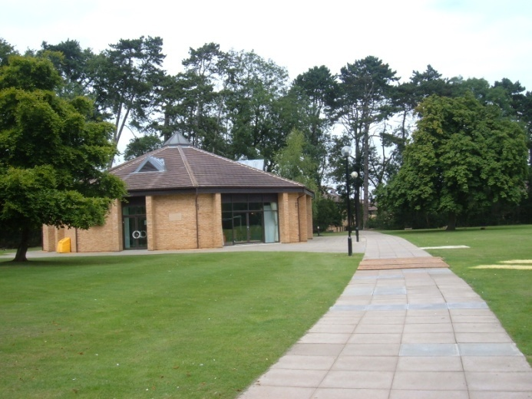
Park Campus
@15 hectares
grassland
“It’s a lovely green campus”
OS Crown Copyright supplied by Edina (2012)

Slide 15
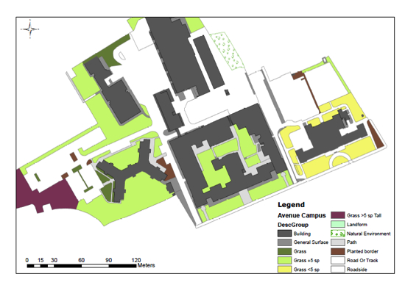
OS Crown Copyright supplied by Edina (2012)

Slide 16
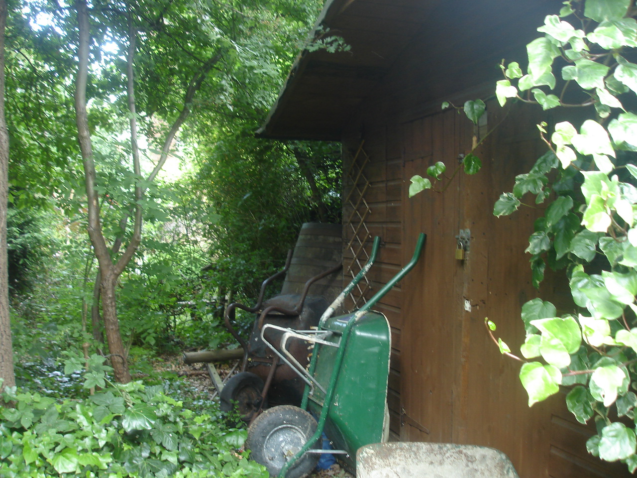
Where are the habitats, patches or ‘neglected’ areas?
Where are the pollinators overwintering?
How do wildlife move from one patch to another?
Can we fill in the gaps or remove barriers?
Think big – scale - linkages – watershed, river catchments, drainage

Slide 17
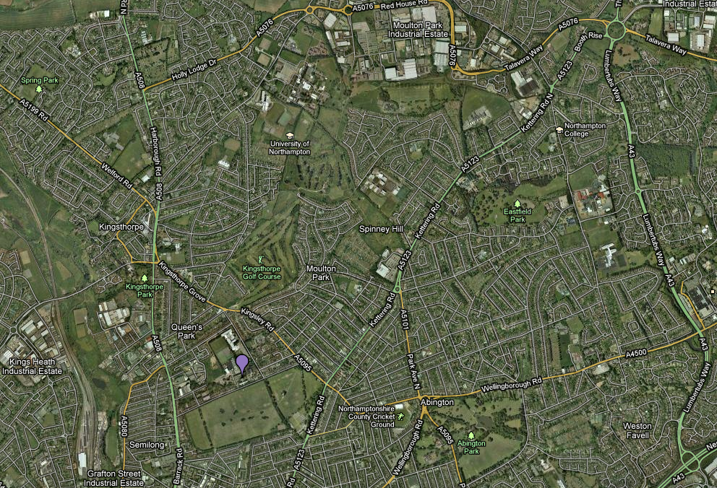
PARK
?
?
?
?
?
?
?
?
AVENUE
Green Infrastructure: connectivity with Schools?
Notes:
Green infrastructure – multifunctional green spaces can be used to halt the decline, enhance and restore biodiversity
Green spaces – might be small but in a landscape context they may provide valuable resources and act as stepping stones to a higher quality habitat.
Small patches may include gardens, waste ground, walls and crevices.
Student Dissertation – Badger mobility
Also: water shed management, flood risk and adaptation/ resilience for climate change – ECOSYSTEM SERVICES

Slide 18
Benefits
helps you develop a Biodiversity Action Plan
Identifies a range of enhancement activities that will benefit biodiversity on your site
Set and met new Corporate Social Responsibility goals
Fulfil Natural Environment & Rural Communities Act 2006 (Public bodies)
Bio-diverse areas create more desirable places to work, rest and play

Slide 19
The Science
The Index calculation is a formula that is
based on the following variables:
The number of different habitats on a site
Number of different plant types (shapes)
A comparative score based on the Shannon Diversity Index

Slide 20
Outcomes
A higher appreciation of existing biodiversity areas
Stop attrition on remnant habitats
Promote the possibility of creating new areas of diverse habitat
Promotes high quality ‘stepping stones’ to facilitate movement of wildlife
Improving the chances of species survival
Higher Corporate Standards for Biodiversity

Slide 21
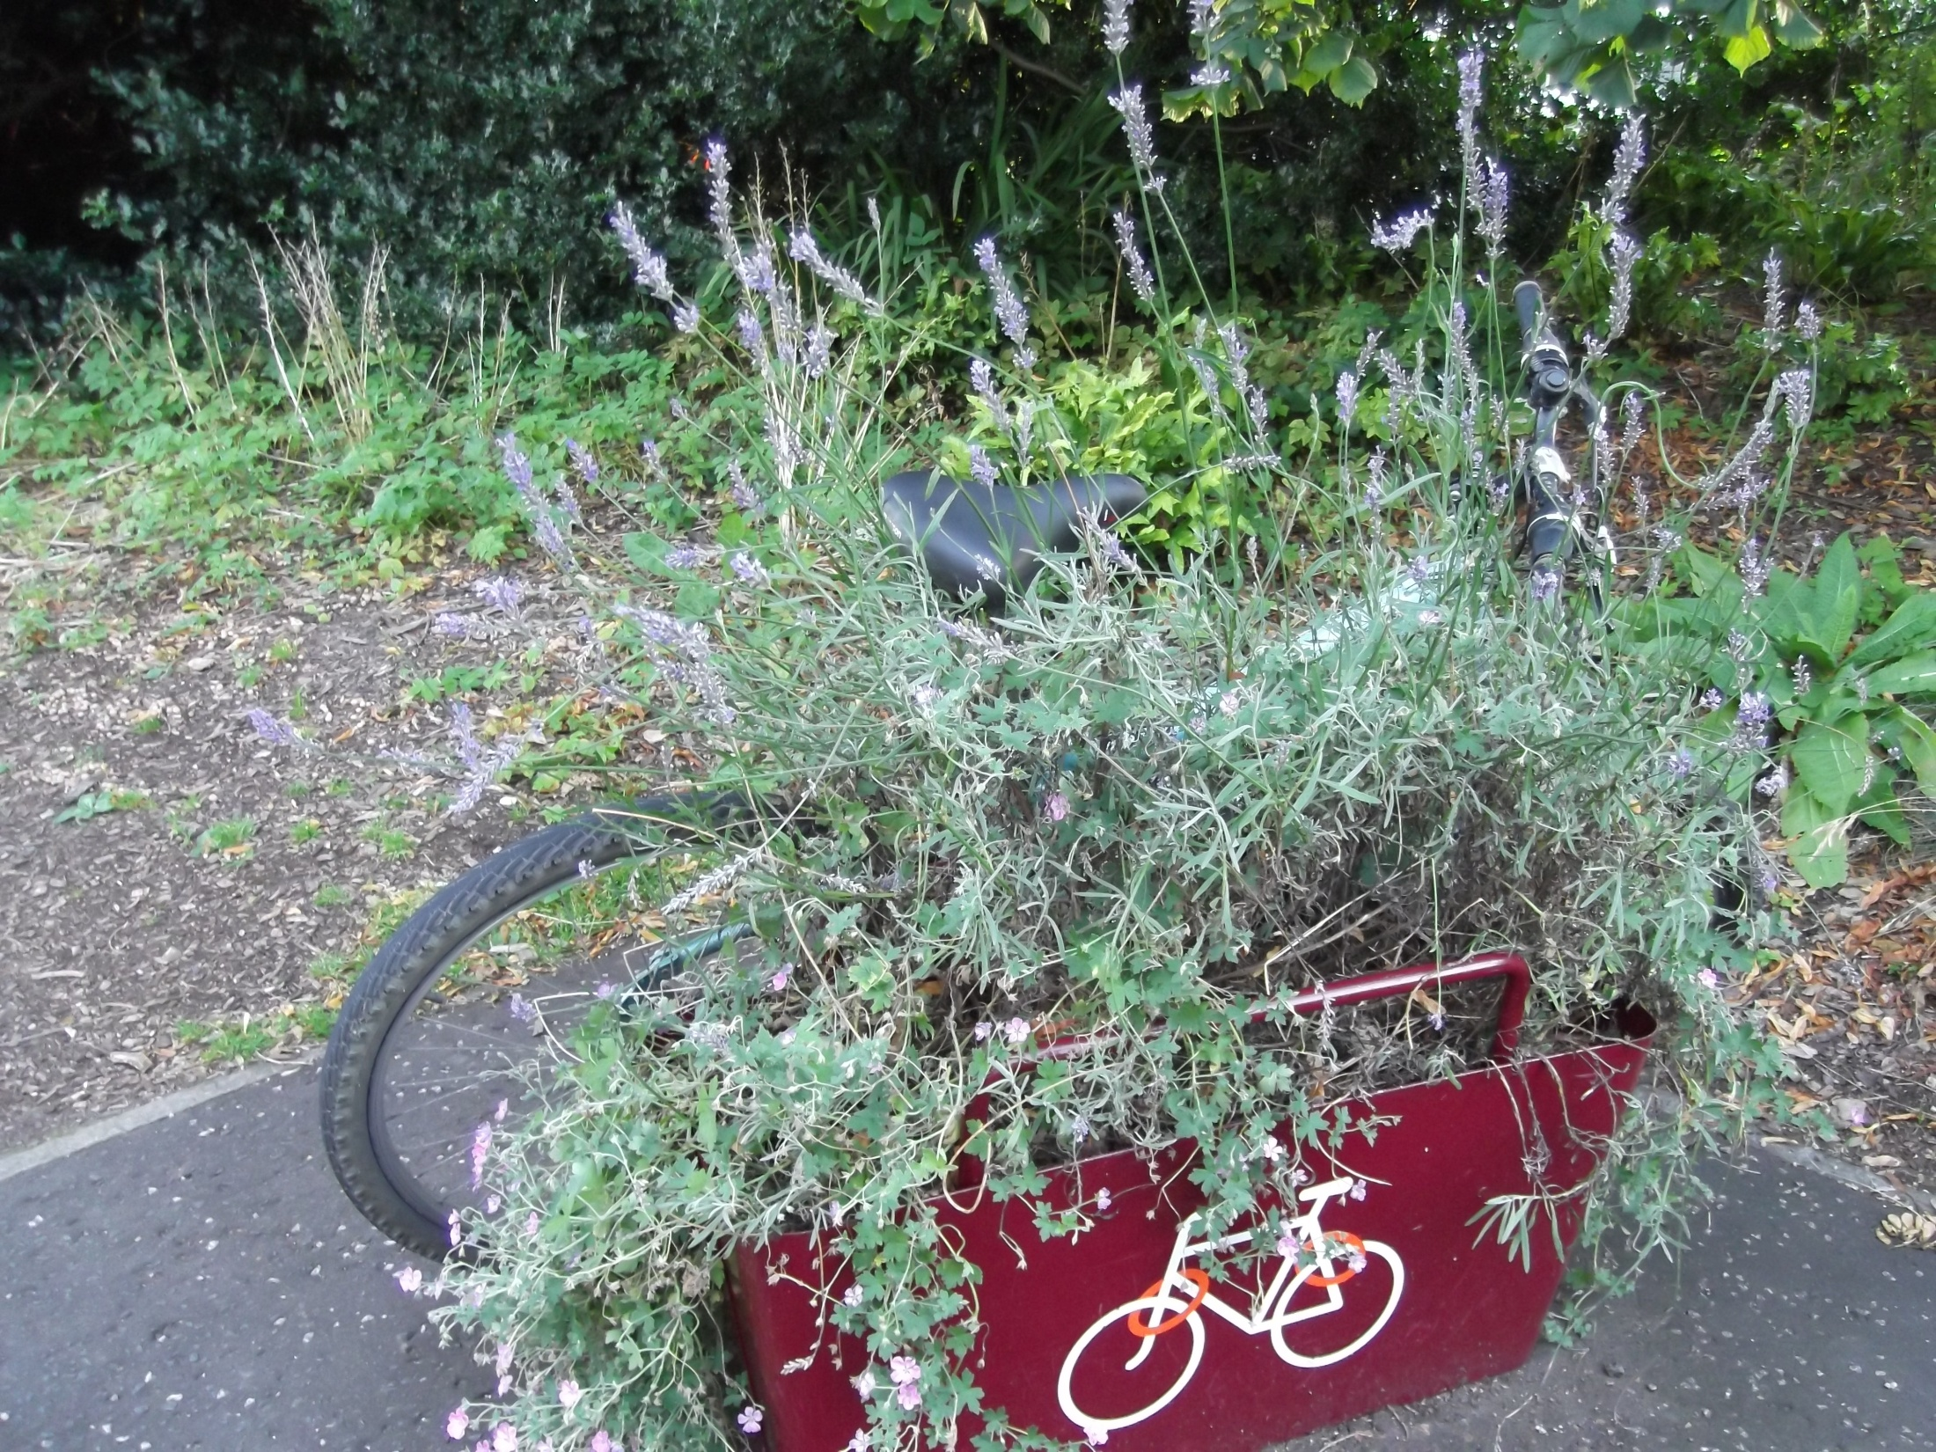
Message 1
Message 2
Message 3

