Slide 1
Effective recruitment of environmental champions
Tom Yearley
Energy Officer
Notes:
Give aways
Dvc sign up
Special events

Slide 2

Effective recruitment of Env champs
Find a consistent goal
Acknowledge not everyone’s green at heart…
…but support may grow more quickly than expected
Communications – old and new

Slide 3

Start with this
Professor Richard Ellis, Dean of the Faculty of Life Sciences: link

Slide 4

Why do you want champions
Consistency and belonging is important
Can be your eyes and your ears
Demonstrate popular agenda
Promote ‘Green’ about the campus
Notes:
Compliance – eyes and ears
Green impact
All levels of engagement

Slide 5
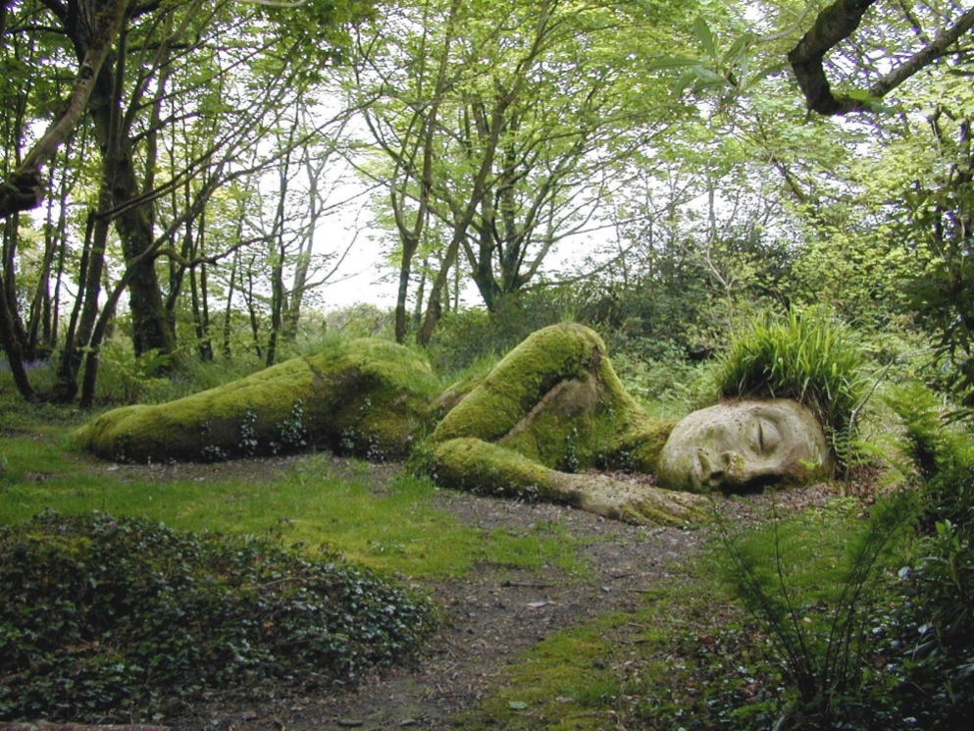
It won’t happen by itself
You have senior buy in
You might even have independent groups
How do you hit the middle ground
Notes:
Induction
Team meetings
H&s network
Green groups
RUSU
Go and work with people
training

Slide 6
Not everyone has a heart of Green
Career motivation
Feeling of importance
Don’t forget their boss!
Understand the finance
  Altruistic green-ness
Proud of their University
Intellectual
Notes:
Make it interesting and be passionate
What can we do for them
What will they get out of it?

Slide 7
How does it sound to you?
Stand in two equal lines
Approach you’re partner with the idea of being a Uni environmental champion
Listen to their feedback
Swap
As a table, identify top 5 pointers!

Slide 8



New Media

Slide 9
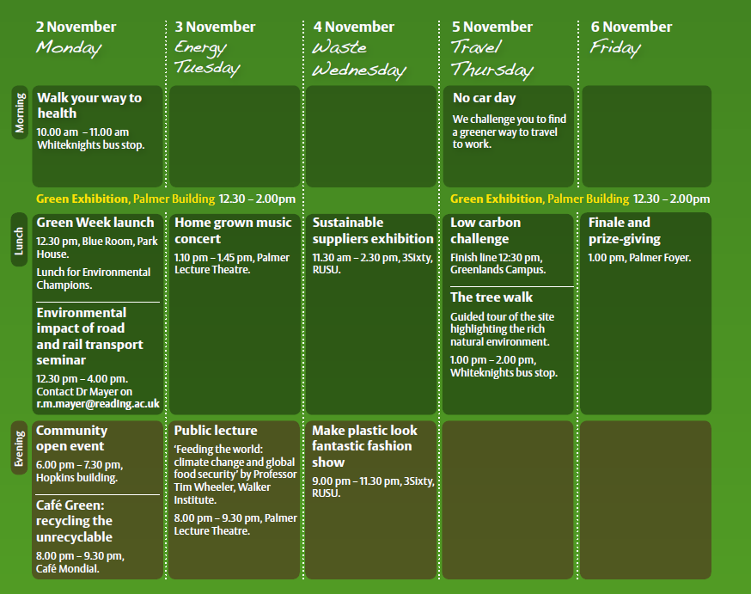
Traditional methods
Green Week
Promote ‘Green’
Raise awareness
Show Support

Slide 10
Traditional methods
Recruit through training
Promote CV enhancement to students
Don’t run all of your events during Green Week
Be prepared to buy lots of coffee!

Slide 11
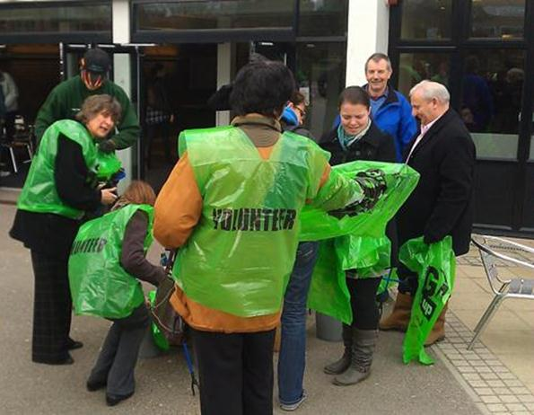
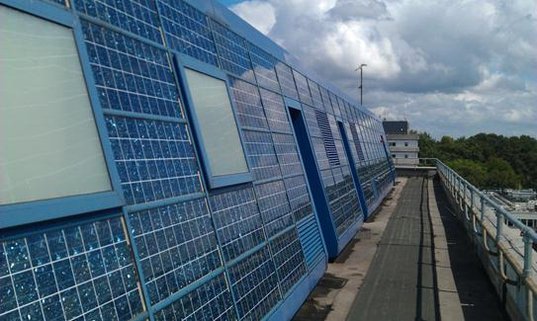
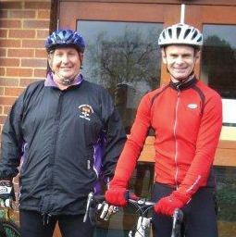
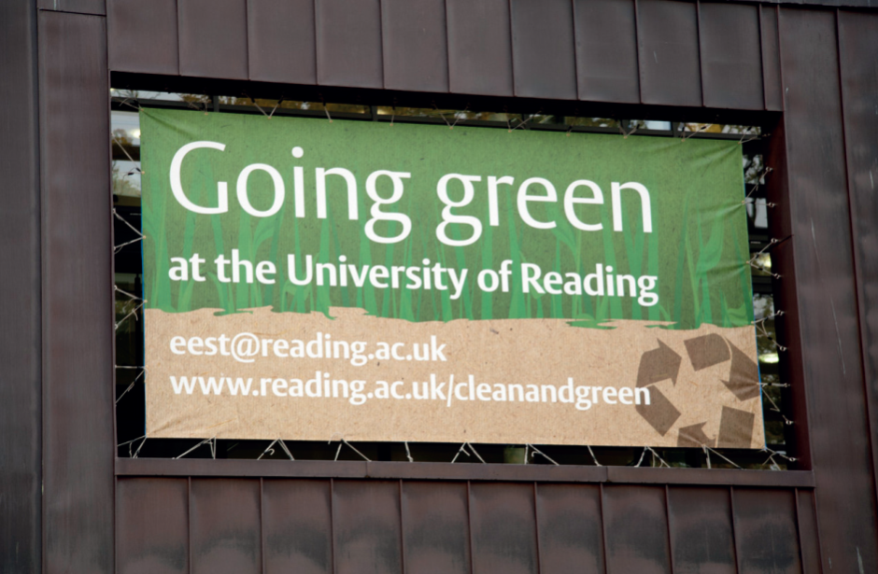
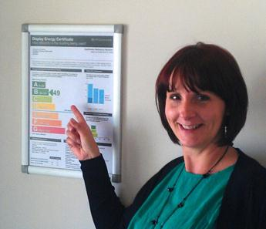
Share success

Slide 12
End with these
Hannah Varley, Design and Print Studio: link

