Slide 1

EAUC Scotland: 2020-23 Review
EAUC Scotland AGM & Forum
30th March 2023
www.eauc.org.uk

Slide 2

Review: 2020 – 2023 Programme
Funded by the Scottish Funding Council
Institutional leadership
Skills, Data and Knowledge
Sector collaboration
Education for Sustainability
Partnerships
5 Key Outcome Areas:
www.eauc.org.uk

Slide 3



Spotlight: Sector Leadership
25 new Race to Zero for Universities and Colleges signatories (33 total)
9 new SDG Accord signatories (18 total)
15 Scottish Green Gown Award Finalists and 8 Winners / Highly Commended (2022)
GGA 2023 open Monday
www.eauc.org.uk

Slide 4
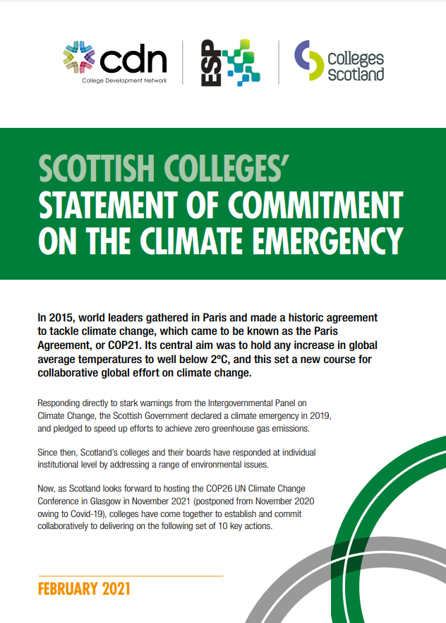



Spotlight: Sector Leadership
Engagement with Senior Leadership through:
Board invitations
Climate Emergency Expert Working Group
Secretaries Group
Committee of Scottish Chairs
SAUDE
www.eauc.org.uk

Slide 5

Spotlight: Carbon Literacy
Delivered CLT to 210 participants over 14 cohorts
31 institutions and partners represented
EAUC and EAUC Scotland certified as Platinum Carbon Literate Organisation by the Carbon Literacy Project
www.eauc.org.uk

Slide 6
Spotlight: Carbon Literacy
Knowledge about climate change:
Confidence to identify work actions:
Motivation to take action:
Thanks for the training- it was excellent, and also really good to get all of the extra resources afterwards too.
Thanks very much for the training provided over the last few weeks. I think it has been very effective in provoking discussion and further inspiration.
www.eauc.org.uk

Slide 7
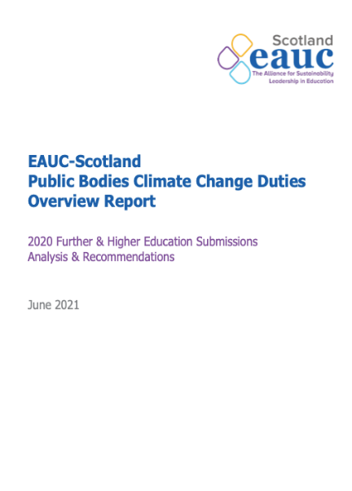


Spotlight: Knowledge, Data and Skills
97 EAUC Scotland events (including 16 training sessions)
with 1800+ participants
91% Scottish FHE institutional engagement
356 sector enquiries
PBCCD Peer Review expanded to 20 institutions
New Health and Wellbeing TSN and Student Leaders Network
www.eauc.org.uk

Slide 8

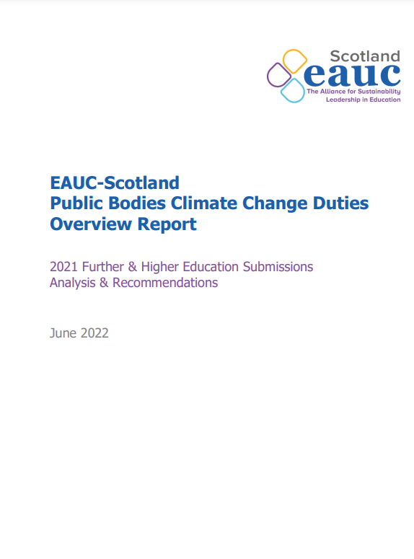
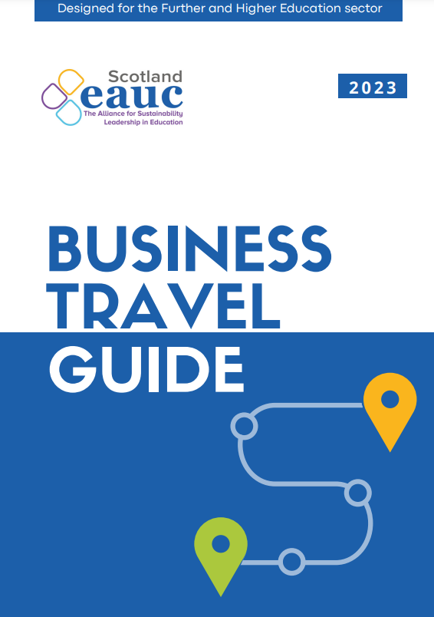
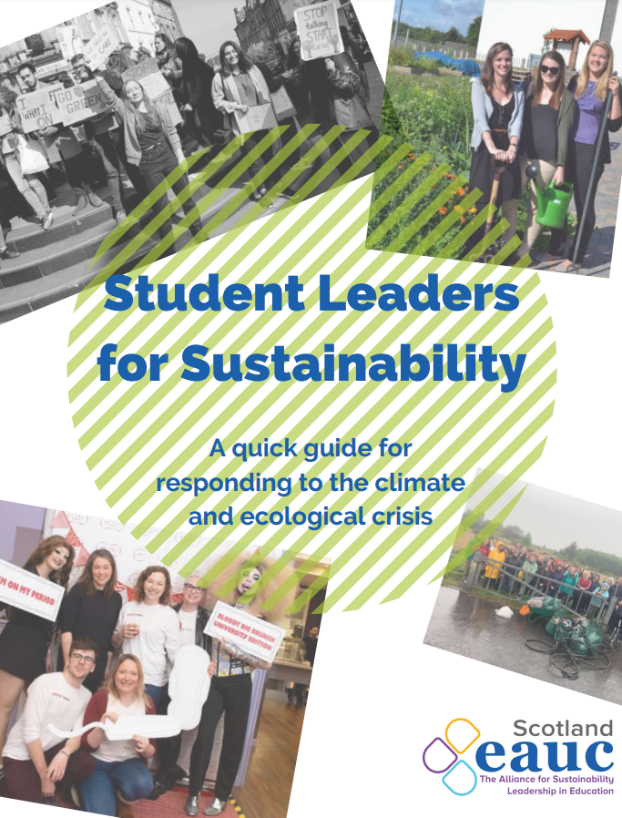
Spotlight: Knowledge, Data and Skills
www.eauc.org.uk

Slide 9


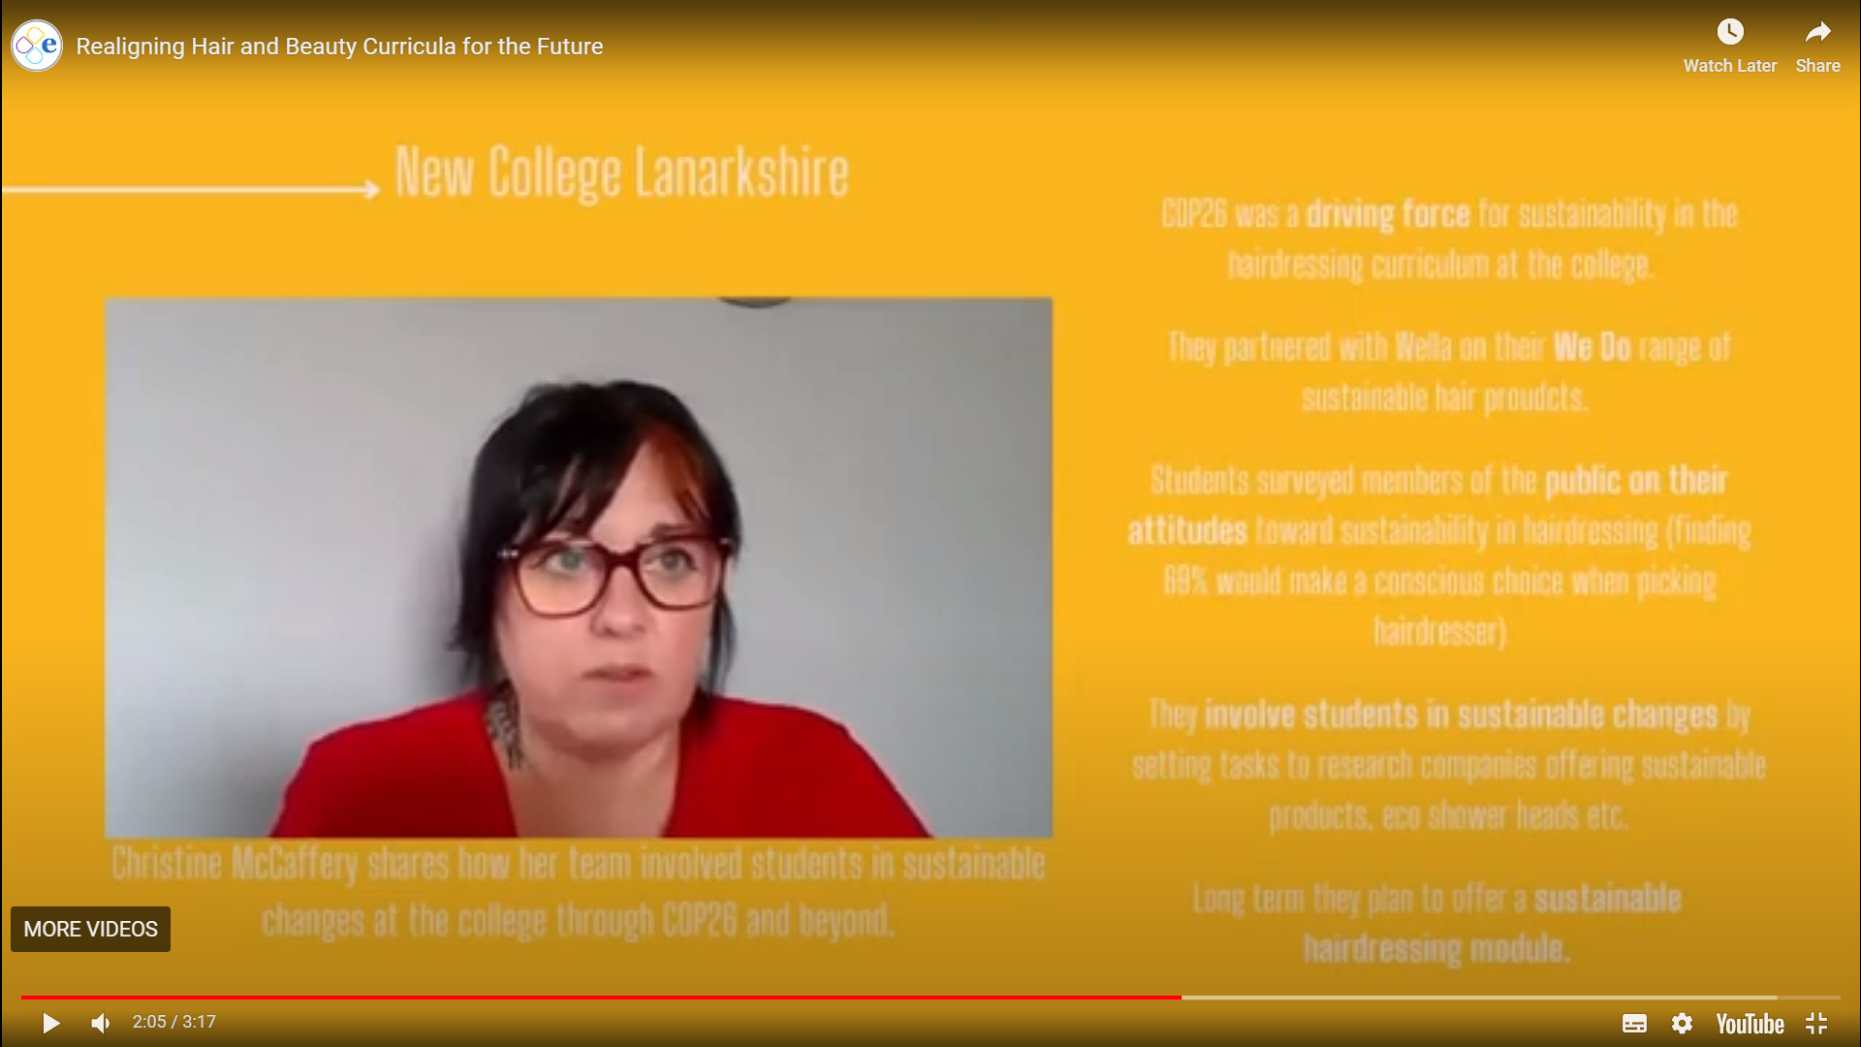
Spotlight: Learning and Teaching
Education for Sustainable Development TSN
Launched ESD Realigning Curricula for the Future Series
QAA Collaborative Enhancement Research Project
Advocacy:
Advance HE professional standards framework consultation
GTCS Proposed Draft Standard for Provisional Registration
Office of National Statistics consultation on a definition of Green Jobs
Learning for Sustainability Action Plan refresh
Climate Emergency Skills Action Plan education subgroup
www.eauc.org.uk

Slide 10




Spotlight: Partnerships & Collaboration
www.eauc.org.uk

Slide 11


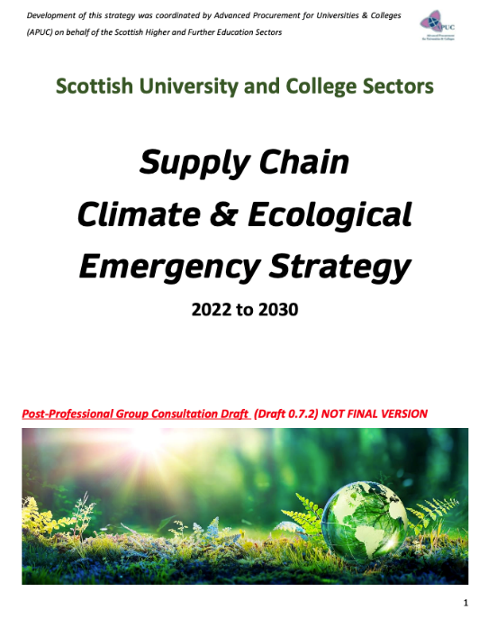


Spotlight: Partnerships & Collaboration
www.eauc.org.uk

Slide 12

Spotlight: Partnerships & Collaboration
Central and South Scotland College Partnership:
www.eauc.org.uk

Slide 13
Thank you
www.eauc.org.uk

Slide 14
Coming up
Launching new SFC-funded 12-month programme:
“Supporting a step-change towards environmental sustainability at
Scotland’s Universities and Colleges”
www.eauc.org.uk

Slide 15
Coming up
Over the next 6 months EAUC-Scotland will focus on:
Launching a Network Communications Pack
Launching a Sustainability Champions toolkit
Facilitating aviation in FHE workshops
Publication of sector Public Bodies Climate Change Duties Report overview
Launching a new sustainability careers guide
Delivery of Spring and Autumn Topic Support Network series
Institutional engagement calls / visits
www.eauc.org.uk

Slide 16
Upcoming activities
24th April – ESD TSN (Student-led ESD Initiatives)
26th April – Travel and Transport TSN (EV Salary Sacrifice; Travel Surveys)
3rd May – Waste Management TSN (Deposit Return Scheme)
17th May – Edinburgh Regional Meet-Up
24th May – SSN Conference (virtual)
25th May – Glasgow Regional Meet-Up
19th June – Roundtable meeting for EAUC Key Contacts and Fellows
22nd June – EAUC AGM
27th – 28th June – EAUC Annual Conference: Conversations on Climate Solutions
TBC – Community Engagement TSN; Health and Wellbeing TSN; SISM;
Open CLT training; Aviation and FHE Workshops
www.eauc.org.uk

Slide 17

Thank you
scotland@eauc.org.uk
www.eauc.org.uk
www.eauc.org.uk

