Slide 1
Climate Conscious Travel: The place of policy
Siôn Pickering
Project Coordinator, Department of Social Responsibility and Sustainability
University of Edinburgh

Slide 2
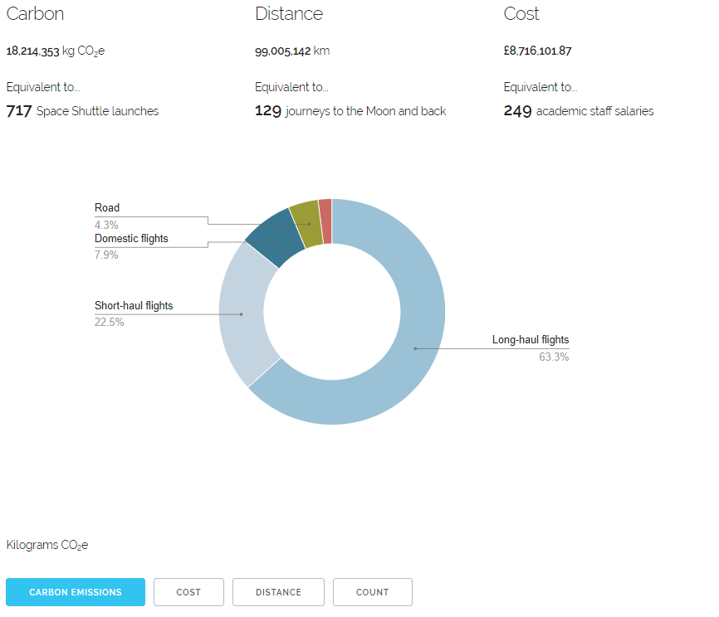
Todays focus
Understanding our travel
Understanding traveler behaviours
Attempting behavior change
TAWG develop recommendations
Evaluation & next steps
Recommendations put into practice
Embedding Change
Stage 1
Stage 2
Stage 3
Stage 4
Stage 5
Stage 6
Stage 7
2016
2017 - 19
2018
2019
2019 - 20
2020 - 24
Current State

Slide 3
Why policy?
Positives
Negatives
Shows commitment
Clarifies expectations for stakeholders
Can be used to support other changes
Top down (disempowering)
Too rigid- Can restrict future changes
Doesn’t incentivise behaviour change - Stick rather than the carrot
Unlikely to be enough on it’s own (but may be perceived as “job done”)
More on this later

Slide 4
Is it (ever) a good time?
Covid-19…
But it has also…
…has fundamentally changed how we see travel
…led to near 100% drop in air journeys since March 2020
….led to significant increase in use of virtual collaboration
… is likely to have significant impacts on University travel into the future:
Environmental impact
Duty of care
Financial costs
… shown the inequalities that exist in our sector
… reduced funding and ability to undertake key research
… focused efforts on saving costs
… shown how unsustainable the sector was prior to the pandemic

Slide 5
A bit about our policy
Notes:
… so, stage 1 looked to build a better understanding of our travel behaviours.

Slide 6
How our policy was developed
Oct 2019- June 2020
August 2020
Travel Policy requested by Adaptation and Renewal Team (as mechanism for managing financial costs)
Aug 2020 – Feb 2021
Joint project: Finance (including procurement) and SRS
Created “gold standard Sustainable Travel Policy” and worked back from there
March 2021
Consulted with colleagues across the University (academic, professional, unions & student representatives) to get buy in
Taken to University Executive
Need for a policy is recommended by the Travel and Aviation Working Group (TAWG)
Based on data, internal research (focus groups & surveys 2017-19) & consultation (March 2020) - roughly 1000 responses
June 2020
Travel and Aviation Working Group convened to develop recommendations for reducing carbon emissions from University business travel

Slide 7
What’s in the policy?
Focus on the three pillars of sustainability:
Across all types of travel:
Applicable to all travellers:
Centred on:
Standardises processes:
Social | Environmental | Financial
Local | National | International
Students | Early career academics | Senior leaders | Visitors | Guests
Reducing travel > Replacing high carbon travel > Sequestering remaining emissions
Set objectives | Pre-authorisation | Risk Assessments & Insurance | use of TMC

Slide 8
So we’ve solved it, right?
Now time to embed the changes enshrined in the policy
Some principles will be less popular than others
Need to finalise and align new processes
Requires supporting documentation, resources, training
Still more to do around supporting individual behaviour change
“Lock-in” new behaviours rather than “snap back” to old ways
Communicating best practice and positive stories from sustainable travel advocates

Slide 9
And then there’s always …
…Student mobility
…Offsetting
…

Slide 10
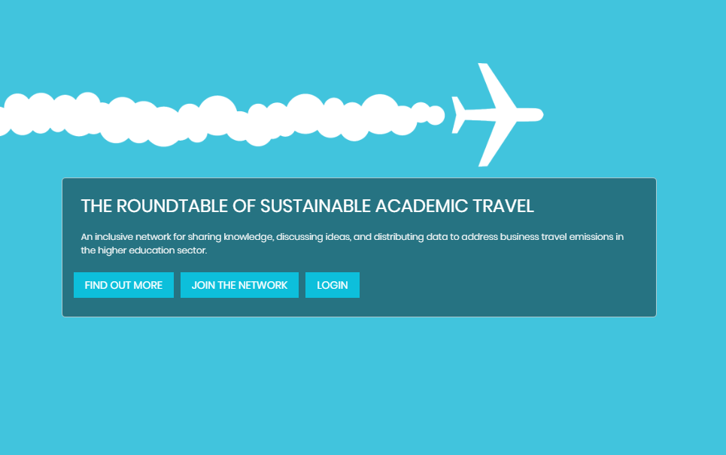
Work within the sector
Other institutions (Google Doc) (Hoolohan et al, 2021)
Domestic flights | Flight reduction where alternatives exist | Offsetting
Guidance Vs Policy (University of Glasgow)
Advanced Procurement for Universities and Colleges (APUC)
Funding bodies
Partner Institutions (national / international) (Google Map) (roundtable network)

Slide 11
Top tips for building a strong policy
Focus on social (EDI) > environment > finances
Get senior leadership buy in early (but don’t ask for too much initially)
Maintain relationships with finance teams - especially procurement
Consider the role of travel management suppliers
Build on what others are doing in this space
Link to the bigger picture (COP26, Covid-19, PBCCD changes, institutional strategies….)
Thing big. You can always scale it back.
Social
Environmental
Economic

Slide 12
And remember….
You may not need a policy
(but, if you get it right, I think it can help)
AND
If you do put a policy in place, that’s not going to fix it all!

Slide 13
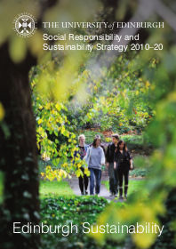
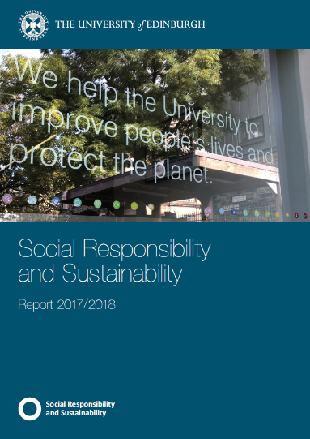
Questions?
sion.pickering@ed.ac.uk
@Sion Pickering
@EdSust
www.ed.ac.uk/sustainability
/Edinburgh Sustainability

