Slide 1

Webinar: Learning from Covid-19 for ESD:
causes, consequences and curriculum
  Welcome!
PLEASE
Mute your audio and switch off your video
Put any questions in the chat box
We will be recording this webinar
15 Sept 2020

Slide 2
Housekeeping
PLEASE
Mute your audio and switch off your video
Put any questions or comments in the chat box
We will be recording the main session in this webinar, but not the group discussions

Slide 3

Who are we?
Learning for Sustainability (LfS) Scotland is a UN Regional Centre in Expertise in Education for Sustainable Development.
Notes:
Free to join, bulletin, task groups, events, resources and projects

Slide 4
Learning from Covid-19 for ESD:
causes, consequences and curriculum
AIMS
Explore how we can learn from Covid-19 to stimulate ESD curricula and pedagogies
Share experiences and ideas
Consider new topics for the series

Slide 5
Mentimeter
three words to describe how you are feeling about teaching ESD in the coming semester….

Slide 6
Time | Activity
14:00 | Introduction to the session
14:05 | Introduction to each other
14:15 | Mentimeter
14:22 | Causes and consequences: Covid-19 and SD – (10 min) plus question for self reflection The future series
14:50 | Breakout groups: how will you integrate Covid-19 into your teaching to enhance ESD?
15:12 | Brief plenary – best 3 points from each group typed in chat
15:20 | Mentimeter
15:25 | Concluding remarks
15:30 | End

Slide 7
What is Education for
Sustainable Development?
ESD empowers learners to take informed decisions and responsible actions for environmental integrity, economic viability and a just society, for present and future generations, while respecting cultural diversity. It is about lifelong learning, and is an integral part of quality education. ESD is holistic and transformational education which addresses learning content and outcomes, pedagogy and the learning environment. It achieves its purpose by transforming society.(UNESCO 2020)
Notes:
For not merely about sustainability

Slide 8
Who is LfS for?
All educators
All learners
Schools, colleges, universities
Communities
Organisations and institutions
Policy makers and leaders
Businesses
Media

Slide 9
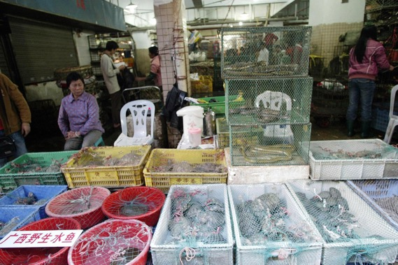
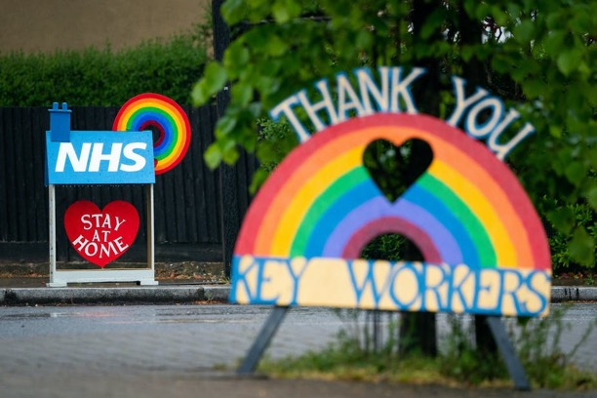
Covid-19 causes and challenges
National Geographic
blogs.lse.ac.uk
The Philadelphia Enquirer
Notes:
Not nature causing pandemic but humans disrupting ecosystems - 75% new and emerging human diseases are zoonoses eg Ebola, SARs, covid 19. Human populations, industrial agriculture.
Exacerbated by globalization, increased trade, international supply trade
Key workers revered (but not super heroes)
Inequality in impact.
Many dead
Systems struggling from austerity oe lack of health facilities or health insurance

Slide 10



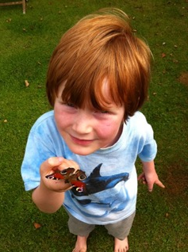
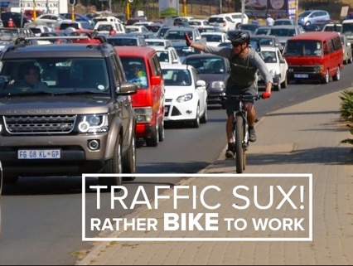
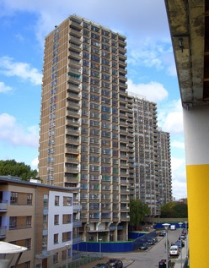

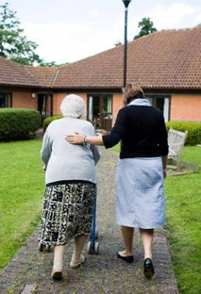
Covid-19 experiences: personal

Slide 11
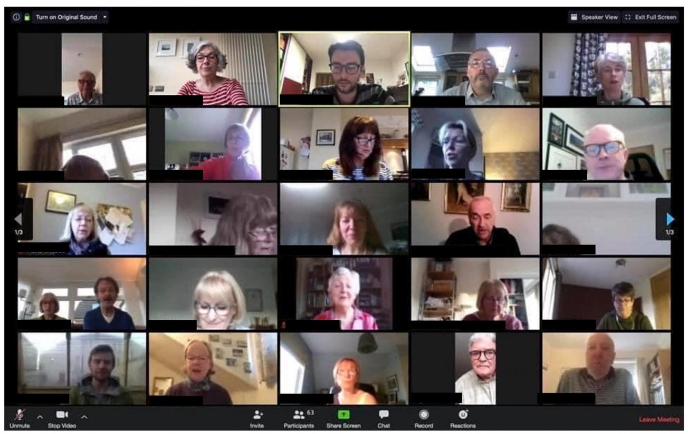
Covid-19 experiences: professional
Peeblesshire News
Notes:
Online possible
Home working
Zoom fatigue – emoting without reading empathy and body language and the energy of a room
Lack of social relations
Difficult to not see body language
So difficult to teach! But some things possible

Slide 12
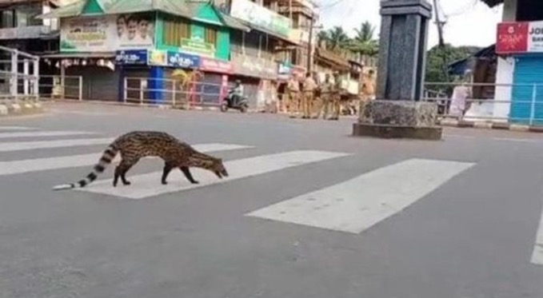
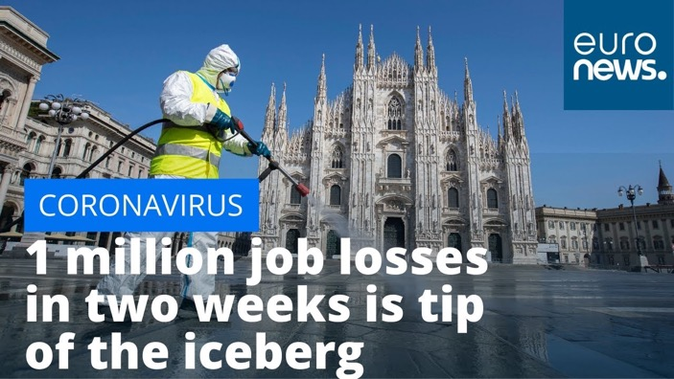
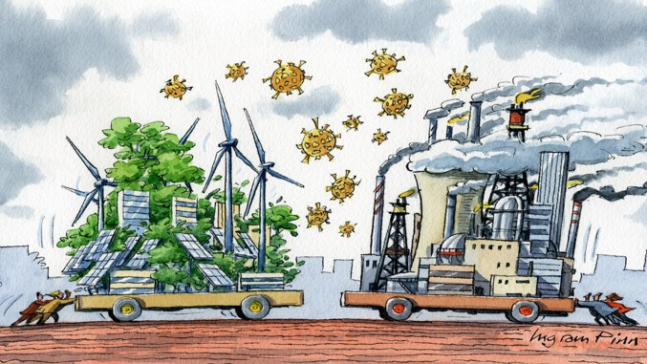
Covid-19 experiences: societal
Notes:
Civet cat in the city in Kerala, India - Spotted Malabar civet... A critically endangered mammal not seen until 1990 resurfaces for the first time in India during lockdown.
Return of wildlife, quiet streets, reduced emissions and pollution. Great community response.
BUT – loss of jobs and fear that recovery will fuel coronavirus capitalism rather than a green deal. This is a choice, and one that we have to influence.
The role of China versus USA after the dust settles…. The old hegemony disrupted.

Slide 13

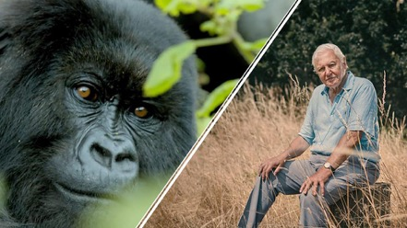
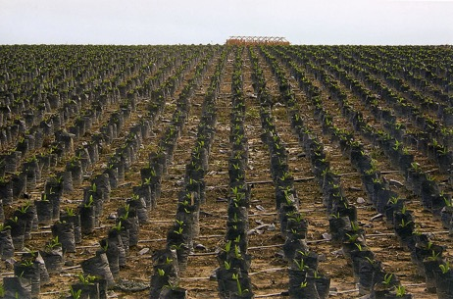
Covid-19 and LfS causes
Opens up wider discussion of systems thinking
Demonstrates wicked problems in real world
Provides rationale for the need to support sustainability competencies
Deeper understanding of importance of human nature relationships

Slide 14

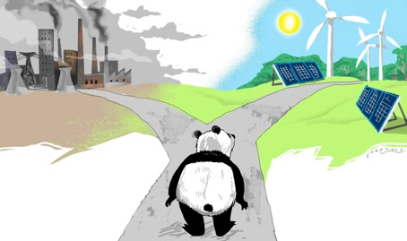
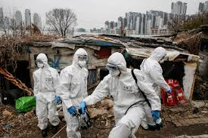
Covid-19 and LfS: consequences
Need for LfS competencies
Need to adapt to uncertainty
Challenges for graduate employment
Glimmers of evidence of societal change
Possibility of Green deal
New positioning for FE and HE
New modes of learning
South China Morning Post

Slide 15




Covid-19 and LfS: curriculum
Teaching for competencies not information
Emphasising systems thinking
Debate controversial issues and develop critical thinking – tackling fake news….
Embracing online and blended learning options
Students and staff emotionally isolated and needing human connection?

Slide 16

Individual reflection

Slide 17
Future needs from the TSN/TG

Slide 18
Group Discussions
How will you integrate Covid-19 into your teaching to enhance ESD? Consider curricular aspects eg systems thinking and also pedagogical aspects eg flipped classroom and permission to trial new things
Unmute yourself when you arrive in your group
Identify a facilitator and a notetaker (send notes and image to Betsy)
Share one or two key points in the chat when you return and be prepared to briefly state them

Slide 19
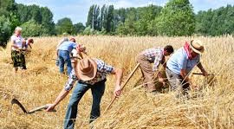
plenary

Slide 20
Mentimeter
What do you feel is most important in teaching ESD this semester?

Slide 21
