Slide 1
Enhancing Waste
Contract Performance with Service Credits
paulo.cruz@gcu.ac.uk
Sustainability Officer
22nd October 2020

Slide 2
Our Waste
One site generating 330-360 tonnes per year:
63% recycled (50:50 front- and back-end)
8% (food) processed at anaerobic digestion
29% converted into refuse derived fuel

Slide 3
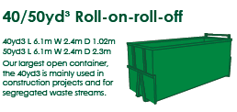
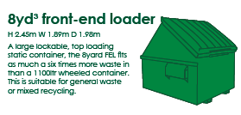
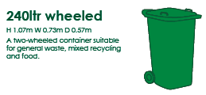
Specification
Waste Stream | Current Containment | Current Frequency | Monthly Average Tonnes | Annual Average Tonnes
DMR* | 30.6 CU M OPEN BC or equivalent | 1-2 week | 7 | 100
Bulky* | 30.6 CU M OPEN BC or equivalent | On-demand (average fortnightly) | 6.35 | 75
General waste * | 4* FEL (8 yrd) or equivalent | Daily, but only full containers emptied. | 11 | 140
Food waste | 6 * 240L or equivalent | Mon, Wed & Fri presented as required. | 2 | 25
Glass | 4 * 240L [catering] 4 * 240L [labs] | Catering: Mon & Friday, presented as required. Labs: on-demand | 0.27 | 5
Paper | 4 * 240L or equivalent | Print Service: Weekly | 0.23 | 4
Waste streams with an “*” to be collected outwith 08:00 -18:00.
24 hrs to complete collections
24 hrs to rectify missed collections.
Duty of care documentation
Management reports
Where KPI not met, 3% service credit applied to the quarterly charge.
Reviewed at quarterly contract meetings.

Slide 4
Why & How
Why:
Help contractor focus on service delivery.
Reduce time administering contract and duty of care.
How:
Draw on monthly management reports.
Standardise internal processes (e.g. email template for service requests).
Potential to be fully ‘managed’ by Admin Team.

Slide 5
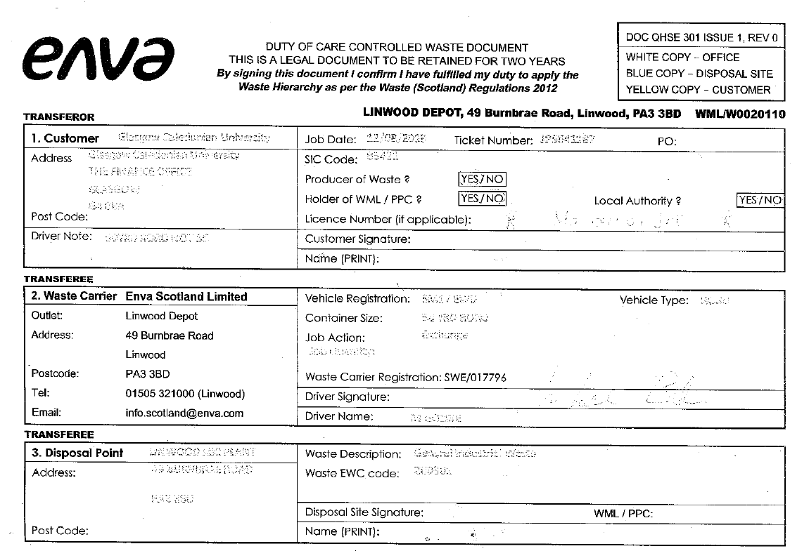

Slide 6
Performance Indicators
KPI # | KPI | KPI | KPI Measure | Calculation Method
1 | Completion of all scheduled service visits | 98% | Response time achieved | KPI = (a/b)*100 a = no. of scheduled visits completed within agreed timescale b = total number of scheduled visits
2 | Collections completed within 24 hrs of request being made. | 90% | Response time achieved | KPI = (1-(a/b))*100 a = no. of service request not completed within 24 hrs b = total service requests
3 | Justification for missed collection provided by 09:00 hrs of the next business day | 75% | Response time achieved | KPI = (a/b)*100 a = no. of missed collections with justification b= total missed collections
4 | High quality, legible scans of WTN to be received by the 15th of the following month | 100% | Response time achieved | KPI = (1-(a/b))*100 a = no. of unclear WTN available by 10th of the month following service completion b= total no. of WTN for the previous month A WTN scan will be deemed not to be of good quality if the Institution has to contact the Contractor for clarity on any information contained in the WTN.
5 | Monthly Management Information and Reports by the 15th of the following month | 95% | Response time achieved | KPI = (a/b)*100 a = no. of reports provided on time b = no. of reports to be submitted to date
6 | Invoicing | 100% | Invoice Accuracy | KPI = (1-(a/b))*100 a = no. of invoices with incorrect information b = total no. invoices.

Slide 7
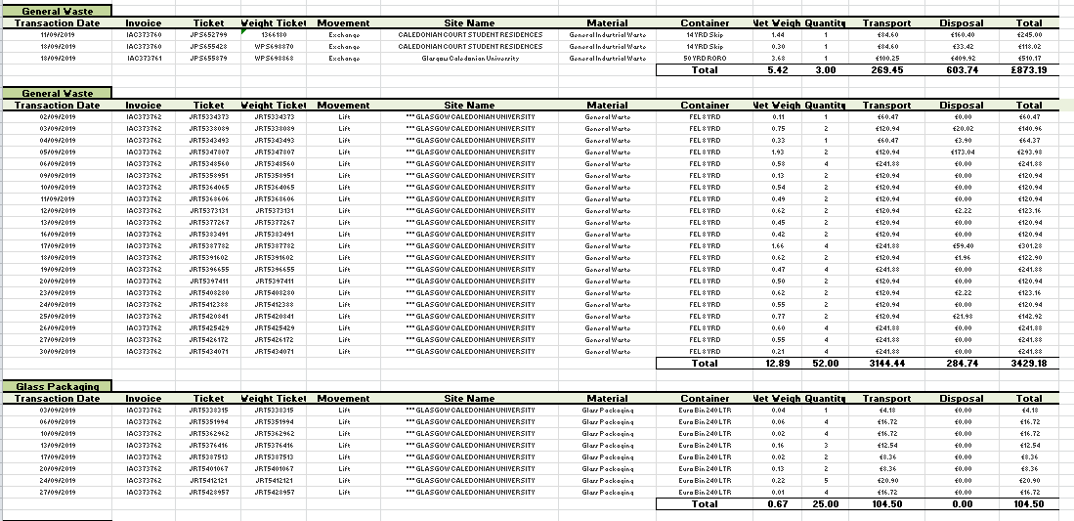
Managing Performance

Slide 8
KPI # | KPI | KPI | KPI Measure | Calculation Method | KPI data source
1 | Completion of all scheduled service visits | 98% | Response time achieved | KPI = (a/b)*100 a = no. of scheduled visits completed within agreed timescale b = total number of scheduled visits | GCU report Contractor CS Team (MI)
2 | Collections completed within 24 hrs of request being made. | 90% | Response time achieved | KPI = (1-(a/b))*100 a = no. of service request not completed within 24 hrs b = total service requests | GCU report (template emails) Contractor CS Team (MI)
3 | Justification for missed collection provided by 09:00 hrs of the next business day | 75% | Response time achieved | KPI = (a/b)*100 a = no. of missed collections with justification b= total missed collections | GCU Report. Contractor CS Team.
4 | High quality, legible scans of WTN to be received by the 15th of the following month | 100% | Response time achieved | KPI = (1-(a/b))*100 a = no. of unclear WTN available by 10th of the month following service completion b= total no. of WTN for the previous month A WTN scan will be deemed not to be of good quality if the Institution has to contact the Contractor for clarity on any information contained in the WTN. | Contractor CS Team. GCU Contract Manager.
5 | Monthly Management Information and Reports by the 15th of the following month | 95% | Response time achieved | KPI = (a/b)*100 a = no. of reports provided on time b = no. of reports to be submitted to date | Contractor CS Team. GCU Contract Manager.
6 | Invoicing | 100% | Invoice Accuracy | KPI = (1-(a/b))*100 a = no. of invoices with incorrect information b = total no. invoices. | Contractor CS Team. GCU Contract Manager.

Slide 9
KPI 4 – 24 hrs turnaround
Dependant on:
  Time of request
  Weekday only

Slide 10
Impact
Retained an element of manual processing.
Less time managing contract.
More focused and responsive service :
  Collections within required timescales.
  Legible waste transfer notes.
  Fewer invoice errors.

Slide 11

Happy to answer questions!

