Slide 1












Supported by

Slide 2
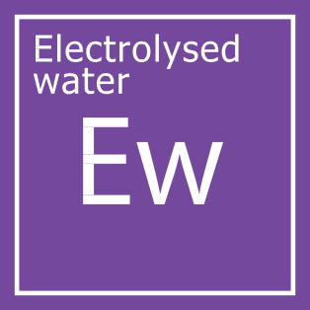
INTRODUCING..
POWERFUL, GREEN
DISINFECTION & CLEANING TECHNOLOGY
utilising Electrolysed Water

Slide 3

WHO ARE WE
Ecoanolytes is a Scottish manufacturer based in Dundee, that provides disinfection & cleaning products.
What sets our products apart from the industry's popular brands, is that our products utilise a special GREEN technology.
That GREEN technology is
'Electrolysed Water'.

Slide 4
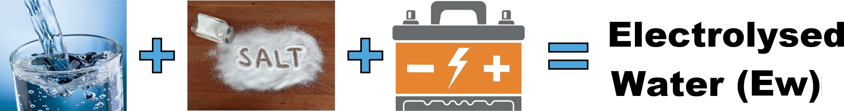
THE TECHNOLOGY
Electrolysed Water (EW) Technology is not new in fact it is over 100 years since it was first used, but the problem was that it wasn't stable, so it only had a very short active life.
Ecoanolytes products have a shelf life of around 2 years and can be use up to 6 months after opening.
ALL of our Disinfectant & Cleaning products utilise Electrolysed water, which is made from water (over 99%), a little salt and some electricity

Slide 5
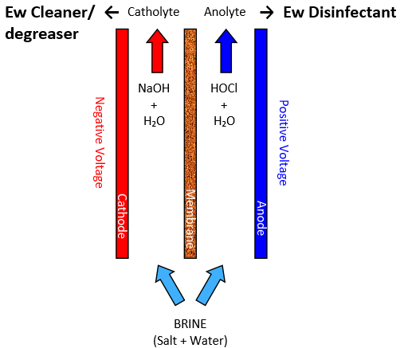
HOW IS IT MADE
Ecoanolytes use a machine with a specially designed chamber that separates the brine solution into our Disinfection products and Cleaning products.
Our Disinfection products are pH Neutral with Hypochlorous Acid as its active ingredient at typically 260ppm
Our Cleaning products have a pH or around 11 with Sodium Hydroxide as its active ingredient at typically 500ppm
Ecoanolytes Electrolysed water products contains NO Harsh or Toxic chemicals, as per European Regulation 548/67/EWG and classed as Not Dangerous as per 88/279/EWG

Slide 6
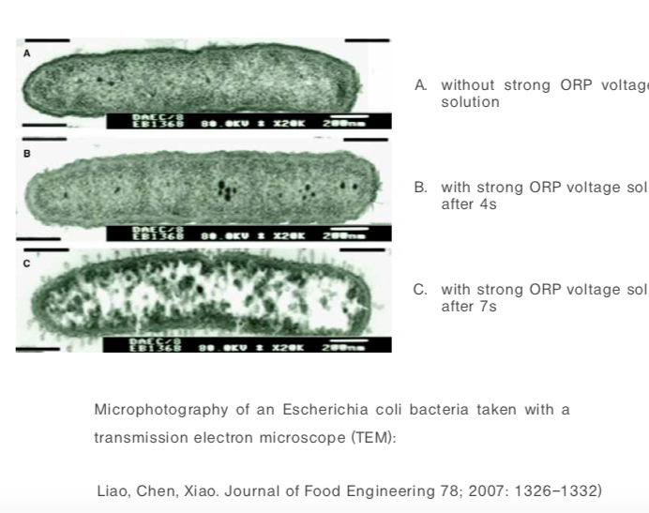
HOW DOES IT KILL GERMS
Every molecule of our Disinfection products contains the same active ingredient our body's produce when fighting an infection.
They also has a very small but important electrical charge which destroys the outer membrane of micro-organisms, enabling the active ingredient to enter and destroy it
very quickly
A – No Ew
B – With Ew added
C – 7 seconds later
Electrolysed water is 30 times more effective than bleach at killing all Germs, including viruses, like Flu and the common cold

Slide 7
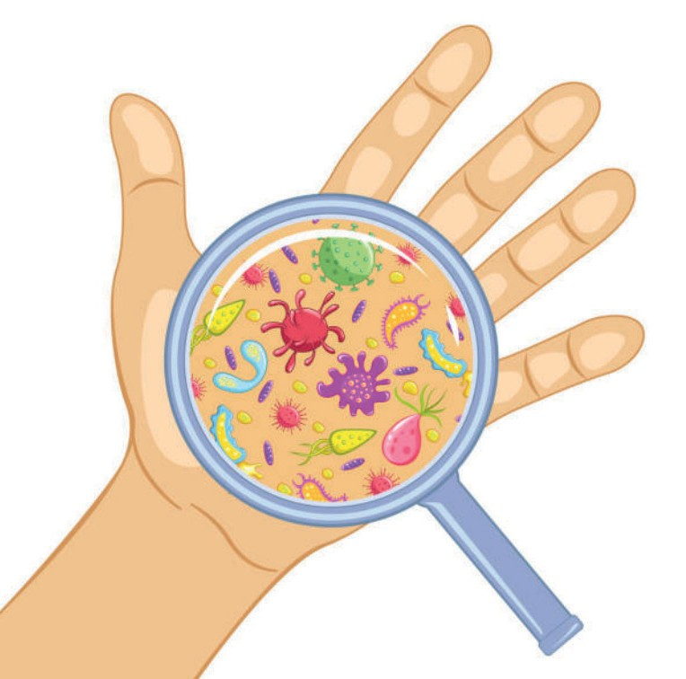
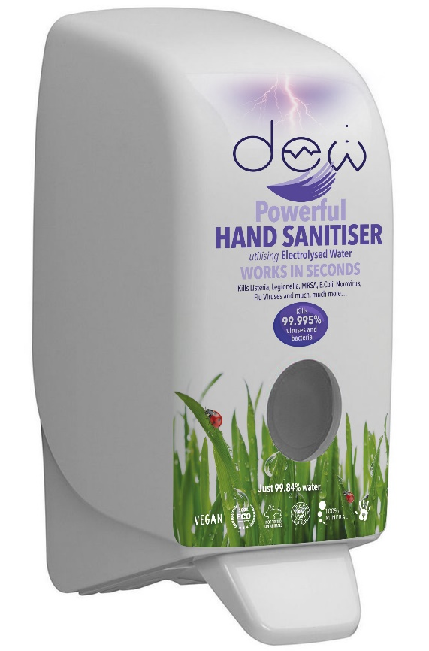
KILLS ALL THESE COMMON VIRUSES
Common Cold
Infuenza
Measles
Chickenpox
Warts
Herpes Group
Hepatitis
Viral meningitis
Viral encephalitis
Rabies
Norovirus
Rotavirus
Ebola
SARS

Slide 8
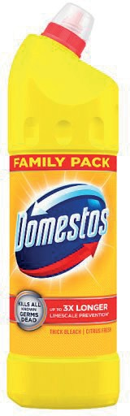
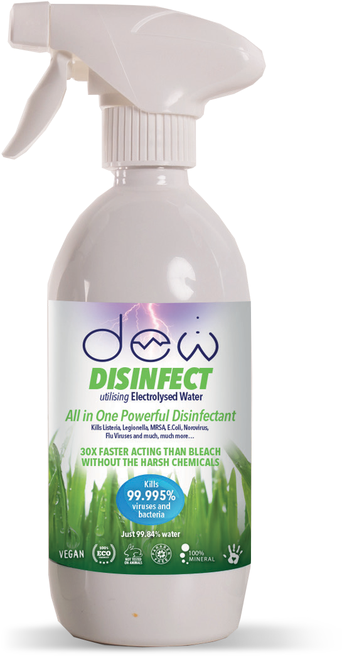
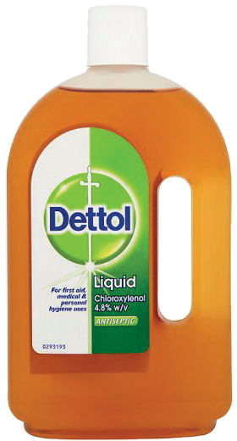
HOW EFFECTIVE ARE OUR PRODUCTS
In successive Laboratory tests, Ew has been proven to be very effective at killing bacteria, viruses, fungi and spores, in most cases, achieving a 99.995% reduction in around 30 seconds.
It achieves this without the use of ANY harsh or toxic chemicals, unlike other popular household brands, which also take much longer to be as effective and they don't kill viruses.
5 Minutes
5 Minutes
Less than
30 Seconds

Slide 9

COMPLIES WITH EUROPEAN STANDARDS
EN 901 - European standard for the treatment of water for human consumption.
EN 1276 - Chemical Disinfectants Bactericidal Activity Testing
EN 1650 - Quantitative suspension test for the evaluation of bactericidal activity of chemical disinfectants and antiseptics for use in the veterinary field.
EN 13697 - Quantitative Surface Test for the Evaluation of Bactericidal or Fungicidal Activity (preferred by the Food Standards Agency)
EN 13623 - Quantitative suspension test for the evaluation of bactericidal activity against Legionella
EN 14476 - Chemical Disinfectants and Antiseptics – Quantitative Suspension Test for the Evaluation of Virucidal Activity in the Medical Area
To comply with the EU Biocide Regulations, Ew has passed the following tests:

Slide 10

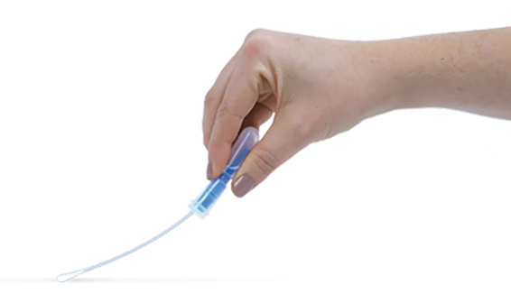
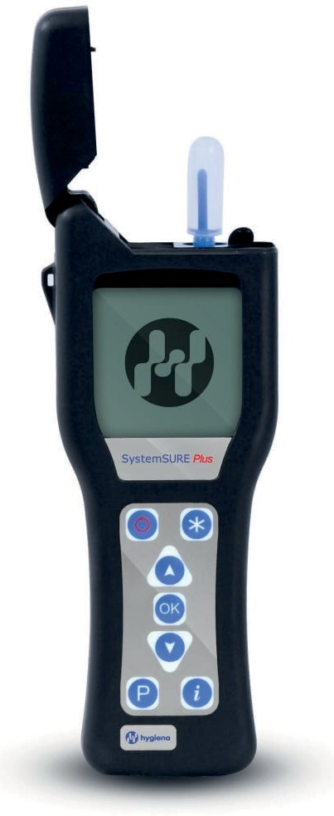
MONITORING PERFORMANCE
When working with bacteria and viruses, it can be very difficult to know when a “clean” surface is hygienically clean. Ecoanolytes has partnered with Hygiena International to provide you with instant readings of before & after Ew treatment. The Hygiena meter, which monitors ATP, is recognised by the NHS Research Institute.
The National Institute of Health Research stated that:
Location | Pass | Caution | Fail
Public Area | 100 50 25 10 | 101 - 200 51 - 100 26 - 50 11 - 30 | >200 >100 >50 >30
Near Patient
Area
High Care
Area
Sterile
Services
“the ideal test for cleaning efficiency then is a test for organic matter itself. The use of ATP bioluminescence can provide this, giving instant indication of total surface contamination and importantly an objective assessment of cleanliness.”

Slide 11


Slide 12

















ALL OUR PRODUCTS ARE

Slide 13

NOW IT'S TIME TO RE-VISIT THE 3Rs
Reduce
Reuse
Recycle

Slide 14
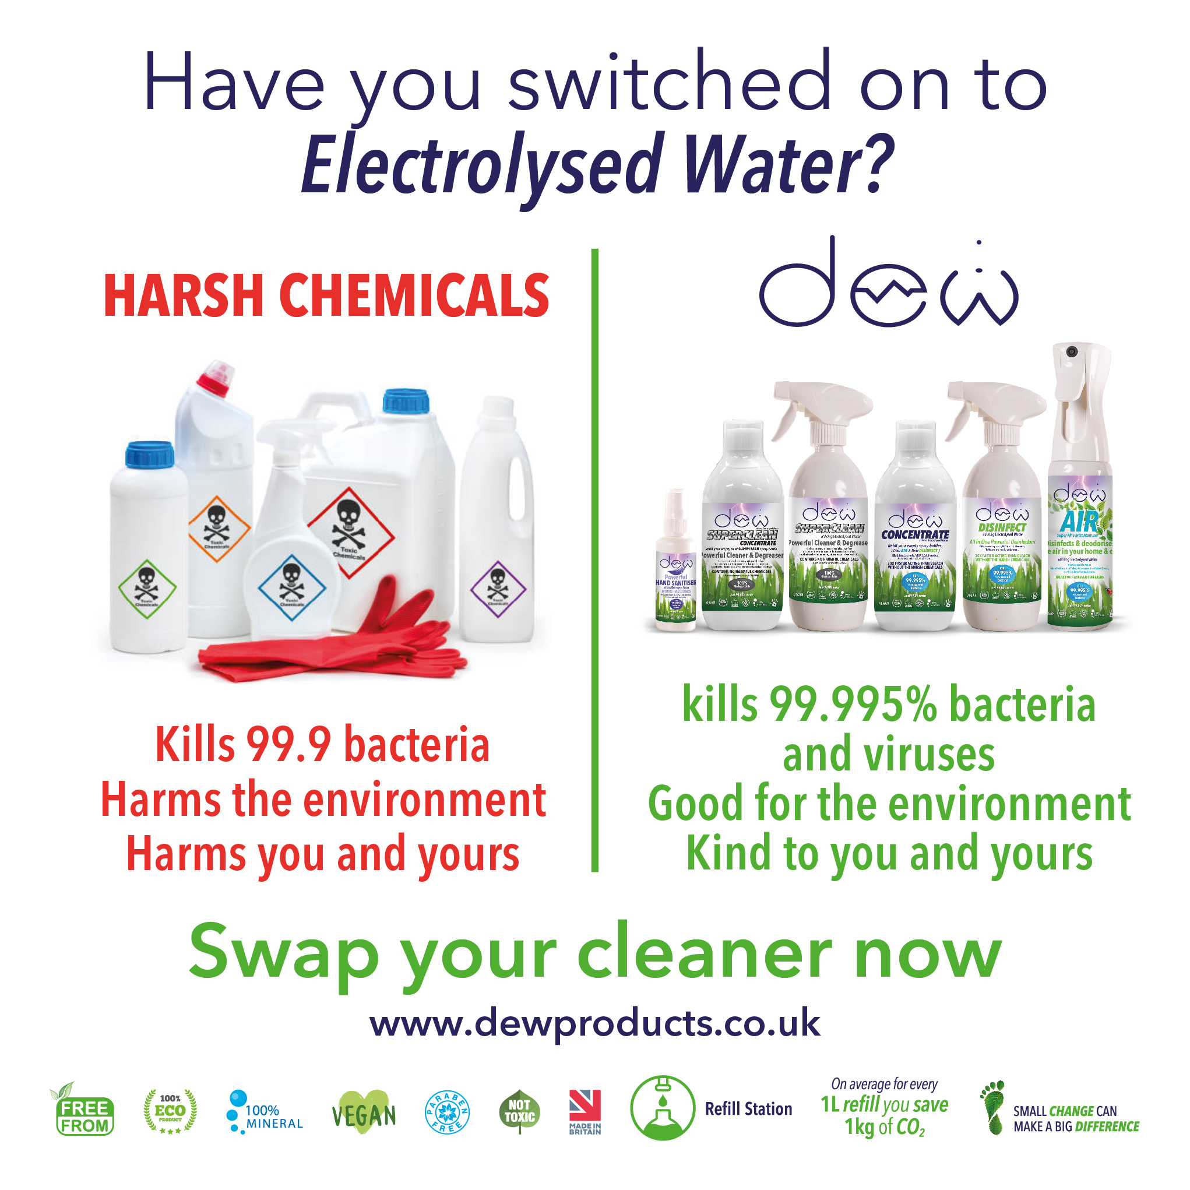

Reduce the use of chemicals
DESTROYING OUR PLANET!

Slide 15
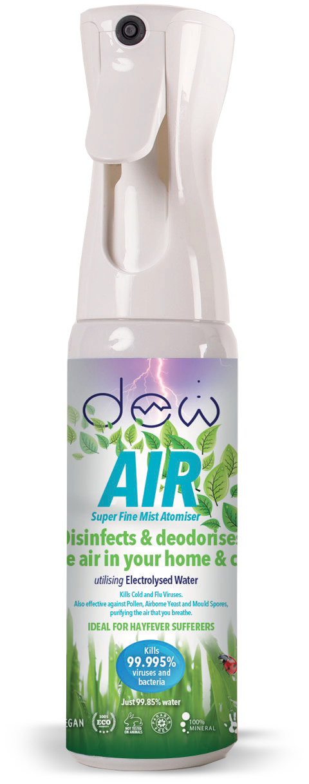
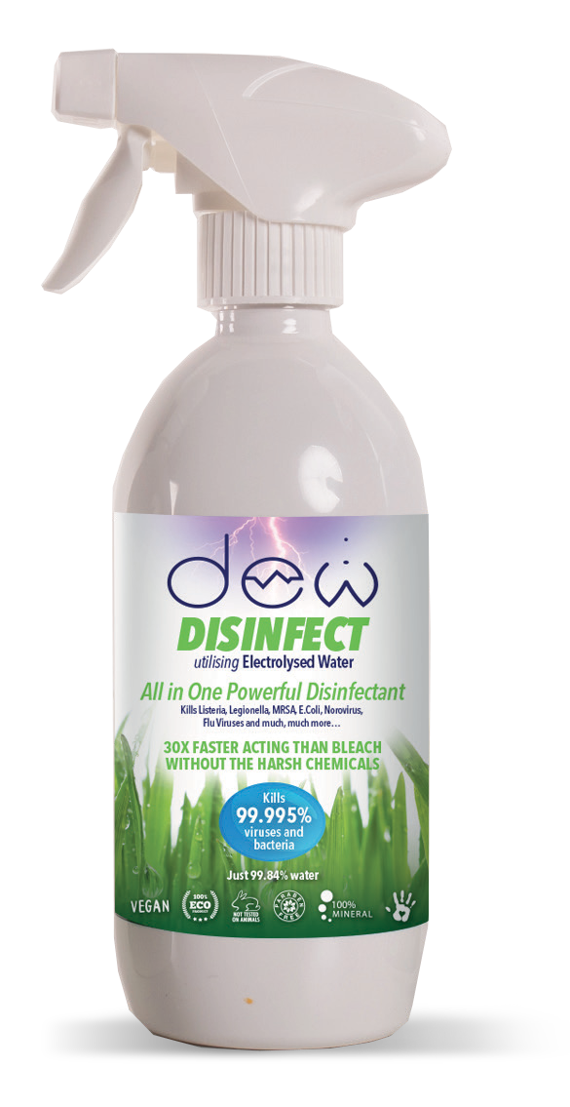
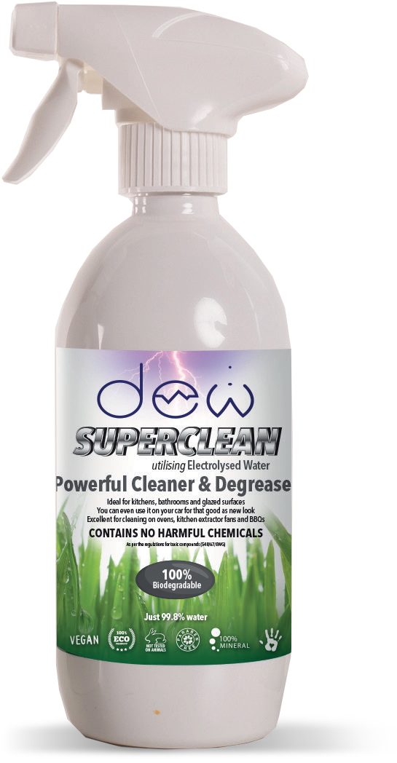
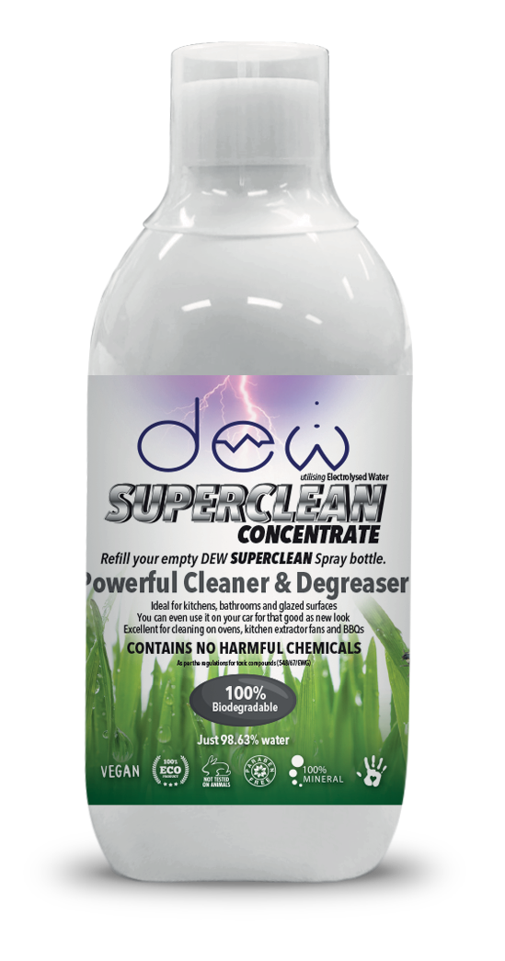
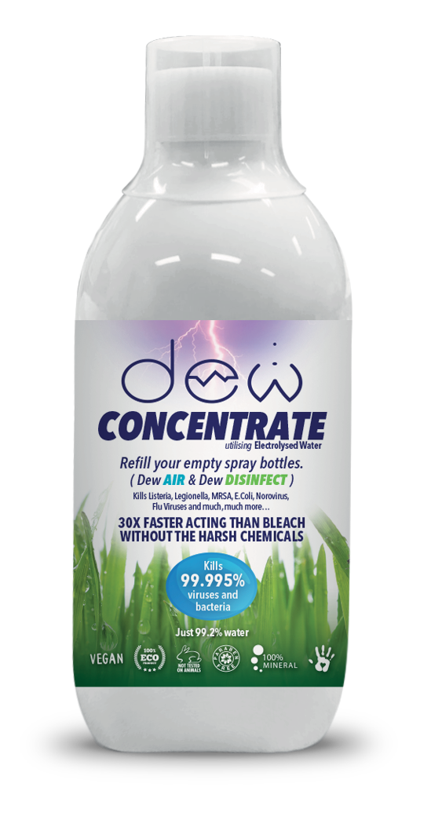
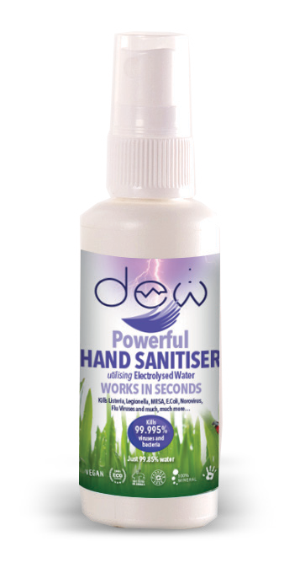
Reduce the use of chemicals
Start using our products for better, safer hygiene at home, at school and in your business or organisation
Disinfect all surfaces safely
Fogg into crowded rooms safely
Not harmful to Humans, Animals or Plants
Help the environment

Slide 16
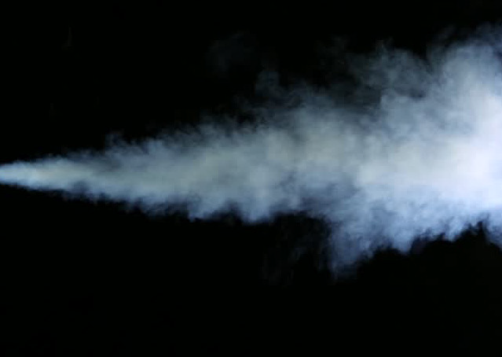
FOGGING SAFELY
Electrolysed Water:
The safest, most efficient, and most effective disinfection available
Kills 99.995% of bacteria, viruses, fungi & spores directly upon contact
Removes bad odours

Slide 17
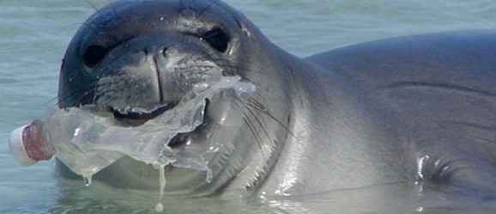
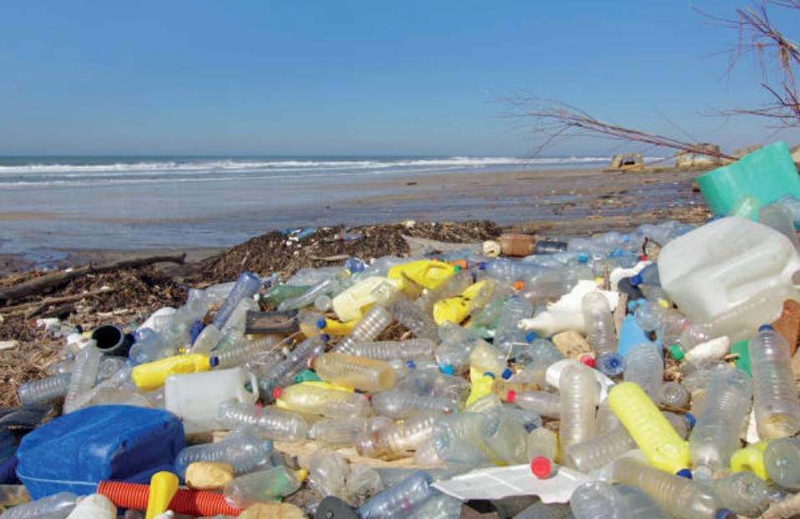
Recycle Plastics
7.7 billion plastic bottles sold in the UK each year
Plastic often ends up in the sea
Recycling helps reduce plastic impact
Re-using plastic bottles is better still

Slide 18

Join the
DEW Community
of
Green Entrepreneurs
and

Slide 19
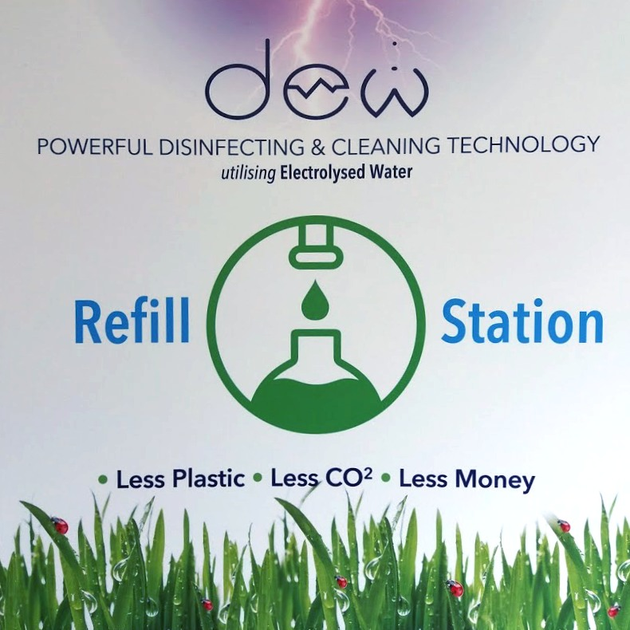
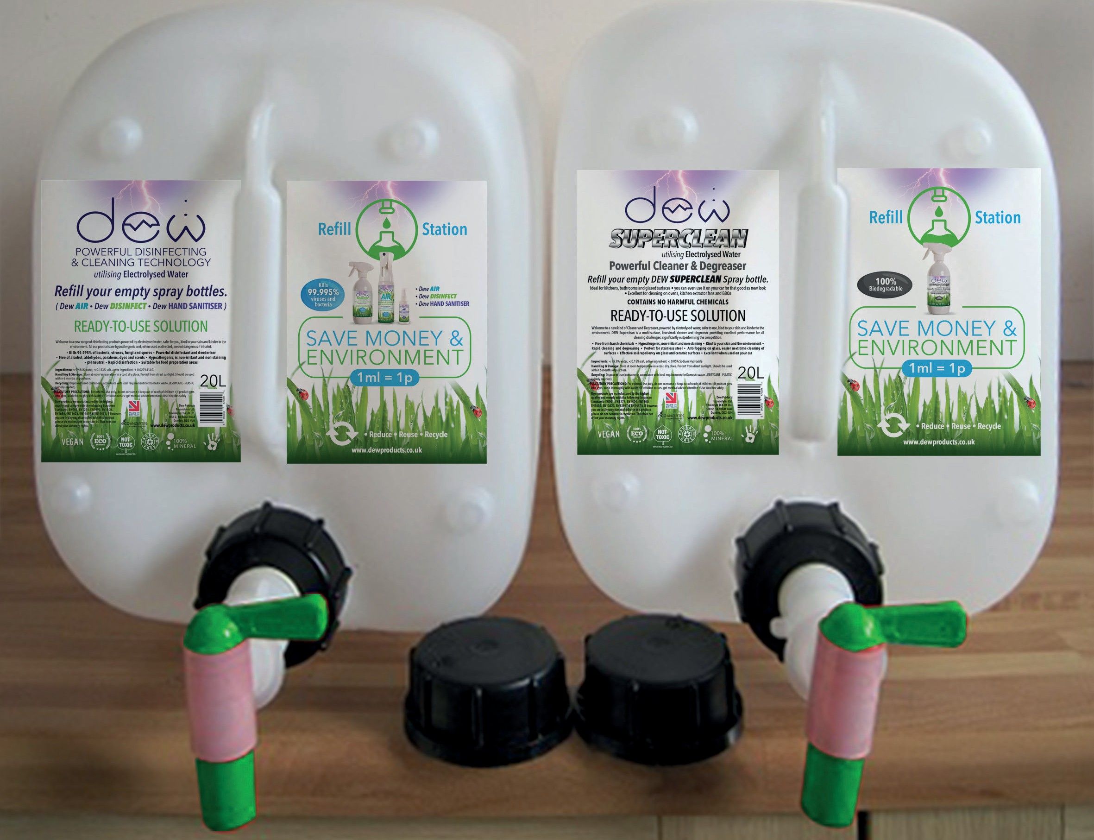
Reuse Plastic Containers
Because DEW products are safe, we are able to locate our Reﬁll Stations almost anywhere
In Schools, the Scouts, businesses and even in the home
Each 20 Litre Refill Station will reduce carbon emissions by a minimum of 16.6 Kg everytime it is emptied
It also saves money
and it reduces travel pollution, because they are located where Children and Parents go anyway
Less Plastic • Less CO₂ • Less Money

Slide 20
HELP SAVE THE PLANET
and MAKE MONEY

Slide 21
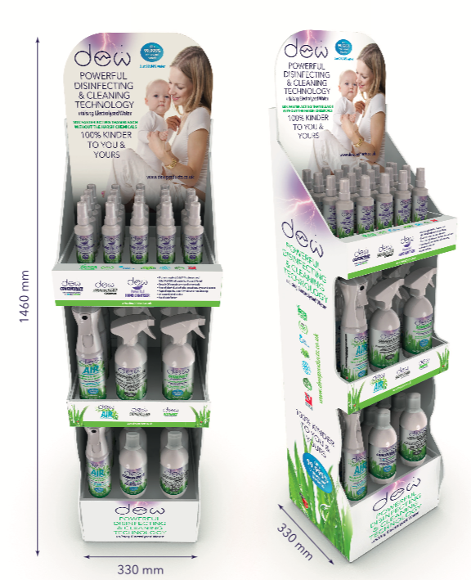
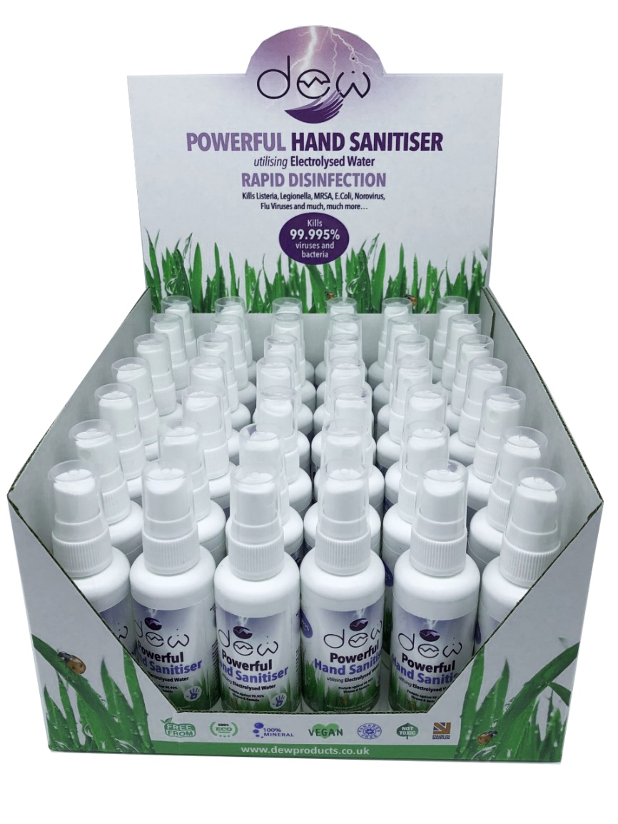
RETAIL
All our products can be safely refilled

Slide 22
THE RETAIL / REFILL CONCEPT
How does it work?
Open to Organisations, Businesses and Individuals
Simply buy our Refill Stations and Products at the discounted reseller price
Sell the products and refills at the RRP to Customers, Employees, Family and Friends
Generate profits of 30% or more

Slide 23
THE CHARITY / REFILL CONCEPT
How does it work?
Open to Charities and Community Groups
Encourage Members, Supporters, Family and Friends to purchase our Products and Refill Vouchers from the DEW PRODUCTS website
We deliver the Products, including where required, a Refill Station to your nominated delivery address
You then deliver to your customers
Generate 30% commission to your funds

Slide 24




DEW A NEW WAY TO RETAIL
SCHOOLS
CHARITY FUND RAISING
ORGANISATION FUND RAISING
BUSINESSES
INDIVIDUALS in fact
Everybody!

Slide 25

Please protect our Earth today for the sake of our future tomorrow

Slide 26


Scotland has been voted the world’s most beautiful country.
- the Guardian
Together let’s keep it beautiful.

Slide 27




Ecoanolytes Ltd.
Unit 2, 14 Nobel Road, Dundee, DD2 4UH
info@dewproducts.co.uk
www.ecoanolytes.com / www.dewproducts.co.uk
dewproducts
dew_products
dewproducts

