Slide 1
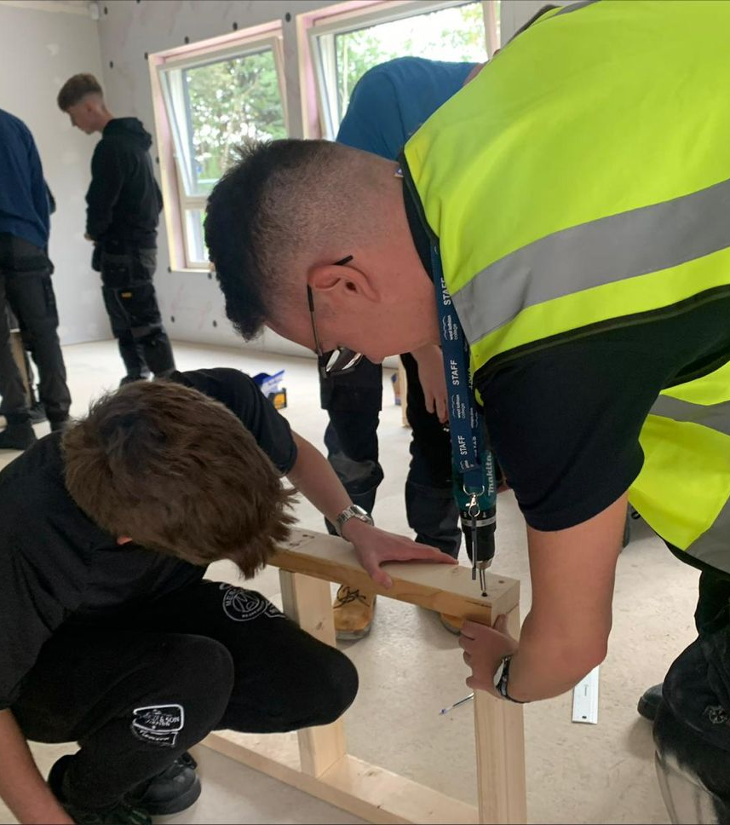
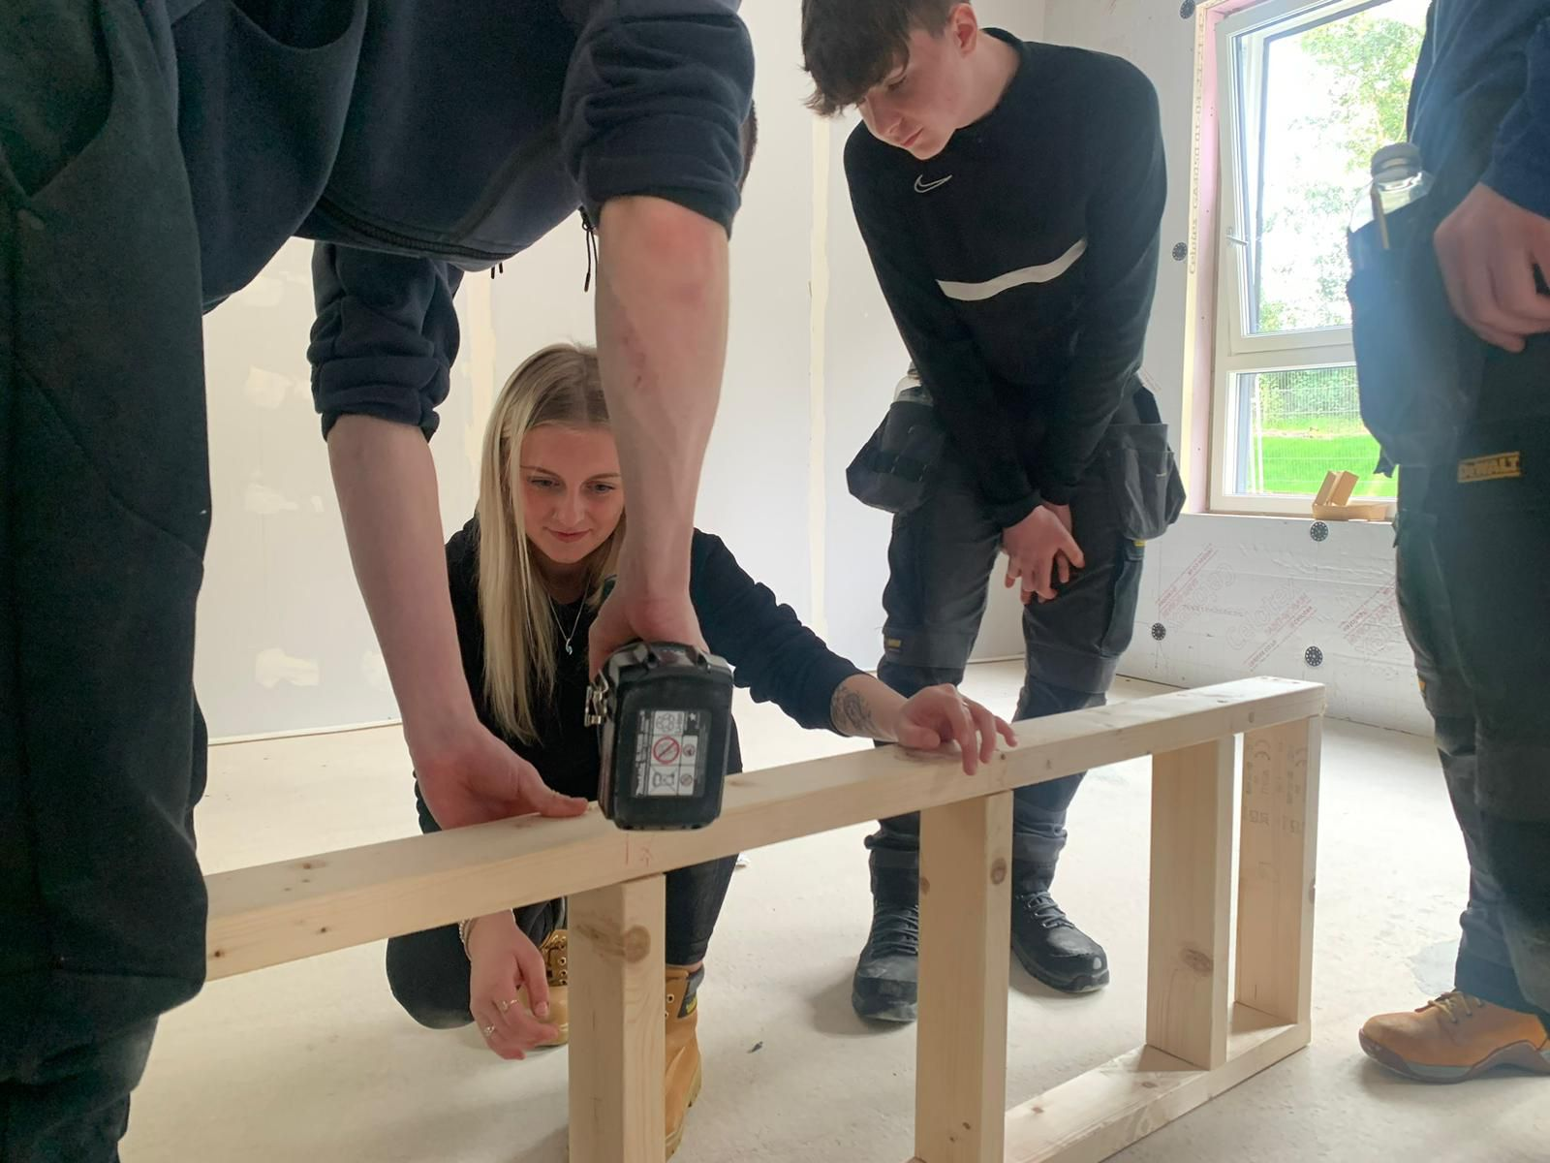
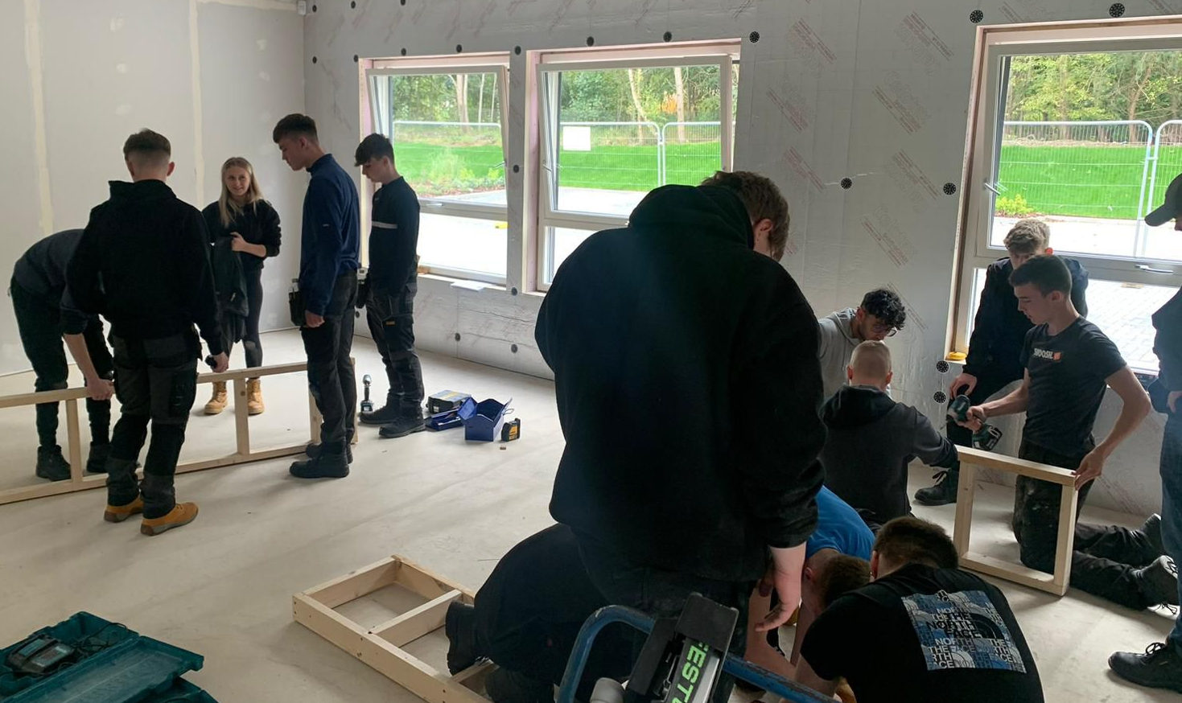

Slide 2
Alex Linkston Skills Centre for Sustainable Living
Opened on 19 September 2023 by
Graeme Dey MSP Minister for Higher Education and Further Education

Slide 3
The ECOHOUSE was one of the projects funded by West Lothian Council using its allocation from the Scottish Government’s Place Based Investment Programme

Slide 4
Eco houses minimise environmental impact while maximising energy efficiency and sustainability
The Skills Centre for Sustainable Living has two houses – a low-carbon house and an unfinished house
This low-carbon house provides sustainable and energy-efficient living solutions and is designed with features that provide platinum, gold and silver level certifications

Slide 5
Low-Carbon House
Built to low-carbon standards with certified air tightness and thermal properties. Triple glazing, solar panels, air source heat pump, heat recovery ventilation and electric car charging
Shell House
Unfinished house for developing skills in a real-life environment to achieve low carbon house standards.
No interior fittings, stud walls or plaster board on walls or ceiling

Slide 6
Passive design
The low-carbon house optimises the building's orientation, window placement and shading to maximise natural light and ventilation, reducing the need for artificial lighting and ventilation

Slide 7
Year 1 Engagement
200 school pupils
150 full time students
50 foundation apprentices
20 teachers
150 modern apprentices

Slide 8
Developing the future workforce
Practical skills development in the unfinished house for courses that prepare students for industry experience and provide real-life settings for data science and engineering projects

Slide 9
Developing the future workforce
Insulation Building Technologies – flooring and wall insulations, preparing for retrofitting and new build
Installation – heat pump installation, solar panel installation, smart controls and EV charging points
Data Gathering and Real-Life Calculations – the low-carbon house will be used to demonstrate Air Source Heat Pumps data gathering and for engineering projects such as air tightness testing and thermal imagery
Mechanical heat ventilation recovery, water bylaws and unvented hot water, and heat pumps

