Slide 1
Dogma – Contaminated Lab Plastics cannot be part of a circular economy
We would argue that they can and must form part of such a system
  Can: Our work will show this
  Must: HE have moral duty to lead in reduction of SUP
Not easy and we don’t have all the answers
Lisa McMillan and Jo Brown – Waste Management TSN 4 May 2021

Slide 2
ENVA Approach - 2018
Both could not continue to bin plastic volumes (University of Exeter estimate 5.5M tonnes plastic per annum)
Summer 2019 – Green light received from ENVA to accept 95% of ENU’s lab plastic items
Influencing waste contract Tender
Lisa McMillan and Jo Brown – Waste Management TSN 4 May 2021

Slide 3
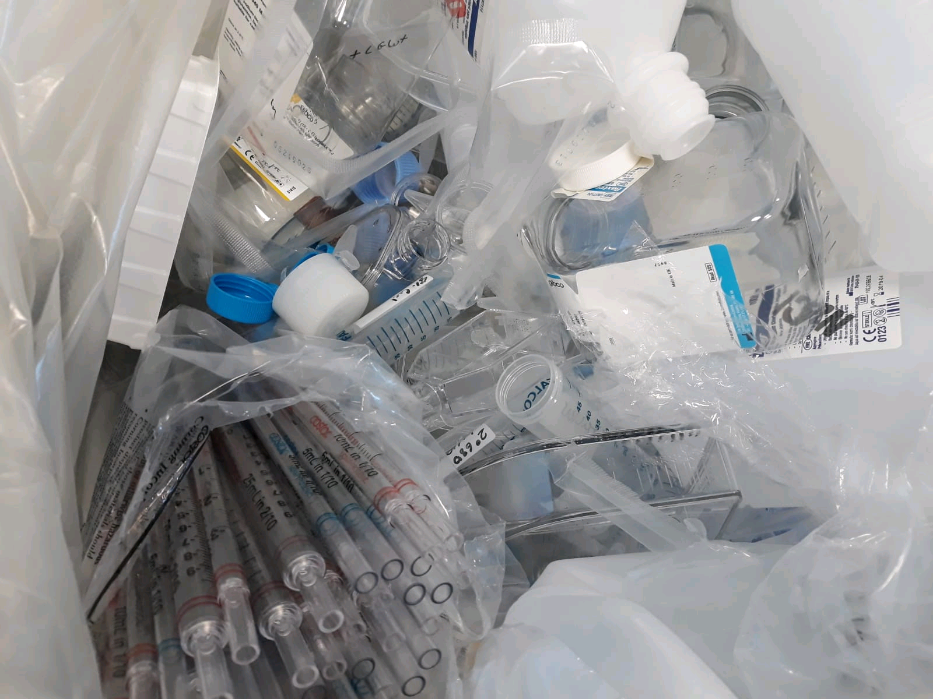
Lisa McMillan and Jo Brown – Waste Management TSN 4 May 2021

Slide 4
Decontamination Protocols
Chemgene 2019-2020
Autoclave work in progress 2021
1.5 tonnes lab plastics recycled to date
Lisa McMillan and Jo Brown – Waste Management TSN 4 May 2021

Slide 5
Take home message – contaminated plastics are not an insurmountable problem
Focus Areas –
  Open up discussions with waste provider
  Consider your waste, what is actually contaminated and/or clinical
Contact – l.mcmillan@napier.ac.uk j.brown5@napier.ac.uk
Lisa McMillan and Jo Brown – Waste Management TSN 4 May 2021

