Slide 1


Slide 2

‘We believe that art should be open to interpretation and encourage any student with an idea to participate. We want to push the boundaries of common understandings of the word ‘art’ and encourage every member of our community to embrace the multitude of interpretations of the word.
Open your mind and take a peek into where we go from here. Experience the new, the fresh, the emerging and the talented world of art from our perspective. After all, we are the next generation.’

Slide 3
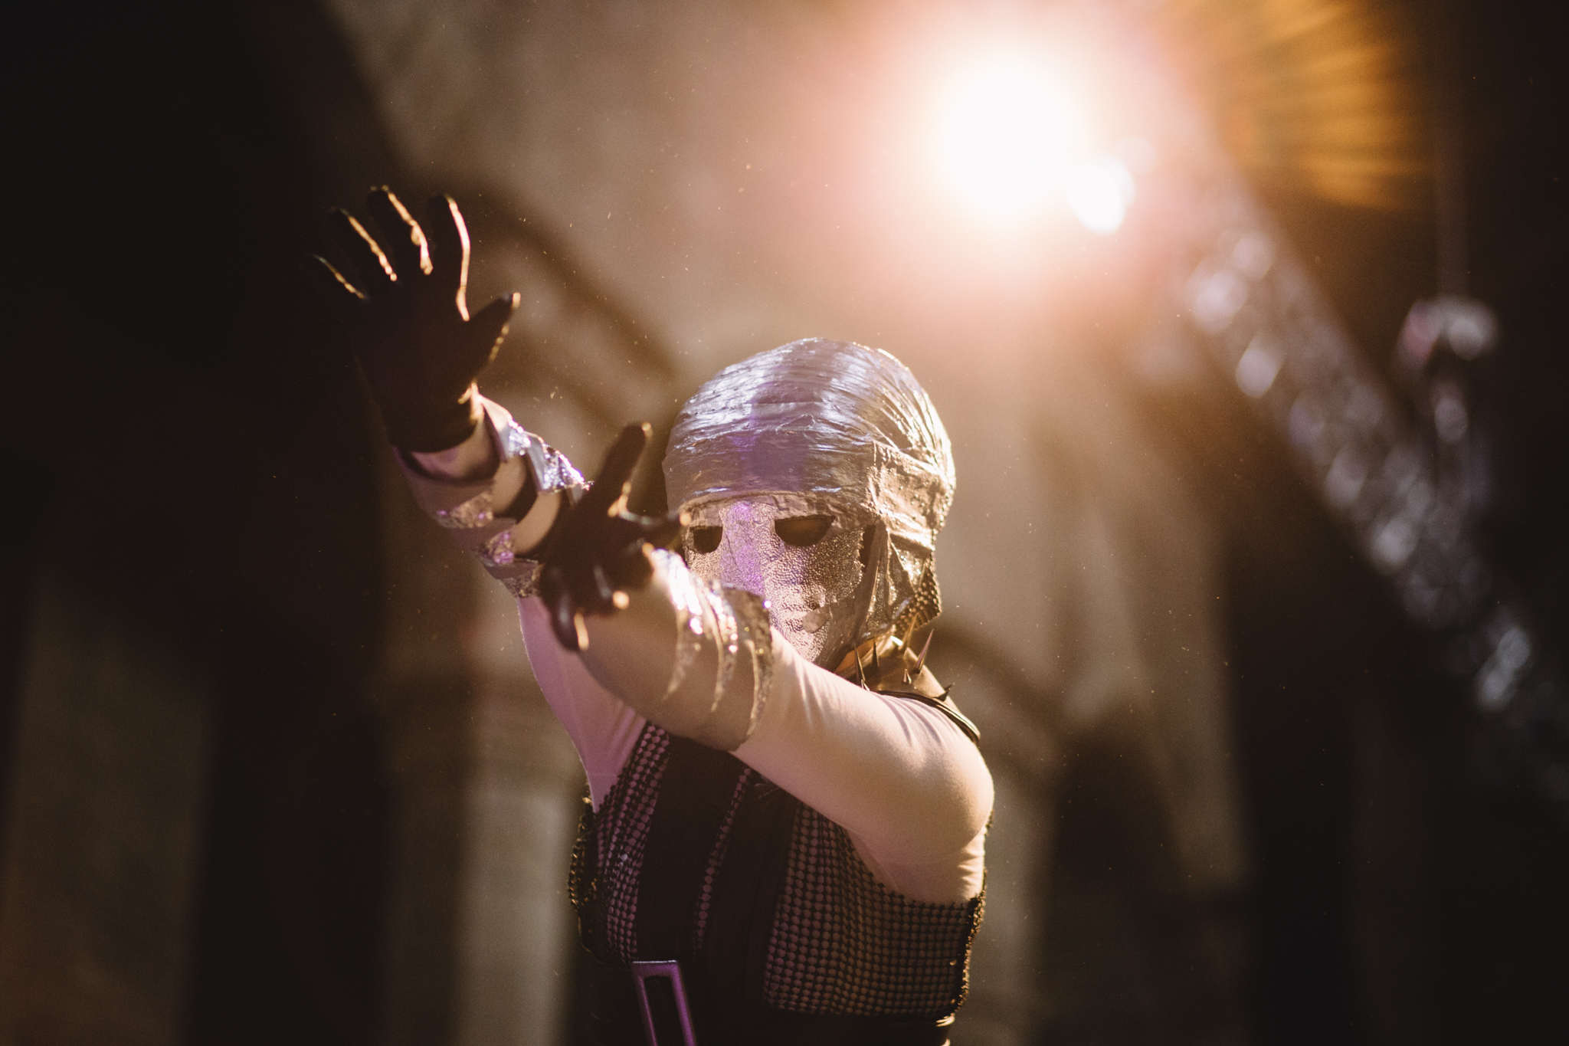

Slide 4
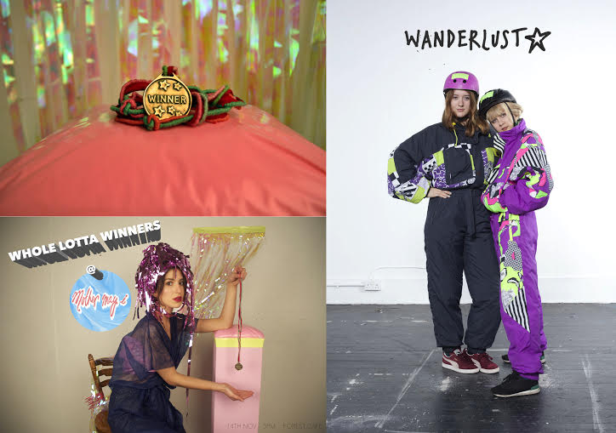

NET WT.

Slide 5
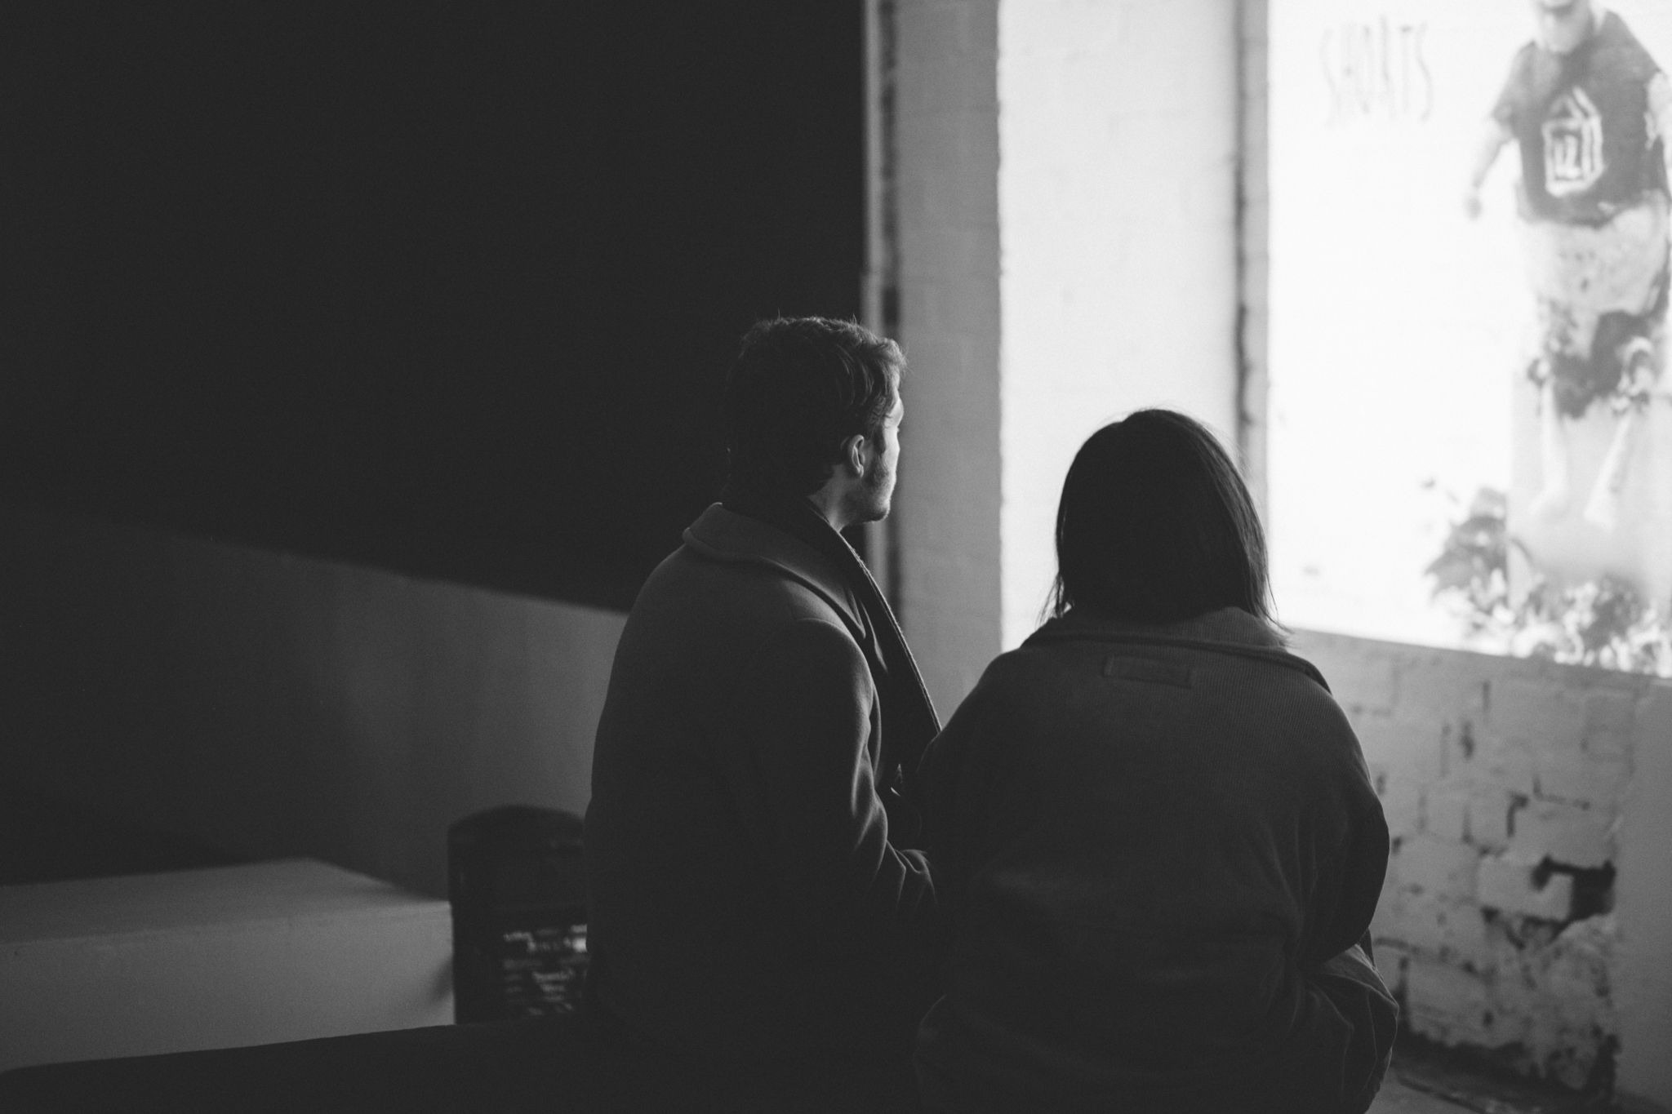


Slide 6
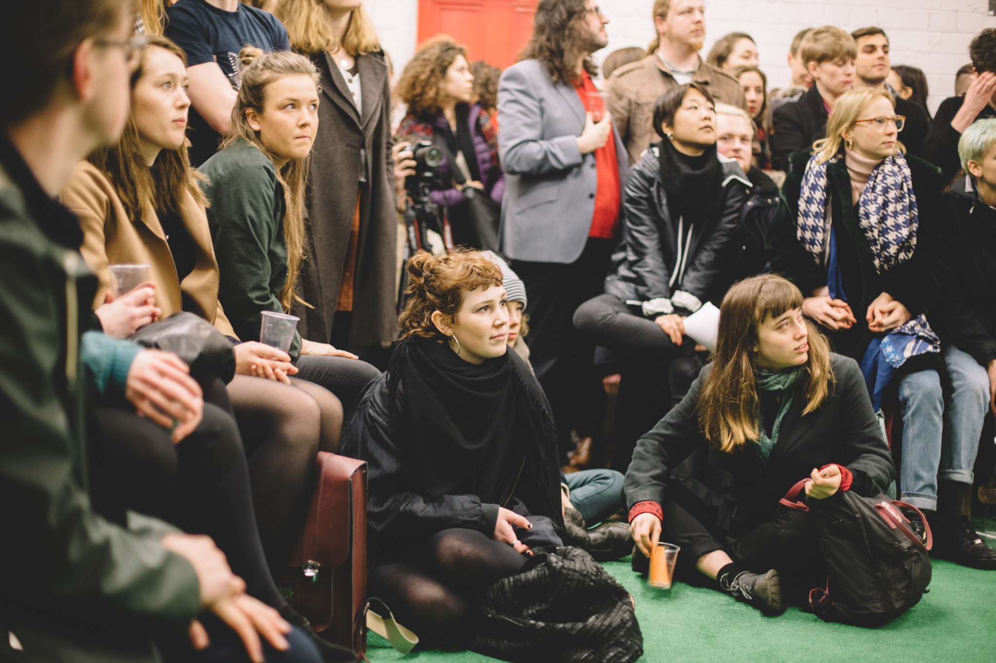

Slide 7


Slide 8
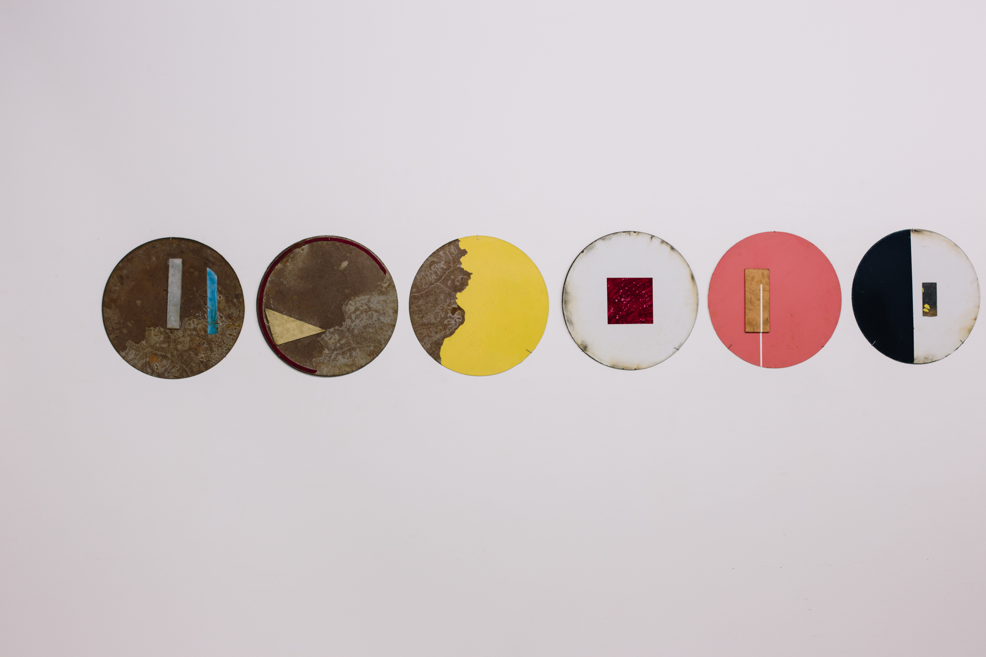

Slide 9
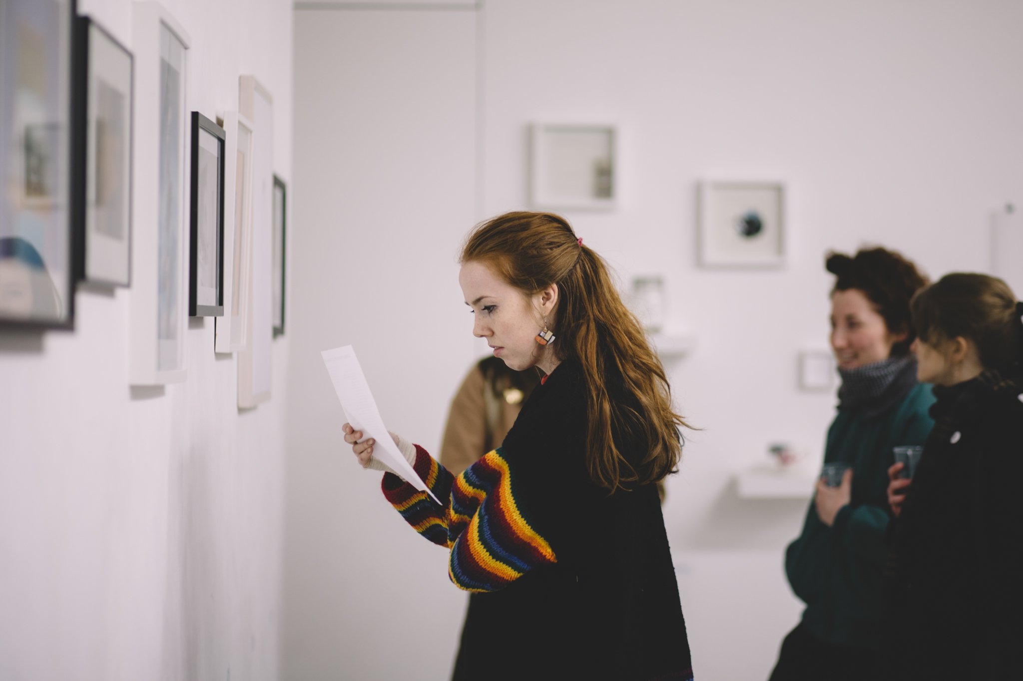

Slide 10
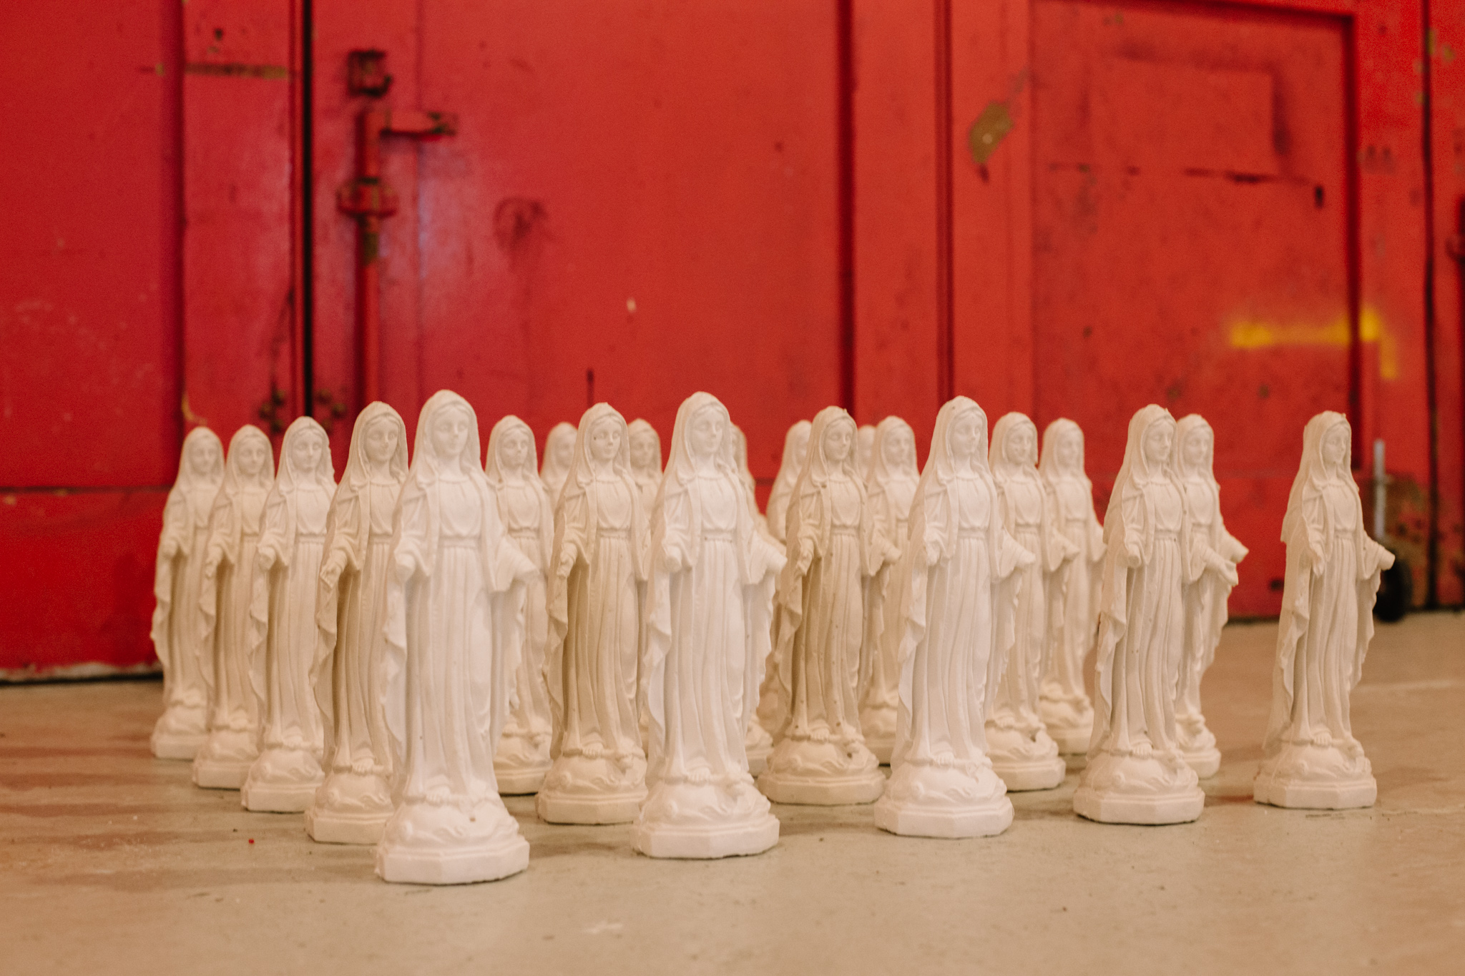

Slide 11
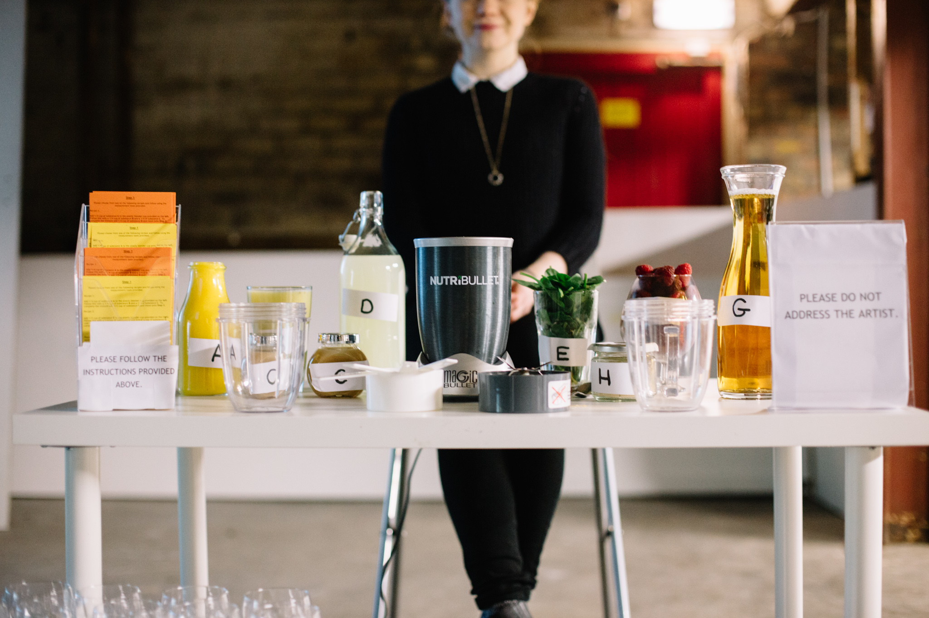

Slide 12
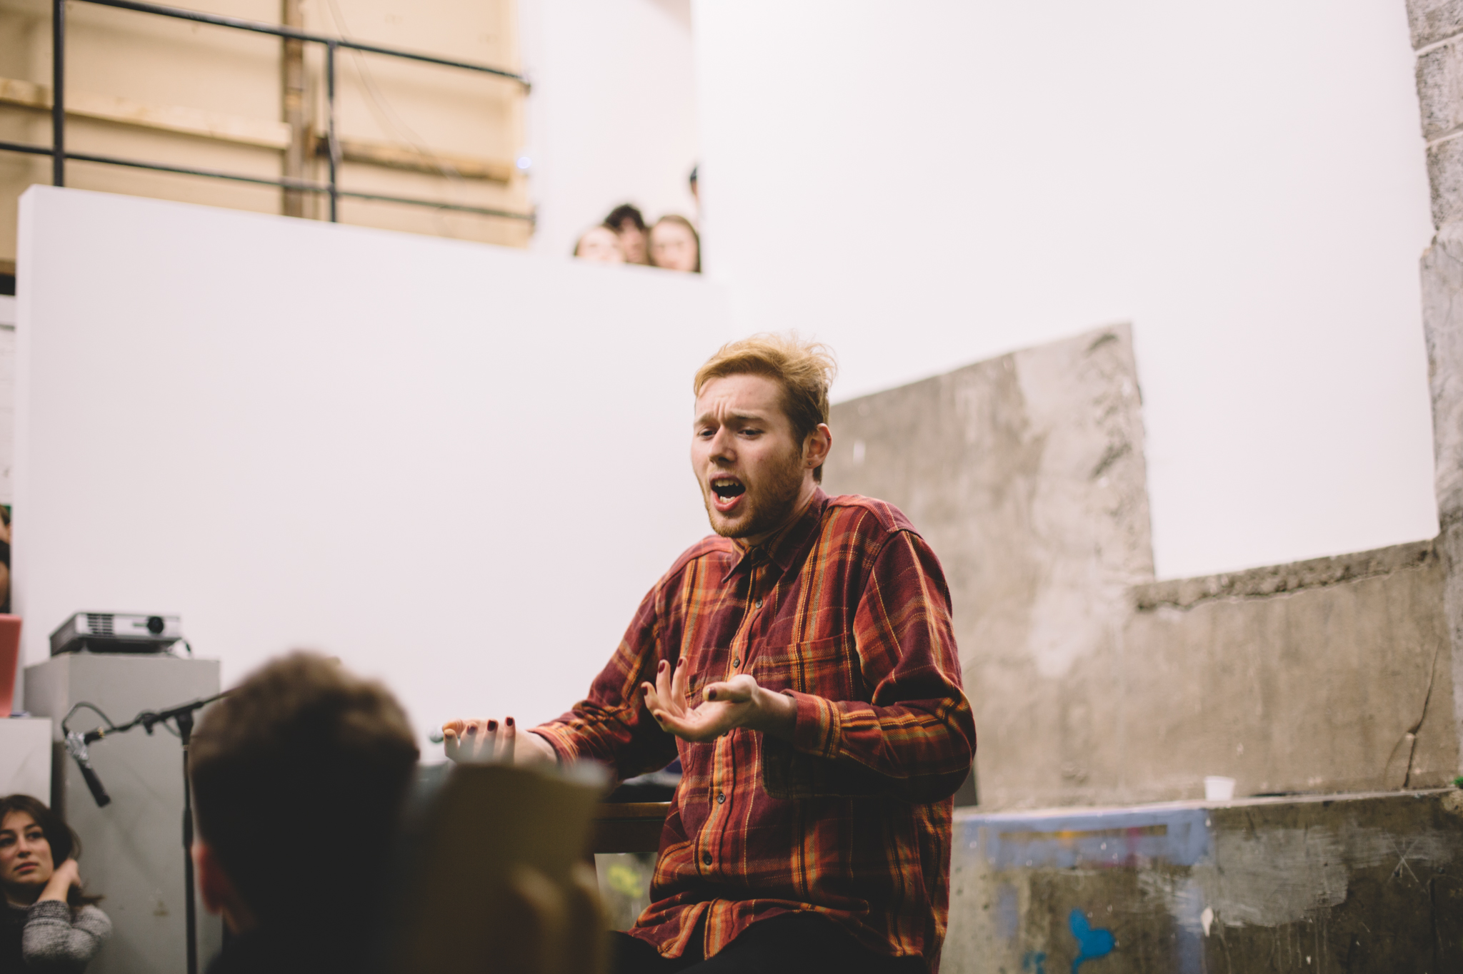

Slide 13
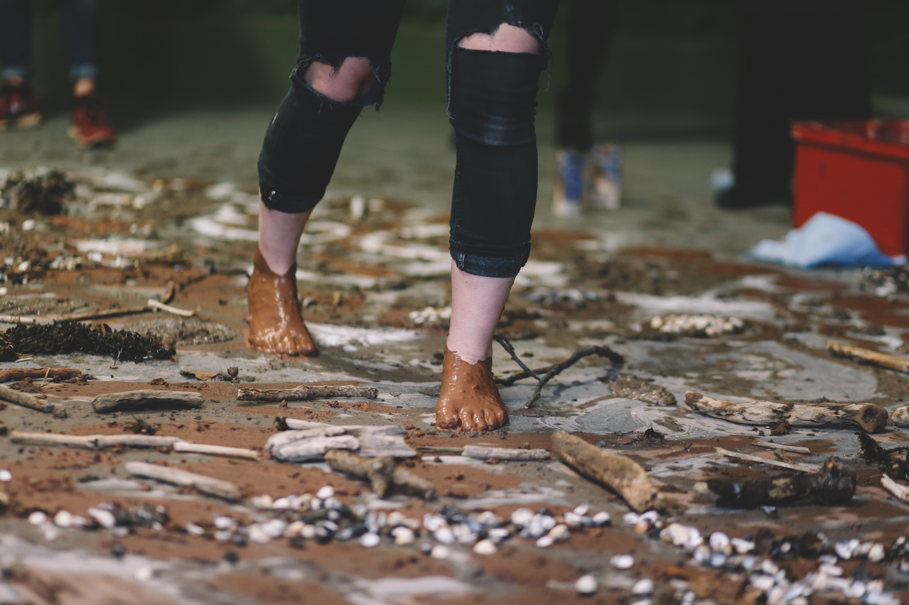

Slide 14
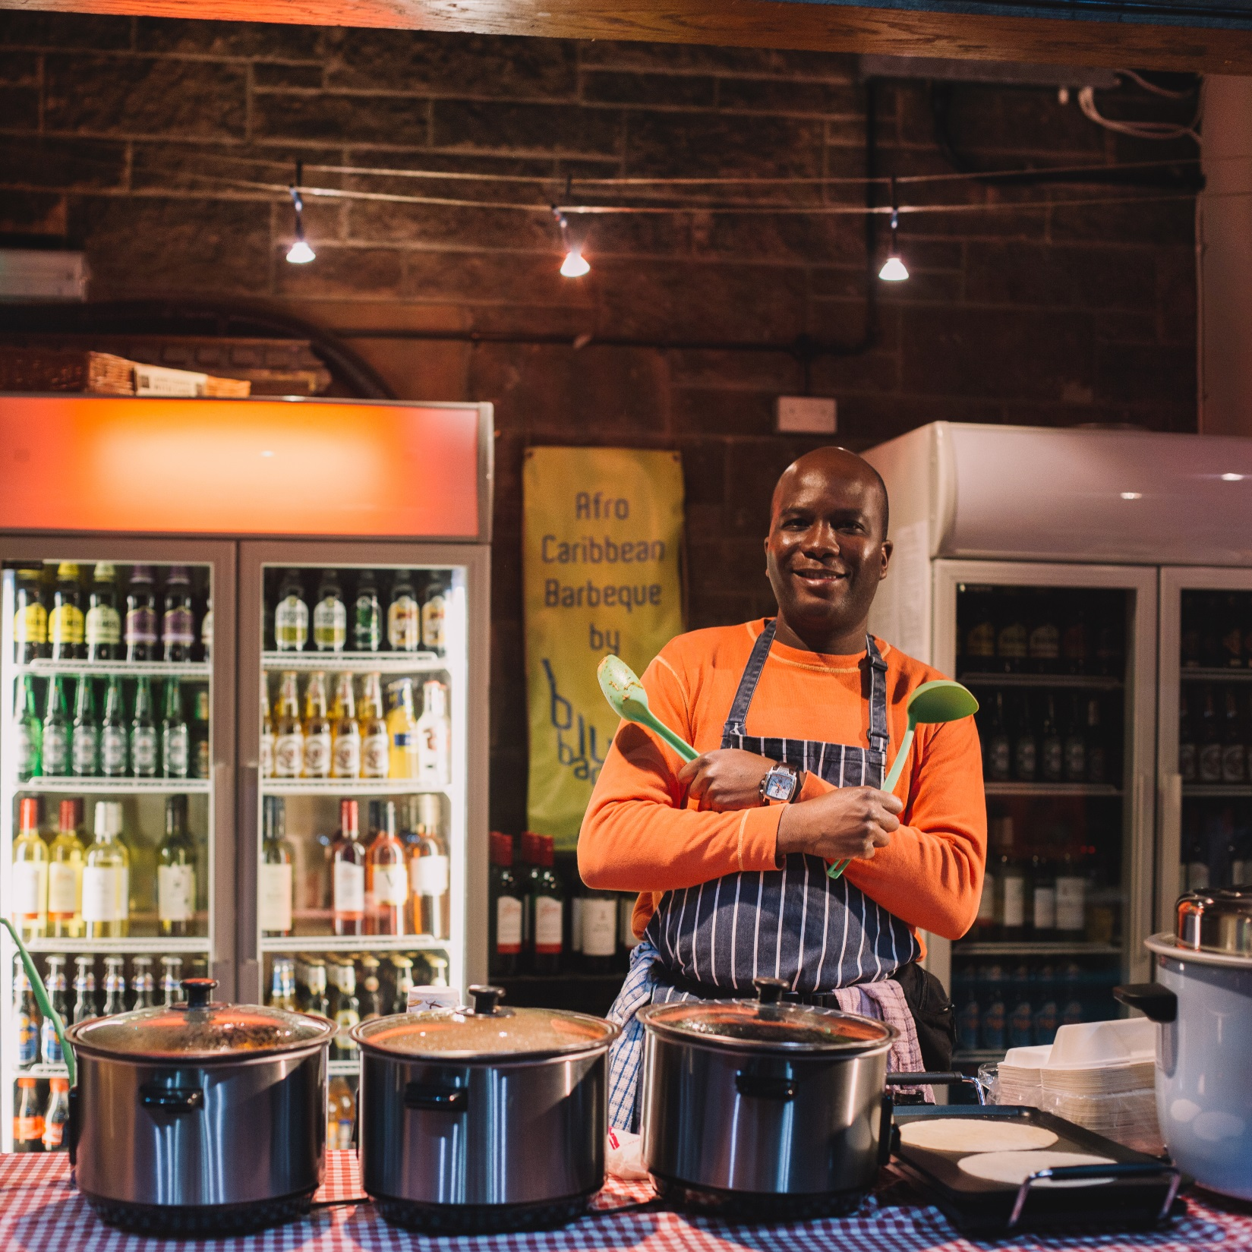

Slide 15
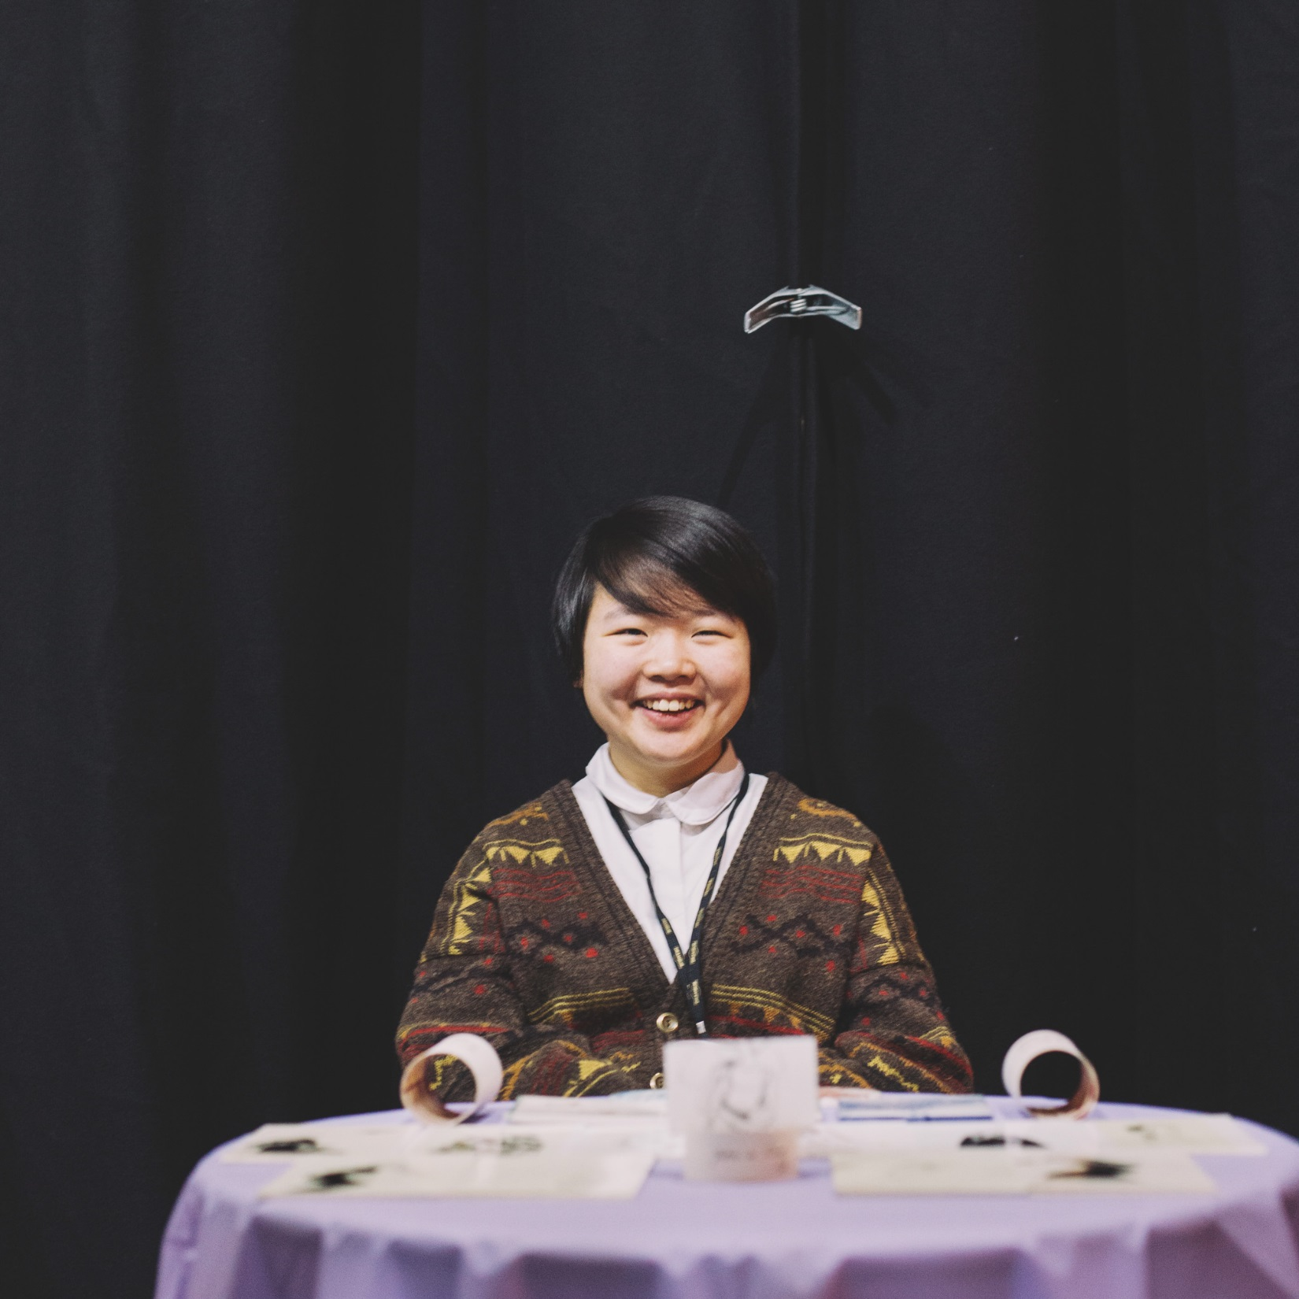

Slide 16
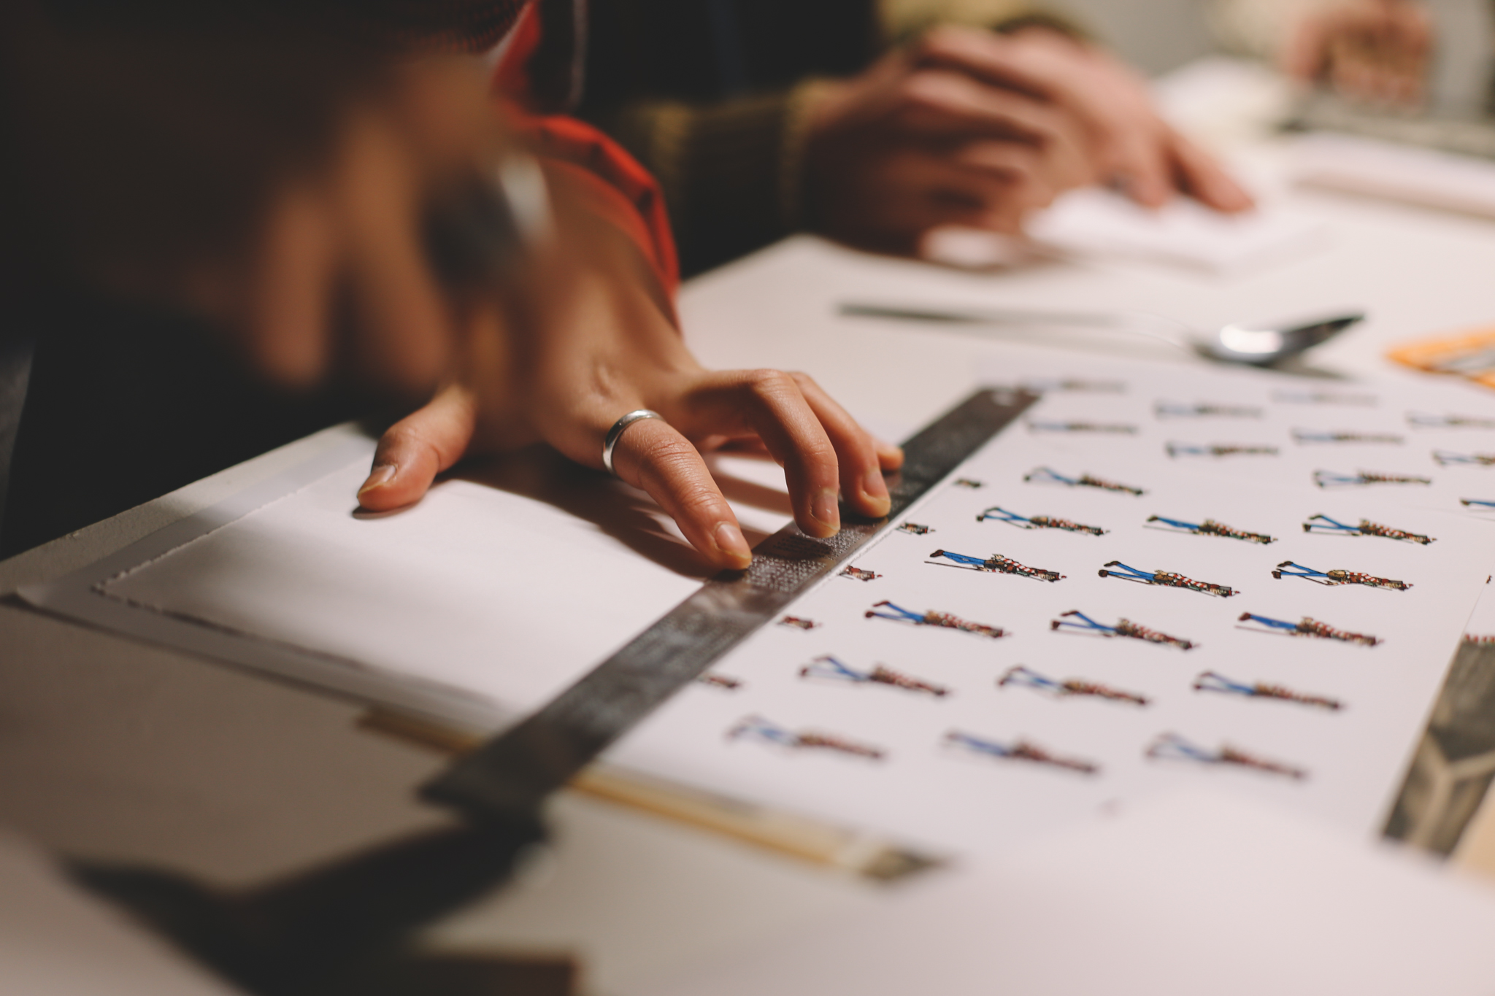

Slide 17
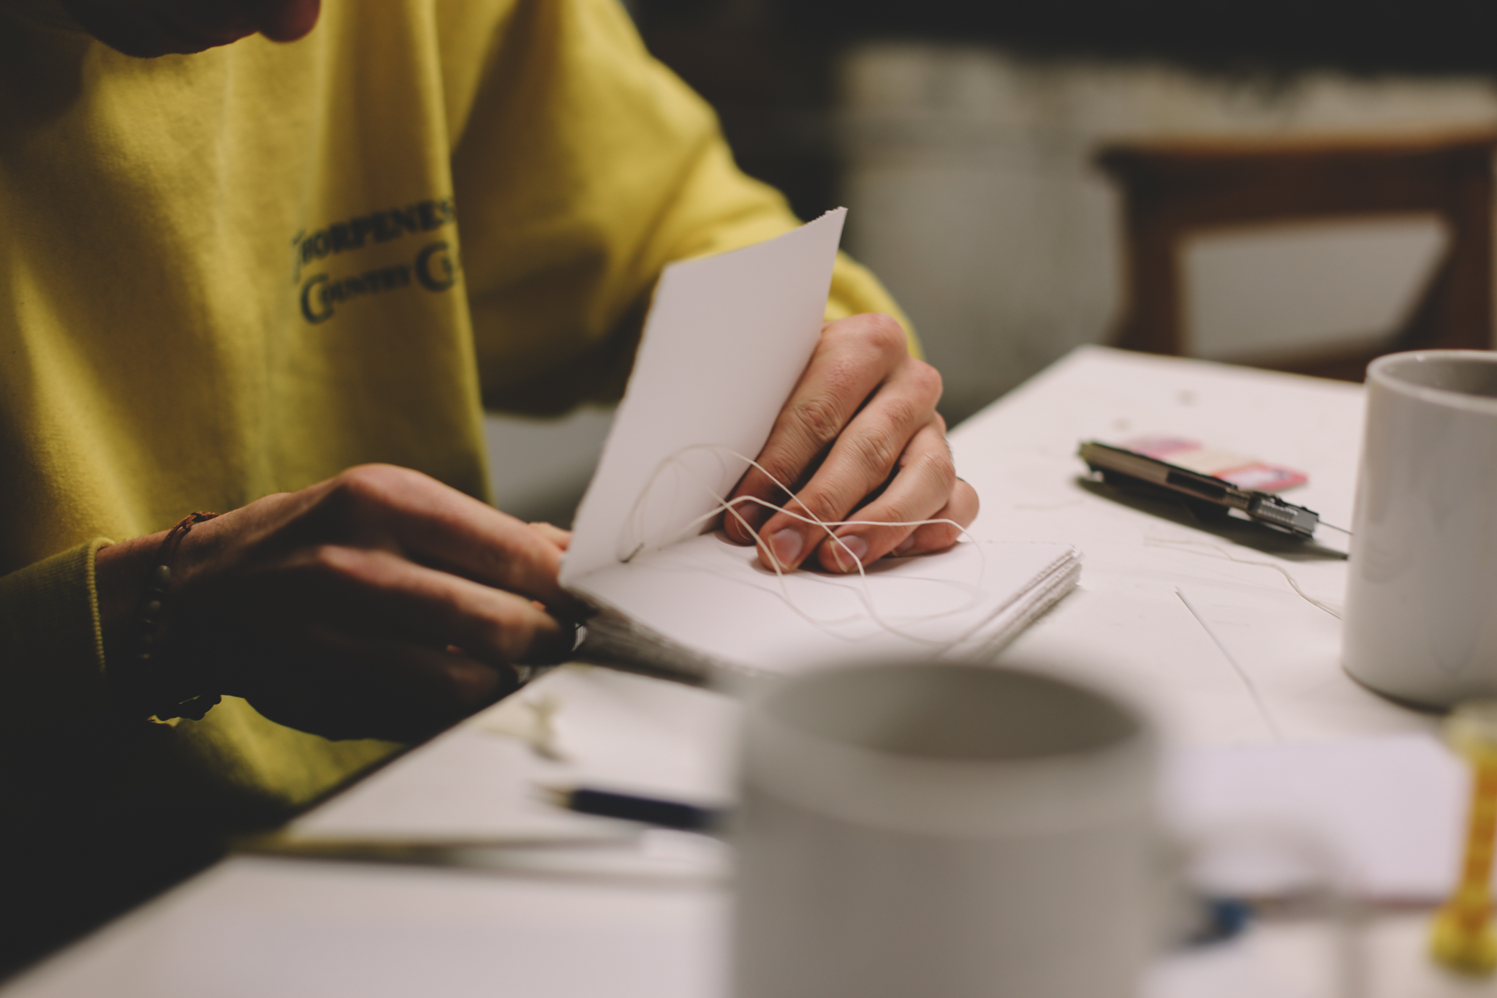

Slide 18
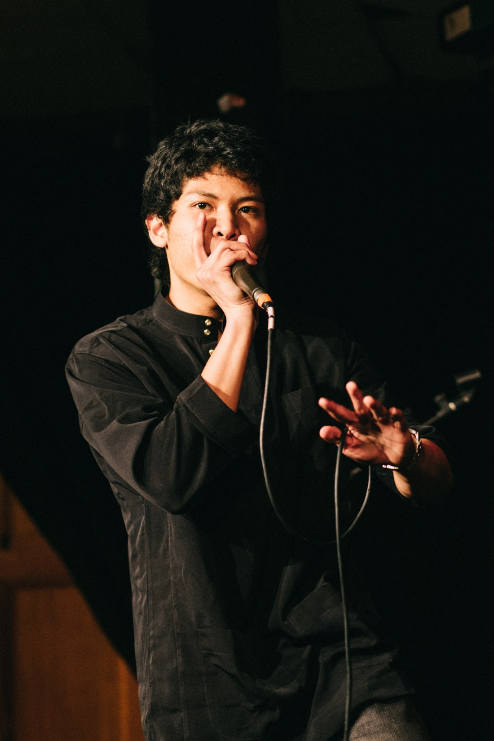

Slide 19
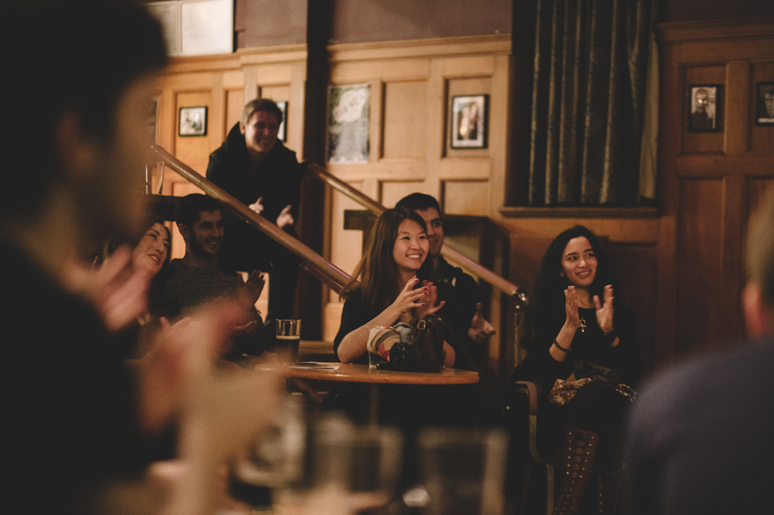

Slide 20
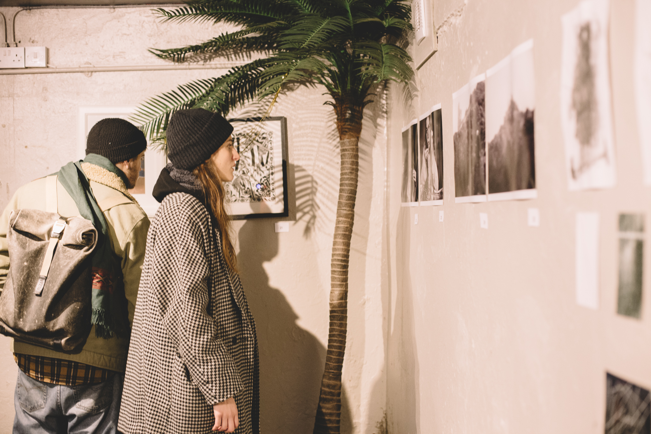

Slide 21


Slide 22
www.edinburghstudentartsfestival.com

