Slide 1
From Critical Thinking to Transformation: Engaging Students Through Practical Projects
Kate Thornback
Environment Officer
Email: kate.thornback@sruc.ac.uk
Twitter: SRUC Environment
Notes:
Text is ranged left

Slide 2
Organisation
6 Campuses, geographically spread across Scotland
Low student numbers
FE, HE and Postgraduate
Notes:
See later slide for Georgia option on title text and diamonds option on background

Slide 3
Advantages
Most students engaged in courses with a focus on practical learning
High proportion of students studying environment/horticulture/agriculture = good awareness of sustainability and the natural world
Upper management supportive
Funding provided

Slide 4
Challenges
No background/culture of engaging students with extra curricular activities
High commitments outside of study
Fledgling student association
Channels for communicating with students underdeveloped
Literacy and numeracy difficulties

Slide 5
Previous Programmes
Externally developed engagement programme trialled in 2012/2013
Too much admin, not enough action!
Competition/winning was not the motivator
Nominees rather than volunteers = disengagement

Slide 6
Development
Gathering student feedback
Fear of over committing
Aversion to greenwash
Priority to make real changes
Want to work with own choices – topics and groups members
Gathering staff feedback
Concerned by the possibility of additional duties
Critical towards extra programme

Slide 7
Key Elements
Simplicity
Low admin
Appropriate for learners of different abilities
Practical
Self selected
Not reliant on staff support

Slide 8

Objective: ‘Work alone or in a group to develop and implement a project that improves sustainability at the campus or within the grounds’
4 steps with simple accompanying feedback sheet
Submissions permissible in writing, scribed or verbal forms
Worksheets can be completed or skipped, where appropriate
Funding application is a real world example

Slide 9
Launch and Communication
Direct to students
Via email, student learning module (Moodle) and face to face
Through education staff
Staff were presented with a slide to show at the end of lectures

Slide 10
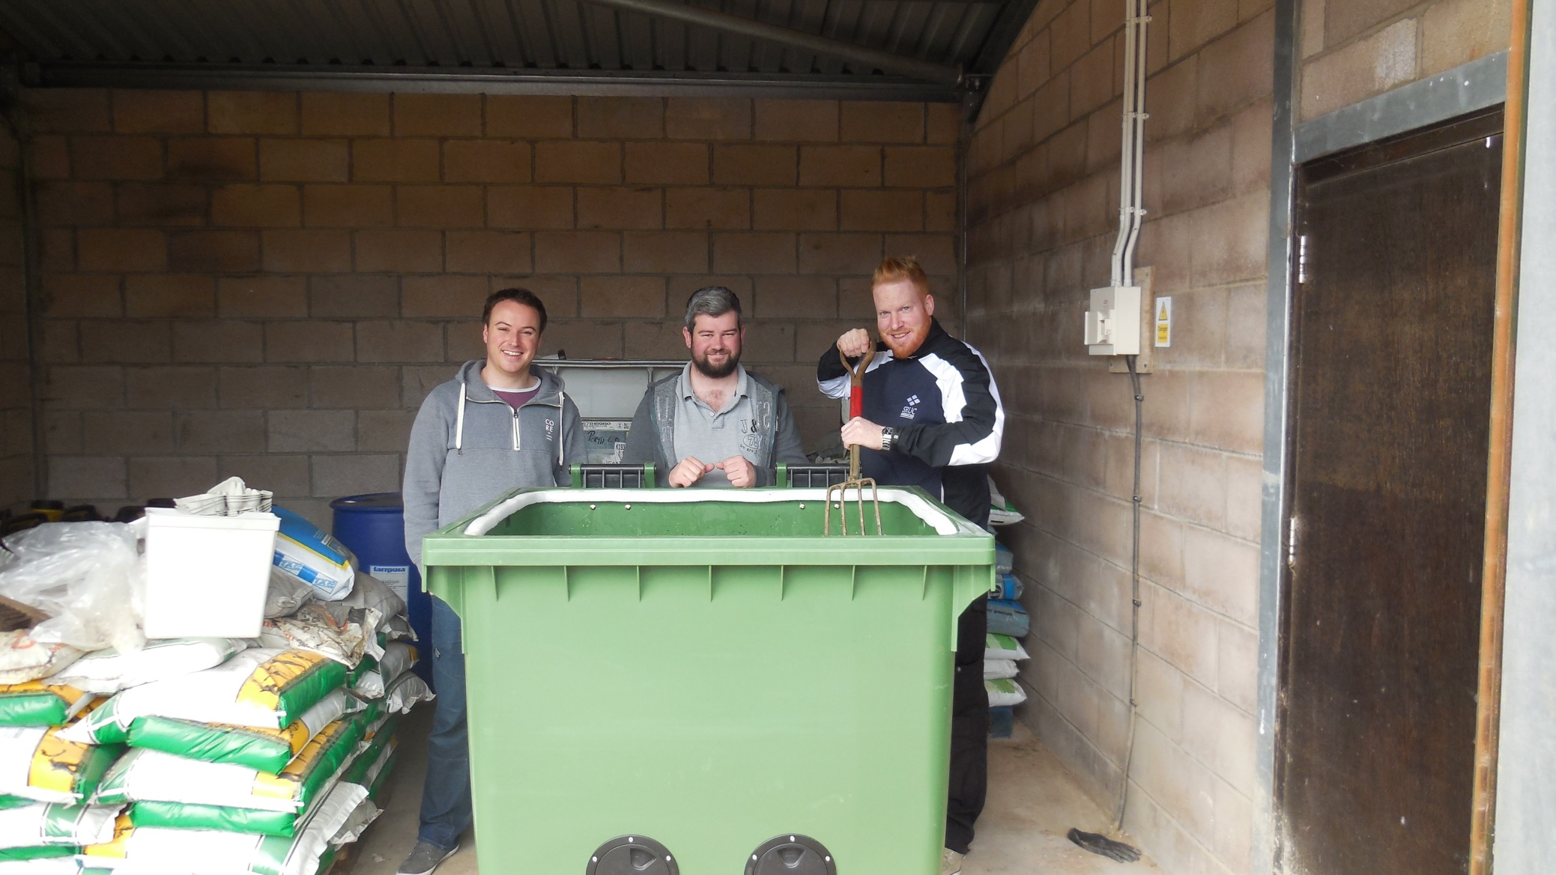
Projects!

Slide 11
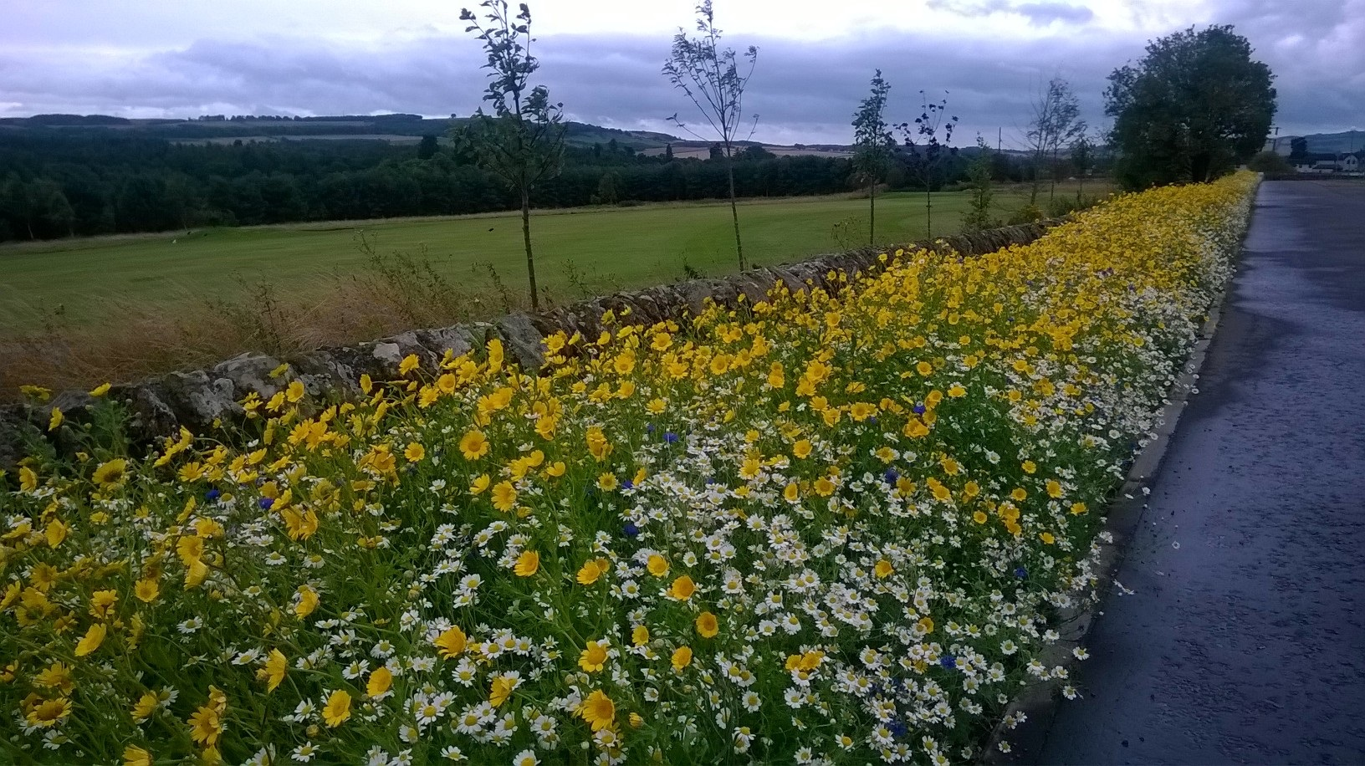
Projects!

Slide 12
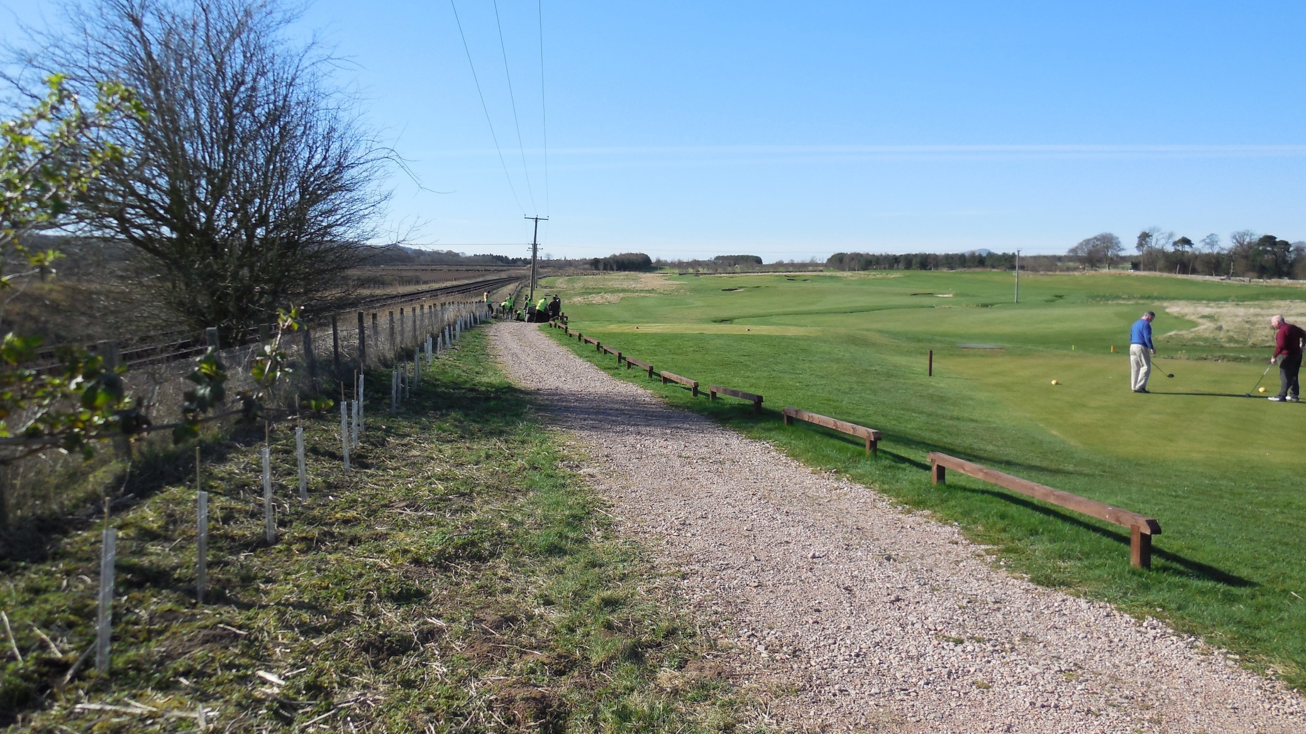
Projects!

Slide 13
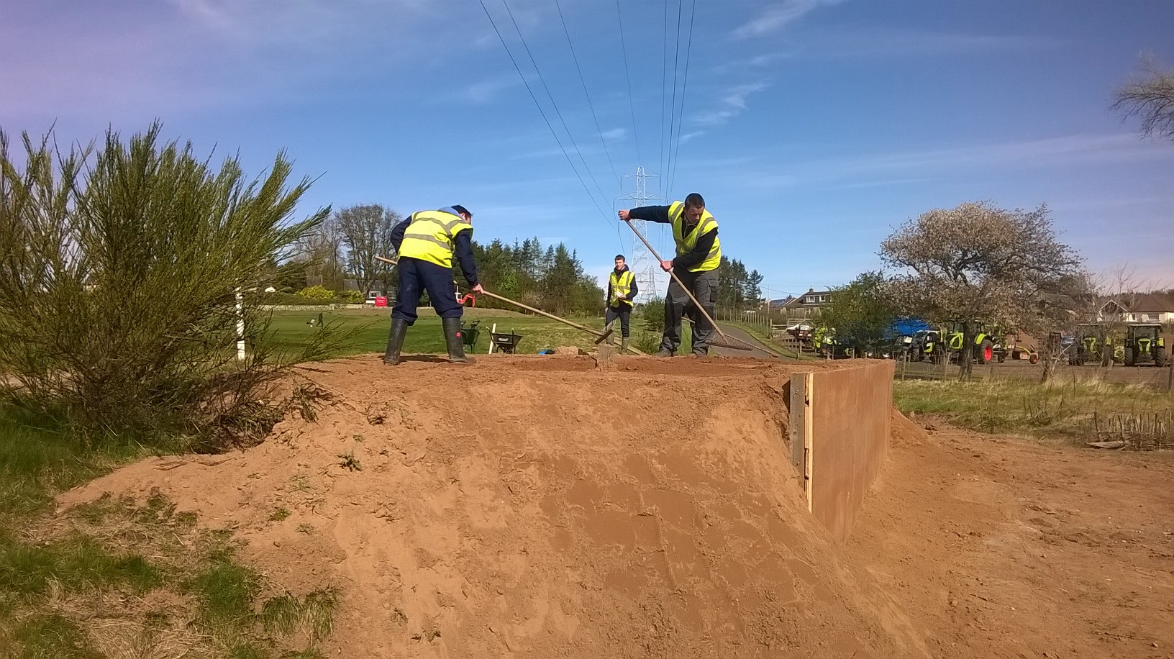
Projects!

Slide 14
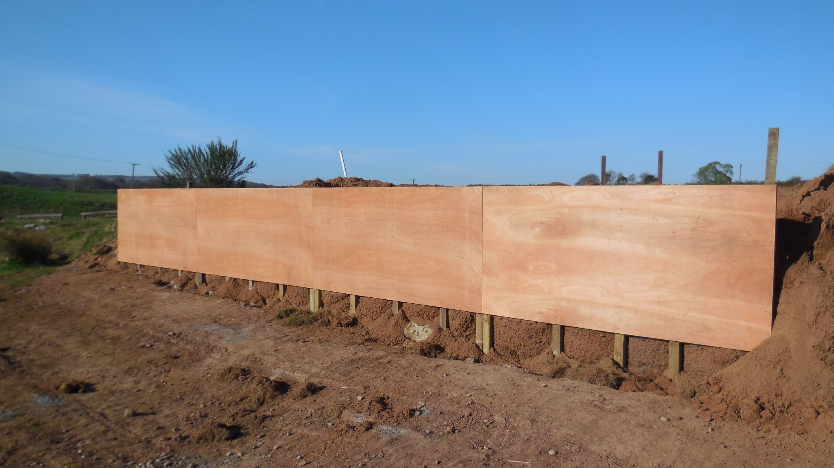
Projects!

Slide 15
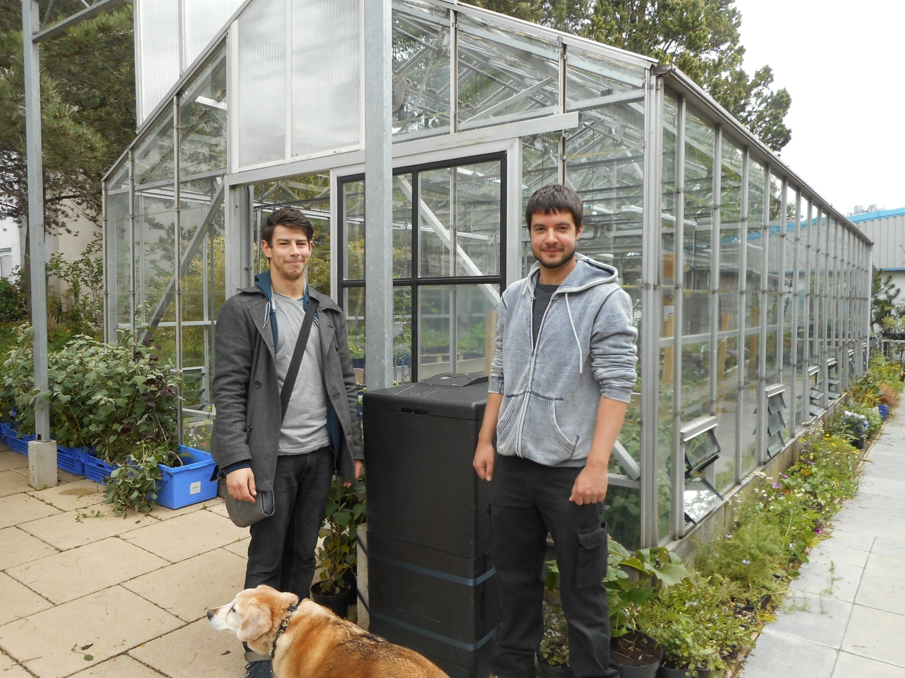
Projects!

Slide 16
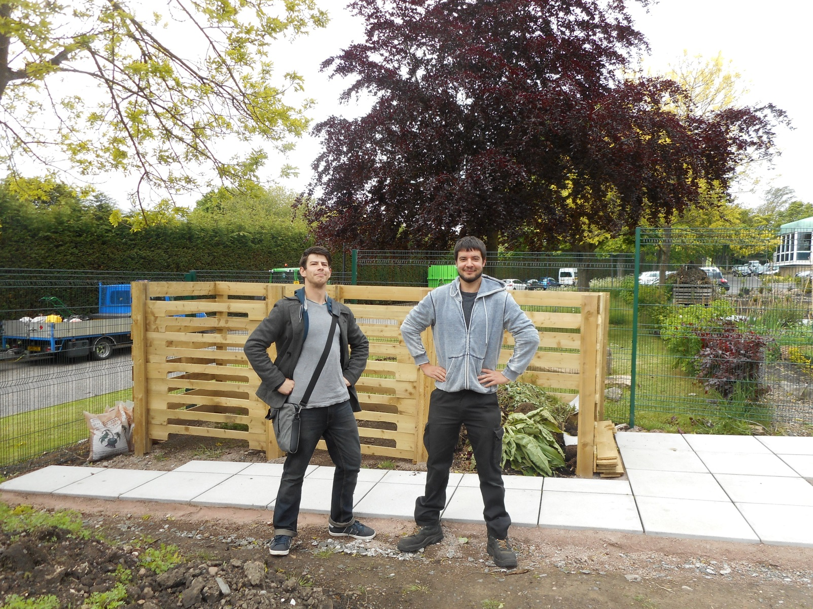
Projects!

Slide 17

Projects!

Slide 18
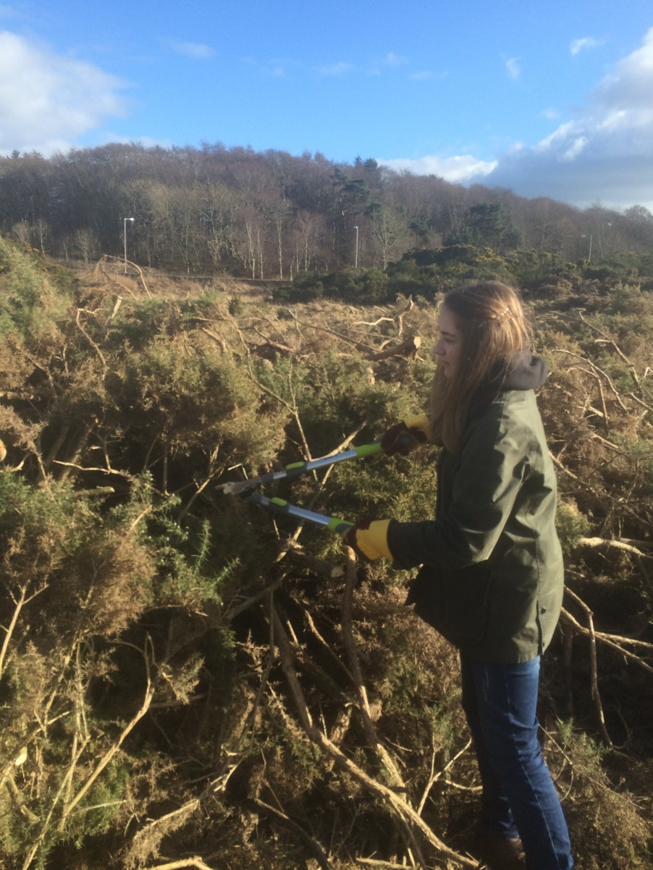
Projects!

Slide 19
Positives
Uptake was strong!
2013/2014 (first year):
11 projects at 4 locations, with 70 students participating
2014/2015:
16 projects at 5 locations with 80 students participating
Supported by the student association
Well recognised internally and externally
Shortlisted for the College Development Network Awards

Slide 20
Negatives
Staff reluctance to publicise/promote
Getting the message to all locations/students
Resourcing
Insecurity of funds – next year’s budget is unclear

Slide 21
Lessons Learned
Communication is key!
Multiple channels (social media, email, learning module, face to face)
Revisit regularly (every 4 - 6 weeks)
Keep ‘musts’ to a minimum
Be flexible – it encourages people to convert from ‘maybe…’ to ‘yes’

Slide 22
Tips!
Leave assumptions behind. Want to know? Ask!
Avoid standardising and embrace difference
Resist the urge to apply pressure! People will participate if they can see value
Be flexible
Be realistic/respectful – students lead complicated lives
Gather and implement feedback

Slide 23
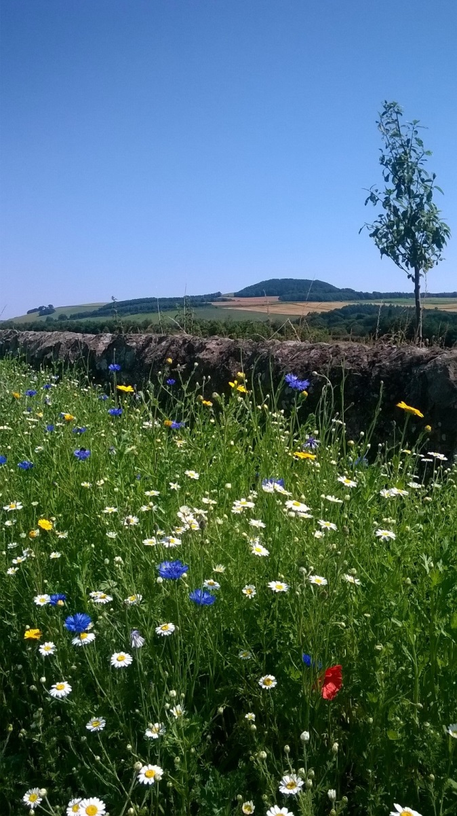
Thanks!

