Slide 1
Developing Green Champions
Environmental Facilitators – why and how
David Stutchfield
Energy Officer

Slide 2
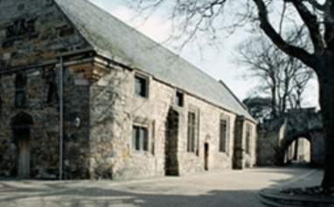
University Estate Overview
149 Buildings
Gross area of all buildings is 253,000 sq m
210 acres excluding farmland
Oldest building is St Leonard’s Chapel (1413)
8,200 students
2,100 staff
£2.8m/yr elec
£2.2m/yr gas
Notes:
Turnover £210m
Gradual expansion of student numbers to 10,000 over next 10 years
Estates expansion £207m over 10 years

Slide 3
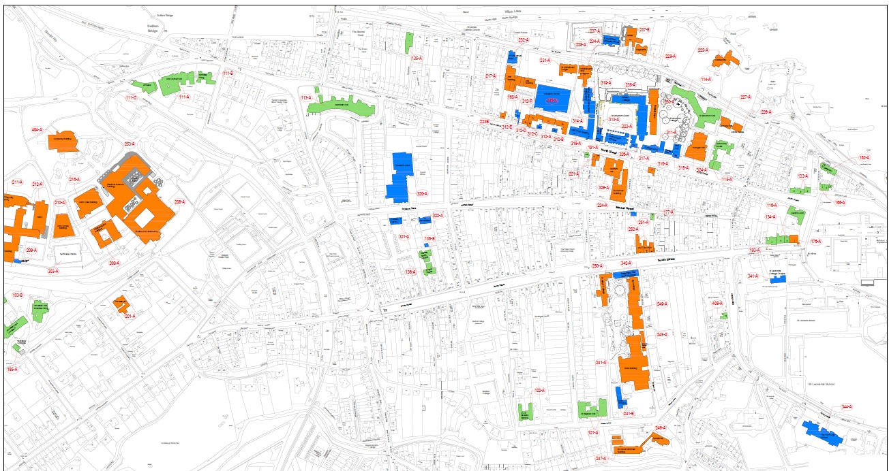
University Estate Overview
Notes:
Long term plan to move all blue service units out and out teaching in.

Slide 4

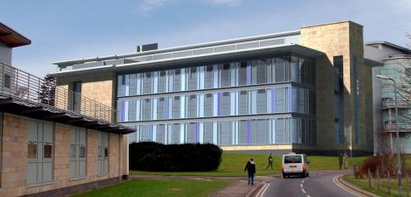


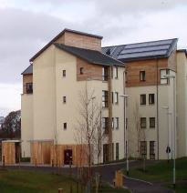


Our Green Achievements
Low Carbon Buildings
Notes:
BMS Annex building - First BREEAM Outstanding building in Scotland and Outstanding laboratory in UK
Green Tourism Gold on all residences open to public in summer
CEEDA gold for energy efficiency of data centre – only public sector body in UK to have this
Salix – largest public sector spend in UK
Fairtrade uni
Transition uni

Slide 5

University of St Andrews and our vision of Sustainability
Carbon Neutral 2016
Zero Waste
Transition University
Smart Buildings
Clean Energy
Conscientious People
Notes:
Our vision sustainability at St Andrews is to be:
Carbon neutral by 2016 – we would be the first University in UK to achieve this
-achieve Zero Waste by 2020 – all the waste we produce is recycled of dealt with properly
-Become a ‘Transition’ University – transitioning to a low carbon way of living.
(received £350k government funding for next three years in conjunction with St Andrews community)
Will achieve this through three part strategy:
-Smart buildings – SALIX funding – largest fund in UK
-clean energy – renewable energy on buildings
-conscientious people – all of us working together to reduce our carbon footprint.
Vision is for sustainability to be at the core of teaching and how we operate, and to be world renowned for our collective practical action and commitment to sustainability.

Slide 6
Behaviour change of staff & students
Environmental Facilitators and training
Hall Environment Reps
Interhall Energy Competition
Transition University of St Andrews

Slide 7
Environmental Facilitators Program (EF)
Carbon Trust Scotland Higher Education - 6 Scottish Universities
Carbon Management Awareness Campaign (CMAC) programme 2011/12
Dec 2011 = Energy Champions
Discussions with CAPOD, School of Psychology
Mar 2012 = Environmental Facilitators
Approved by Heads of Schools and Units
Developed Passport for Environmental Excellence with CAPOD and Carbon Trust - Launch April 2012
Notes:
Current plans for major redevelopment to 800 bed student accommodation and extending Marine science building

Slide 8
Why we went for an Environmental Facilitator Approach…
To harness enthusiastic people!
To give ‘ownership’ for the Environment to more people
To give a better chance of changing behaviour
To build a network that crosses Schools, Unit, Buildings, Roles
To better understand local environmental issues
To improve the visibility of environmental issues
To allow Environmental Facilitators to develop a new skill set
Notes:
As you can see there a lots of things happening already but we really need staff on board to help us take this further. The Environmental Facilitator approach is about building a network of green activities, people and actions that crosses all schools,. Depts. and units – holistic approach – inclusive – to encourage behaviour change.

Slide 9

The role of an Environmental Facilitator
Reducing energy consumption through ‘smart’ workplace operations
Reducing the amount of recyclables going to landfill
Reducing the amount of overall waste by promoting reuse
Reducing water wastage
Promoting and advising on sustainable work travel options
Encouraging sustainable purchasing
Notes:
So we have talked about the green credentials of the University and about the role of an ef but part of being an ef is to gain a new skill set and this is provided by passport to environmental excellence

Slide 10
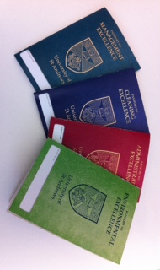

Passport for Environmental Excellence
Part of a suite of training courses developed by our central organisational development centre.
Notes:
Current plans for major redevelopment to 800 bed student accommodation and extending Marine science building

Slide 11

Support for you in your role
5 strands
18 months
2 ‘Flying Start’ workshops
Core and Optional workshops
12 hours of development time
30 mins per week in the role
Support from line manager

Slide 12

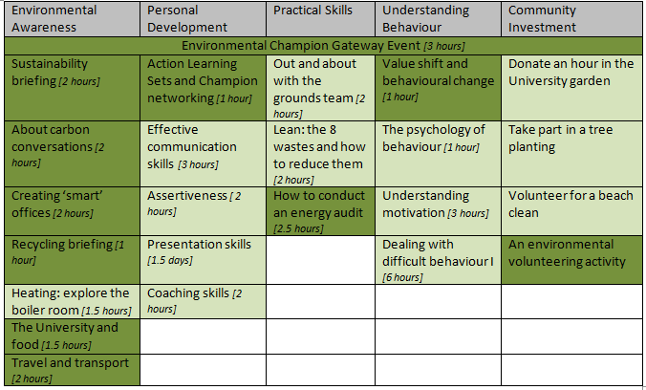
Passport for Environmental Excellence

Slide 13
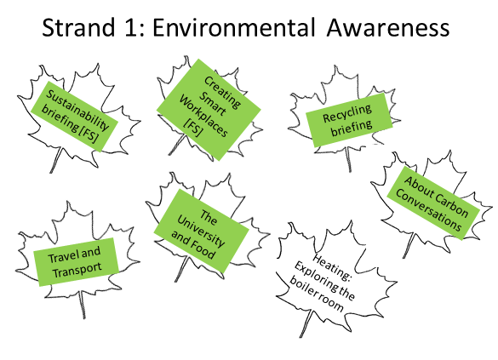
Passport for Environmental Excellence

Slide 14
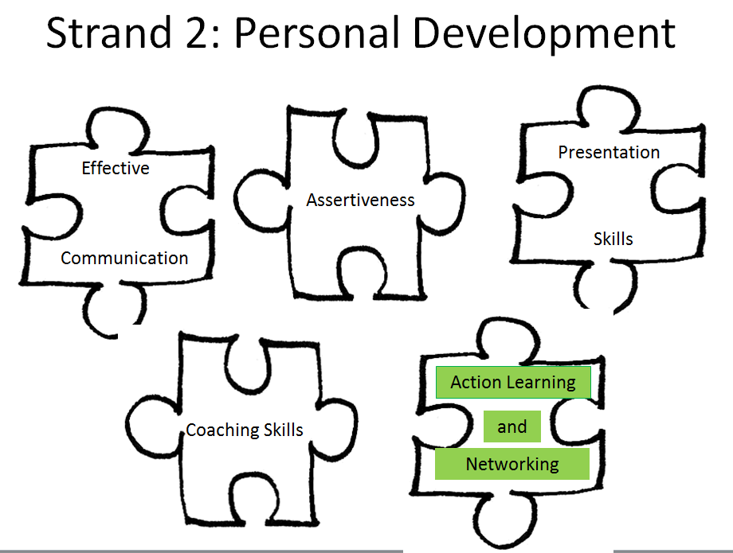
Passport for Environmental Excellence

Slide 15
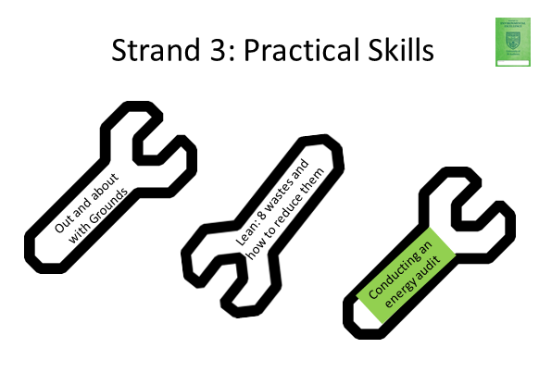
Passport for Environmental Excellence

Slide 16
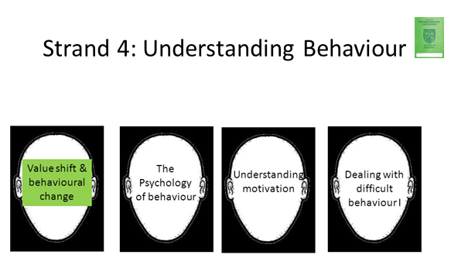
Passport for Environmental Excellence

Slide 17
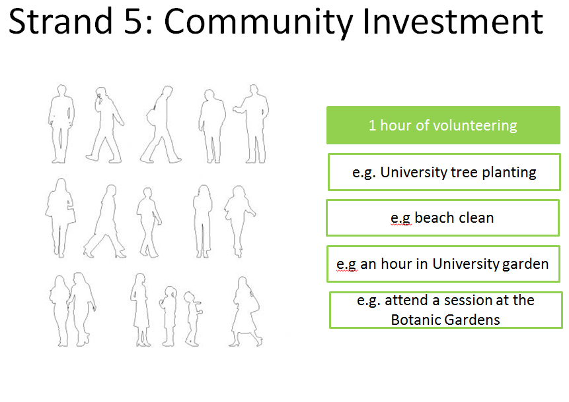
Passport for Environmental Excellence

Slide 18
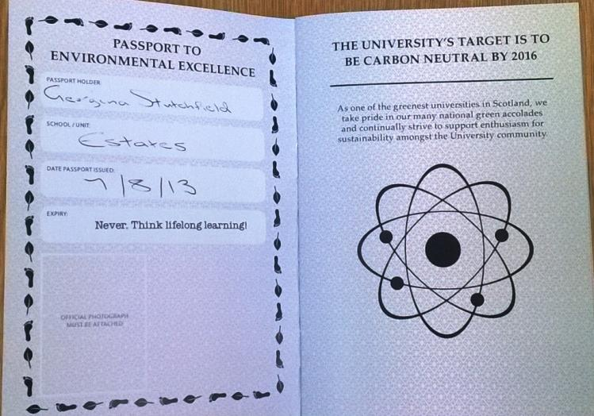
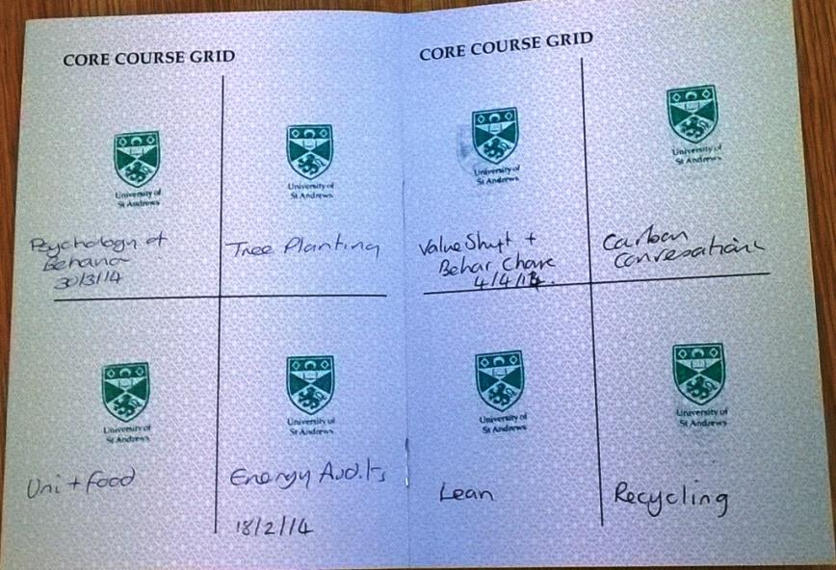
Passport for Environmental Excellence
Stamped for every course

Slide 19

Assessment of program
Student intern to evaluate
progress and effectiveness
August 2012

Slide 20
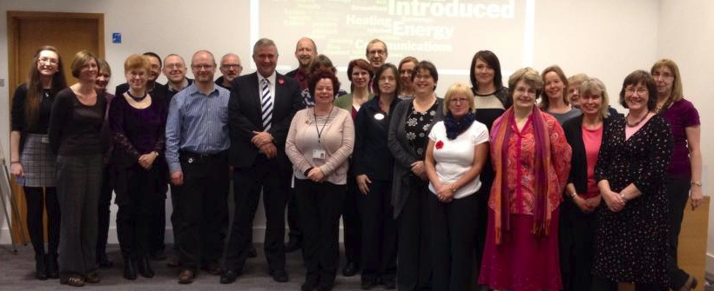
Environmental Facilitators
Graduation Events

Slide 21
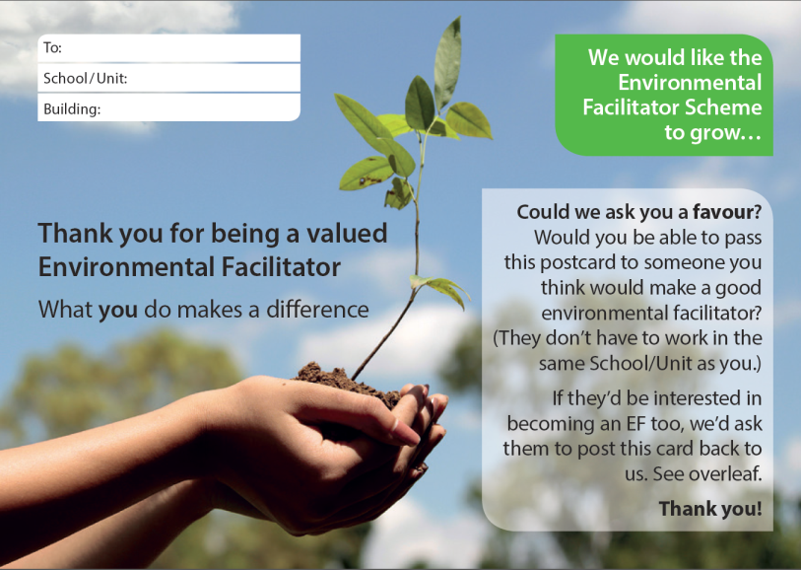
Recruitment of new facilitators
Constantly looking for more
Facilitators
Marketing to existing EFs

Slide 22

Further Progress
Issues with recruitment and scheduling the training courses
Passport for Environmental Excellence closed
Solution – single day training with “flipped classroom”
All materials presented on video before the training – detailed training

Slide 23
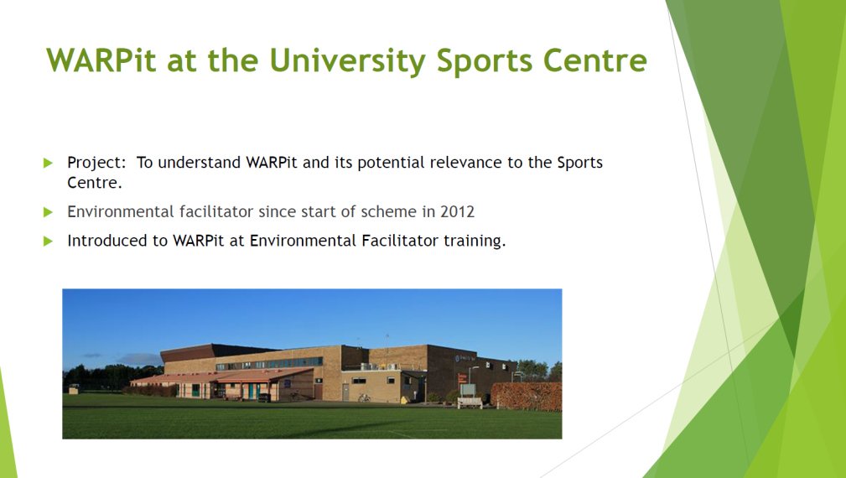
Environmental Facilitators networking events
EF case study presentations
EF networking
EF help with current issues – eg. business travel reduction

Slide 24

Environment presentations to other passports
Passport for Administrative Excellence -

Slide 25
What’s Next?
Still recruiting more Environmental Facilitators
Training days scheduled
Networking events scheduled

Slide 26

Thank You

