Slide 1

Evaluation of the Embedding of Sustainability
West Lothian College Style
Beth Brownlee, bbrownlee@west-lothian.ac.uk

Slide 2
So What?
Various approaches to sustainability over last 10 years, in response to SFC and other contexts; so what, before we progress?
Estates driven approach - heat and light
Carbon reduction approach - travel, paper, waste, curriculum
Sustainable Development Goals approach - Erasmus project
The Climate Emergency approach - what would Greta do?

Slide 3
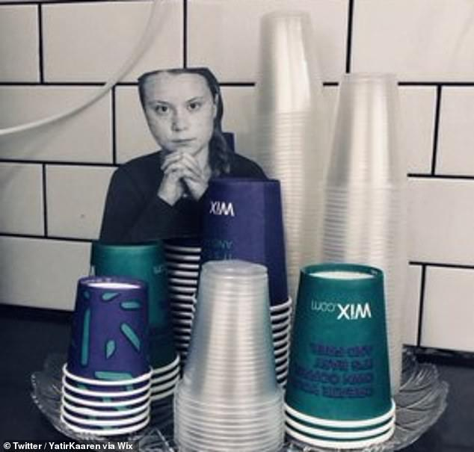
Raising
Expectations

Slide 4
Initial
Barriers
‘We’re Scottish! We’re not like that!!’
Level 5
Business Student

Slide 5
Research in 18-19
New strong lead from professional standards
Surveyed curriculum staff - patchy good practice
Met with:
curriculum teams - confirmed patchy good practice, but some highlights e.g. forest classroom (our first Green Gown Award submission)
Students Association - welcome consistent approach to assessment via Moodle, need awareness raising

Slide 6
The Baseline (curriculum):
Patchy good practice
FE students are not so interested in sustainability, but like digital convenience

Slide 7
Actions This Year 19-20
Continue to build awareness and momentum
WasteSwitch online learning - Waste in the Circular Economy SCQF Level 5 pilot
Highlight importance for employability
Establish new action plan and raise strategic importance - analogy with embedding equalities?

Slide 8

Surprises
Period poverty sustainability silver lining
Principal’s visible support - Summit in March
Green Gown short list

Slide 9
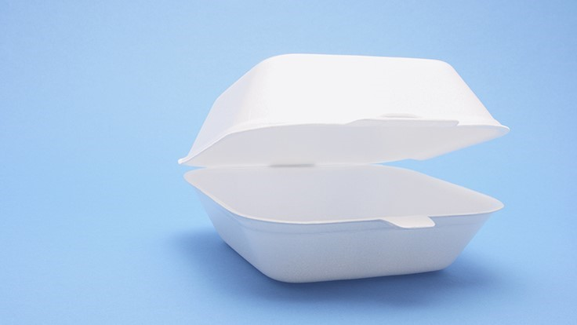
Remaining Challenges
One of many hats in FE
Low aspirations?
Polystyrene!
Smoking!

Slide 10
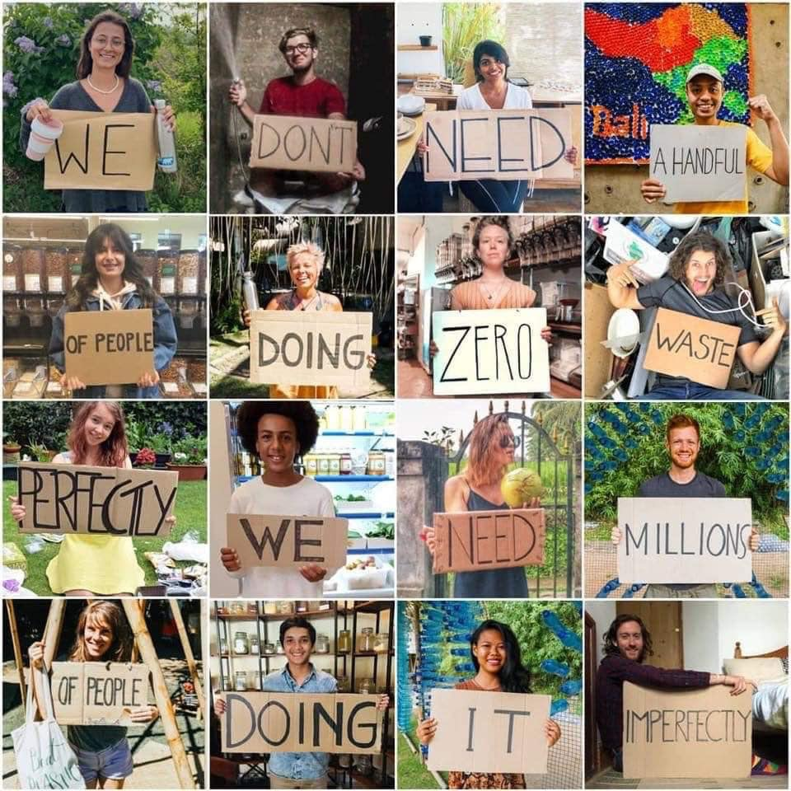
Conclusion
Keep going!

