Slide 1
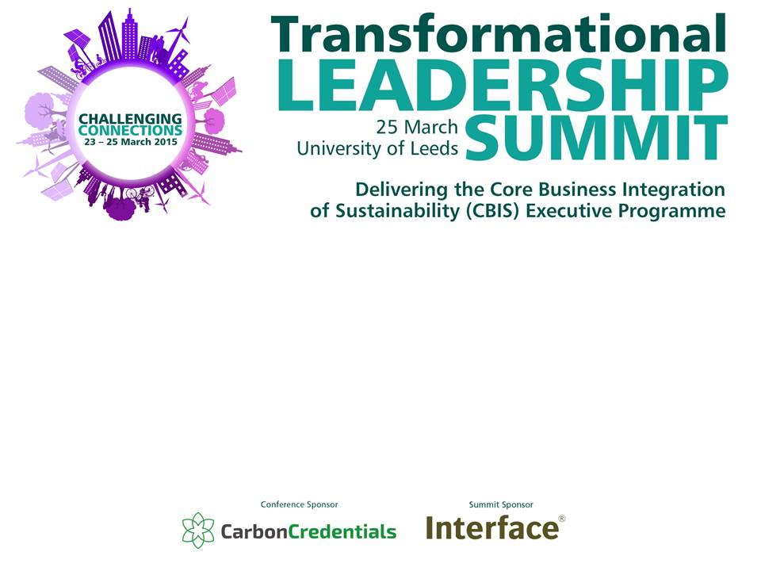
Leanne Denby, Macquarie University, Australia
Christa Gyori, Unilever
Rosi Kerr, Dartmouth University USA
Notes:
‘Challenging Connections’ is about inspiring and challenging you to look again at your connections, your partnerships and the voices you are hearing and those you are not.
How can you overcome any potential challenges?
What connections you could make? How can people in the room help?
Who do you need to challenge internally?
Alternatively you could embed this as a key theme in your presentation and reference it throughout.
Delegates are encouraged to note these points in the back of the delegate brochure to take back and implement at their institutions.

Slide 2
The Plan
11:20 Welcome from EAUC and Sponsors
11:30 Introductions to each other
11:35 Introduction to the Framework
12:30 Break for Lunch
1:35 YOU LEAVE LUNCH
1:45-2:25 Activity
2:30 Case Studies
3:10 Break
3:20 Activity and Stunning Conclusion

Slide 3
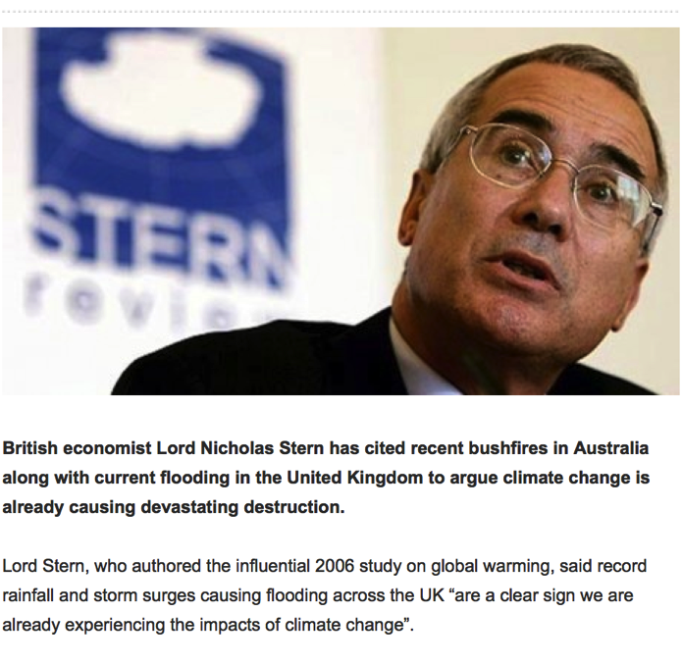
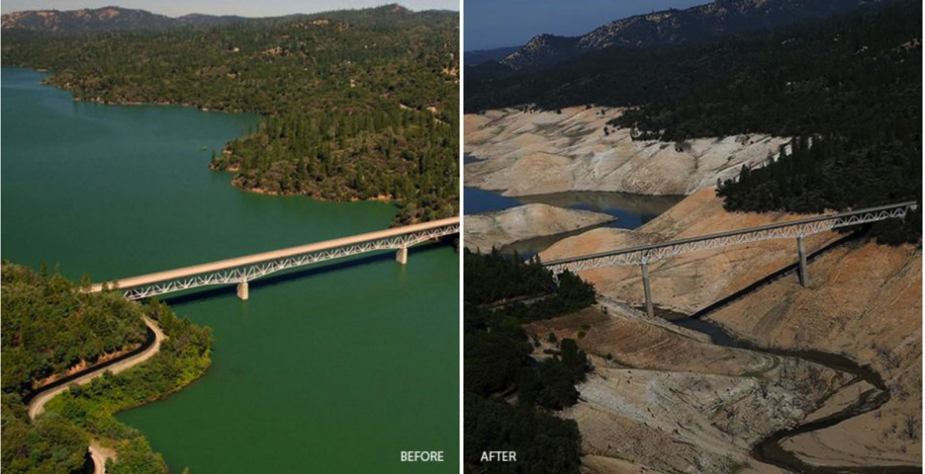
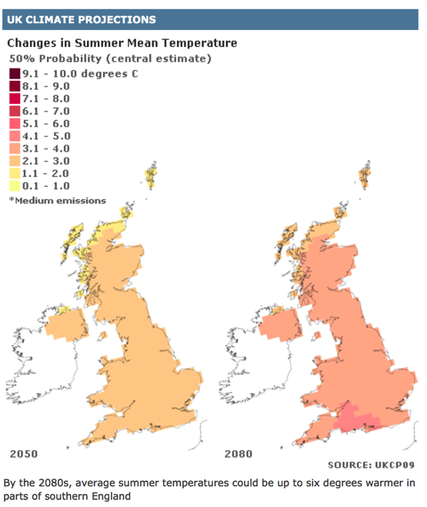
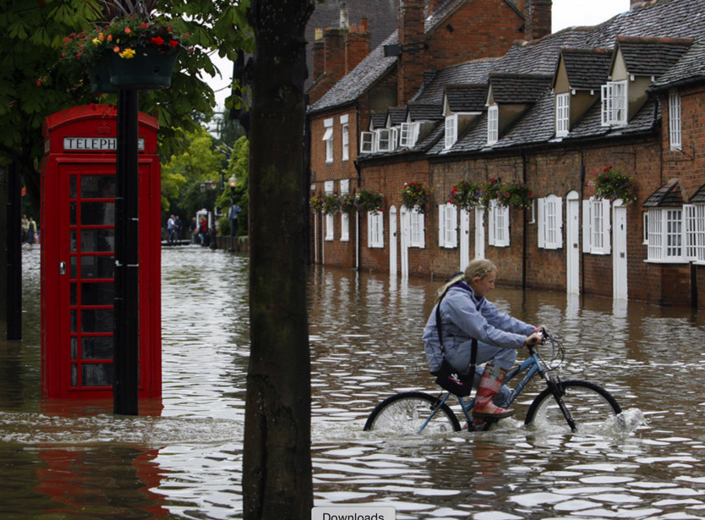
MegaTrends
Notes:
Planetary Systems

Slide 4
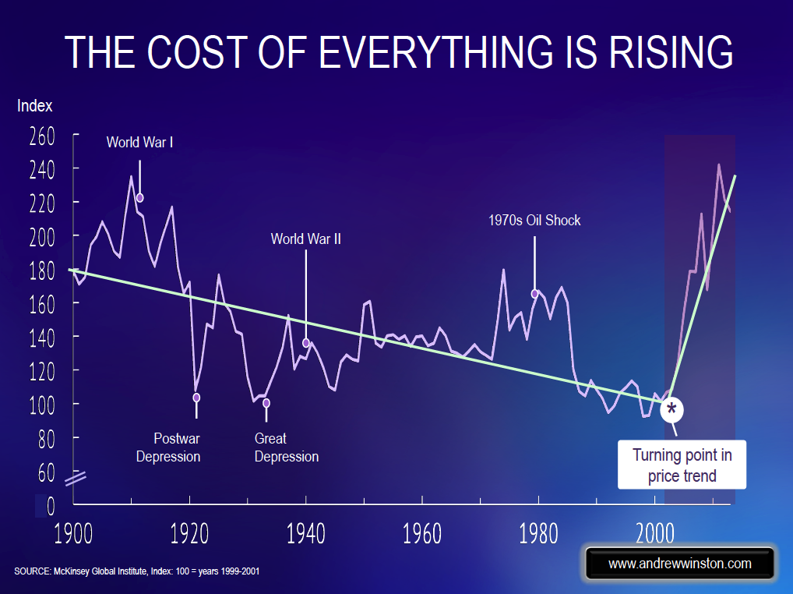

MegaTrends
Notes:
Human systems
Complex webs or organizations, rapidly changing

Slide 5
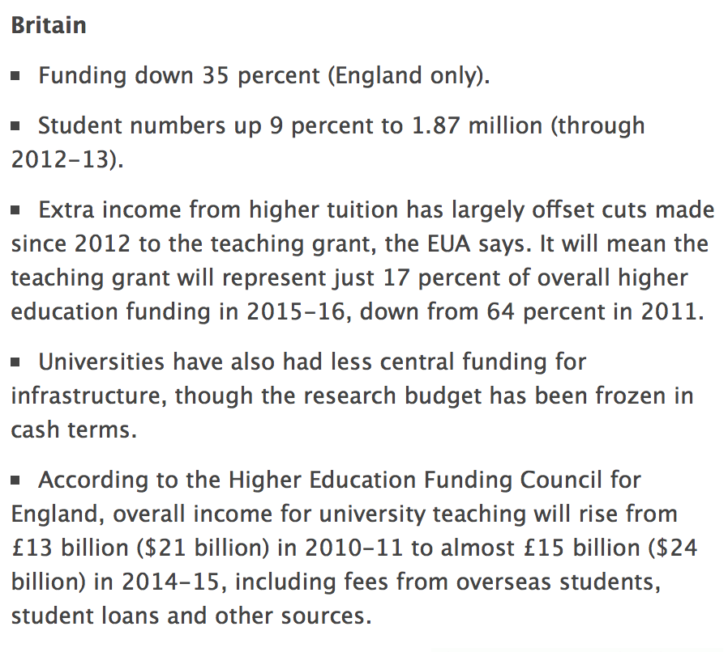
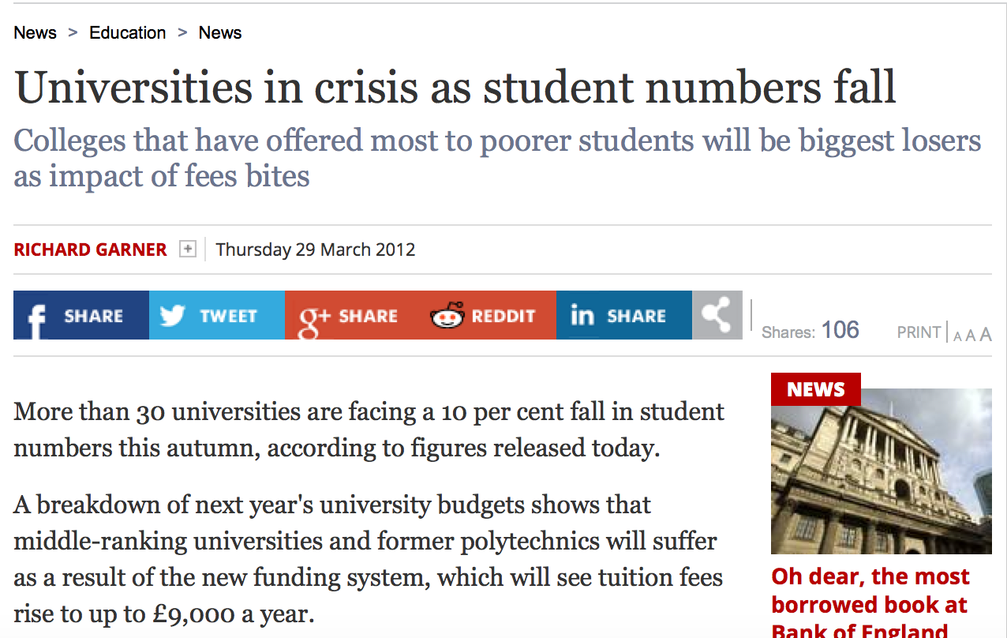
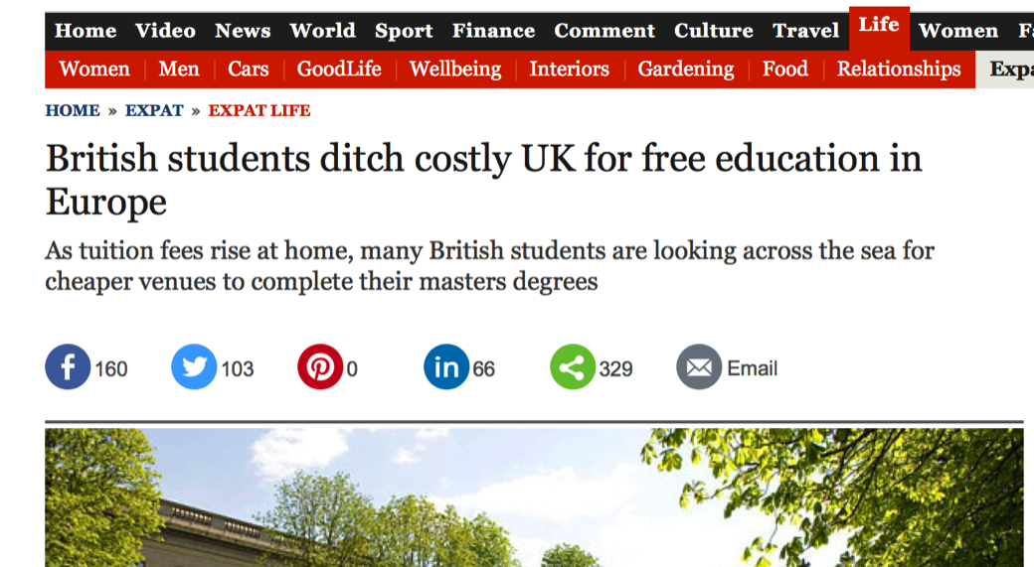

Slide 6

PLANETARY SYSTEMS
The Source of Change is Here
INDIVIDUALS
ORGANIZATIONS
“CBIS Rationale” by lsharp is licensed for sharing and adapting under Creative Commons CC BY-AS 4.0
Notes:
Planetary life support systems provide all of the resources, conditions and cycles of renewal upon which we depend for survival as a species
The accumulative impact of individual intentions, values & capabilities generate institutional priorities & behaviors.
A complex web of organizations drive almost all local and global environmental impacts.

Slide 7
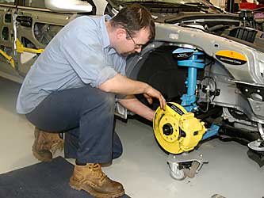
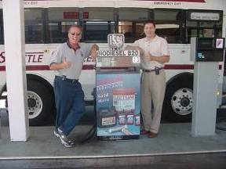
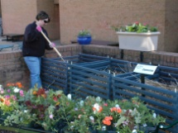
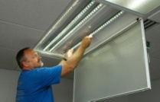
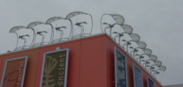
What’s Needed to Change?
Consumer demand: A change in values
Supportive policy instruments:
A market providing product & services
A trained workforce
Access to capital
To Change Society We Must Change a Complex Interdependent Web of Organizations
“CBIS Rationale” by lsharp is licensed for sharing and adapting under Creative Commons CC BY-AS 4.0

Slide 8
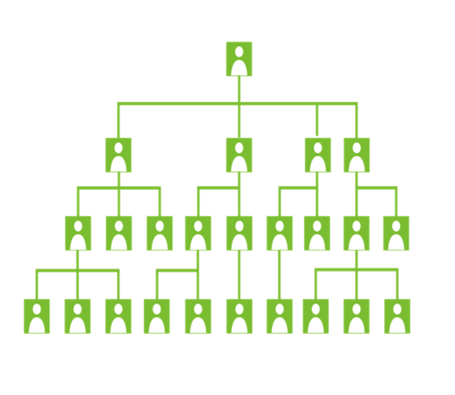
How Does a “Traditional Organization” Look?
Top Level Leadership
Authority
Middle Management
Management & Accountability
Grass Roots: Employee base
Implementation
Management Driven Hierarchy (Command Control) Predominates in All Sectors Including Higher Education
“CBIS Rationale” by lsharp is licensed for sharing and adapting under Creative Commons CC BY-AS 4.0
Notes:
What Does a “Traditional Organization” Look Like?
Let’s talk about the risks here for everyone.
How many good leaders are finding themselves facing more change demands than their organization is capable of undertaking? What choice does that leave the leader with….push as hard as you know you should from a moral, eithical and best interest of the org – and suffer the results of getting blamed and squeezed out…when the rebelion happens….or just turn away and follow the pace of your organziaiton…even when you know in your heart of hearts – that this is not in our collective interest. It’s a growing ethical and moral crisis for leaders. Push and risk going under the turning wheel….or keep behind the wheel at all times.
There is actually an enormous human toll in our orgs.

Slide 9
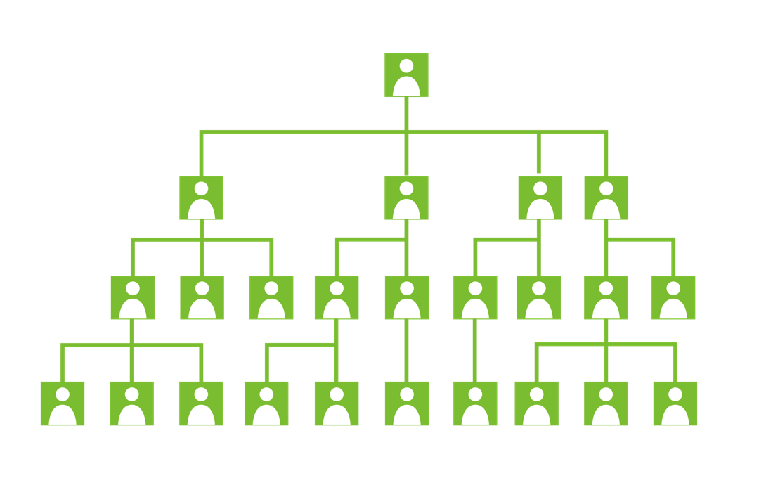
Management Driven Hierarchy (or Command and Control)
“CBIS Rationale” by lsharp is licensed for sharing and adapting under Creative Commons CC BY-AS 4.0
Notes:
There are weaknesses and strengths of this model…..

Slide 10
Hardwired Separation
“CBIS Case Story: How Many People at Harvard Does it Take to Change a Lightbulb?” by lsharp is licensed for sharing and adapting under Creative Commons CC BY-AS 4.0
Notes:
3 months of constant facilitation by change management team to create the necessary connectivity, engagement and decision-making
Simple Lighting Upgrade in Student Residence at Harvard.
Project Process Map in 2001:

Slide 11
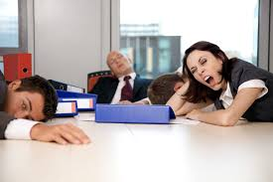
Disengagement
70 % of workers in the USA are not engaged in their work. Defined as essentially sleep walking throughout their day.
Gallop “State of the American Workplace Report 2013”

Slide 12
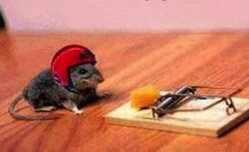
Exhaustion
Analogies from Change Leaders
Being Tonto with the Lone Ranger at a bank-robbers’ convention
Trying to interest people who like junk food in a healthy diet
Learning Spanish but finding myself in China
Being a competitor on American Idol
Being Stephen Bradbury winning gold at the Winter Olympics
Pinning jelly to the wall
http://www.olt.gov.au/project-turnaround-leadership-sustainability-higher-education-2011
“CBIS Rationale” by lsharp is licensed for sharing and adapting under Creative Commons CC BY-AS 4.0
Notes:
180 Sustainability Change Leaders in Higher Education Surveyed:
Analogies that Describe their World

Slide 13
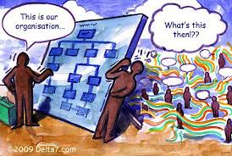
Leadership Challenge
Seeking to transform, not just fit initiatives in with existing cultures, structures & incentives
Inadequate senior leadership support or funding
Being seen as challenging existing ‘empires’
Seeking to introduce collaboration
in a content that rewards individual success
Unclear, different or limited understandings of sustainability
http://www.olt.gov.au/project-turnaround-leadership-sustainability-higher-education-2011
“CBIS Rationale” by lsharp is licensed for sharing and adapting under Creative Commons CC BY-AS 4.0
Notes:
What do 180 change leaders think the distinctive leadership challenge posed by sustainability is?

Slide 14
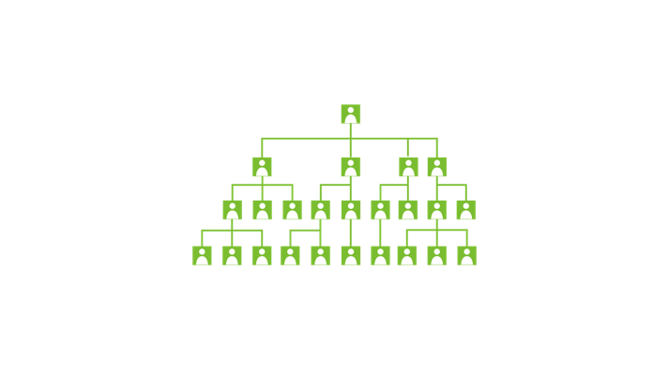
Management Driven Hierarchy (or Command and Control) alone is inadequate for the task of leading significant amounts of change & innovation.
“CBIS Rationale” by lsharp is licensed for sharing and adapting under Creative Commons CC BY-AS 4.0

Slide 15
As it turns out, sustainability is the ideal
problem to solve our organizations.
“CBIS Rationale” by lsharp is licensed for sharing and adapting under Creative Commons CC BY-AS 4.0

Slide 16
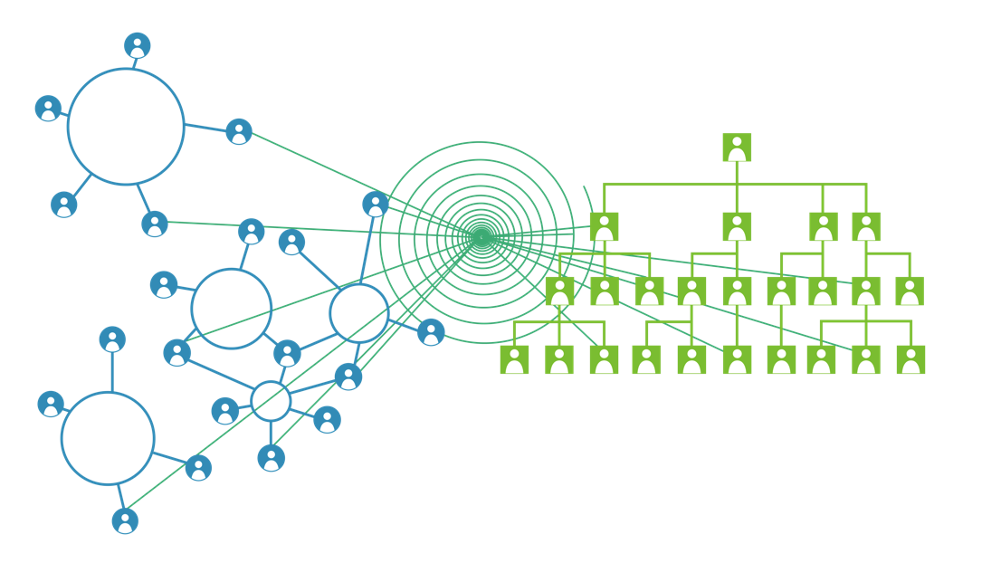
We are moving from a command control operating system to a dual operating system aligned around shared purpose.
“CBIS Graphic” by L.Sharp & R.Gutter, adapted in part from J.Kotter, is licensed for open sharing and adapting under Creative Commons CC BY-AS 4.0
Notes:
We won’t create big change through hierarchy on its own
We need a dual operating system of hierarchy AND network
Many change agents, not just a few, with many acts of leadership

Slide 17
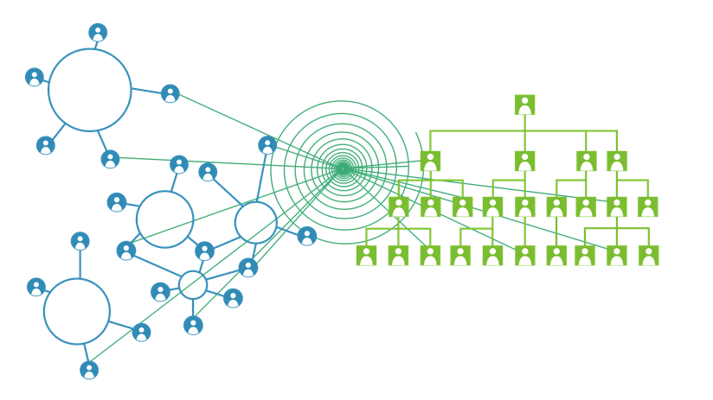
ADAPTIVE OPERATING SYSTEM |  | COMMAND CONTROL OPERATING SYSTEM
Intrinsic motivation to enact shared purpose |  | Extrinsic motivation to enact mission & vision
Community structure, relationships |  | Authority structure, transactions
Boundary crossing connectivity |  | Division and hierarchy
Co-created change, leadership as a system |  | Top-down change, leadership as a linear
Applied learning focus |  | Execution focus
Socially supported learning, story |  | Strategy, metrics, reporting
Dynamic, multiple, transient |  | Rigid, single, permanent
ALIGNED THROUGH PURPOSE
“CBIS Content” by L.Sharp, is licensed for open sharing and adapting under Creative Commons CC BY-AS 4.0

Slide 18
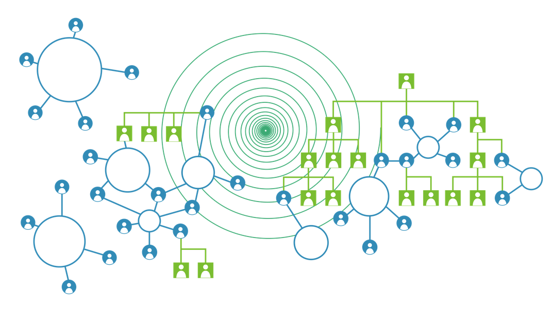
Over Time the Systems Can Transform One Another
“CBIS Content” by L.Sharp, is licensed for open sharing and adapting under Creative Commons CC BY-AS 4.0
Notes:
As transformation deepens the dual operating system becomes more of a dual operating cycle with less and less distinction.

Slide 19
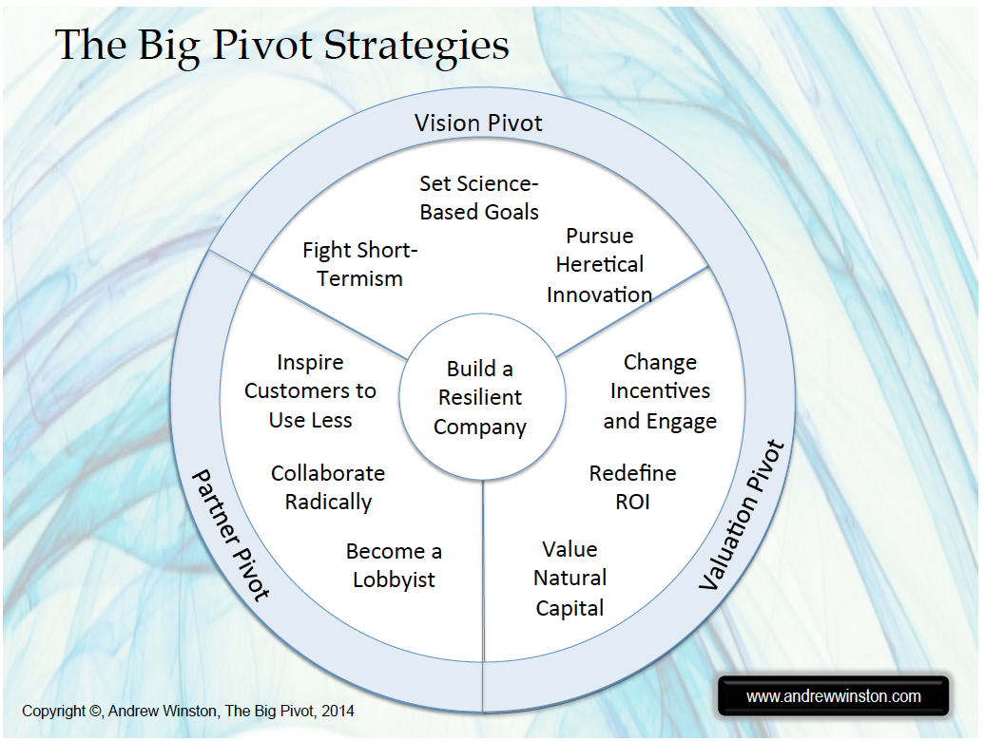
Notes:
It turns out, the business community has begun to catch on to sustainability as a tool for innovation, resiliency

Slide 20
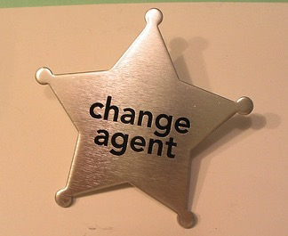
The Good News!
It can be taught, it can be learned and it can change everything.
“CBIS Rationale” by lsharp is licensed for sharing and adapting under Creative Commons CC BY-AS 4.0
Notes:
HERE’s WHERE YOU COME IN!!!!!
We Need an Army of Capable & Committed Change Agents Working in the Small and Large Arenas of all Sectors
Change Agency is a Professional Field of Expertise.
It can be taught, it can be learned and it can change everything. including the very nature of your organization

Slide 21
Actions for Change Agents
Create Shared Understanding and Shared Purpose to Transform
Pursue Conditions & Processes as Well as Goals & Plans
Focus on Removing Risk & Fostering Stability
Be Amazing at Fostering and Leveraging Positive Social Dynamics
Pilot, Pilot, Pilot!
Democratize Access to Capital for Seed Funds and Pilots
Leverage Social Learning
Explore New Ways to Advance Group Intelligence
Engage Senior Leaders and Middle Managers to Improve Decision Making Agility

Slide 22
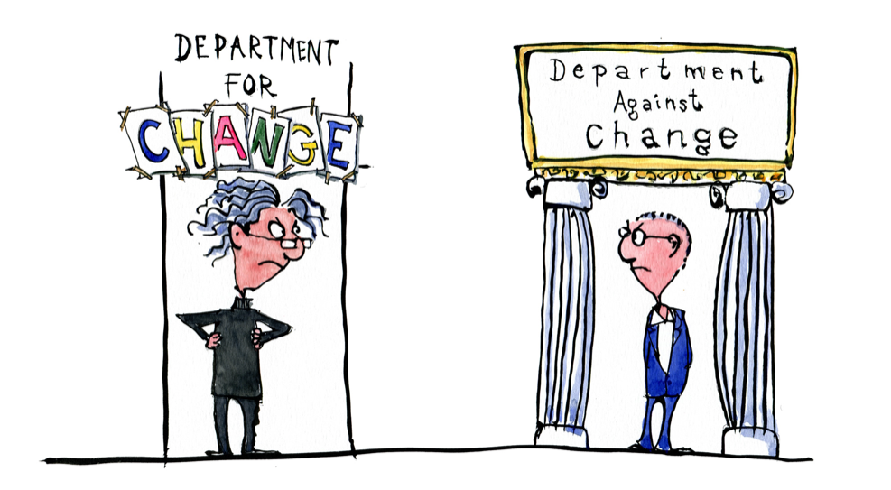
1. Create Shared Understanding and Shared Purpose
Get Senior Leaders and Middle Managers into the conversation using enough shared language about this new organizational model.
Co-Create Your Own Convenings for Senior Leaders and Middle Managers

Slide 23
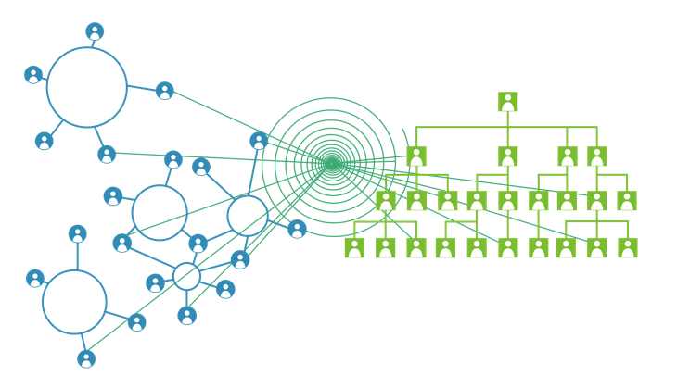
2. Pursue Conditions & Processes
Trust based culture
Access to seed funding for pilots
Shared ownership, credit, public recognition
Psychological safety
Agile decision-making processes for scaling.
Forums, processes and permission for idea flow
High functioning group processes/meetings with optimal patterns of interaction
Stories that model emotional resources: courage, hope, drive
Permission for piloting and exploration
Forums for social (peer to peer) learning
“CBIS Content” by L.Sharp, is licensed for open sharing and adapting under Creative Commons CC BY-AS 4.0

Slide 24
3. Focus on Removing Risk & Fostering Stability
High Perceived Stability
Low Perceived Stability
Low
High
Willingness to Embrace Change
A change agent and a change capable organization creates stability and reduces risk so that others can join in.
Notes:
Most people believe that humans are innately averse to change.
This is not the case.
Change leadership is about stability as much as it is about change.
People are actually invigorated by change when it occurs with adequate stability and low risk.
A change agent and a change capable organization creates stability and reduces risk so that others can join in.

Slide 25
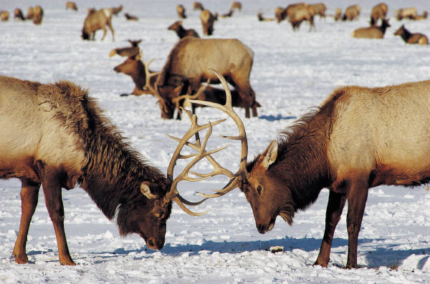
4. Be Amazing at Fostering and Leveraging Positive Social Dynamics
Mastering the new leadership frontier of social dynamics and social architecture will be critical for our success.
“CBIS Rationale” by lsharp is licensed for sharing and adapting under Creative Commons CC BY-AS 4.0

Slide 26
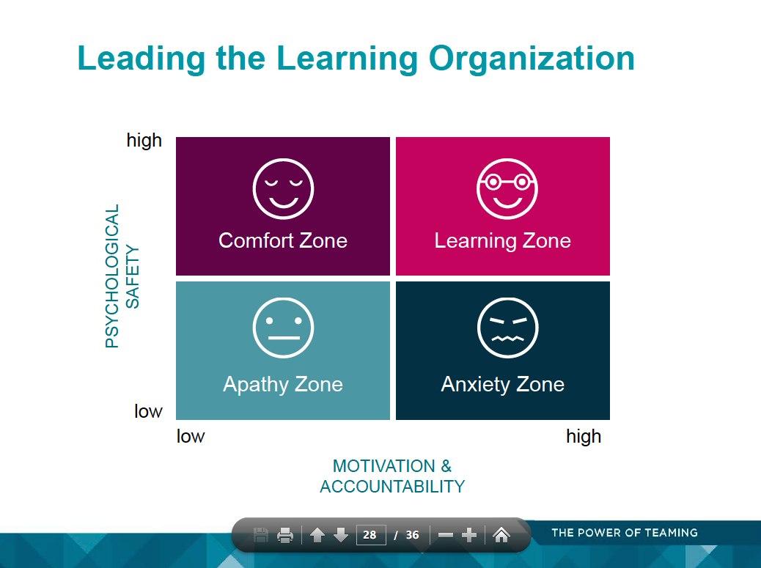
4. Be Amazing at Fostering and Leveraging Positive Social Dynamics
Source: Amy C. Edmondson | Novartis Professor of Leadership & Management | Harvard Business School THE POWER OF TEAMING
Notes:
You see this refelcted increasingly in how top business schools such as Harvard Business School, are teaching leadership and organizational change.
Often, perceived social risks/uncertainties exist semi-consciously or unconsciously in the form of old stories, feelings and even physical sensations.
The pathway of resolving social risk must typically be experiential. That is, the change agent must support people to experience their way into new ways of thinking/feeling, rather than hoping that they will think their way into new ways of acting.

Slide 27
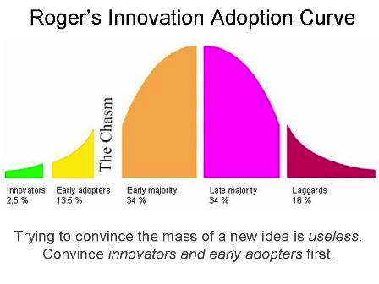
5. Pilot, Pilot, Pilot
Notes:
Innovators/Growth Oriented: On board once critical concerns addressed
Followers: Need to see some others that matter to them have come on board.
Followers of Followers: Need to see a critical mass of people on board
Curmudgeons: They will only come on board once it is embarrassing not to.

Slide 28
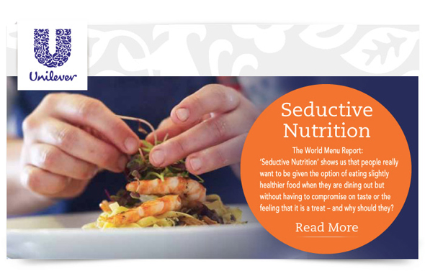
Scale up Pilots

Slide 29
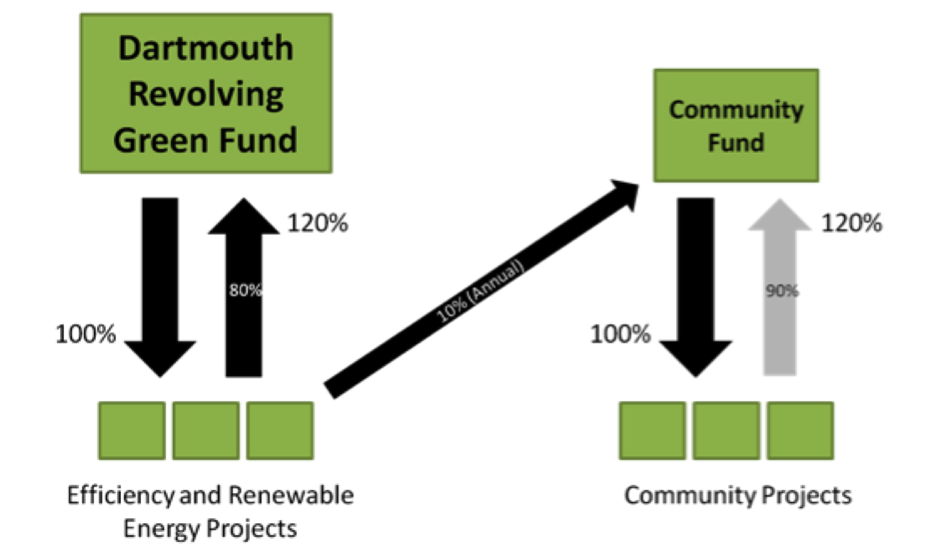

6. Democratize Access to Capital

Slide 30
Reform Finance & Accounting Barriers
Capital and operating budget disconnect.
No commitment to capturing and reinvesting savings (costs avoided).
No annual innovation/piloting/seed funds for the Emergence Operating System
No efficiency funding in annual maintenance/operating budgets
“CBIS Rationale” by lsharp is licensed for sharing and adapting under Creative Commons CC BY-AS 4.0

Slide 31
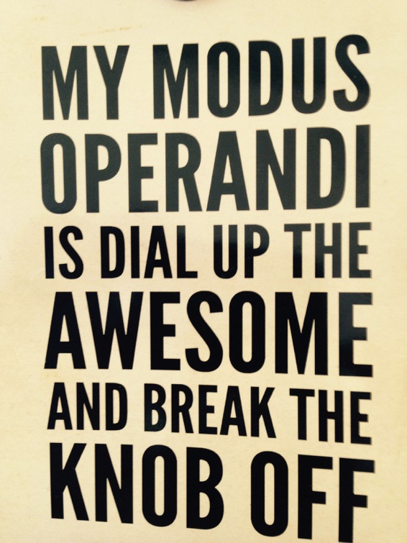

7. Leverage Social Learning
Notes:
Exposure to surrounding peer behaviors is the largest single factor in driving idea flow

Slide 32
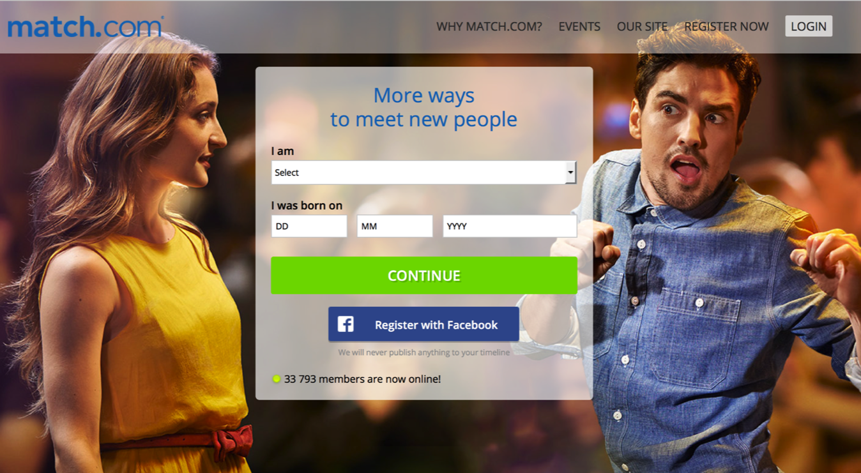
8. Explore New Ways to Advance Group Intelligence
Notes:
Instituionalize
Use technology

Slide 33
9. Engage Senior Leaders and Middle Managers to Improve Decision Making Agility
Single Unit
Business Case
Multi Unit Business Case
Organization Wide Business Case
Some Decision Making Agility
Less Decision Making Agility
Little Decision
Making
Agility
“CBIS Rationale” by lsharp is licensed for sharing and adapting under Creative Commons CC BY-AS 4.0
Notes:
For group intelligence the pattern of interaction is more important that all other factors taken together – individual intelligence, personality and skill.

Slide 34
Individual Systems | Social Systems | Organizational Systems | Infrastructure Systems
Personal & Interpersonal Capabilities Skills/Abilities Motivation/ Values/Attitudes Habits/Behaviors | Status Trust Social Influence Inclusiveness Fairness Relatedness Autonomy Emotional Sensitivity Group Intelligence | Vision/Mission Governance Management Structures Planning Processes Decision Making Processes Finance & Accounting Policy Instruments Information Systems Procurement Systems Human Resources | Buildings Transportation Energy Materials Food Supply Water Sewerage Landscaping IT
“Organizational Ecosystem” by L.Sharp, is licensed for open sharing and adapting under Creative Commons CC BY-AS 4.0
Notes:
Idea Pipeline Design Needs to Factor in the Organizational Ecosystem
Even just Thinking this way changes how you approach change

Slide 35
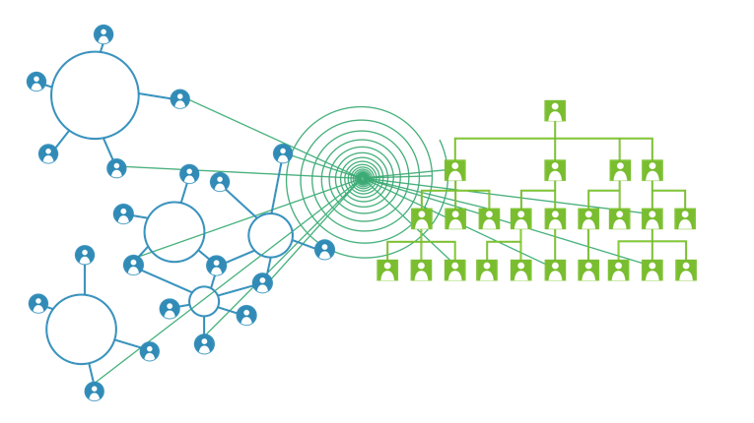
Increasing organization-wide idea flow, exploration, group intelligence & social learning
Reducing Risk Across the Organizational Ecosystem
Locating diverse business models
Unleashing new levels of purpose & engagement
Improving Decision-Making Agility
This organizational model open new idea pipelines by:
“CBIS Rationale” by lsharp is licensed for sharing and adapting under Creative Commons CC BY-AS 4.0

Slide 36
ACTIVITY ONE
Select someone at your table to be the Reporter
As a group, you have 10-12 minutes to answer the question:
WHAT IS ONE THING THAT RESONATES MOST POWERFULLY WITH YOU ABOUT THE CONTENT AND WHY?
Summarise your 1 minute report out (4 minutes)
5. Each group will have 1 minute to report back
If you agree then raise your hand! No repeating!

Slide 37
ACTIVITY TWO
Individual reflection time (5-10 minutes):
What are your biggest insights about how you might apply this framework? What are your next steps, how will you use these ideas?
Join to make groups of 3 and share reflections – make note of key reflections, insights, ideas and summarise these to report back (15 minutes)
Groups to share insights through open discussion (25 minutes)

Slide 38
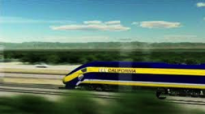
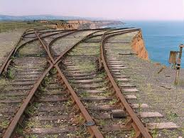
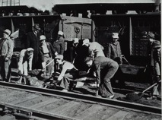
The Future?
Speeding Up Towards the Cliff
Changing Direction &
Doing Well By Doing Good
Slowing Down &
Doing Less Bad
Eco-Absurdity
Eco-Efficiency
Eco-Effectiveness
“CBIS Rationale” by lsharp is licensed for sharing and adapting under Creative Commons CC BY-AS 4.0

Slide 39
WANT MORE?

Slide 40
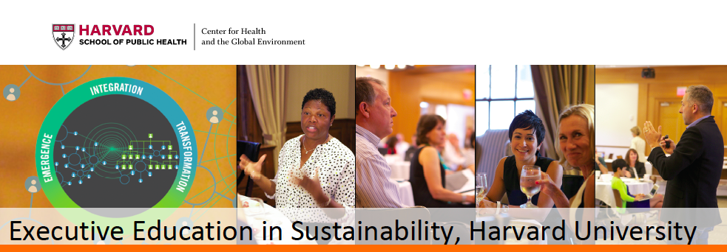

In collaboration with
Sessions in 2015: July 7th-10th Oct. 19th-22nd
To learn more or request an application
www.chgeharvard.org/CBIS
“I left energized & ready to tackle the most complex adaptive problems that my college faces. Wherever your organization is in relation to sustainability this program helps you go to the next level.” Community College President

