Slide 1
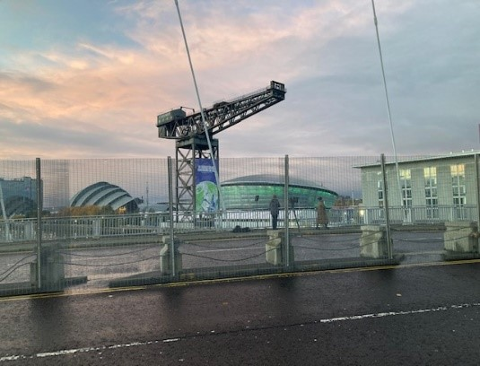
Law and Sustainability
Realigning Curricula for the Future
20 April 2022
Gillian Mawdsley Associate Lecturer Open University
Gillian.Mawdsley@open.ac.uk
Notes:
What does this slide indicate – it indicates a waiting Glasgow – analogy for the world the day before COP26 opened.

Slide 2
Purpose of the talk
1. Consider what the responsibility of law, the profession and the societal role of law is.
2. Law and Sustainability
3. My experience and motivation
4. What to change?

Slide 3

1. Consider what the responsibility of law, the profession and the societal role of law-

Slide 4
Define law
The discipline and profession is concerned with the customs, practices, and rules of conduct of a community that are recognized as binding by the community. Enforcement of the body of rules is through a controlling authority.

Slide 5

Who are the Legal Profession?
The legal profession is a 'vocation that is based on expertise in the law and in its applications. ' Those who pursue these 'vocations' collectively form a 'body of individuals who are qualified to practise law in particular jurisdictions

Slide 6
The Societal Role of law
Laws protect individual rights and liberties.
Laws provide a framework and rules to help resolve disputes between individuals
Without laws, there would be no way to set standards
Laws help societies to maintain order and the rule of law

Slide 7



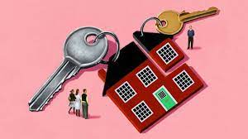
Types of Law
Environmental law is an up-and-coming area of law in an age of concern over the 'footprint' humans are leaving on our planet. It covers diverse areas such as climate control, sources of energy, pollution and Corporate Social Responsibility.

Slide 8
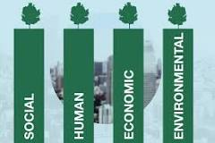
2. Interaction of Law and Sustainability
Notes:
Attending COP26 – setting up working Group
Law Society of Scotland My background
Criminal law
Important people
Consultation and legislation
World- leading to things can change

Slide 9

3. My experience and motivation
Notes:
COP26 Working Group – statistics/ blogs and conferences including Annual Conference and conference on human rights
Aims were to raise awareness

Slide 10
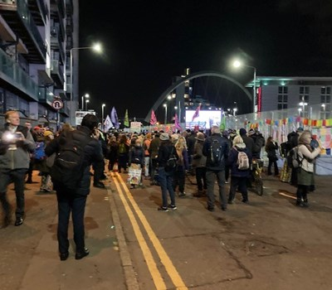
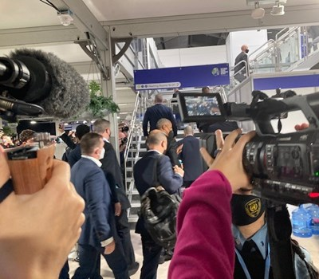
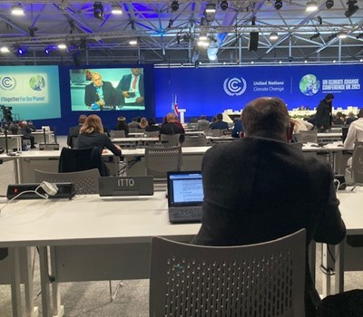
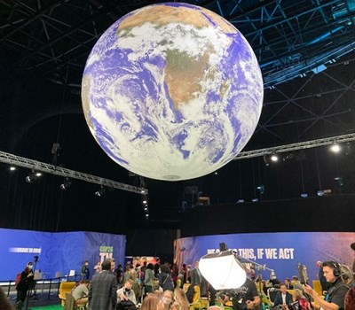
My experience and motivation
Notes:
OU appointed as attendee at the COP26 representative from the Business and faculty
Experience outline
Criminal climate activists
Important meetings
Consultation negotiation
World – impact on poorer groups

Slide 11
4. What to change?
Glasgow Climate pact was the result
A move away from fossil fuel as a source of energy.
The 1.5℃ global warming target was now clearly flagged and fully within the public awareness. There was recognition that actions are required to reach the set targets.
Mitigation of nature and ecosystems are required, including protecting forests and biodiversity. Australia and 123 other countries promised to end deforestation by 2030.
Countries are “urged” to fully deliver on an outstanding promise to deliver US$100 billion per year for five years to developing countries vulnerable to climate damage. Transparency is required on delivery.
A high-level ministerial roundtable meeting is to be held each year focused on raising ambition out to 2030.

Slide 12
And my personal thoughts
Legal Teaching should encompass sustainability – not just for environmental lawyers
Need to respect human rights and diversity and equality considerations
Profession to respect green credentials
Legal Ethics should be aware of responsibility
Adoption of Ecocide as a crime against humanity

Slide 13
Thank you

