Slide 1
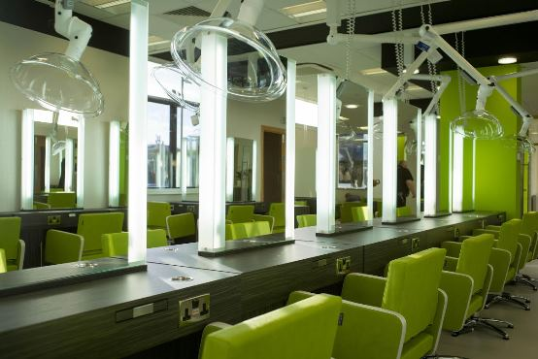

The Green Salon & The Ripple Effect
Leading the sector through positive change
Christina Laing

Slide 2
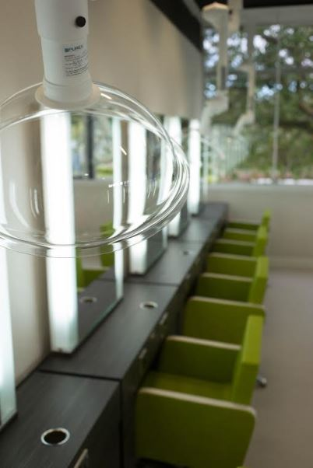


The following design concepts are included in the Fife College ‘Green Salon’
’
Bespoke LEV Local Extraction Venting bespoke filtration system to remove airborne fine hair, dust and chemicals for clean air working - as is mandatory in Denmark
This is the first installation of its kind in the UK

Slide 3


Design concepts continued…………
Virtual Salon walk through learning resource/ website for school and college learners, being developed by games technology /design students in The Creatives department
Selected green hairdryers and electrical equipment for minimum power consumption
Low level LED lighting around mirrors
Recycled doors from previous room

Slide 4

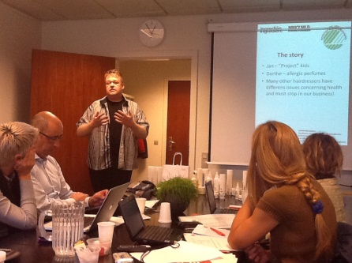
REM furniture from green ranges in the new Salon
Water pressure limiting shower heads
All products selected from green Eco ranges such as Ingredien
Recycled Tassimo coffee pods through teracycle
Wallpaper from recycled ranges
Forbo Nairn Marmolium flooring
Door matting from Forbo Nairn natural materials
Design concepts continued…………

Slide 5
Design concepts continued…………
Digital advertising imagery through plasma frames or FSC paper posters with green info for clients and students
Product companies asked for CSR and sustainability information on products and green credentials to build a ‘green’ product list
Bamboo brushes (from Salon Alternatives ) for student kits and retail sale
Soya towels for when we cant use bio degradable one as these dry quicker
Rotary dryers for outdoor drying and PR

Slide 6

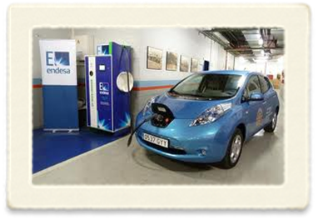
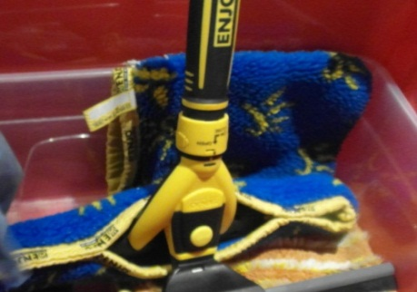
Design concepts continued…………
Recycling bins in salons
Cleaning products for teaching and cleaning of mirrors etc to be from water only cleaning ranges (ENJO range)
Biodegradable eco towels used for hair services
Colora Henna natural colour to be used in ‘green’ sessions
E -charging points at door of salon for the college e-car and consumers to come to our salons

Slide 7
Not forgetting.....
Cycle space / changing lockers for students
All learning materials being digitized and online assessment centers being implemented across all areas
Online assessment and learning being increased
Salon Plants to add oxygen, placed around the salon

Slide 8

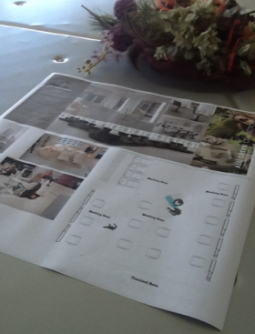
And…..
Strategic Green planning for the Academy with SMART targets
Plans for web streaming to have live hair presentation's from across the UK and beyond to share information and cut down on travel and emissions
New builds of the future for Fife College to include all the green components we can include

Slide 9
What now?
Involvement of all stakeholders to create a network of green practioner’s through “The Green Salon Ripple Effect “google group to share and grow green information across the sector and encourage suppliers to provide greener tools products and equipment
Please leave your email address if you wish to be invited to join us!

Slide 10

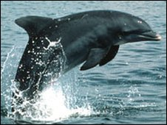



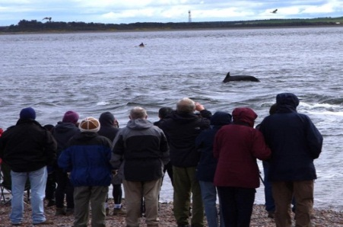
As time moves on and new technologies and products become available Fife College will be at the forefront of all sustainable practices and be the driving force for the learners of Fife to embed sustainability choices in their everyday lives for work and play.....for all of our futures
Thanks for listening
Christine

