Slide 1
Greener UK
Supported by…
Working with…

Slide 2
Overview of Greener UK’s recent activity
16 January 2020
Greener UK quarterly coalition meeting
Agathe de Canson

Slide 3
Political developments since last meeting
15 October
Full Environment Bill is published
28 Oct
Environment Bill second reading
12 Dec
General Election result: the Conservatives win with a majority of 80
Jan
Parliament returns
WAB going through Parliament
Nov
Manifestos released
Climate and nature Leaders’ debate
17-20 Dec
Parliament returns
Queen’s speech
New WAB is introduced to Parliament
17 October
New Withdrawal Agreement and Political Declaration agreed with the EU

Slide 4
The Environment Bill
After submitting select committee inquiry evidence and working intensively with Defra during the pre-legislative scrutiny period, we secured significant improvements to the bill compared to its draft form
The improvements include:
A framework for setting legally binding targets.
Stronger powers and a five-year ring fenced budget for the new environmental oversight body (the Office for Environment Protection). Its remit was also extended to cover climate change.
We briefed Parliamentarians ahead of the bill’s second reading in the Commons. Much of our briefing was reflected by parliamentarians in the debate
We are now seeking further improvements to the bill which we expect to return soon

Slide 5
2019 Withdrawal Agreement
As detailed in our analysis, the 2019 Withdrawal Agreement puts environmental protections and standards at high risk
This is largely due to non-regression provisions being relegated from the binding Withdrawal Agreement to the non-binding Political Declaration
Our analysis was referenced in the debate, e.g. by Shadow BEIS Secretary Rebecca Long-Bailey
Attention now turns to the national implementation legislation – the EU (Withdrawal Agreement) Bill

Slide 6
2019 General Election campaign: Manifestos
Greener UK published its four main manifesto asks:
A future UK-EU partnership that has strong environmental co-operation and high standards at its heart
An ambitious environment act
Ambitious agricultural reform
Truly sustainable fisheries management
We were pleased that the main parties’ manifestos closely reflected our asks across all areas, including maintaining high standards of environmental protection.

Slide 7
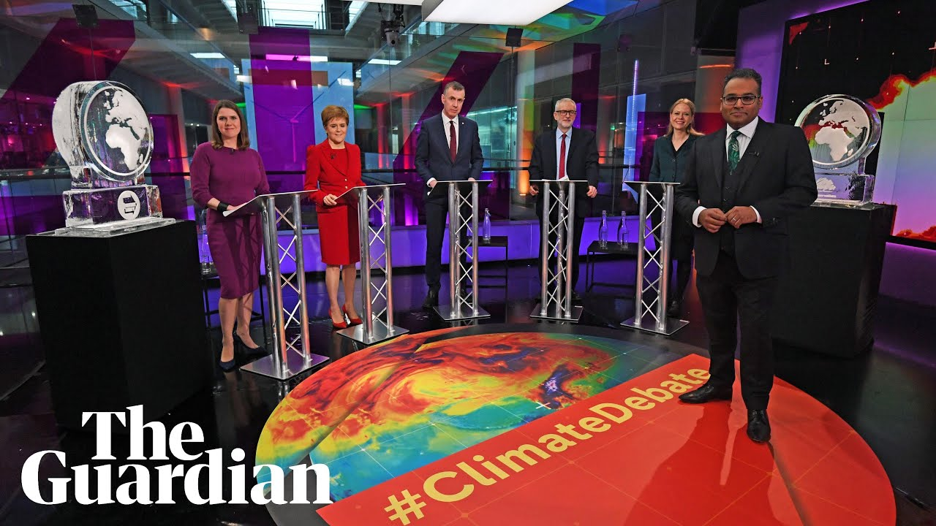
2019 General Election campaign: leaders’ debate
Working with Possible (formerly 10:10), we called for party leaders to take part in a televised climate and nature debate. This ask was communicated in a petition signed by over 200,000 people.
We helped to expand the original remit to cover nature as well as climate.
The debate was the first of its kind. It was watched by 3 million people across all platforms.

Slide 8
The new political landscape
Conservatives
Secured a majority of 80 in the general election
Several Brexit moderates stepped down, including ~18 green Conservative MPs
We identified 30 new MPs as potentially supportive, including 11 new CEN members
Zac Goldsmith now attends Cabinet as a peer with the same DFID-Defra brief
Labour
Key green figures lost their seat (e.g. Sue Hayman, Sandy Martin, Mary Creagh); some supportive backbenchers returned
We identified ~12 new MPs as potentially supportive.
SNP and other
The SNP is now a large voice in Parliament
Northern Ireland is now represented by 3 parties in Parliament: DUP, SDLP & Alliance
An executive has now formed in Stormont

Slide 9
Other considerations
The Labour Party and Liberal Democrats are in the midst of leadership contests
The SNP is focusing its attention on the call for a new Scottish independence referendum
Commons Select Committees are not expected to be up-and-running until late February/early March
There will be a cabinet reshuffle and possible civil service re-structuring in late January/early February
Government therefore faces little short-term scrutiny, which increases the importance of civil society monitoring and advocacy

Slide 10
Questions?

Slide 11
What next? Greener UK and the 1st 100 days of the new administration
16 January 2020
Greener UK quarterly coalition meeting
Sarah Williams

Slide 12
Domestic: legislation
The EU (Withdrawal Agreement) Bill (WAB) is passing rapidly through Parliament. Our aim has been to make clear our support for environmental non-regression and parliamentary scrutiny in the future relationship negotiations, and to get some useful statements from government on the record
The Queen’s speech also contained the environment, agriculture, fisheries and trade bills
Current intel suggests that all bills will be introduced imminently

Slide 13
Domestic: Greener UK
Ensuring the maintenance of high standards via a binding non-regression commitment – focusing on the WAB and then the Environment Bill
Making the case for scrutiny and accountability provisions in the WAB and Trade Bill (working in partnership with the Trade Justice Movement)
Ensuring robust and coherent environmental governance across the UK. Namely, improvements to the Office of Environmental Protection set-up process amongst other issues in the Environment Bill & action from the Devolved Administrations
Seeking technical and policy improvements across the Environment Bill, Agriculture Bill and Fisheries Bill
Scrutinising the carrying over of EU law and implementation of bills and other key policy measures via statutory instruments. E.g. in 2019 we worked with parliamentarians to scrutinise significant changes to chemicals regulation

Slide 14
International: political context
The UK government will be negotiating trade deals for the first time in 40 years, arguably from a position of relative weakness
The demands of our likely trading partners are known to varying degrees. E.g. US and EU have contradictory demands on standards
The tight time schedule means deals could be rushed through with little transparency (although extensions are theoretically feasible)

Slide 15
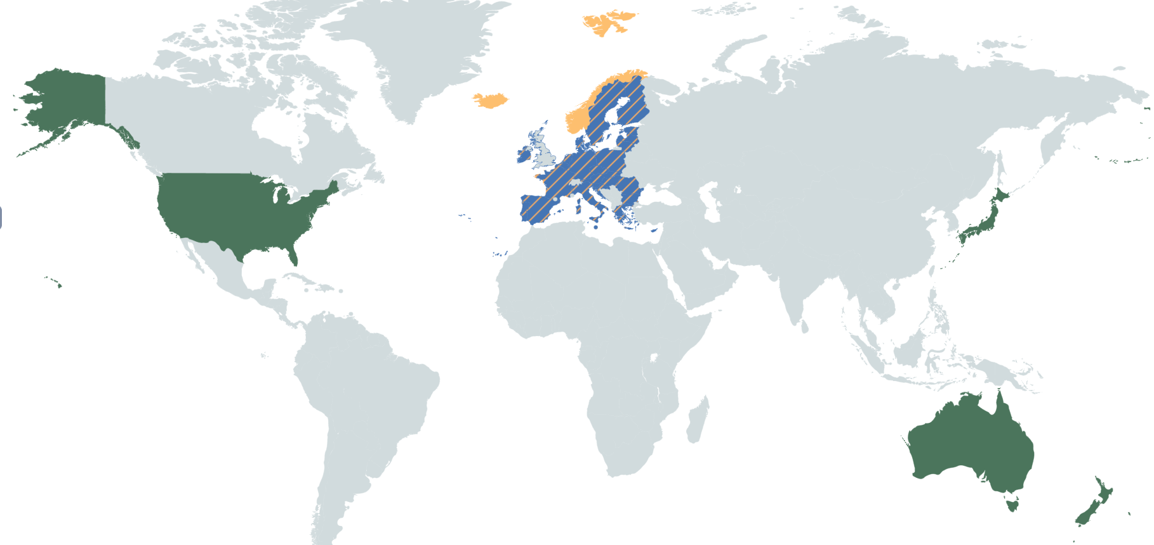
International: Legislation
Key
UK-EU Future Relationship negotiations
Fisheries agreements
Parallel trade agreement negotiations

Slide 16
International: Provisional timeline
UK-EU Fisheries agreement deadline
Future Relationship extension deadline
Deals with US, AUS, NZ and JPN complete?
Transition period ends
30 Jun 2020
1 July 2020
1 Jan 2021
Dec 2022

Slide 17
International: Greener UK
Working to influence all of the Future Relationship, fisheries and trade negotiations, with democratic oversight and sustainability measures the underpinning theme
We will seek to co-ordinate with civil society groups in other countries who have access to more transparent negotiation processes
Embedding trade knowledge and focus across working groups to join-up our domestic and international strategies
Holding a trade & environment basics workshop, run by Centre for International Sustainable Development Law experts, 0900-1300 24th Jan

Slide 18
Questions?

