Slide 1

Sustainability communications and behavioural change.
Our plans for 2012 and beyond
Greg Sandford – June 2012

Slide 2
What’s our process?
Awareness
Engagement
Behaviour change
Results

Slide 3
What do we want to achieve?
Reduce carbon emissions by 20% by 2020 – from a 2005/2006 baseline.
From today’s date, that’s closer to a 33% reduction.
Embed sustainability principles into all of our activities, as part of our role as a flagship Green Academy:
  Curriculum
  Operations
  Research
  Student Experience

Slide 4
Phase 1: Raising awareness
Since January 2012 we have focused on raising awareness of our sustainability and carbon goals.
  Established plan
  Brought existing work under one consistent banner
  Ensured that the agenda is highlighted regularly through ALL of our existing channels
  And organised high profile activities – our Blackout!

Slide 5
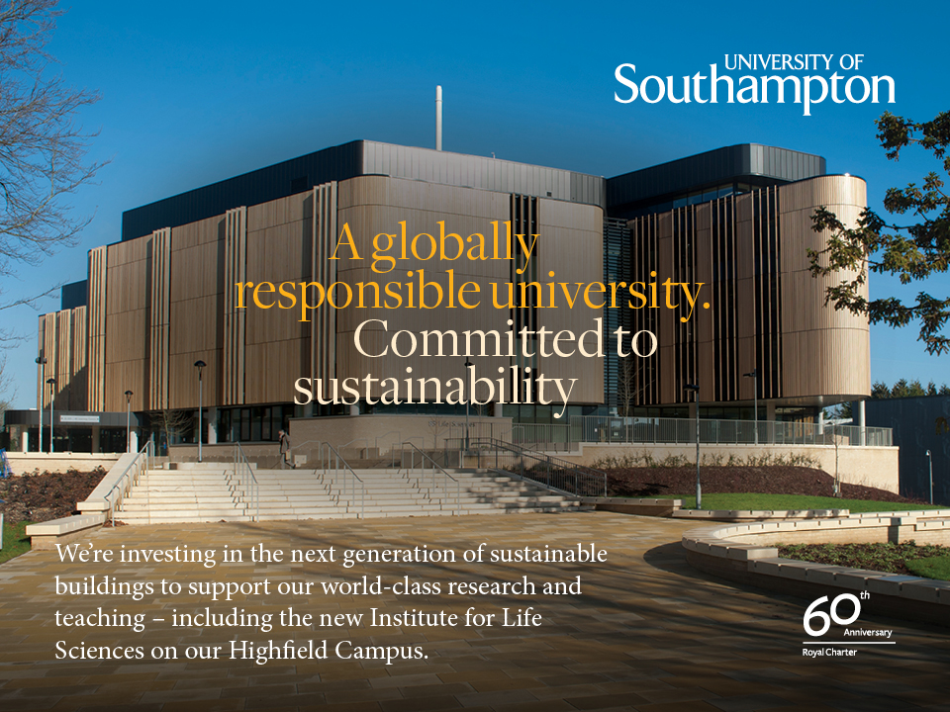

Slide 6
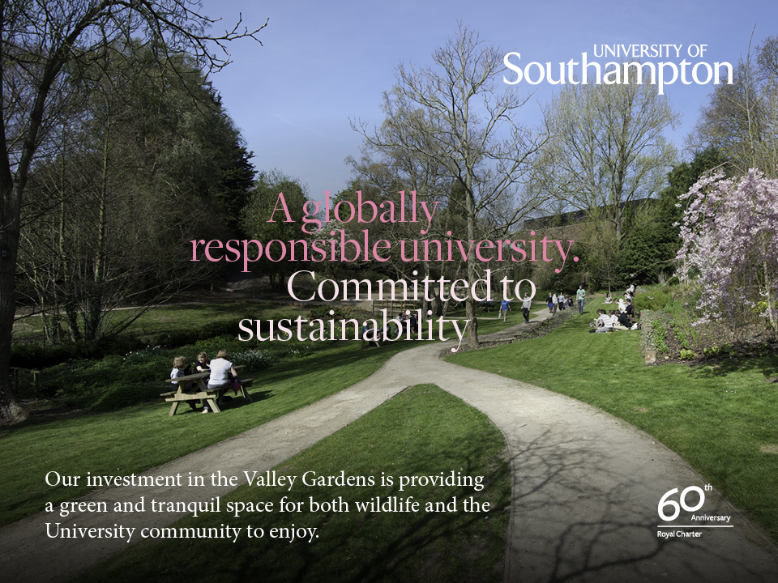

Slide 7
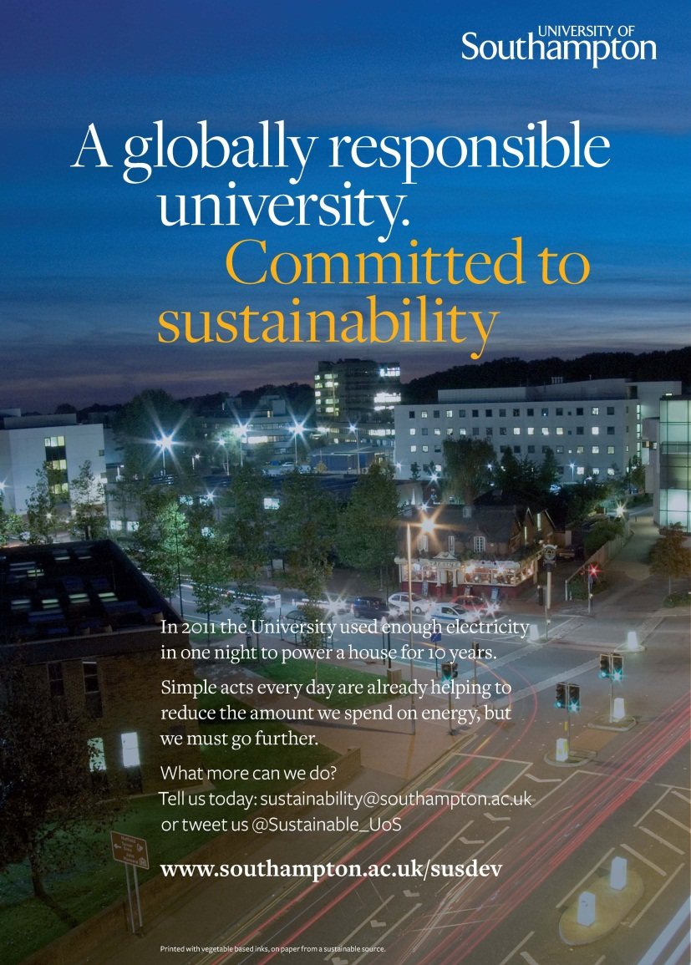
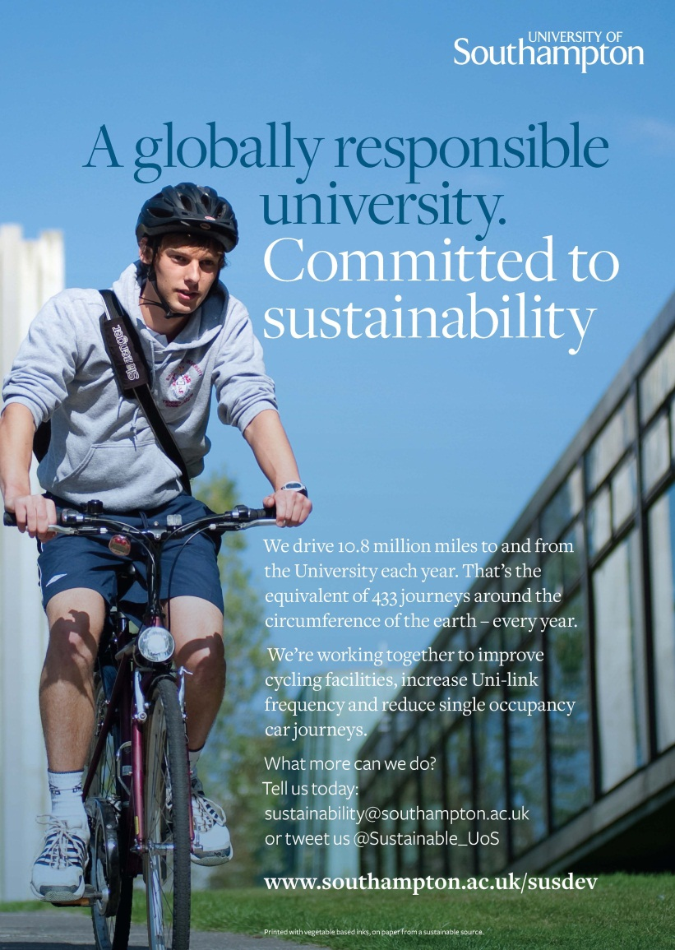
Raising profile internally

Slide 8
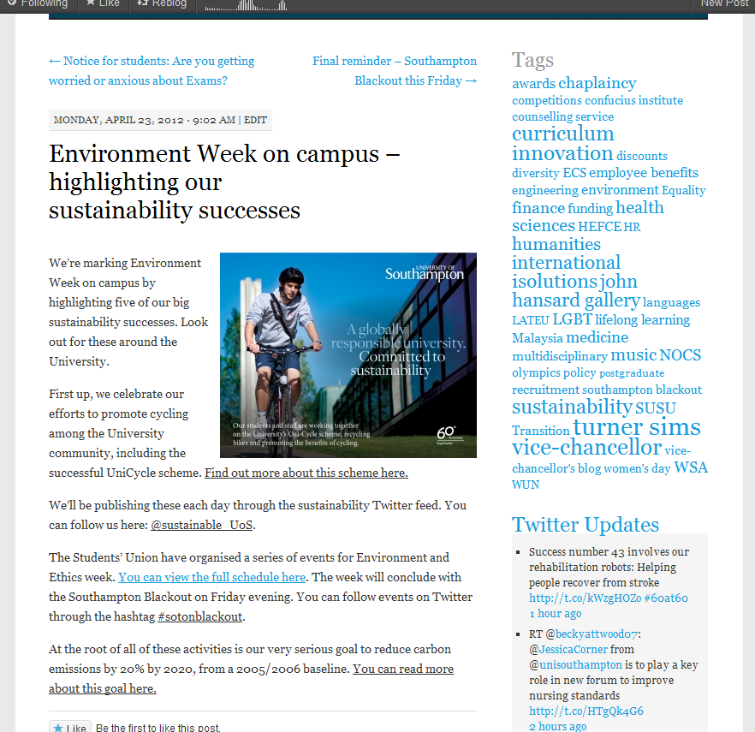
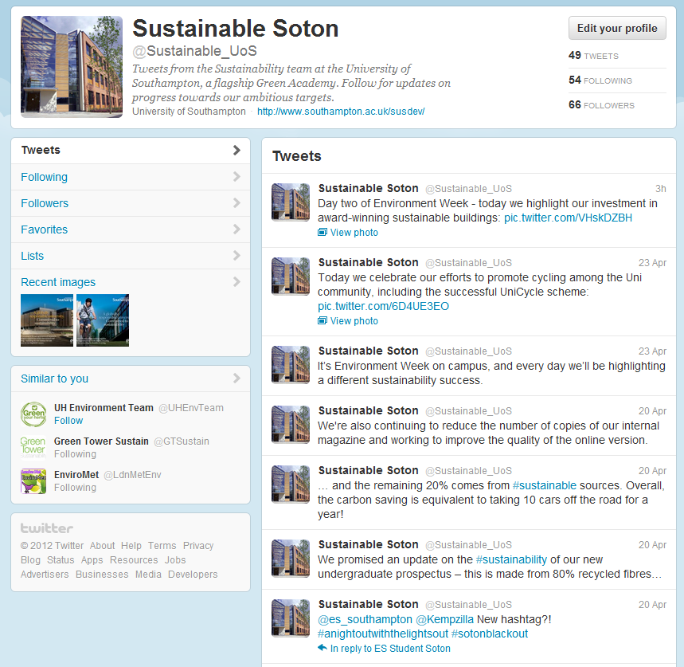
Raising profile internally

Slide 9
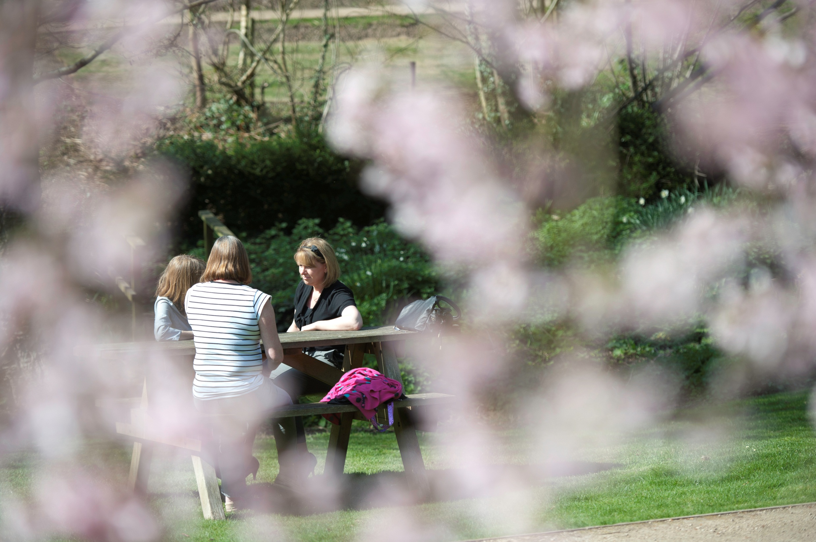
What’s next?

Slide 10
Engaging staff and students in 2012/13
From September we will move to the next phase of our plan:
  Organise staff survey and focus groups to understand motivations and barriers
  Highlight good practice, changes, investments and progress – and act on suggestions
  Re-launch our network of sustainability officers and train them as effective champions
  Establish and outline the sustainable behaviours that we most need to embed – and encourage pledges

Slide 11
Behavioural change
Ultimately, having raised awareness and engaged staff, we will look to innovatively embed more sustainable behaviours across the organisation – including:
  Transport
  Energy usage
  Procurement
  Water
  Recycling

Slide 12
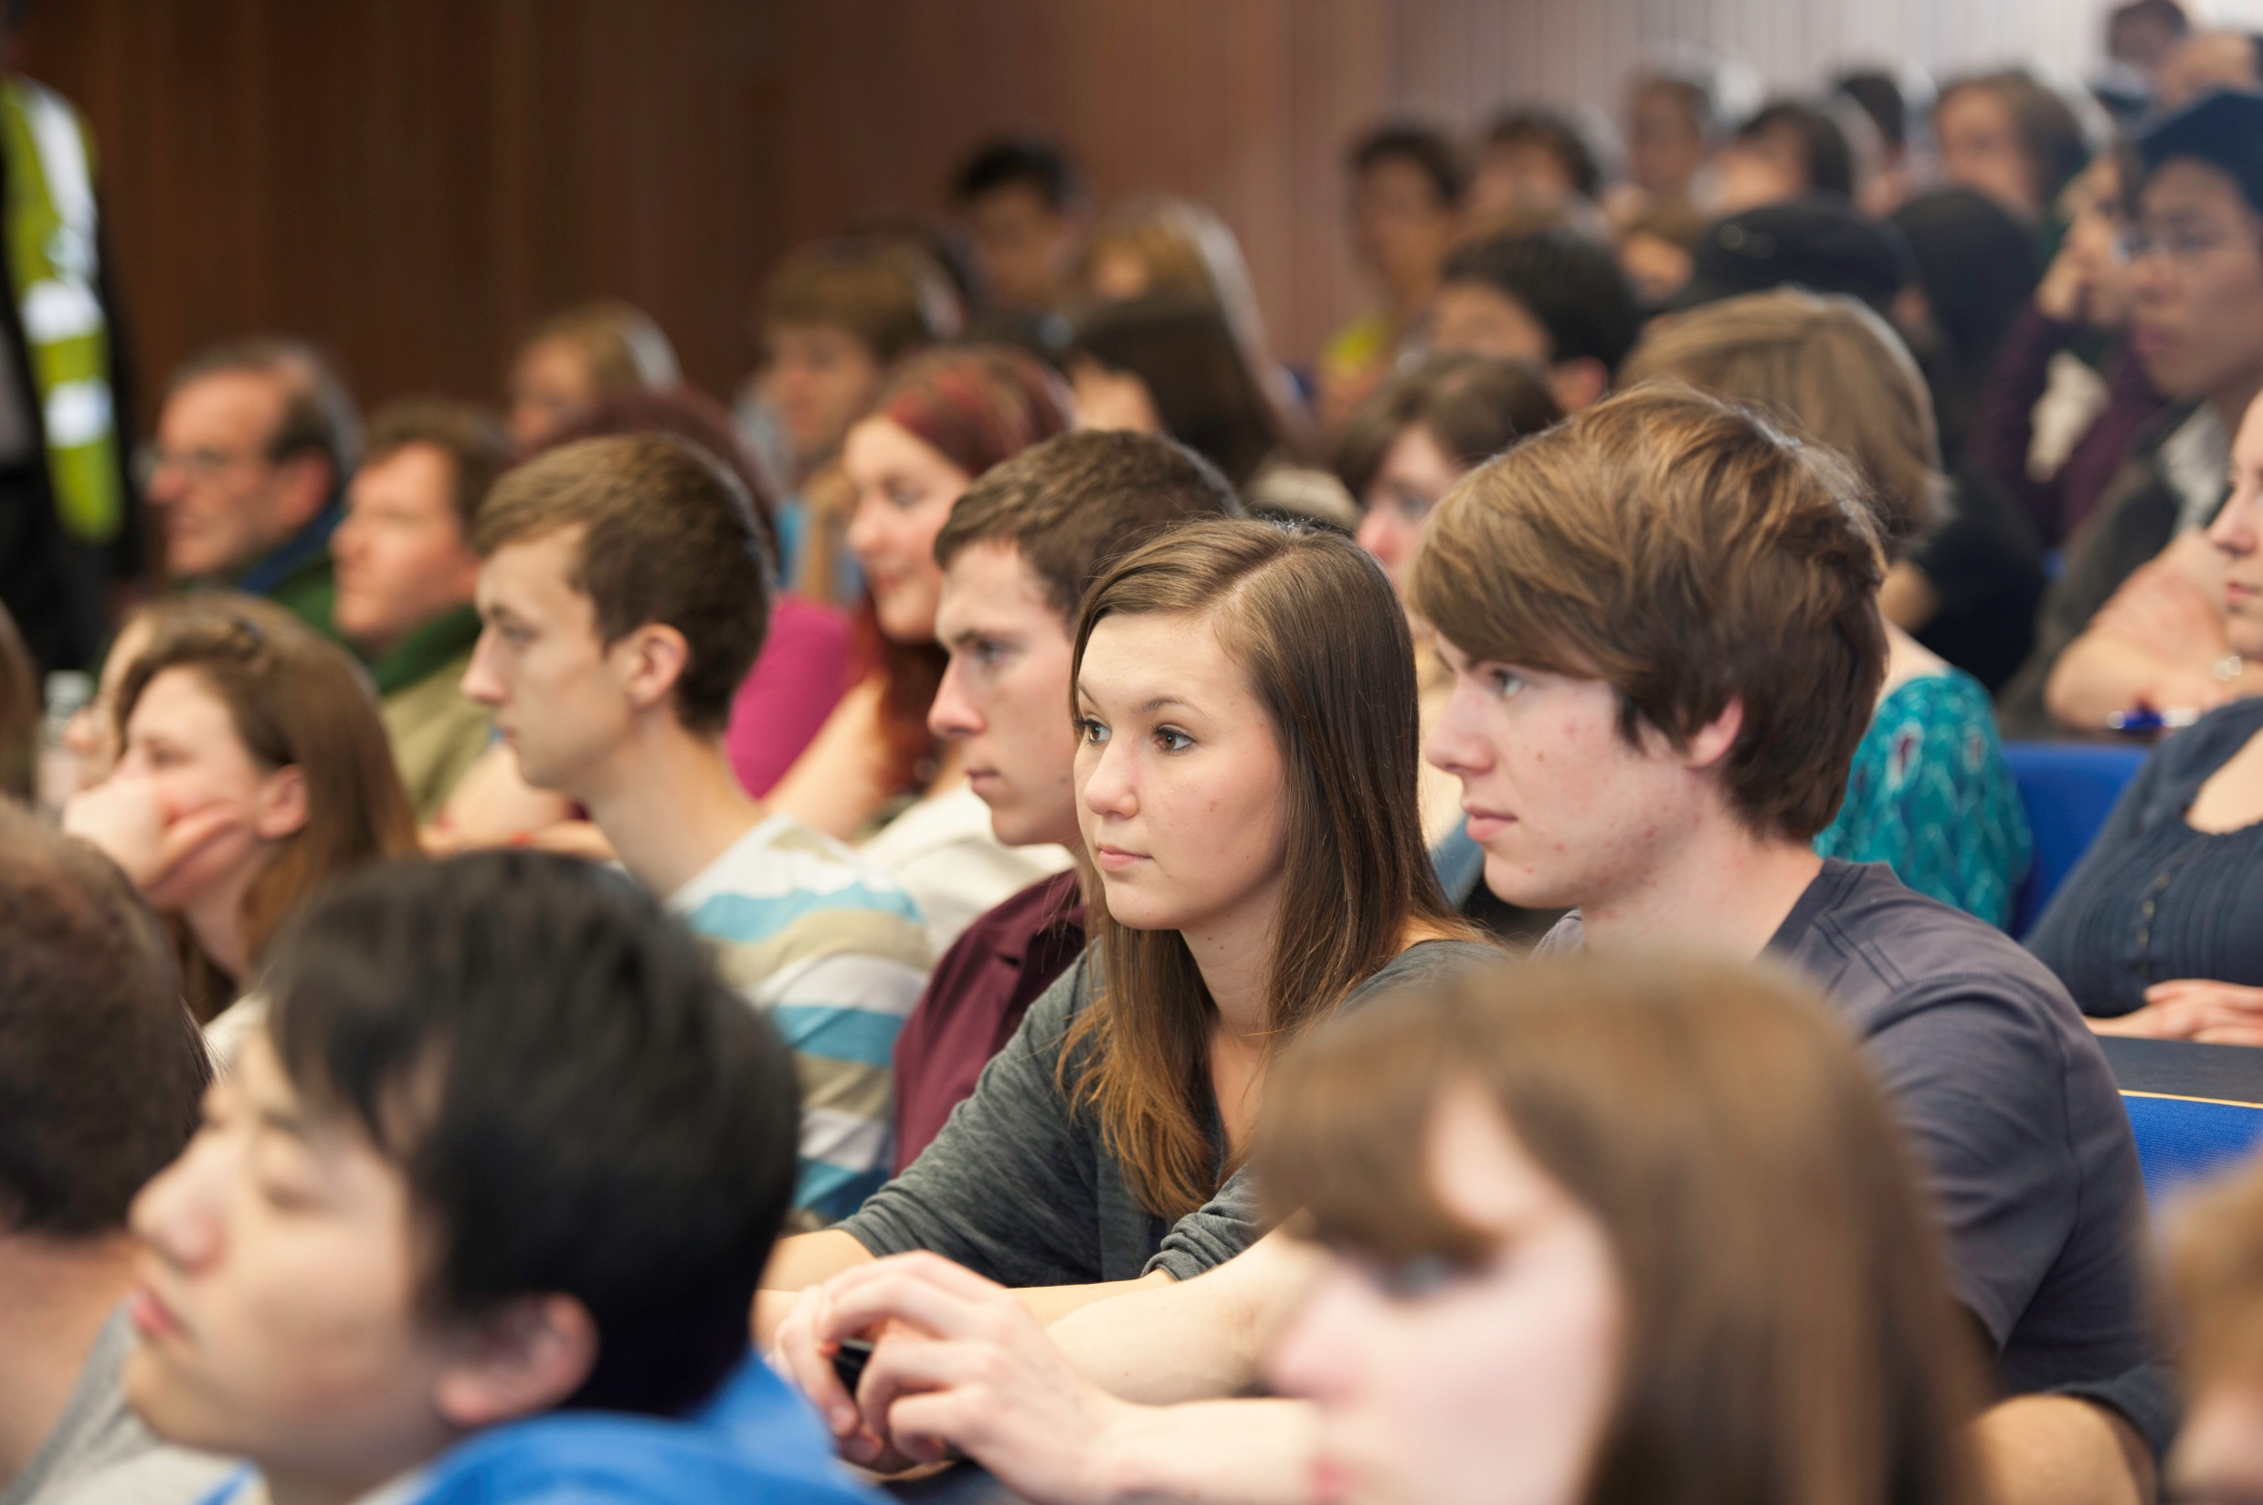
Southampton Blackout

Slide 13
Southampton Blackout
More than 250 staff and student volunteers audited all of the buildings on our main campus and switched off equipment left on unnecessarily before the weekend.
Main aims:
  Highlight the impact that small actions can have and our energy usage over a typical weekend
  Reduce carbon footprint and contribute to long term behavioural change
  Involve the whole University community in one high-profile and fun sustainability event
  Give students an opportunity to gain experience

Slide 14
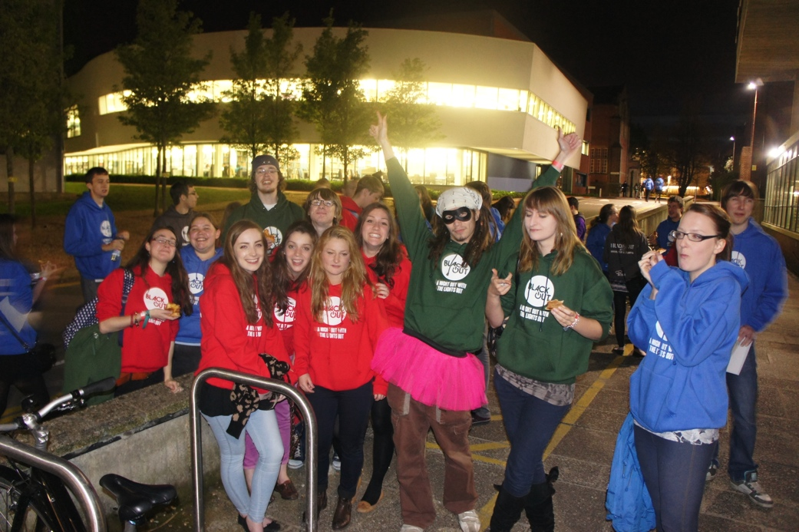
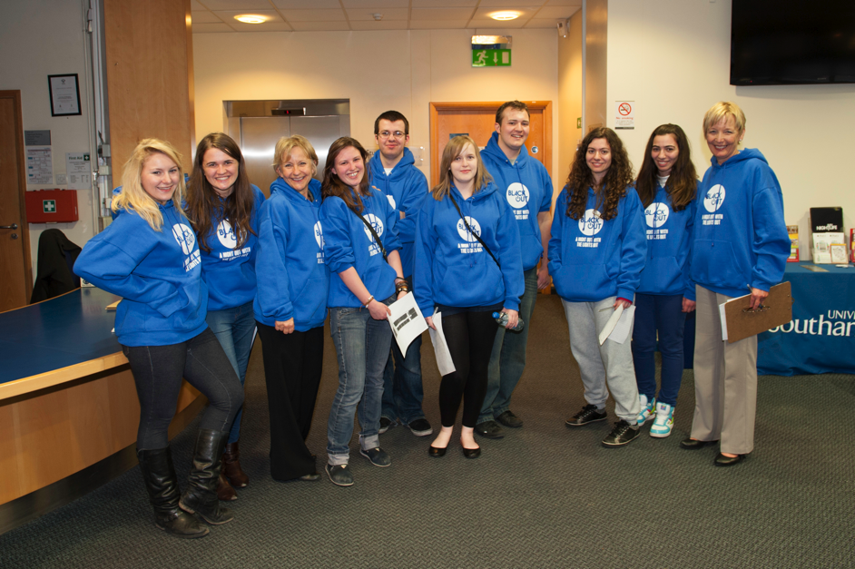
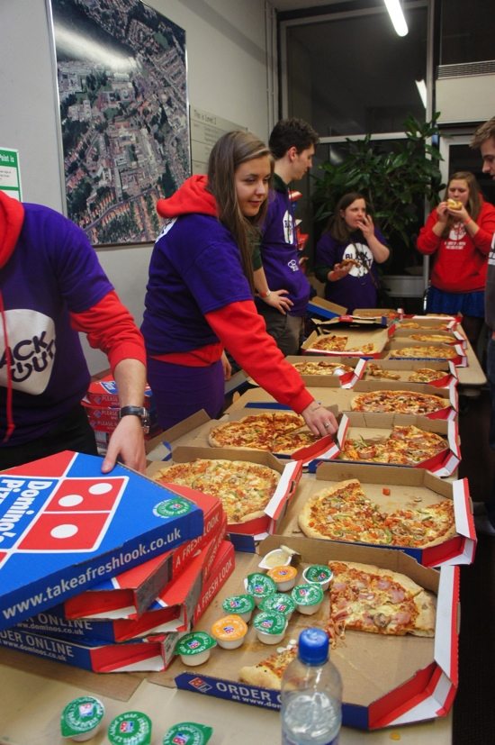
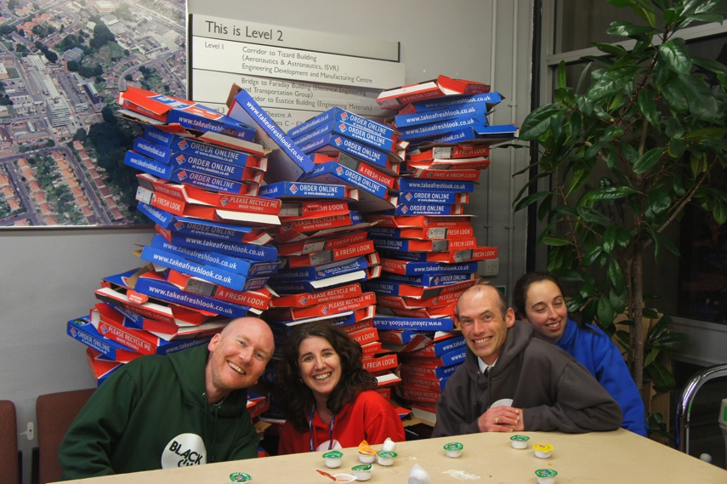
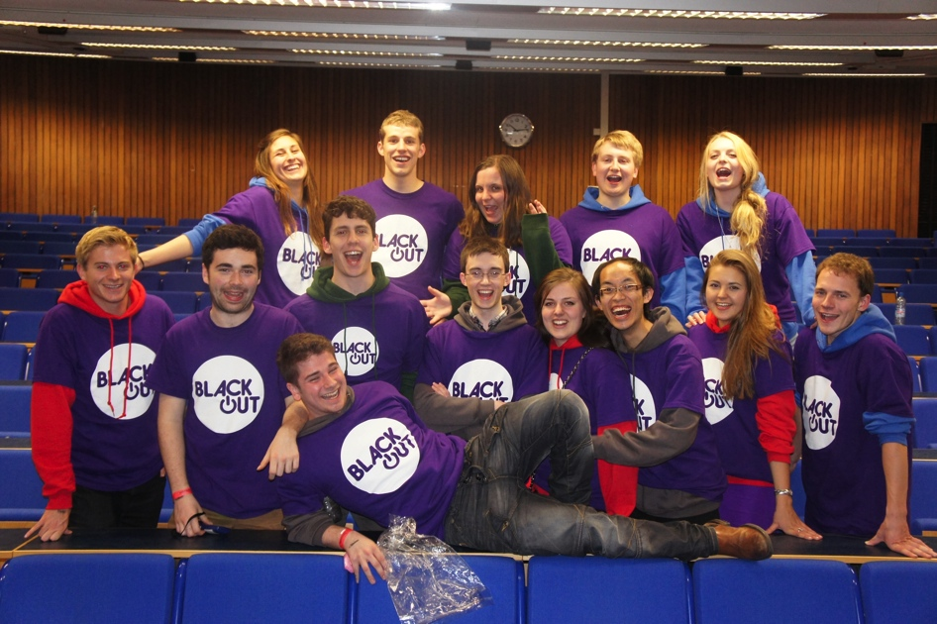
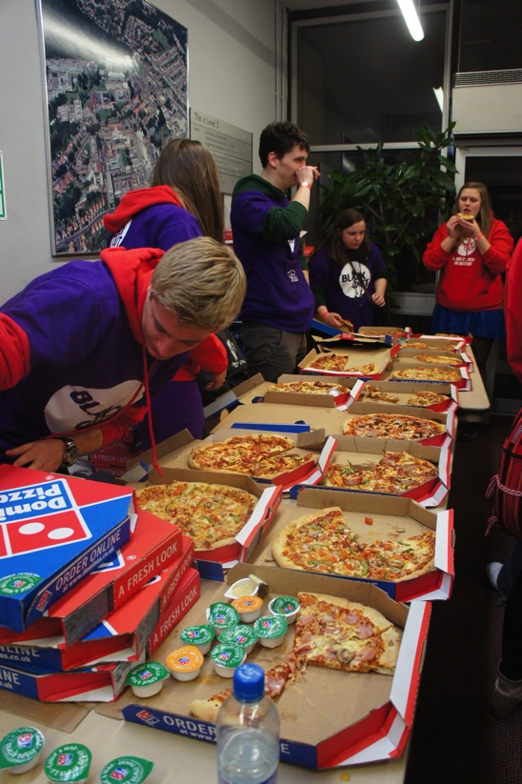
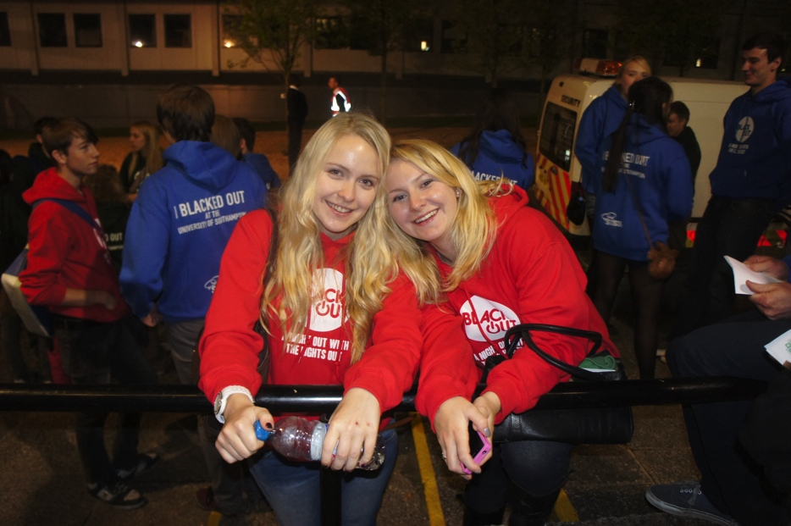
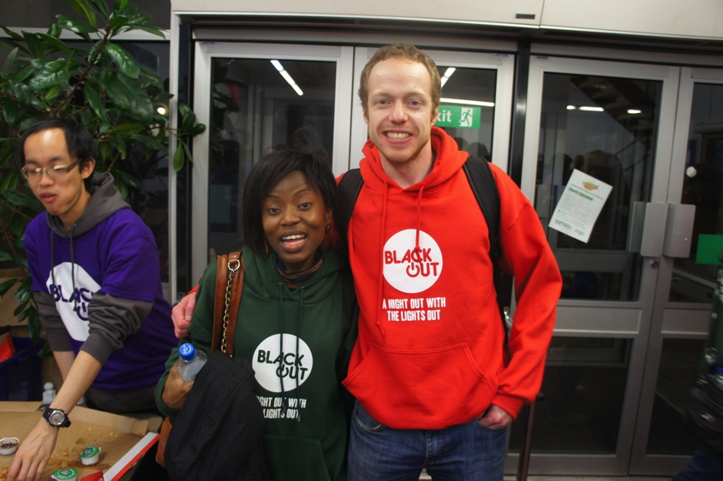

Slide 15
Blackout communications
Consistent and persistent communications about the Blackout across all of our channels
Most popular topic to date on our corporate internal blog
Utilised sustainability officers and cascaded through line managers
Engaged students and other universities through our social media channels – including #sotonblackout hashtag
Promptly published headline results and lessons – soon to publish infographic highlighting best and worst buildings.

Slide 16
6%
7 tonnes

Slide 17
16,000 kWh
£1,600

Slide 18
Headline results
6% reduction in electricity usage compared to average of three similar weekends.
Saved 7 tonnes of carbon and 16,000 kWh of electricity – enough to power five family homes for a year.
Saved £1,600 worth of electricity – equivalent to £85,000 over a year.
One single complaint – out of a university community of 25,000+
Highly engaged staff and students volunteers worked together and gained valuable experience.

Slide 19
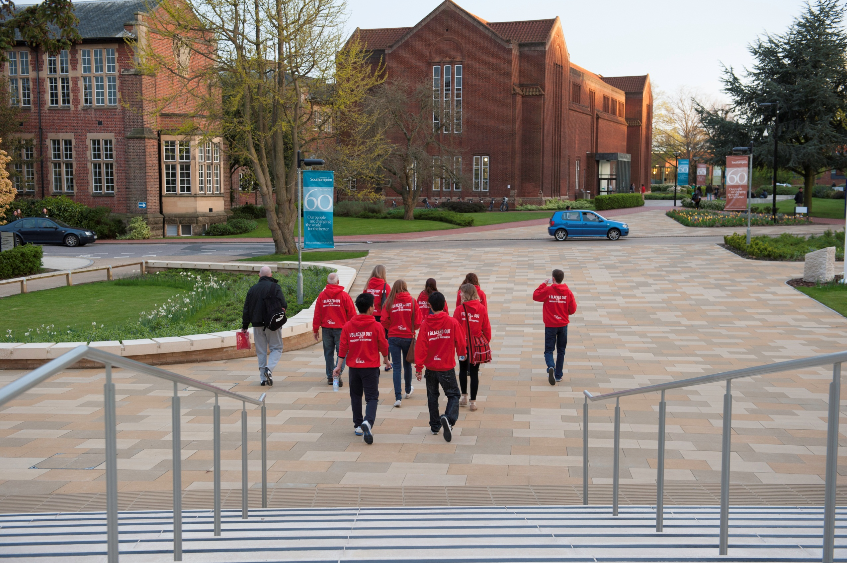
Blackout 2013

Slide 20
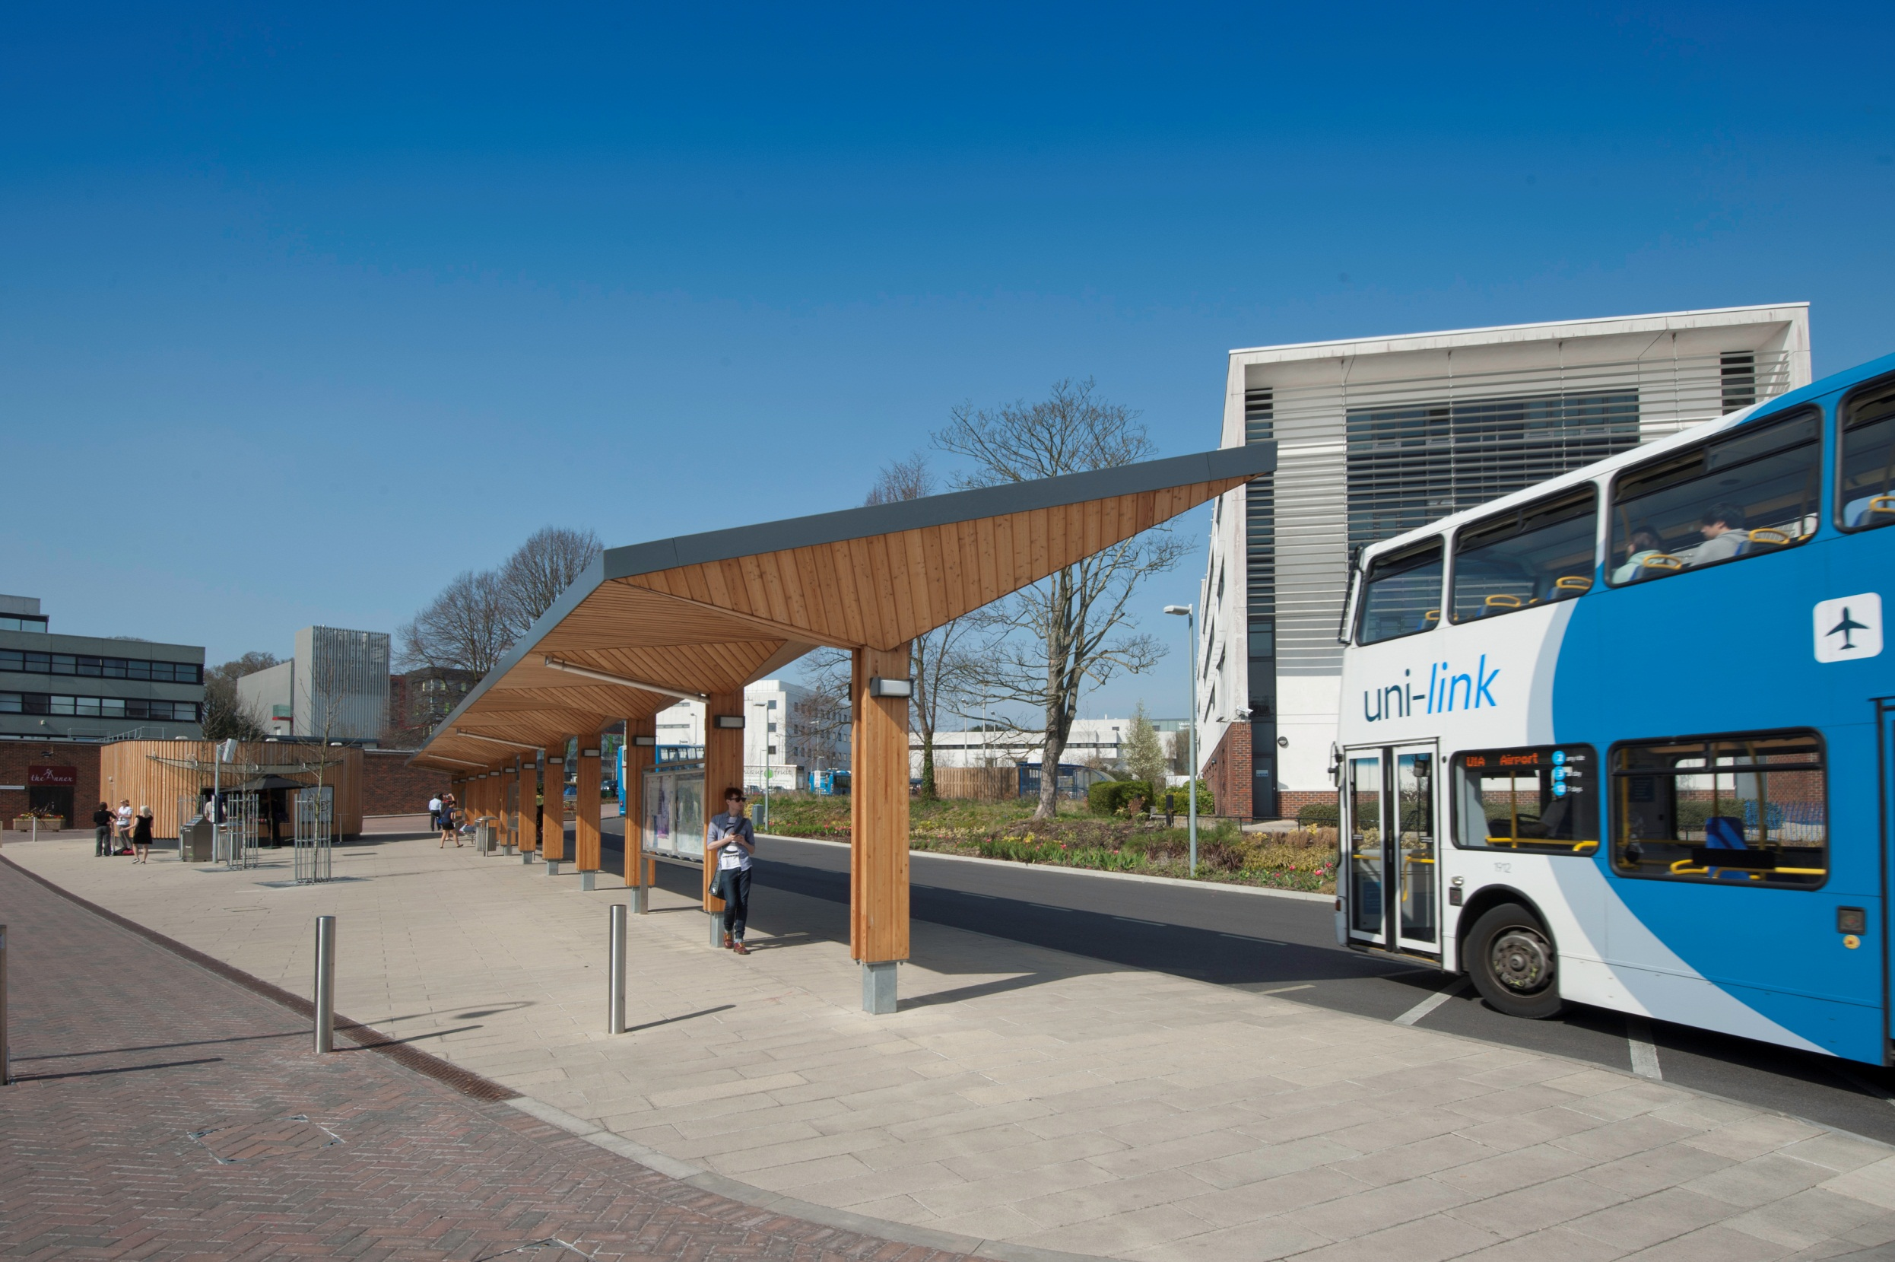
UK Blackout?

