Slide 1
Sustainable Transport Advice
Support available for organisations from your local Home Energy Scotland advice centre
Emma Lawrie
Sustainable Transport Advisor
Home Energy Scotland advice centre North East

Slide 2
Why Low Carbon Transport You say?
Climate Change (Scotland) Act 2009
        Transportation accounts for 29% emissions
        Road Transport makes up 80% of this
        Cut by 42% by 2020 & 80% by 2050
Cycle Action Plan 2010
        Aspiration that 10% of all journeys are made by bicycle
Close relationship between low carbon and low cost
        Majority of households and business’ spend more on Transport than any other expenditure category

Slide 3
Sustainable Transport Advice
Services
Free Sustainable Transport Review’s
Free online resources
Interest-free Low-Carbon Transport Loan
Funded work place charge points
Fully-subsidised “FuelGood” fuel-efficient driver training
Free employee engagement events
  Sustainable transport presentations
  Fuel-efficient driving simulator

Slide 4
Sustainable Transport Review
Company vehicles, grey fleet vehicles, business travel
Analysis of current situation, rationale for change, recommendations
No cost, low cost and capital cost recommendations to reduce unnecessary travel and make necessary travel more efficient
Potential annual cost and CO₂ savings from implementation
  Average identified savings of over £13,000 and 22 tonnes CO₂
Can then access interest-free Low-Carbon Transport Loan

Slide 5

Low-Carbon Transport Loan
£500-£100,000 available (capped at £35,000 for each plug-in vehicle)
Interest-free!!
Repayment period of up to 6 years
Funded by Transport Scotland
Available to all sizes of organisation in Scotland wishing to become more sustainable
For measures that help reduce CO₂ emissions and costs from the organisation’s transport and travel

Slide 6
What can be funded by the loan?
Plug-in vehicles – EVs, PHEVs, E-REVs
Cycling facilities – cycle storage, bicycle racks
Video and teleconferencing facilities
Fleet management software
Vehicle efficiency devices (which don’t void warranty)
Season ticket loans
http://www.energysavingtrust.org.uk/low-carbon-transport-business-loan

Slide 7
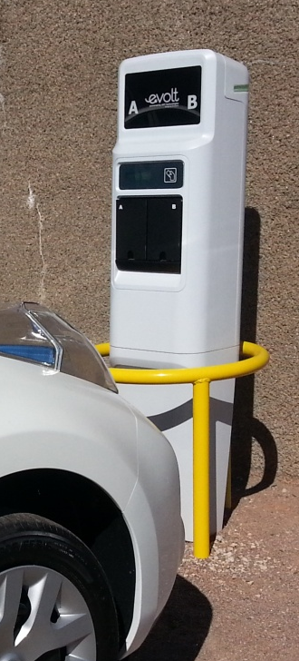
Workplace charge points
Transport Scotland provide this funding to complement the growing national network of charge points
100%, 75% or 50% funded
  “Fast” charge points available
    Fully charge EVs in 3-8 hours (car-dependent)
Charge point should be available to the public

Slide 8
Free Online Resources
Fleet Health Checks
Provides business with transport carbon footprint and recommendations to help you take the first steps towards greening your fleet and saving money.
Buying a Fuel Efficient Vehicle Tool
For each car the results will show the:
Amount of CO₂ the car emits
VED Band
Average mile per gallon
Fuel cost and type of fuel used by the car
Buying an Electric Vehicle Tool
Office EV range
Standard charge time
On the road price
Battery lease options

Slide 9
FuelGood Driver Training
Our FuelGood fuel-efficient driver training is fully subsidised by transport Scotland.
350 organisations in Scotland which includes;
- 28 Scottish local authorities
- 8 NHS trusts
- 16 universities and colleges
Nigel Homes, CEO from Scottish Hydrogen and fuel cell association once said “If you do just one thing to reduce your fleet costs, book your drivers on FuelGood training”.

Slide 10
FuelGood Driver Training
50-minute training session with professional driving instructor
Lap 1: Drive as normal
Lap 2: Instructor points out small changes in technique that can make big changes in fuel consumption
MPG of the two laps compared to see the difference
Average saving of 13% or up to 2 months fuel per year
Save £235
per year!

Slide 11
Employee Engagement Events
Through the Home Energy Scotland network, we can provide organisations with a unique employee engagement programme to increase your staff wellbeing. From online modules to home visits, we offer a wide range of services to help your employees not only lower their transport and travel costs but also their household energy bills.
Presentations on sustainable transport
Lunch and Learn sessions
Workshops and webinars
Fuel-efficient driving simulator

Slide 12
Case study – University of Dundee
The University of Dundee received a free Sustainable Transport Review which focused on their grey fleet miles. The review included recommendations such as;
introducing cycle to work schemes for staff to buy discounted bicycles.
Provide free use of pool cars, vans and bikes to encourage more efficient modes of travel.
Introducing driver declaration forms and a system for regular driver documentation checks.
Results: Since 2010, the university of Dundee has seen an impressive 70% reduction in grey fleet miles. This equates to nearly £170,000 and carbon dioxide emissions of approximately 140 tonnes.
“EST’s GFR helped us to target specific areas to reduce business miles and promote other sustainable forms of transport. We now have pool vans, pool bikes, various cycling promotions and an electric vehicle Nissan Leaf from Co-wheels car club”

Slide 13

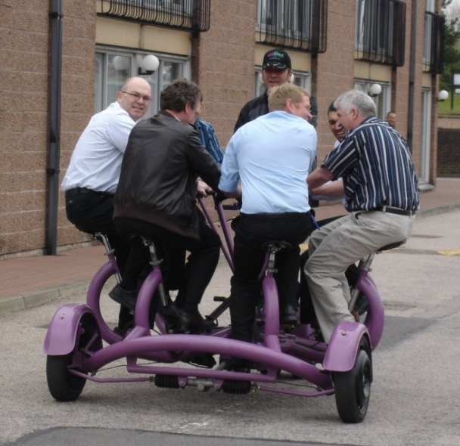
For more information, please contact…
Emma Lawrie
01224 253916
emma.lawrie@ne.homeenergyscotland.org
Conference bike –
a new way to hold meetings!
“When I see an adult on a bicycle,
I do not despair for the future of the human race”
H G Wells

