Slide 1
A Shared Responsibility: Increasing our Green Impact
naomi.arnold@uws.ac.uk
www.uws.ac.uk/sustainability ׀ www.greenimpact.org.uk/uws

Slide 2
Agenda
My role at UWS
What is Green Impact?
A look at the workbook
Department specific workbooks
Good practise examples
Green Impact as a tool
Top tips

Slide 3
My role
Naomi Arnold
Sustainable Behaviours Coordinator
Green Impact
Energy Awareness
Sustainability Hub & Free Shop
Volunteer management
Sustainable Travel
Community Gardens

Slide 4
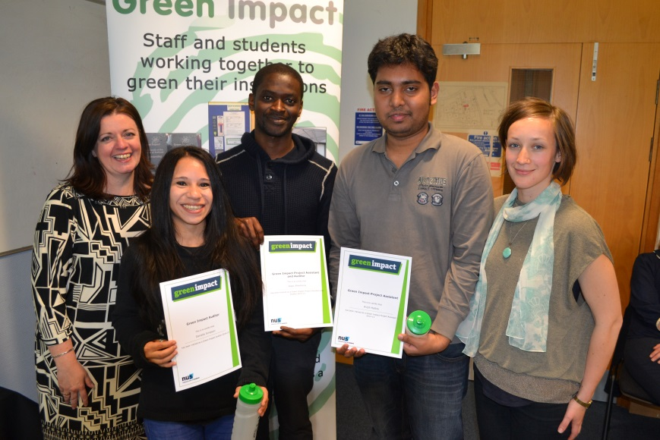
What is Green Impact?
“Green Impact is an environmental accreditation and awards scheme run by the National Union of Students. We bring together staff and students to green campuses, curriculums and communities across the country.”
Green Impact
Engages
Encourages
Enables
Exemplifies

Slide 5
Green Impact at UWS - Headline Figures
2014 – 2015
10 teams
243 staff, 55 were directly involved
11 student assistants and auditors trained
375 greening actions complete
Potential carbon saving of 71,000kg CO2e & cost savings of £15,000
2015 – 2016
19 teams
16 student assistants trained
Nationally
Over 1,500 teams
Over 55,000 greening actions
…small changes can make a BIG impact.

Slide 6
Notes:
Has a new look too.

Slide 7
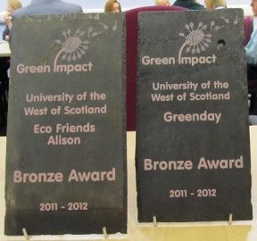
Department specific workbooks
Catering, cleaning, Facilities, Grounds and Chemistry labs.
Engineering department – to be written…
Tailored and appropriate
Better staff engagement
More effective impact

Slide 8
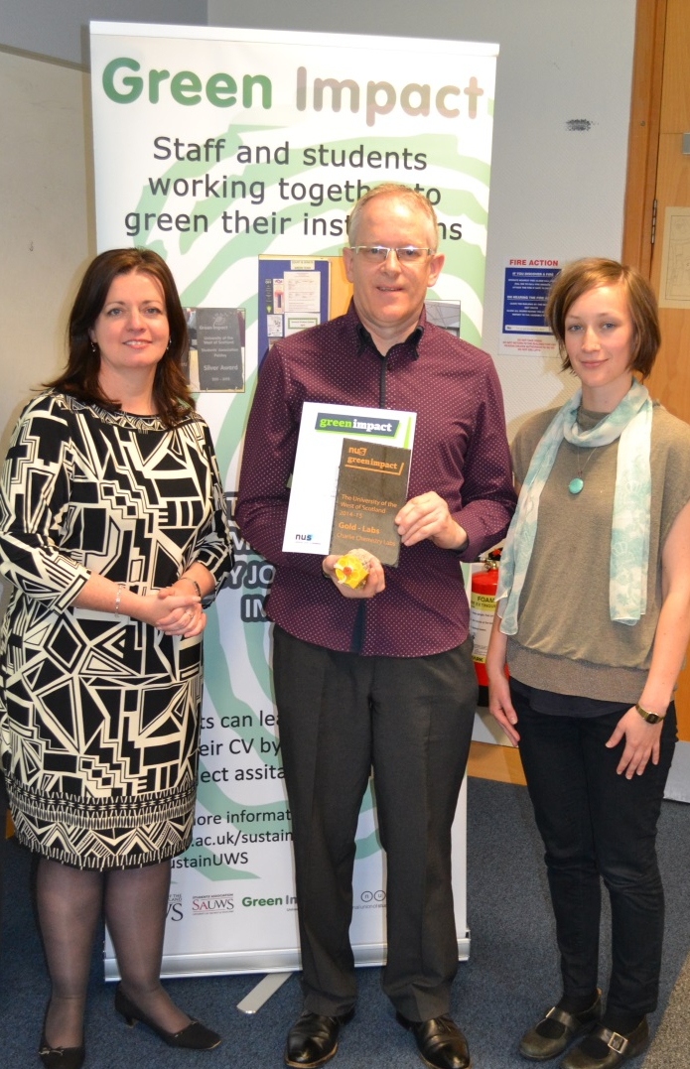
Department specific workbooks
Charlie McGuiness, Chemistry Lab Technician
Alternatives to helium
Replacement of Fume hoods for new ones – 80% more energy efficient
Energy consumption added as procurement procedure e.g. A+ fridges and freezers; and waterless condensers purchased
Bottle collection facilities
Smaller, compressed gas canisters
LED lighting in labs

Slide 9
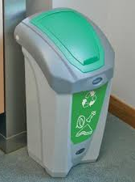
Department specific workbooks
Catering teams – across all campuses
2014 – 2015 = 1 team (Paisley)
2015 – 2016 = 6 teams (All campuses)
Working much more closely with Estates team to ensure responsible waste management
Working specifically to minimise food waste from catered events

Slide 10
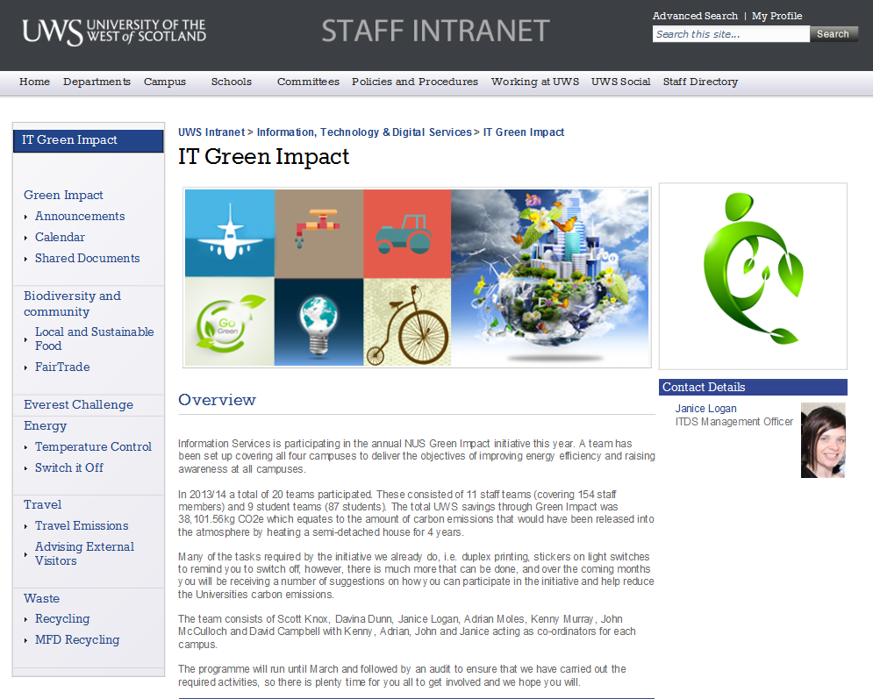
Best Practise examples
Information, Technology and Digital Services – Intranet site

Slide 11
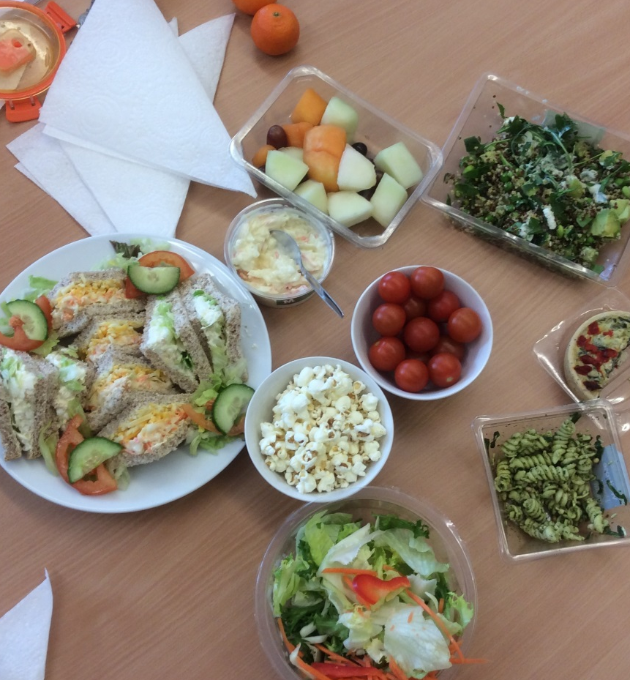
Best Practise examples
Court & Senate – Lunch and Learn
Communicate Green Impact messages
Social – something outside of ‘work’ norm
‘Ticks’ Green Impact criteria B019
Colleagues educating colleagues

Slide 12
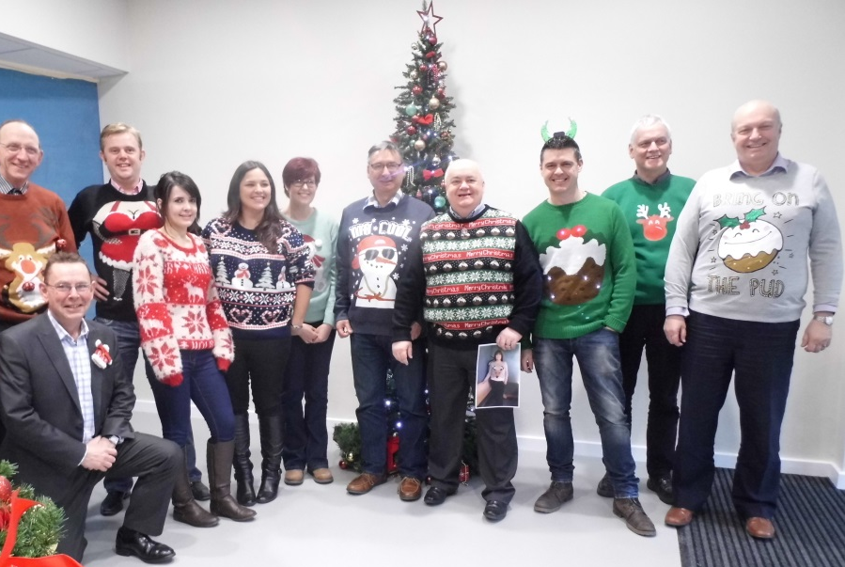
Green Impact as a tool
‘Bin the Bin’ movement
Christmas Switch Off and woolly jumper days
Sustainability Hub communications and donations
Health and Safety – recycled First Aid kits and Fire Extinguishers

Slide 13
Green Impact as a tool
Education – Events Management & School of Health, Nursing and Midwifery
Events Management
ISO regulation (since London 2012 Olympics)
Wider professional understanding / experience
Auditing to understand environmental impact of events
School of Health, Nursing and Midwifery
Air pollution: Breathing problems and lung diseases; underweight newborns
Responsible waste management
Diminished resources: e.g. oil for plastics
Increased temperatures: asthma and hay fever

Slide 14
Green Impact
Top tips…
Some changes can be easy, others take more time and more people
Work together – spread the impact
Not just emails, talk and organise activities
Reward efforts
Be aware of time
Encourage others to get involved
Cake does help!

Slide 15
Thank you
naomi.arnold@uws.ac.uk
www.greenimpact.org.uk/uws

