Slide 1


The Lifecycle of Electronics
Joint Waste and Procurement TSN
11th March 2015
Queen Margaret University

Slide 2
Agenda
10-00 Registration and refreshments
10-15 Welcome and Introductions
10-30 Electronics and the Circular Economy in HFE
1045 Lifecycle considerations at Procurement
11-15 Circular Economy thinking
12-00 Ethical Procurement
12-30 Networking lunch
13-30 Disposal and Reuse considerations
14-10 Opportunities for moving up the hierarchy
15-00 Summary and discussion
15-30 Close

Slide 3
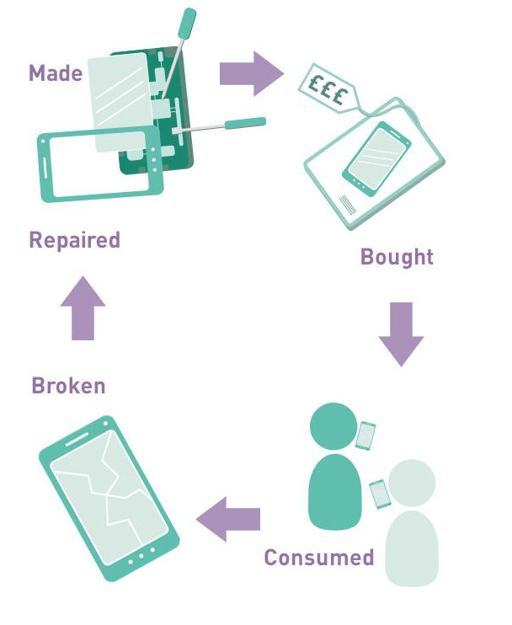
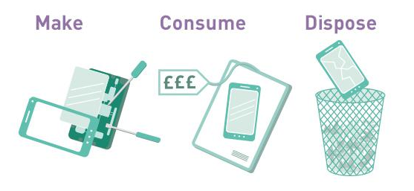
What is the Circular Economy?
The circular economy is an alternative system in which products and materials are re-used in continual cycles.
All graphics from ZWS Website © Zero Waste Scotland

Slide 4
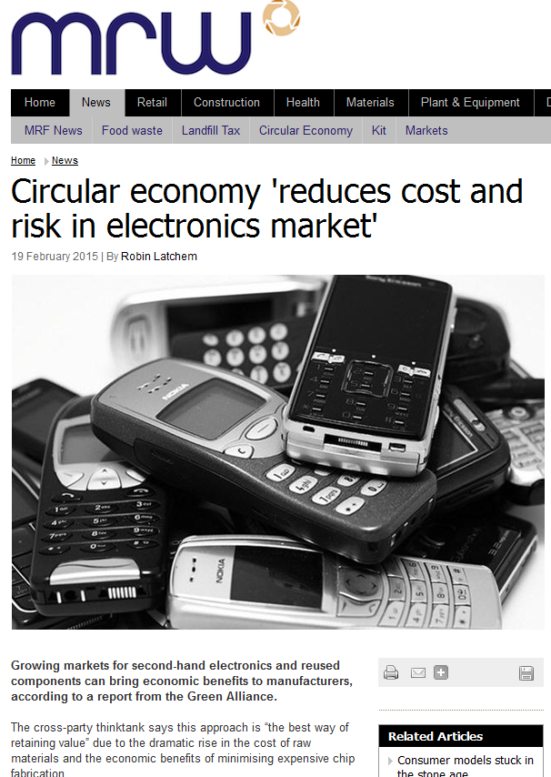
Electronics and the Circular Economy
Obvious place to focus
  Quick turnover due to changes in design, functionality and desirability
  High environmental costs
    Resource availability/cost
    Rising population
    etc
  Potential for change
    Rapid changes in market
    Local (and global) economy
  FHE sector => huge market and huge potential for change

Slide 5
Agenda
10-00 Registration and refreshments
10-15 Welcome and Introductions
10-30 Electronics and the Circular Economy in HFE
1045 Lifecycle considerations at Procurement
11-15 Circular Economy thinking
12-00 Ethical Procurement
12-30 Networking lunch
13-30 Disposal and Reuse considerations
14-10 Opportunities for moving up the hierarchy
15-00 Summary and discussion
15-30 Close

Slide 6
Understanding electronics waste
The 'No Time to Waste' workshop gave students the opportunity to deconstruct electronic equipment to find out what everyday items are made of, in order to consider design issues and think about how components and materials can be reused and recycled.​
  https://www.youtube.com/watch?v=BSwOqkG0qpw

Slide 7
Agenda
10-00 Registration and refreshments
10-15 Welcome and Introductions
10-30 Electronics and the Circular Economy in HFE
1045 Lifecycle considerations at Procurement
11-15 Circular Economy thinking
12-00 Ethical Procurement
12-30 Networking lunch
13-30 Disposal and Reuse considerations
14-10 Opportunities for moving up the hierarchy
15-00 Summary and discussion
15-30 Close

Slide 8

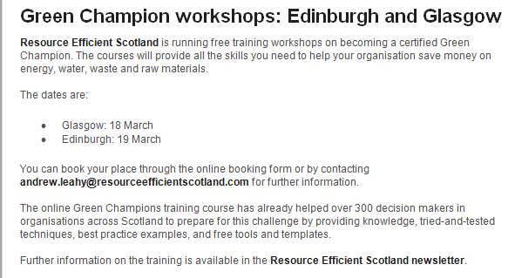
Training opportunities
EAUC
CIWM
Resource Efficient Scotland

Slide 9









Thanks for the support!

