Slide 1

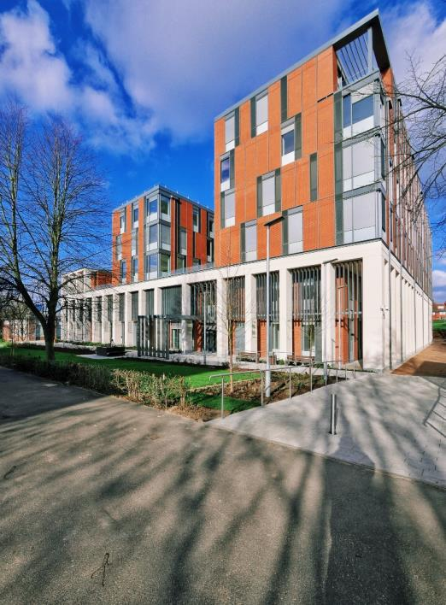

Scaling Up Passivhaus
The Centre for Medicine, University of Leicester
James Elliment
Operations Manager
Willmott Dixon Construction

Slide 2
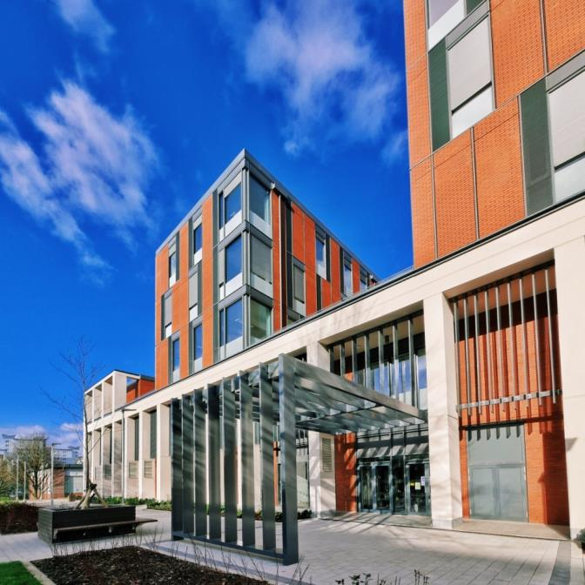
Key Facts
Total GIA -13,526 m²
Certified to the PassivHaus standard
15 kWh/m2 per year heating demand
120 kWh/m² per year total primary energy demand
BREEAM ‘Excellent’ Rating
Air-tightness target of 1m³/m².hr @50Pa (0.33 ACH)
Energy Performance Certificate ‘A’
DEC rating target of ‘A ‘– how the building performs in use
First use of computer controlled shading system in the UK
Ground to Air Heat Exchange Labyrinth under the building - 1.6km of ventilation pipework
Connected to the Leicester District Heating Scheme & CHP unit within the University
£42M investment by the University

Slide 3
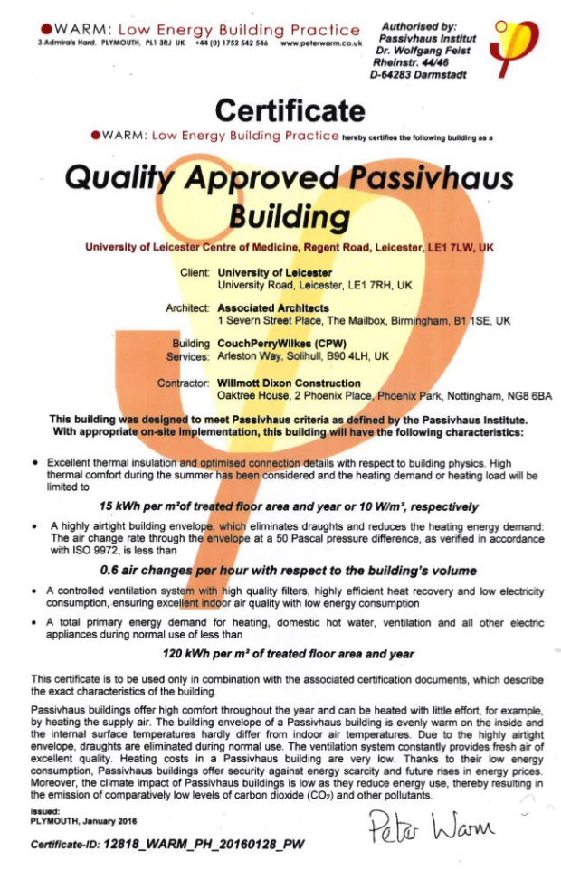


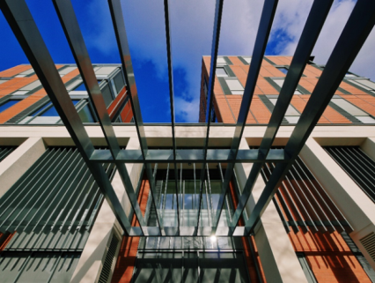
The Centre for Medicine is the largest non-residential Certified Passivhaus project in the UK
Also achieving BREEAM Excellent

Slide 4
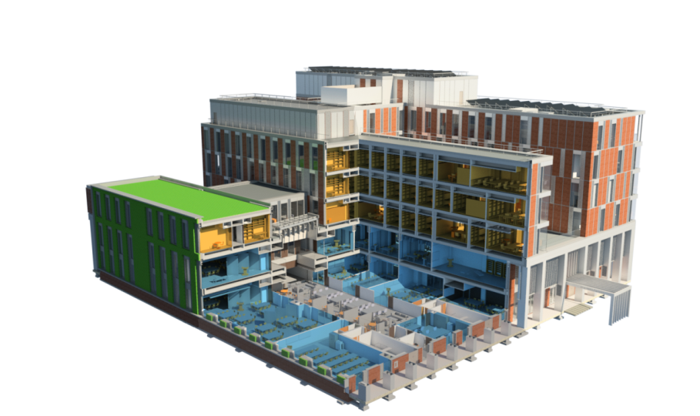
Shallow floor plates for natural ventilation
Efficient AHUs with Heat Recovery
Rooflights with external shading
Full curtain walling façade with brick slips
PV Panels
Active external shading blinds
District heating
Green Roof / Brown Roof
Green Wall
Cavity wall
PH certified curtain walling
Fixed Brise Soleil
Exposed thermal mass
GAHE Labyrinth
Glazed screens
TABS soffit cooling and UFH to atria
Notes:
Typical construction PT slab, curtain walling, raised access floors, exposed soffits, PV panels
Additional thermal mass façade,
TABS soffit cooling
GAHE
District heating
Plant room ducts beneath slab and above roof

Slide 5
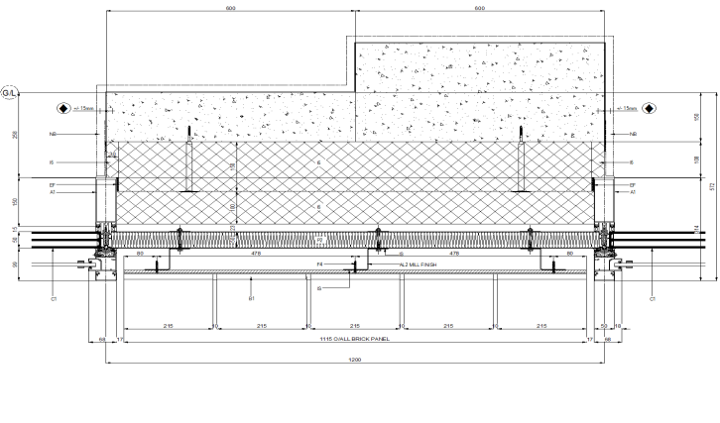
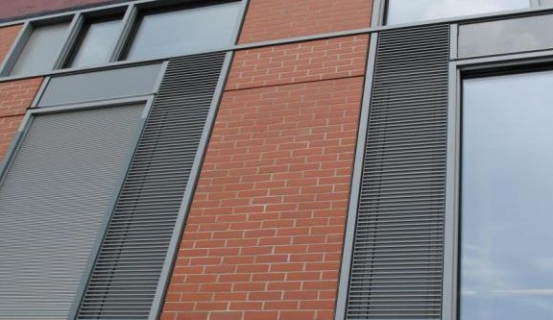
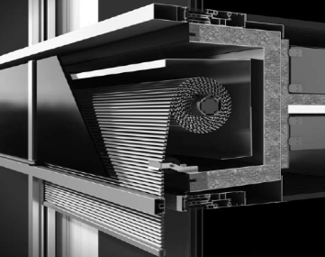
C/Walling with Brick Slips
The Technical Details of Passivhaus
Building component | U value (W.m²K)
Masonry | 0.11
Glazing | 0.57
Roller blind boxes | 0.4
Opening panels | 0.4
Brick cladding | 0.1
CW frame | 0.85
Roof | 0.13
Ground | 0.13
Single subcontractor responsibility
Faster construction programme
Tighter tolerances
PH certified products
Incorporates vent panels and external shading blinds
Notes:
Single subcontractor responsible for airtightness and thermal performance
Easier construction sequence – all built from outside
Faster construction programme
Tighter construction tolerances

Slide 6
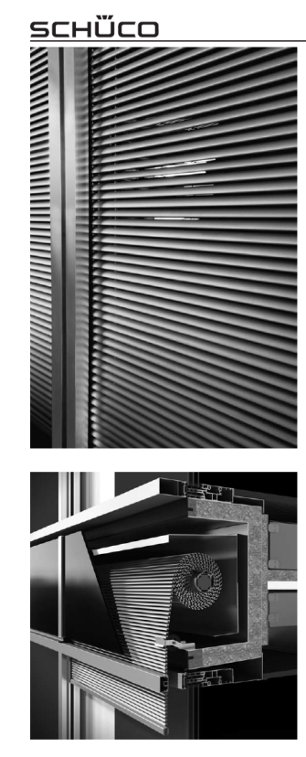
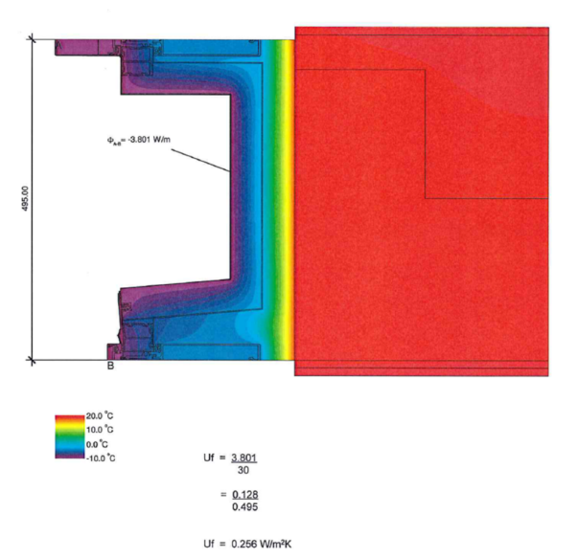
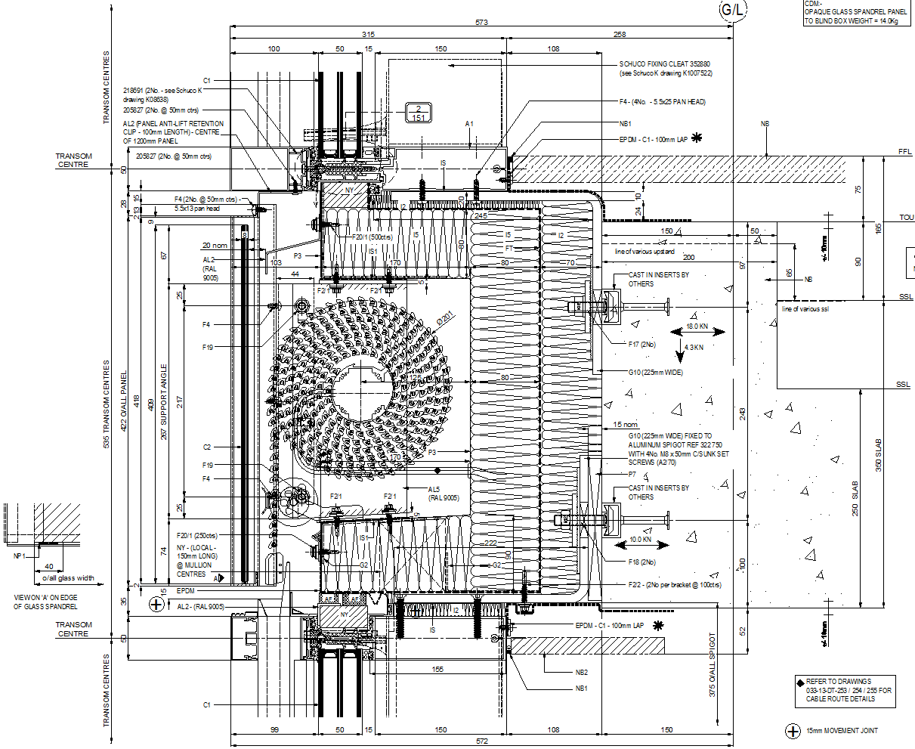
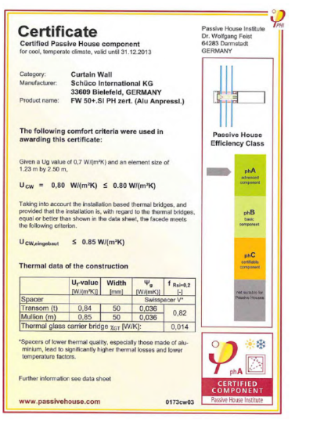
External Shading Blinds
Outside Air Temp
Inside Air Temp
CTB blinds - Rarely used in UK
Automatic operation - linked to BMS
Automatically retract in high winds
Tender design - small sections
Contract - continuous ‘ribbon’
Blind box - thermal weak link
Thermal Bridging Control

Slide 7
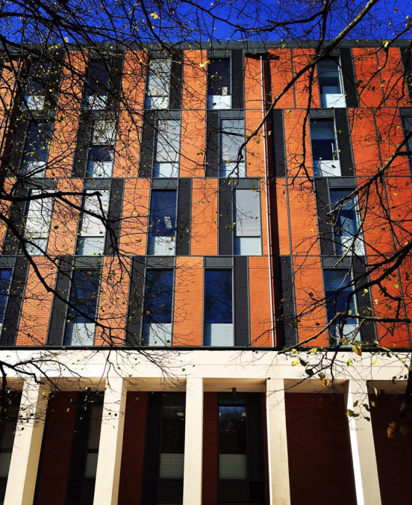
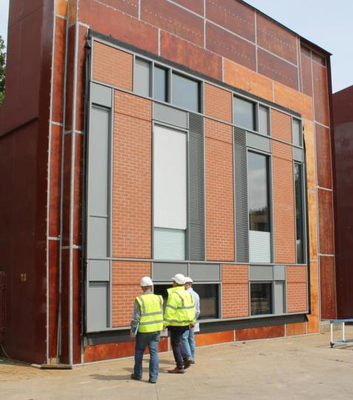
Large Floor to Ceiling Windows
Maximise Natural Light
Less Energy Used on Electricity (Biggest Energy Use)
Installed Façade v Factory Tested Mock-up
Inspection of the façade mock-up prior to air & water testing at Wind-techs Telford Facility. Colours and workmanship benchmark.

Slide 8
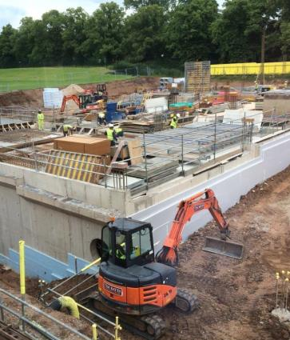
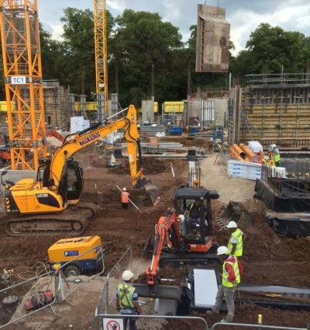
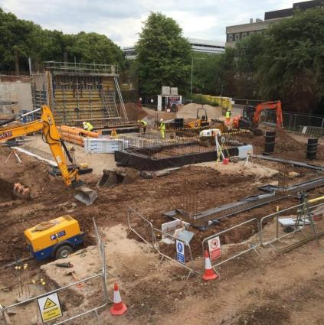
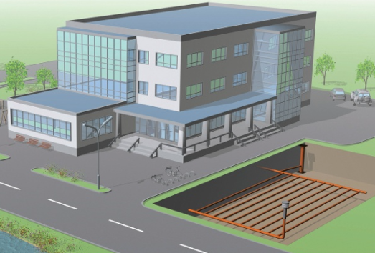
July 2014 Progress to Install the GAHE Pipework (Ground to Air Heat Exchanger)
University Road
Pitch
MSB
At a depth of 1 - 2 metres, there is a constant annual temp of 6 - 8°C.
GAHE are usually located to the side (in landscaping) not under the building!

Slide 9
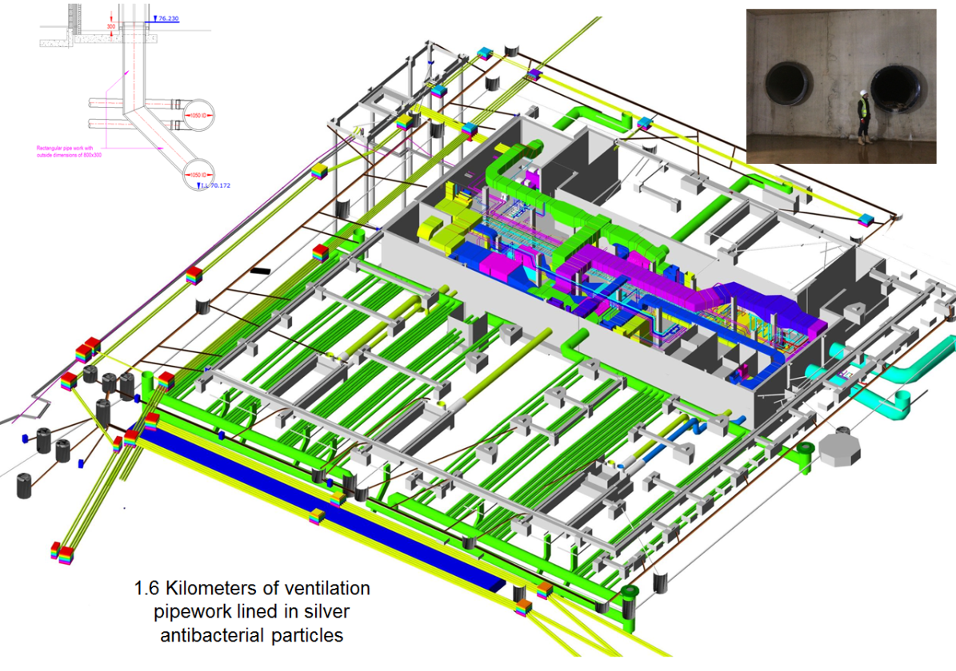
Intake duct
1m dia header duct
Exhaust
Exhaust
Exhaust
Green = GAHE Labyrinth
Grey = Concrete Structure
Blue/Green = Air Ductwork

Slide 10
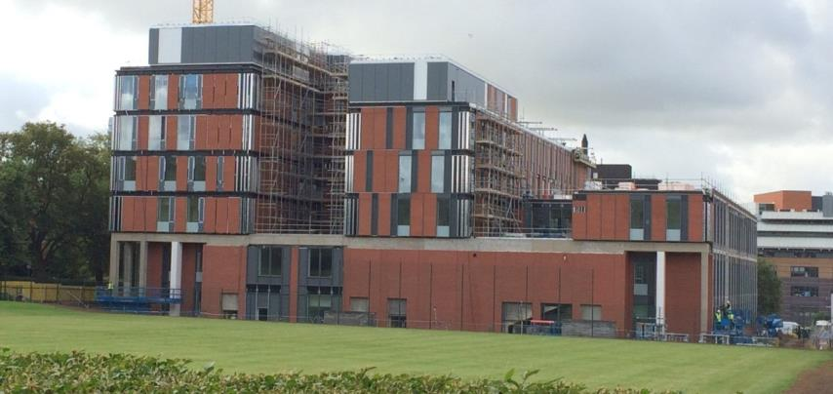
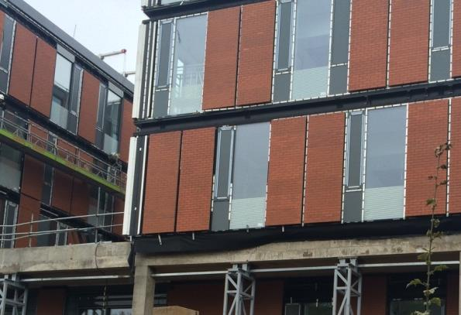
Contractor’s Challenges
Design and Procurement Stage
Main contract procurement route – Single stage D&B ?
Sub-contractor procurement – design responsibility and timing ?
Notes:
Main contract procurement route - Passivhaus needs good design to work effectively and needs adequate time for this process. Single stage JCT D&B contracts are not the right way to achieve this, by it’s nature it pushes the design too far into the construction phase.
Procurement of sub-contractors – where you have sub-contract design portion, which ideally you would not, this needs to be developed early on which requires early procurement of them. The above contractual route does not easily allow this to happen. At CfM, all of the envelope packages are ‘Contractors Design Portion’, which has tested the respective contractors design knowledge in being able to coordinate and understand the requirements of PassivHaus. Incorporating the cold bridging, thermal, condensation and airtightness requirements has considerably extended the design period and subsequently placed huge pressure on the construction programme.

Slide 11
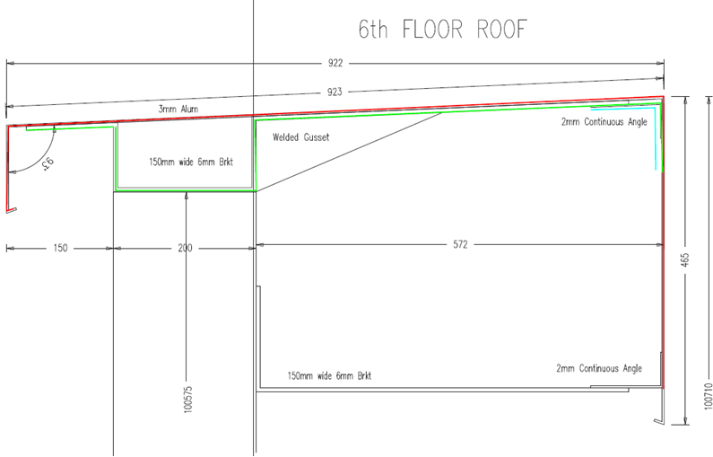
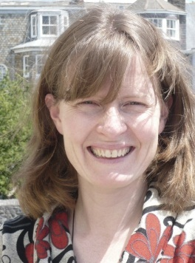
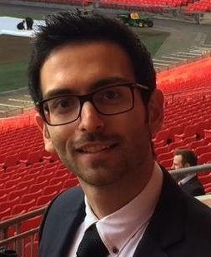
Construction Stage
Resources required for specialist PH designer support throughout the project
Late design changes impacting on PHPP margins
Notes:
I would make it clear that the contractor has to utilise a specialist designer such as yourselves to guide you through the process.
Build in an insulation buffer early in the design – impact of parapet example
Proposal by subcontractor: (No insulation at all)
Note heavy 1 meter long capping needs a robust fixing to take the wind forces

Slide 12
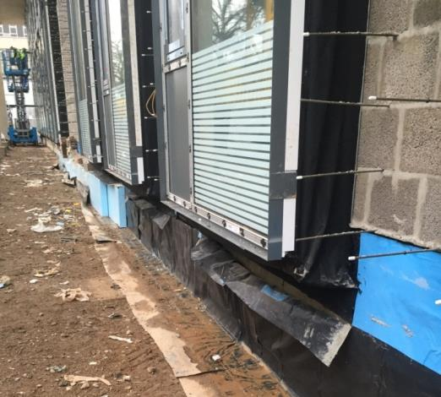
Design and Procurement Stage
Simplicity of design and detailing needed
Structural materials choices for air-tightness and thermal bridging
Notes:
Simplicity of design and detailing
– having a simple design and clear, simple, buildable details is key. I don’t think we have achieved that at CfM. There are too many interfaces between different trades and contractors. For example the use of traditional brickwork on the lower levels externally has interfaces with metsec, windposts, curtain walling etc, the more different interfaces the harder it is to control.
Utilise a concrete frame, which makes the airtight details simpler compared to a steel frame. However, avoid concrete upstands to the roof as with hindsight, these would have been easier in steelwork posts with farret pads to avoid cold bridging.

Slide 13
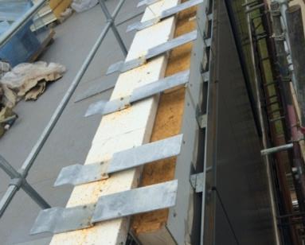
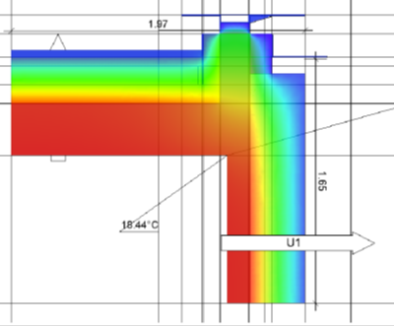
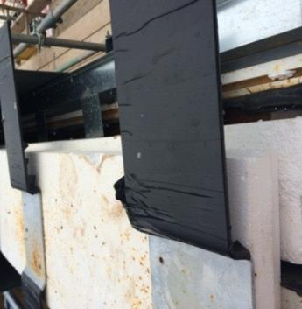
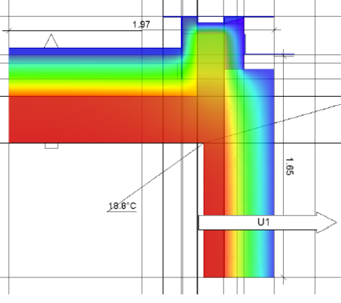
Final design:
Standard roof Insulation
λD = 0.038 W/(m·K)
Ψ = 0.210 W/m.K
During construction continuity of insulation was checked and rectified
Ψ = 0.105 W/m.K
Notes:
This is a detail where we had difficulty with the subcontractor’s design. The upstand detail is repeated over 600meters which means if the right PH detail is not used it can result in significant thermal bridges.
As a result we had to accept some delays whilst the right detail was agreed between the subcontractor, architect and structural engineer.
Due to the unusually large size of cappings which cause more wind forces two brackets were required to support the capping which mean higher thermal bridges. It was difficult to come up with a design that was both easy to install on site/ buildable by the manufacturer in a sensible timeframe and had minimum thermal bridges.

Slide 14
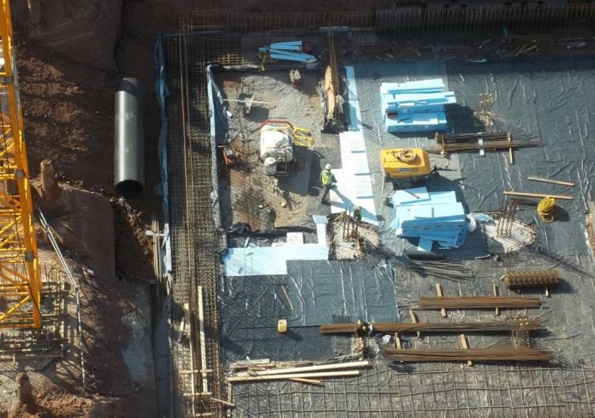
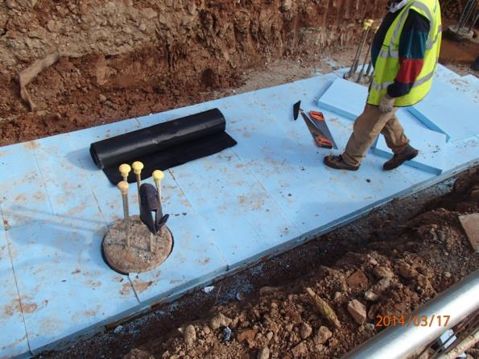
Design and Procurement Stage
Integration of insulation to the slab/foundations for multi-storey structures
Notes:
The requirement for insulation to the foundations and slabs, restricts the design to a piled solution only. Depending on the height of the building and the subsequent foundation loads, strip footings, mass concrete pads and raft slabs cannot be used as the insulation will not take the imposed loads.

Slide 15
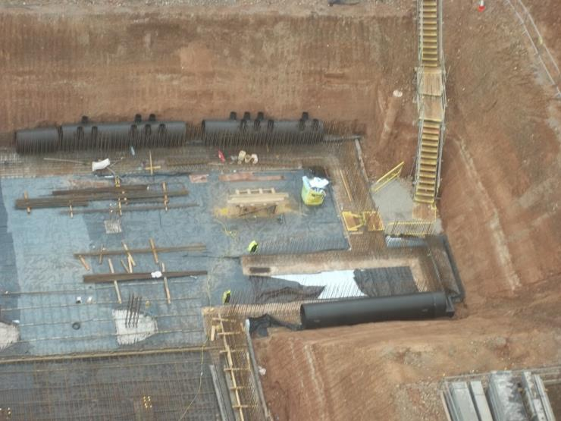
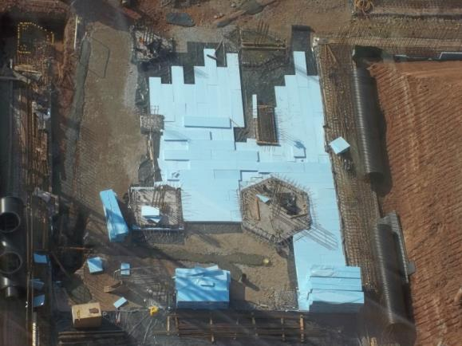
Construction Stage
Programme challenges with ground ducts and piled foundations
Notes:
With the Rehau installation being under the building footprint due to the site constraints, the piling design had to be strengthened. As the buried pipework would not take the loads imposed by a piling rig, the piles had to be installed first and then the ground around them excavated afterwards to install the pipes. This sequence adds additional horizontal loads to the piles that need to be taken into account. Excavating carefully around the piles and subsequently laying and backfilling the Rehau pipework, took 17 weeks compared to the 4 weeks that was allowed for in the contract programme. If there is an open area of adjacent land eg. a sports field, that is the place to put the pipework, which would remove it from the critical path.

Slide 16
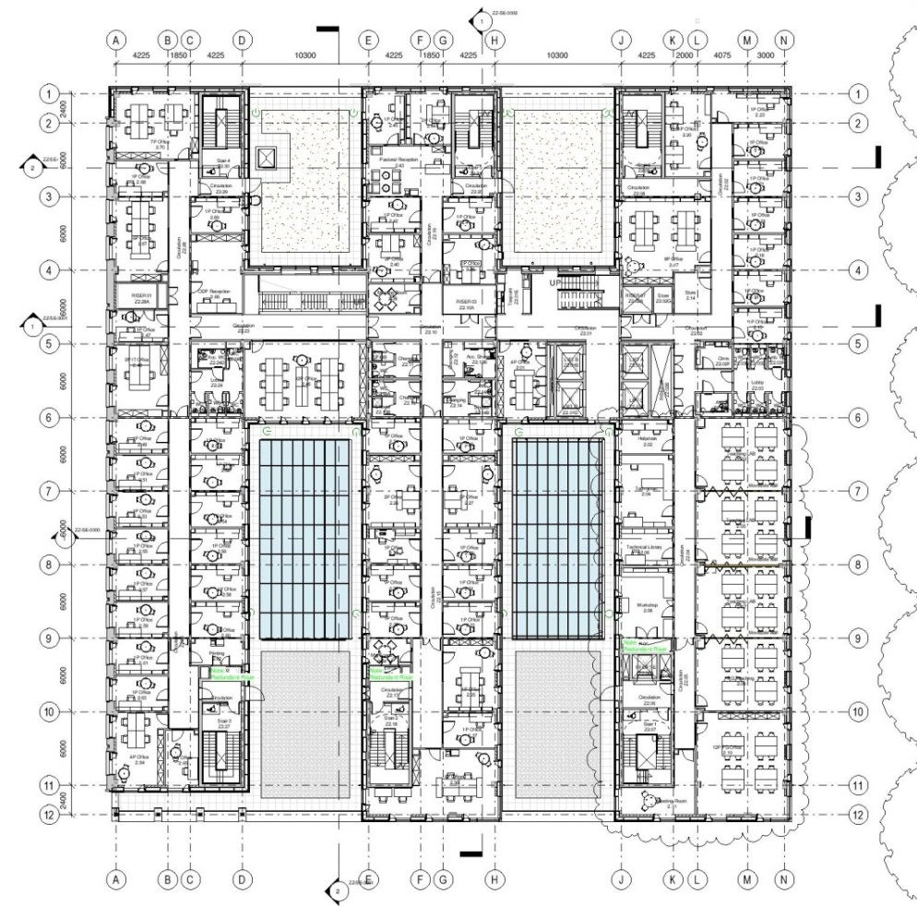
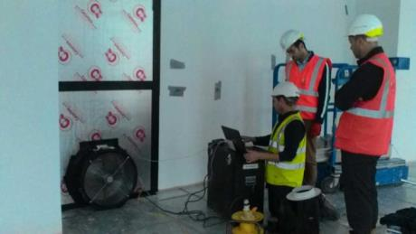
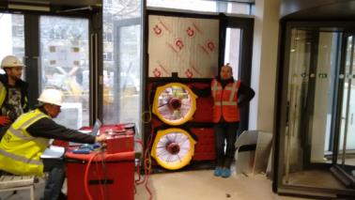
Construction Stage
Sectional air permeability testing in a large/complex building
Notes:
Building in time for air testing and designing the building to be able to complete sectional air tests.
Air test areas on various floors. (Identified to test maximum external envelope and different types of construction i.e. curtain wall, masonry.
Red- Ground floor
Blue- 1st floor
Some of the weak spots identified by intermediate air tests. That would have otherwise been difficult to spot once whole envelope is tested.
Orange- 2nd floor

Slide 17
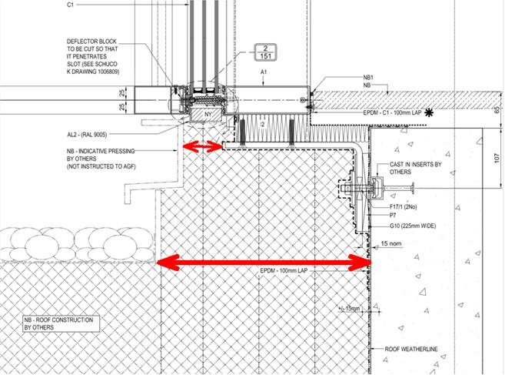
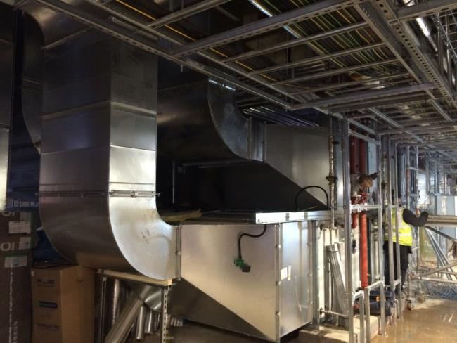
Construction Stage
Achieving Passivhaus standard on build quality control measures
Procurement limitations and PHPP design penalties on large-scale AHUs
Notes:
for large complex buildings is nothing like houses – consultants like Warm do not seem to understand the construction process for large buildings. The control measures employed on smaller simpler buildings are easy in comparison. When you have 200 plus men on site, many of whom are working on a measured basis, it is very difficult to maintain the tight controls required. The skills shortage and common use of migrant labour also impacts on this.
Good example to show how many different subcontractors are needed to do this detail.
I think 4 different subbies are working to do this and I found out that the part in front of the metal angel was not going to be insulated originally but is now being done. (huge thermal bridge if not insulated).
AHU’s!!!! The process surrounding the 12% penalty is frankly ridiculous. I accept that there needs to be testing but why should they have to be sent to Germany to avoid such a big penalty?

Slide 18
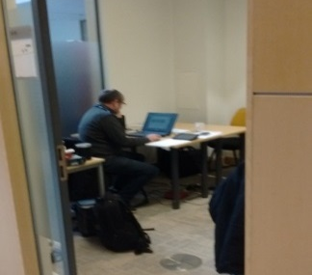

Soft Landings - Translating
Passivhaus/Low Carbon Build to Low Carbon Operation
Soft Landings and Passivhaus (needs to go hand-in-hand).
Involvement in Soft Landings (final stages of construction, handover and post occupancy support for 3 years).
Importance of operations and actual use of the building from a energy and carbon reduction strategy is paramount.
Building user training during handover is key.
First time where users, University FM teams and contractor working together post construction.

Slide 19
Soft Landings - Translating
Passivhaus/Low Carbon Build to Low Carbon Operation

Slide 20
Notes:
26% below cumulative target usage to date

Slide 21
Space Heating Usage | Basis | MWh/yr | kWh/m2.yr
Target | NGB model | 113 | 9.6
Target | PHPP model | 149 | 12.6
Target | PHPP standard | 176 | 15
Actual | 12m measured | 231 | 17
Notes:
125% above cumulative target usage to date (NGB target) - note that Cofely DHS meter strongly suspected of false elevated data, UoL investigating

Slide 22
17% below cumulative target emissions to date
12% below cumulative target costs to date

Slide 23
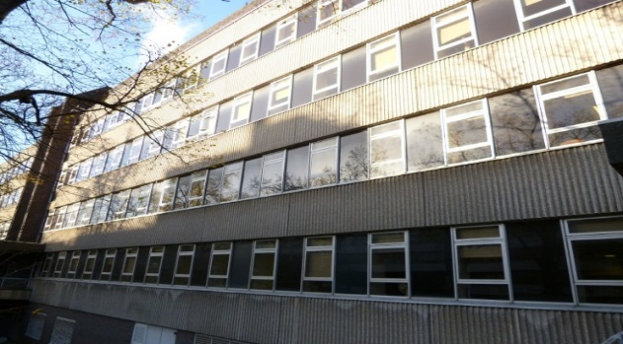
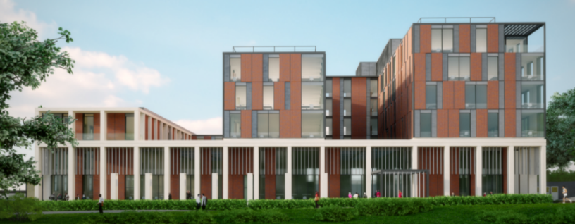
Future Monitoring & Management Issues
Current Building Stock Vs New Building Stock
Maurice Shock Building (GIA – 18,983) The Centre for Medicine (GIA – 13,526)
320 kWh/m² per annum space heating 17 kWh/m² or £0.50/m2 per annum space Heating
500 kWh/m² per annum total energy 59 kWh/m² or £2.84/m2 per annum total energy
£360K per annum energy bill £38K per annum energy bill

Slide 24
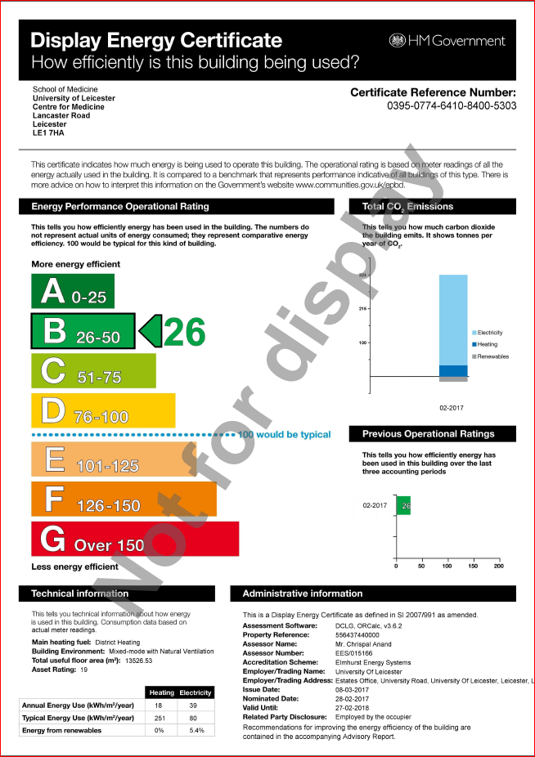
Future Monitoring & Management Issues
Provide monthly feedback to building users.
Using automated metering alarms to pick up anomalies on data and consumption.
Key ongoing challenges:
  On-going building user engagement
  Maintaining competency of how to use the building
Issue the first Display Energy Certificate (DEC) during May 2017.
Aim is to obtain DEC ‘A’ by May 2019.

Slide 25
Key Lessons Learned:
Passivhaus certification achieved 3rd Feb 2016…
Designed in 2010 - some difficulties sourcing products to suit the aesthetic (greater range available now)
Lack of Passivhaus knowledge & experience amongst contractors during tender period 2013
PHPP proved a useful design tool - testing impacts of ‘what if’ scenarios
Individual components have less impact on larger schemes - able to trade off performance in some areas
But…. don’t get complacent! Constant monitoring of progress is required - ‘death by 1000 cuts!’
Effective communication of key design requirements is more difficult to achieve on larger sites
Good intentions to do early phased air tests was not possible - but air testing of sample rig was vital.
PH certification won’t be achieved until after practical completion but is a requirement of the contract conflict
Early involvement of CDP sub-contractors is essential.
Achieving DEC A will be a significant challenge - three year soft landings period required

Slide 26
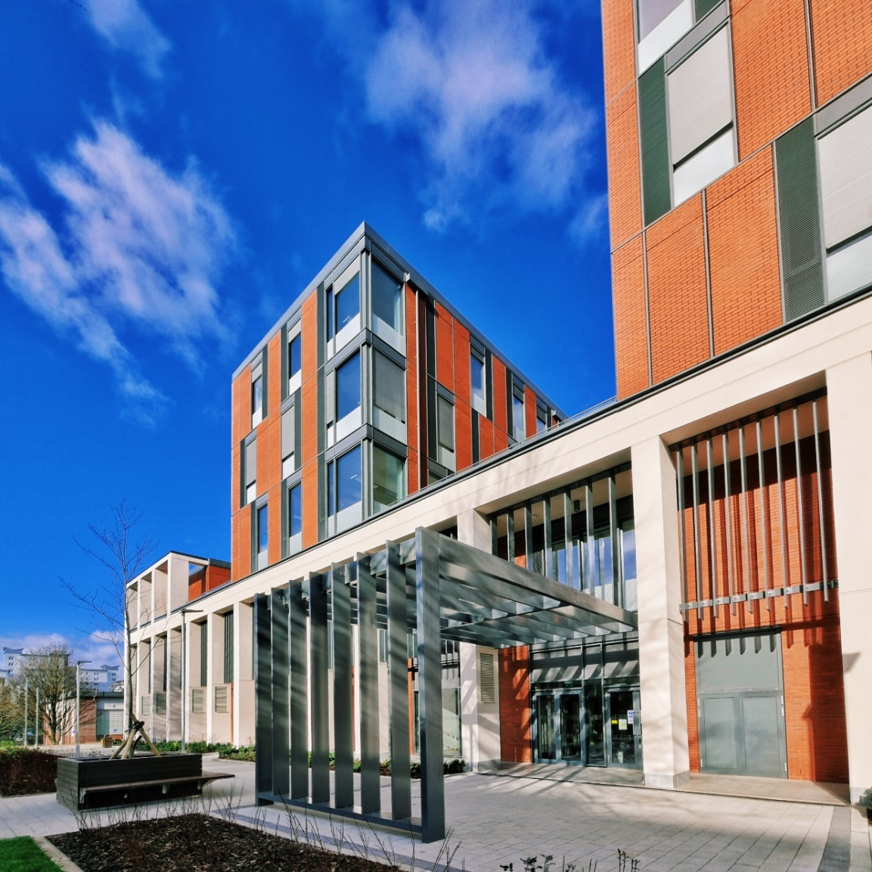
Thank You.

