Slide 1
ISM Behaviour Change Model
09th December 2014

Slide 2
What is ISM
Individual- Social – Material
Developed by Scottish Government
Holistic approach to considering behaviour change
A form of categorisation of ideas and issues

Slide 3



It is not -

Slide 4
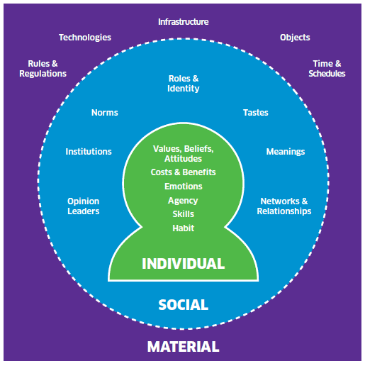
What is ISM

Slide 5
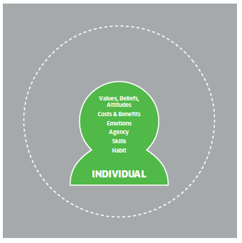
Individual
Your requirements to change.
Values and beliefs – challengeable?
Knowledge, or lack of it.
Agency.
Skills.

Slide 6
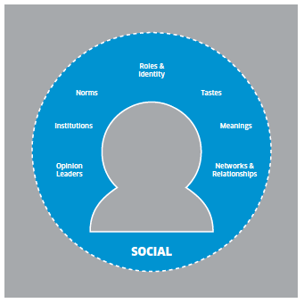
Social
The social norm?
Are you an early or late adopter?
Other peoples influence on you an society.
Networks and relationships.

Slide 7
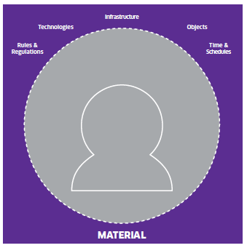
Material
National infrastructure – help or hindrance?
Technologies – would make change easier?
Rules and regulations.
Time and schedules.

Slide 8
Workshop – 3 groups
Topic 1 – Getting people to walk to work.
Topic 2 - Establishing a workplace temp of 18ºC.

Slide 9
Further Information
Contact
June Graham
Low Carbon Behaviours Development Officer
june.graham@keepscotlandbeautiful.org
01786 468 785
07703 733763

