Slide 1
Unlocking a Vast Missing Contribution
Collaborations for Change – Global Goals for Tomorrow’s Education Today
20 June 2018
Judy Ling Wong CBE Honorary President Black Environment Network (BEN)

Slide 2
Sustainable Development depends on
The relationship of people to the environment
The relationship of people to each other

Slide 3
“There is no such thing as a pure
environmental project.
A so-called pure environmental project is one
that has rejected its social, cultural and
economic dimensions.”
Judy Ling Wong CBE

Slide 4
“Who we are
And
What we can achieve
depends on
How we see ourselves
against
The enormous pressure
of
How others see us”
Judy Ling Wong CBE

Slide 5
A Big Question
How do we unlock the hidden and unmanifested contribution
that is possible only with the full integration of diverse cultural visions?

Slide 6
A Multicultural World
The mobility of people is a prime characteristic of 20th and 21st Century life.
We move for educational, social, cultural, environmental, economic reasons within and beyond nations.

Slide 7
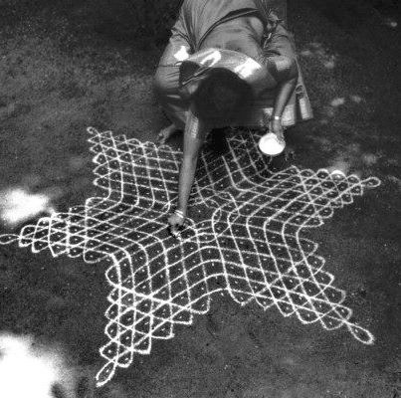
Kolams – blessings and ritual in India

Slide 8
Shamanic Presence
Dance groups from different parts of the country beside the Cathedral in Mexico City.
As the cathedrals and churches were built on top of sacred sites, the groups are in fact dancing on their sacred land.
Mother Earth
Nature as family

Slide 9
Bonsai
A cultural solution to a longing for wildness
Indoor Plants
A connection to the great forests of the world

Slide 10
Recognise
The World within Britain
as an opportunity to
work at the local/global reality
We are all Ethnic Minorities
Overseas students as potential
Key Players of the Future
in their own countries

Slide 11
Integration of Head and Heart
to address Local and Global Realities
Rational. Practical. Assertive. Action-oriented. Directive. Evidence-based. Scientific.
With
Inspiration. Emotion. Magic. Soul. Sensuality. Sensitivity. Spontaneity. Contemplation.
Potential for Environmental Actions
That integrate Cultural Visions and Values
Authenticity through fullness of presence
Creative actions within personal encounter
Brainstorming cross-cultural solutions
Put into place structures of empowerment for cultural equality
Incorporating cultural dimensions into committees and in policy work

Slide 12
Black Environment Network
Resources and publications
http://www.ben-network.org.uk/resources/publs.aspx
Contact:
judy@ben-network.org.uk

