Slide 1
Corporate Social Responsibility at HEFCE
Joanna Simpson
Higher Education Policy Adviser
31 March 2009

Slide 2
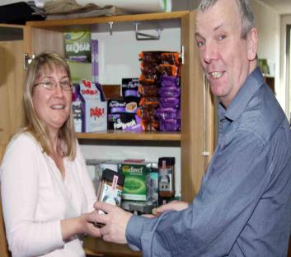
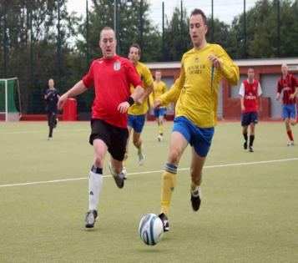
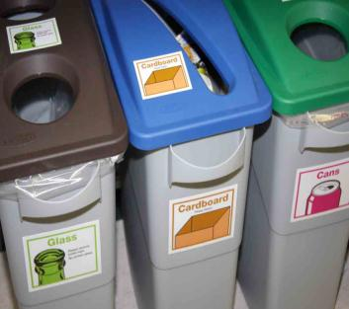
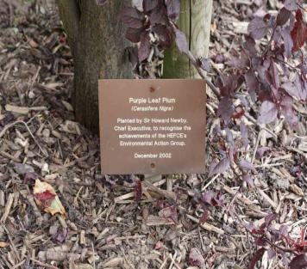
Overview
CSR Policy 2008 – 14
Business ethics
Environmental impact
Procurement
Our people
In the community
Working with the sector
CSR action plan 2008 -10

Slide 3
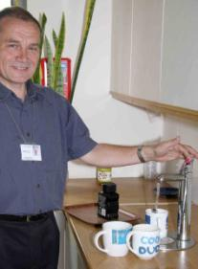
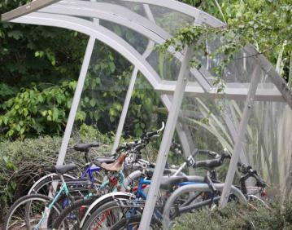
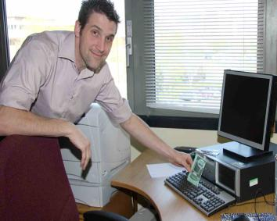
How are we doing it?
Looked at what we were already doing
Discussions with stakeholders
Involving all our staff
Embedding processes
ISO14001
CSR steering group
CSR implementation group
Reporting publicly

Slide 4
Has it made a difference?
Reduced costs
Demonstrates we are leading by example
Engaged all staff
Improved performance
Reduced carbon emissions by 11% between 2006-07 and 2007-08

Slide 5
Was it easy?
Was it worth it?

Slide 6
Further information
www.hefce.ac.uk/aboutus/environ/
Joanna Simpson
j.simpson@hefce.ac.uk
0117 9317411

