Slide 1
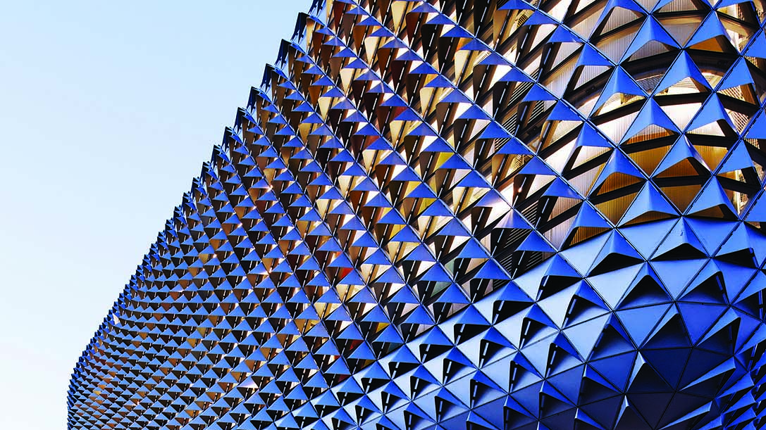


University of Oxford
Performance Gap Solutions
May 2017

Slide 2
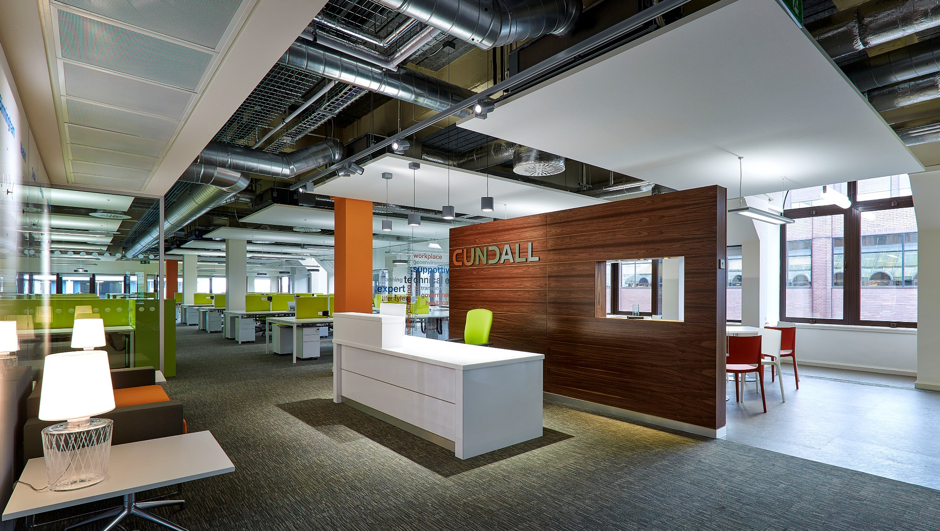

What do we mean by Building Performance?
It is……….
How well a building performs with respect to its needs and requirements.
If we can't guarantee an output………….what use are targets?

Slide 3
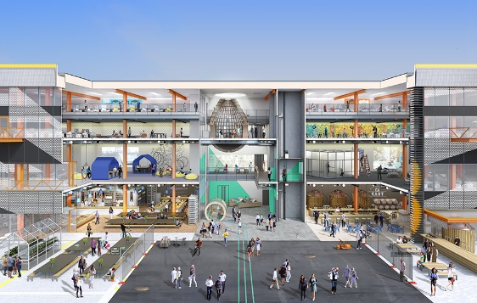

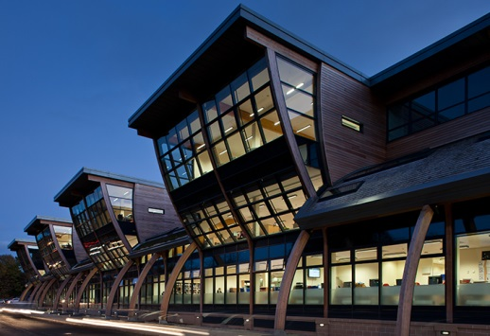


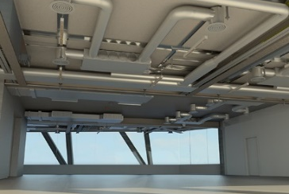
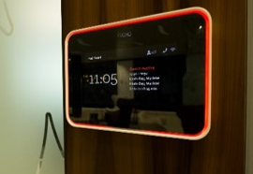
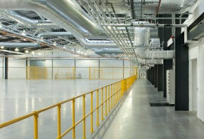


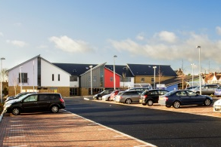

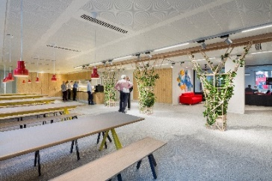

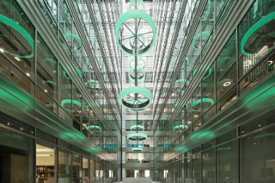
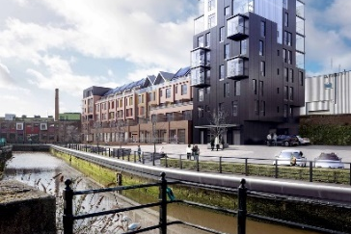
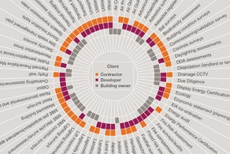
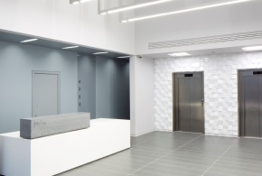
Our Services
Core Services
Building services engineering
Civil engineering
Structural engineering
Sustainable design
Specialist Services
Acoustic engineering
Building Information Modelling (BIM)
Building automation
CDM Consultancy
Planning
Fire engineering
Transportation
Geotechnical
Health and wellbeing
IT and audio visual
Lighting design
Planning
Survey solutions
Vertical transportation

Slide 4
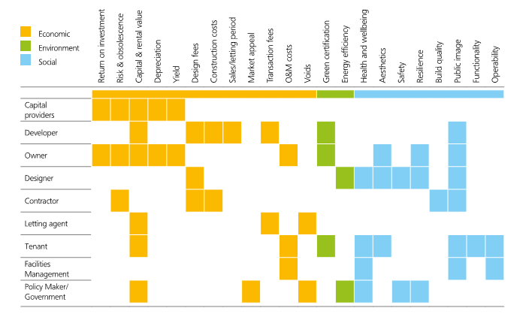
Building Performance Expectations
What are the Performance requirements across the built environment?

Slide 5
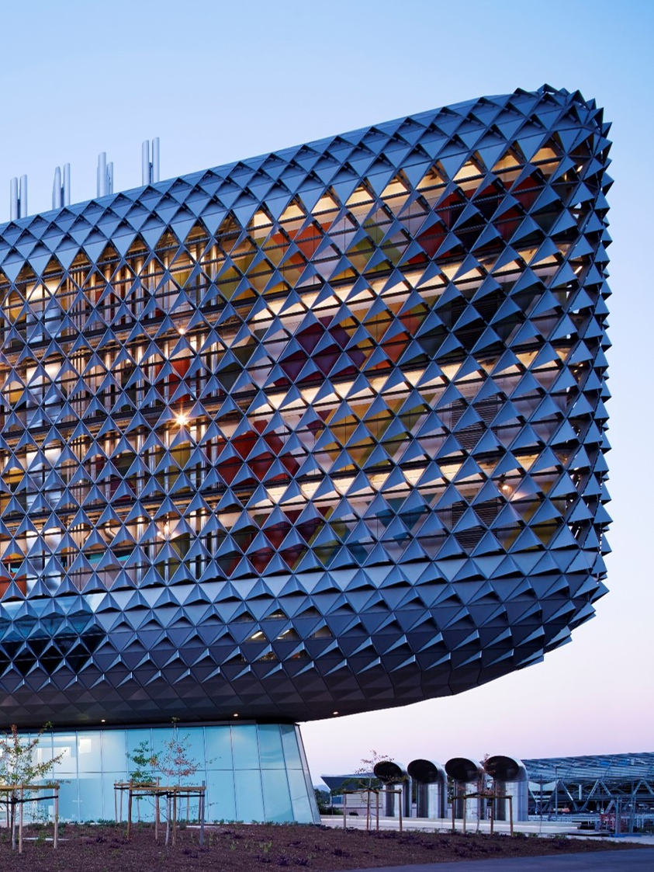
The Business Case
Predictable building performance leads to better building performance and delivers……………….
Reduced costs
Meeting market demand
Superior financial performance
Employee recruitment, retention and productivity

Slide 6
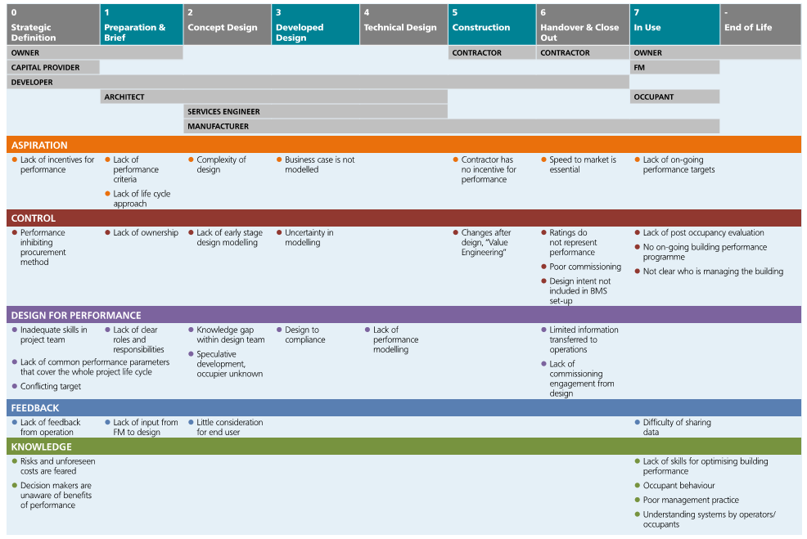
Barriers to Building Performance

Slide 7
Common Issues
Many organisations and decision makers in the building procurement process are not engaged in the setting of performance targets and defining the value they represent
The built environment sector makes this subject and the debate about it too complex
There is a tendency to equate building performance to exemplar green buildings only
There are too many metrics and few that are common across the industry
The construction Industry is fragmented and responsibility distributed
The contradiction between value engineering and cost cutting
Design for compliance instead of performance

Slide 8
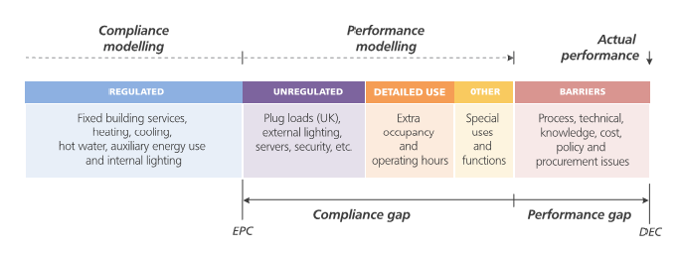
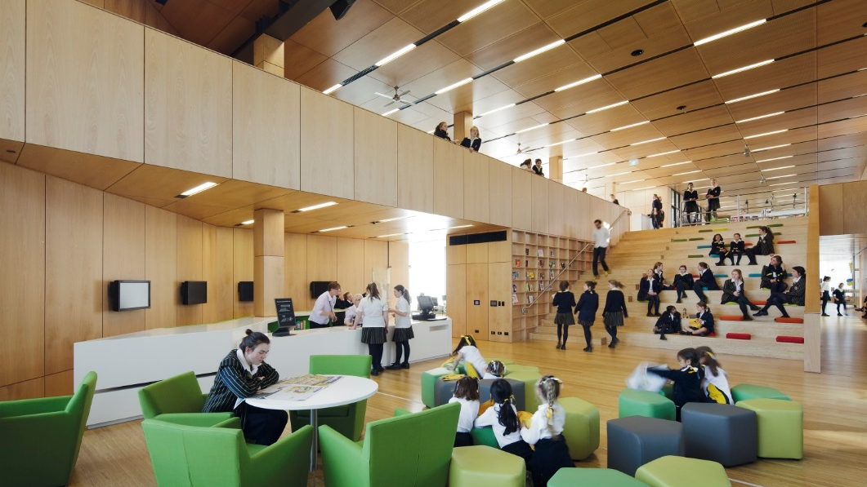

The dreaded GAP

Slide 9

Aim for the Ceiling and not the Floor!
Don’t confuse compliance with performance

Slide 10
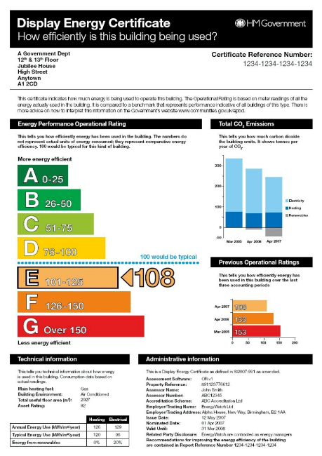
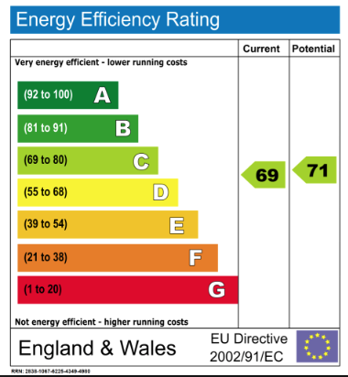



Compliance vs Performance
These are Compliance standards only!

Slide 11
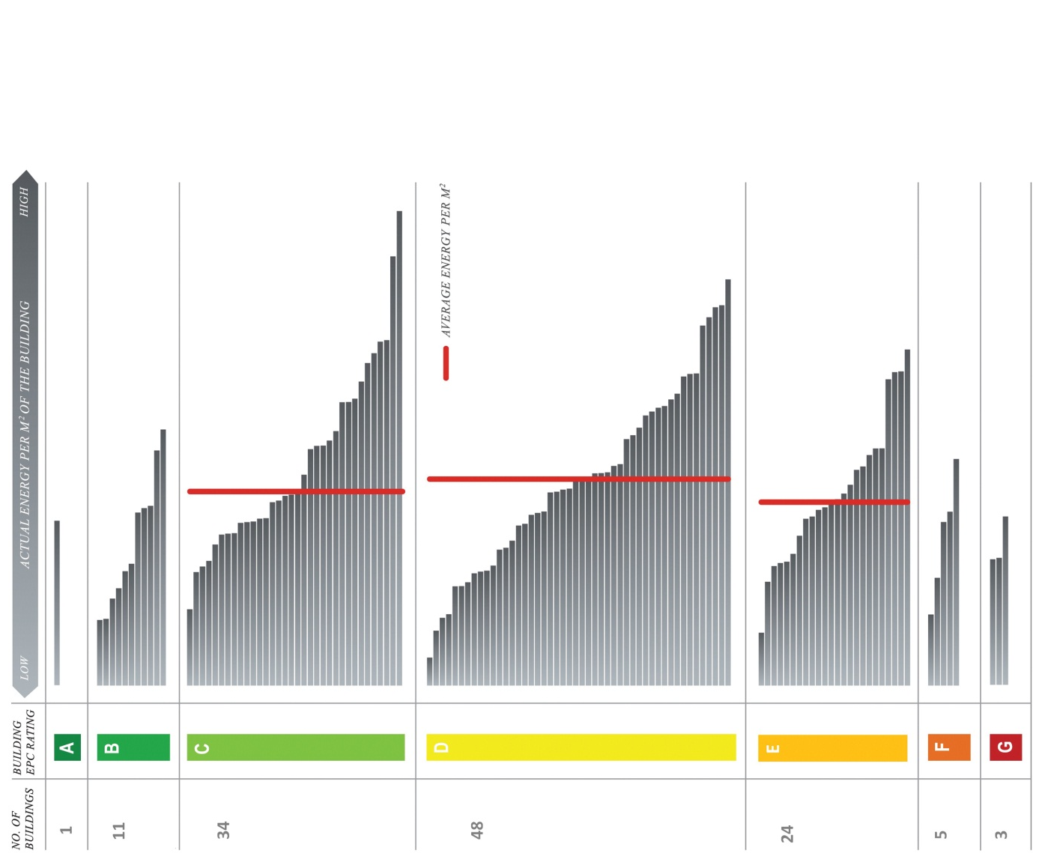
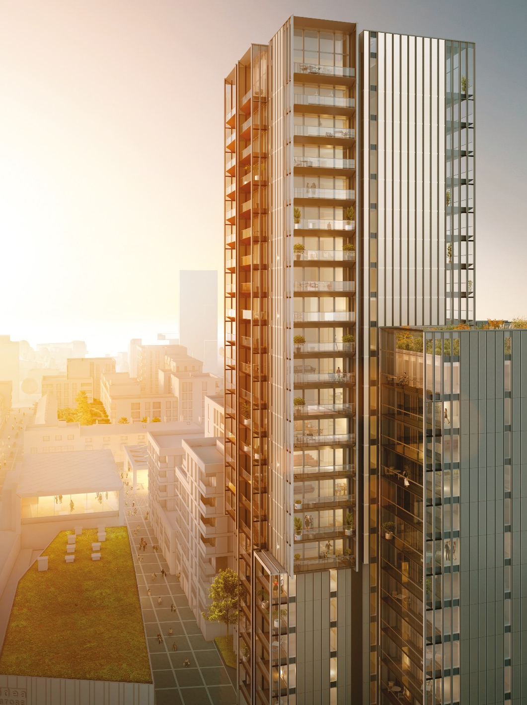
EPC’s
New Design Parameter 150 – 200 kWh/m²

Slide 12
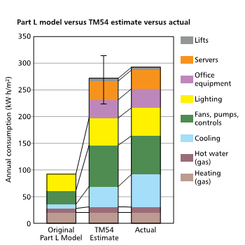
Over simplification is a problem
We can't find the optimum solution and understand best value if we don’t have all the facts

Slide 13
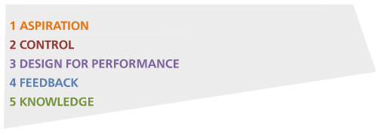
5 Key Factors for Success

Slide 14
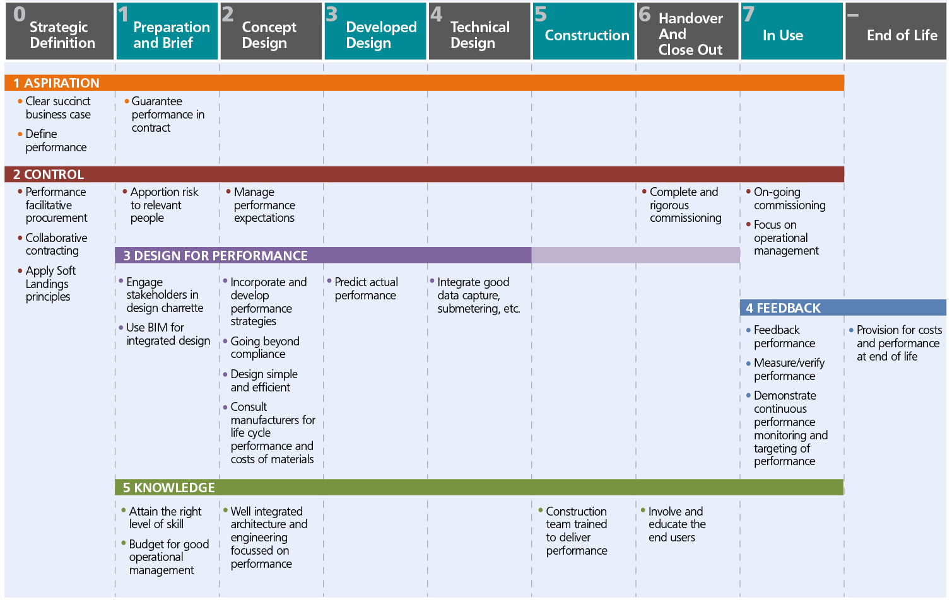
Alignment with RIBA Plan of Work

Slide 15

Aspiration?
MINIMUM
BEST PRACTISE
ENHANCED
BESPOKE
Energy
+
Carbon
Water
Waste
Indoor Air Quality
+
Wellbeing
Catering
Carbon footprint
Green capital
+
Bespoke metrics that represent value to the occupier, owner, tenant
INCREASING MATURITY
Setting a simple target – at the very least for energy use (kWh/m²) helps to create a common language and shared aspirations across the delivery process
An experienced design team can advise on this using benchmarks and an understanding of your operations

Slide 16



Control
Collaborative contracting, with performance guaranteed and control maintained throughout the delivery process helps to ensure predictable outcomes
Ensure that the requirement to meet operational performance targets is included in all contracts that govern the supply chain
Ensure that performance against the top level performance indicators is monitored throughout the process and reported to the senior level

Slide 17
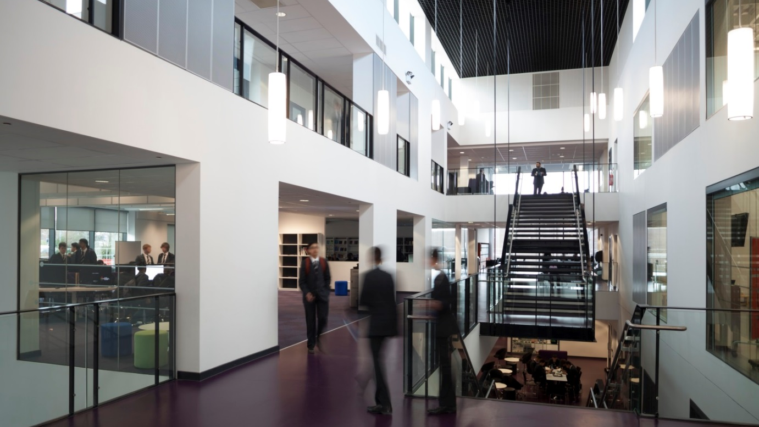
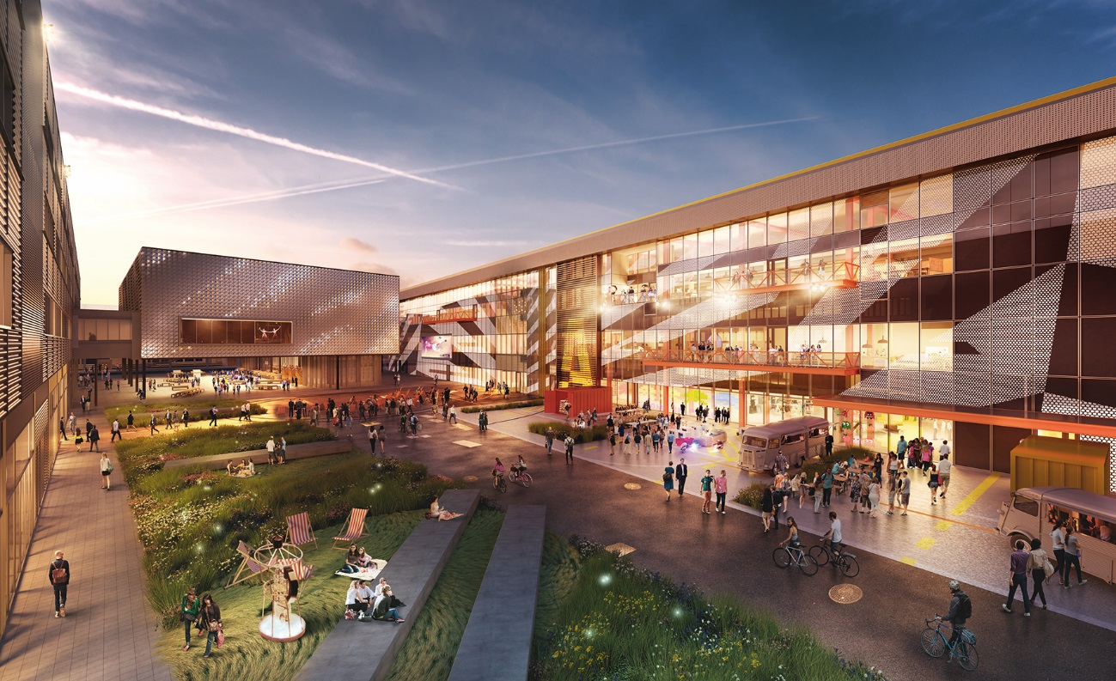
Design for Performance
Do not design simply for compliance. Performance improves when aspirations are not limited to compliance or, in other words.
Use real measurable metrics.
The more certainty around the building’s fit out, uses and operating models, the more accurate the design can be

Slide 18

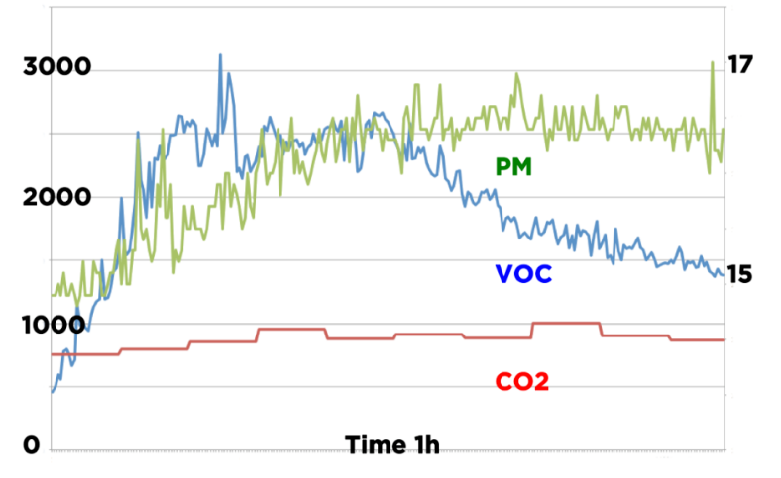
Feedback
IEQubeTM
Reciprocal links and a commitment to monitor and feedback, particularly during the handover process, is vital. So too is giving time for well documented building commissioning. ‘Links must be made between operational facilities management (FM) and the design team, and between FM and building occupiers.

Slide 19
Knowledge
Improved knowledge, across the whole value chain, supports good outcomes. This is enabled by participating openly in lesson sharing activities
Ensure that your organisation and delivery partners are appropriately skilled
The Board do not need to be experts, but having a client side advisor with experience in good building performance and the mandate to deliver predictable building performance is essential

Slide 20
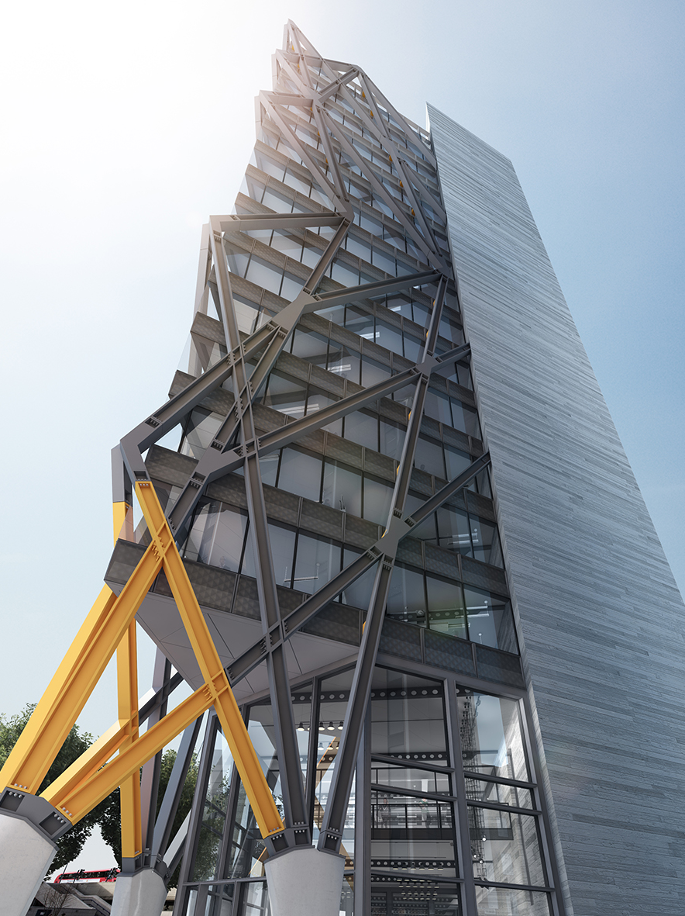
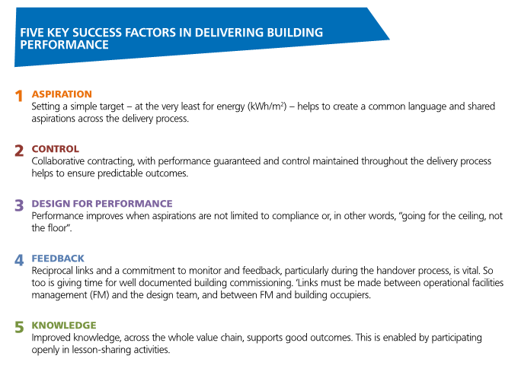
UKGBC Building Performance Task Group

