Slide 1

Keele University’s First
Schools Climate Summit
Sarah Briggs, Sustainability Project Officer, Keele University
Professor Dominic Swords, Future Lives Project
#KeeleClimate

Slide 2
Keele’s First Climate Summit
Sarah Briggs
Sustainability Project Officer
Professor Dominic Swords
Future Lives Project

Slide 3
Outline
Origins of the Climate Summit
Objectives of the Climate Summit
Building the Programme
Sense Maker and collaboration with Future Lives
Successes
Reflections
Recommendations

Slide 4
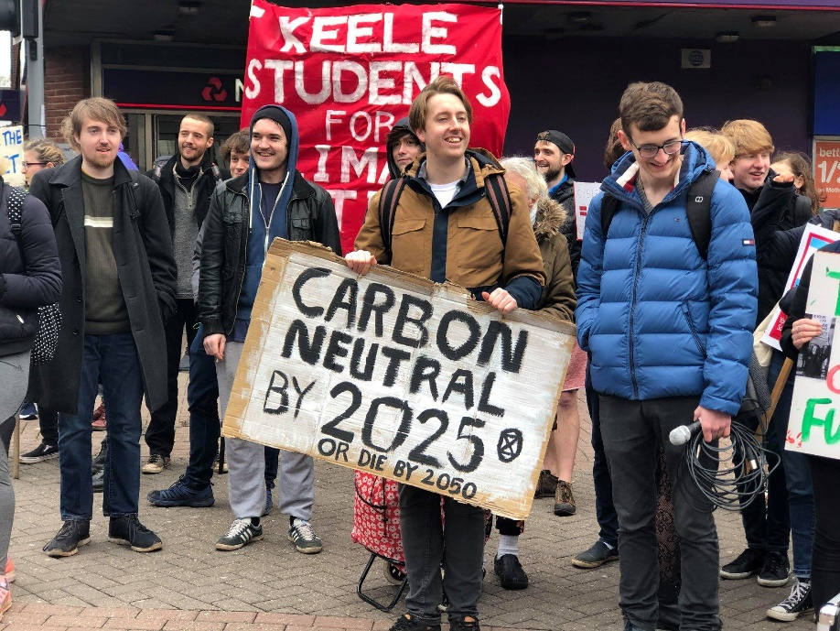
Origins of the
Climate Summit
Changing social dialogue around climate change
Schools strikes and climate marches
Keele students leading
local marches
Inspired Keele event for
local schools
Planned in 4 weeks!

Slide 5

Objectives of the
Climate Summit
Bring together schools/student voices from Staffordshire, Cheshire and Shropshire
Build from the science behind sustainability challenges to individual actions students can adopt
Provide a toolkit that schools can utilise with larger groups of students beyond the summit
Empower students to feel connected to and able to help contribute to tackling climate change
Connect to outreach activities and build links with schools for future events and collaborations
Embed the Sustainable Development Goals

Slide 6
Building the programme
Linking to the Institute for Sustainable Futures
Funding from Faculty Outreach Fund
Utilising expertise from within School of Geography, Geology and the Environment + external collaboration
Bigger picture through to exploration of individual impact
Exploring through hands-on workshops
Equipping students with tools to express their voice
Culminating in Forum to share current practices and inspire change beyond the summit

Slide 7
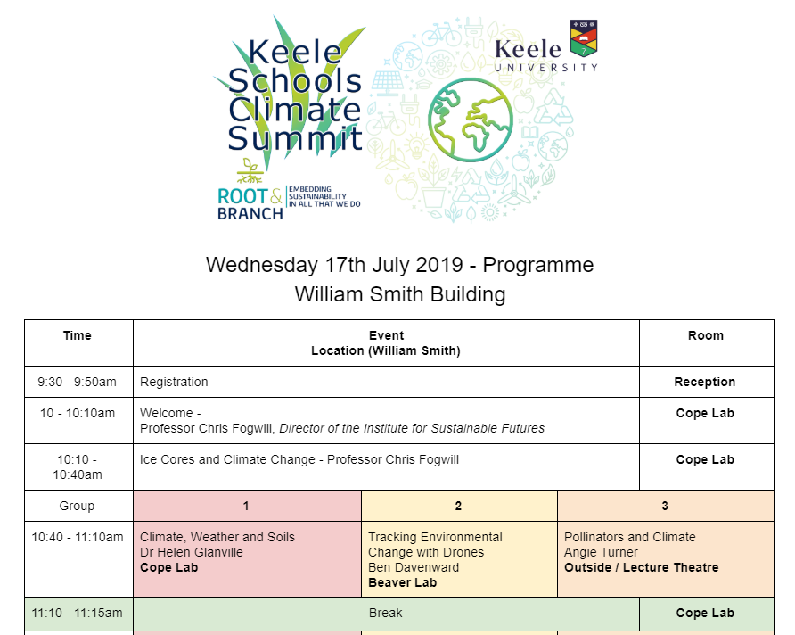

Slide 8
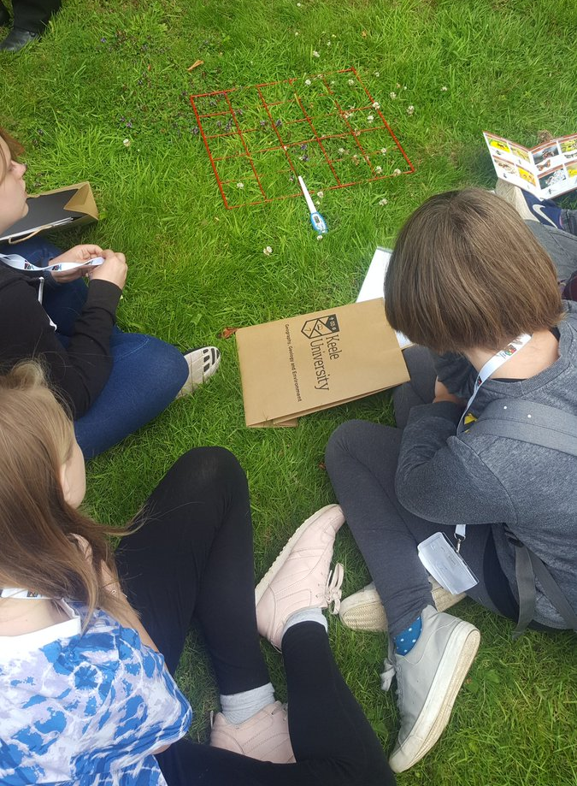
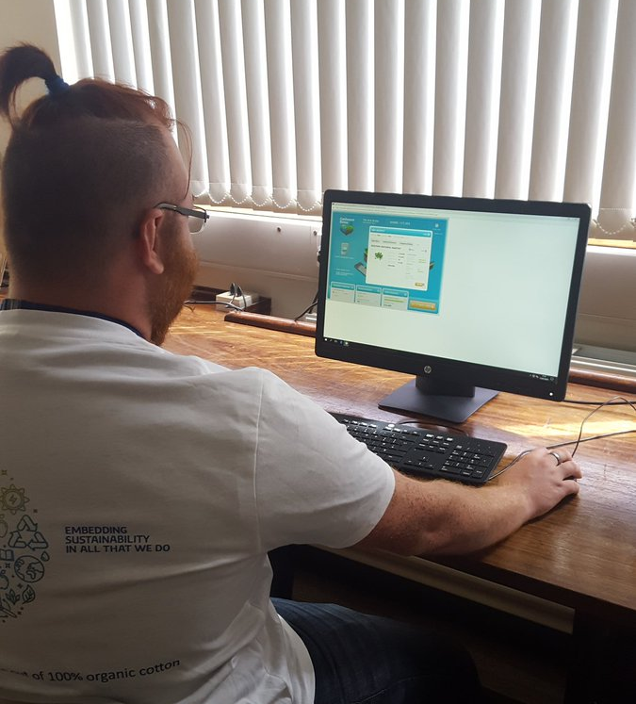
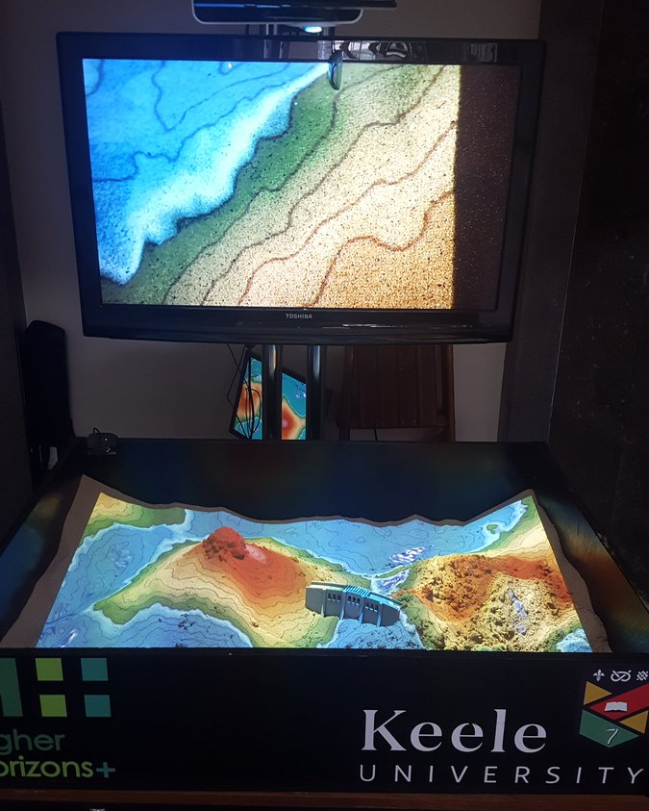
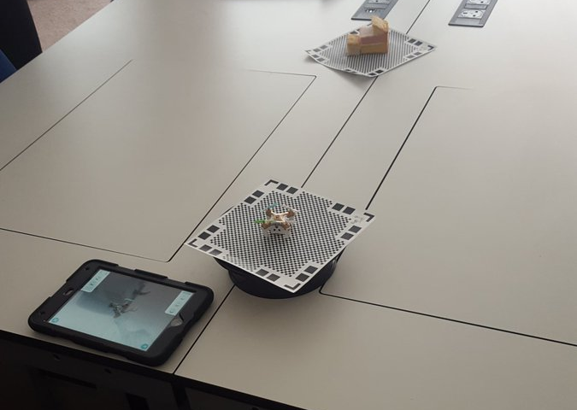
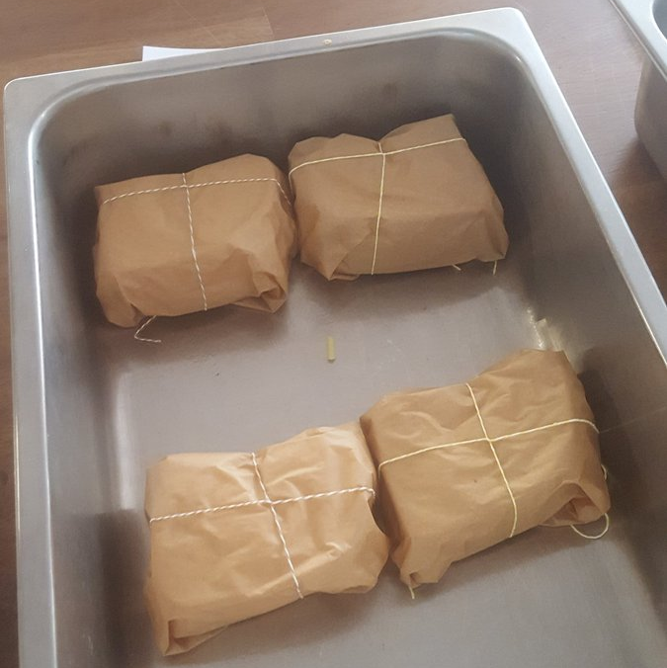
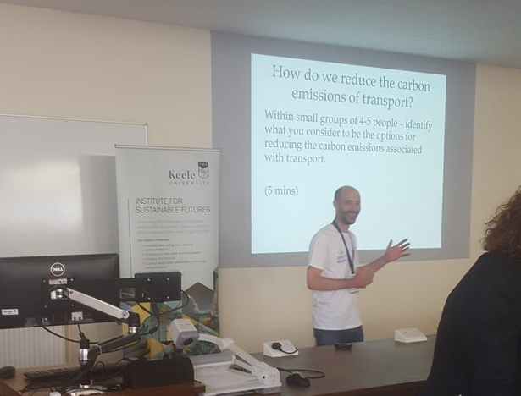
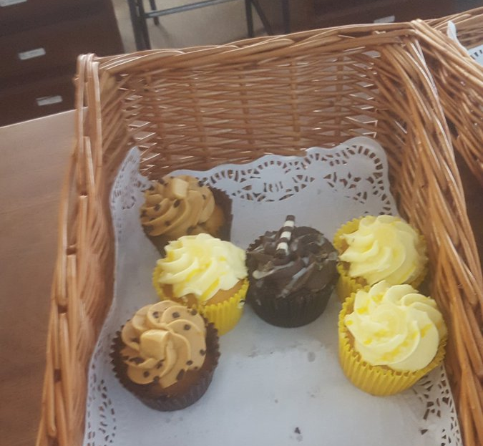

Slide 9
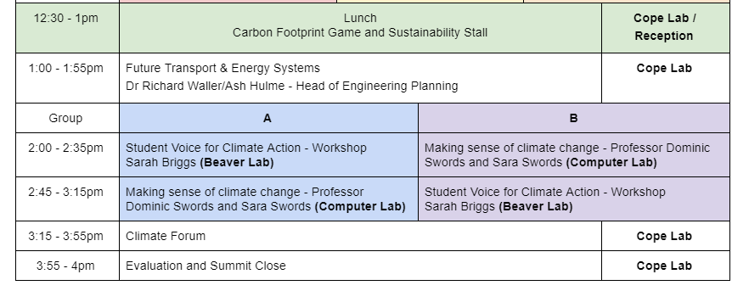
Opportunity to collaborate with Dominic and Sara
Connection made through CTRLShift Summit in Stoke
Enabled a workshop using SenseMaker

Slide 10
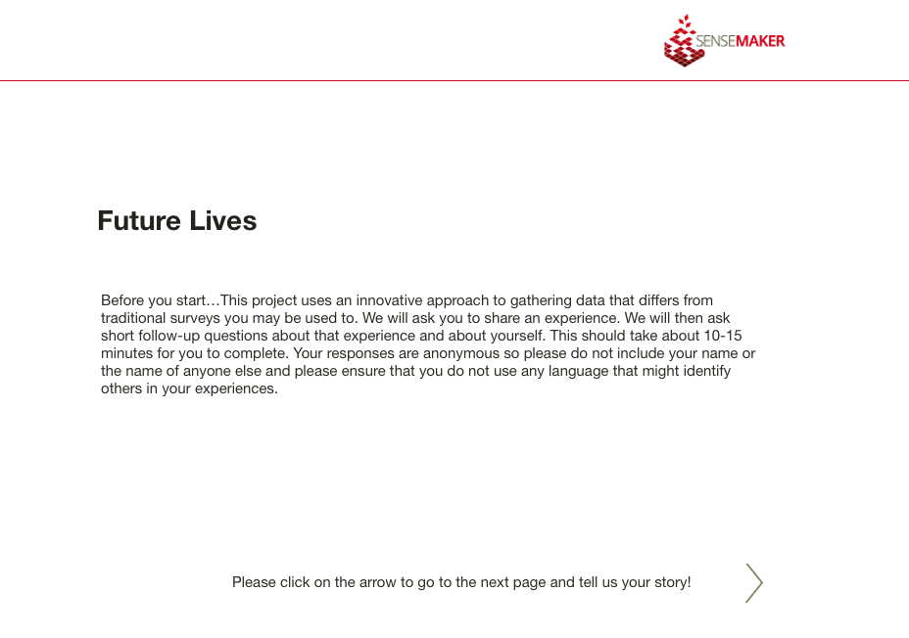
Future Lives – making sense

Slide 11
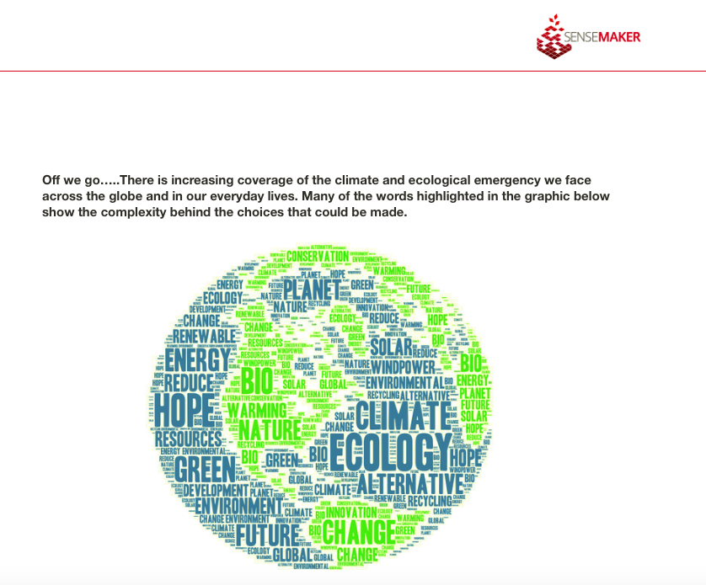
ploring narrative patterns
What is needed to make a difference?
You can see and complete the instrument here: https://tinyurl.com/y2xxwhc6

Slide 12
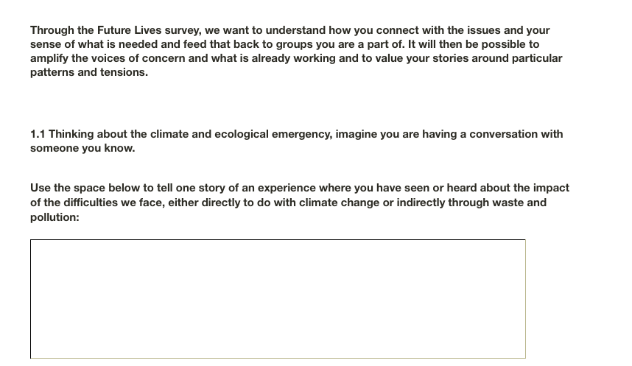
ploring narrative patterns
What is needed to make a difference?
You can see and complete the instrument here: https://tinyurl.com/y2xxwhc6

Slide 13
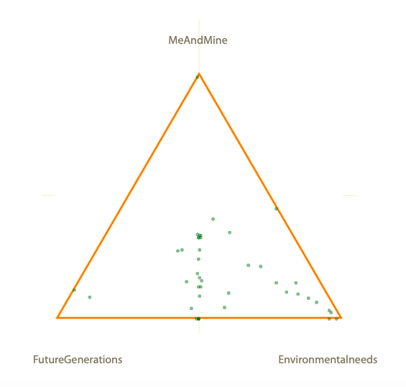
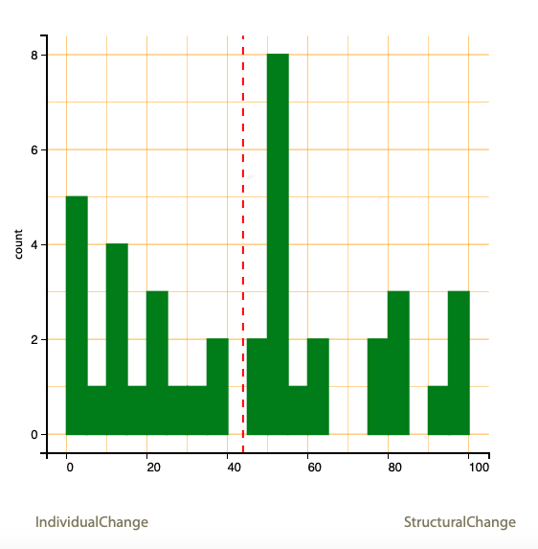
Exploring narrative patterns
What is needed to make a difference?
What is the focus for your concern?

Slide 14
What? So, what? Now, what?
Make sense of the group’s responses together: what do they notice? what surprises them?
What actions can they take to influence the groups they are part of?
At school, at college or university and beyond: what future behaviours are required?

Slide 15
Successes
~40 Y7-Y10 students from 11 schools across 3 counties
Workshops well received - wide variety of sustainability challenges linked to climate change
Student participation through afternoon sessions provided feed-forward work for schools
“Just wanted to say how great it was today. Students were buzzing all the way home on the train with ideas. So important to inspire our students.”
West Kirby Grammar School

Slide 16
Student feedback
‘What did you most like?’
“It raises awareness for future generations”
“It taught me a lot that I was not previously aware of”
“I like when we want outside and looked at all the different flowers that insects like”
“The sand thing where you build up different gradients and the ice room holding old ice”
“I enjoyed doing the catchment game because it involved using problem solving to help environmentally.”
“Lots of people that are enthusiastic about the environment getting together to educate other people about the environment.”

Slide 17
Staff feedback
‘What did you most like?’
The range of different sessions provided for students.
The range of subjects that affect climate change.
Varied programme and wide range of speakers. Visiting the ice core lab.
Very well organised with a range of topics implied to climate change.
Looking at different topic areas / mixture of workshops / hands on work

Slide 18
Reflections
Bringing students together from different areas brought more ideas together for student voice sessions but we could have made more of their different perspectives
Workshops offered diversity but hard to fit into 30 mins
Grouping by age groups could be more effective - y7-9 and y10-13 - especially for feed forward links to curriculum
Staff involved enjoyed working with the students, and student ambassadors gained great experience
Some schools had to leave early

Slide 19
Recommendations
Utilise your experts - embrace the diversity of sustainability -> this could link into work to embed sustainability in the curriculum within the university too
Think about practical sessions that are easy to reset and run in parallel especially for larger numbers
Consider room sizes for whole group sessions - more efficient but limits on numbers?
Consider your age groupings - benefits of mixed ages for some projects - co-curriculum? - vs feed into curriculum and knowledge/skills
Consider timing in the school year and for the programme
Connect with wider stakeholders - i.e. catering teams

Slide 20
Our actions (Future Lives)
Further groups of schools – as part of eco-groups
Present at Youth Strikes
In Universities – as part of learning programmes exploring climate change and sustainability in relation to their studies and future careers: what will future leaders and decision making look like in the roles I aspire to?
It is both revealing the system to itself and collecting advocacy data e.g. report from latest Youth Strike in Sheffield being sent to local MPs present that day

Slide 21
Thank you
Facebook.com/GreenKeele
Twitter: @GreenKeele s.j.briggs@keele.ac.uk
dominicswords@icloud.com
+44 (0)7901 556508

Slide 22
Keele University’s First
Schools Climate Summit
Sarah Briggs, Sustainability Project Officer, Keele University
Professor Dominic Swords, Future Lives Project
#KeeleClimate

