Slide 1

Interdisciplinarity and Sustainability Teaching
Sustainable Business Initiative Case Study Dr Kenneth Amaeshi, SBI Director
18 March 2016

Slide 2
Sustainable Business Initiative (SBI)
Who are we?
SBI is a world-class research centre focused on sustainability and the challenges and opportunities it presents. Based within the University of Edinburgh’s Business School, our aim is to advance current understanding of the business-society interface and equip leaders with the requisite skills to contribute to positive social change. We also work towards promoting the integration of sustainability in teaching across the University.

Slide 3

Net Impact
We support the University of Edinburgh Net Impact Chapter which is student led and works across various departments.

Slide 4
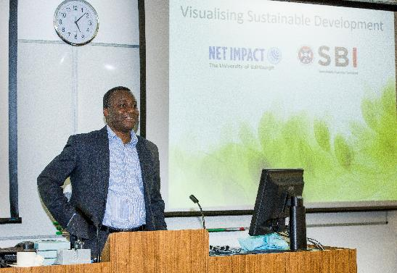
Innovative Learning Week 2015
Visualising Sustainable Development

Slide 5

Innovative Learning Week 2015 Winner
Recycling and Reuse ‘Garbage City’ in Cairo.

Slide 6
Innovative Learning Week 2016
‘There Is No Alternative! … Or is there?
3 events
2 days
150 people (staff, students, general public) in attendance

Slide 7
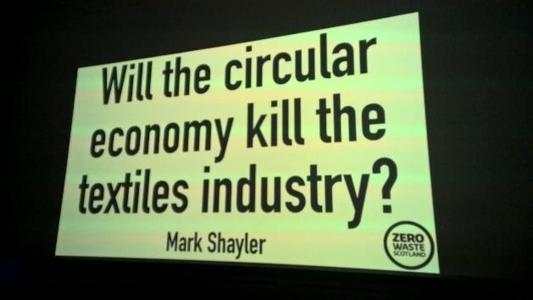
Event One
Guest Lecture: Mark Shayler

Slide 8
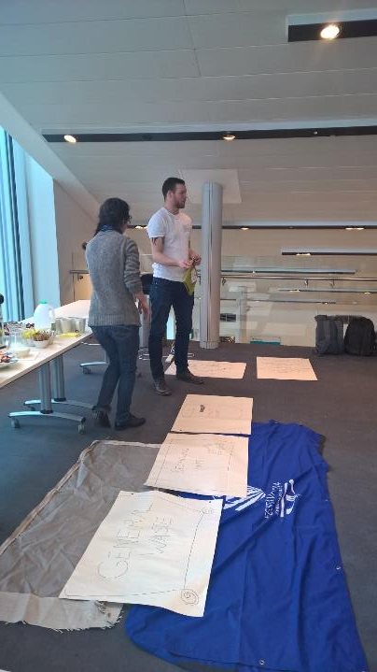
Event Two
Circular Economy Challenge

Slide 9
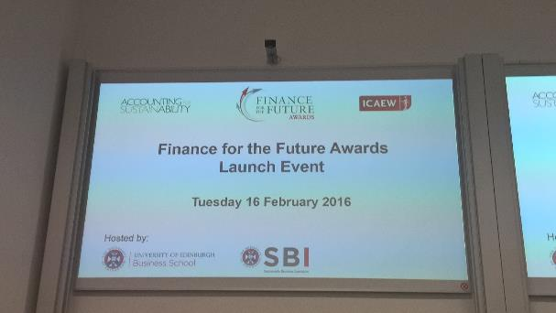
Event Three
Finance for the Future Awards Launch Event

Slide 10
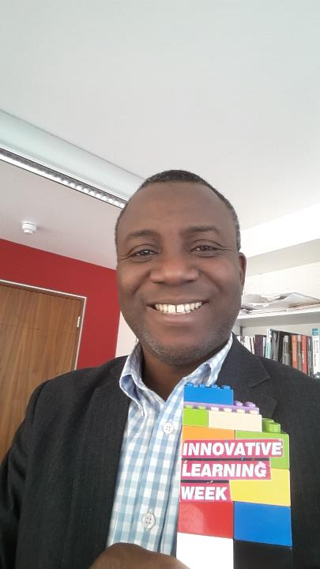
Success …
Most Impact Award

Slide 11
Building a Sustainable Business
Executive Masterclass: 15 – 17 June 2016
Integrate sustainability into your organisation and create
responsible business practices across cultures and borders.
Find out more about:
Sustainability Values and Strategies
Circular Economy Thinking
Carbon Markets
Banking Values
Communicating Sustainability Strategy
Dr Kenneth Amaeshi, Director Sustainable Business Initiative
Dr Brad MacKay, Chair of Strategic Management
Caroline Marchant, Early Career Research Fellow in Marketing

Slide 12
Thank you for your time!
sbi@ed.ac.uk
@SBIedinburgh

