Slide 1

How to run a successful campaign
28 June 2012
Imperial College London
EAUC CPD event

Slide 2
Welcome!
Kirsti Norris

Slide 3
Today’s aims
To outline some essential theory as you plan a behaviour change campaign. You will leave with a comprehensive plan in place.
Look at lots of different campaigns
Identify what makes them successful
Explore barriers to change
Essential campaign ingredients
Learning from each other’s experiences

Slide 4
campaigning
activism
influencing
CHANGE
advocacy
voice
lobbying
policy work
protest

Slide 5
Campaign
(noun) organised course of action for particular purpose, esp. to arouse public interest
Oxford Pocket dictionary

Slide 6
Our experiences
Discuss a campaign you’ve already been involved with.
What worked well
Why? What made it work well?

Slide 7






Why do we need campaigns?

Slide 8
Tell me, I forget
Show me, I remember
Involve me, I understand

Slide 9
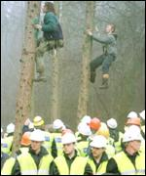
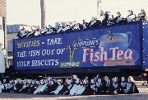
Campaign styles

Slide 10
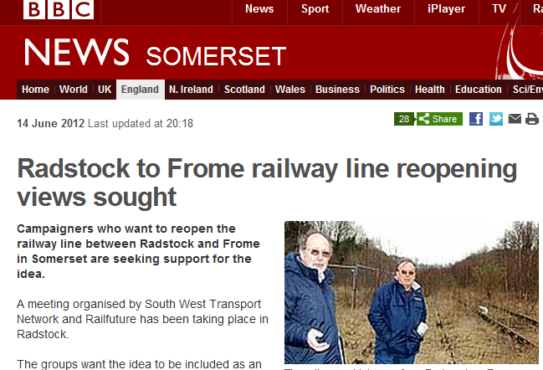
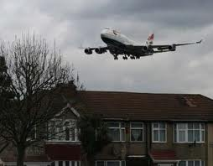
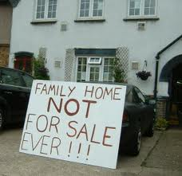

Slide 11
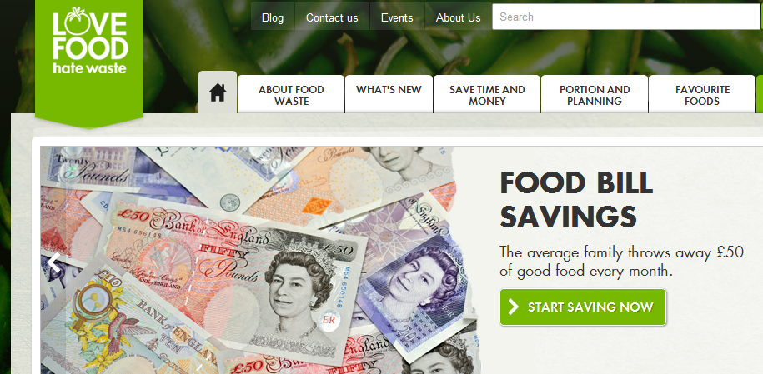
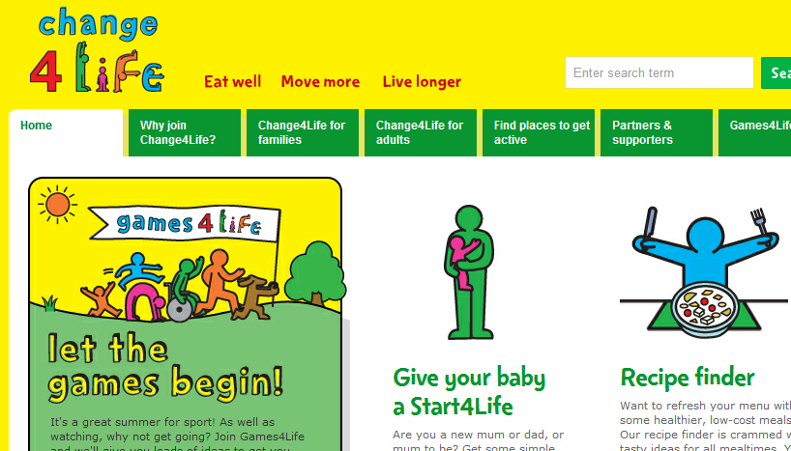
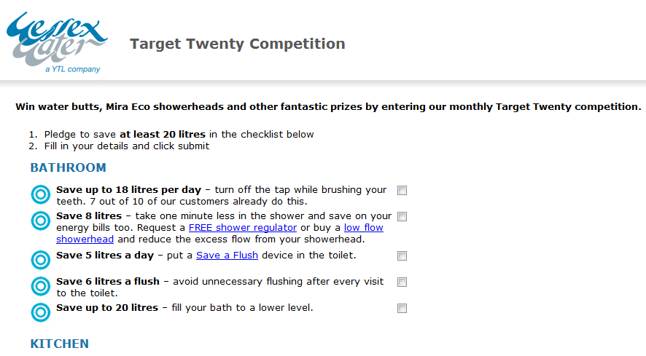

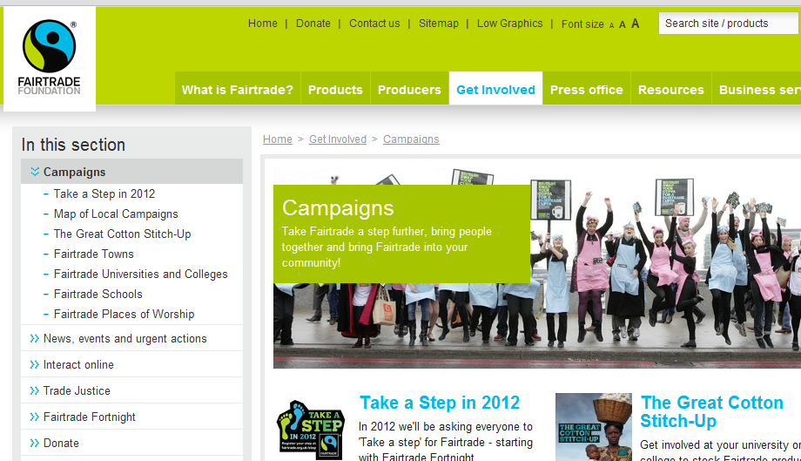

Slide 12
Insider | Outsider
Collaborative | Oppositional
Based on establishing shared goals | Based on pushing a particular goal
Mutual compromise | Consistent stance on issue
Evidence-based arguments | Emotion-based arguments
Direct access to decision-makers | Indirect access to decision-makers
Less publicly focused | More publicly focused
Systemic process-based | Creative and changing methods

Slide 13
Understanding change
Blissful ignorance
Let me tell you about this great idea we’ve adopted…
EXTERNALISE
It doesn’t affect me….
Denial
Commitment
I’ll ignore doing anything about this and maybe it’ll go away.
This is great, I’m really enjoying this.
INTERNALISE
Resistance
Exploration
How can I oppose this threat…
I’ll try but it’s risky…

Slide 14
Understanding behavioural barriers
“the … champion who recognises a constraint sees addressing it as an opportunity to increase agency, since by removing it, much wider change is enabled.”
i.e. if only we knew the barriers we
could work to remove them

Slide 15
Contextual constraints
Issue | Subjective / interior | Objective / exterior
Personal | Limiting personal values Worldview Emotions Assumptions Etc. | Limitation of one’s role Skills Knowledge Relationship set Etc.
Collective | Group cultures Shared mindsets Shared norms Etc. | Political Economic Social Technological Legal Environmental Informational
Notes:
Based on Ken Wilber’s Cultural Collectives model.
Developed by David Ballard

Slide 16
Contextual constraints
Factors constraining me from printing double-sided at College
 | Subjective / interior | Objective / exterior
Personal
Collective

Slide 17
Exercise
Completing a matrix

Slide 18
Reflecting on the barriers exercise

Slide 19
Greg Sandford Internal Communications Officer
University of Southampton

Slide 20
lunch

Slide 21
Post-lunch campaign success story

Slide 22
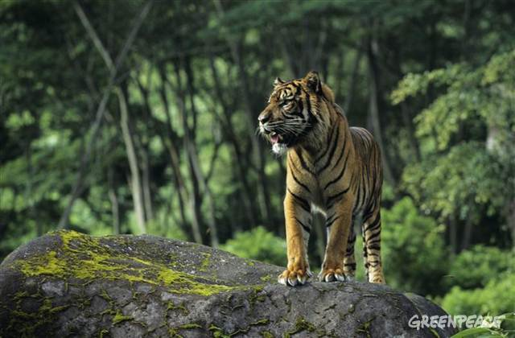
Challenge:
to influence the world’s largest pulp and paper company (Asia Pulp and Paper) to stop destroying Indonesian rainforests, home of the endangered Sumatran tiger

Slide 23
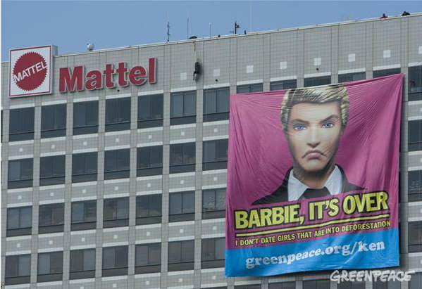
June 2011 – Mattel HQ, California

Slide 24
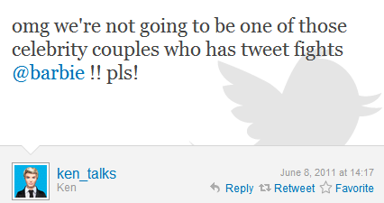
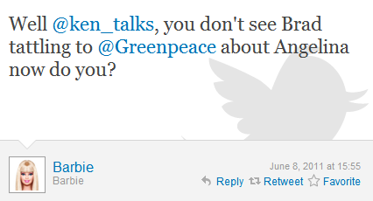

Slide 25
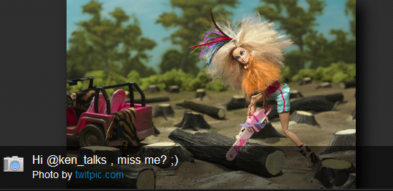
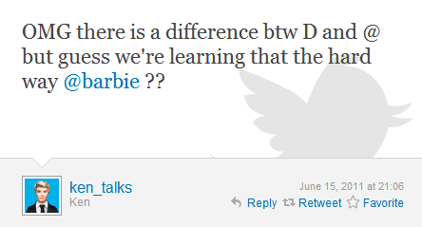
Barbie accidently tweets a picture of herself, instead of DMing to Ken:

Slide 26
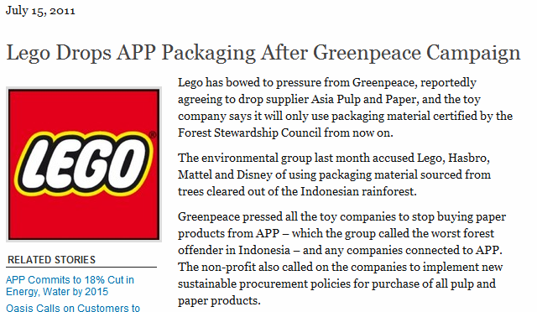

Slide 27
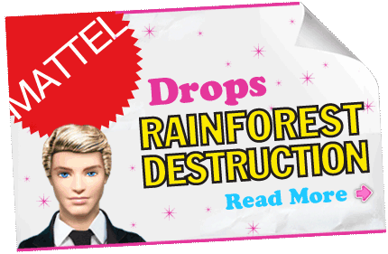
October 2011

Slide 28
Dave Andrew
PhD community groups & social media
University of Northampton

Slide 29
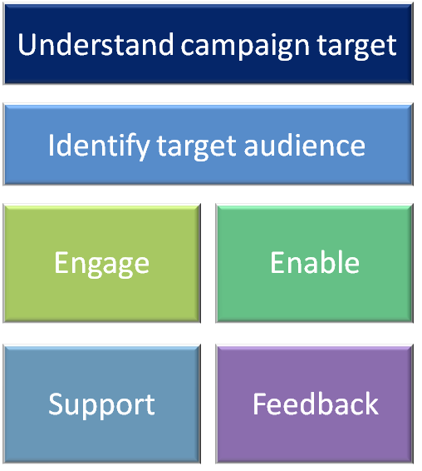
What makes a successful campaign?

Slide 30



getting yourself or your kids eating well, moving more and living longer
encouraging customers to save 20 litres of water per person per day (Wessex Water)

Slide 31
What is it you are hoping to achieve?

Slide 32

Who are you trying to influence?
What are they interested in?
What do you want them to do?
Why don’t they already do this?
Why should they do it?
Check your assumptions!

Slide 33
Reflection:
  testing barriers and assumptions
    How?

Slide 34

Engage
Raising awareness of the campaign – how to go about it?
  Memorable name
  Clear branding
  Clear message - you’ve identified what do you want them to do...but how to say it?

Slide 35
Engage
Core principle of influence
It’s not what you say, it’s how you say it.
Telling them what they should do. 
Clarifying what we want to do. 

Slide 36
Engage
A shared identity needs to be created between messenger and audience
The source is one of us
The message speaks for us

Slide 37
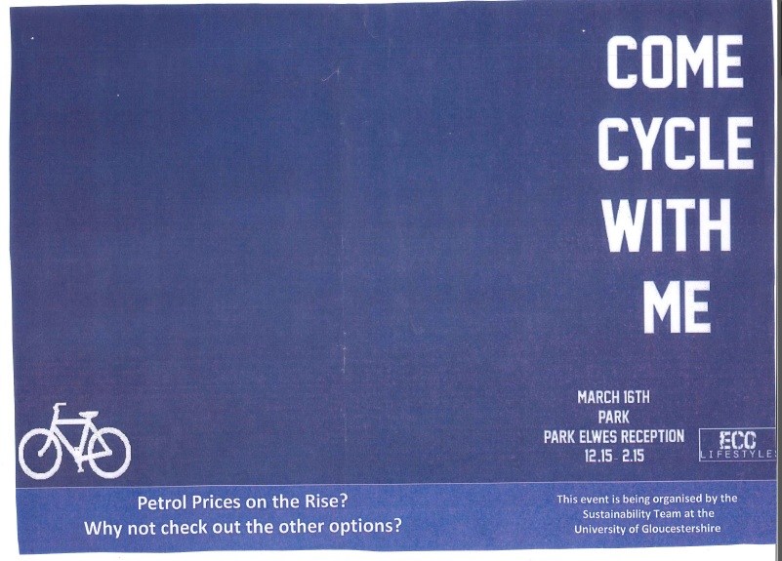

Slide 38
Engage
The message needs to:
  1. reflect group identity
  2. make the group distinctive
  3. be a source of group pride
“We” is the most important word in behaviour change
Source: Stephen Reicher, Psychology, University of St Andrews

Slide 39

Power of Social Proof
“the majority of hotel guests who encounter the towel reuse signs do actually recycle their towels at least some time during their stay.”
Increase reuse by 26%
The majority of guests who have stayed in this room participate in the towel reuse scheme at least some time during their stay
Increase reuse by 33%
Source: Cialdini in Yes!

Slide 40


Slide 41


Slide 42
Your campaign

Slide 43
Engage
Tools for raising awareness of the campaign
  Launch event
  Face to face events / communication opportunities
  Visual displays
  Posters
  Email
  Social media
  Articles on intranet
  Tutor sessions
  Curriculum links

Slide 44
Enable
Making it easy to take action
  Easy-to-do actions (easy to adopt)
  21-day (habit forming) actions
  Targets
  Materials – energy monitoring plug / literature with tips / switch-off booklet
  Training programmes / events
  Pledges
  Active and passive commitments

Slide 45
Enable
Making it easy to take action
In our Target Twenty campaign, we are encouraging customers to save 20 litres of water per person per day.
Using 10 litres less a day will leave 20 litres more in the environment.

Slide 46
Support
Encourage everyone to get involved
  Visible support
  Best practice sharing
  Recruit champions
  Set up support groups
  Facebook group
  Twitter
  Competitions
  Advice and information

Slide 47

Support

Slide 48
Feedback
How will you share and celebrate successes?
  Communications on progress
  Celebrate improvements (motivates those already taking action and encourages others to get involved)
  Rewards?
  Recognition?
  Articles in a newsletter / on intranet
  / twitter post

Slide 49

Feedback

Slide 50


Slide 51
All elements are essential for a successful campaign – making it more likely to succeed.

Slide 52
Campaign Plan
Stage 1 – understand the audience
Stage 2 – preparing the campaign elements
Stage 3 – going live!
Stage 4 – celebrating the successes, moving forward

Slide 53
Peer review

Slide 54
Final thoughts

Slide 55
Quick evaluation
What have you particularly found most useful today?
What would have made it even better?

Slide 56
Best of luck with your campaigns!
kirsti@actionforsustainability.com
www.actionforsustainability.com

