Slide 1
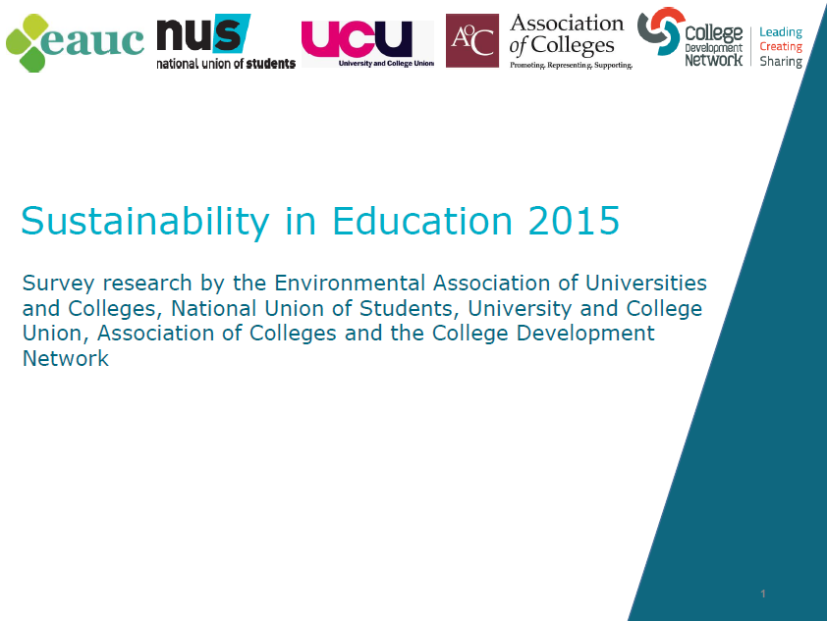

Slide 2
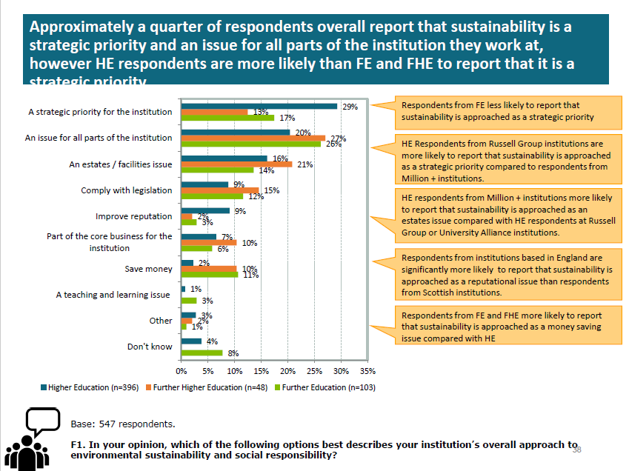

Slide 3
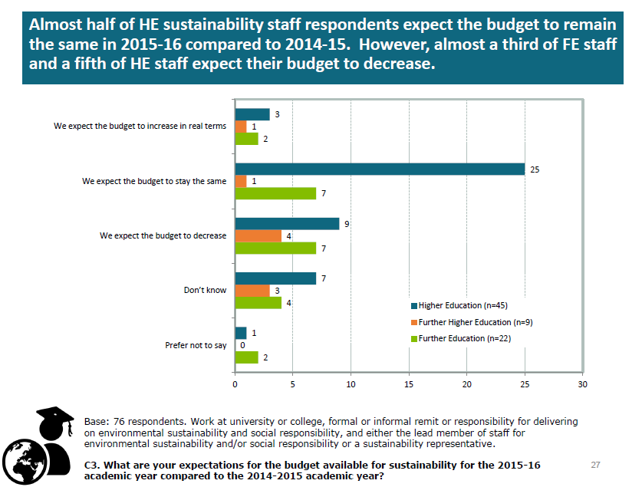

Slide 4
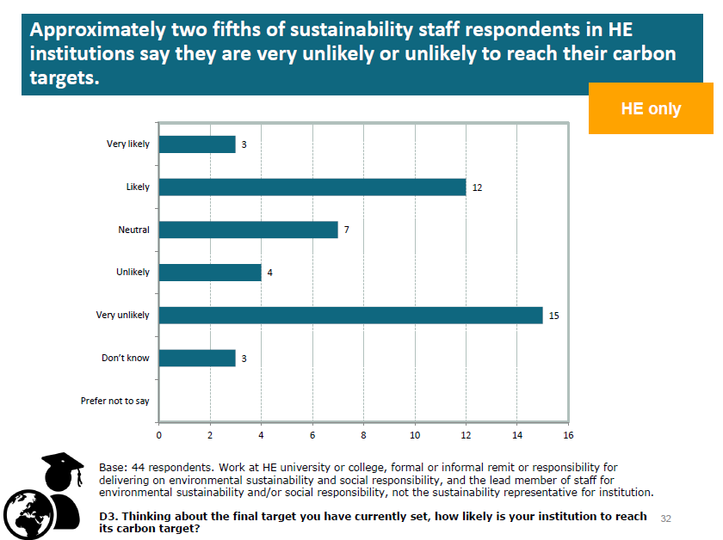

Slide 5
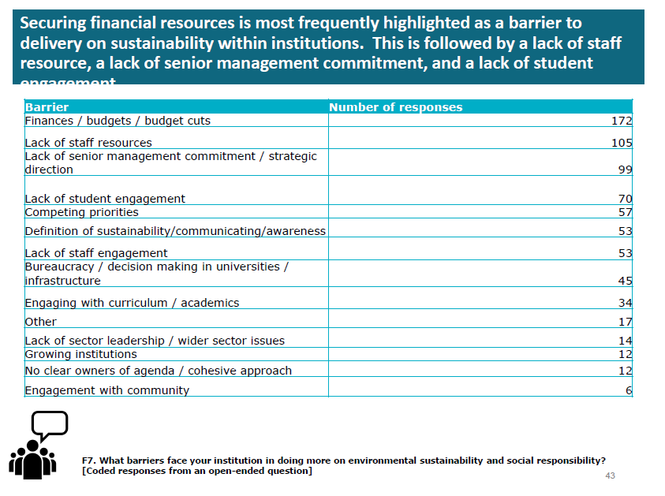

Slide 6
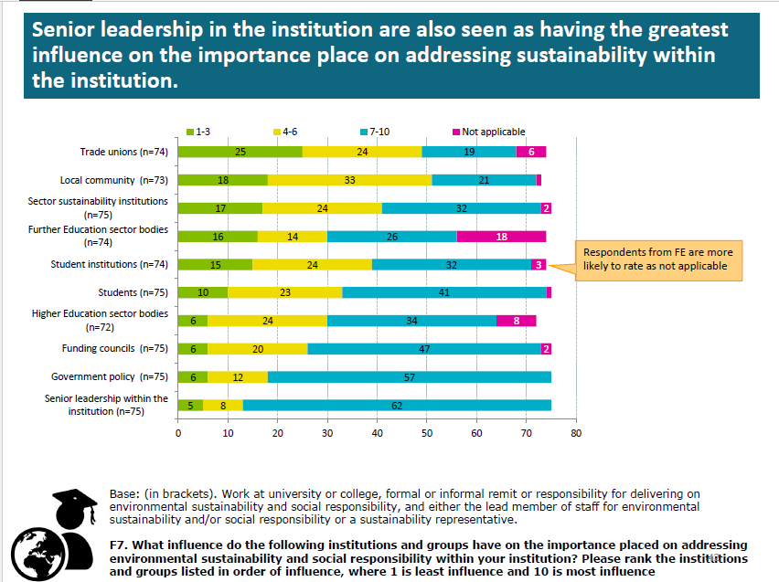

Slide 8
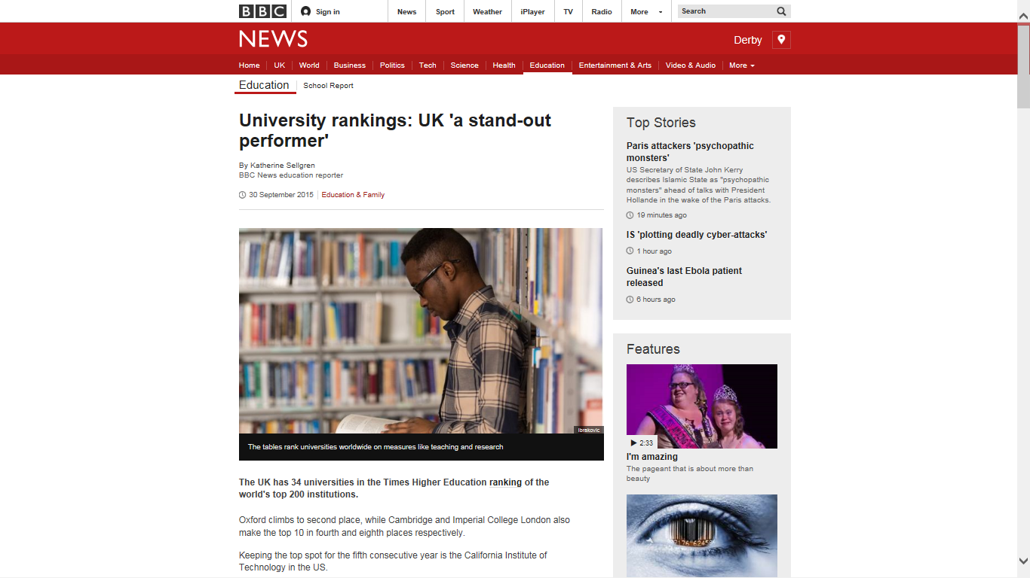

Slide 9
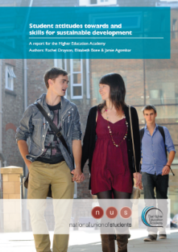
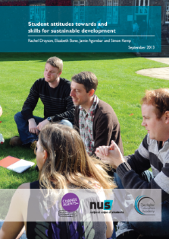
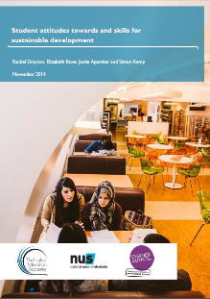
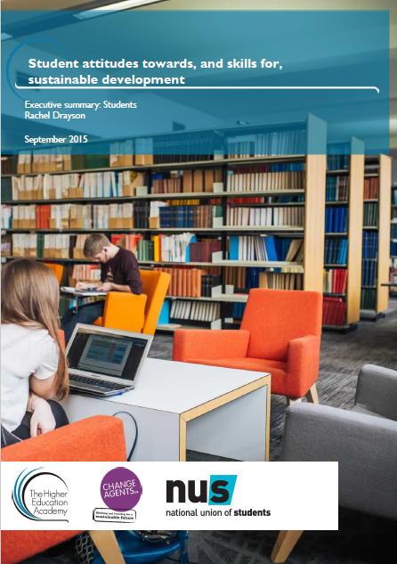

Slide 10
Tactics?!

Slide 11
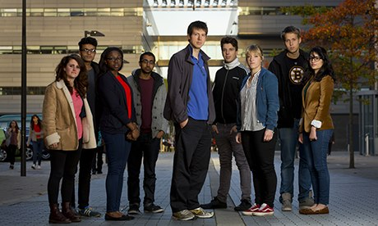

Slide 12
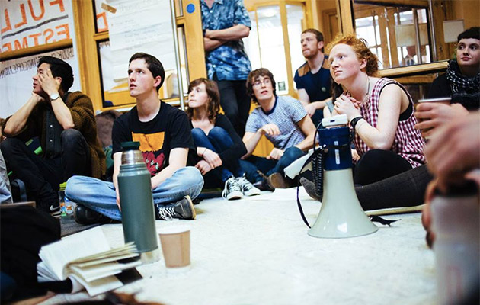

Slide 13
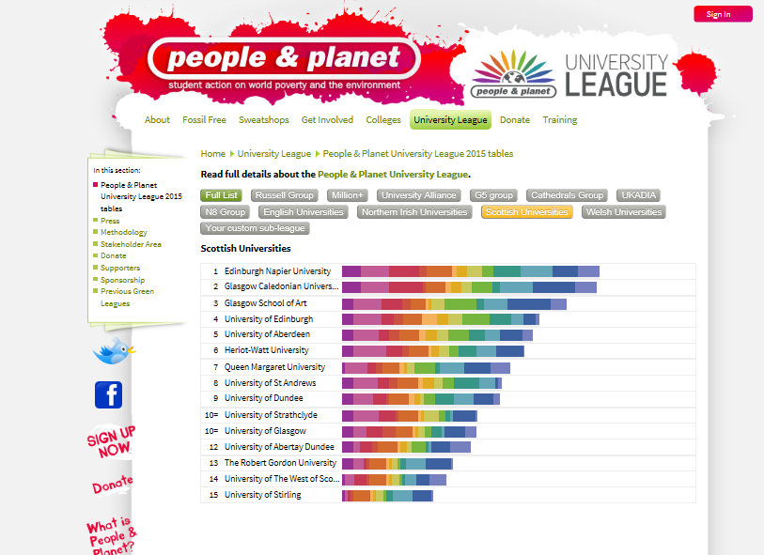

Slide 14
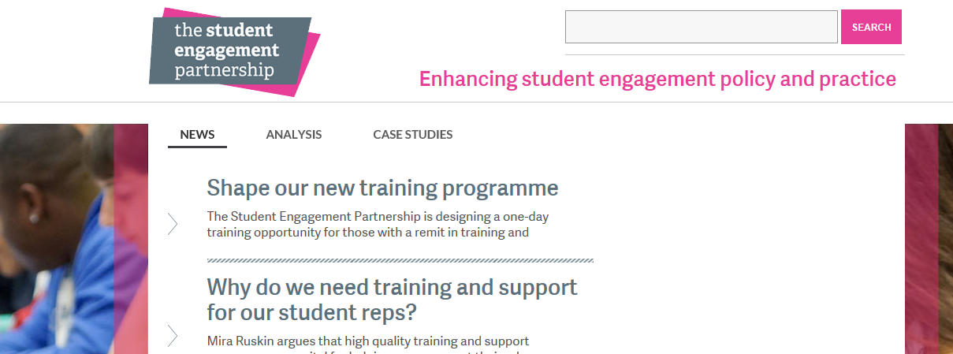

Slide 15
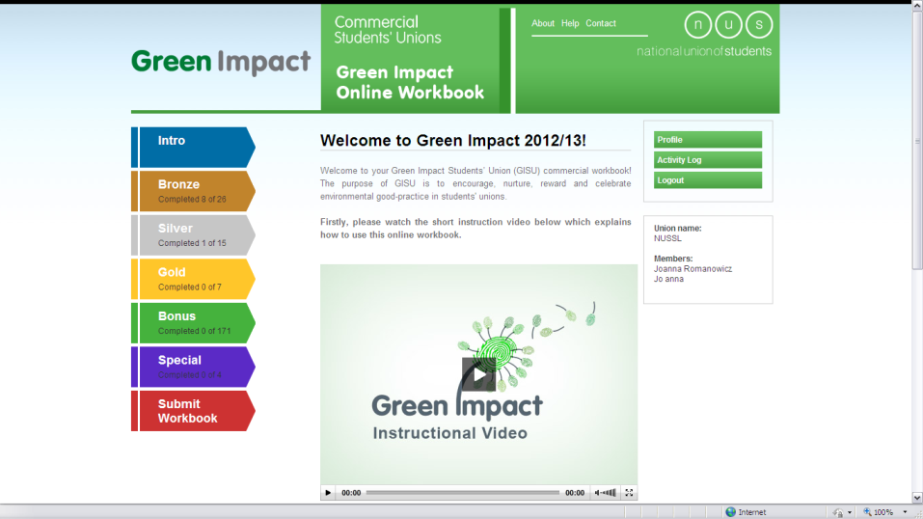

Slide 16
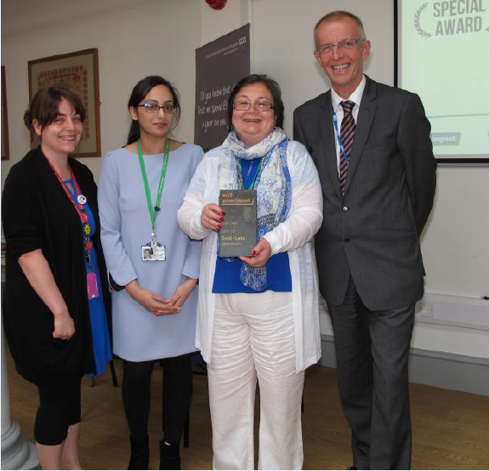

Slide 17
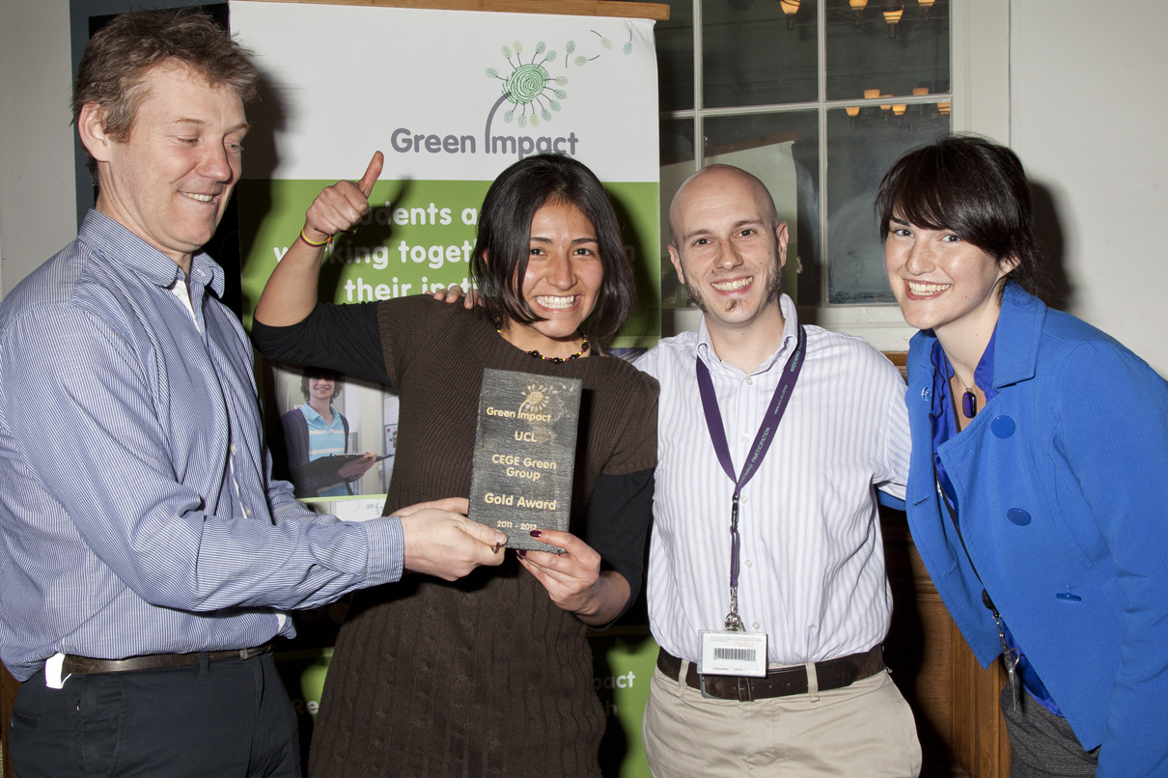

Slide 18
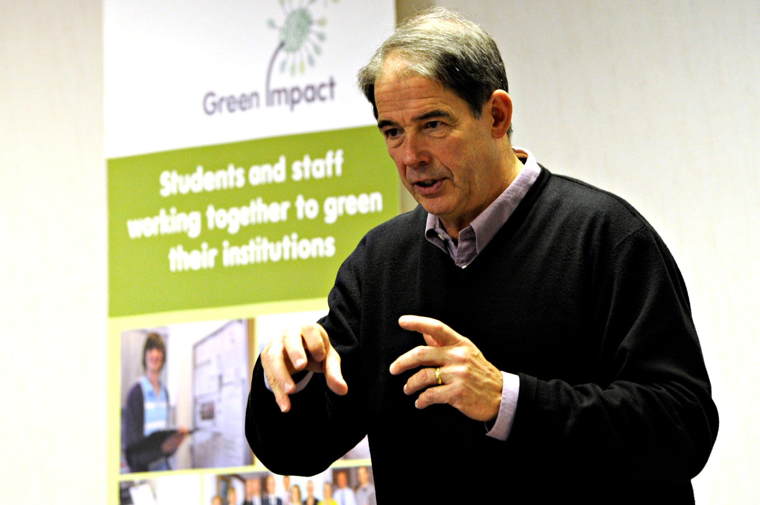

Slide 19
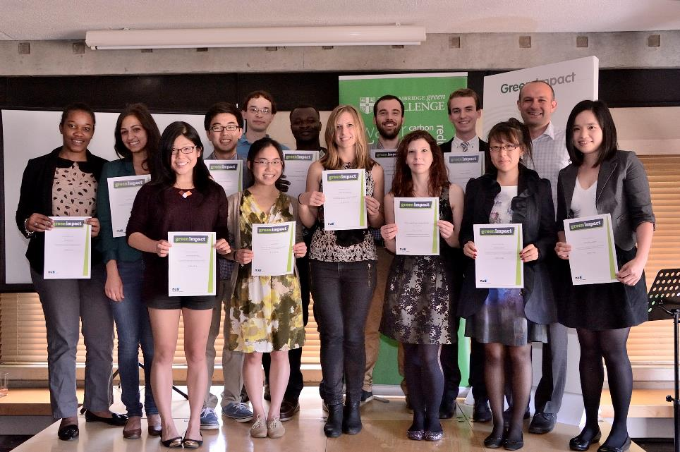
Student involvement in GI

Slide 20
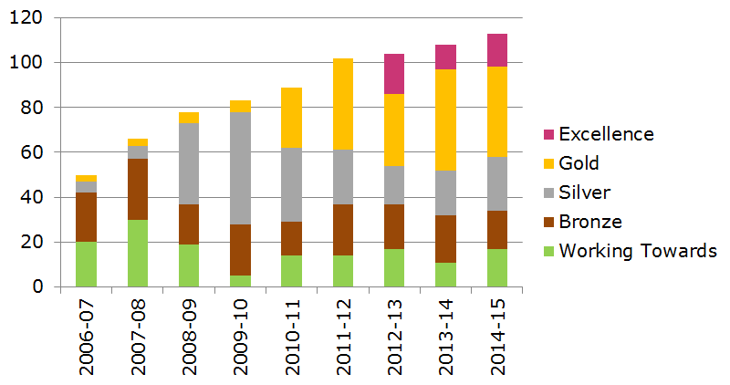

Slide 21
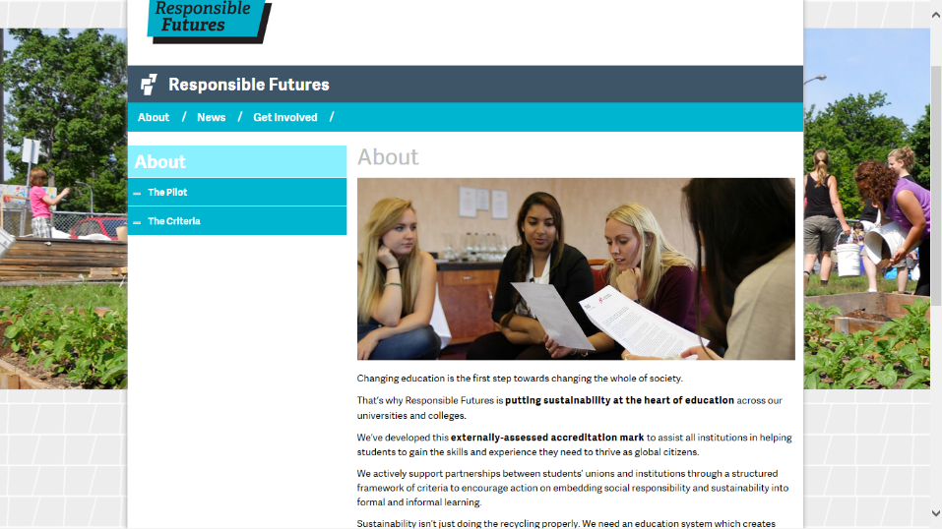

Slide 22
Responsible Futures
The vision for Responsible Futures is of a desirable, externally assessed accreditation mark for a whole-institution approach to environmental sustainability and social responsibility, spanning the formal and informal curriculum, applicable to both further and higher education.

Slide 23
260 points available; 10 mandatory

Slide 24
Opinions and outcomes
“[It was an] opportunity to improve…get people involved…provide validity and improve the profile [of the university]” University
Engaging and empowering
“It’s given us (the SU) a seat and a legitimacy to sit and talk about the curriculum; not a lot of FE unions have this.” Students’ Union
“A major benefit of participating in Responsible Futures has been getting buy in from Senior Management and from the whole University. We’ve seen each other on equal footing through this project.” Students’ Union
“We would have had an environmental and sustainability agenda into the future anyway. What it’s done it put that into a bigger external context and corporate context. It’s enabled us to see ways to use it to link across to other aspects within the university.” University
Partnership development
“It has been beneficial because it’s made them set up the wider steering group to drive ESD.” University
Fun!
It’s been great fun, actually! University

Slide 25
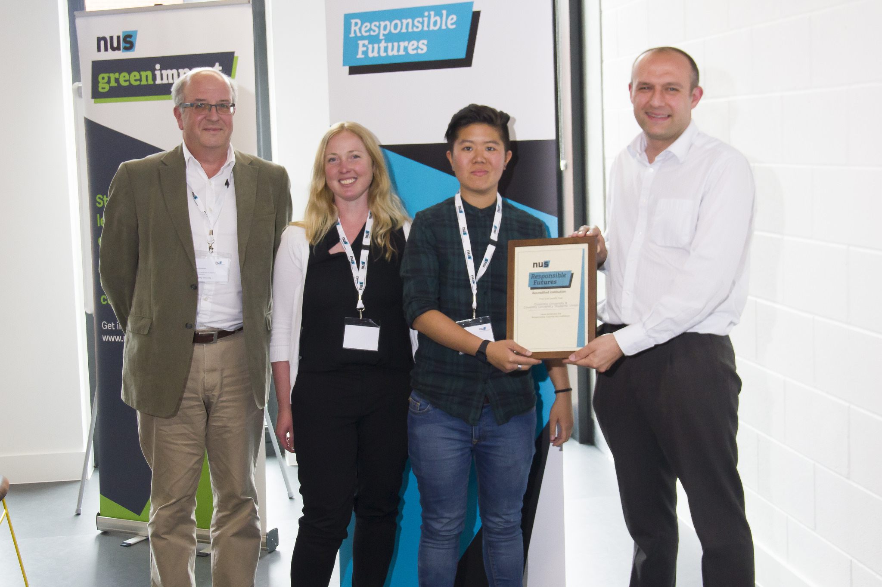

Slide 26
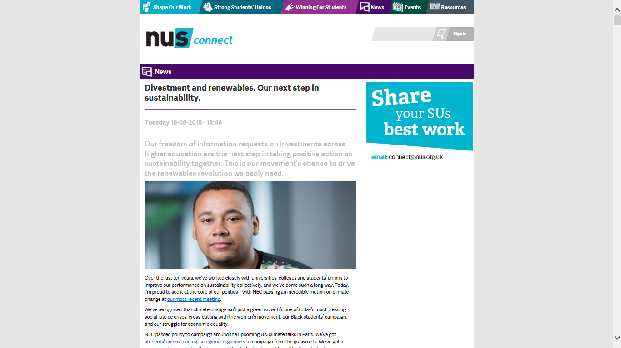

Slide 27
`
Jamie Agombar
jamie.agombar@nus.org.uk

