Slide 1
Living Labs for Social Responsibility & Sustainability at the University of Edinburgh
Michelle Brown and Matthew Lawson

Slide 2
Context
Social responsibility and sustainability living lab

Slide 3
Strategic context
“We aim to make a significant, sustainable and socially responsible contribution to Scotland, the UK and the world, promoting healthy economic growth and cultural wellbeing” (UoE Strategic Plan)

Slide 4
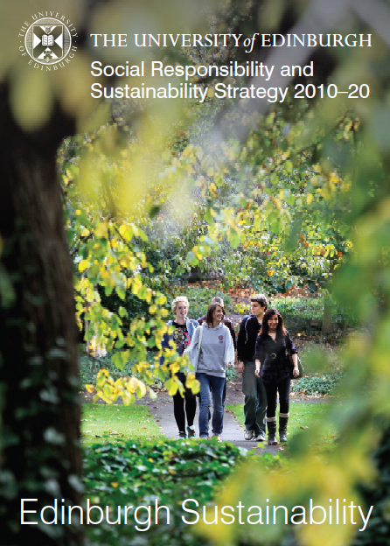
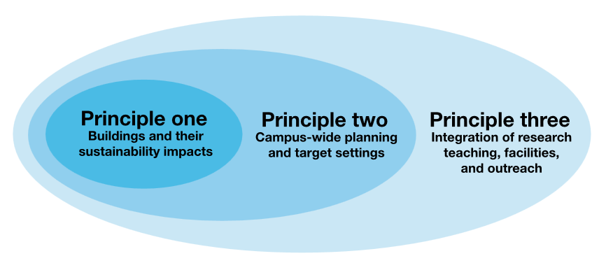

Slide 5
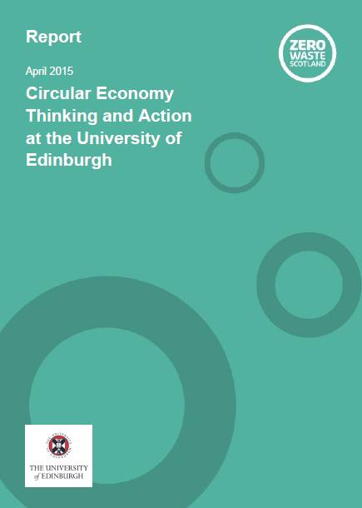
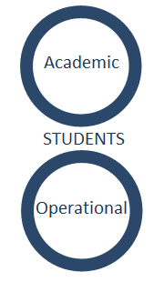

Slide 6
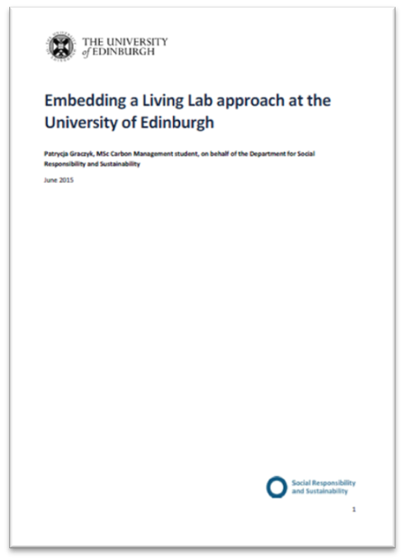
Research carried out April-June 2015 by Patrycja Graczyk.
15 staff interviews, student focus group, literature, document and web review.

Slide 7
Student engagement
Social responsibility and sustainability living lab

Slide 8
Harnessing expertise at the University of Edinburgh to influence and inform the global debate around climate change.
Learn more about the campaign at
www.ed.ac.uk/sustainability
Notes:
Discuss new campaign – framing of student collaboration with staff, COP21 focus, Buchanan Institute

Slide 9
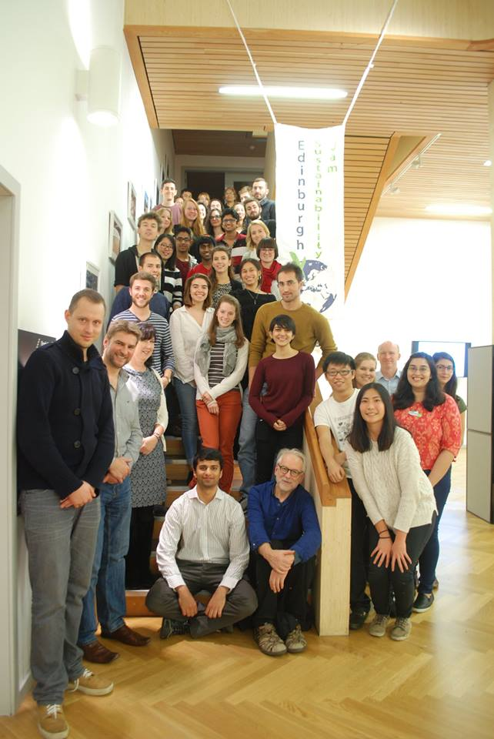
Edinburgh sustainability jam

Slide 10
Further opportunities
Practical based volunteering (eg. Café waste audits)
Working with student-led projects (eg. SHRUB)
Case studies in sustainable development
Participation in policy and planning
Video

