Slide 1

ENGAGING WITH EXTERNAL COMMUNITIES
MILTON ROAD COMMUNITY GARDEN – EDINBURGH COLLEGE

Slide 2
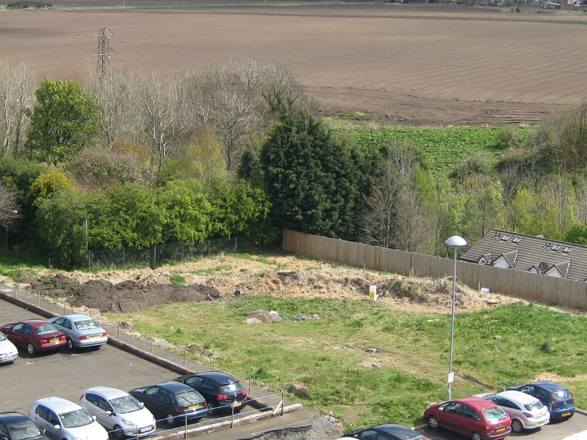
FROM THERE (August 2012)…

Slide 3
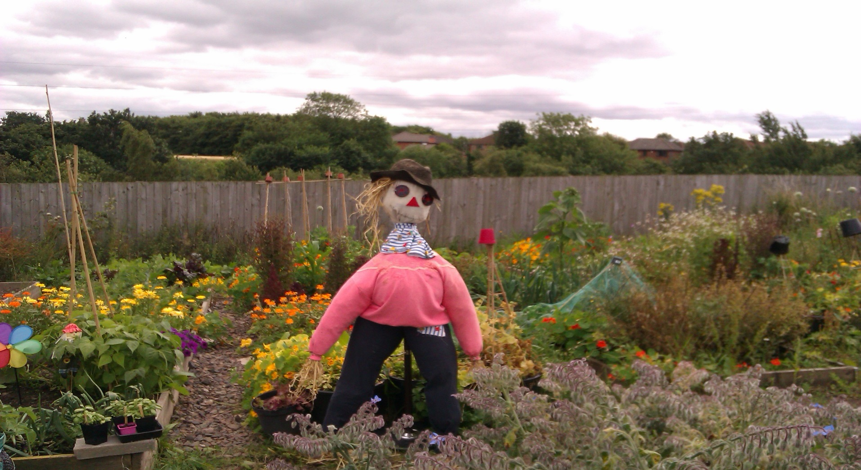
…TO HERE (August 2014)

Slide 4
OUR OUTCOMES
Improving environmental awareness and promote sustainability
Improving and enhance biodiversity on campus
Increasing links with the community
Providing opportunities to grow your own
Promoting healthier lifestyle and a better well-being
Improving transferable employability skills
Increasing self-esteem and building confidence
Improving social understanding and integration

Slide 5
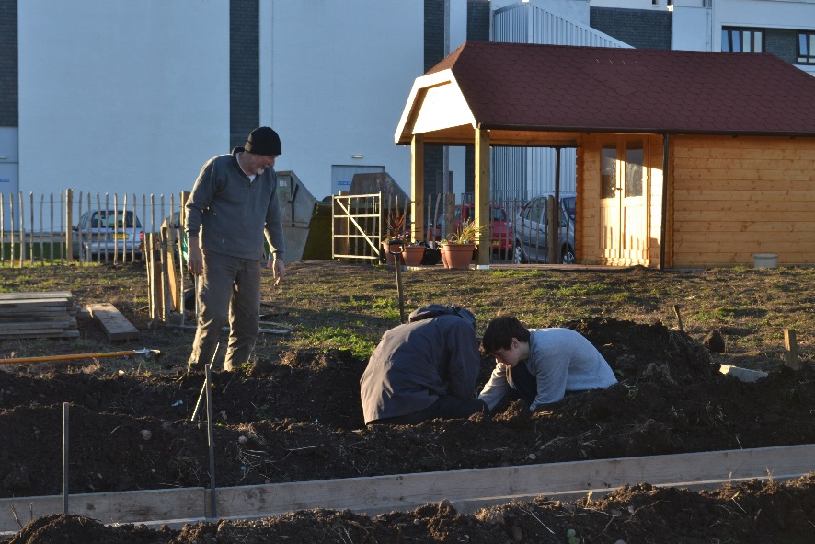
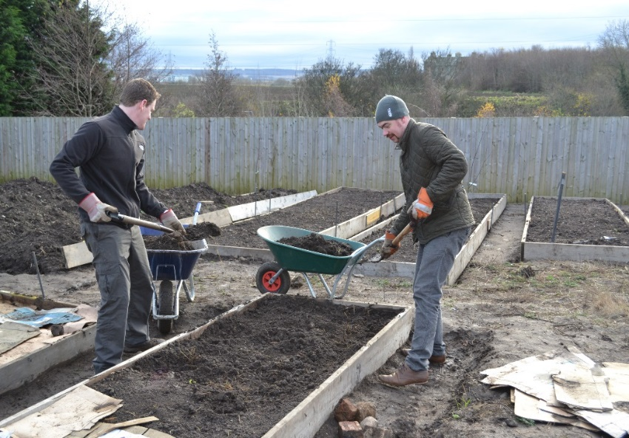
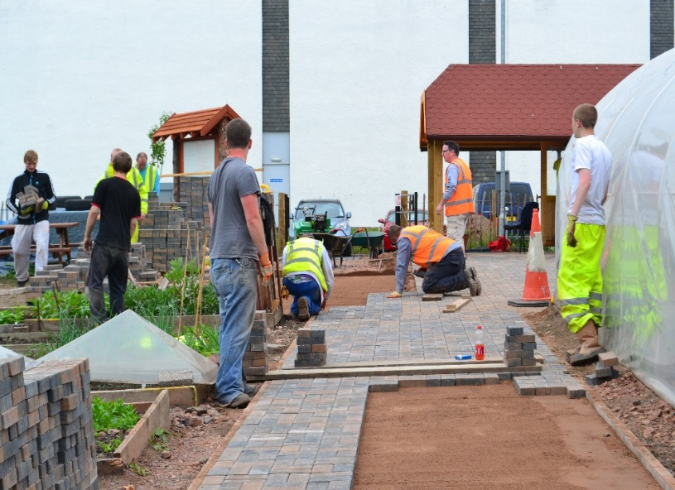
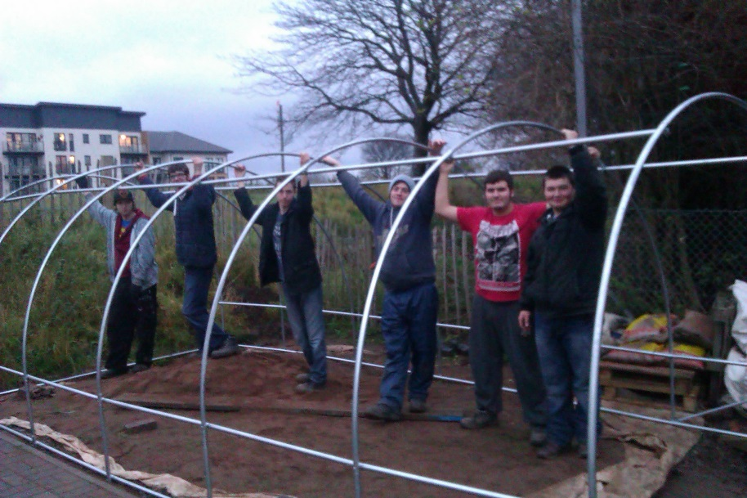
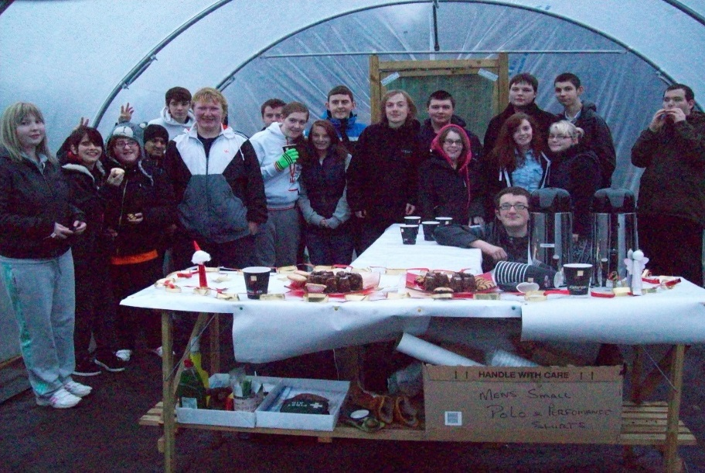
COLLEGE COMMUNITY ENGAGEMENT

Slide 6
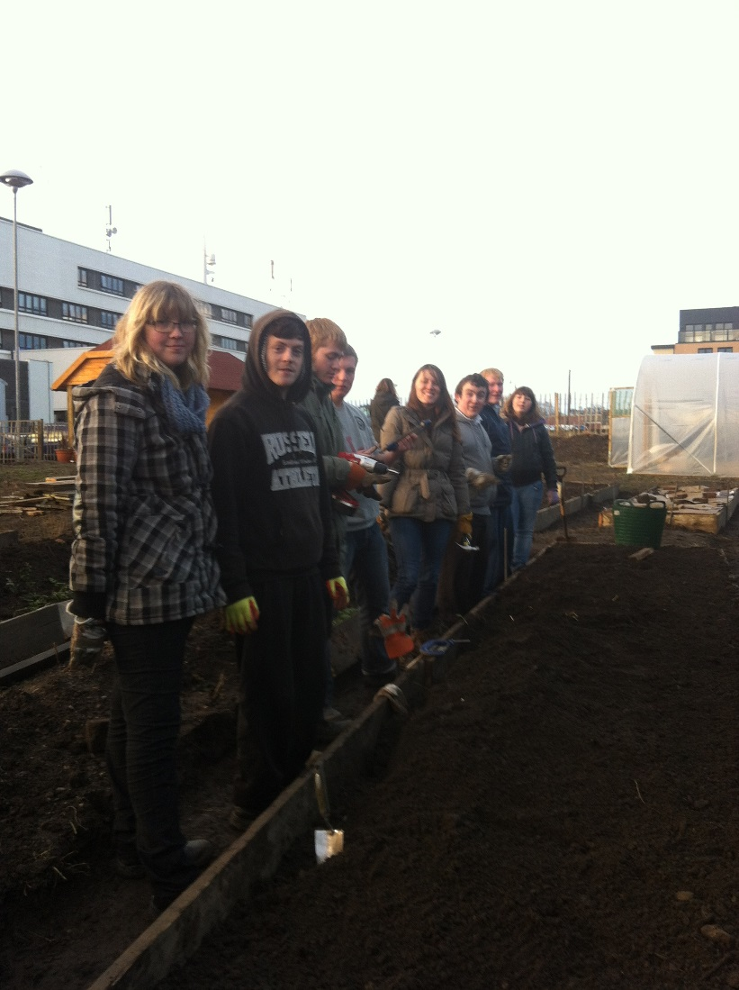
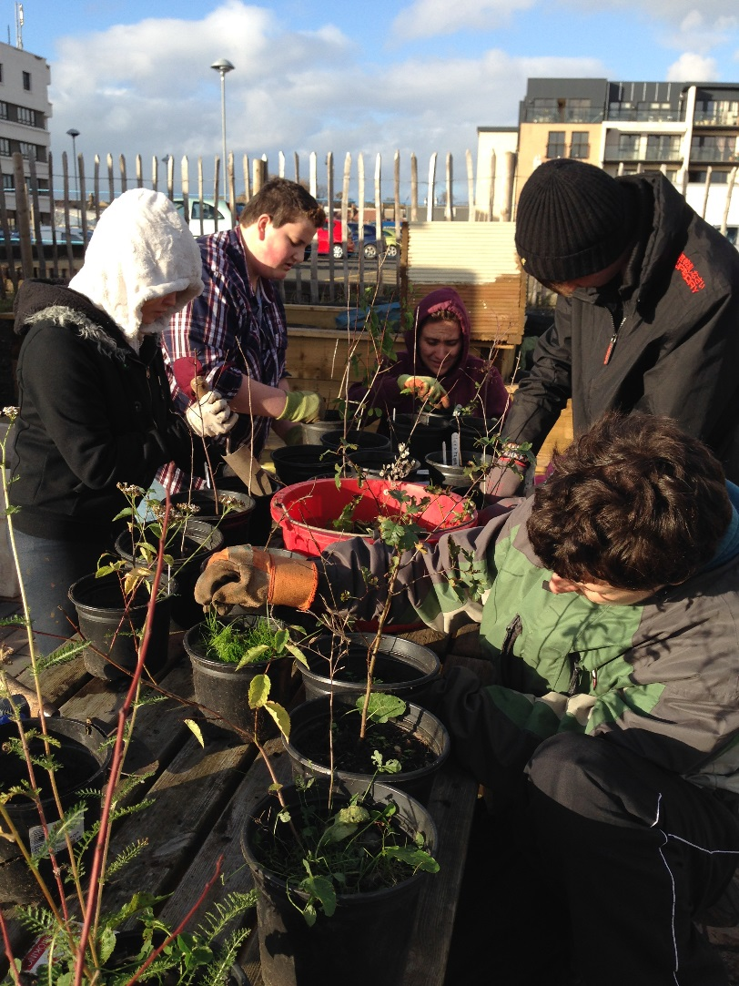
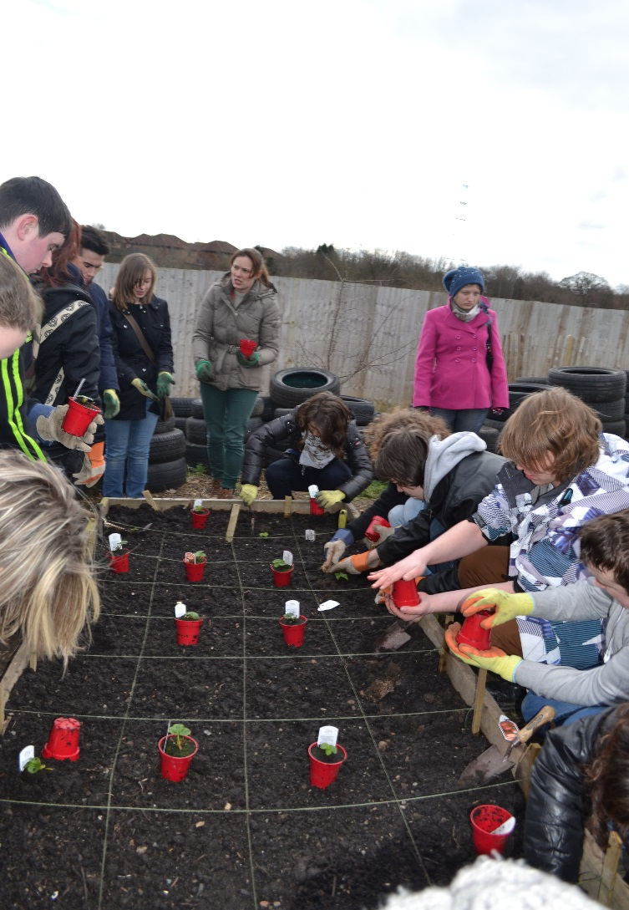
INTERNATIONAL GROUPS

Slide 7
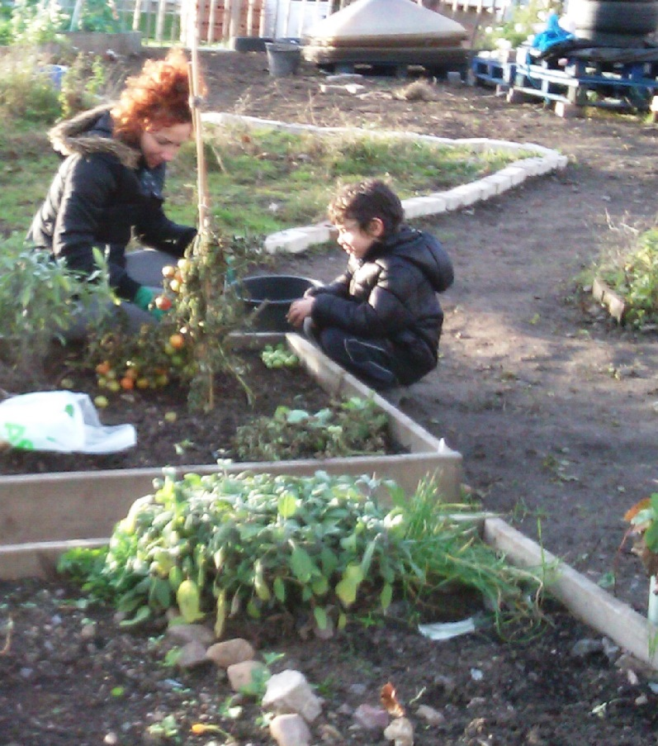
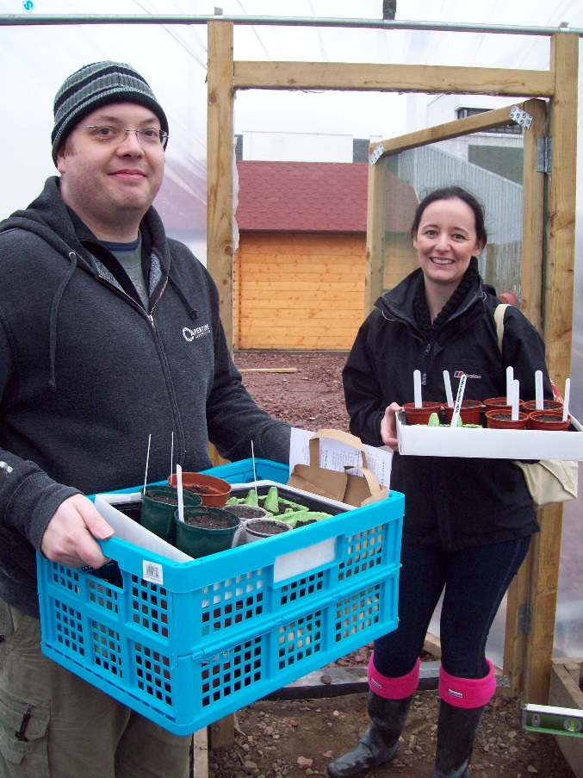
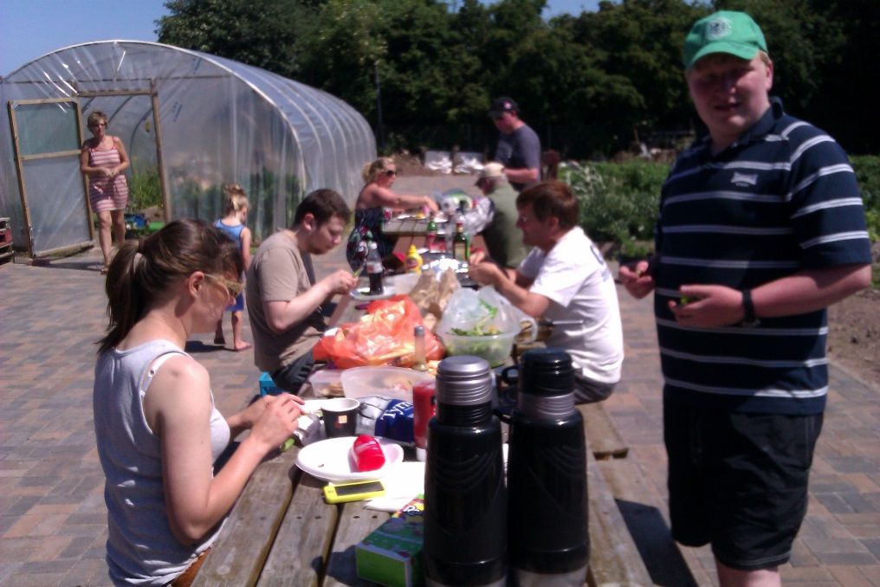
COMMUNITY MEMBERS

Slide 8
EXTERNAL COMMUNITY ENGAGEMENT
Creating links between Edinburgh College and the community
With agencies supporting young peoples, adults with additional support needs, and minority groups
  Promoting inclusiveness
  Introducing the College to young peoples giving them the confidence to join courses

Slide 9
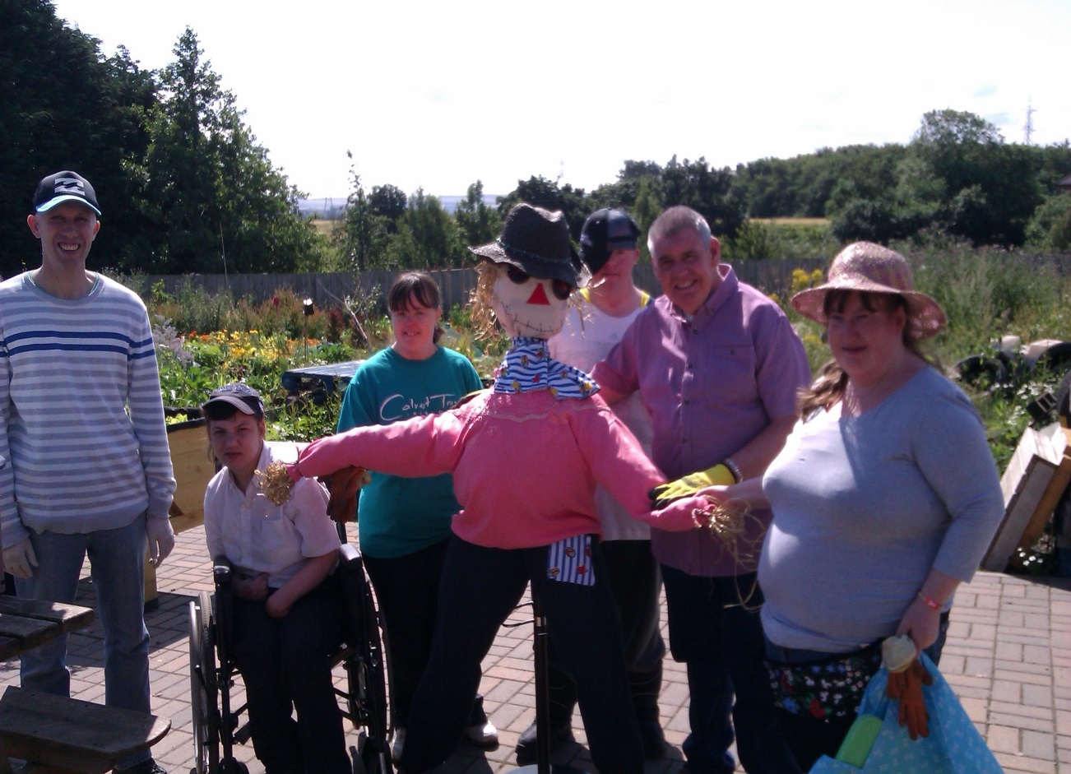
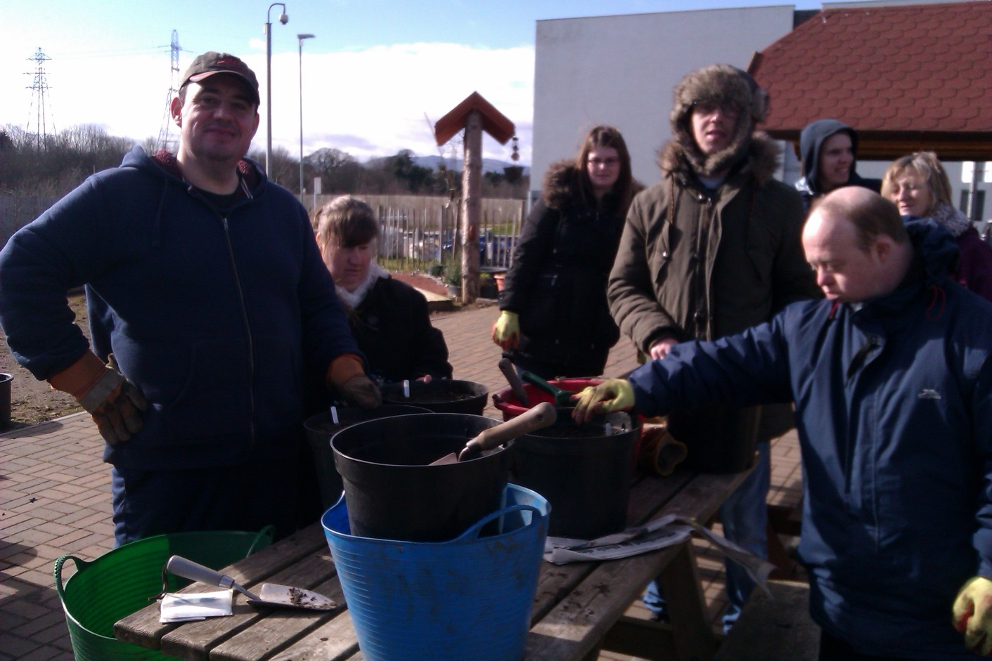
FISHERROW HUB

Slide 10

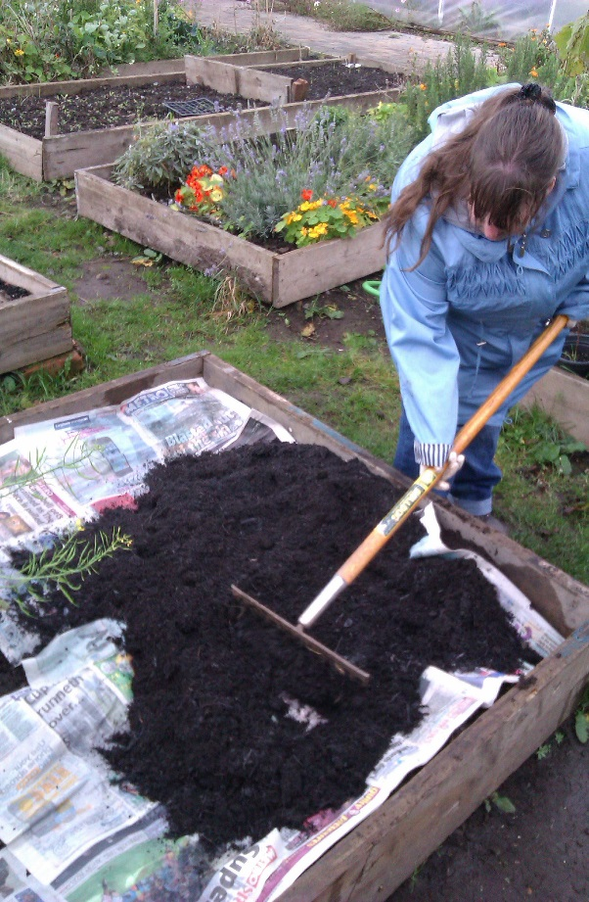
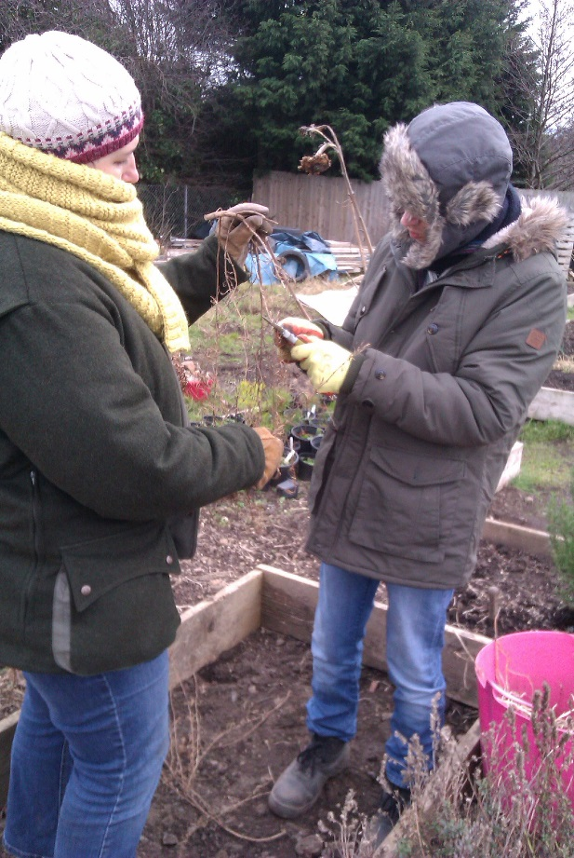
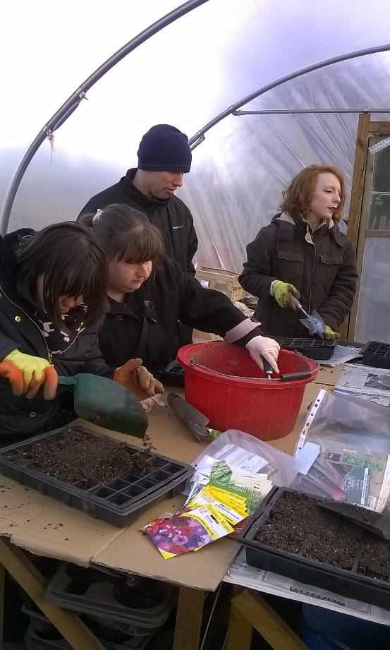
ROYAL CALEDONIAN HORTICULTURAL SOCIETY: GROW & LEARN AWARD

Slide 11
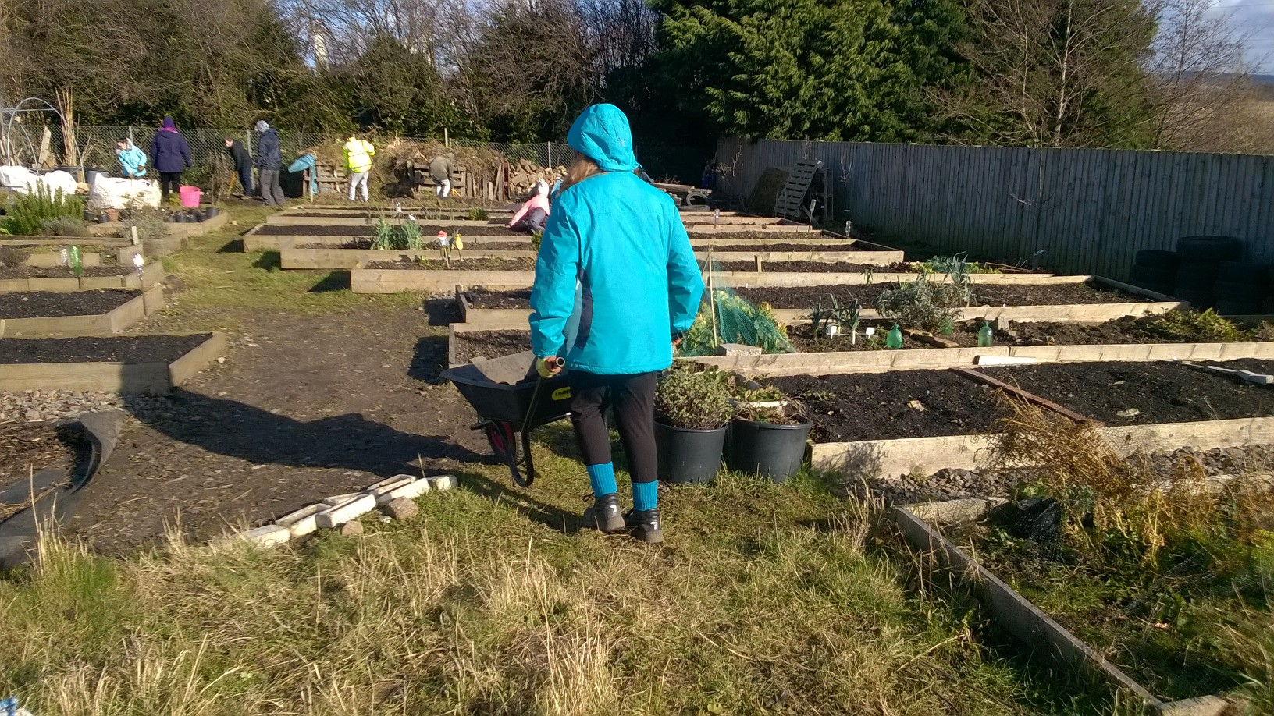
SCHOOL GROUPS

Slide 12
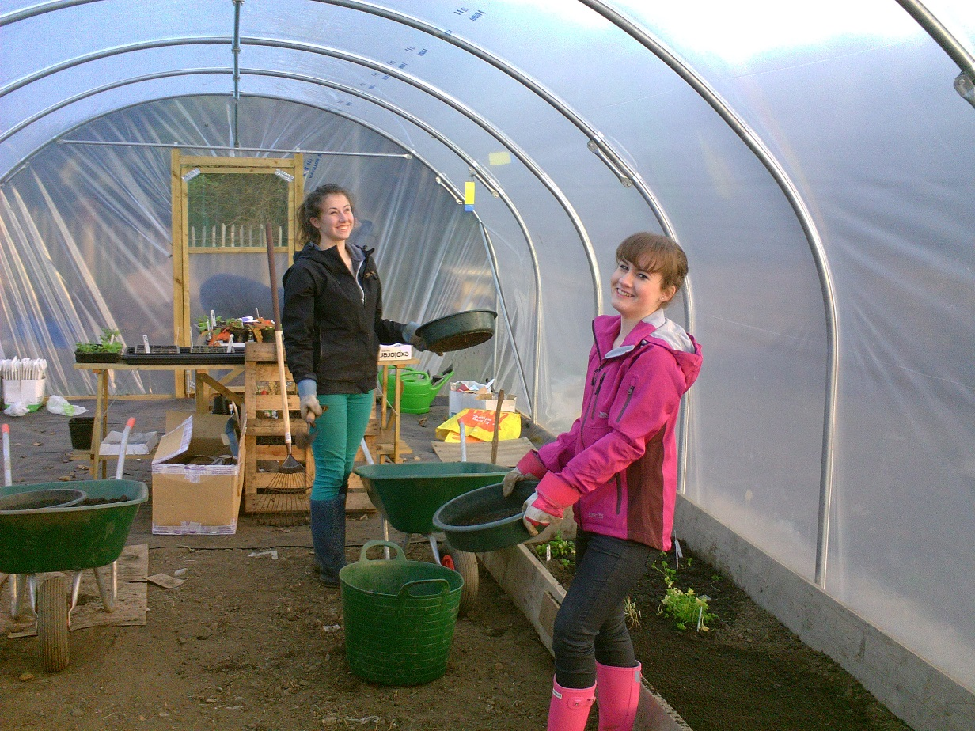
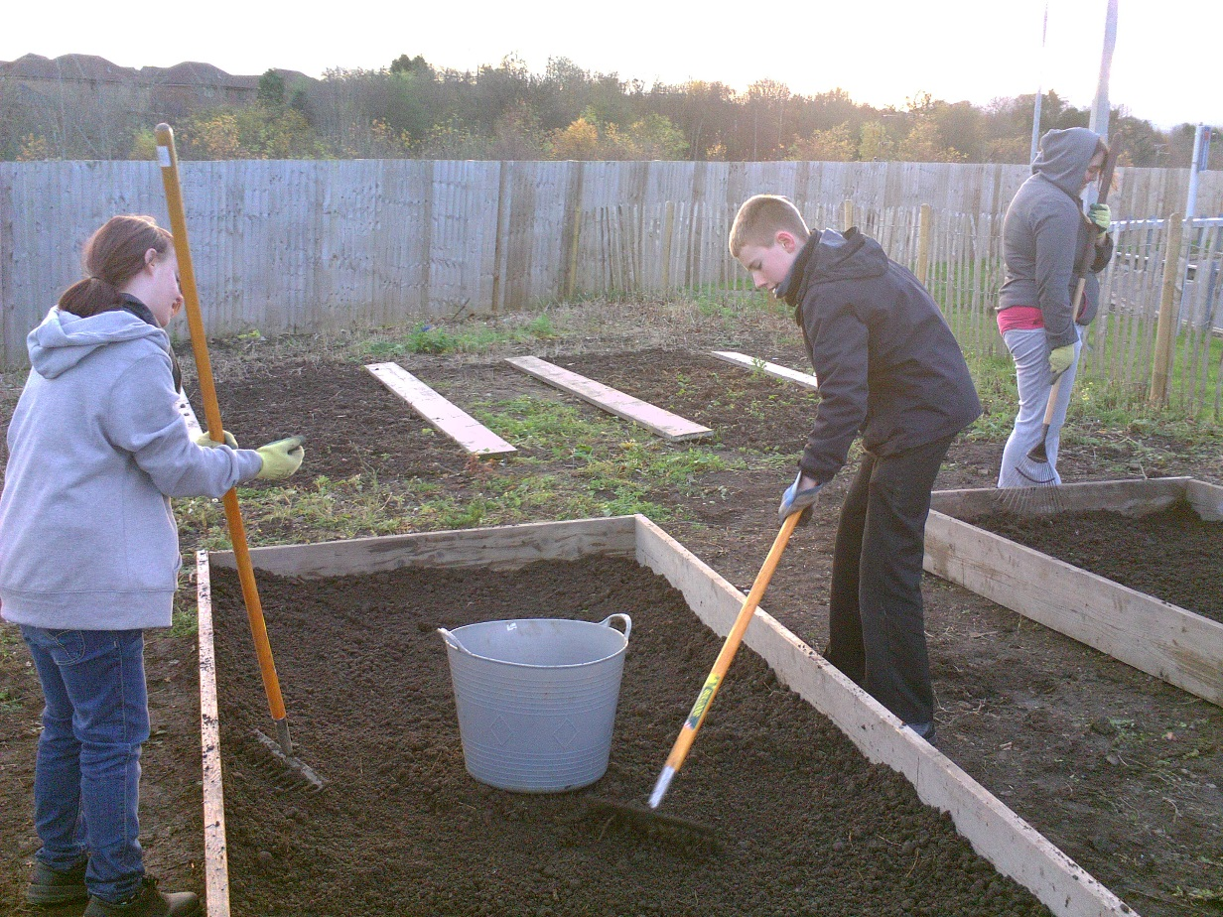
PORTOBELLO HIGH SCHOOL

Slide 13
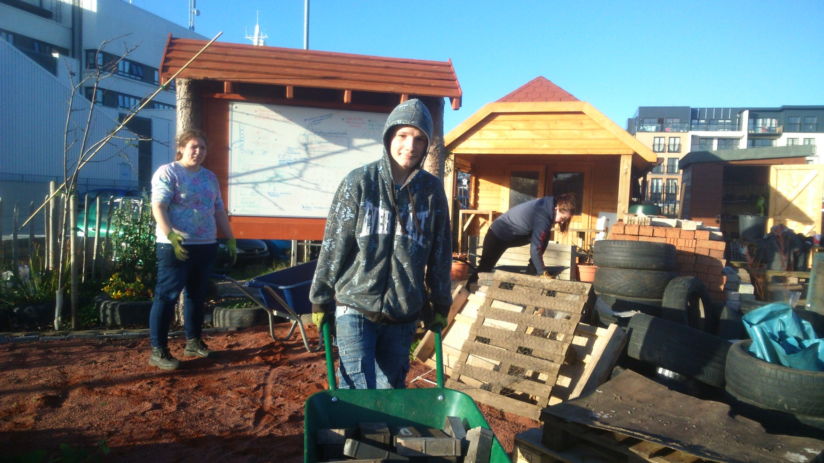
MIDLOTHIAN TRAINING SERVICES
AND EAST LOTHIAN WORKS

Slide 14




OTHER AGENCIES

Slide 15
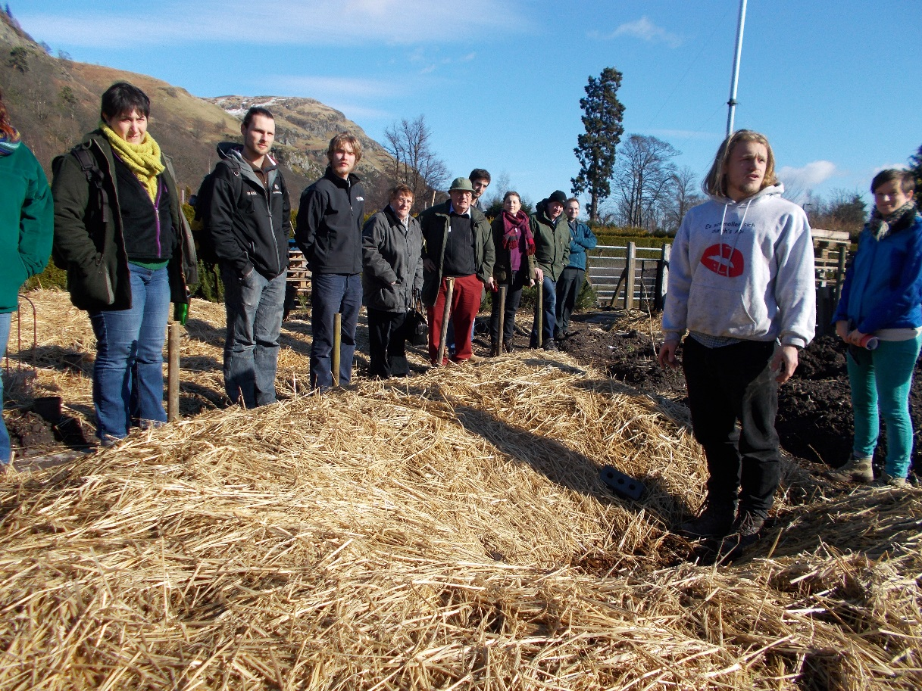




VALUABLE NETWORK

Slide 16
Many thanks
Milton Road Community Garden – Edinburgh College
Community Garden Coordinator: Severine Monvoisin
Severine.Monvoisin@edinburghcollege.ac.uk

