Slide 1
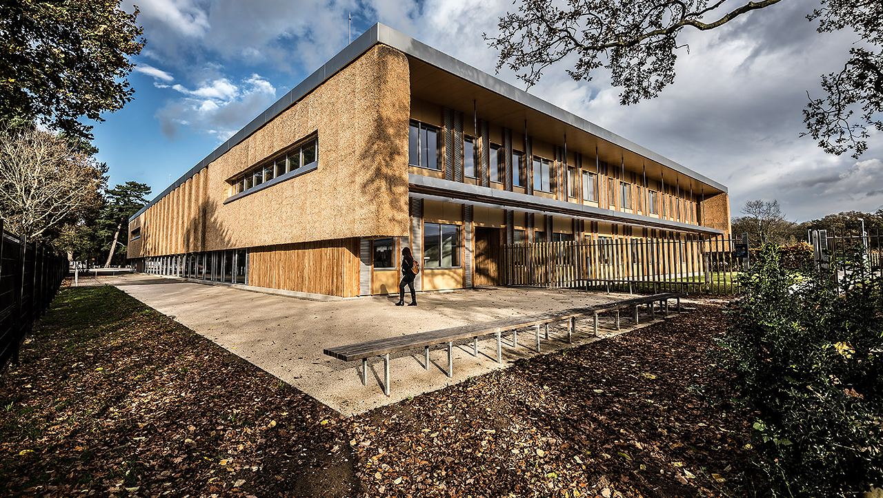


The Enterprise Centre
University of East Anglia

Slide 2
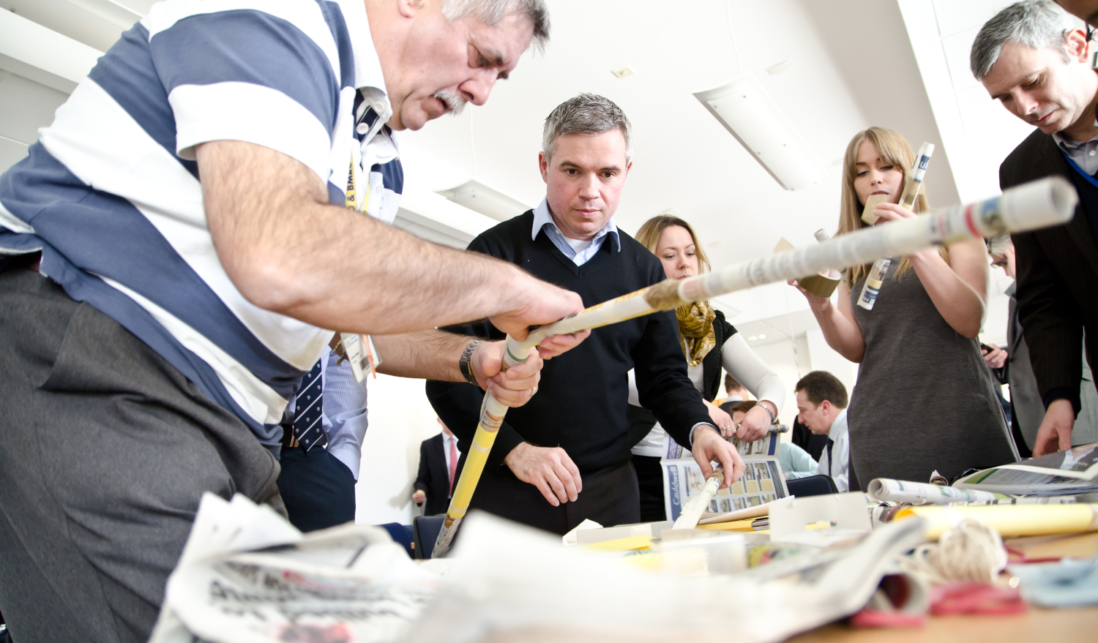
From a blank
sheet of paper
Notes:
An innovative client is key to encouraging true sustainability.
UEA and Adapt were certainly this.
Using a unique, single point delivery method, ensured we were engaged early
The challenge? To create a flagship gateway to the campus with leading sustainable credentials
Starting with a blank sheet of paper at RIBA Stage Zero, our integrated team captured imagination at the design competition, and framed every decision with a sustainable option

Slide 3
The Magnificent 7 Setting the standards
3
1
2
Bio Based Materials
Passivhaus
BREEAM Outstanding
4
6
7
5
75% lower embodied
carbon
100 year
design life
Soft landings
& 3yr POE
Local
suppliers
Notes:
After capturing the clients imagination during the design stage, the integrated team secured the project and developed the sustainable design from RIBA Stage Zero to achieve the magnificent 7
To succeed, changes had to ripple throughout the supply chain.
In a single project the rulebook was completely re-written

Slide 4
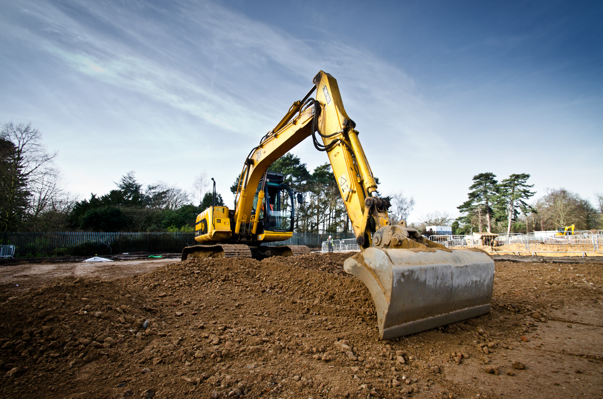
100% recycled
sub base
Notes:
Proving sustainability underpinned every decision, even the sub base was 100% recycled
The team got in touch with a demolition project just five miles away
Using the WRAP protocol, the aggregate was transported direct to site

Slide 5
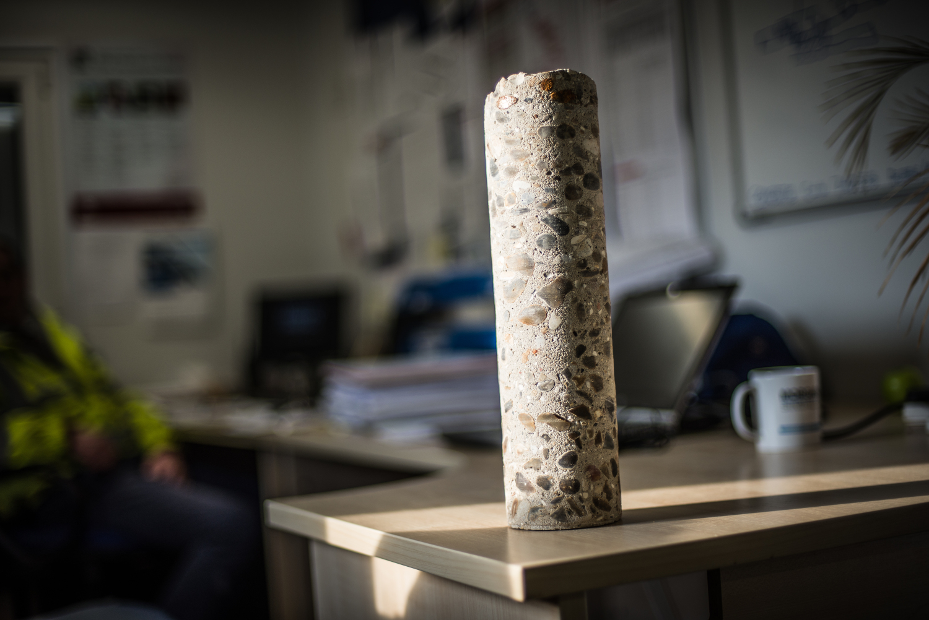
Ultra low carbon
concrete mix
Notes:
Even the choice of concrete was sustainable, using an ultra low carbon unique mix
70% GGBS, recycled sand, and recycled aggregate

Slide 6
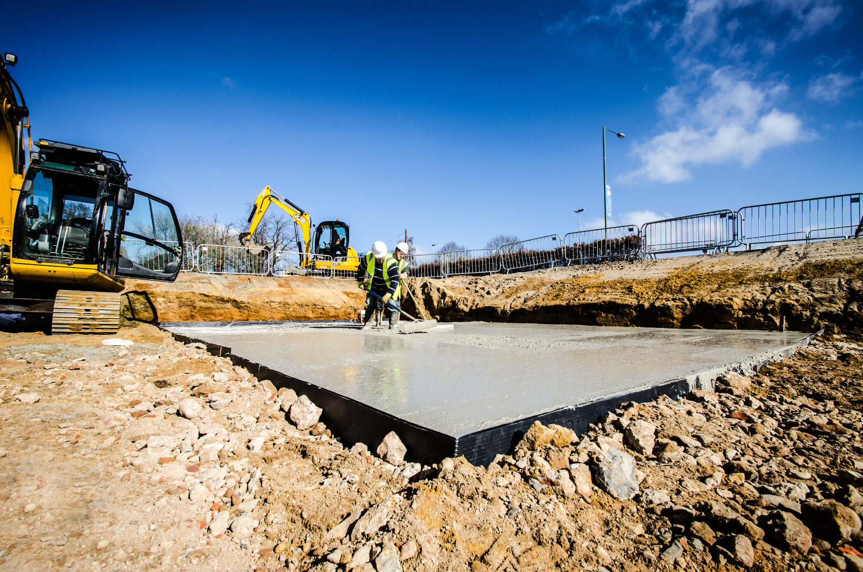
Testing the
concrete mix
Notes:
We didn’t know how it was going to turn out, so tested the mix on capping rafts, and were delighted with its performance and even settlement of aggregate
As a side note – the site’s geology presented difficult challenges with dissolution features all over the site
Our engineers designed these capping features using the low carbon concrete to ensure works did not stop

Slide 7
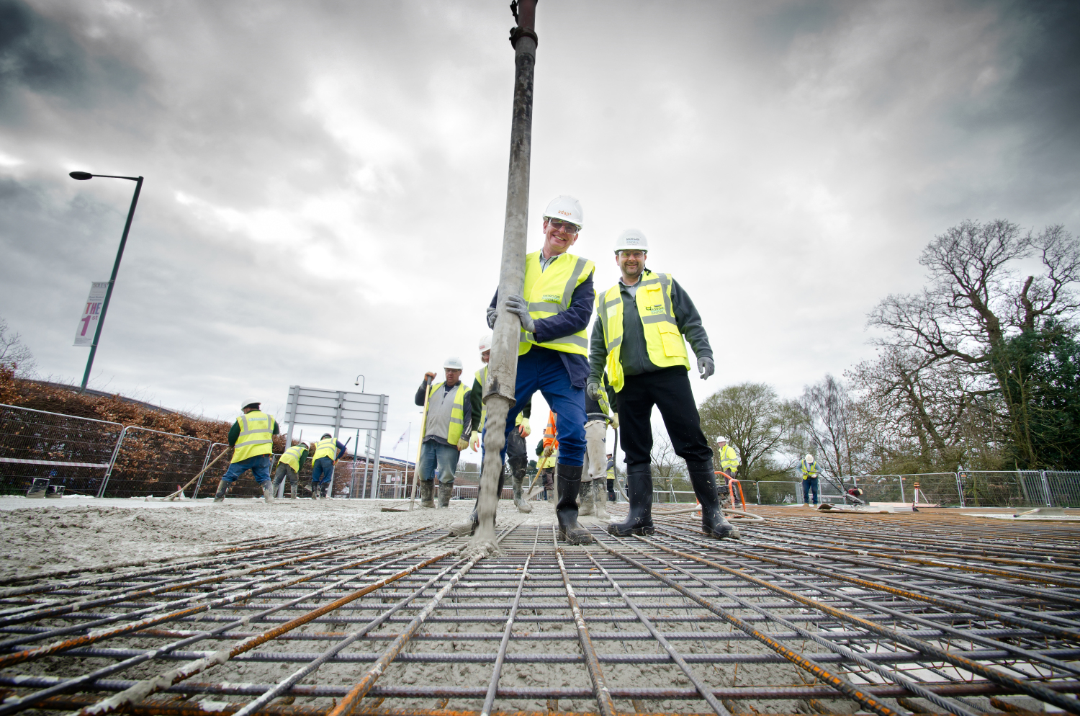
The floor
finishes
Notes:
The concrete would prove to be even more sustainable, with the design insight to use the concrete as a polished finish in the building
This provided maintenance savings across the life span of the building and was one of the key decisions in providing flexibility across the Enterprise Centre’s footprint

Slide 8
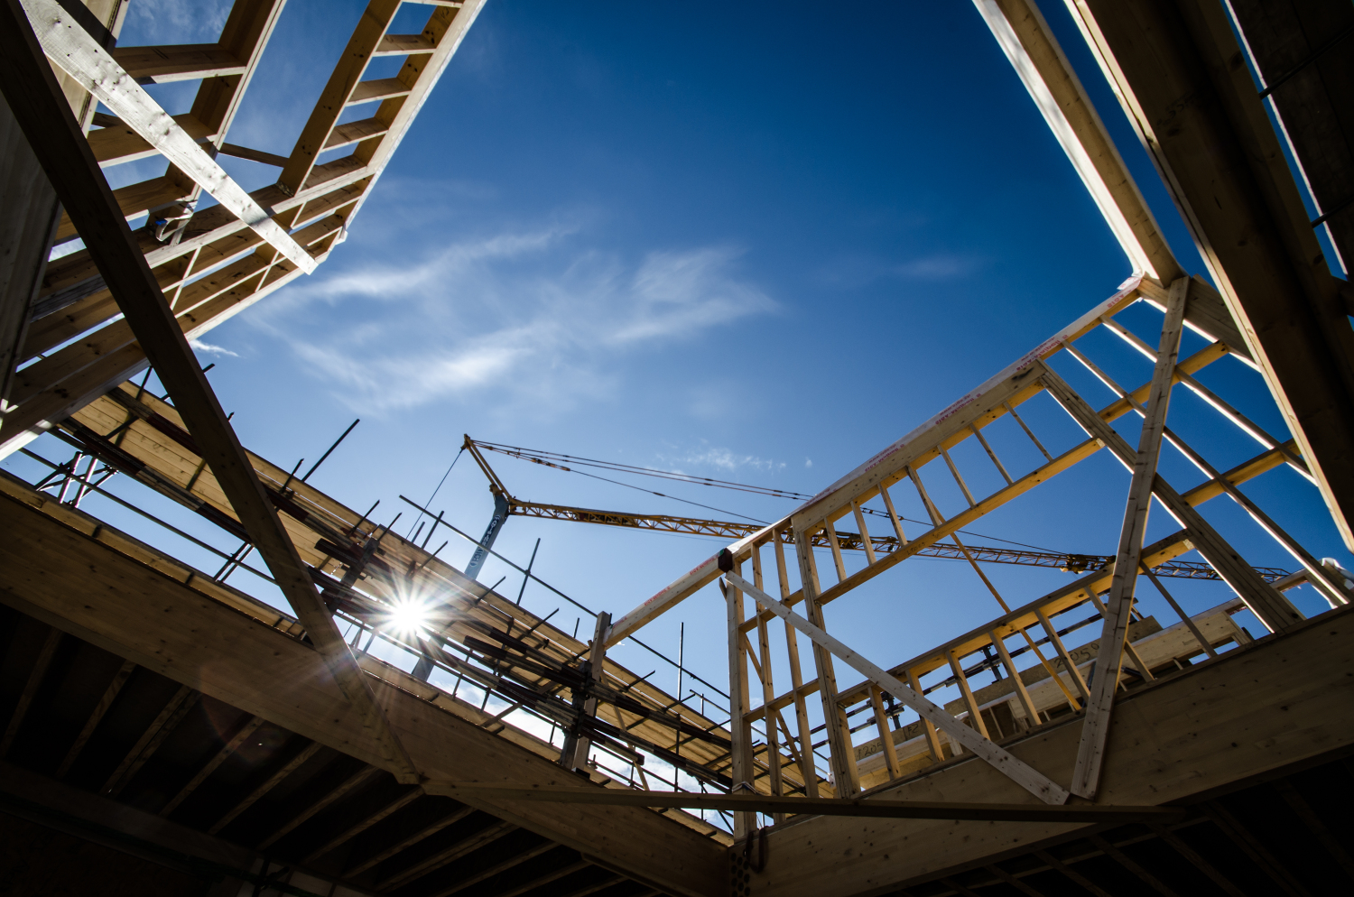
A global
first
Notes:
Another global first for the project was the timber…
Usually used for fencing and pallets, Thetford Corsican Pine had not been considered for structural timber frames before

Slide 9
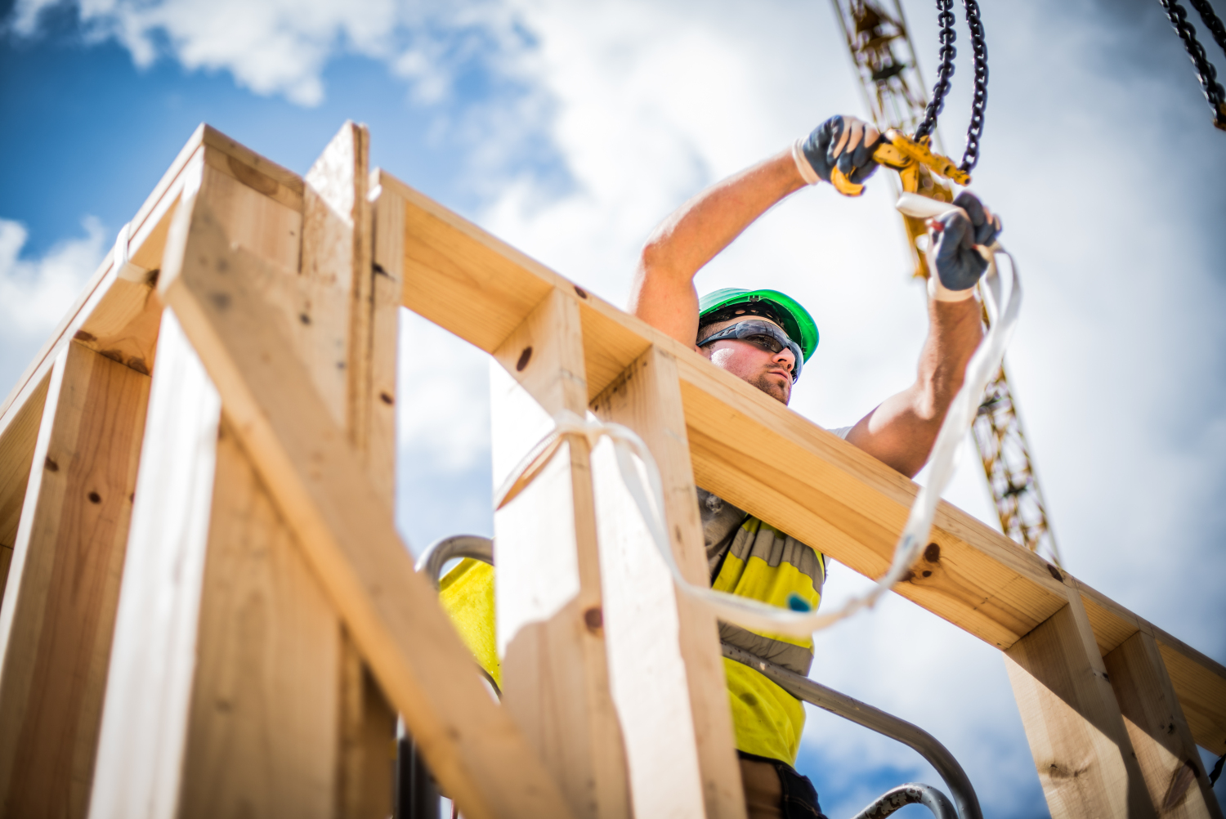
Tested and certified
Notes:
But, after working closely with the BRE, we tested and had certified the timber for use in the frame.
It’s now helping to inspire the next generation of projects, including engineer Max Fordham who is developing a concept for 100% Thetford timber in his project using our calculations, detailing and design

Slide 10
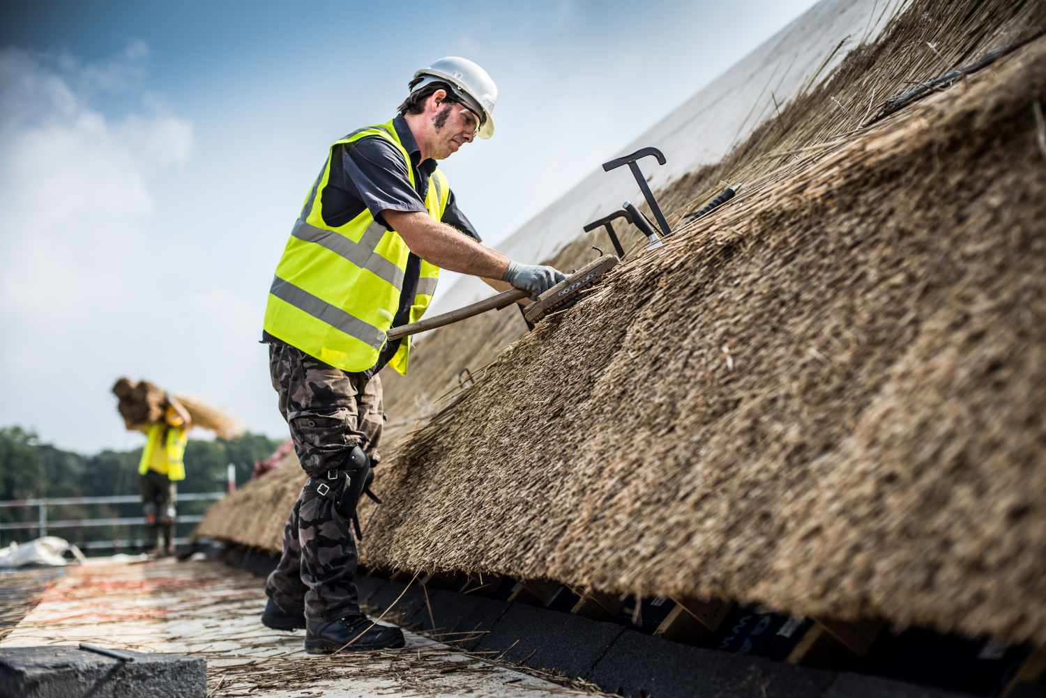
On an
epic
scale
Notes:
Possibly the greatest innovation was the use of thatch
Using Reed and Straw from Norfolk and Suffolk, we embraced the ethos of local materials and traditional craft to take it onto an epic scale
Here you can see the Reed being used to thatch the clerestory lights on the roof
The thatched timber cassette panels were a global first
Rather than dive straight in, test panels were hung off the scaffold to get out teams used to the installation methods before we reached this point in the programme

Slide 11
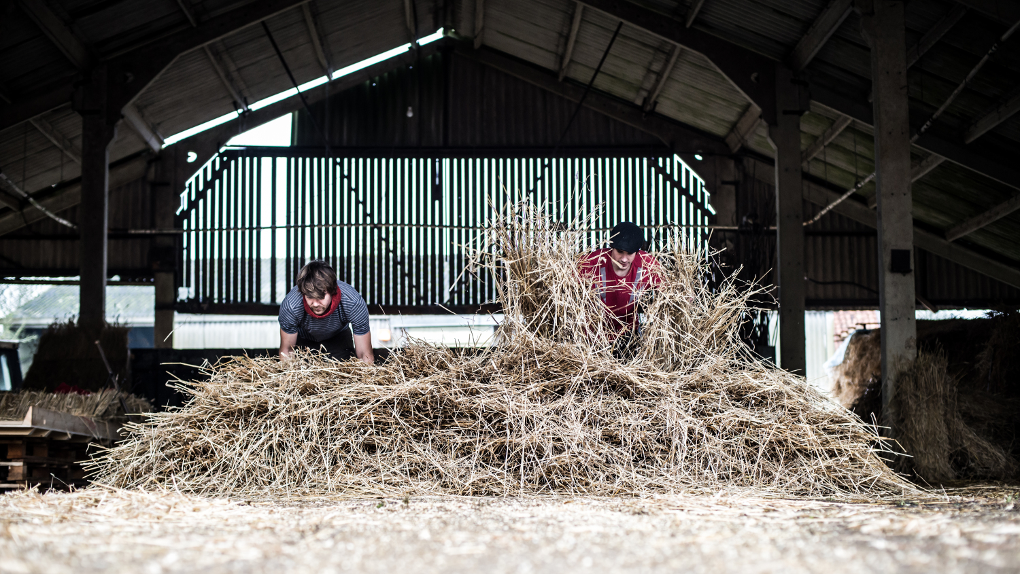
Winter working
Notes:
Not only was it a global first, it helped breathe new life into a dying industry, validating its use in large scale commercial projects
We also programmed the works so that the thatcher’s could work through the winter
Typically they would have less work in the wet winters in the UK – by using a timber cassette system, we ensured the cassettes were delivered direct to the thatchers barns, so they could continue to work, and get paid, in the dry confines of their barns

Slide 12
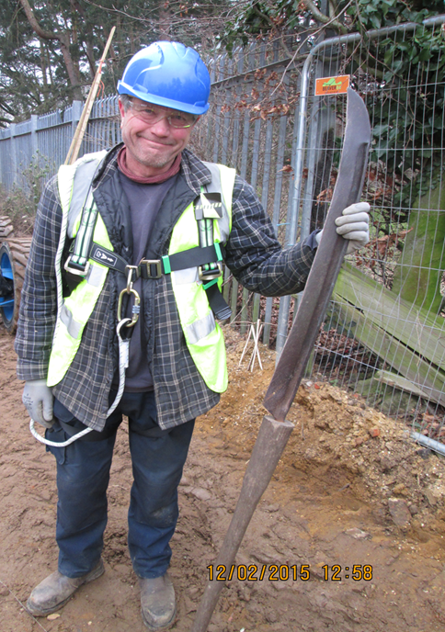
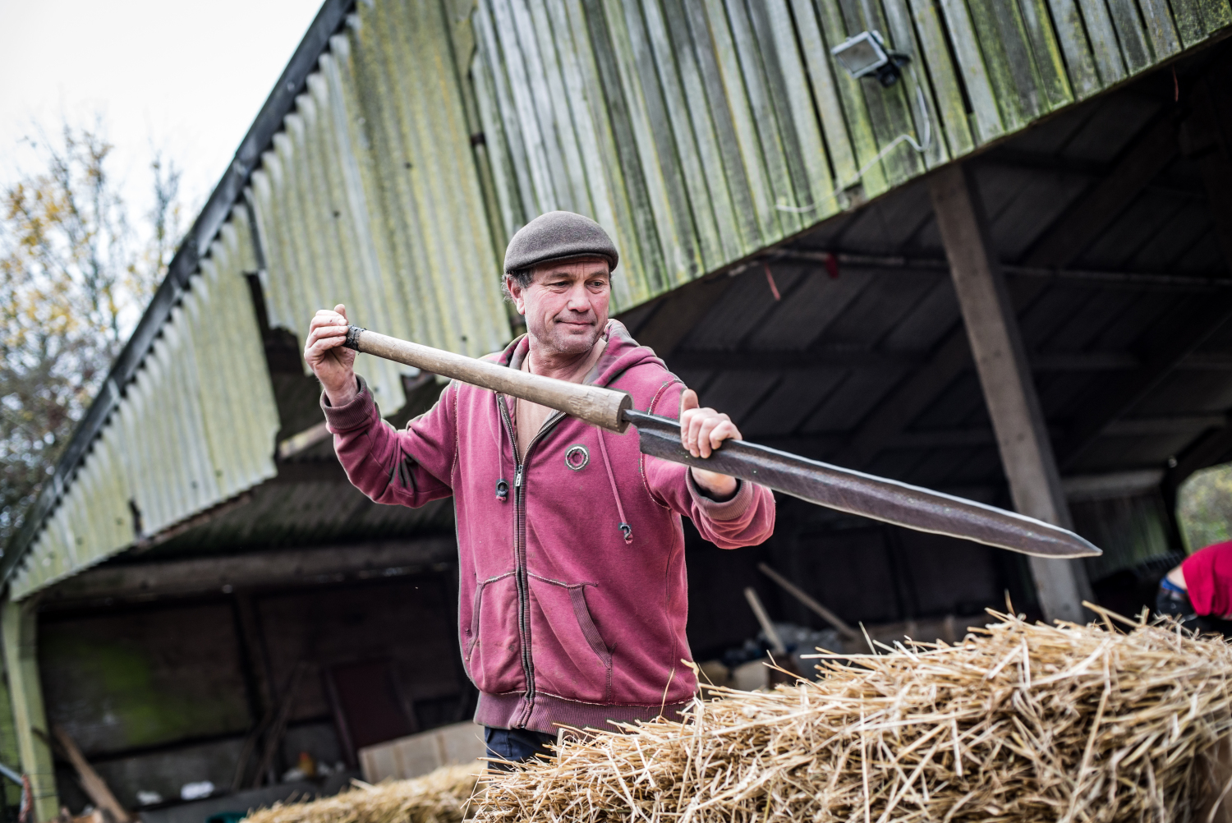
Notes:
We did insist on retractable blades!

Slide 13
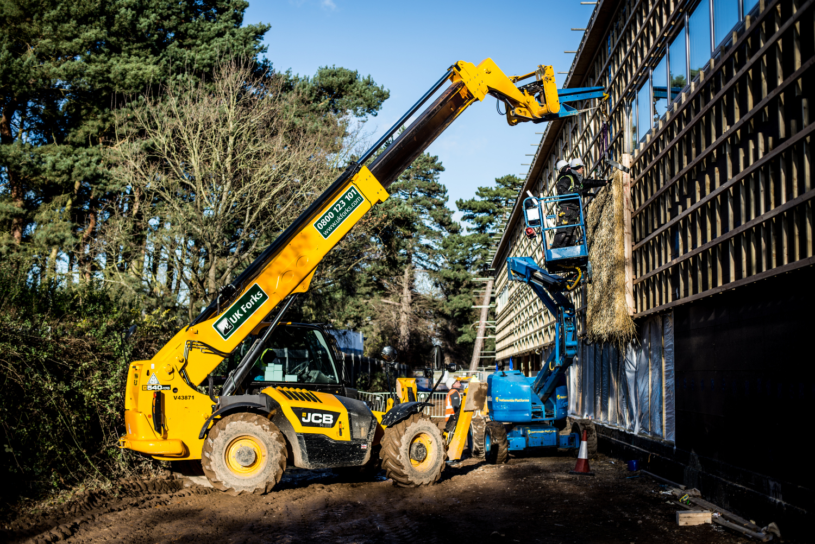
Simple
installation
Notes:
The cassettes were then delivered to site for installation in a bespoke numbered system
They also provide added maintenance benefits – it means that where required, individual cassettes can be removed and repaired/refurbished as required…

Slide 14
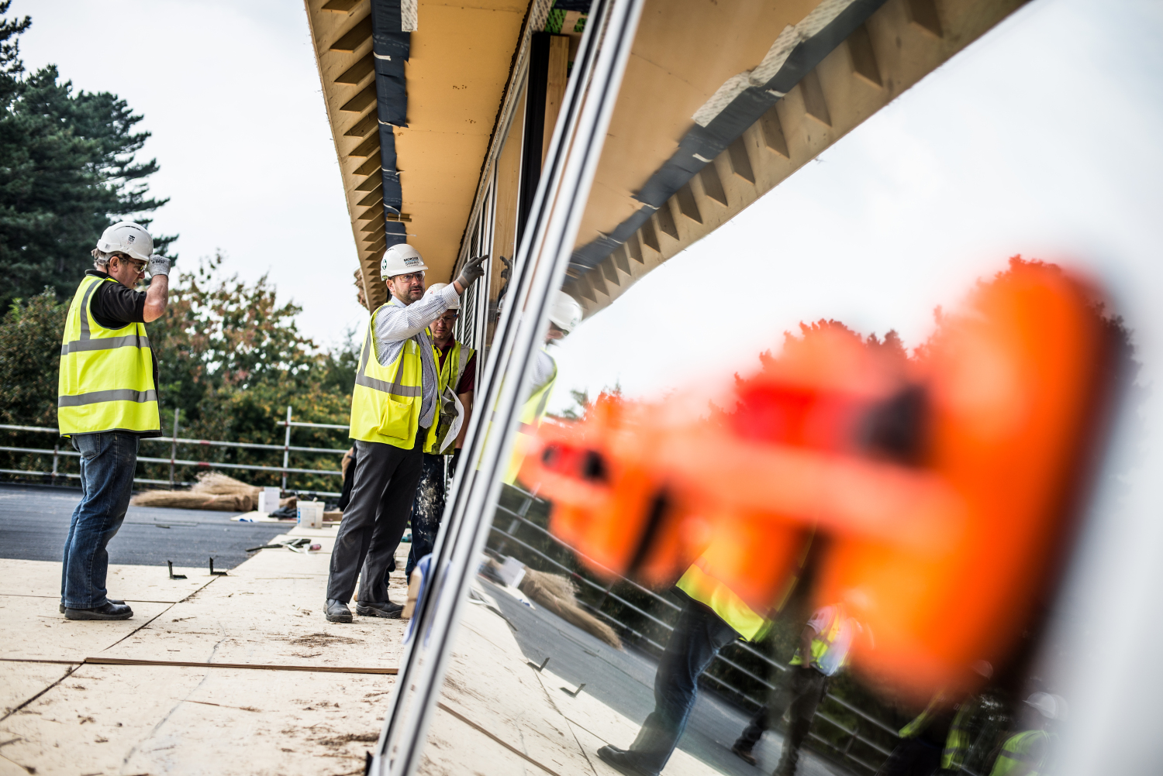
A fabric first approach
to Passivhaus
Notes:
Detailing and design of the fabric was key to the achievement of Passivhaus.
Here you see the installation of the triple glazed windows – one such item which helped contribute to the final air test achievement of 0.21 ACH@50pa
That’s 50 times better than building regulations!

Slide 15
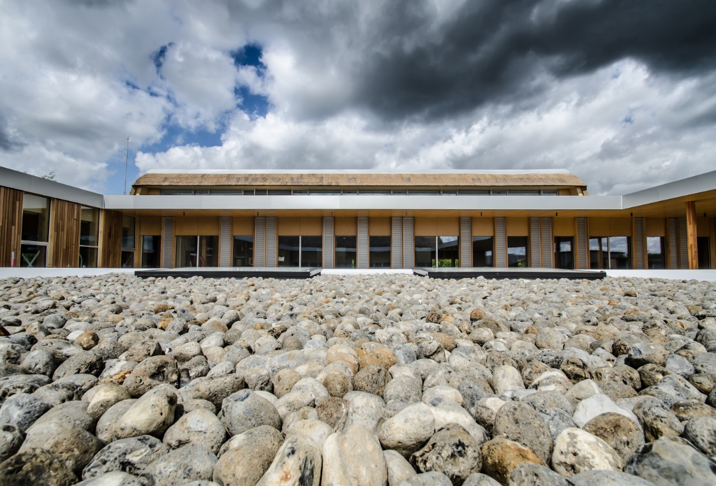
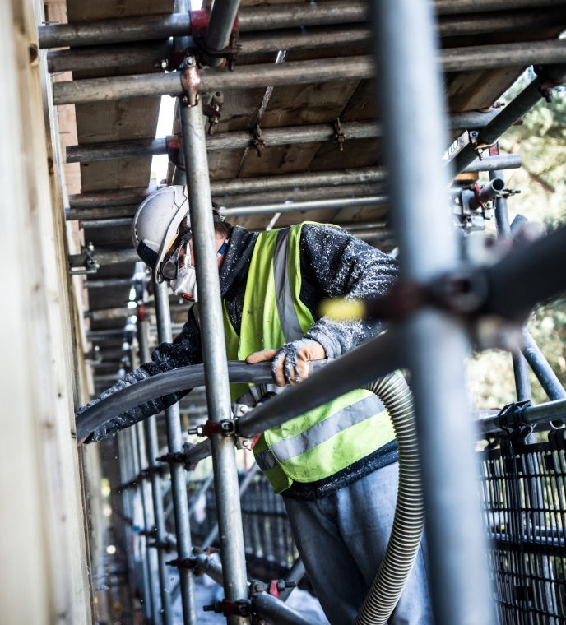
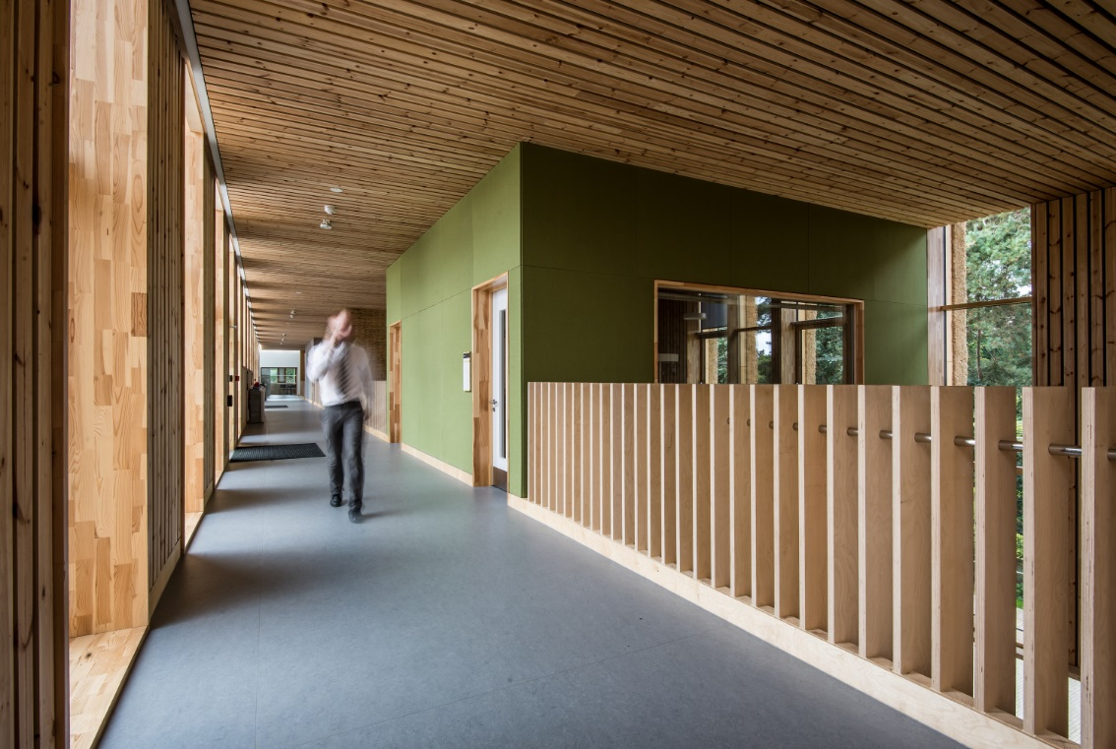
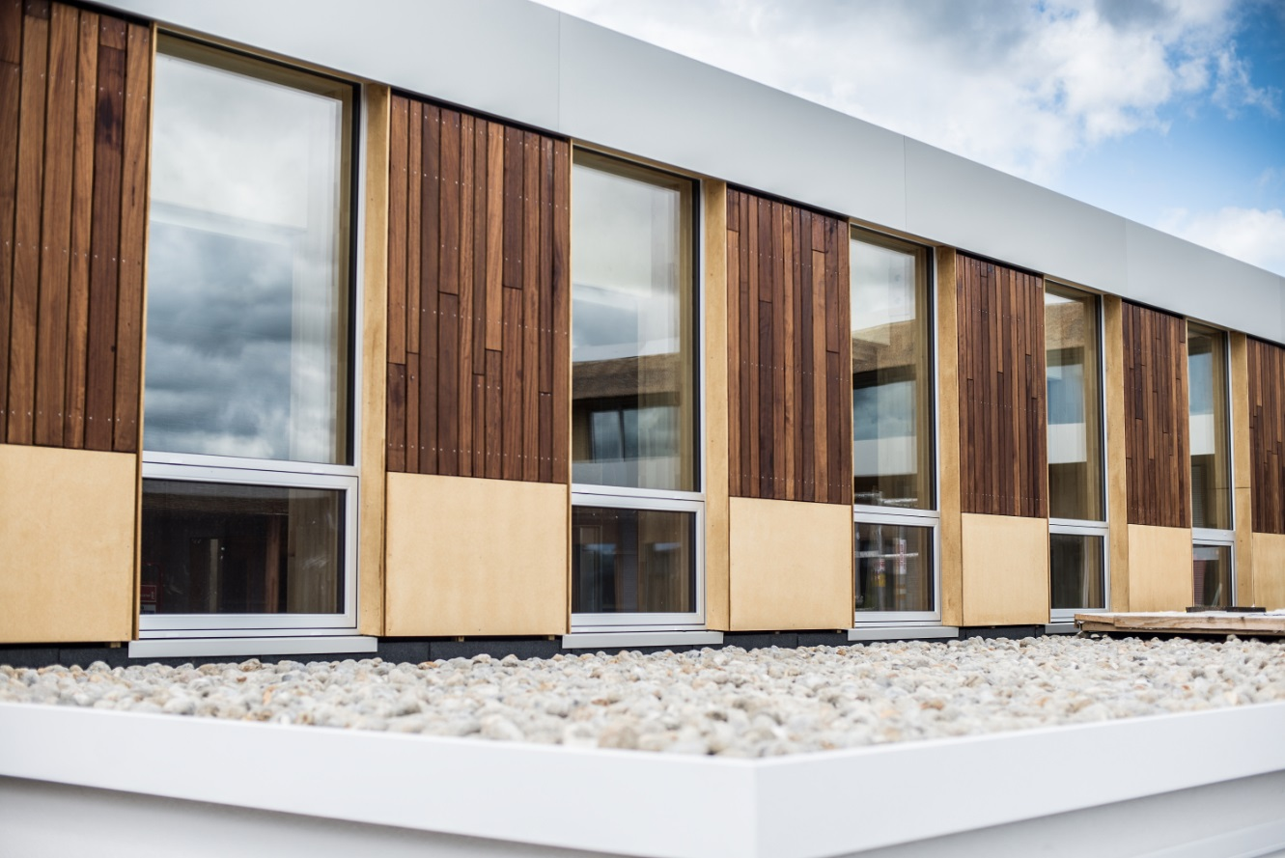
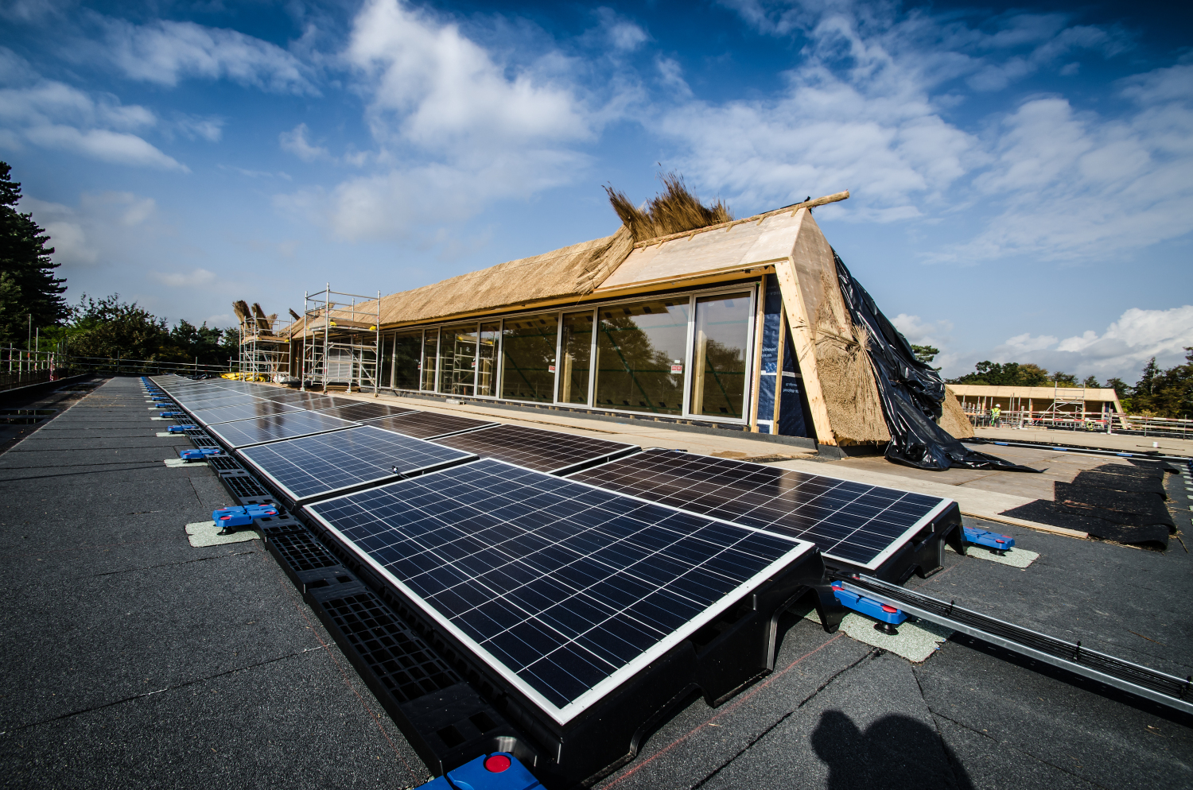
Notes:
A host of other recycled and renewables were installed across the project:
Norfolk flint
100% recycled insulation
Nettle boards, clay plasters and reed fabrics
Old science lab desks
480m2 PVs

Slide 16
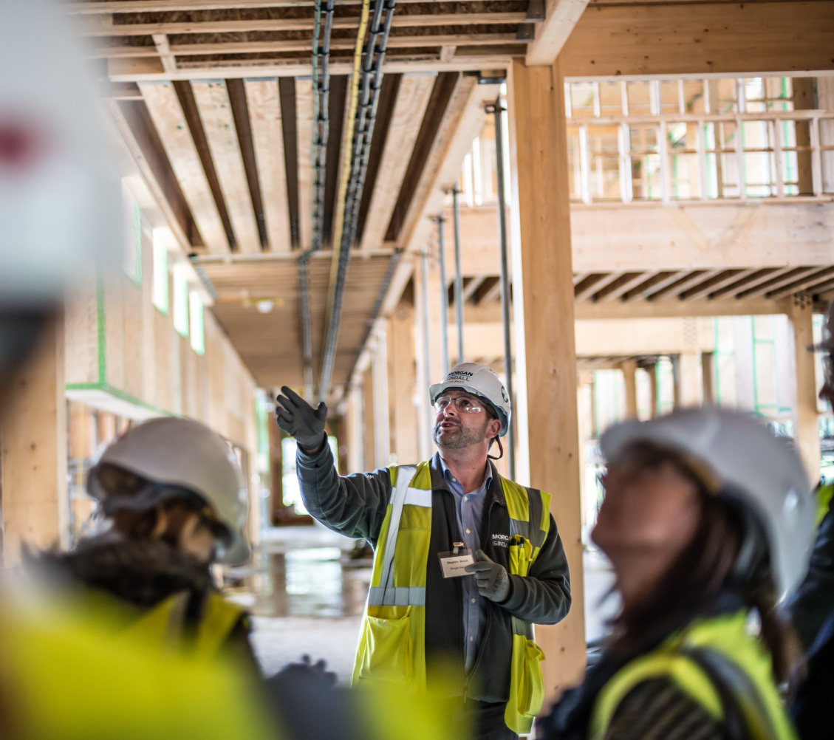
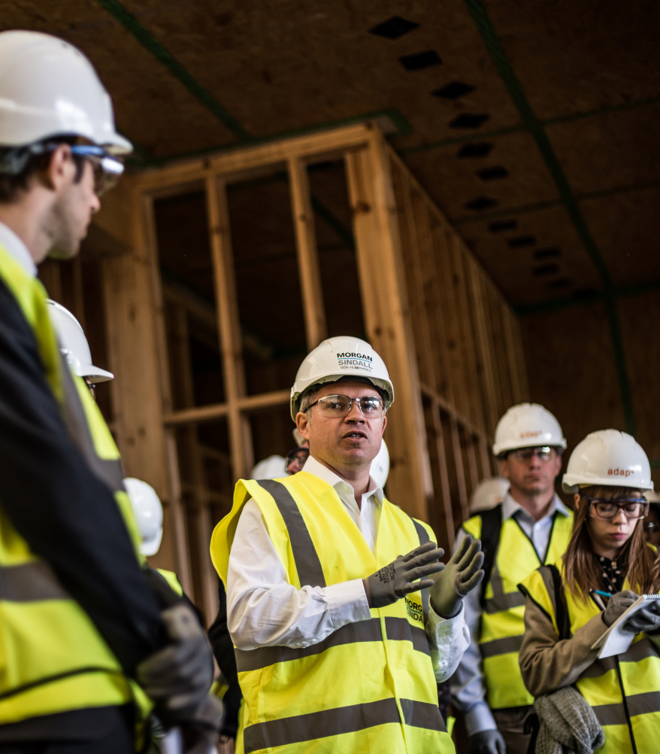
Notes:
The project was also used as a showcase for industry, and a haven for local suppliers, with over 200 local jobs created, 300 SME’s engaged.
For every £1 invested, we ensured that an additional £1.34 was re-invested in the local economy (25 miles)

Slide 17
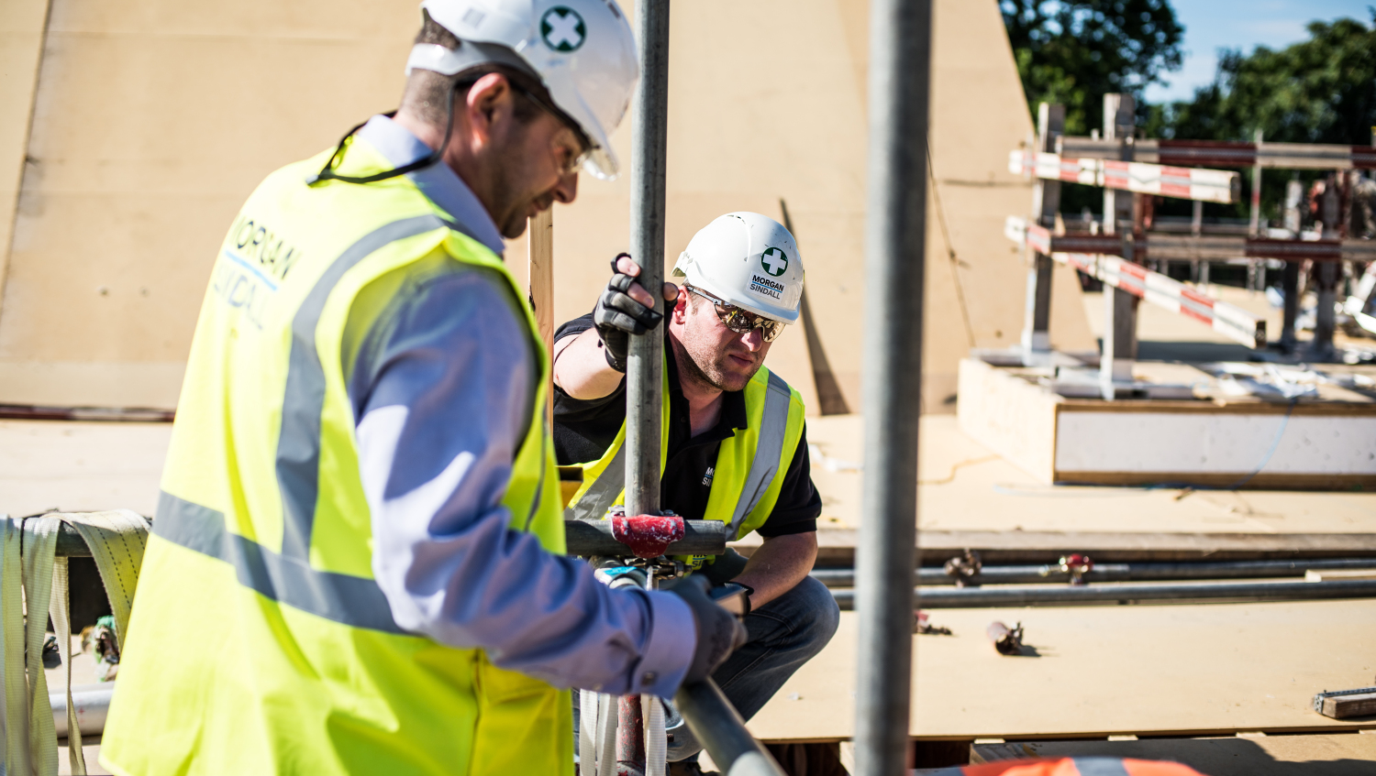
A collaborative approach to risk management
Notes:
The transfer of risk was one which we managed in a collaborative fashion.
Rather than transfer down to supply chain, we appointed a full time Passivhaus Champion, who was responsible to working with the s/chain, checking their works and ensuring things like the air test measures were achieved.

Slide 18
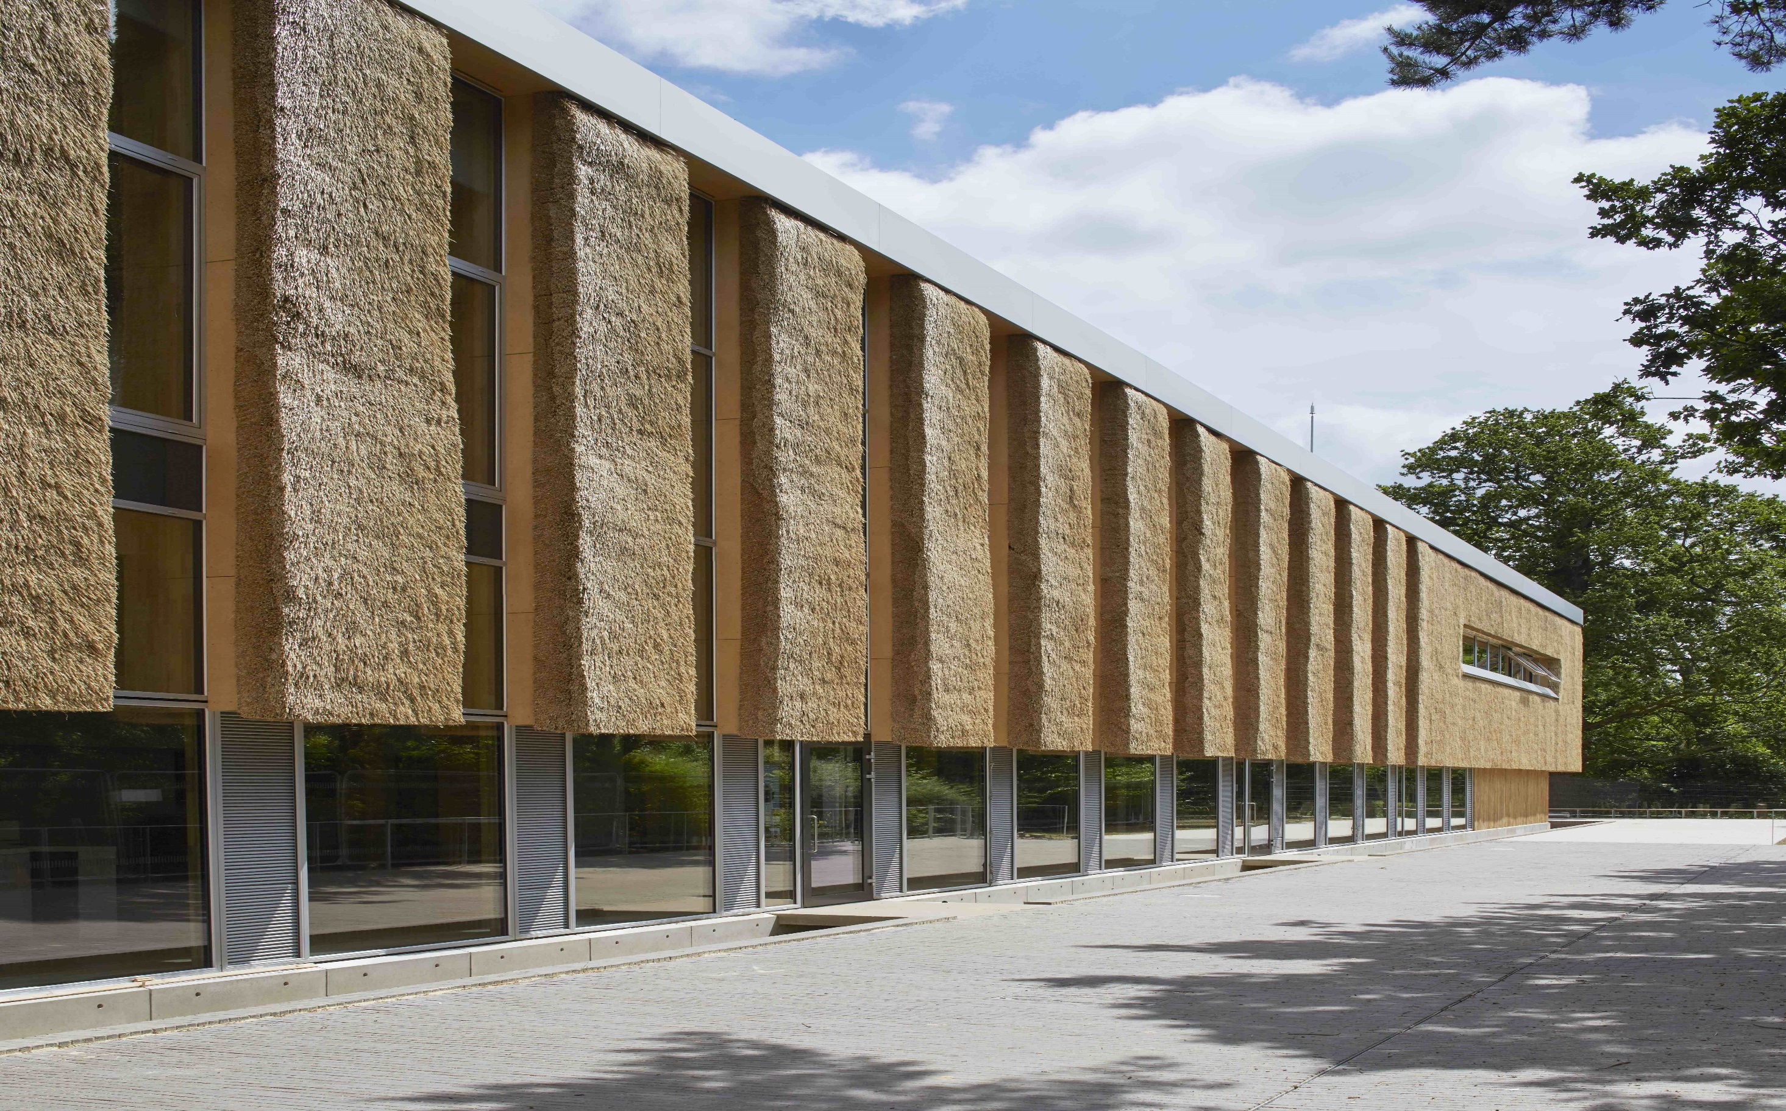
The UK’s greenest commercial building
443kgCO₂m² across 100 years
Notes:
With only 443kgCO2m2 across 100 years it has 75% lower embodied carbon than a conventionally built building
Passivhaus and embodied carbon over 100 years show significant savings
In truth, this has been an unconventionally collaborative project…and we’d like to leave you with the legacy of our customer’s experience of the project

Slide 19
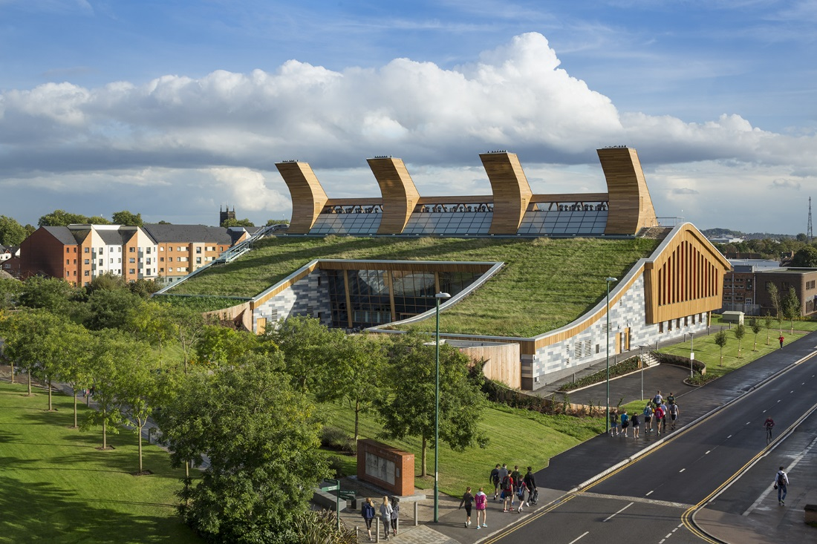
The Centre for Sustainable Chemistry
University of Nottingham / GSK

Slide 20
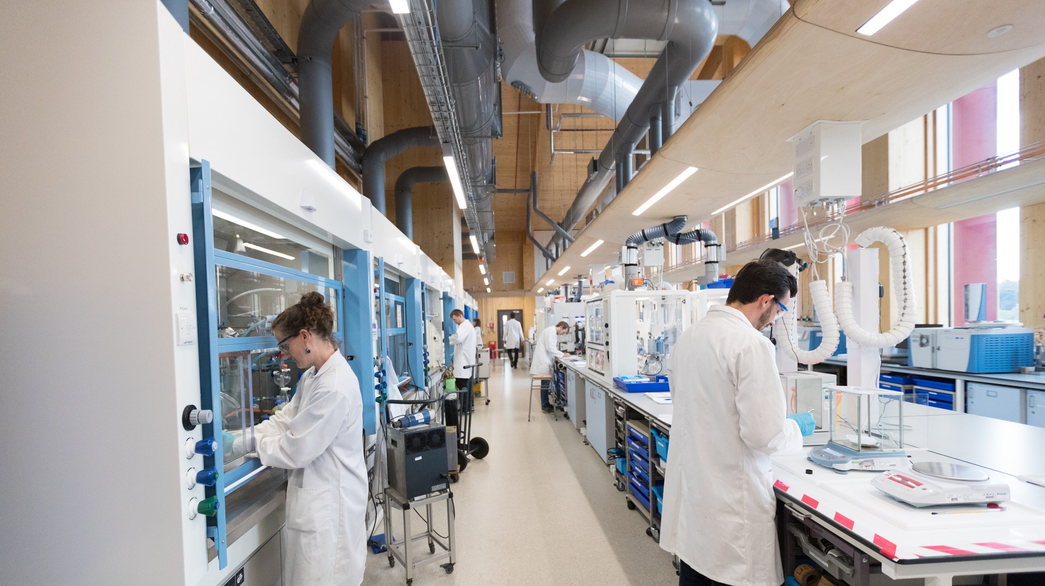
Right from the start, the challenge was set
Notes:
The GSK Centre of Sustainable Chemistry is globally breaking new ground in sustainable construction.
Right from the start, the challenge was set.
Discovering new medicines is a resource and carbon intensive activity, and the design for laboratories has to take this into account.
GSK’s long term goal to be carbon neutral by 2050 spearheaded the development of a Carbon Neutral Laboratory as an integral part of their overall strategy

Slide 21
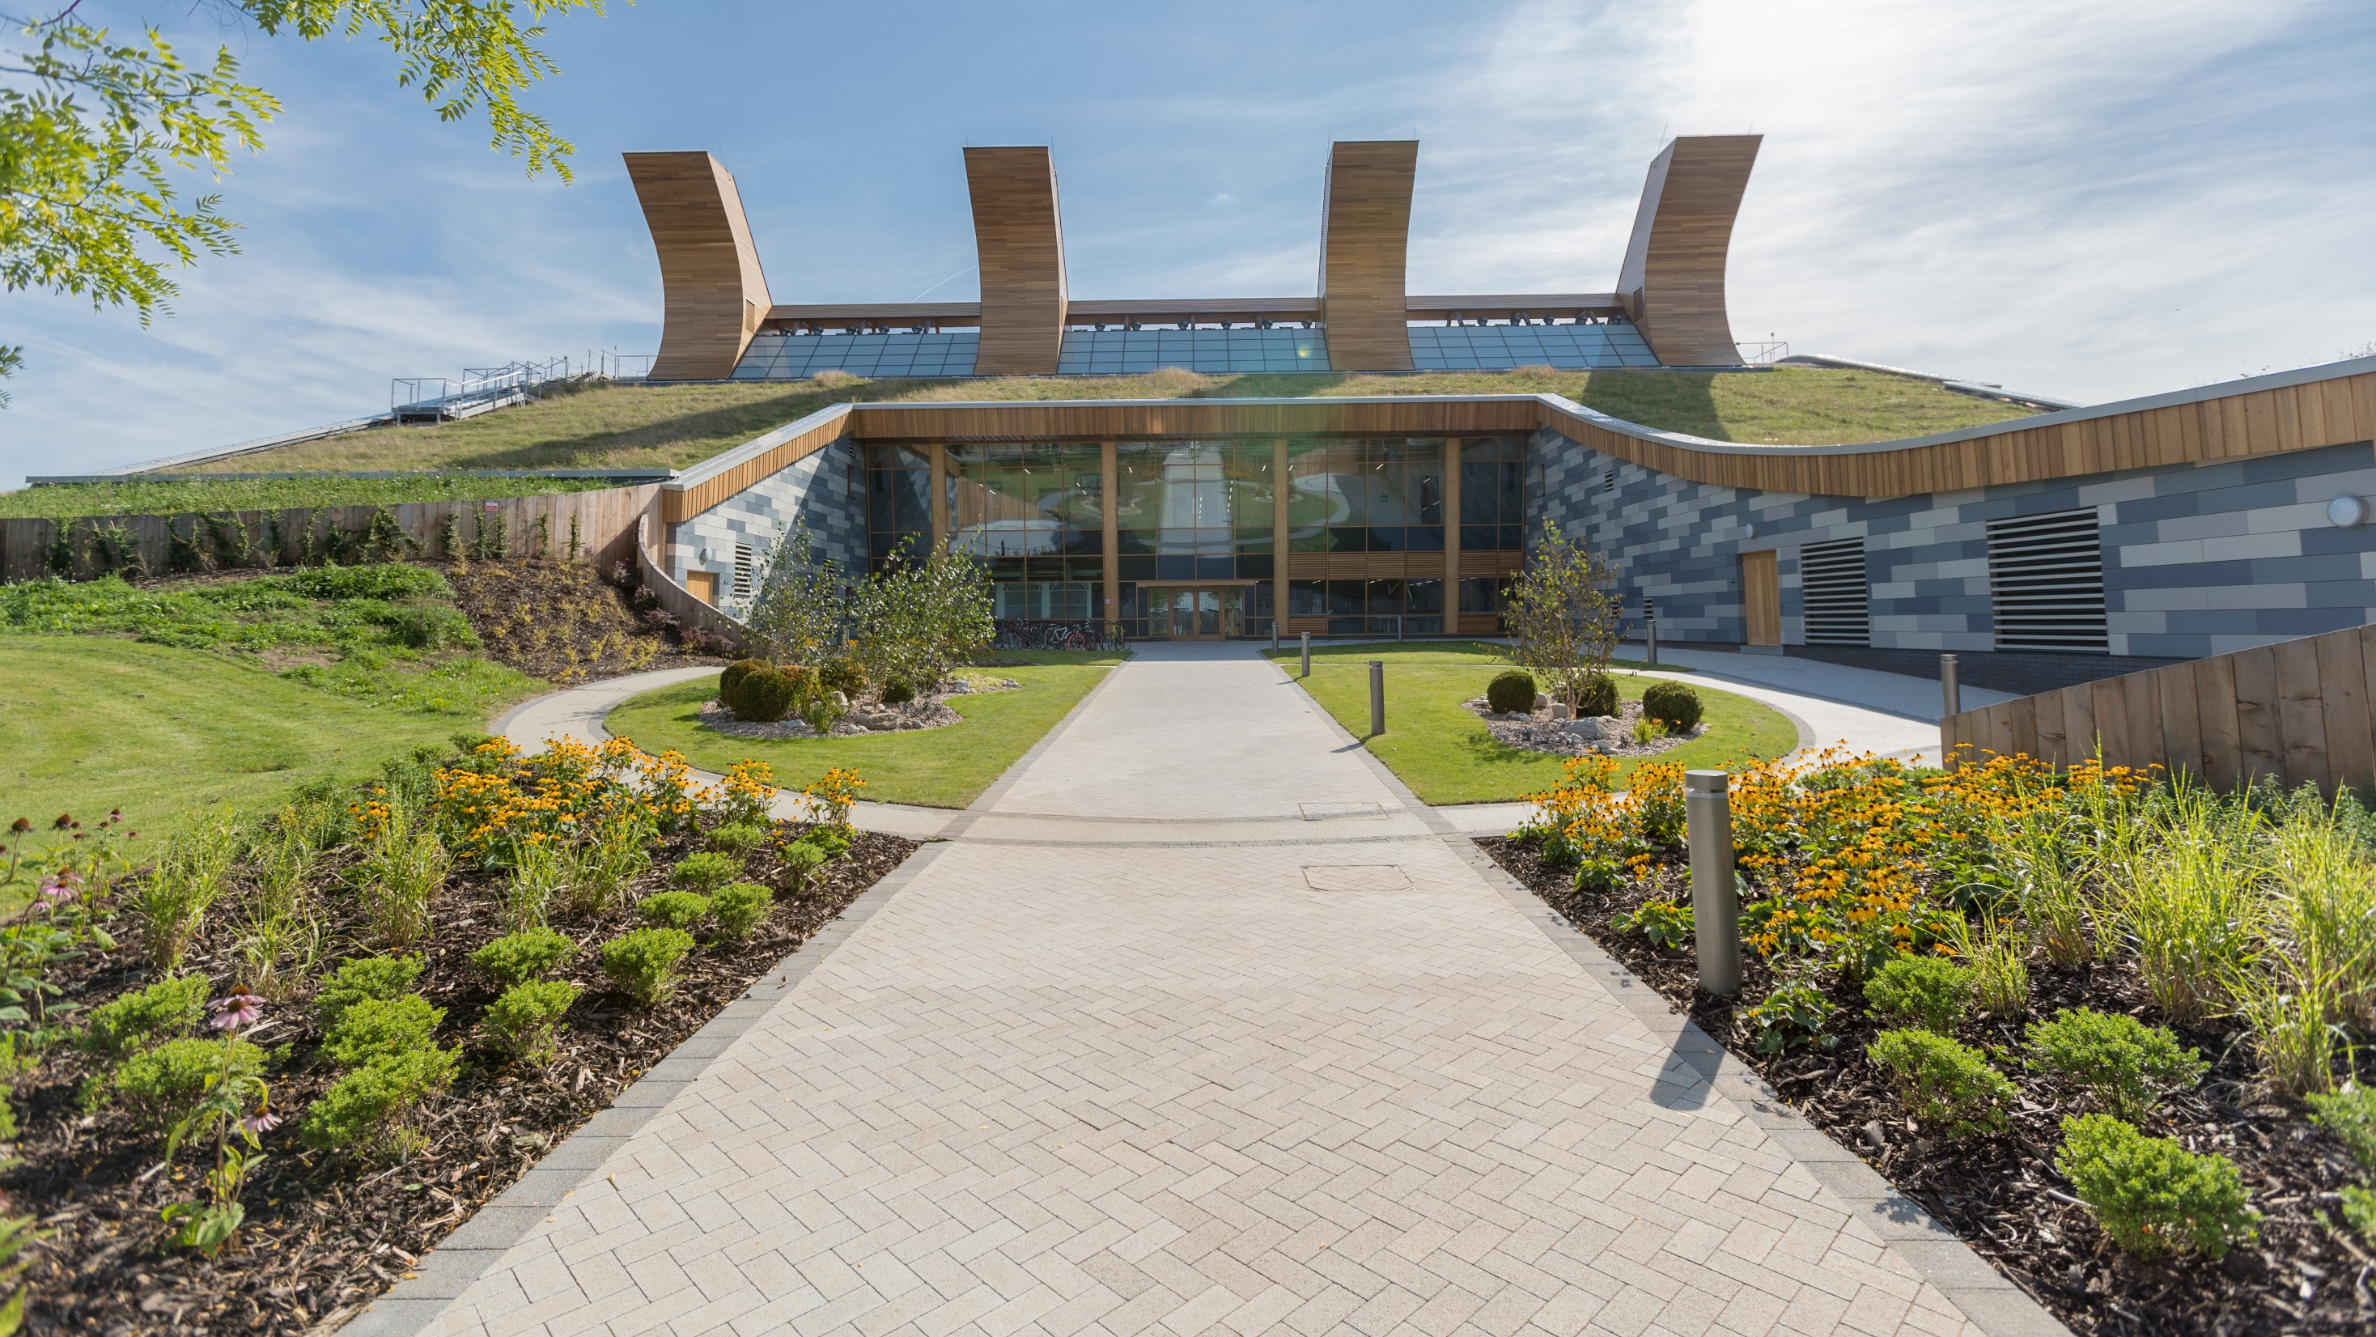
CARBON Neutral
BREEAM Outstanding
LEED Platinum
Notes:
Not only were we required to achieve Carbon Neutral status, we were also to achieve BREEAM Outstanding and LEED platinum

Slide 22
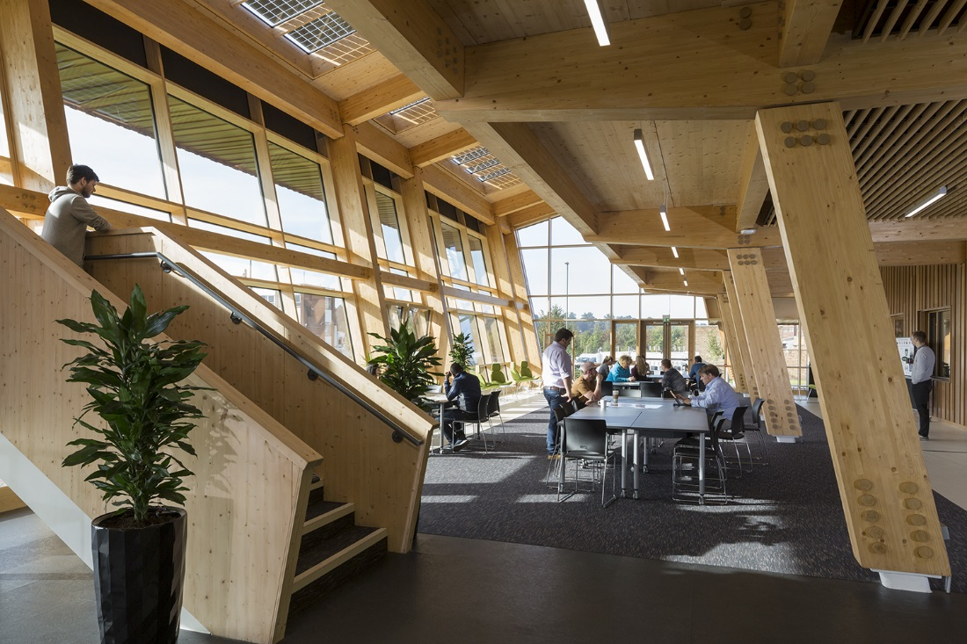
Natural materials played a huge part in the design
Notes:
So, the founding principles for design included natural materials, ridge ventilation and integrated renewables to meet the buildings energy demands
Determining the appropriate materials was ensured through detailed analysis of products readily available and local to the site
Information available through Environmental Product Declarations (EPD’s) was assessed, along with detailed data determining embodied carbon and recycled content were assessed before developing proposals

Slide 23
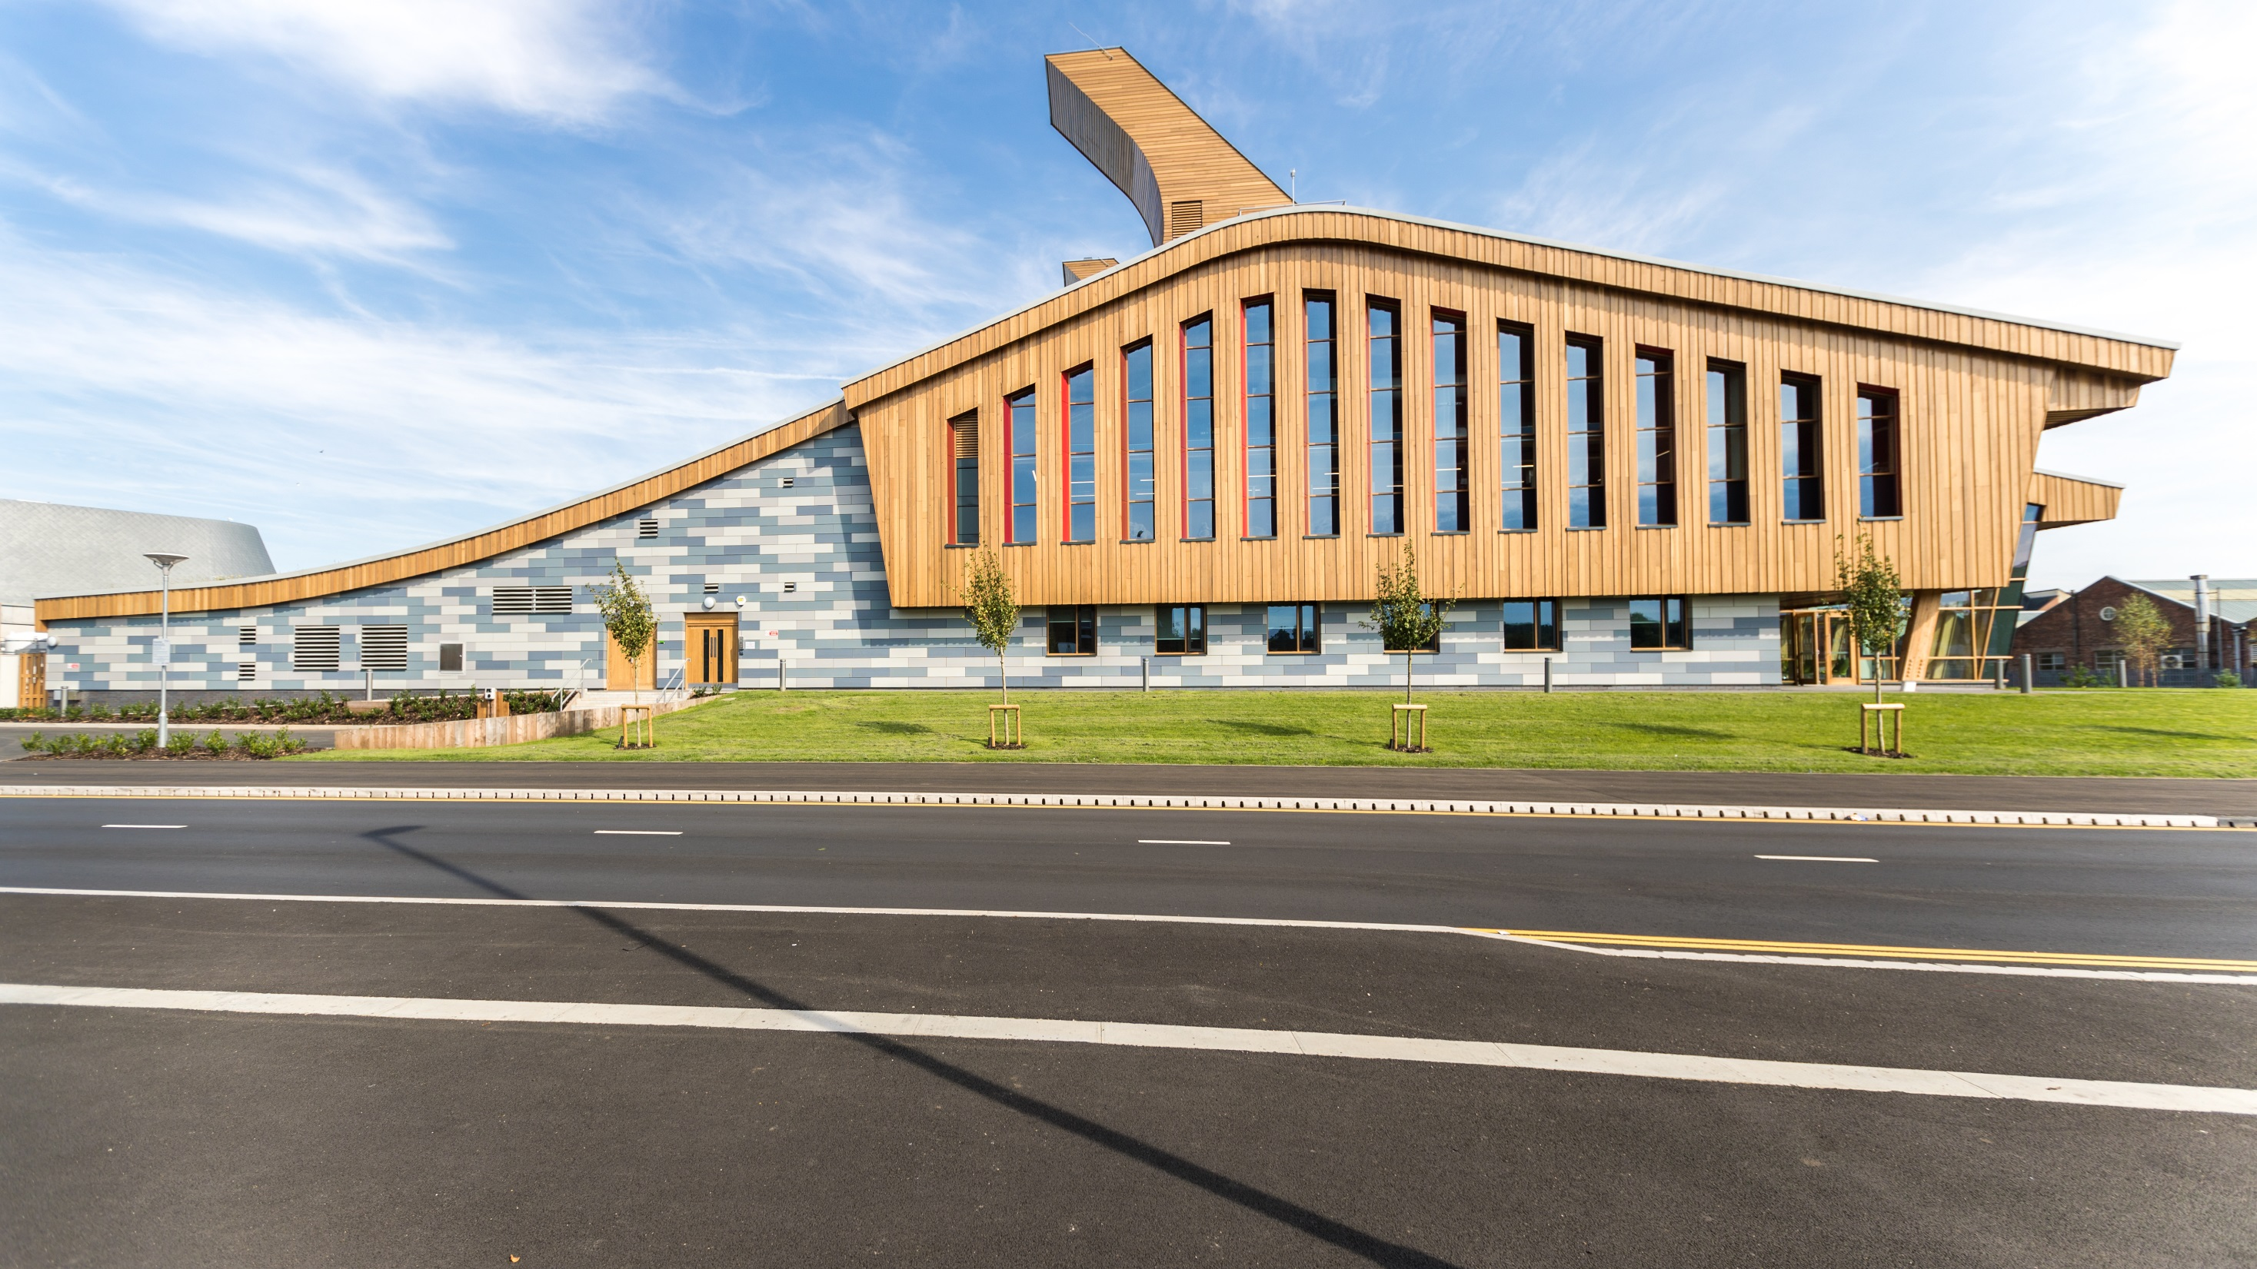
A distinctive shape to enhance sustainability
Notes:
It’s distinctive shape isn’t just for aesthetics, it is partially informed by orientation, (with its south facing pitch clad in photovoltaics, and north facing expressed as a sloping green rood).
But it’s also the ventilation strategy that plays a huge role in its composition – designed to work in a similar way to a plane wing, air accelerates across the roof and draws on the inclined surface to create a greater amount of wind energy, which is then evenly distributed throughout the building.

Slide 24
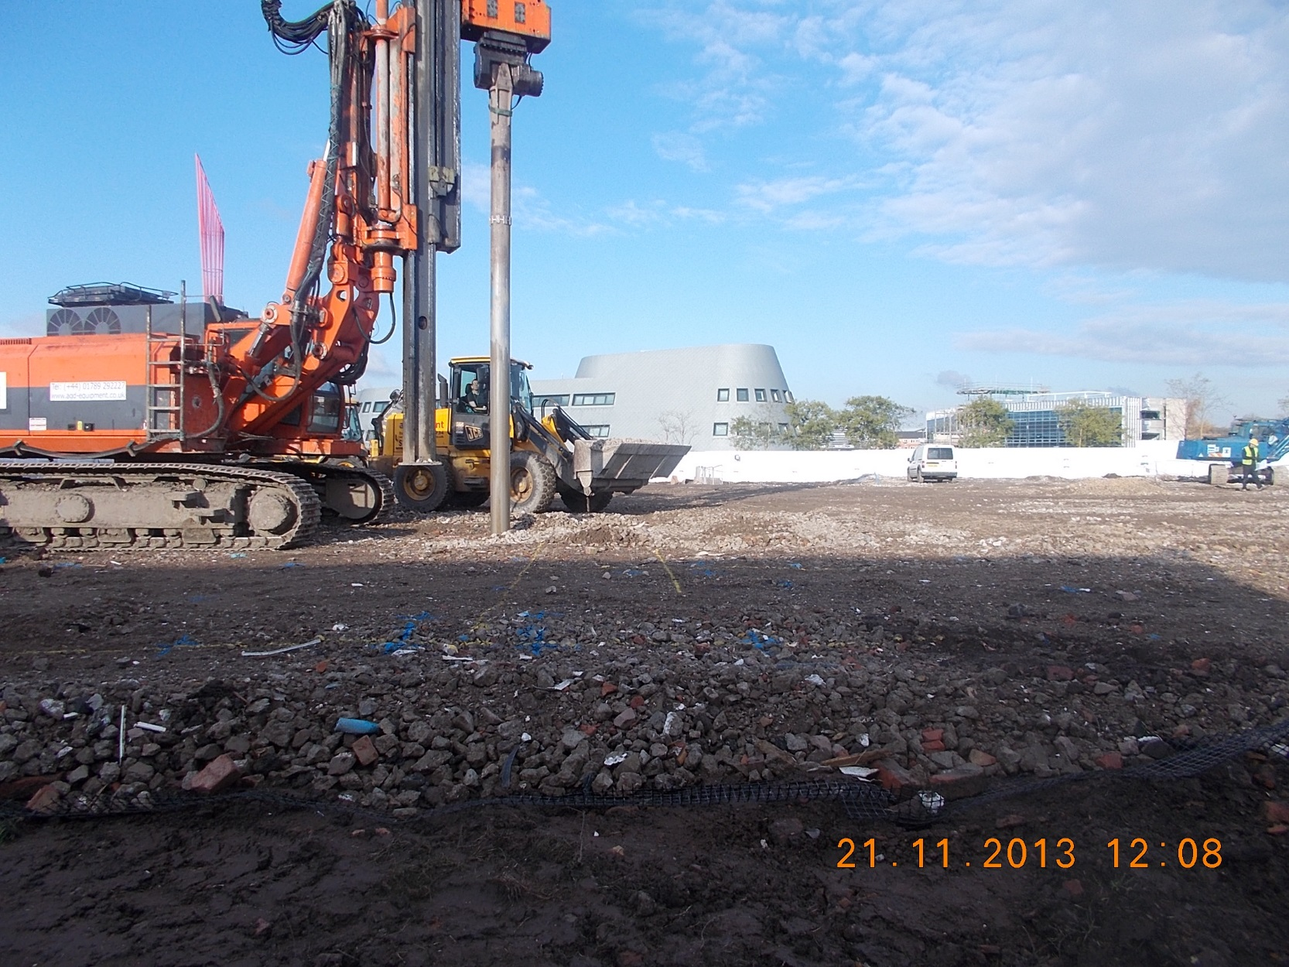
Saving 90 tonnes of carbon in foundation design
Notes:
Working closely with our supply chain partners, we were able to bring sustainable innovation and best practice to the scheme. Early analysis of foundation design enabled us to change from a CFA pile to a vibro-stone method, which reduced embodied carbon from 90 tonnes to just 6 tonnes in this element alone.

Slide 25
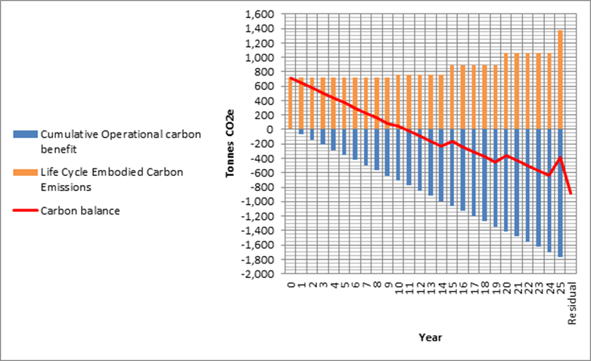
A Bespoke carbon model
Notes:
We set a max carbon expenditure targets of 800 tonnes CO2 and in use energy target of 51 tonnes CO2
By getting involved early we were able to engage key supply chain members to enable measured carbon auditing
It was at this stage that we developed a bespoke carbon model in line with BS 15978
The model calculated the operational energy balance of the building, and its 25 year payback (11 in final report)
This provided assurances to the stakeholder team that the design would work!

Slide 26
“
“
Upon delivery, our external auditors forecast suggested that embodied carbon would be offset in just over 16 years. A testament to all, and commitment and vision of Morgan Sindall who’s lean methodology has ensured that we will now have the highest profile, lowest impact facility in the world. The CSC is an inspiring place to work, much of this comes down to the commitment of Morgan Sindall to deliver the best chemistry lab in the world!
Professor Peter Licence, Director of the
GSK Carbon Neutral Laboratory
Notes:
Testimonial

Slide 27
This can be, and was done, with our existing supply chain
Notes:
In summary, these projects were extremely complex and challenging. But despite both projects being in different locations, with different project teams, both achieved the high standards by working with our existing supply chain in a collaborative manner from the earliest possible stage

